Slide 1
Lecture 24: Communities
Apr 27, 2022

Slide 2
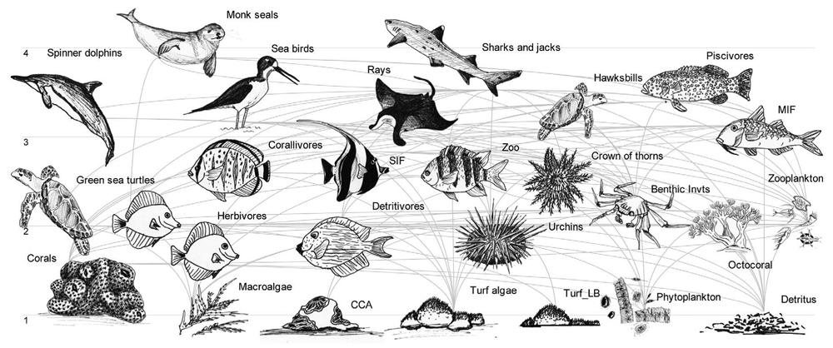
What is a biological community?
An assemblage of populations of two or more species inhabiting the same geographical area at a particular time

Slide 3
Metrics
Populations
Individuals
Occupancy
Abundance
Survival
Immigration
Emigration
Communities
Species
Multi-species occupancy
Species richness
Persistence or viability
Colonization
Extinction
Unit
Parameters
Abundance changes via birth, death, immigration, emigration
Richness changes via colonization and extinction

Slide 4
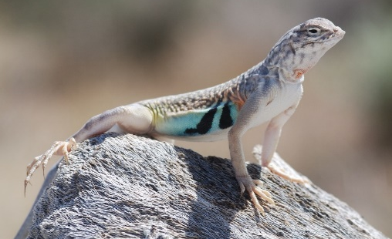
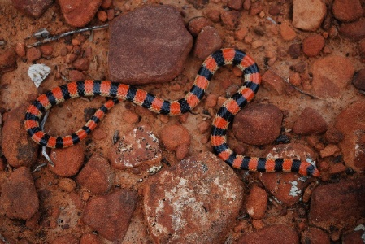
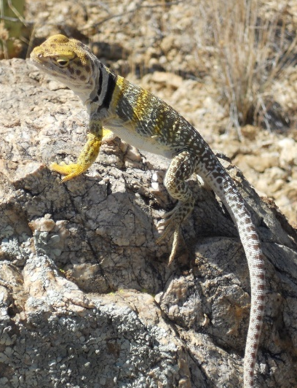
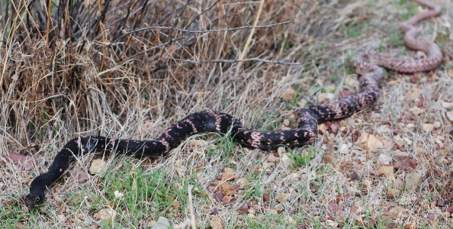
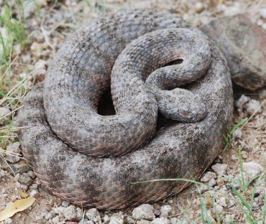
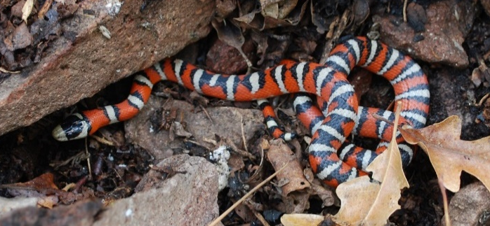
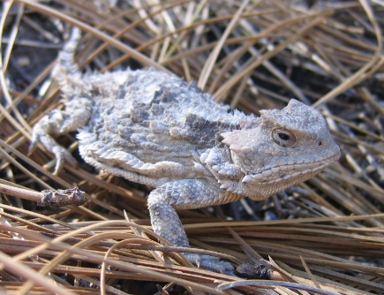
Species richness
Number of species inhabiting an area
  Usually considered for specific taxonomic groups, i.e., small mammals, reptiles, grasses, trees

Slide 5
Species diversity
A combination of species richness and abundance (evenness)
richness = 5
richness = 5
abundances = even
abundances = uneven
Many metrics are available for species diversity, including Shannon’s Index, Simpson’s Index, and many more

Slide 6
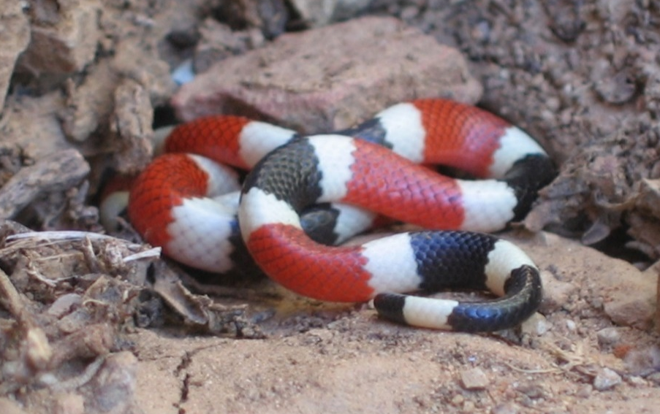
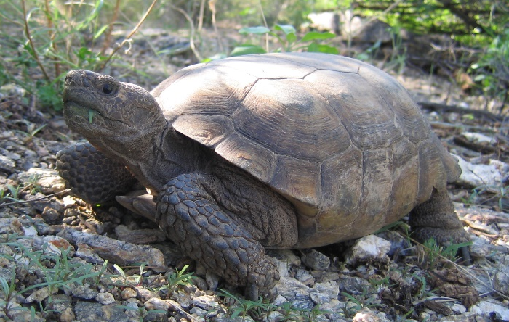
Species richness
Number of species inhabiting an area
Can we expect the number of species we observe during surveys to be a reliable estimate of true species richness?

Slide 7
Estimating species richness
Two common strategies when surveys are imperfect and detection probability < 1
  Species-accumulation (rarefaction) curves
  Capture-recapture sampling

Slide 8

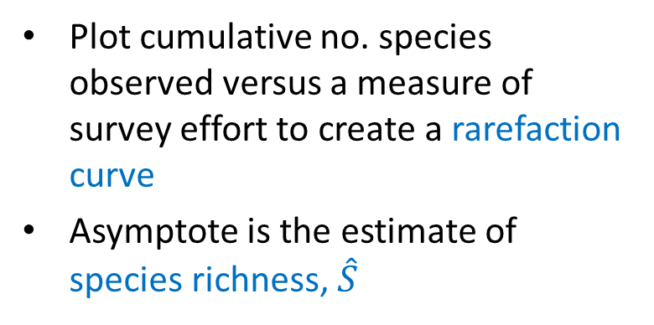
Accumulation curves
Estimated richness, $\hat{S}$
Plot cumulative no. species observed versus a measure of survey effort to create a rarefaction curve
Asymptote is the estimate of species richness, $\hat{S}$
Cumulative
no. species
Survey effort
Disadvantages:
Works well when only a few species are rare
Requires a high level of sampling effort

Slide 9
Accumulation curves
Cumulative no. reptile and amphibian species observed, Bisbee, AZ
Cumulative no. species
No. surveys
Prival & Weise 2010

Slide 10
Capture-recapture sampling
Estimate richness using an approach similar to estimating abundance of a population using capture-recapture methods
Recall, we created encounter histories for individuals:
Species ID
To estimate richness, substitute species for individuals
 | Sampling occasion
Individual ID | 1 | 2 | 3 | 4
A | 1 | 0 | 0 | 1
B | 1 | 0 | 1 | 0
C | 0 | 1 | 0 | 0
D | 0 | 0 | 1 | 0
E | 1 | 0 | 1 | 1
F | 1 | 1 | 1 | 1

Slide 11
Capture-recapture sampling
Two approaches to create encounter histories:
Survey multiple locations at one time = spatial replication
Survey one location multiple times = temporal replication
S2
S1
S3
T1
T2
T3
T4
T5
S4
S5

Slide 12
Capture-recapture sampling
Two approaches to create encounter histories:
Survey multiple locations at one time = spatial replication
 | Site ID
Species ID | S1 | S2 | S3 | S4
A | 1 | 0 | 0 | 1
B | 1 | 0 | 1 | 0
C | 0 | 1 | 0 | 0
D | 0 | 0 | 1 | 0
E | 1 | 0 | 1 | 1
F | 1 | 1 | 1 | 1
S2
S1
S3
S4
S5

Slide 13
Survey multiple locations
Recommendations
Sample areas that are homogeneous, where the concept of a single community seems reasonable
Consider stratifying if area is heterogeneous
S2
S1
S3
S4
S5

Slide 14
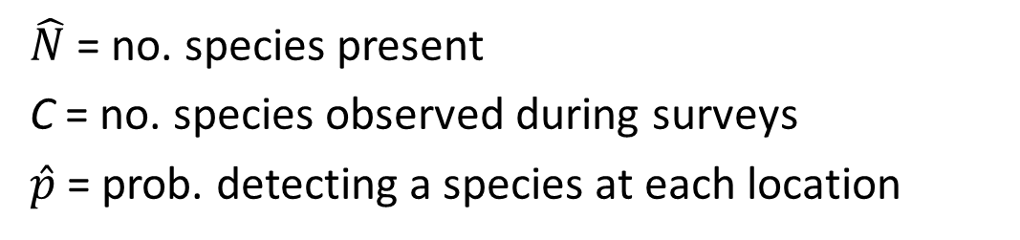

Estimating richness
$$\hat{N}=\frac{C}{\hat{p}}$$
$\hat{N}$ = no. species present
C = no. species observed during surveys
$\hat{p}$ = prob. detecting a species at each location
Reasonable to assume $\hat{p}$ to be the same for all species?
Detection probability likely to vary among species:
  Abundance
  Activity patterns
  Coloration
= heterogeneity

Slide 15
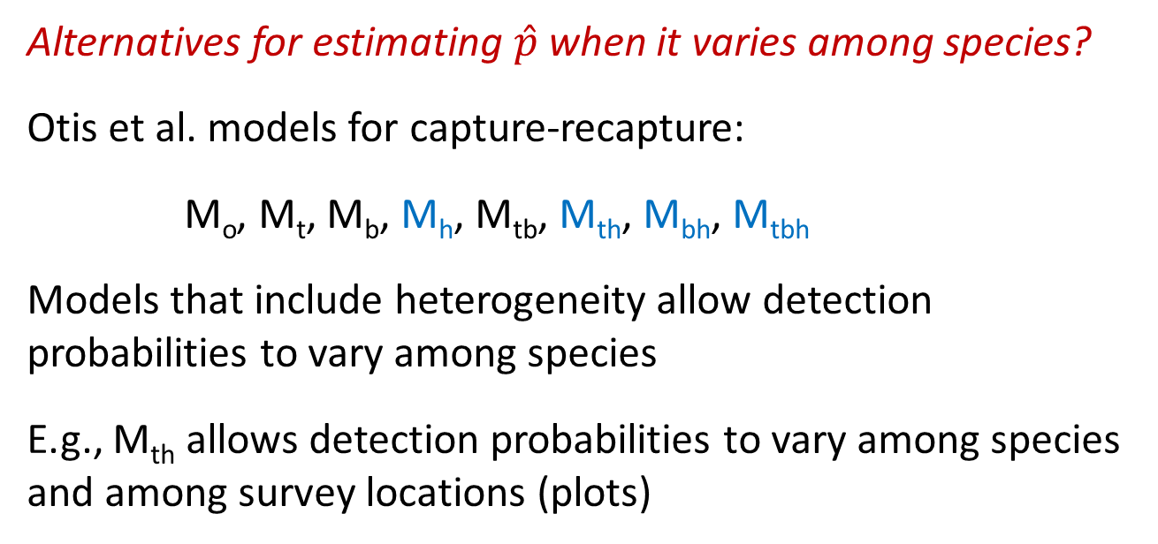
Estimating richness
Alternatives for estimating $\hat{p}$ when it varies among species?
Otis et al. models for capture-recapture:
M_{o}, M_{t}, M_{b}, M_{h}, M_{tb}, M_{th}, M_{bh}, M_{tbh}
Models that include heterogeneity allow detection probabilities to vary among species
E.g., M_{th} allows detection probabilities to vary among species and among survey locations (plots)

Slide 16
Capture-recapture sampling
Second approach to create encounter histories:
Survey one location multiple times = temporal replication
 | Survey occasion
Species ID | T1 | T2 | T3 | T4
A | 1 | 0 | 0 | 1
B | 1 | 0 | 1 | 0
C | 0 | 1 | 0 | 0
D | 0 | 0 | 1 | 0
E | 1 | 0 | 1 | 1
F | 1 | 1 | 1 | 1
T1
T2
T3
T4
T5

Slide 17
Survey one site multiple times
Assume that community composition is ‘closed’ between first and last occasions
T1, T2, T3, T4, and T5 could represent different:
Surveys / times (T1, T2, … T5)
Observers (O1, O2, … O5)
Survey methods (M1, M2…, M5)
T1
T2
T3
T4
T5

Slide 18
Surveyor-based encounter histories
Species | Joe | Sue | Louise | Jerome | Fred
ACFL | 1 | 0 | 0 | 1 | 0
BAWW | 0 | 0 | 1 | 0 | 1
EAWP | 1 | 0 | 0 | 1 | 1
OVEN | 1 | 1 | 0 | 1 | 1
  Columns correspond to surveyors (substitute surveyors for time)
  Each surveyor develops a species list independently
Consider models for heterogeneity so that detection probability can vary among species
Why might M_{th} be worth considering?
    permits detection probability to vary among species and among observers

Slide 19
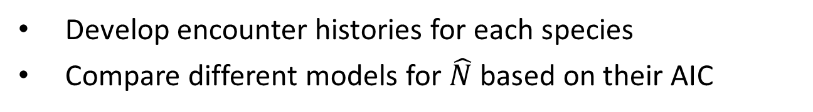
Alternatives for estimates
Develop encounter histories for each species
Compare different models for $\hat{N}$ based on their AIC
 | Site ID
Species ID | 1 | 2 | 3 | 4
CADR | 1 | 0 | 0 | 1
COTE | 1 | 0 | 1 | 0
UROR | 0 | 1 | 0 | 0
UTST | 0 | 0 | 1 | 0
SCCL | 1 | 0 | 1 | 1
ASSO | 1 | 1 | 1 | 1

Slide 20
Summary
Can characterize communities with species richness (no. species) or diversity (no. species and their abundances)
Two approaches to estimate species richness:
Accumulation curves
Capture-recapture sampling, by surveying multiple locations once or one location multiple times
Consider variation in detection probability when estimating species richness
Consider heterogeneity models to account for variation in detection probabilities among species

