Slide 1
Module 3: More Sampling!
Feb 28, 2022

Slide 2
Reminders
Chats 3 & 4 and Discussion 2 are due today!
Assignments 3 & 4 are due Wednesday by 11am
Coffee & Code (8-10am), R help via Main Libraries (9-11am), my office hours (12:30-2 tomorrow)
We’re counting rocks in lab today! Once we are done, I’ll be back in the computer lab (in person & on Zoom) to help with assignments.

Slide 3
Statistical inference
Use probability to justify statements or conclusions about a population based on information in a sample
statistical
inference
population
conclusion
sample
Scope of inference — the population to which inferences from a sample apply

Slide 4
Estimators “convert” sample data to estimates
Estimate of population parameter
sample
data
estimator
E.g., To estimate density of agaves on Fort Huachuca, we count the number of agaves on a sample of 1-ha plots and use those counts to estimate density for the entire Fort
Estimators can vary in quality

Slide 5
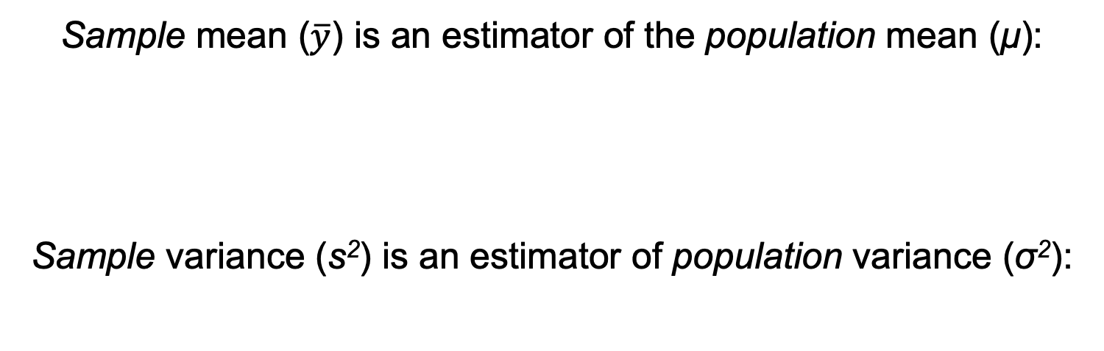
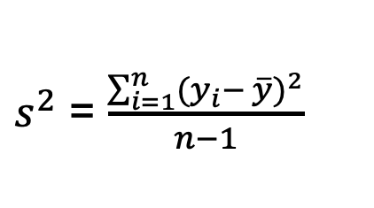
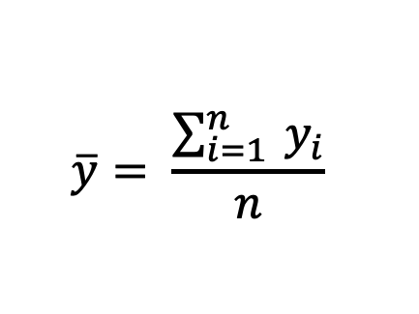
Estimating population parameters
Sample mean ($\overline{y}$) is an estimator of the population mean (μ):
Sample variance (s²) is an estimator of population variance (σ²):
$$\overline{y}= \frac{\sum_{i=1}^{n}{{ y}_{i}}}{n}$$
$s^{2}$ = $\frac{\sum_{i=1}^{n}{{(y_{i}− \overline{y})}^{2}}}{n−1}$

Slide 6
Ideal estimators
Provide estimates that are close to the value of the true population parameter
Estimates from multiple samples drawn from the same population would be similar to one another
→ Bias
→ Precision

Slide 7
Accuracy
Describes uncertainty in an estimate
Two aspects: bias and precision
Bias is error introduced into sampling data that causes estimates to differ systematically from the true value of the parameter
Precision is a measure of similarity among estimates from multiple samples drawn from the same population

Slide 8
Accuracy
Unbiased
Biased
The true value of the parameter is the black dot at the center of the target
Precise
Each red dot represents an estimate of a parameter from a different sample drawn from the population
The blue dot is the average
Not precise
In practice, we draw only one sample for a study, so we will have only one dot
Notes:
Left off 9/14/2021
Center of target = true mean
Red dots = estimates = sample means (NOT measurements from sample units)
Blue dot = mean of all samples. Unbiased means on average, the sample is close to true mean.
Which is the worst case scenario?
Each red dot = one sample. How do we know how precise our sample is when we only have one???????

Slide 9
More on precision…
No estimate is likely to equal the population parameter exactly because a sample contains only a fraction of the population
Estimates, therefore, have uncertainty
This uncertainty results from sampling ‘error’
Precision is a gauge of the amount of uncertainty in an estimate
Measures of uncertainty include standard error and confidence intervals

Slide 10
But how can we gauge precision with information from only one sample?
in practice, we get just one estimate from one sample from a population
Notes:
Each red dot = one sample. How do we know how precise an estimate is when we only have one?
Each target is like a sampling distribution = a distribution of estimates drawn from multiple samples of the same size from the same population.

Slide 11
Sampling distributions
We make inferences about population parameters from the estimates we compute from sample data
Because a sample represents only a fraction of a population, estimates have uncertainty
We gauge this uncertainty by measuring the variation among multiple estimates from multiple hypothetical samples, all of the same size (n), and all drawn from the same population

Slide 12
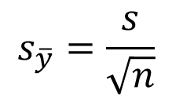
Standard error
Standard error of an estimate is the standard deviation of the sampling distribution of an estimate, which quantifies the amount of uncertainty in or precision of that estimate
Standard error of the mean
$$s_{\overline{y}}=\frac{s}{\sqrt{n}}$$
Reflects variation in the population (s)
Reflects the amount of information available (n = sample size)
While the standard deviation provides a measure of the spread of the data from the mean, the standard error (SE) represents the uncertainty in the calculation of the mean.
Notes:
Left off 9/15/2021

Slide 13
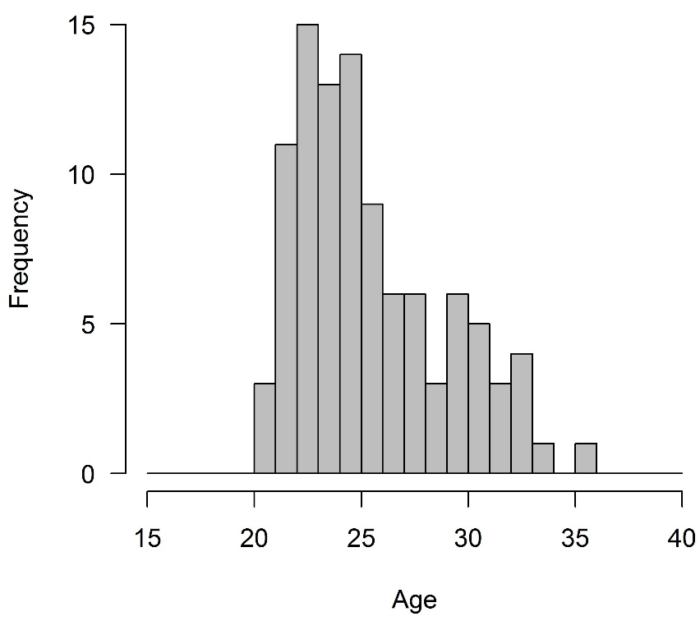


distribution of values in the entire population
n=5
n=5
21, 27, 22, 22, 22
33, 25, 21, 22, 32
$\overline{y}$ = 22.8
$\overline{y}$ = 26.6
This difference is due to sampling ‘error’

Slide 14
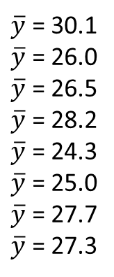


distribution of values in the entire population
n=5
33, 25, 21, 22, 32
$\overline{y}$ = 26.6
21, 27, 22, 22, 22
$\overline{y}$ = 22.8
$\overline{y}$ = 30.1
$\overline{y}$ = 26.0
$\overline{y}$ = 26.5
$\overline{y}$ = 28.2
$\overline{y}$ = 24.3
$\overline{y}$ = 25.0
$\overline{y}$ = 27.7
$\overline{y}$ = 27.3

Slide 15
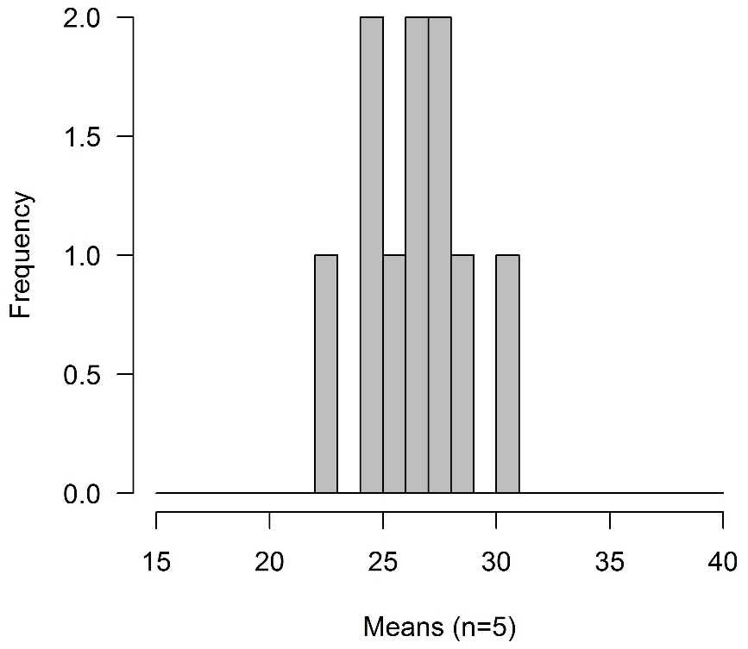

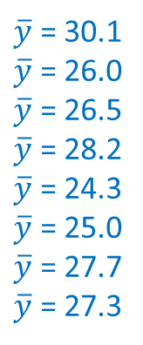


distribution of values in the entire population
33, 25, 21, 22, 32
measure spread with s
$\overline{y}$ = 26.6
21, 27, 22, 22, 22
$\overline{y}$ = 22.8
$\overline{y}$ = 30.1
$\overline{y}$ = 26.0
$\overline{y}$ = 26.5
$\overline{y}$ = 28.2
$\overline{y}$ = 24.3
$\overline{y}$ = 25.0
$\overline{y}$ = 27.7
$\overline{y}$ = 27.3
distribution of many estimates of the sample mean (all for n=5)
measure spread with $\frac{s}{\sqrt{n}}$
Continue for all possible samples

Slide 16
Effect of increasing sample size (n) on standard deviation vs. standard error?
SD stabilizes
SE decreases
Describes variation in the population
Describes variation in an estimate

Slide 17
Why worry about uncertainty?
Management decisions are based on estimates from sampling
Gauging how much confidence we have in our estimates is critical to making reliable decisions
How many animals can we harvest sustainably?
Will we leave a sufficient number of flowering agaves for bats if we burn grasslands?
Is abundance of a rare species increasing, decreasing, or stable?

Slide 18
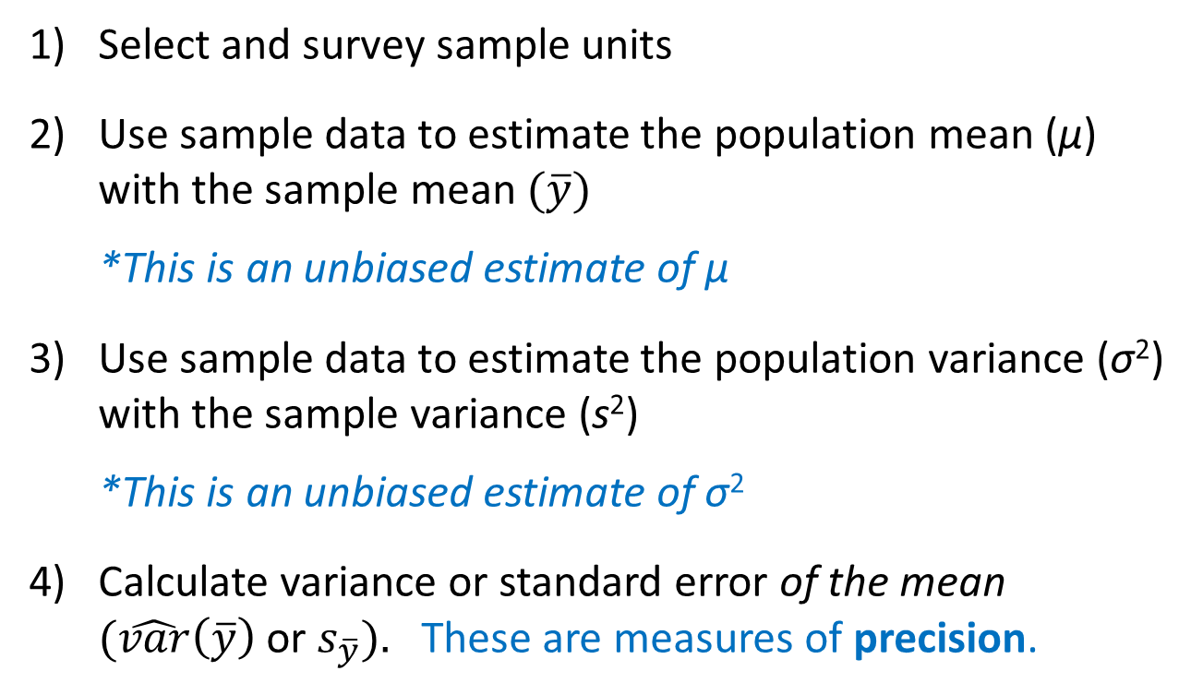
Review: To characterize the population mean
Select and survey sample units
Use sample data to estimate the population mean (μ) with the sample mean $(\overline{y})$
*This is an unbiased estimate of μ
Use sample data to estimate the population variance (σ²) with the sample variance (s²)
*This is an unbiased estimate of σ²
Calculate variance or standard error of the mean $(\hat{var}\left(\overline{y}\right)$ or $s_{\overline{y}}).$ These are measures of precision.

Slide 19
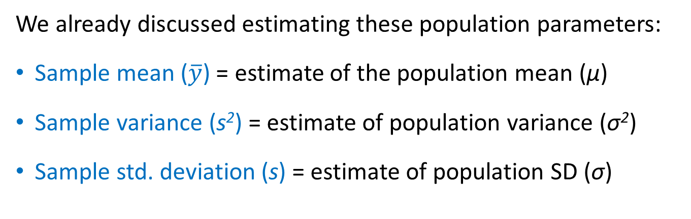
Simple random sampling
We already discussed estimating these population parameters:
Sample mean ($\overline{y}$) = estimate of the population mean (μ)
Sample variance (s²) = estimate of population variance (σ²)
Sample std. deviation (s) = estimate of population SD (σ)

Slide 20
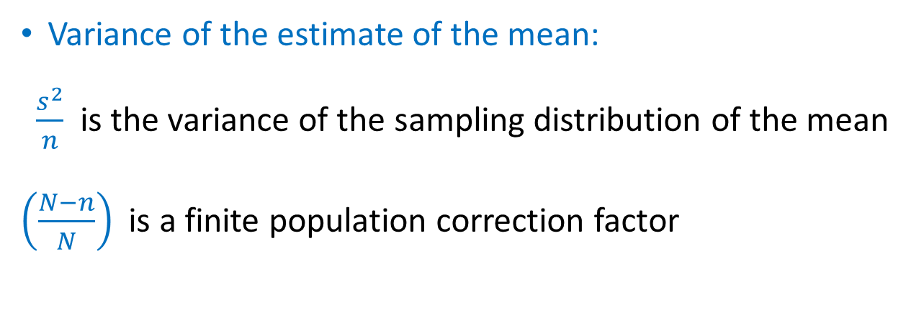
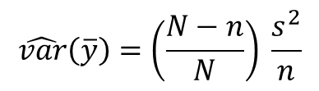
Simple random sampling
$$\hat{var}\left(\overline{y}\right)=\left(\frac{N−n}{N}\right) \frac{s^{2}}{n}$$
Variance of the estimate of the mean:
$\frac{s^{2}}{n}$ is the variance of the sampling distribution of the mean
$\left(\frac{N−n}{N}\right)$ is a finite population correction factor
Used only when the total number of sample units in a population (N) is known
If N is unknown, eliminate the correction factor from the equation
Notes:
How does the factor change if n is close to N or close to 1?

Slide 21
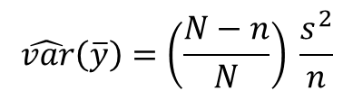



Simple random sampling
$$\hat{var}\left(\overline{y}\right)=\left(\frac{N−n}{N}\right) \frac{s^{2}}{n}$$
Variance of the mean:
Standard error of the mean (SE):
If we know N:
If we don’t know N:
$$s_{\overline{y}}=\sqrt{\hat{var}(\overline{y})}$$
$$s_{\overline{y}}=\sqrt{\left(\frac{N−n}{N}\right)\frac{s^{2}}{n}}$$
$$s_{\overline{y}}=\sqrt{\frac{s^{2}}{n}}=\frac{s}{\sqrt{n}}$$

Slide 22

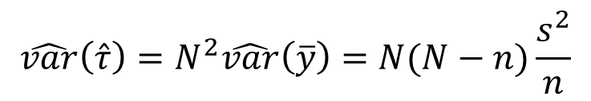
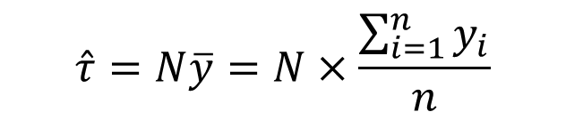
Population total (i.e., Abundance)
Estimate the population total $(\hat{τ})$:
Variance of the estimated population total:
$$\hat{τ}=N\overline{y}=N×\frac{\sum_{i=1}^{n}{y_{i}}}{n}$$
$$\hat{var}\left(\hat{τ}\right)=N^{2}\hat{var}\left(\overline{y}\right)=N(N−n)\frac{s^{2}}{n}$$
Notes:
Left off 9/20/2021

Slide 23
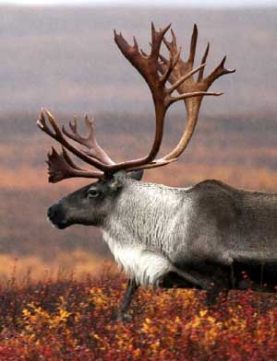

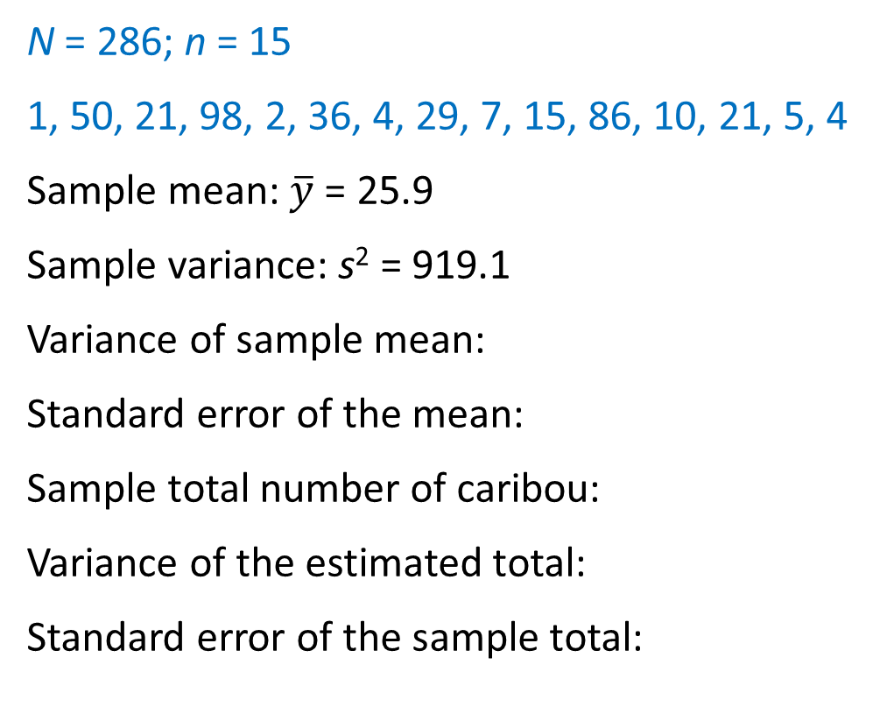




Back to the Caribou ex.
N = 286; n = 15
1, 50, 21, 98, 2, 36, 4, 29, 7, 15, 86, 10, 21, 5, 4
Sample mean: $\overline{y}$ = 25.9
Sample variance: s² = 919.1
Variance of sample mean:
Standard error of the mean:
Sample total number of caribou:
Variance of the estimated total:
Standard error of the sample total:
$\hat{var}\left(\overline{y}\right)= \left(\frac{286−15}{286}\right)\frac{919.1}{15}=$ 58.1
$\sqrt{\hat{var}\left(\overline{y}\right)}=\sqrt{58.1}=$ 7.6
$\hat{τ}=286×25.9=$ 7,417
$$\hat{var}\left(\hat{τ}\right)= {(286)}^{2} ×58.1=4,748,879$$
$\sqrt{\hat{var}\left(\hat{τ}\right)}=\sqrt{4,748,879}=$ 2,179

