Slide 1
Lecture 12: Std. Error, Population Estimates, and Confidence Intervals
March 2, 2022

Slide 2
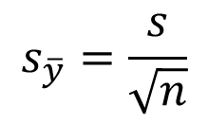
Standard error
Standard error of an estimate is the standard deviation of the sampling distribution of an estimate, which quantifies the amount of uncertainty in or precision of that estimate
Standard error of the mean
$$s_{\overline{y}}=\frac{s}{\sqrt{n}}$$
Reflects variation in the population (s)
Reflects the amount of information available (n = sample size)
While the standard deviation provides a measure of the spread of the data from the mean, the standard error (SE) represents the uncertainty in the calculation of the mean.
Notes:
Left off 9/15/2021

Slide 3
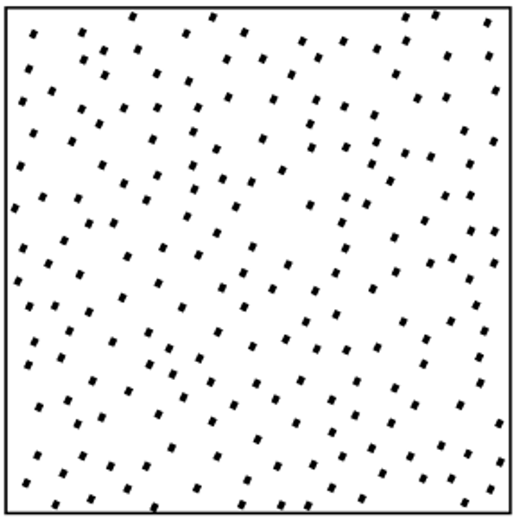
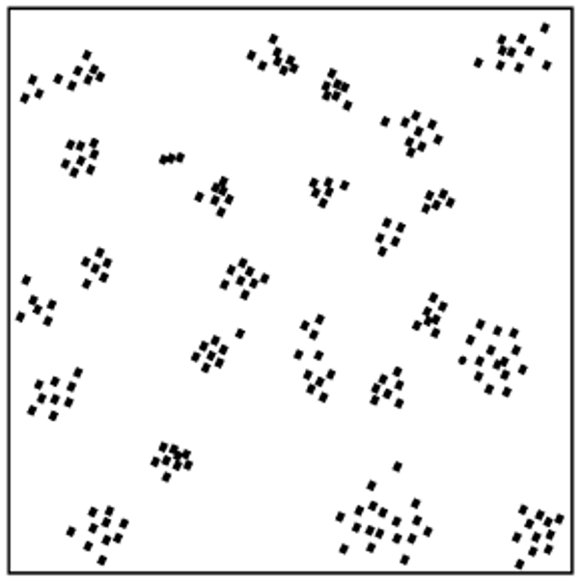

Slide 4
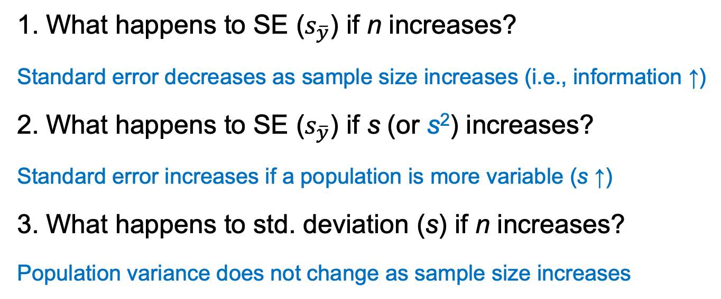

Let’s practice!
$$s_{\overline{y}}=\sqrt{\frac{s^{2}}{n}}=\frac{s}{\sqrt{n}}$$
1. What happens to SE ($s_{\overline{y}}$) if n increases?
Standard error decreases as sample size increases (i.e., information ↑)
2. What happens to SE ($s_{\overline{y}}$) if s (or s²) increases?
Standard error increases if a population is more variable (s ↑)
3. What happens to std. deviation (s) if n increases?
Population variance does not change as sample size increases
Notes:
Ended second sampling lecture (lab, about 2 hrs)

Slide 5
Effect of increasing sample size (n) on standard deviation vs. standard error?
SD stabilizes
SE decreases
Describes variation in the population
Describes variation in an estimate

Slide 6
Why worry about uncertainty?
Management decisions are based on estimates from sampling
Gauging how much confidence we have in our estimates is critical to making reliable decisions
How many animals can we harvest sustainably?
Will we leave a sufficient number of flowering agaves for bats if we burn grasslands?
Is abundance of a rare species increasing, decreasing, or stable?

Slide 8
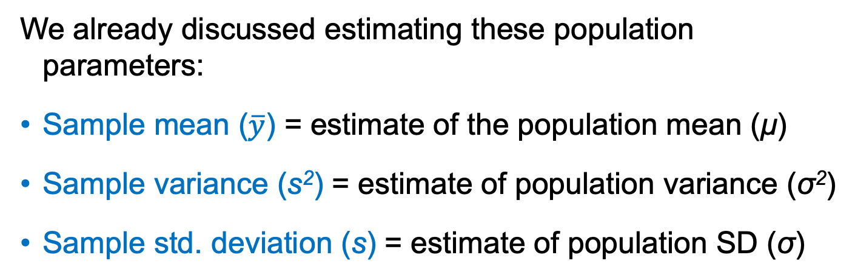
Simple random sampling
We already discussed estimating these population parameters:
Sample mean ($\overline{y}$) = estimate of the population mean (μ)
Sample variance (s²) = estimate of population variance (σ²)
Sample std. deviation (s) = estimate of population SD (σ)

Slide 9
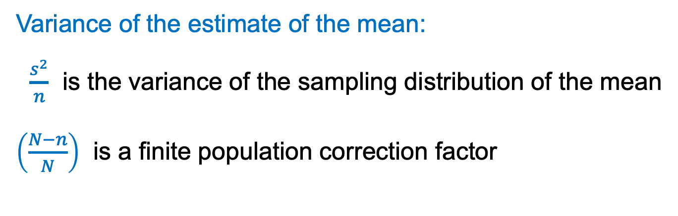
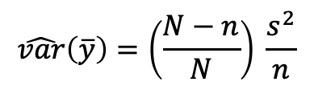
Simple random sampling
$$\hat{var}\left(\overline{y}\right)=\left(\frac{N−n}{N}\right) \frac{s^{2}}{n}$$
Variance of the estimate of the mean:
$\frac{s^{2}}{n}$ is the variance of the sampling distribution of the mean
$\left(\frac{N−n}{N}\right)$ is a finite population correction factor
Used only when the total number of sample units in a population (N) is known
If N is unknown, eliminate the correction factor from the equation
Notes:
How does the factor change if n is close to N or close to 1?

Slide 10
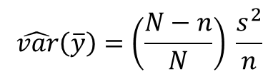



Simple random sampling
$$\hat{var}\left(\overline{y}\right)=\left(\frac{N−n}{N}\right) \frac{s^{2}}{n}$$
Variance of the mean:
Standard error of the mean (SE):
If we know N:
If we don’t know N:
$$s_{\overline{y}}=\sqrt{\hat{var}(\overline{y})}$$
$$s_{\overline{y}}=\sqrt{\left(\frac{N−n}{N}\right)\frac{s^{2}}{n}}$$
$$s_{\overline{y}}=\sqrt{\frac{s^{2}}{n}}=\frac{s}{\sqrt{n}}$$

Slide 11

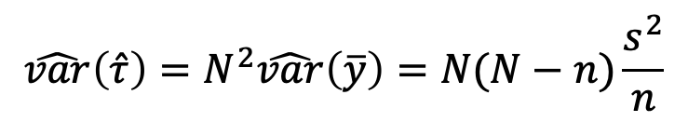
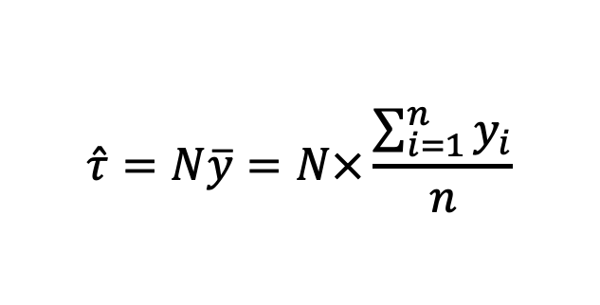
Population total (i.e., abundance)
Estimate the population total $(\hat{τ})$:
Variance of the estimated population total:
$$\hat{τ}=N\overline{y}=N×\frac{\sum_{i=1}^{n}{y_{i}}}{n}$$
Sampling frame (i.e., total sample units)
Average # entities per sample unit
$$\hat{var}\left(\hat{τ}\right)=N^{2}\hat{var}\left(\overline{y}\right)=N(N−n)\frac{s^{2}}{n}$$
Notes:
Left off 9/20/2021

Slide 12
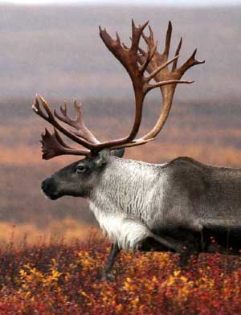

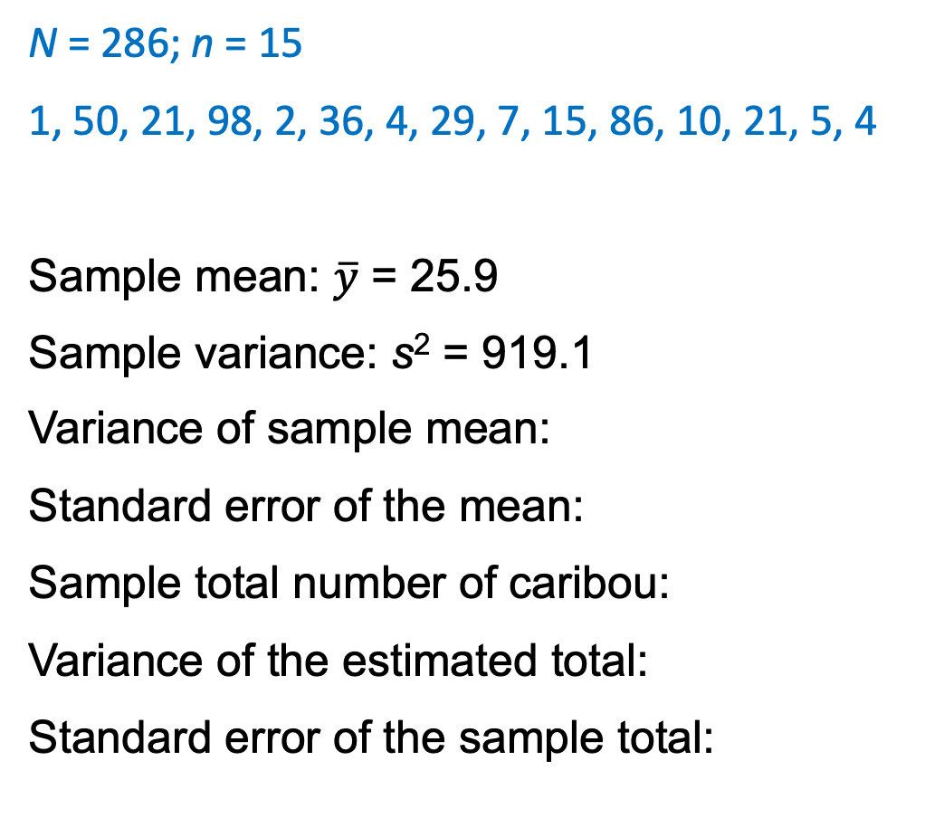




Back to the Caribou ex.
N = 286; n = 15
1, 50, 21, 98, 2, 36, 4, 29, 7, 15, 86, 10, 21, 5, 4
Sample mean: $\overline{y}$ = 25.9
Sample variance: s² = 919.1
Variance of sample mean:
Standard error of the mean:
Sample total number of caribou:
Variance of the estimated total:
Standard error of the sample total:
$\hat{var}\left(\overline{y}\right)= \left(\frac{286−15}{286}\right)\frac{919.1}{15}=$ 58.1
$\sqrt{\hat{var}\left(\overline{y}\right)}=\sqrt{58.1}=$ 7.6
$\hat{τ}=286×25.9=$ 7,417
$$\hat{var}\left(\hat{τ}\right)= {(286)}^{2} ×58.1=4,748,879$$
$\sqrt{\hat{var}\left(\hat{τ}\right)}=\sqrt{4,748,879}=$ 2,179

Slide 13
Confidence intervals
Range of values within which the true value of a parameter is likely to exist with a fixed probability
For a 95% confidence interval (95% CI):
If we drew 100 different samples of size n from the same population, the 95% confidence intervals for the estimates will include the true value of the parameter 95 of 100 times

Slide 14
Confidence intervals
For any individual sample, we cannot know with certainty if the CI for the estimate includes the true value of the parameter

Slide 15
Confidence intervals
Nothing special about a 95% CI; we could compute a 90% CI, 99% CI, or any other value
In general, we establish the α-level in a 100(1 – α)% CI as the proportion of times we are willing to risk not capturing the true parameter in the interval
For a 95% CI, α = 0.05: 100(1 – 0.05)% = 95%

Slide 16
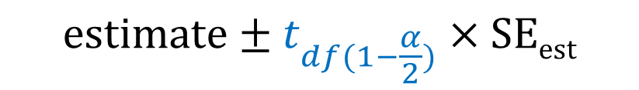
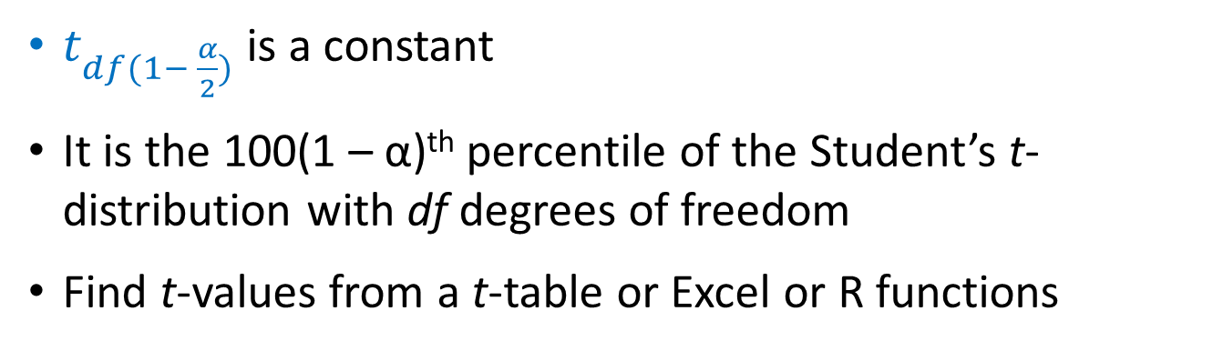
Confidence intervals
General form for a 100(1 – α)% CI:
$$estimate±t_{df(1−\frac{α}{2})}×SEest$$
t x SE = “half width”
$t_{df(1− \frac{α}{2})}$ is a constant
It is the 100(1 – α)^{th} percentile of the Student’s t-distribution with df degrees of freedom
Find t-values from a t-table or Excel or R functions
Notes:
t-values in Excel: T.INV.2T(α, n - 1)

Slide 17
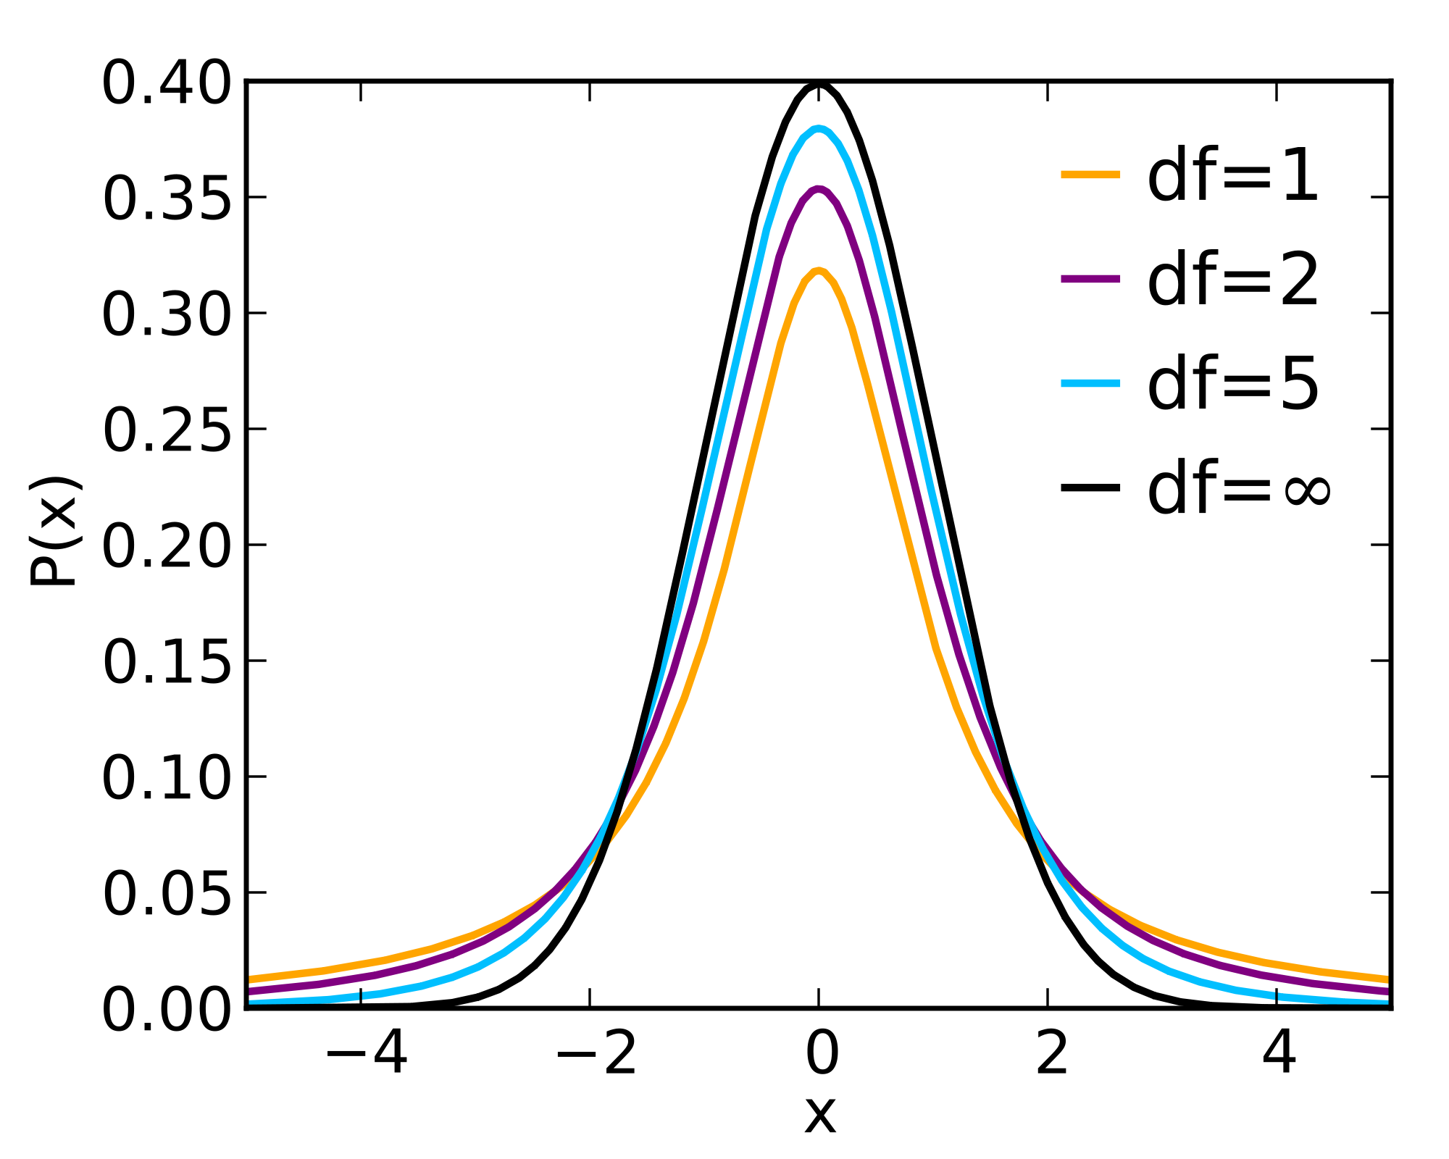
Student’s t-distributions
= Normal
distribution
df = number of observations – number of parameters estimated

Slide 18
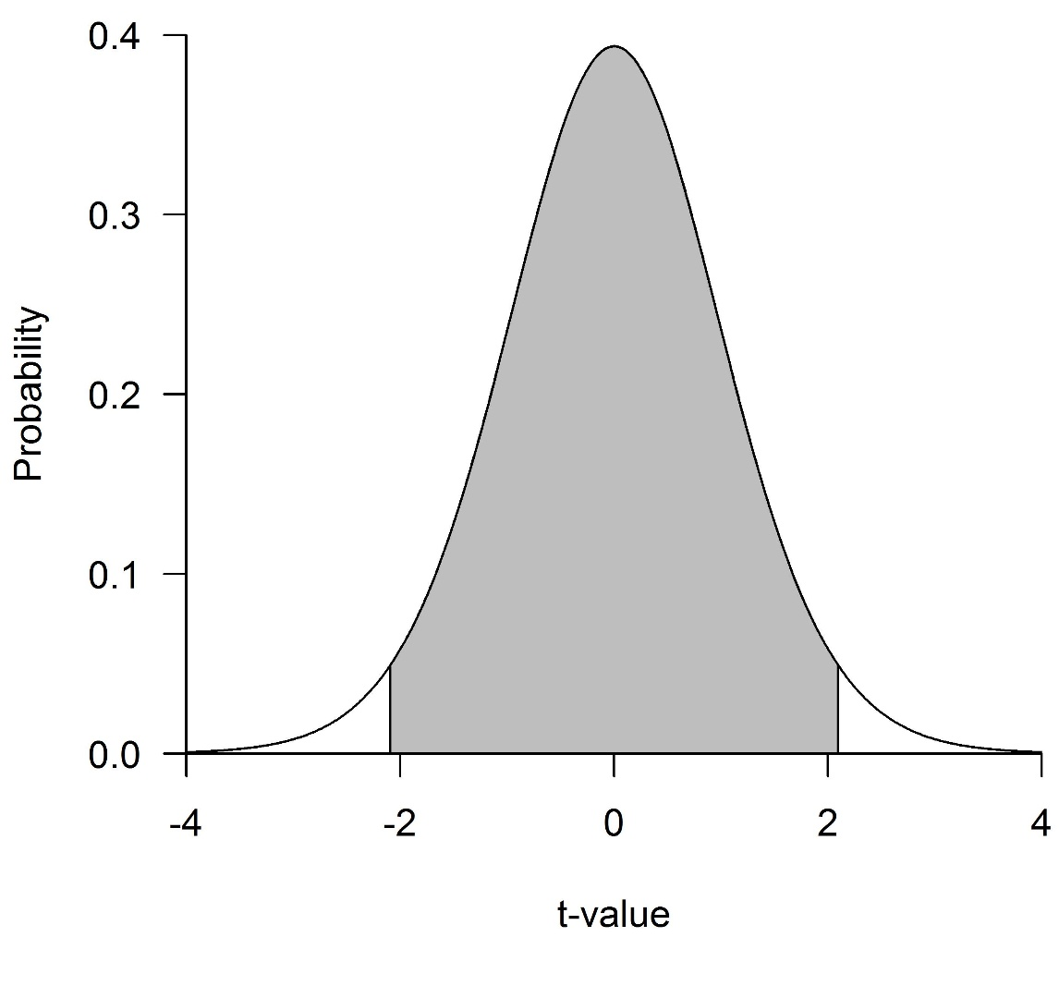
Student’s t-distribution with 19 df
What t-value yields a probability equal to α?
Depends on df and α
2.5%
95%
2.5%
For example:
n = 20 (so 19 df)
α = 0.05/2 = 0.025
?

Slide 19
Student’s t-distribution with 19 df
2.5%
2.5%
Critical value
-2.093
2.093

Slide 20
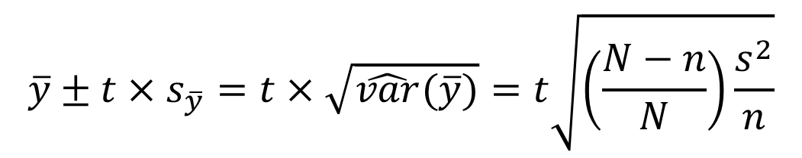
Confidence intervals
For a simple random sample, a confidence interval for an estimate of the population mean (μ) is:
where t is the upper α/2 point of a Student’s t distribution with n – 1 degrees of freedom
$$\overline{y}±t×s_{\overline{y}}=t×\sqrt{\hat{var}(\overline{y})}=t\sqrt{\left(\frac{N−n}{N}\right)\frac{s^{2}}{n}}$$

Slide 21
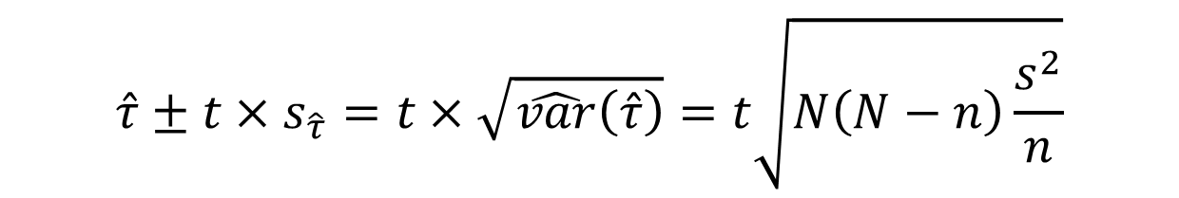
Confidence intervals
For a simple random sample, a confidence interval for an estimate of the population total (τ) is:
where t is the upper α/2 point of a Student’s t distribution with n – 1 degrees of freedom
$$\hat{τ}±t×s_{\hat{τ}}=t×\sqrt{\hat{var}\left(\hat{τ}\right)}=t\sqrt{N\left(N−n\right)\frac{s^{2}}{n}}$$

