Slide 1
Lecture 13: Confidence Intervals
Mar 14, 2022

Slide 2
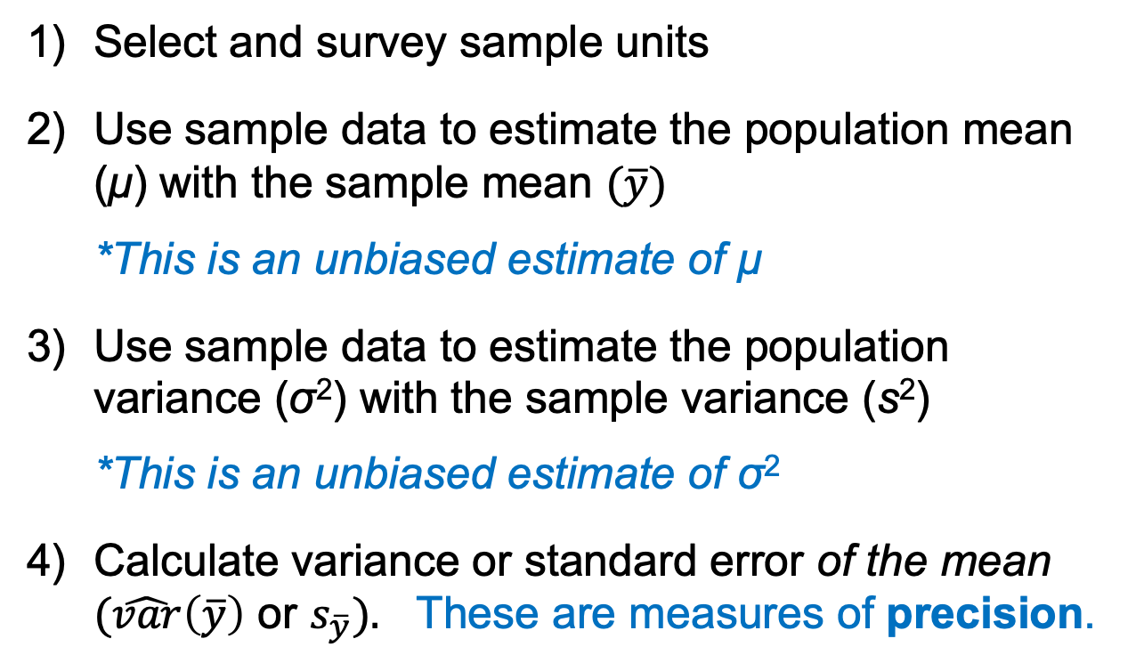
Review: characterize the population mean
Select and survey sample units
Use sample data to estimate the population mean (μ) with the sample mean $(\overline{y})$
*This is an unbiased estimate of μ
Use sample data to estimate the population variance (σ²) with the sample variance (s²)
*This is an unbiased estimate of σ²
Calculate variance or standard error of the mean $(\hat{var}\left(\overline{y}\right)$ or $s_{\overline{y}}).$ These are measures of precision.

Slide 3
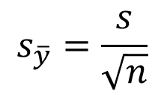
Standard error
Standard error of an estimate is the standard deviation of the sampling distribution of an estimate, which quantifies the amount of uncertainty in or precision of that estimate
Standard error of the mean
$$s_{\overline{y}}=\frac{s}{\sqrt{n}}$$
Reflects variation in the population (s)
Reflects the amount of information available (n = sample size)
While the standard deviation provides a measure of the spread of the data from the mean, the standard error (SE) represents the uncertainty in the calculation of the mean.
Notes:
Left off 9/15/2021

Slide 4
Confidence intervals
Range of values within which the true value of a parameter is likely to exist with a fixed probability
For a 95% confidence interval (95% CI):
If we drew 100 different samples of size n from the same population, the 95% confidence intervals for the estimates will include the true value of the parameter 95 of 100 times

Slide 5
Confidence intervals
For any individual sample, we cannot know with certainty if the CI for the estimate includes the true value of the parameter

Slide 6
Confidence intervals
Nothing special about a 95% CI; we could compute a 90% CI, 99% CI, or any other value
In general, we establish the α-level in a 100(1 – α)% CI as the proportion of times we are willing to risk not capturing the true parameter in the interval
For a 95% CI, α = 0.05: 100(1 – 0.05)% = 95%

Slide 7
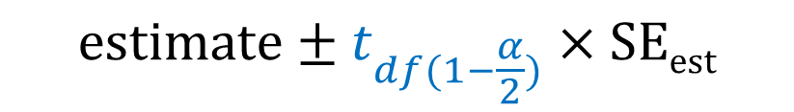
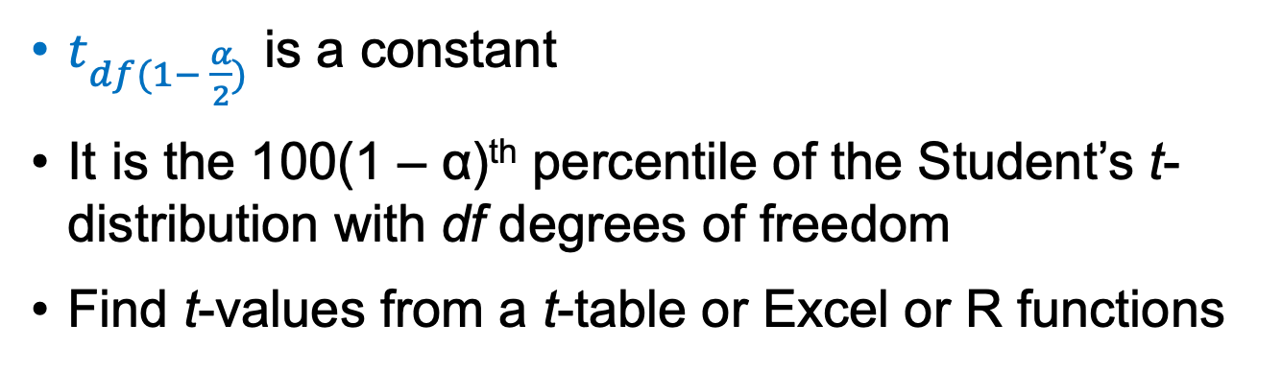
Confidence intervals
General form for a 100(1 – α)% CI:
$$estimate±t_{df(1−\frac{α}{2})}×SEest$$
t x SE = “half width”
$t_{df(1− \frac{α}{2})}$ is a constant
It is the 100(1 – α)^{th} percentile of the Student’s t-distribution with df degrees of freedom
Find t-values from a t-table or Excel or R functions
Notes:
t-values in Excel: T.INV.2T(α, n - 1)

Slide 8
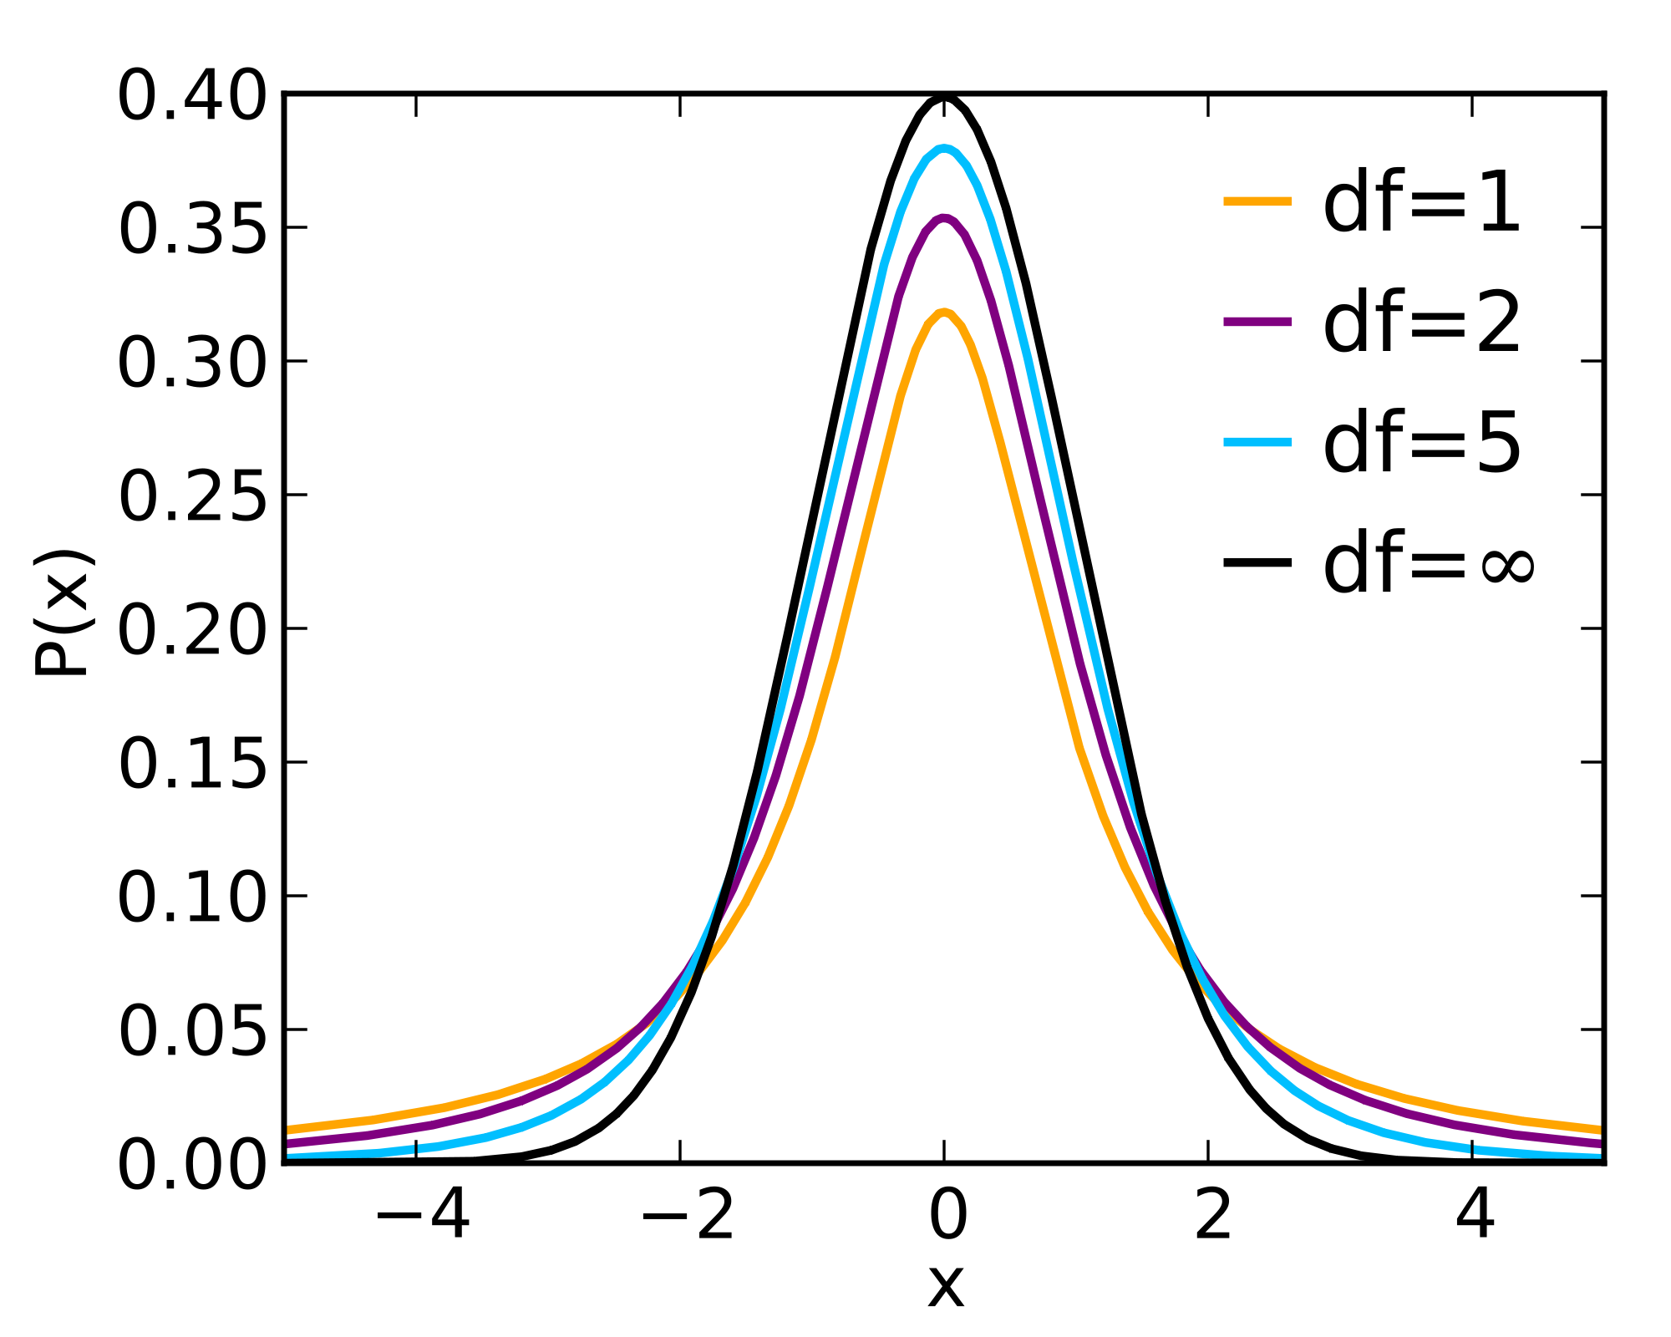
Student’s t-distributions
= Normal
distribution
df = number of observations – number of parameters estimated

Slide 9
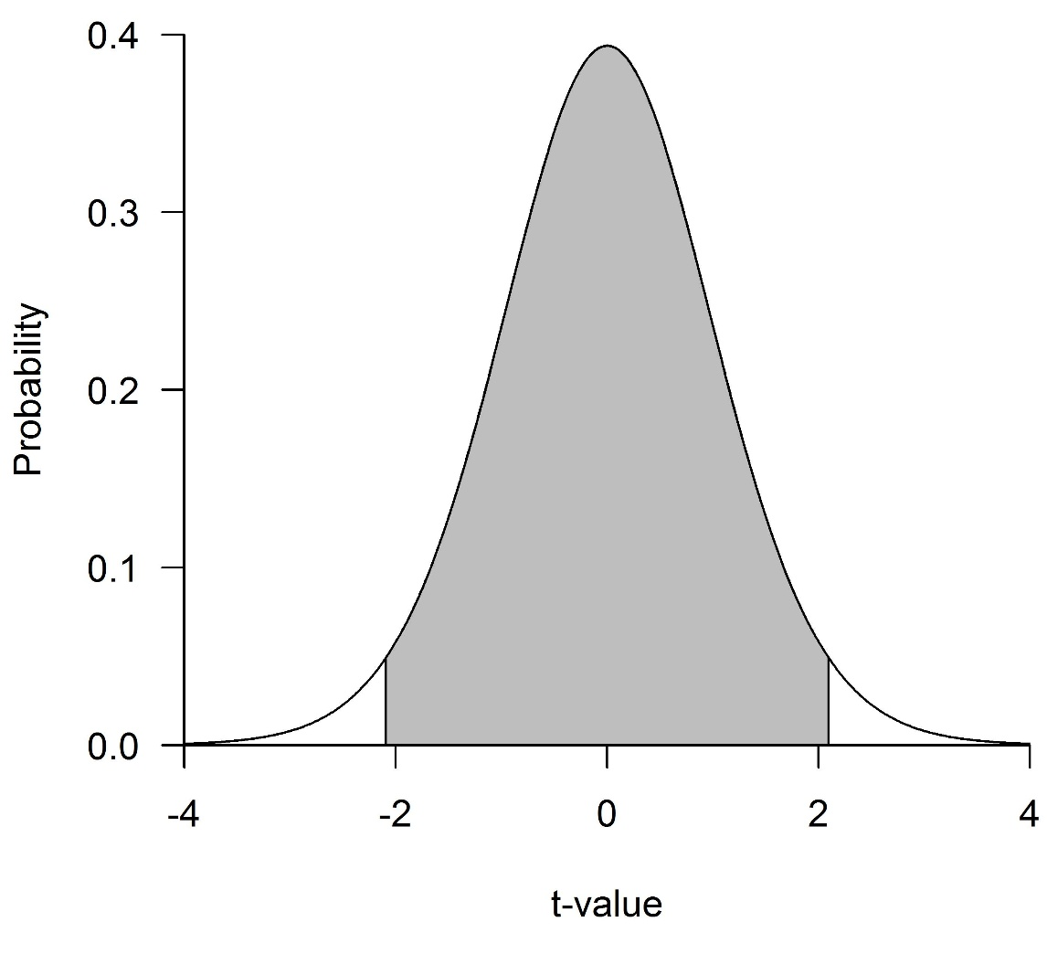
Student’s t-distribution with 19 df
What t-value yields a probability equal to α?
Depends on df and α
2.5%
95%
2.5%
For example:
n = 20 (so 19 df)
α = 0.05/2 = 0.025
?

Slide 10
Student’s t-distribution with 19 df
2.5%
2.5%
Critical value
-2.093
2.093

Slide 11
As n increases…
CI half-width: t x SE
 | t-value (2-tailed)
df | 95% CI | 90% CI
5 | 2.57 | 2.02
10 | 2.23 | 1.81
50 | 2.01 | 1.68
infinite | 1.96 | 1.64

Slide 12
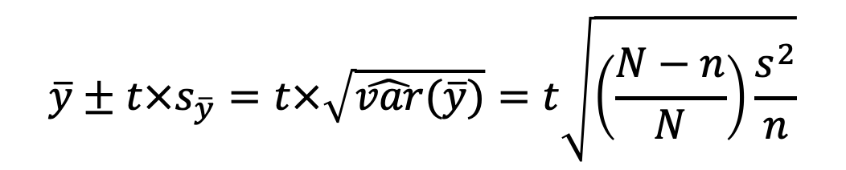
Confidence intervals
For a simple random sample, a confidence interval for an estimate of the population mean (μ) is:
where t is the upper α/2 point of a Student’s t distribution with n – 1 degrees of freedom
$$\overline{y}±t×s_{\overline{y}}=t×\sqrt{\hat{var}(\overline{y})}=t\sqrt{\left(\frac{N−n}{N}\right)\frac{s^{2}}{n}}$$

Slide 13
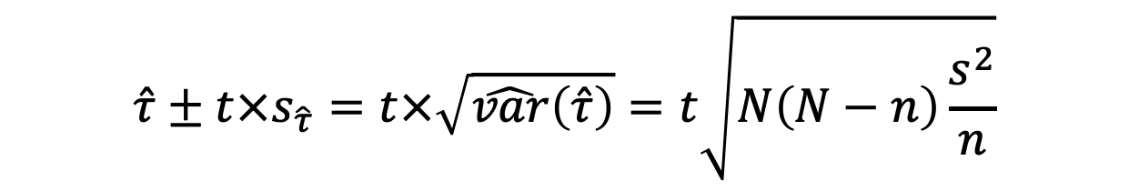
Confidence intervals
For a simple random sample, a confidence interval for an estimate of the population total (τ) is:
where t is the upper α/2 point of a Student’s t distribution with n – 1 degrees of freedom
$$\hat{τ}±t×s_{\hat{τ}}=t×\sqrt{\hat{var}\left(\hat{τ}\right)}=t\sqrt{N\left(N−n\right)\frac{s^{2}}{n}}$$

Slide 14
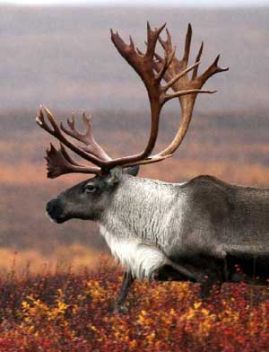

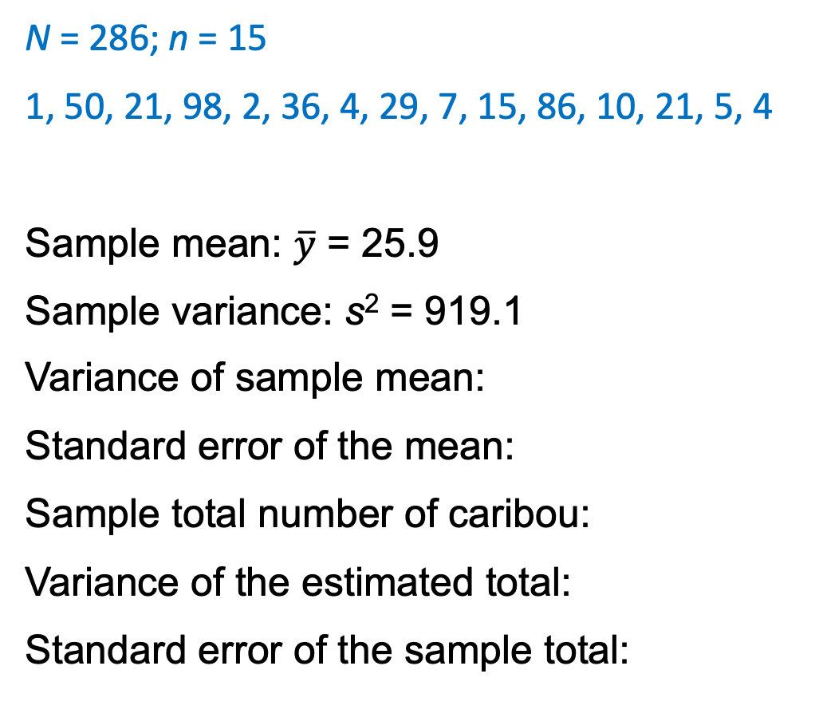




Back to the Caribou ex.
N = 286; n = 15
1, 50, 21, 98, 2, 36, 4, 29, 7, 15, 86, 10, 21, 5, 4
Sample mean: $\overline{y}$ = 25.9
Sample variance: s² = 919.1
Variance of sample mean:
Standard error of the mean:
Sample total number of caribou:
Variance of the estimated total:
Standard error of the sample total:
$\hat{var}\left(\overline{y}\right)= \left(\frac{286−15}{286}\right)\frac{919.1}{15}=$ 58.1
$\sqrt{\hat{var}\left(\overline{y}\right)}=\sqrt{58.1}=$ 7.6
$\hat{τ}=286×25.9=$ 7,417
$$\hat{var}\left(\hat{τ}\right)= {(286)}^{2} ×58.1=4,748,879$$
$\sqrt{\hat{var}\left(\hat{τ}\right)}=\sqrt{4,748,879}=$ 2,179

Slide 15

Caribou example
95% CI for mean no. caribou/transect
n = 15
sample mean = 25.9
SE of the mean = 7.6
Equation for CI:
$$\overline{y}±t×s_{\overline{y}}$$
25.9 ± 2.145 x 7.6 = 25.9 ± 16.3 =
25.9 - 16.3, 25.9 + 16.3 = (9.6, 42.2)
t-value for 14 df and α = 0.05
What about a 90% CI?
*Notice the 95% CI is wider than the 90% CI
(12.5, 39.3)

Slide 16

Caribou example
95% CI for total no. caribou/transect
n = 15
sample total = 7,417
SE of the sample total = 2,179
Equation for CI:
$$\overline{y}±t×s_{\overline{y}}$$
7,417 ± 2.145 x 2,179 = 7,417 ± 4,674 =
(2,743, 12,091)
90% CI = (3,579, 11,255)
*Again, 95% CI is wider than the 90% CI
Notes:
Ended next hr lecture (Monday, 2/10/2014)

Slide 17
Sampling designs
Simple random sampling
Systematic sampling
Stratified sampling

Slide 18
Random samples can sometimes seem less than ideal
Poor dispersion

Slide 19
Systematic sampling
Sample units chosen at uniform intervals, usually after choosing a random start point(s)

Slide 20

Systematic sampling
Sample units chosen at uniform intervals, usually after choosing a random start point(s)

Slide 21
Systematic sampling
Randomly select one unit from the first k sample units in the population and every k^{th} unit thereafter.
This is a 1-in-k systematic sample
k = No. units in population / No. units in sample
Example: If we plan to choose 40 plots from a field of 400 plots, k = 400/40 = 10
This is a “1-in-10” systematic sample

Slide 22
Systematic sampling
Advantages:
Easy to implement
Ensures good dispersion of sample units throughout the population
Disadvantages:
Risk of bias

Slide 23
Systematic sampling

Slide 24
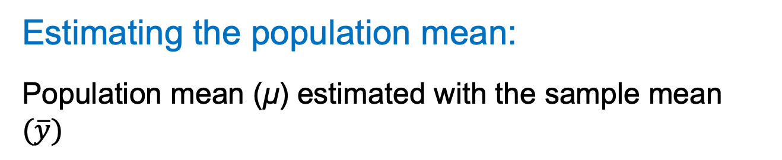
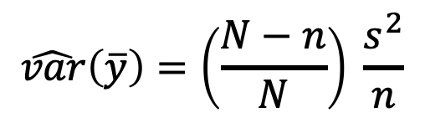
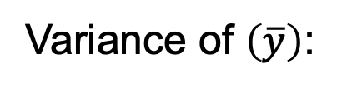
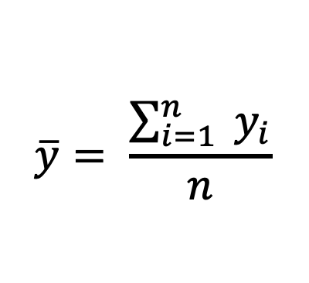
Systematic sampling
Estimating the population mean:
Population mean (μ) estimated with the sample mean $(\overline{y})$
$$\overline{y}= \frac{\sum_{i=1}^{n}{{ y}_{i}}}{n}$$
(same as SRS)
$$\hat{var}\left(\overline{y}\right)=\left(\frac{N−n}{N}\right) \frac{s^{2}}{n}$$
Variance of $\left(\overline{y}\right)$:
(same as SRS)
Recall that if N is unknown, we ignore the finite population correction factor

Slide 25
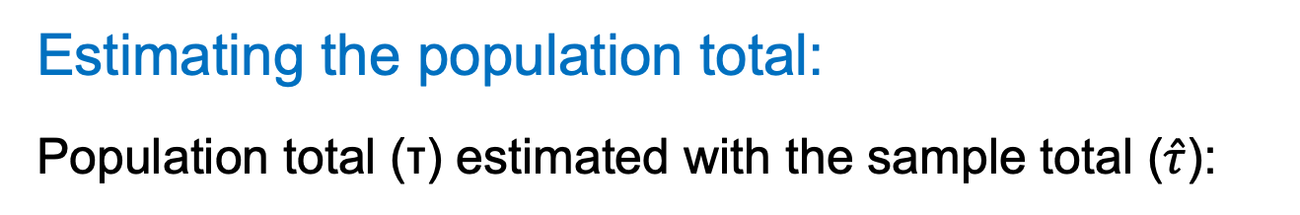

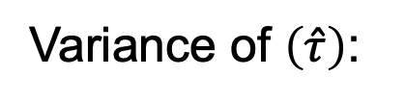
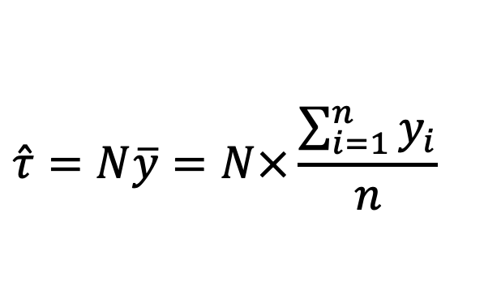
Systematic sampling
Estimating the population total:
Population total (τ) estimated with the sample total ($\hat{τ}$):
$$\hat{τ}=N\overline{y}=N×\frac{\sum_{i=1}^{n}{y_{i}}}{n}$$
(same as SRS)
Variance of $\left(\hat{τ}\right)$:
$$\hat{var}\left(\hat{τ}\right)=N^{2}\hat{var}(\overline{y})$$
(same as SRS)

Slide 26
Mid-semester Feedback!
https://tinyurl.com/RNR321-Spring2022-midsemester

