Slide 1
Lecture 20: Removal Methods
Apr 11, 2022

Slide 2
Capture-based approaches
Two common approaches to estimate abundance of closed populations:
Capture, mark, and return individuals to the population = Capture-recapture methods
Capture and remove individuals from the population = Removal methods

Slide 3
Removal methods
Two or more survey occasions
Individuals captured are not returned to the population until sampling is completed
Relevant model: N_{i+1} = N_{i} – n_{i}
i indexes survey occasion
No. individuals in the population at the start of survey occasion i
No. individuals captured and removed during survey occasion i

Slide 4
Removal methods
Two or more survey occasions
Individuals captured are not returned to the population until sampling is completed
Abundance should decrease with repeated sampling occasions because of removals: N₁ > N₂ > … > N_{m}
Sometimes called “depletion sampling”
Want to estimate N₁, the number of individuals before any were removed

Slide 5
Removal strategies
Capture and remove live animals
Remove through harvest
Mark and release individuals that we ignore during subsequent surveys
This means that most capture-recapture data can be treated as removal data

Slide 6
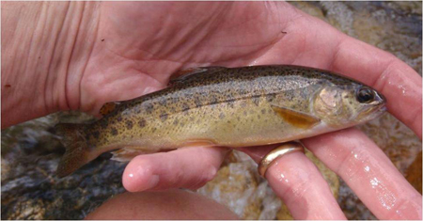
Removal methods
Used commonly for harvested populations, especially fisheries
Two classes of removal models:
Sampling effort held constant during each occasion = constant-effort removal methods
Sampling effort allowed to vary among occasions = catch per unit effort or CPUE
Arizona Game and Fish Dept.

Slide 7
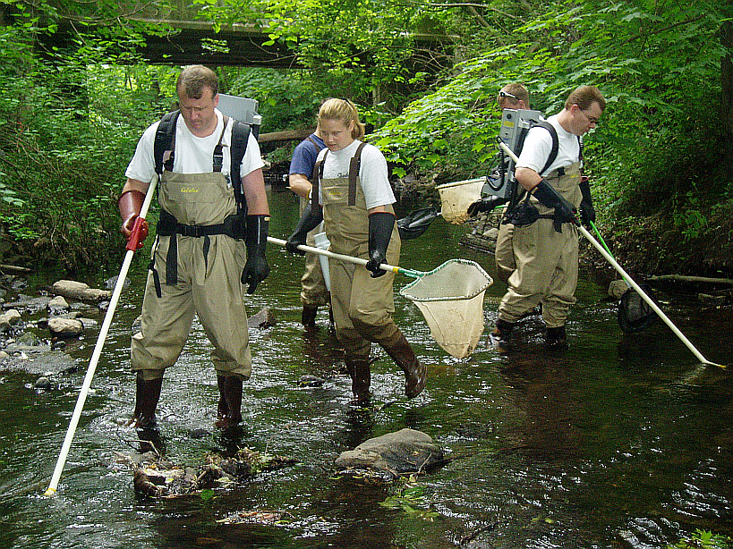
Example: Electrofishing
Upper and lower limits of a stream section “closed” with nets
Area traversed with electroshocking unit
Stunned fish float to the top are collected and placed in tanks
Same reach is traversed (“shocked”) again

Slide 8
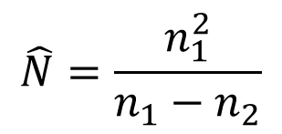
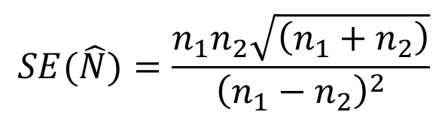
Constant-effort removal methods
A simple estimator for two survey occasions:
$$\hat{N}=\frac{n_{1}^{2}}{n_{1}−n_{2}}$$
$$SE(\hat{N})=\frac{n_{1}n_{2}\sqrt{\left(n_{1}+n_{2}\right)}}{{\left(n_{1}−n_{2}\right)}^{2}}$$
Where: n₁ = number removed in first sample
n₂ = number removed in second sample
Assumptions:
Closed population—no animals move in or out of area
Equal sampling effort on both occasions

Slide 9
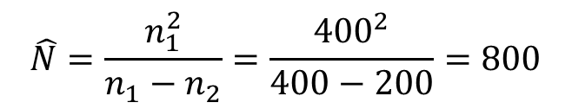

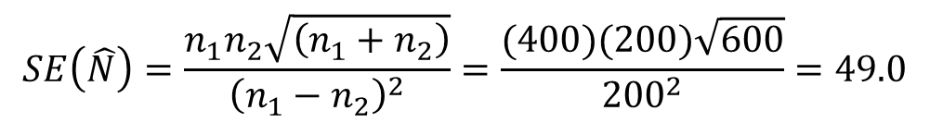
Example: Two sampling occasions
Estimate abundance of stream fish
400 fish removed on first pass and 200 on the second pass
$$\hat{N}=\frac{n_{1}^{2}}{n_{1}−n_{2}}=\frac{{400}^{2}}{400−200}=800$$
$$SE\left(\hat{N}\right)=\frac{n_{1}n_{2}\sqrt{\left(n_{1}+n_{2}\right)}}{{\left(n_{1}−n_{2}\right)}^{2}}=\frac{(400)(200)\sqrt{600}}{{200}^{2}}=49.0$$
$$95\% CI?$$

Slide 10
Removal methods
Used commonly for harvested populations, especially fisheries
Two classes of removal models:
Sampling effort held constant during each occasion = constant-effort removal methods
Allows sampling effort to vary among occasions = catch per unit effort or CPUE
Arizona Game and Fish Dept.

Slide 11
Catch per Unit Effort (CPUE)
Idea: number of individuals removed will be proportional to the effort expended
Works well only when a relatively large fraction of the population is removed so there is a clear decline in catch/effort
Assumptions:
Population is closed
All individuals in the population have the same probability of being captured during sampling occasion i
Arizona Game and Fish Dept.

Slide 12
Catch per Unit Effort (CPUE)
Relate CPUE to cumulative catch
CPUE
(n_{i} / f_{i})
Expect a negative relationship
Cumulative catch (x_{i})
n_{i} = number of individuals removed during sampling occasion i
f_{i} = effort expended during sampling occasion i
x_{i} = cumulative removals prior to (up until) sampling occasion i

Slide 13
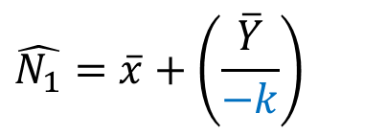
Catch per Unit Effort (CPUE)
Use the slope of this line (k) to estimate N₁, abundance before sampling began
CPUE
Y_{i} = (n_{i} / f_{i})
$$\hat{N_{1}}=\overline{x}+\left(\frac{\overline{Y}}{−k}\right)$$
Cumulative catch (x_{i})
n_{i} = number of individuals removed during sampling occasion i
f_{i} = effort expended during sampling occasion i
x_{i} = cumulative removals prior to (up until) sampling occasion i
Arizona Game and Fish Dept.

Slide 14
Example: Catch per Unit Effort (CPUE)
Survey occasion | Catch (n_{i}) | Effort (f_{i})
1 | 60,400 | 33.664
2 | 49,500 | 27.743
3 | 28,200 | 17.254
4 | 20,700 | 14.764
5 | 11,900 | 11.190
6 | 15,600 | 16.263
7 | 13,200 | 14.757
8 | 25,400 | 32.922
9 | 29,900 | 45.519
10 | 32,500 | 43.523
11 | 24,700 | 37.478
12 | 27,600 | 43.367
13 | 22,200 | 37.960
Commercially harvested lobster population, Nova Scotia, 1950-1951. Effort = thousands of trap hauls
Arizona Game and Fish Dept.

Slide 15
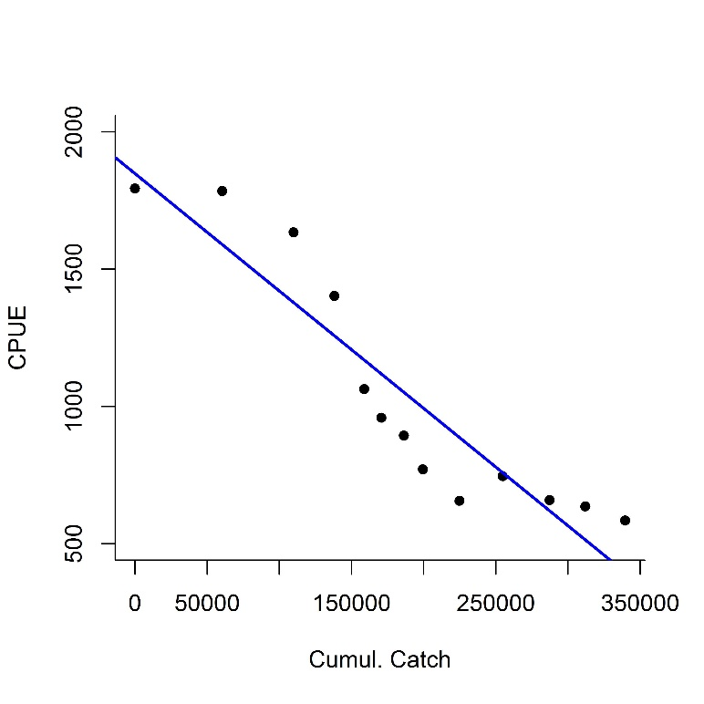
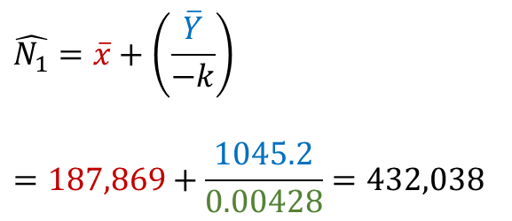
Example: Catch per Unit Effort (CPUE)
Survey occasion | Catch (n_{i}) | Effort (f_{i}) | CPUE (n_{i}/f_{i}) | Cumulative catch (x_{i})
1 | 60,400 | 33.664 | 1794.2 | 0
2 | 49,500 | 27.743 | 1784.2 | 60400
3 | 28,200 | 17.254 | 1634.4 | 109900
4 | 20,700 | 14.764 | 1402.1 | 138100
5 | 11,900 | 11.190 | 1063.4 | 158800
6 | 15,600 | 16.263 | 959.2 | 170700
7 | 13,200 | 14.757 | 894.5 | 186300
8 | 25,400 | 32.922 | 771.5 | 199500
9 | 29,900 | 45.519 | 656.9 | 224900
10 | 32,500 | 43.523 | 746.7 | 254800
11 | 24,700 | 37.478 | 659.1 | 287300
12 | 27,600 | 43.367 | 636.4 | 312000
13 | 22,200 | 37.960 | 584.8 | 339600
means |  |  | 1045.2 | 187869
slope = -0.00428
$$\hat{N_{1}}=\overline{x}+\left(\frac{\overline{Y}}{−k}\right)$$
$$=187,869+\frac{1045.2}{0.00428}=432,038$$

