Slide 1
Distance Sampling Lab
Apr 25, 2022

Slide 2
How do we establish a detection function?
Choose one function from a set of functions that best fits the general shape of the distance data
UNMARKED package in R
1.0
g(x)
x
w

Slide 3
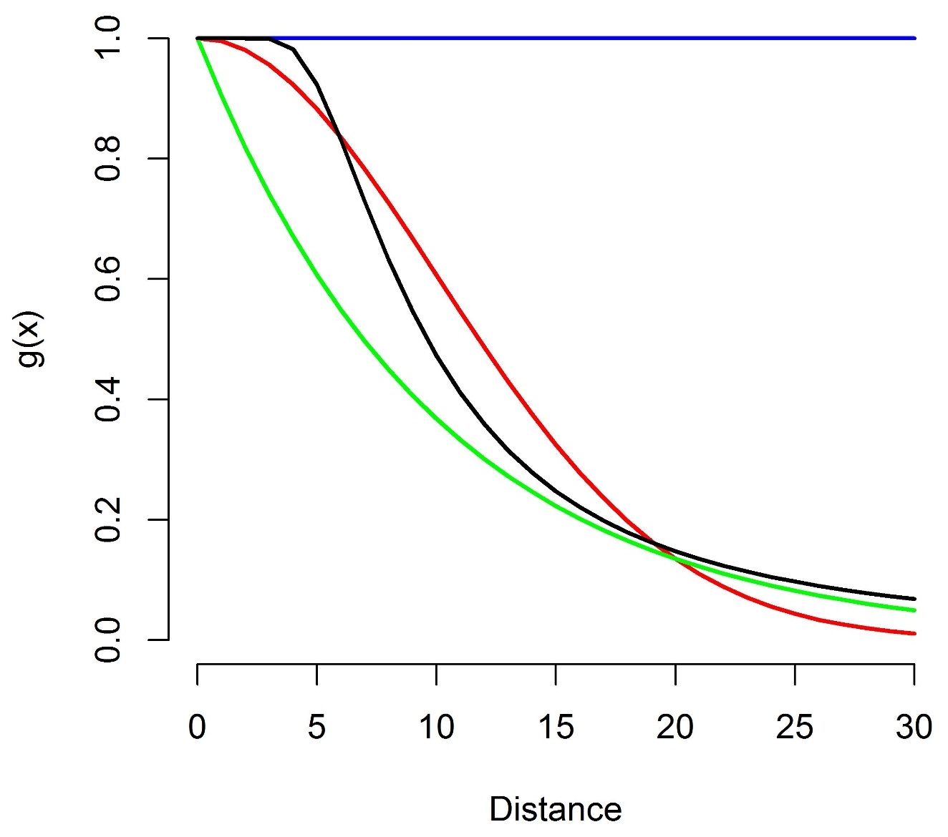
Functions
uniform
hazard-rate
negative
exponential
half-normal

Slide 4
Models
“reality”
Model 1
Model 4
2 parameters
Model 2
Model 3
many parameters
3 parameters
4 parameters

Slide 5
Selecting a model
Models are used to represent an unknown process or relationship
Our ability to represent or model that relationship depends in part on the amount of data available – small data sets cannot fully capture complex relationships
Goal of model selection: find a model that fits the data well but does not have more parameters than can be supported by the data (= a parsimonious model)
Want to avoid:
Overfitting (too many parameters)
Underfitting (too few parameters)

Slide 6
Akaike’s Information Criterion (AIC)
AIC is one measure to identify the most parsimonious model from a set of plausible or candidate models
The process:
Develop a set of candidate models
Fit each model to the data and compute its AIC
Select model with lowest AIC as the ‘best’ or ‘top’ model
For distance sampling, we use AIC to identify a model to represent the detection function based on the available data

