Slide 1
Lecture 14: Systematic and Stratified Sampling
Mar 16, 2022

Slide 2
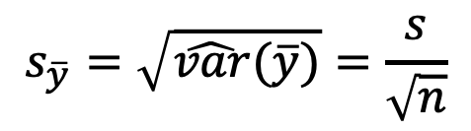
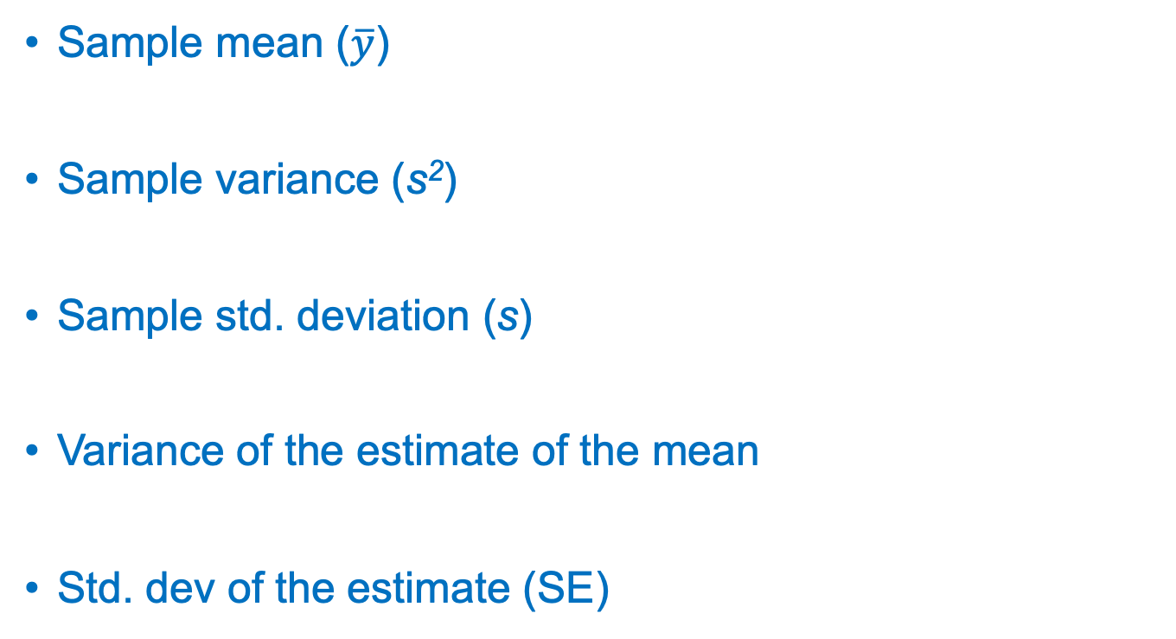
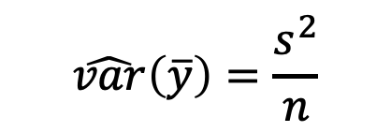
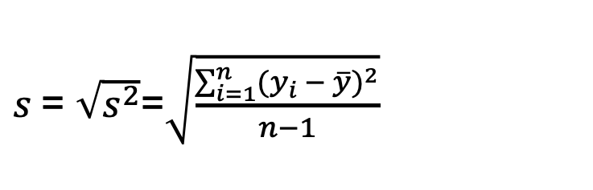
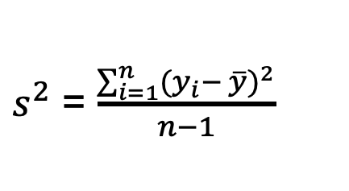
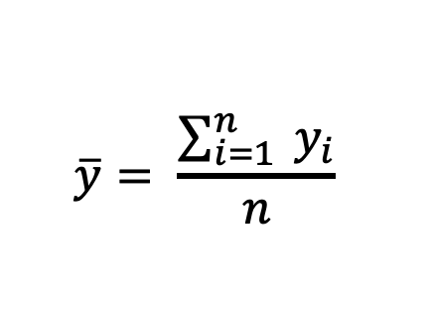
Review:
$$\overline{y}= \frac{\sum_{i=1}^{n}{{ y}_{i}}}{n}$$
Sample mean ($\overline{y}$)
Sample variance (s²)
Sample std. deviation (s)
Variance of the estimate of the mean
Std. dev of the estimate (SE)
$s^{2}$ = $\frac{\sum_{i=1}^{n}{{(y_{i}− \overline{y})}^{2}}}{n−1}$
$s$= $\sqrt{s^{2}}$=$\sqrt{\frac{\sum_{i=1}^{n}{{(y_{i} − \overline{y})}^{2}}}{n−1}}$
$$\hat{var}\left(\overline{y}\right)=\frac{s^{2}}{n}$$
$$s_{\overline{y}}=\sqrt{\hat{var}(\overline{y})}=\frac{s}{\sqrt{n}}$$

Slide 3
Sampling designs
Simple random sampling
Systematic sampling
Stratified sampling

Slide 4
Simple random sampling
Advantages:
Easy to implement
Requires minimum knowledge of the population
Disadvantages:
When the population is heterogeneous, estimates can have large variance (i.e., high uncertainty)
Notes:
Define heterogeneous…..
What does estimate mean?
Ended first sampling lecture (1 hr)

Slide 5
Random samples can sometimes seem less than ideal
Poor dispersion

Slide 6
Systematic sampling
Sample units chosen at uniform intervals, usually after choosing a random start point(s)

Slide 7

Systematic sampling
Sample units chosen at uniform intervals, usually after choosing a random start point(s)

Slide 8
Systematic sampling
Randomly select one unit from the first k sample units in the population and every k^{th} unit thereafter.
This is a 1-in-k systematic sample
k = No. units in population / No. units in sample
Example: If we plan to choose 40 plots from a field of 400 plots, k = 400/40 = 10
This is a “1-in-10” systematic sample

Slide 9
Systematic sampling
Advantages:
Easy to implement
Ensures good dispersion of sample units throughout the population
Disadvantages:
Risk of bias

Slide 10
Systematic sampling

Slide 11
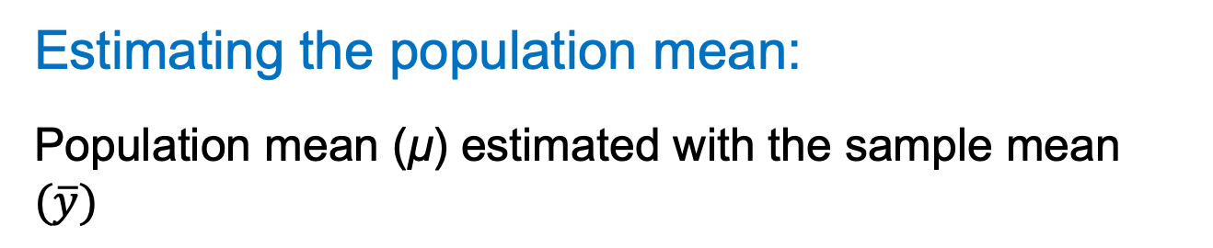
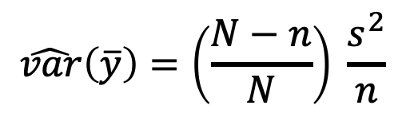
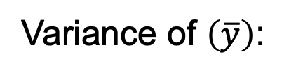
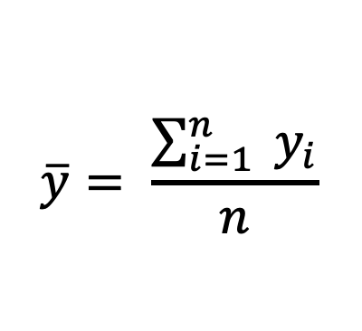
Systematic sampling
Estimating the population mean:
Population mean (μ) estimated with the sample mean $(\overline{y})$
$$\overline{y}= \frac{\sum_{i=1}^{n}{{ y}_{i}}}{n}$$
(same as SRS)
$$\hat{var}\left(\overline{y}\right)=\left(\frac{N−n}{N}\right) \frac{s^{2}}{n}$$
Variance of $\left(\overline{y}\right)$:
(same as SRS)
Recall that if N is unknown, we ignore the finite population correction factor

Slide 12
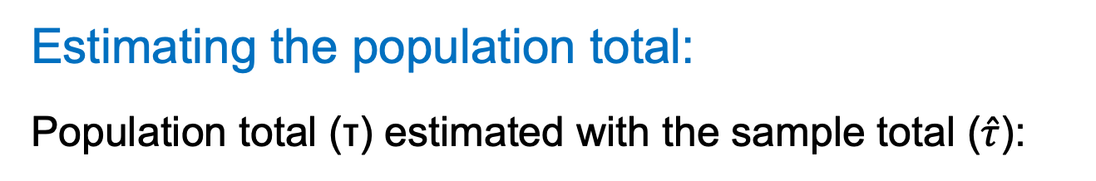

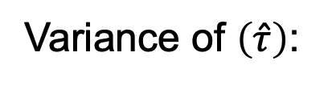
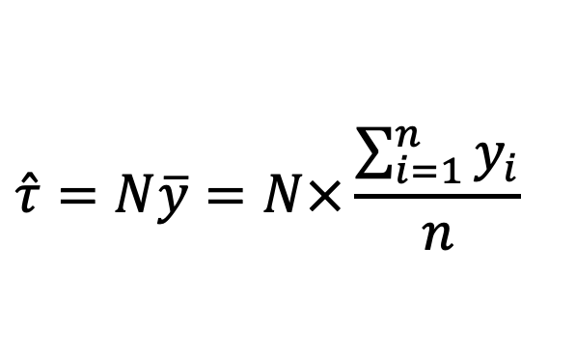
Systematic sampling
Estimating the population total:
Population total (τ) estimated with the sample total ($\hat{τ}$):
$$\hat{τ}=N\overline{y}=N×\frac{\sum_{i=1}^{n}{y_{i}}}{n}$$
(same as SRS)
Variance of $\left(\hat{τ}\right)$:
$$\hat{var}\left(\hat{τ}\right)=N^{2}\hat{var}(\overline{y})$$
(same as SRS)

Slide 13
Sampling designs
Simple random sampling
Systematic sampling
Stratified sampling
Thus far, we have selected samples without requiring any knowledge of the population
But what if we have information about the way in which the parameter of interest varies across the population?

Slide 14
Sampling designs
Simple random sampling
Systematic sampling
Stratified sampling
Thus far, we have selected samples without requiring any knowledge of the population
But what if we have information about the way in which the parameter of interest varies across the population?

Slide 17
Stratified random sampling
A stratified random sample is established by:
dividing the population into non-overlapping strata
selecting a random sample from within each stratum

Slide 18
Stratified random sampling
Strata are:
Mutually exclusive—each sample unit belongs to only one stratum and no sample units are excluded
Relatively homogeneous
Established in advance based on ancillary data—information other than the attribute of interest but that varies with that attribute

Slide 19

Stratified sampling
Example: Estimate density of agaves
Know from previous studies that density varies with soil type
Stratify the population by soil type

Slide 20
When to stratify?
When the population is heterogeneous
Effectively, stratifying divides the population into smaller, homogeneous subpopulations
Why stratify?
Estimates have higher precision (i.e., lower uncertainty) than a simple random sample with the same effort

Slide 21
What features used to define strata?
Any feature associated with unit-to-unit variation in the attribute of interest
Common: vegetation community, soil type, elevation
Can stratify the same population multiple times
Key Idea: minimize variation of units within strata and maximize variation of units among strata

Slide 22
Stratified sampling
Advantages:
Higher precision of estimates
More information: Separate parameter estimates for each stratum plus the usual estimate for the entire population
Notation
L = number of strata
N_{i} = number of sample units in stratum i

Slide 23
L = 3
N = 108
N₁ = 43
N₂ = 40
N₃ = 25

Slide 24
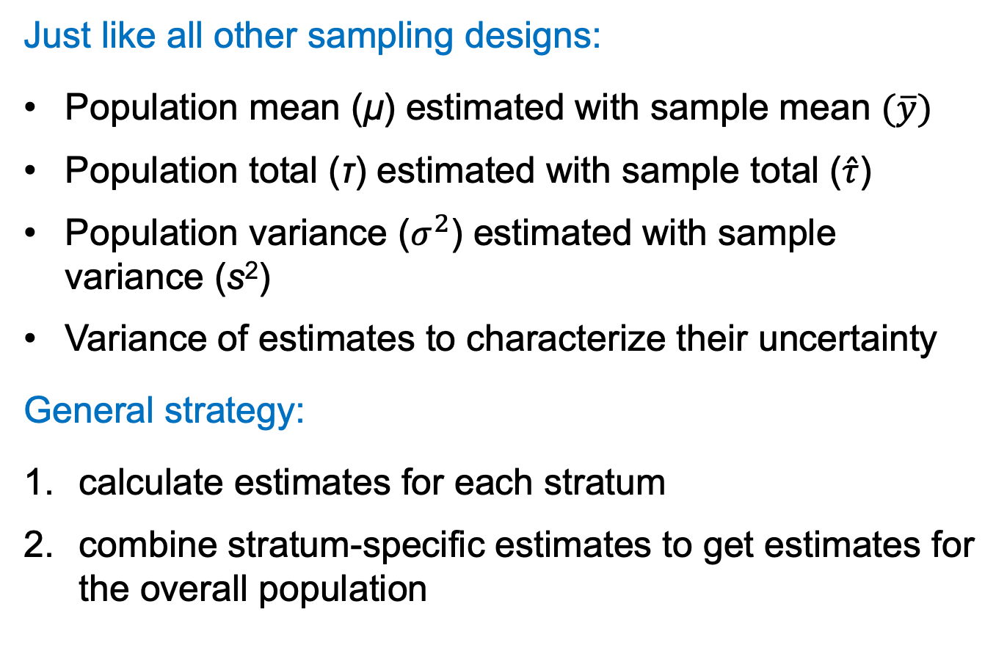
Stratified sampling
Just like all other sampling designs:
Population mean (μ) estimated with sample mean $(\overline{y})$
Population total (τ) estimated with sample total ($\hat{τ}$)
Population variance ($σ^{2}$) estimated with sample variance (s²)
Variance of estimates to characterize their uncertainty
General strategy:
calculate estimates for each stratum
combine stratum-specific estimates to get estimates for the overall population
Notes:
Left off editing here ***

Slide 25
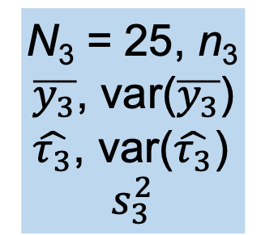
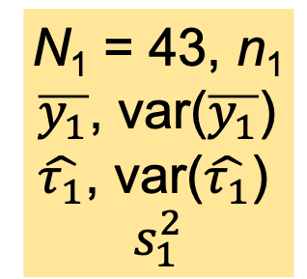
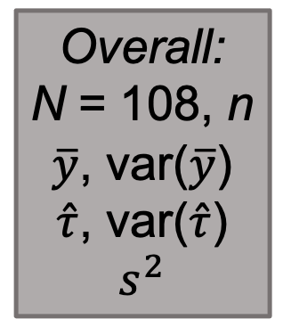
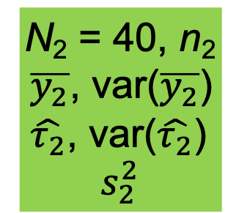
L = 3
N = 108
N₁ = 43, n₁
$\overline{y_{1}}$, var($\overline{y_{1}}$)
$\hat{τ_{1}}$, var($\hat{τ_{1}}$)
$$s_{1}^{2}$$
N₂ = 40, n₂
$\overline{y_{2}}$, var($\overline{y_{2}}$)
$\hat{τ_{2}}$, var($\hat{τ_{2}}$)
$$s_{2}^{2}$$
N₃ = 25, n₃
$\overline{y_{3}}$, var($\overline{y_{3}}$)
$\hat{τ_{3}}$, var($\hat{τ_{3}}$)
$$s_{3}^{2}$$
Overall:
N = 108, n
$\overline{y}$, var($\overline{y}$)
$\hat{τ}$, var($\hat{τ}$)
$$s^{2}$$

Slide 26
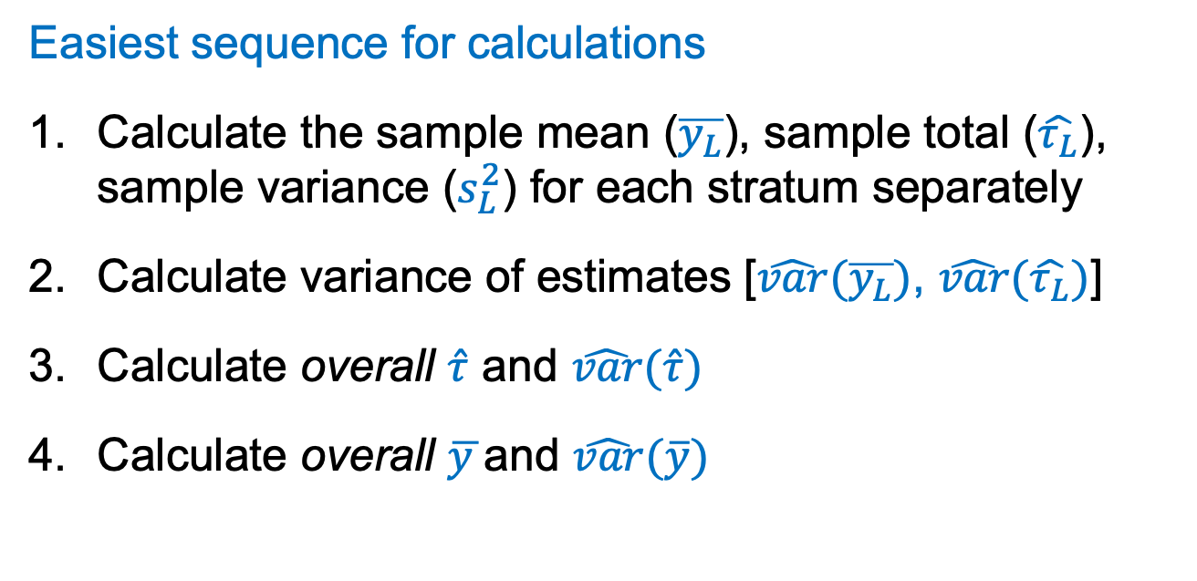
Stratified sampling
Easiest sequence for calculations
Calculate the sample mean ($\overline{y_{L}}$), sample total ($\hat{τ_{L}}$), sample variance ($s_{L}^{2}$) for each stratum separately
Calculate variance of estimates [$\hat{var}(\overline{y_{L}})$, $\hat{var}(\hat{τ_{L}})$]
Calculate overall $\hat{τ}$ and $\hat{var}(\hat{τ})$
Calculate overall $\overline{y }$and $\hat{var}(\overline{y})$

Slide 27
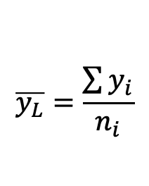

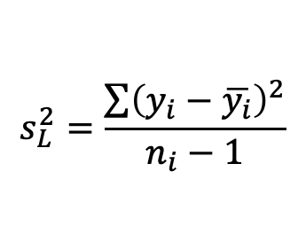
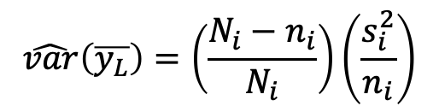
Stratified sampling
For each stratum separately, calculate:
Sample mean
Sample variance
Variance of sample mean
SE of sample mean
$$\overline{y_{L}}=\frac{\sum{y_{i}}}{n_{i}}$$
$$s_{L}^{2}=\frac{\sum{{\left(y_{i}−\overline{y_{i}}\right)}^{2}}}{n_{i}−1}$$
$$\hat{var}\left(\overline{y_{L}}\right)=\left(\frac{N_{i}−n_{i}}{N_{i}}\right)\left(\frac{s_{i}^{2}}{n_{i}}\right)$$
$$\sqrt{\hat{var}\left(\overline{y_{L}}\right)}$$

Slide 28
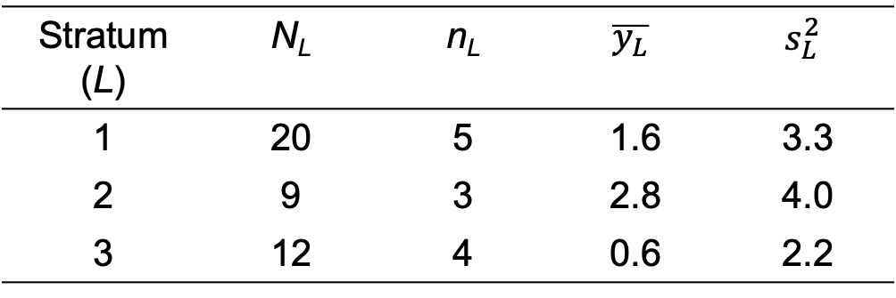
Example:
12 sample units from a population of 41 units:
Stratum (L) | N_{L} | n_{L} | $$\overline{y_{L}}$$ | $$s_{L}^{2}$$
1 | 20 | 5 | 1.6 | 3.3
2 | 9 | 3 | 2.8 | 4.0
3 | 12 | 4 | 0.6 | 2.2

Slide 29
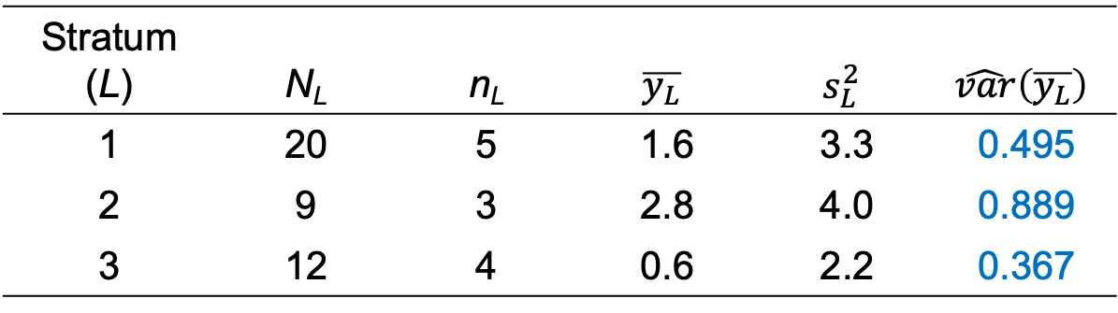
Example:
12 sample units from a population of 41 units:
Stratum (L) | N_{L} | n_{L} | $$\overline{y_{L}}$$ | $$s_{L}^{2}$$ | $$\hat{var}\left(\overline{y_{L}}\right)$$
1 | 20 | 5 | 1.6 | 3.3 | 0.495
2 | 9 | 3 | 2.8 | 4.0 | 0.889
3 | 12 | 4 | 0.6 | 2.2 | 0.367
Stratum 1: $\hat{var}\left(\overline{y_{1}}\right)=\left(\frac{N_{1}−n_{1}}{N_{1}}\right)\left(\frac{s_{1}^{2}}{n_{1}}\right)=\left(\frac{20−5}{20}\right)\left(\frac{3.3}{5}\right)=0.495$
Stratum 2: $\hat{var}\left(\overline{y_{2}}\right)=\left(\frac{N_{2}−n_{2}}{N_{2}}\right)\left(\frac{s_{2}^{2}}{n_{2}}\right)=\left(\frac{9−3}{9}\right)\left(\frac{4.0}{3}\right)=0.889$
Stratum 3: $\hat{var}\left(\overline{y_{3}}\right)=\left(\frac{N_{3}−n_{3}}{N_{3}}\right)\left(\frac{s_{3}^{2}}{n_{3}}\right)=\left(\frac{12−4}{12}\right)\left(\frac{2.2}{4}\right)=0.367$

Slide 30
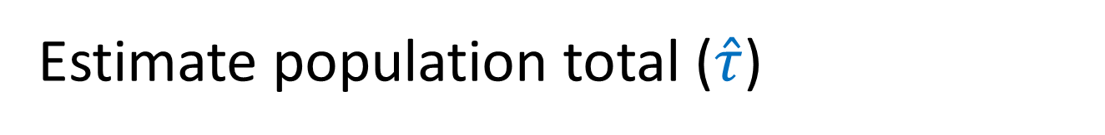
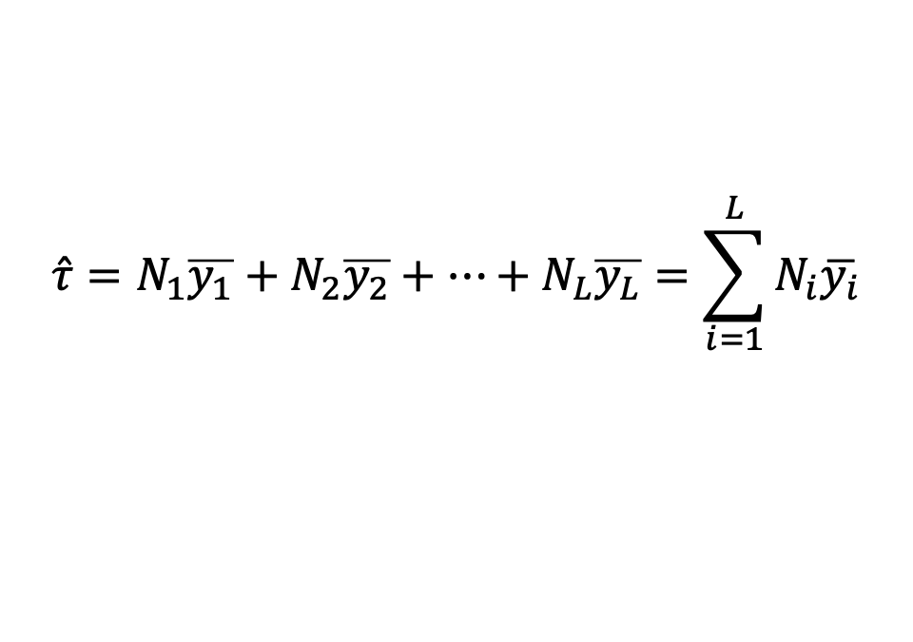
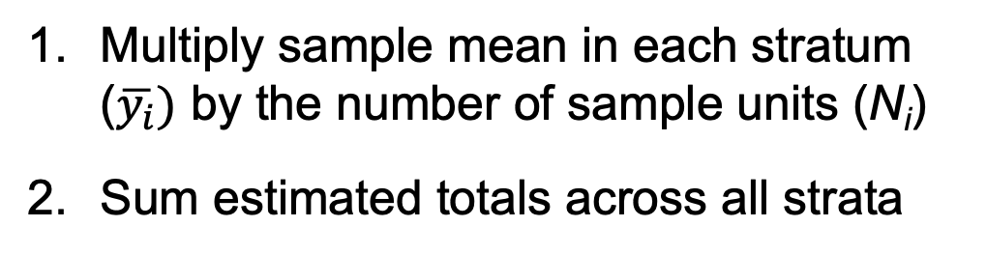
Estimate population total ($\hat{τ}$)
Multiply sample mean in each stratum ($\overline{y_{i}})$ by the number of sample units (N_{i})
Sum estimated totals across all strata
= estimated total in each stratum
$$\hat{τ}=N_{1}\overline{y_{1}}+N_{2}\overline{y_{2}}+⋯+N_{L}\overline{y_{L}}=\sum_{i=1}^{L}{N_{i}\overline{y_{i}}}$$

Slide 31

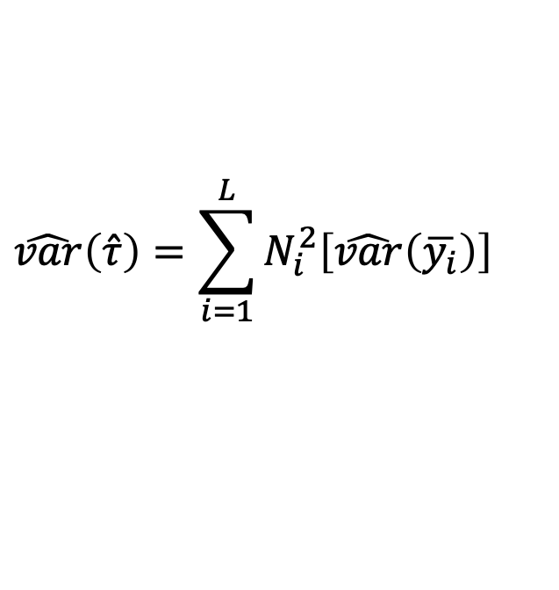
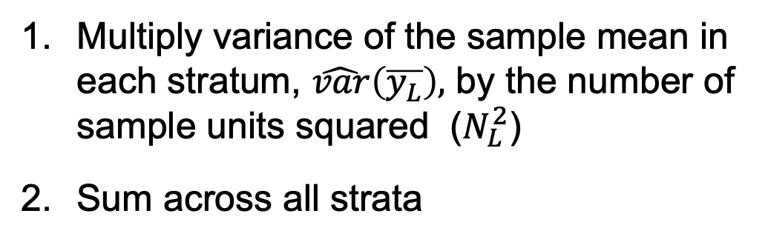
Variance of estimated pop. total ($\hat{τ}$)
Multiply variance of the sample mean in each stratum, $\hat{var}\left(\overline{y_{L}}\right),$ by the number of sample units squared ($N_{L}^{2}$)
Sum across all strata
= variance of the estimated total in each stratum
$$\hat{var}\left(\hat{τ}\right)=\sum_{i=1}^{L}{N_{i}^{2}\left[\hat{var}\left(\overline{y_{i}}\right)\right]}$$

Slide 32
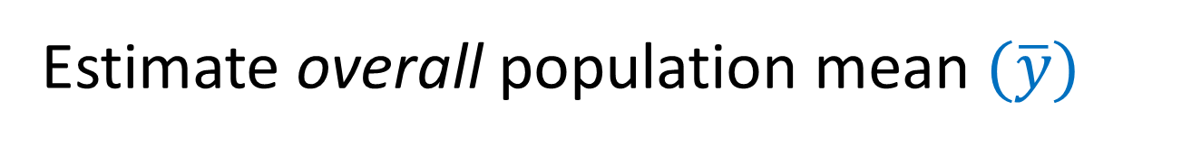
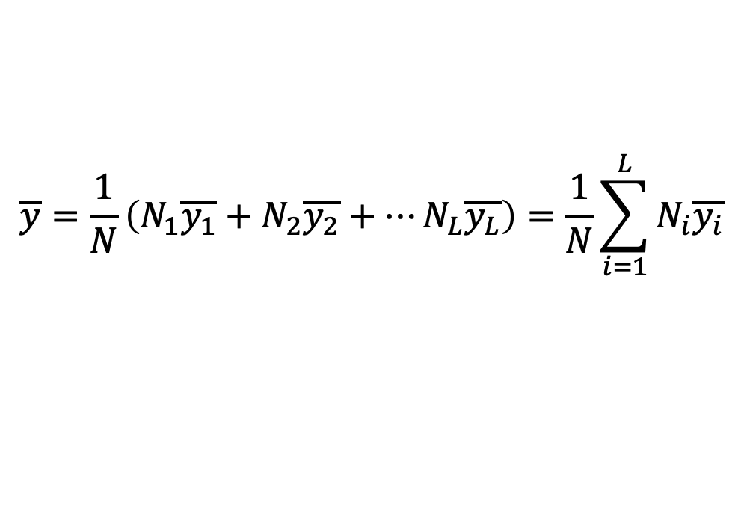
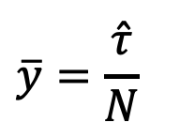
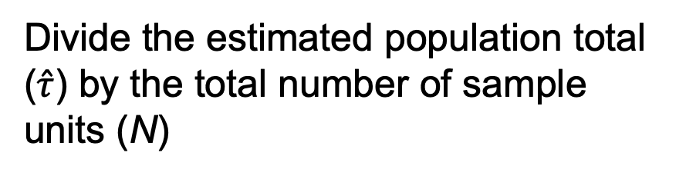
Estimate overall population mean $(\overline{y})$
Divide the estimated population total ($\hat{τ}$) by the total number of sample units (N)
$$\overline{y}=\frac{\hat{τ}}{N}$$
OR: Compute the mean as a weighted average of stratum-specific estimates
$$\overline{y}=\frac{1}{N}\left(N_{1}\overline{y_{1}}+N_{2}\overline{y_{2}}+⋯N_{L}\overline{y_{L}}\right)=\frac{1}{N}\sum_{i=1}^{L}{N_{i}\overline{y_{i}}}$$
Note that the size of each stratum (N_{i}) is included to “weight” the overall estimate. Why?

Slide 33
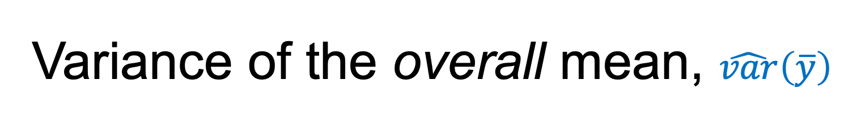

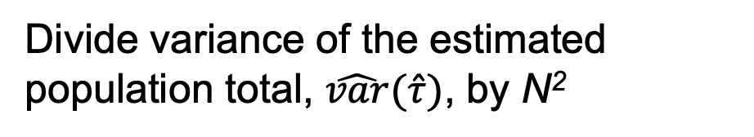
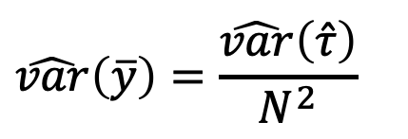
Variance of the overall mean, $\hat{var}\left(\overline{y}\right)$
Divide variance of the estimated population total, $\hat{var}(\hat{τ})$, by N²
$$\hat{var}\left(\overline{y}\right)=\frac{\hat{var}\left(\hat{τ}\right)}{N^{2}}$$
OR: Compute as a weighted average of stratum-specific estimates
$$\hat{var}\left(\overline{y}\right)=\frac{1}{N^{2}}\left[N_{1}^{2}\hat{var}\left(\overline{y_{1}}\right)+⋯+N_{L}^{2}\hat{var}\left(\overline{y_{L}}\right)\right]$$

Slide 34
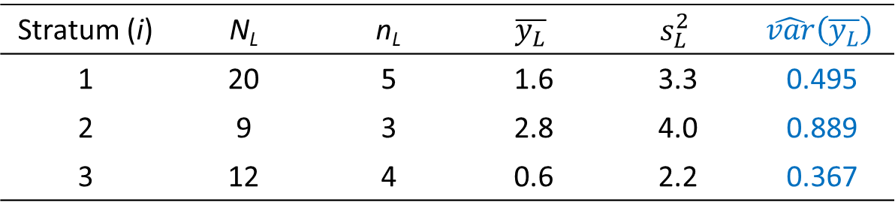

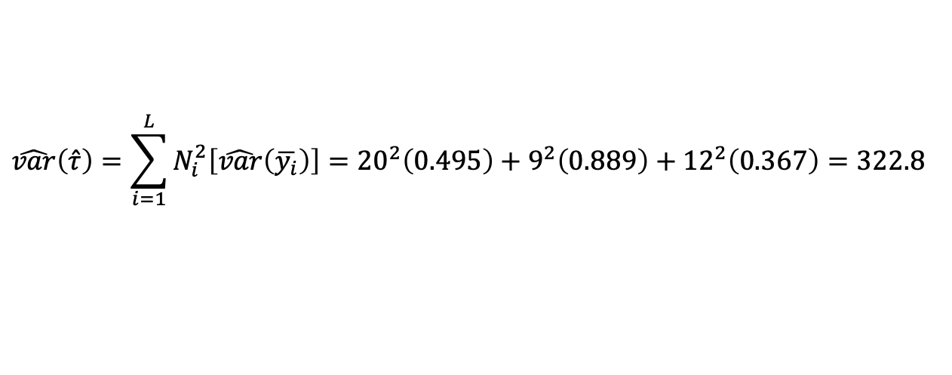
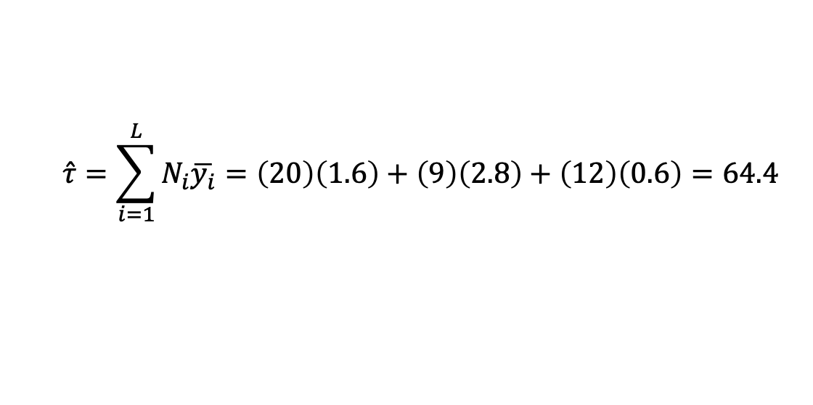
Stratum (i) | N_{L} | n_{L} | $$\overline{y_{L}}$$ | $$s_{L}^{2}$$ | $$\hat{var}\left(\overline{y_{L}}\right)$$
1 | 20 | 5 | 1.6 | 3.3 | 0.495
2 | 9 | 3 | 2.8 | 4.0 | 0.889
3 | 12 | 4 | 0.6 | 2.2 | 0.367
Estimate of population total:
$$\hat{τ}=\sum_{i=1}^{L}{N_{i}\overline{y_{i}}=\left(20\right)\left(1.6\right)+\left(9\right)\left(2.8\right)+\left(12\right)\left(0.6\right)=64.4}$$
Estimated variance of population total:
$$\hat{var}\left(\hat{τ}\right)=\sum_{i=1}^{L}{N_{i}^{2}\left[\hat{var}\left(\overline{y_{i}}\right)\right]}={20}^{2}\left(0.495\right)+9^{2}\left(0.889\right)+{12}^{2}\left(0.367\right)=322.8$$
$$SE\left(\hat{τ}\right)=\sqrt{\hat{var}\left(\hat{τ}\right)}=\sqrt{322.8}=18.0$$

Slide 35
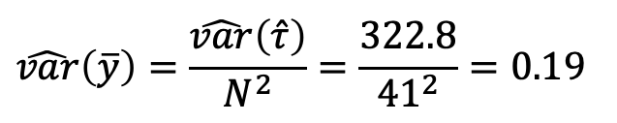
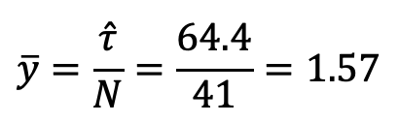
Stratum (i) | N_{L} | n_{L} | $$\overline{y_{L}}$$ | $$s_{L}^{2}$$ | $$\hat{var}\left(\overline{y_{L}}\right)$$
1 | 20 | 5 | 1.6 | 3.3 | 0.495
2 | 9 | 3 | 2.8 | 4.0 | 0.889
3 | 12 | 4 | 0.6 | 2.2 | 0.367
Estimate of overall population mean:
$$\overline{y}=\frac{\hat{τ}}{N}=\frac{64.4}{41}=1.57$$
Estimated variance of overall population mean:
$$\hat{var}\left(\overline{y}\right)=\frac{\hat{var}\left(\hat{τ}\right)}{N^{2}}=\frac{322.8}{{41}^{2}}=0.19$$

Slide 36



Reference: Formulae for stratified random sampling 1. Estimates of population parameters
Population mean (μ) estimated with the sample mean $\left(\overline{y}\right)$:
$$\overline{y}=\frac{1}{N}\left(N_{1}\overline{y_{1}}+N_{2}\overline{y_{2}}+⋯N_{L}\overline{y_{L}}\right)=\frac{1}{N}\sum_{i=1}^{L}{N_{i}\overline{y_{i}}}$$
Population variance (σ²) estimated with sample variance (s²):
$$s^{2}=\frac{1}{N}\left(N_{1}s_{1}^{2}+N_{2}s_{2}^{2}+⋯N_{L}s_{L}^{2}\right)=\frac{1}{N}\sum_{i=1}^{L}{N_{i}s_{i}^{2}}$$
Population total (τ) estimated with the sample total ($\hat{τ}$):
$$\hat{τ}=N_{1}\overline{y_{1}}+N_{2}\overline{y_{2}}+⋯+N_{L}\overline{y_{L}}=\sum_{i=1}^{L}{N_{i}\overline{y_{i}}}=N\overline{y}$$
Example R code:
overallMean <- (1/N) * (N1*mean1 + N2*mean2 + N3*mean3)
overallVar <- (1/N) * (N1*var1 + N2*var2 + N3*var3)
overallTot <- N1*mean1 + N2*mean2 + N3*mean3
Notes:
Ended Monday lecture

Slide 37
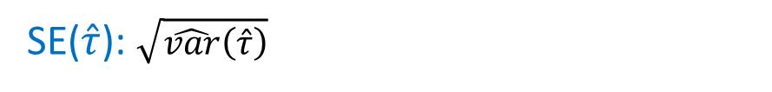
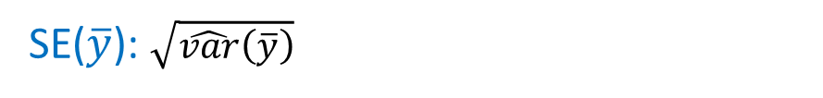

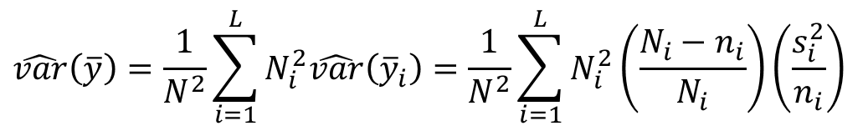
Reference: Formulae for stratified random sampling 2. Variance (uncertainty) in estimates
Variance of $\overline{y}$:
$$\hat{var}\left(\overline{y}\right)=\frac{1}{N^{2}}\sum_{i=1}^{L}{N_{i}^{2}\hat{var}\left({\overline{y}}_{i}\right)}=\frac{1}{N^{2}}\sum_{i=1}^{L}{N_{i}^{2}\left(\frac{N_{i}−n_{i}}{N_{i}}\right)\left(\frac{s_{i}^{2}}{n_{i}}\right)}$$
SE($\overline{y}$): $\sqrt{\hat{var}\left(\overline{y}\right)}$
Variance of $\hat{τ}$:
$$\hat{var}\left(\hat{τ}\right)=N^{2}\hat{var}\left(\overline{y}\right)=\sum_{i=1}^{L}{N_{i}^{2}\left(\frac{N_{i}−n_{i}}{N_{i}}\right)}\left(\frac{s_{i}^{2}}{n_{i}}\right)$$
SE($\hat{τ}$): $\sqrt{\hat{var}\left(\hat{τ}\right)}$

