Slide 1
Lecture 15: Stratified Sampling, con’t.
Mar 21, 2022

Slide 2
Reminders/Updates
Mid-semester Feedback: https://tinyurl.com/RNR321-Spring2022-midsemester
Module 3 Quiz is Wednesday (Mar 23); activities due next Monday (Mar 28) before class.
Assignment Resubmission Policy:
Can resubmit assignments to get average of the 2 grades
Due with the next set of assignments (e.g., Module 2 assignment resubmissions are due when Module 3 assignments are due)
OPTIONAL!
No extensions will be granted for resubmissions
Reminder about general late work policy…
5 points off for each day down to 60%
Even if you are past that point, still submit! 60% is WAY BETTER than 0%
None of this applies to resubmissions. We won’t look at it if it’s late.

Slide 3
Stratified random sampling
A stratified random sample is established by:
dividing the population into non-overlapping strata
selecting a random sample from within each stratum

Slide 4
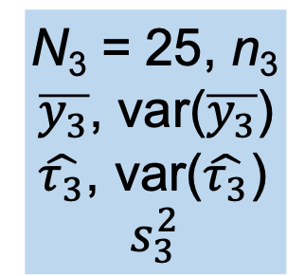
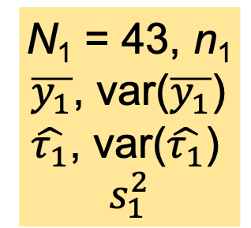
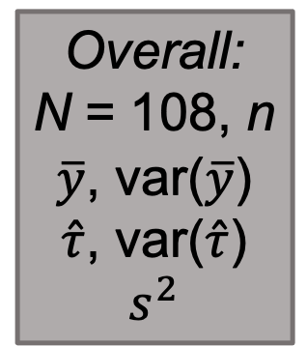
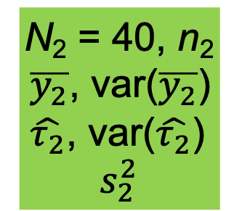
L = 3
N = 108
N₁ = 43, n₁
$\overline{y_{1}}$, var($\overline{y_{1}}$)
$\hat{τ_{1}}$, var($\hat{τ_{1}}$)
$$s_{1}^{2}$$
N₂ = 40, n₂
$\overline{y_{2}}$, var($\overline{y_{2}}$)
$\hat{τ_{2}}$, var($\hat{τ_{2}}$)
$$s_{2}^{2}$$
N₃ = 25, n₃
$\overline{y_{3}}$, var($\overline{y_{3}}$)
$\hat{τ_{3}}$, var($\hat{τ_{3}}$)
$$s_{3}^{2}$$
Overall:
N = 108, n
$\overline{y}$, var($\overline{y}$)
$\hat{τ}$, var($\hat{τ}$)
$$s^{2}$$

Slide 5
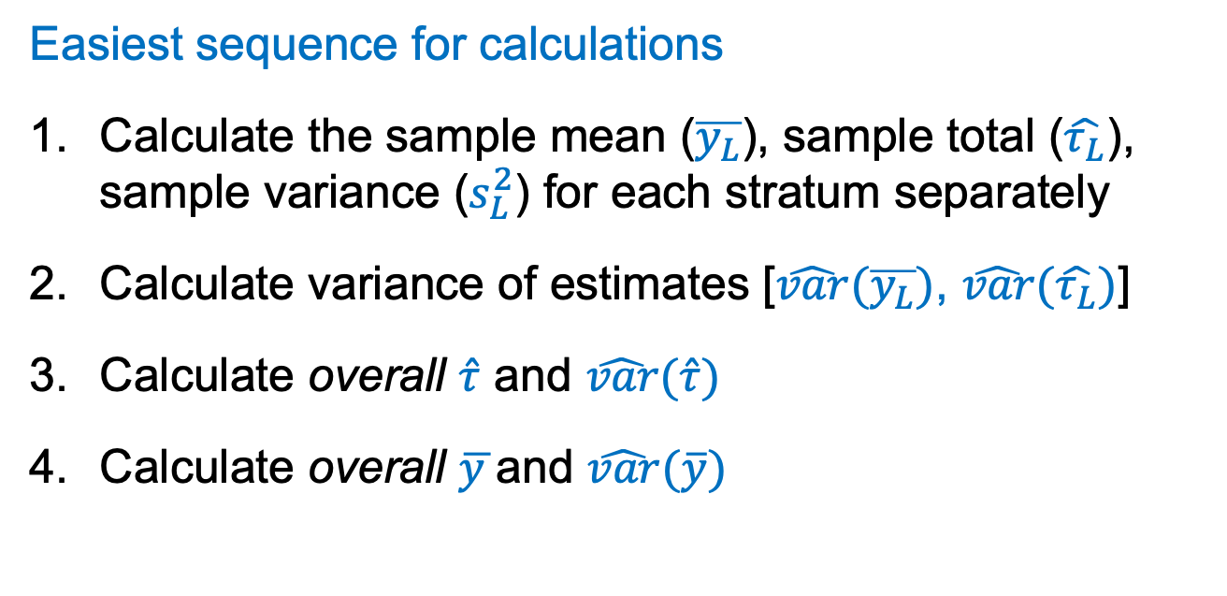
Stratified sampling
Easiest sequence for calculations
Calculate the sample mean ($\overline{y_{L}}$), sample total ($\hat{τ_{L}}$), sample variance ($s_{L}^{2}$) for each stratum separately
Calculate variance of estimates [$\hat{var}(\overline{y_{L}})$, $\hat{var}(\hat{τ_{L}})$]
Calculate overall $\hat{τ}$ and $\hat{var}(\hat{τ})$
Calculate overall $\overline{y }$and $\hat{var}(\overline{y})$

Slide 6
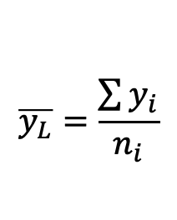

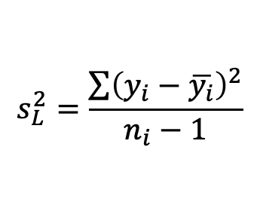
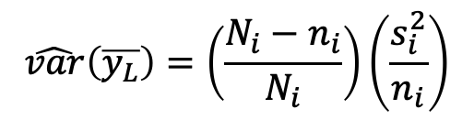
Stratified sampling
For each stratum separately, calculate:
Sample mean
Sample variance
Variance of sample mean
SE of sample mean
$$\overline{y_{L}}=\frac{\sum{y_{i}}}{n_{i}}$$
$$s_{L}^{2}=\frac{\sum{{\left(y_{i}−\overline{y_{i}}\right)}^{2}}}{n_{i}−1}$$
$$\hat{var}\left(\overline{y_{L}}\right)=\left(\frac{N_{i}−n_{i}}{N_{i}}\right)\left(\frac{s_{i}^{2}}{n_{i}}\right)$$
$$\sqrt{\hat{var}\left(\overline{y_{L}}\right)}$$

Slide 7
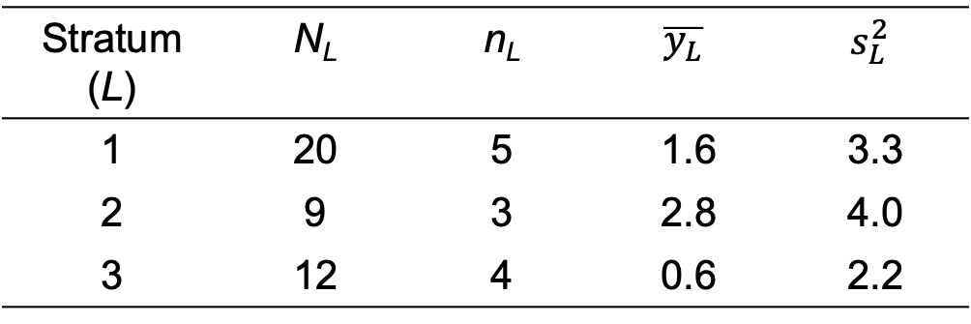
Example:
12 sample units from a population of 41 units:
Stratum (L) | N_{L} | n_{L} | $$\overline{y_{L}}$$ | $$s_{L}^{2}$$
1 | 20 | 5 | 1.6 | 3.3
2 | 9 | 3 | 2.8 | 4.0
3 | 12 | 4 | 0.6 | 2.2

Slide 8
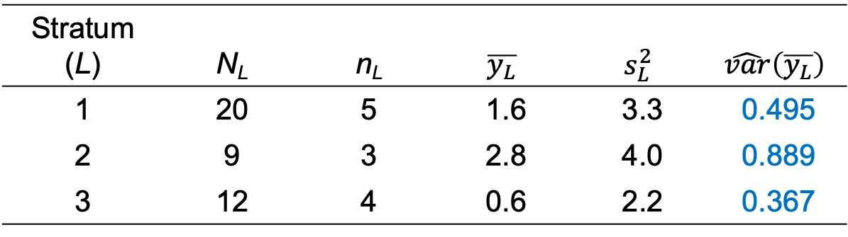
Example:
12 sample units from a population of 41 units:
Stratum (L) | N_{L} | n_{L} | $$\overline{y_{L}}$$ | $$s_{L}^{2}$$ | $$\hat{var}\left(\overline{y_{L}}\right)$$
1 | 20 | 5 | 1.6 | 3.3 | 0.495
2 | 9 | 3 | 2.8 | 4.0 | 0.889
3 | 12 | 4 | 0.6 | 2.2 | 0.367
Stratum 1: $\hat{var}\left(\overline{y_{1}}\right)=\left(\frac{N_{1}−n_{1}}{N_{1}}\right)\left(\frac{s_{1}^{2}}{n_{1}}\right)=\left(\frac{20−5}{20}\right)\left(\frac{3.3}{5}\right)=0.495$
Stratum 2: $\hat{var}\left(\overline{y_{2}}\right)=\left(\frac{N_{2}−n_{2}}{N_{2}}\right)\left(\frac{s_{2}^{2}}{n_{2}}\right)=\left(\frac{9−3}{9}\right)\left(\frac{4.0}{3}\right)=0.889$
Stratum 3: $\hat{var}\left(\overline{y_{3}}\right)=\left(\frac{N_{3}−n_{3}}{N_{3}}\right)\left(\frac{s_{3}^{2}}{n_{3}}\right)=\left(\frac{12−4}{12}\right)\left(\frac{2.2}{4}\right)=0.367$

Slide 9
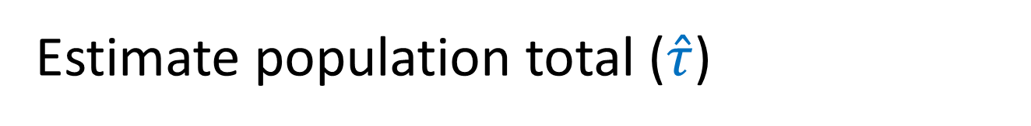
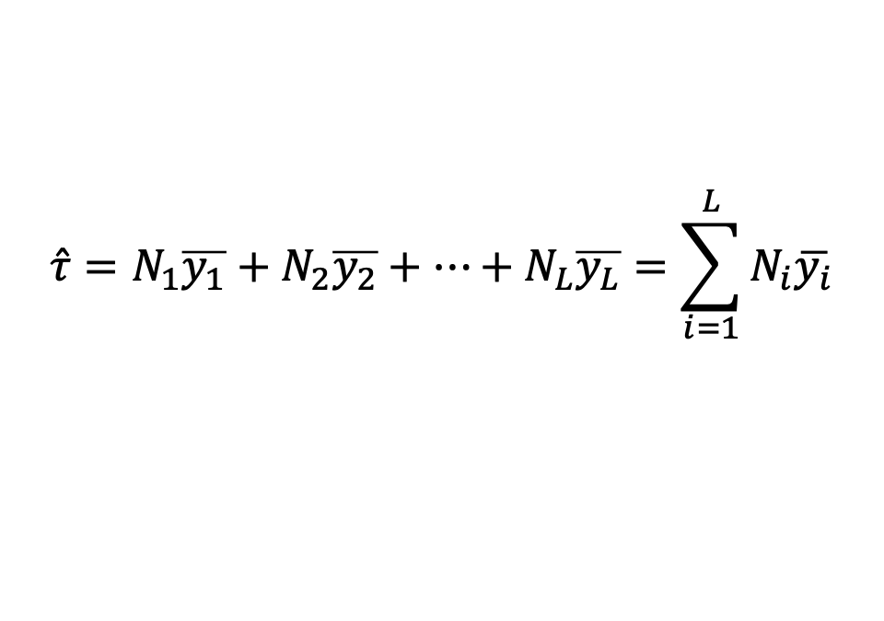
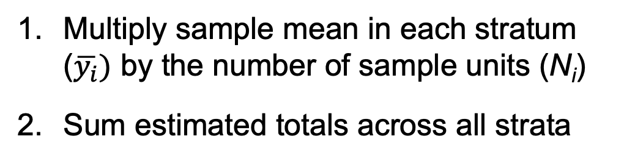
Estimate population total ($\hat{τ}$)
Multiply sample mean in each stratum ($\overline{y_{i}})$ by the number of sample units (N_{i})
Sum estimated totals across all strata
= estimated total in each stratum
$$\hat{τ}=N_{1}\overline{y_{1}}+N_{2}\overline{y_{2}}+⋯+N_{L}\overline{y_{L}}=\sum_{i=1}^{L}{N_{i}\overline{y_{i}}}$$

Slide 10

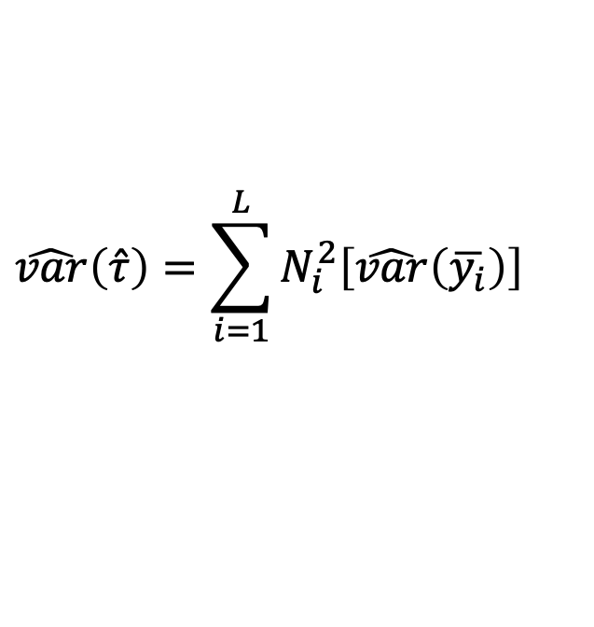
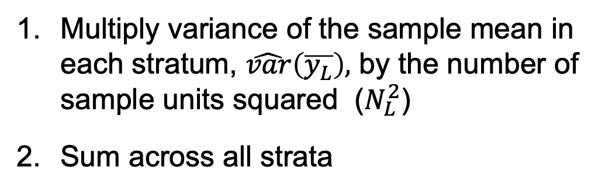
Variance of estimated pop. total ($\hat{τ}$)
Multiply variance of the sample mean in each stratum, $\hat{var}\left(\overline{y_{L}}\right),$ by the number of sample units squared ($N_{L}^{2}$)
Sum across all strata
= variance of the estimated total in each stratum
$$\hat{var}\left(\hat{τ}\right)=\sum_{i=1}^{L}{N_{i}^{2}\left[\hat{var}\left(\overline{y_{i}}\right)\right]}$$

Slide 11
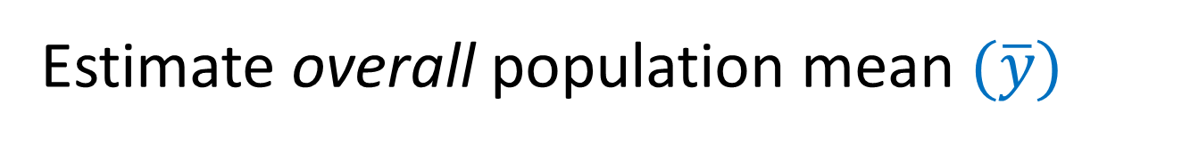
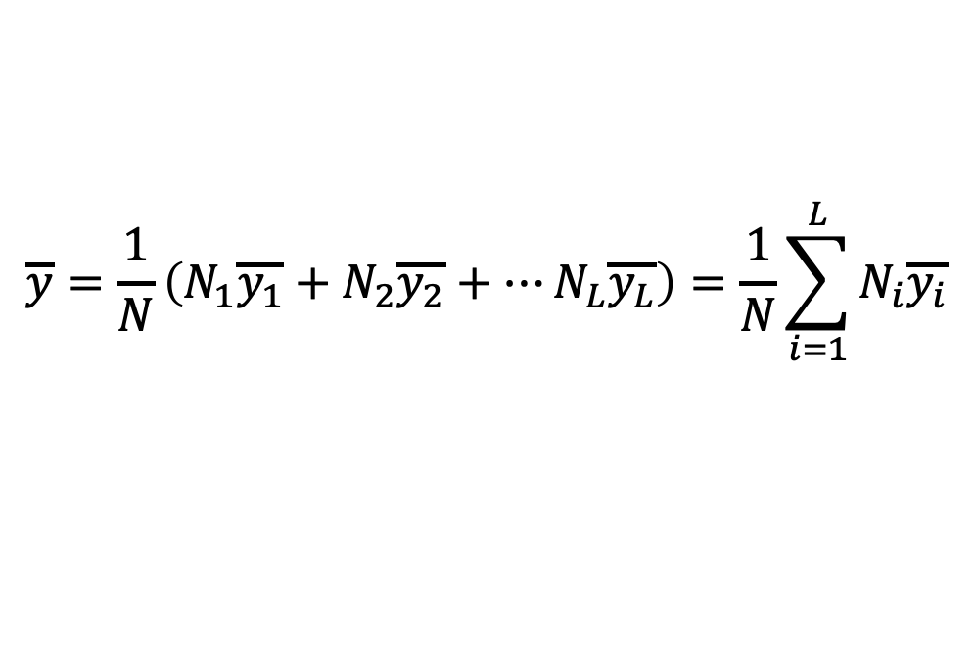
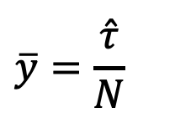
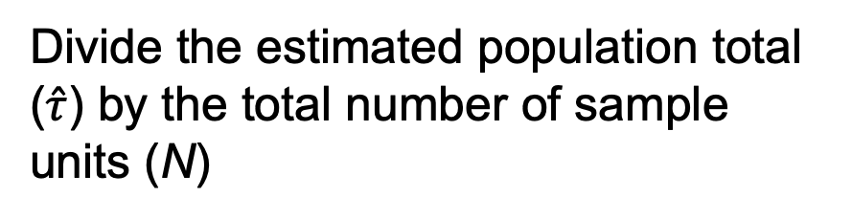
Estimate overall population mean $(\overline{y})$
Divide the estimated population total ($\hat{τ}$) by the total number of sample units (N)
$$\overline{y}=\frac{\hat{τ}}{N}$$
OR: Compute the mean as a weighted average of stratum-specific estimates
$$\overline{y}=\frac{1}{N}\left(N_{1}\overline{y_{1}}+N_{2}\overline{y_{2}}+⋯N_{L}\overline{y_{L}}\right)=\frac{1}{N}\sum_{i=1}^{L}{N_{i}\overline{y_{i}}}$$
Note that the size of each stratum (N_{i}) is included to “weight” the overall estimate. Why?

Slide 12
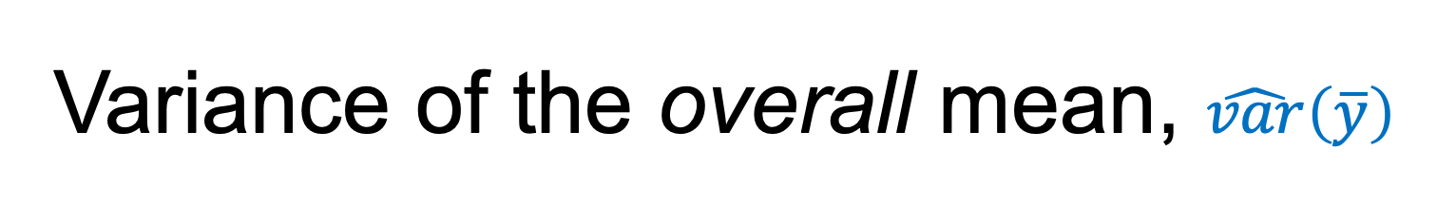

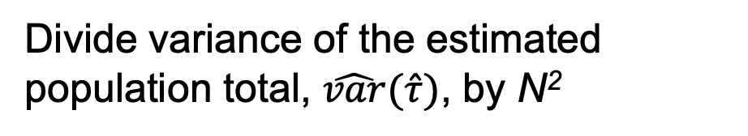
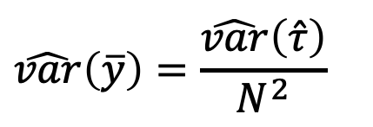
Variance of the overall mean, $\hat{var}\left(\overline{y}\right)$
Divide variance of the estimated population total, $\hat{var}(\hat{τ})$, by N²
$$\hat{var}\left(\overline{y}\right)=\frac{\hat{var}\left(\hat{τ}\right)}{N^{2}}$$
OR: Compute as a weighted average of stratum-specific estimates
$$\hat{var}\left(\overline{y}\right)=\frac{1}{N^{2}}\left[N_{1}^{2}\hat{var}\left(\overline{y_{1}}\right)+⋯+N_{L}^{2}\hat{var}\left(\overline{y_{L}}\right)\right]$$

Slide 13
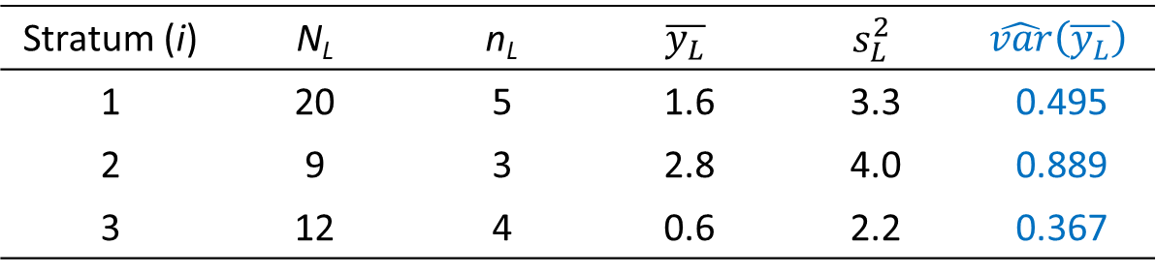

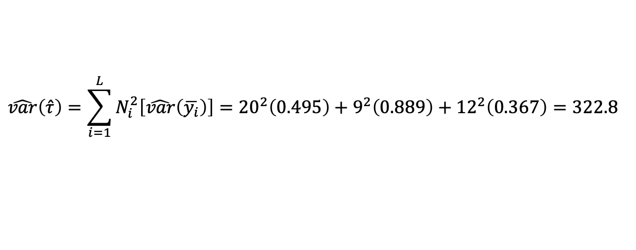
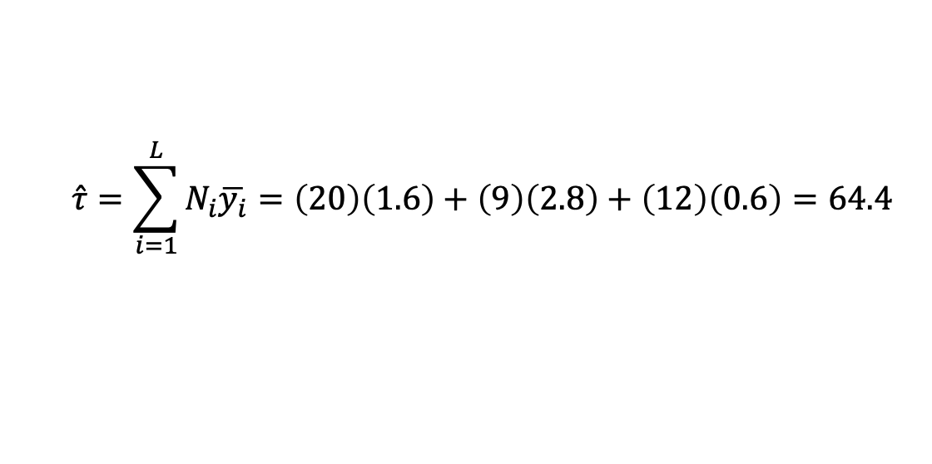
Stratum (i) | N_{L} | n_{L} | $$\overline{y_{L}}$$ | $$s_{L}^{2}$$ | $$\hat{var}\left(\overline{y_{L}}\right)$$
1 | 20 | 5 | 1.6 | 3.3 | 0.495
2 | 9 | 3 | 2.8 | 4.0 | 0.889
3 | 12 | 4 | 0.6 | 2.2 | 0.367
Estimate of population total:
$$\hat{τ}=\sum_{i=1}^{L}{N_{i}\overline{y_{i}}=\left(20\right)\left(1.6\right)+\left(9\right)\left(2.8\right)+\left(12\right)\left(0.6\right)=64.4}$$
Estimated variance of population total:
$$\hat{var}\left(\hat{τ}\right)=\sum_{i=1}^{L}{N_{i}^{2}\left[\hat{var}\left(\overline{y_{i}}\right)\right]}={20}^{2}\left(0.495\right)+9^{2}\left(0.889\right)+{12}^{2}\left(0.367\right)=322.8$$
$$SE\left(\hat{τ}\right)=\sqrt{\hat{var}\left(\hat{τ}\right)}=\sqrt{322.8}=18.0$$

Slide 14
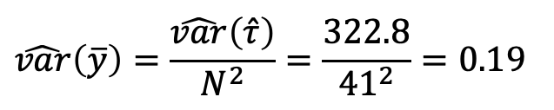
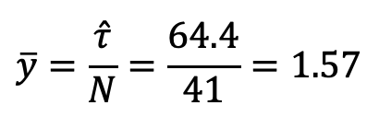
Stratum (i) | N_{L} | n_{L} | $$\overline{y_{L}}$$ | $$s_{L}^{2}$$ | $$\hat{var}\left(\overline{y_{L}}\right)$$
1 | 20 | 5 | 1.6 | 3.3 | 0.495
2 | 9 | 3 | 2.8 | 4.0 | 0.889
3 | 12 | 4 | 0.6 | 2.2 | 0.367
Estimate of overall population mean:
$$\overline{y}=\frac{\hat{τ}}{N}=\frac{64.4}{41}=1.57$$
Estimated variance of overall population mean:
$$\hat{var}\left(\overline{y}\right)=\frac{\hat{var}\left(\hat{τ}\right)}{N^{2}}=\frac{322.8}{{41}^{2}}=0.19$$

Slide 15
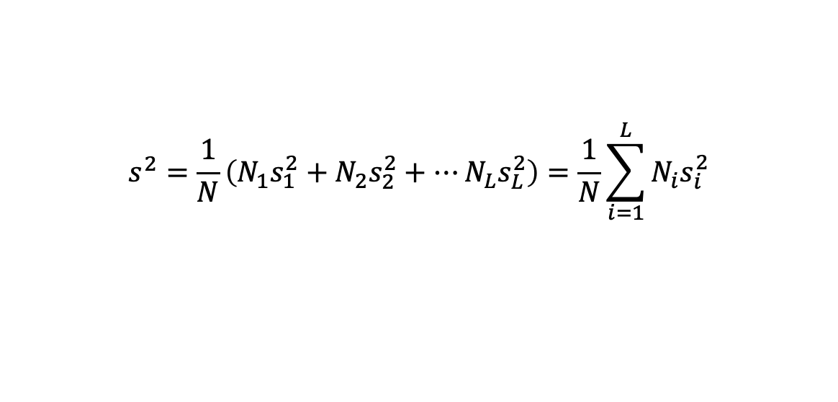
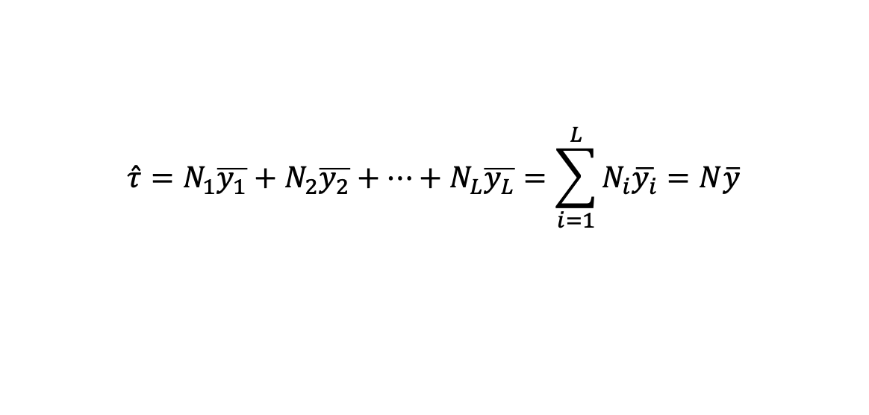
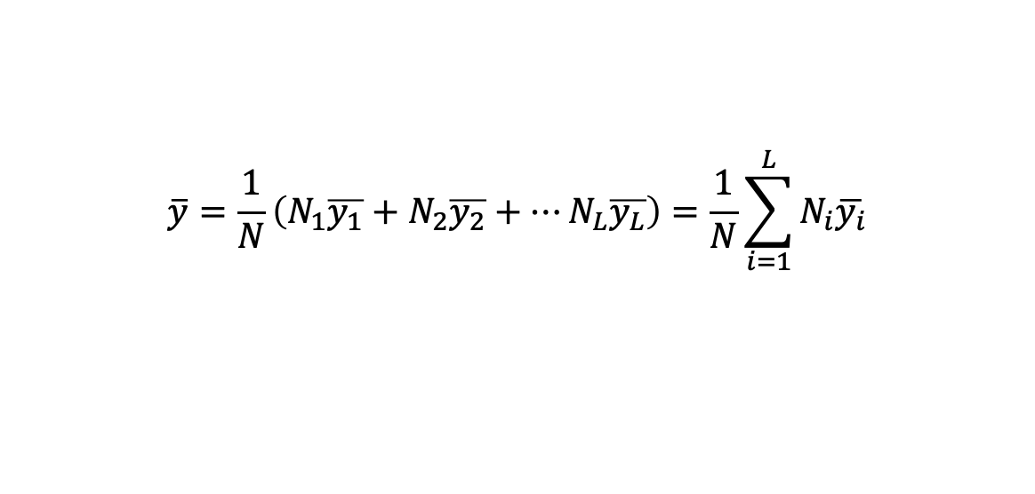
Reference: Formulae for stratified random sampling 1. Estimates of population parameters
Population mean (μ) estimated with the sample mean $\left(\overline{y}\right)$:
$$\overline{y}=\frac{1}{N}\left(N_{1}\overline{y_{1}}+N_{2}\overline{y_{2}}+⋯N_{L}\overline{y_{L}}\right)=\frac{1}{N}\sum_{i=1}^{L}{N_{i}\overline{y_{i}}}$$
Population variance (σ²) estimated with sample variance (s²):
$$s^{2}=\frac{1}{N}\left(N_{1}s_{1}^{2}+N_{2}s_{2}^{2}+⋯N_{L}s_{L}^{2}\right)=\frac{1}{N}\sum_{i=1}^{L}{N_{i}s_{i}^{2}}$$
Population total (τ) estimated with the sample total ($\hat{τ}$):
$$\hat{τ}=N_{1}\overline{y_{1}}+N_{2}\overline{y_{2}}+⋯+N_{L}\overline{y_{L}}=\sum_{i=1}^{L}{N_{i}\overline{y_{i}}}=N\overline{y}$$
Notes:
Ended Monday lecture

Slide 16


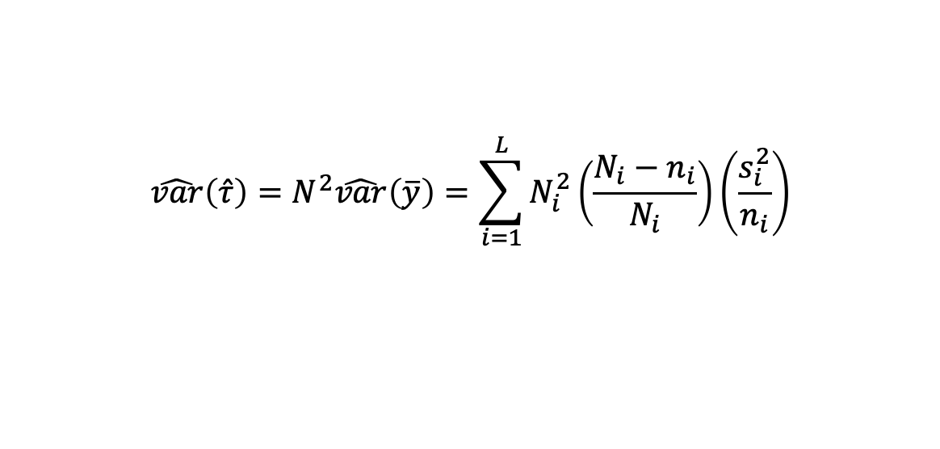
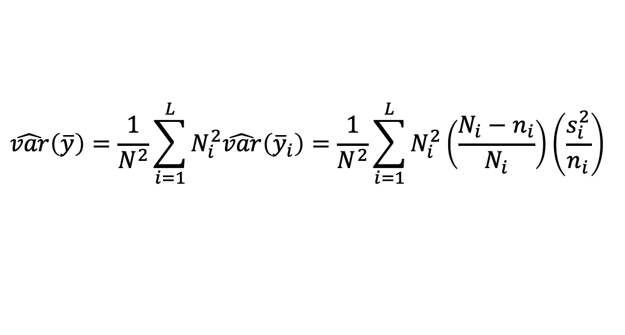
Reference: Formulae for stratified random sampling 2. Variance (uncertainty) in estimates
Variance of $\overline{y}$:
$$\hat{var}\left(\overline{y}\right)=\frac{1}{N^{2}}\sum_{i=1}^{L}{N_{i}^{2}\hat{var}\left({\overline{y}}_{i}\right)}=\frac{1}{N^{2}}\sum_{i=1}^{L}{N_{i}^{2}\left(\frac{N_{i}−n_{i}}{N_{i}}\right)\left(\frac{s_{i}^{2}}{n_{i}}\right)}$$
SE($\overline{y}$): $\sqrt{\hat{var}\left(\overline{y}\right)}$
Variance of $\hat{τ}$:
$$\hat{var}\left(\hat{τ}\right)=N^{2}\hat{var}\left(\overline{y}\right)=\sum_{i=1}^{L}{N_{i}^{2}\left(\frac{N_{i}−n_{i}}{N_{i}}\right)}\left(\frac{s_{i}^{2}}{n_{i}}\right)$$
SE($\hat{τ}$): $\sqrt{\hat{var}\left(\hat{τ}\right)}$

Slide 17
Allocation of sample units
How to choose a stratified random sample?
For example, if we wish to survey 10 units, where should we locate them?
= Sample Allocation

Slide 18
Allocation of sample units
How many sample units to survey per stratum?
Several alternative (but related) approaches
The more we know about the population, the more efficiently we can allocate sampling effort
What would we like to know about each stratum?
size – number of units
relative variation among sample units
cost of surveying units

Slide 19
Allocation of sample units
Alternative strategies:
Uniform
Proportional to size
Proportional to variation
Optimal (Neyman)

Slide 20
Uniform
Number of sample units selected is the same from each stratum
Total sample size (n) is 10

Slide 21
Uniform
Number of sample units selected is the same from each stratum
Total sample size (n) is 10
5 in stratum 1 (n₁ = 5)
5 in stratum 2 (n₂ = 5)

Slide 22

Proportional to size
Number of sample units selected from each stratum is proportional to the size of each stratum
Appropriate when survey costs are approximately equal in each strata and we have no other information about the population
$$n_{i}=n\left(\frac{N_{i}}{N}\right)$$
N_{i} is the number of sample units in each stratum i

Slide 23

Proportional to size
Number of sample units selected from each stratum is proportional to the size of each stratum
N₁ = 79
N₂ = 29
$$n_{i}=n\left(\frac{N_{i}}{N}\right)$$

Slide 24
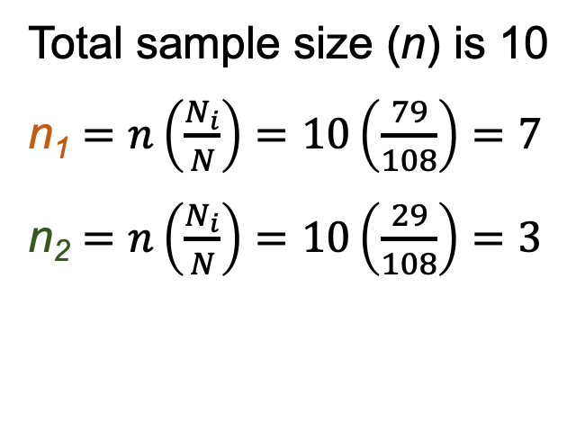
Proportional to size
Number of sample units selected from each stratum is proportional to the size of each stratum
N₁ = 79
N₂ = 29
$$n_{i}=n\left(\frac{N_{i}}{N}\right)$$
Total sample size (n) is 10
n₁ $=n\left(\frac{N_{i}}{N}\right)=10\left(\frac{79}{108}\right)=7$
n₂ $=n\left(\frac{N_{i}}{N}\right)=10\left(\frac{29}{108}\right)=3$

Slide 25
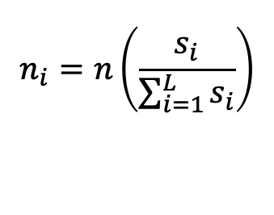
Proportional to variation
Number of sample units selected from each stratum is proportional to the standard deviation of each stratum
Appropriate when survey costs are approximately equal in each strata and we have estimates of SD for each stratum; these are sometimes available from previous studies or from pilot studies
$$n_{i}=n\left(\frac{s_{i}}{\sum_{i=1}^{L}{s_{i}}}\right)$$
s_{i} is the estimated standard deviation for each stratum i

Slide 26

Why place more sample units in strata that are more variable?
Increasing sample size:
Decreases standard error
Increases precision
$$s_{\overline{y}}=\sqrt{\frac{s^{2}}{n}}$$

Slide 27
Proportional to variation
Number of sample units selected from each stratum is proportional to the standard deviation of each stratum
Imagine we know that insect densities are more variable among units in riparian areas than in upland areas
From a previous study:
s_{upland} = 8 insects/ha
s_{riparian} = 12 insects/ha

Slide 28
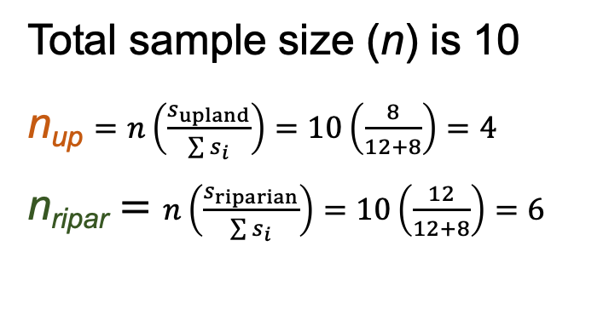
Proportional to variation
Number of sample units selected from each stratum is proportional to the standard deviation of each stratum
s_{upland} = 8 insects/ha
s_{riparian} = 12 insects/ha
Total sample size (n) is 10
n_{up} $=n\left(\frac{s_{upland}}{\sum{s_{i}}}\right)=10\left(\frac{8}{12+8}\right)=4$
n_{ripar} $=$ $n\left(\frac{s_{riparian}}{\sum{s_{i}}}\right)=10\left(\frac{12}{12+8}\right)=6$
Notes:
Left off 4 Oct 2021

Slide 29
Optimal allocation
All allocation methods are simplified versions of optimal allocation, where cost, variation, or size of strata are unknown, assumed equal, or ignored.
Optimal allocation weights the sample allocation to maximize sampling efficiency, which means providing the highest degree of precision for a given sampling effort or cost

Slide 30

Optimal allocation
Number of sample units selected from each stratum is proportional to:
standard deviation among units in each stratum
size of each stratum, and
cost of sampling in each stratum
$$n_{i}=n\left(\frac{\frac{N_{i}s_{i}}{\sqrt{c_{i}}}}{\sum_{i=1}^{L}{\left(\frac{N_{i}s_{i}}{\sqrt{c_{i}}}\right)}}\right)$$
c_{i} = cost of sampling one unit in stratum i

Slide 31
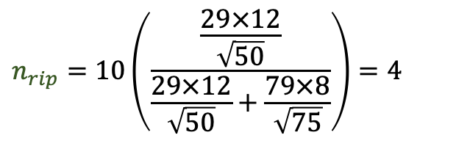
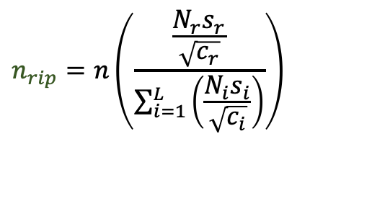
Optimal allocation
Imagine that sampling in upland areas costs more than sampling in riparian areas
c_{upland} = $75/unit
c_{riparian} = $50/unit
$$n_{rip}=n\left(\frac{\frac{N_{r}s_{r}}{\sqrt{c_{r}}}}{\sum_{i=1}^{L}{\left(\frac{N_{i}s_{i}}{\sqrt{c_{i}}}\right)}}\right)$$
$$n_{rip}=10\left(\frac{\frac{29×12}{\sqrt{50}}}{\frac{29×12}{\sqrt{50}}+\frac{79×8}{\sqrt{75}}}\right)=4$$

Slide 32
Optimal allocation
Imagine that sampling in upland areas costs more than sampling in riparian areas
c_{upland} = $75/unit
c_{riparian} = $50/unit
$$n_{rip}=n\left(\frac{\frac{N_{r}s_{r}}{\sqrt{c_{r}}}}{\sum_{i=1}^{L}{\left(\frac{N_{i}s_{i}}{\sqrt{c_{i}}}\right)}}\right)$$
$$n_{rip}=10\left(\frac{\frac{29×12}{\sqrt{50}}}{\frac{29×12}{\sqrt{50}}+\frac{79×8}{\sqrt{75}}}\right)=4$$

Slide 33
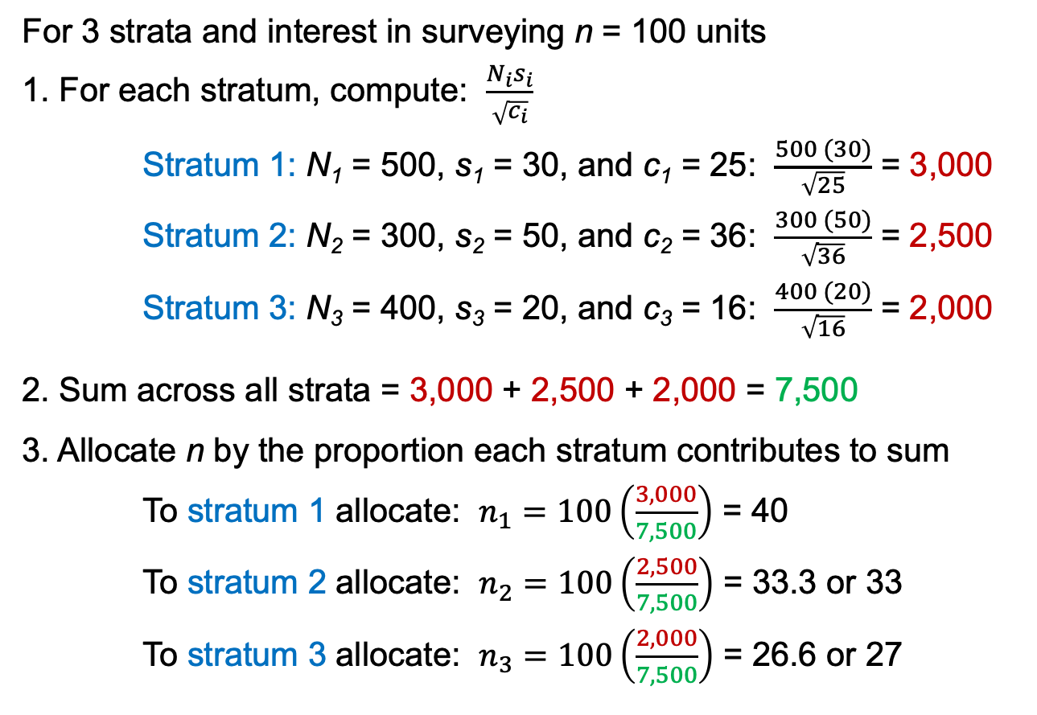
Example: optimal allocation
For 3 strata and interest in surveying n = 100 units
1. For each stratum, compute: $\frac{N_{i}s_{i}}{\sqrt{c_{i}}}$
Stratum 1: N₁ = 500, s₁ = 30, and c₁ = 25: $\frac{500 (30)}{\sqrt{25}}$ = 3,000
Stratum 2: N₂ = 300, s₂ = 50, and c₂ = 36: $\frac{300 (50)}{\sqrt{36}}$ = 2,500
Stratum 3: N₃ = 400, s₃ = 20, and c₃ = 16: $\frac{400 (20)}{\sqrt{16}}$ = 2,000
2. Sum across all strata = 3,000 + 2,500 + 2,000 = 7,500
3. Allocate n by the proportion each stratum contributes to sum
To stratum 1 allocate: $n_{1}=100\left(\frac{3,000}{7,500}\right)$ = 40
To stratum 2 allocate: $n_{2}=100\left(\frac{2,500}{7,500}\right)$ = 33.3 or 33
To stratum 3 allocate: $n_{3}=100\left(\frac{2,000}{7,500}\right)$ = 26.6 or 27

Slide 34
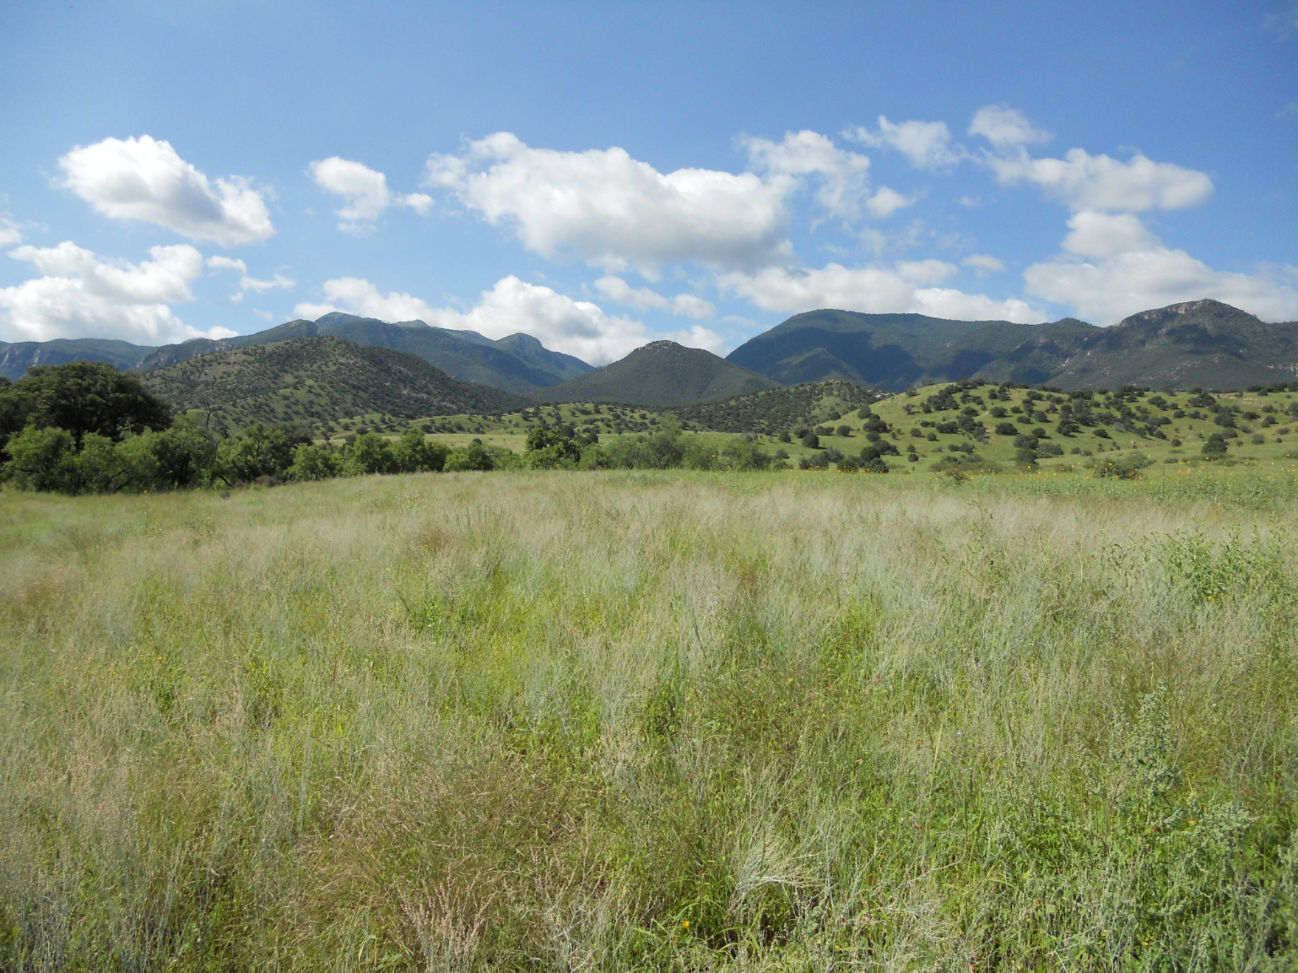
How many sample units to survey?
Notes:
6 Oct 2021

Slide 35
Establishing sample size, n
Until now, we’ve assumed that sample size (n) has been pre-determined.
Ideally, we establish the number of units to survey to obtain estimates with a desired level of precision.
Several ways to do this; we’ll consider one.

Slide 36
How many sample units?
Decide on desired bounds (B) for estimate
B = half-width of confidence interval
B = Z x SE
Z-value
Similar to the t-value we used previously
Depends only on α – assumes large n (∞ df)
Solve for n in the half width

Slide 37
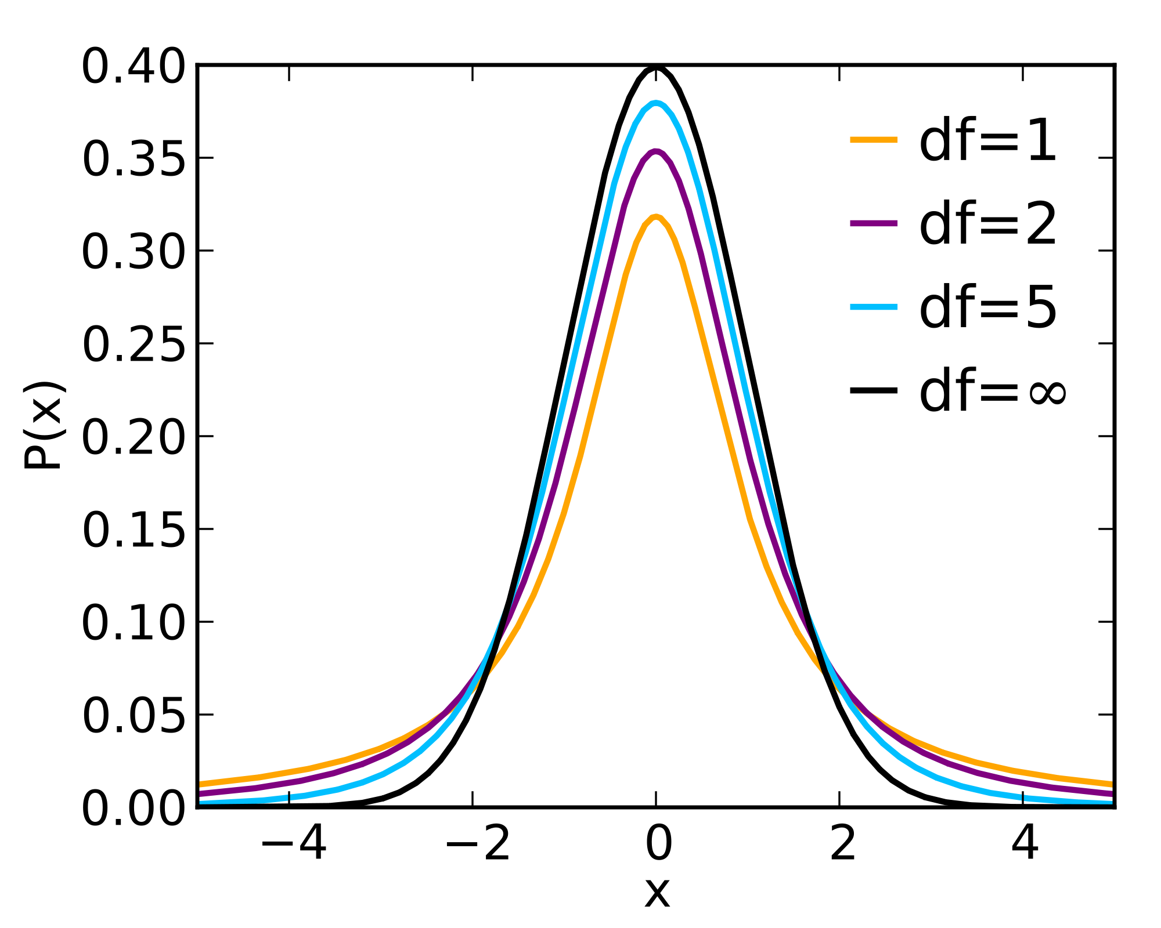
Z- and t-distributions
Student’s t-distributions
Normal
distribution (= Z)

Slide 38
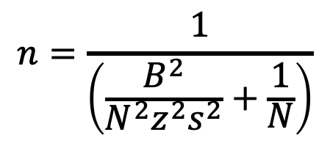
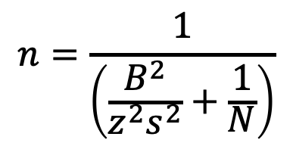
How many sample units to survey?
To estimate the population mean with bounds B:
$$n=\frac{1}{\left(\frac{B^{2}}{z^{2}s^{2}}+\frac{1}{N}\right)}$$
To estimate the population total with bounds B:
$$n=\frac{1}{\left(\frac{B^{2}}{{N^{2}z}^{2}s^{2}}+\frac{1}{N}\right)}$$

Slide 39
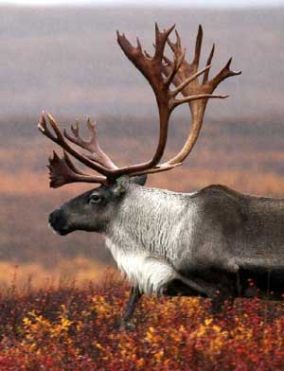
Caribou example
90% CI for total caribou on study area
n = 15
estimated total = 7417
SE of the est. total = 2179
t =1.761 (14 df, α = 0.10)
7417 ± 1.761 x 2179 = 7417 ± 3837 = (3579, 11255)
How many sample units would we need to survey if we wanted to reduce the half-width to 2000 with 90% confidence?

Slide 40
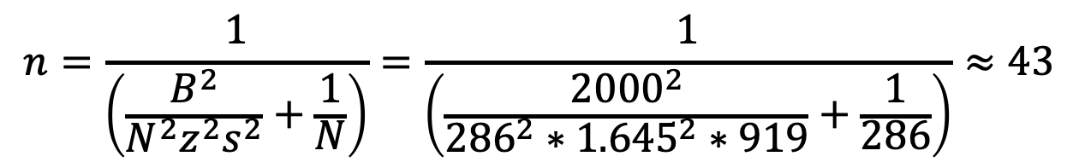
How many sample units?
s² = 919 N = 286 B = 2000
Z = 1.645 for α = 0.10
$$n=\frac{1}{\left(\frac{B^{2}}{{N^{2}z}^{2}s^{2}}+\frac{1}{N}\right)}=\frac{1}{\left(\frac{{2000}^{2}}{{{286}^{2}∗1.645}^{2}∗919}+\frac{1}{286}\right)}≈43$$

