Slide 1
Lecture 18: Occupancy, cont.
Apr 4, 2022

Slide 2
One of the ways we can determine detection probability is through occupancy
Detection probability (p): probability of detecting an entity that is present during a survey
Detected = Observed = seen, heard, captured, etc.
It is a probability, so values range from 0 to 1
Occupancy (ψ = psi) – Proportion of sites inhabited by a species; equivalently, the probability that a site is inhabited

Slide 3
Basic sampling scheme for occupancy
Select a sample of s units (no. sites in sample) from a larger set of S units (no. sites in population)
Survey each site multiple times (K) and record whether the species of interest is observed or not observed during each survey
Resurvey all sites, even those where the species was detected previously – this redundancy is the basis for estimating detection probability (p)
Can use direct (visual) or indirect (tracks, scat) evidence, whichever is appropriate for the target species

Slide 4
Notation for occupancy
Survey for the species of interest at i sites over j occasions
s = number of sites in the sample (i = 1, 2, … , s)
s_{D} = number of sites where species detected at least once
K = number of surveys per site (j = 1, 2, …, K)
ψ_{i} = probability that site i is occupied
p_{ij} = probability that the species is detected at site i during survey j if the species is truly present on the site
We use survey data to estimate these parameters

Slide 5
Assumptions
Sites “closed” to changes in occupancy (= closure); no sites become occupied or abandoned during the survey period
Species never detected falsely when truly absent
Detecting a species at a site is independent of detecting a species at other sites

Slide 6
Encounter histories
Notes:
Left off 27 Oct 2021

Slide 7
Encounter histories
0
Detection
No detection

Slide 8
Encounter histories
0, 1
Detection
No detection

Slide 9
Encounter histories
0, 1, 0
Detection
No detection

Slide 10
Encounter histories
0, 1, 0, 1
Detection
No detection

Slide 11
Encounter histories
0, 1, 0, 1, 1
1, 0, 1, 1, 1
0, 0, 0, 0, 0
Detection
No detection

Slide 12
Encounter history matrix
Each row represents a site
Each column represents a survey occasion
Each cell has a value of 1 when the species was detected during a survey and 0 when it was not detected
 | Survey occasion
Site ID | 1 | 2 | 3 | 4 | 5
A | 1 | 1 | 0 | 1 | 1
B | 0 | 0 | 0 | 0 | 0
C | 0 | 0 | 0 | 0 | 0
D | 0 | 1 | 1 | 0 | 0
E | 1 | 0 | 0 | 0 | 1
F | 1 | 1 | 1 | 1 | 1
…

Slide 13
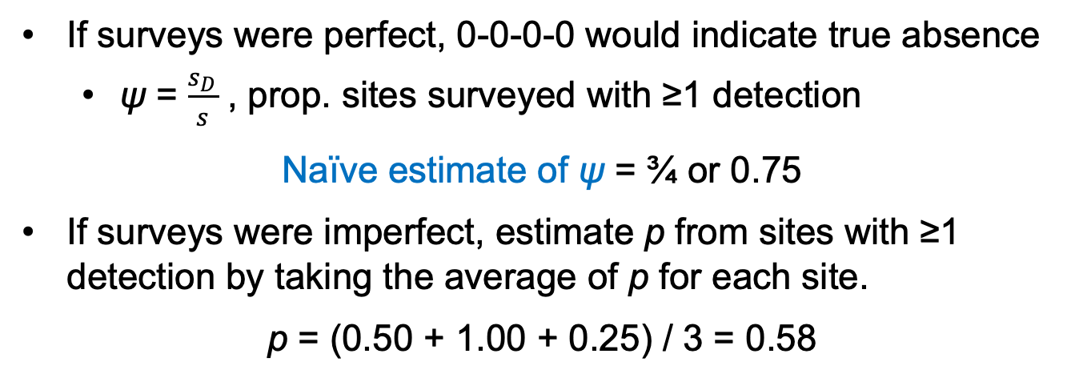
Ideas underlying estimates of ψ and p
Site | Survey 1 | Survey 2 | Survey 3 | Survey 4
1 | 0 | 1 | 1 | 0
2 | 1 | 1 | 1 | 1
3 | 1 | 0 | 0 | 0
4 | 0 | 0 | 0 | 0
If surveys were perfect, 0-0-0-0 would indicate true absence
ψ = $\frac{s_{D}}{s}$ , prop. sites surveyed with ≥1 detection
Naïve estimate of ψ = ¾ or 0.75
If surveys were imperfect, estimate p from sites with ≥1 detection by taking the average of p for each site.
p = (0.50 + 1.00 + 0.25) / 3 = 0.58

Slide 14
Sites with ≥1 detection are known to be occupied and can be used to estimate detection probability (p)
 | Survey occasion
Site ID | 1 | 2 | 3 | 4 | 5
A | 1 | 1 | 0 | 1 | 1
B | 0 | 0 | 0 | 0 | 0
C | 0 | 0 | 0 | 0 | 0
D | 0 | 1 | 1 | 0 | 0
E | 1 | 0 | 0 | 0 | 1
F | 1 | 1 | 1 | 1 | 1
…

Slide 15
Sites with no detections represent two possible “states” that we cannot distinguish:
The site is truly unoccupied
The site is occupied, but the species was never detected
 | Survey occasion
Site ID | 1 | 2 | 3 | 4 | 5
A | 1 | 1 | 0 | 1 | 1
B | 0 | 0 | 0 | 0 | 0
C | 0 | 0 | 0 | 0 | 0
D | 0 | 1 | 1 | 0 | 0
E | 1 | 0 | 0 | 0 | 1
F | 1 | 1 | 1 | 1 | 1
…

Slide 16
Sites with no detections represent two possible “states” that we cannot distinguish:
The site is truly unoccupied
The site is occupied, but the species was never detected
If surveys were imperfect (p < 1), classifying sites with no detections as unoccupied will underestimate true occupancy (ψ)
Why? Because some proportion of sites are likely to be occupied even though the species was never detected

Slide 17

General approach to estimating occupancy
$p$ = prob. species was detected during one survey
$1−p$= prob. species was not detected during one survey
${\left(1−p\right)}^{K}$ = prob. species was not detected during K surveys
Calculate the probability that a species is detected at least once after K surveys of a site (p*):
$$p^{∗}=1−{\left(1−p\right)}^{K}$$
So p* is 1 minus the probability of the species going undetected during all K surveys of a site that is truly occupied

Slide 18
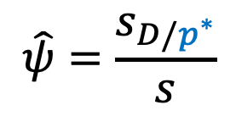

General approach to estimating occupancy
Calculate the probability that a species is detected at least once after K surveys of a site (p*):
$$p^{∗}=1−{\left(1−p\right)}^{K}$$
Use estimate of p* to adjust our estimate of occupancy to account for imperfect surveys:
$$\hat{ψ}=\frac{s_{D/p^{∗}}}{s}$$
Notes:
End first lecture

Slide 19
Estimate ψ and p
Two binary processes—one ecological, one survey-based:
Occupancy (ecological): a site is either…
truly occupied with probability ψ
or unoccupied with probability 1 – ψ
Detection (survey-based):
if a site is unoccupied, species cannot be detected
if a site is occupied, then there is some probability of detecting the species during each survey (p)
Sites where species detected = ψ
Sites where species not detected = 1 – ψ or ψ(1 – p)

Slide 20
Estimate ψ and p
Pr(occupied) = ψ
Pr(unoccupied): 1 – ψ
Pr(detected, if present) = p
Pr(undetected, if present): 1 – p
Construct probability statements from encounter histories:
Pr(h_{i} = 01010) $= ψ∗\left(1−p\right)∗p∗\left(1−p\right)∗p∗(1−p)$
Probability of a 01010 encounter history
Species detected on surveys 2 and 4 and overlooked on surveys 1, 3, and 5
Site is occupied

Slide 21
Estimate ψ and p
Pr(occupied) = ψ
Pr(unoccupied): 1 – ψ
Pr(detected, if present) = p
Pr(undetected, if present): 1 – p
Construct probability statements from encounter histories:
Pr(h_{i} = 00000)
Probability of a 00000 encounter history

Slide 22
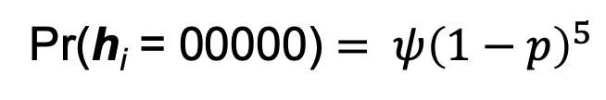
Estimate ψ and p
Pr(occupied) = ψ
Pr(unoccupied): 1 – ψ
Pr(detected, if present) = p
Pr(undetected, if present): 1 – p
Construct probability statements from encounter histories:
Pr(h_{i} = 00000) $= ψ{\left(1−p\right)}^{5}$
Probability of a 00000 encounter history
Site is occupied, but species never detected

Slide 23
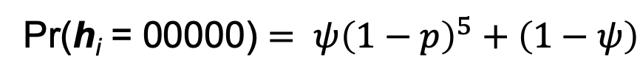
Estimate ψ and p
Pr(occupied) = ψ
Pr(unoccupied): 1 – ψ
Pr(detected, if present) = p
Pr(undetected, if present): 1 – p
Construct probability statements from encounter histories:
Pr(h_{i} = 00000) $= ψ{\left(1−p\right)}^{5}+\left(1−ψ\right)$
Probability of a 00000 encounter history
Site is occupied, but species never detected
OR, the site is unoccupied

Slide 24
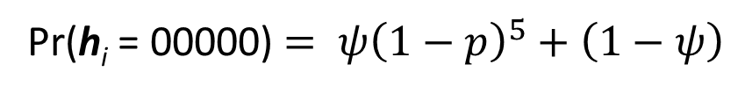
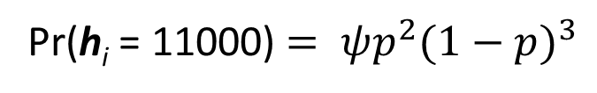
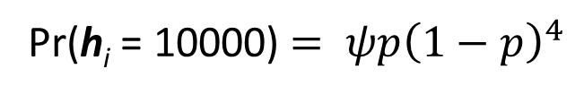
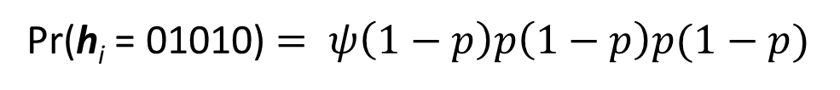
Estimate ψ and p
Pr(h_{i} = 01010) $= ψ\left(1−p\right)p\left(1−p\right)p(1−p)$
Pr(h_{i} = 00000) $= ψ{\left(1−p\right)}^{5}+\left(1−ψ\right)$
Pr(h_{i} = 10000) $= ψp{\left(1−p\right)}^{4}$
Pr(h_{i} = 11000) $= ψp^{2}{(1−p)}^{3}$
…
Once we have probabilities statements for each encounter history, ψ and p can be estimated across all sites
Software, such as PRESENCE or MARK, or the R package UNMARKED does these computations for us
Notes:
Left off 28 March 2016

Slide 25


Details
Pr(h_{i} = 01010) $= ψ\left(1−p\right)p\left(1−p\right)p(1−p)$
Pr(h_{i} = 00000) $= ψ{\left(1−p\right)}^{5}+\left(1−ψ\right)$
These probability statements assume that:
detection probability is the same for all sites i and for all surveys j (i.e., p not p_{i} or p_{j} or p_{ij})
probability of occupancy is the same for all sites (ψ not ψ_{i})
Although these might be reasonable starting points, we can explore additional models that do not require us to make these assumptions

Slide 26
Details
Dot (.) notation indicates that a parameter is a constant
Simplest model:
ψ(.)p(.) – assumes occupancy and detection probabilities are constant across sites and across surveys
Alternative models:
ψ(.)p(t) – assumes probability of occupancy is the same for each site, but allows detection probability to vary for each survey
ψ(site covariates)p(site or survey covariates) –
allows probability of occupancy to vary with site features, such as elevation or vegetation cover
allows detection probability to vary with site or survey features, such as temperature, week of the year, or observer

Slide 27
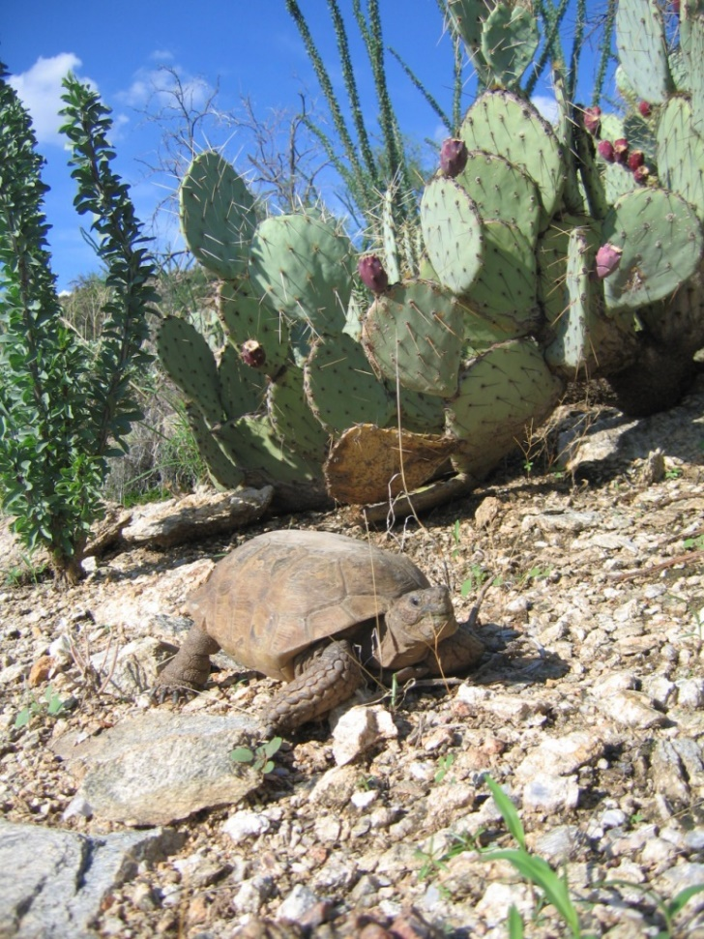
Data examples
0 0 1 0 0
1 1 1 0 1
0 0 0 0 0
0 0 1 0 1
0 0 0 0 0
0 0 0 0 0
….
A portion of an encounter-history matrix from a desert tortoise study with 20 sites and 5 surveys at each site

Slide 28
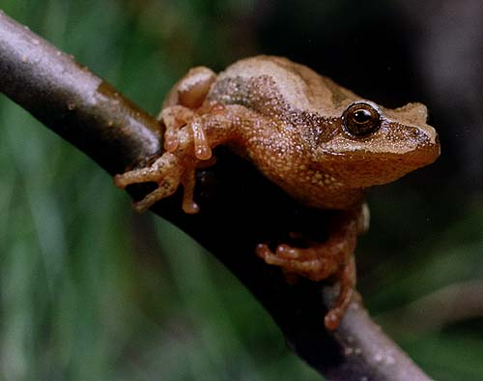
After this point, p drops to nearly zero
Data examples
On this particular date, only one site was surveyed
p changes over time
--------1----------------------1---1-----------------1---1-----------0----------------0-----
-----1-11------1--1-------------1---------------------------1-------------------------0-----
--------1------------------------1-------------------1---0-----------0----------------0-----
1----1-------1------1------1------1------1---1--------1------1-------0---0--------0----0----
---------------------------1--------------1------------1------0-------------00--------------
-----------------------------------1----------------------1--------------------------1------
-11110-11111111111111111----111111-11111--1111---1111---1111111---010000000--00000--0000----
----------0--------------------11---------1-0--------------0-------------0---0------------0-
-----------1------------------1--------1-------------------------------1------------------1-
----------------1--------1----------1-------------------------1------0-------0--------------
A portion of an encounter history matrix from a study of spring peepers with 29 sites and 92 visits
Lots of missing data (--)!
Missing data are acceptable, but the more information you have, the more precise your estimates will be

Slide 29
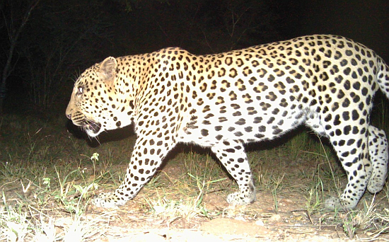
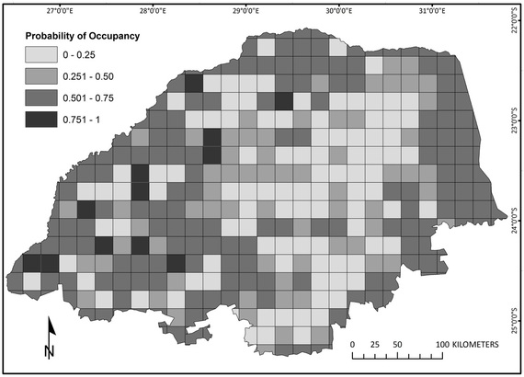
Leopards in South Africa
Notes:
Ended 1 Nov 2021

Slide 30
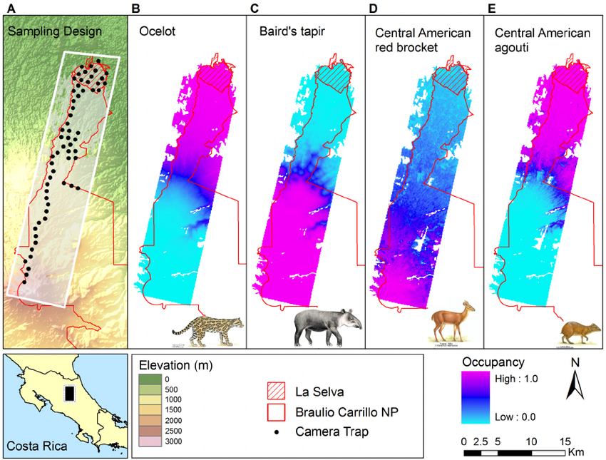

Slide 31
How this all works in practice
Establish study areas to define population of interest
Decide how to define a site (species-specific)
Establish sites, then choose a random sample from the sampling frame
Survey each site multiple times, recording whether or not at least one individual is detected
Use the encounter histories from surveys as the basis for estimating p so that the estimate of ψ is reliable

Slide 32
Estimate ψ and p
Probability that:
a site is occupied: ψ
a site is unoccupied: 1 – ψ
species will be detected if present during one survey: p
species will not be detected if present during one survey: 1 – p

