Slide 1
MindTheAge
Friar Health
Bridging the gap between older folks and mental healthcare.

Slide 2
Outline for presentation (not shown in presentation)
Statistics (for elderly population in California, mental healthcare)
Give a user profile (this will be used for the demo)
Give solution (introduce it)
Give URL
Give background
Demo (is it live or not i honestly have no idea) -> ???
Give some background (like algorithms used?) -> ???
Q&A probably

Slide 3
11.4%
15.5%
2010
2022
Population makeup of 65+ individuals in San Diego County
Population makeup of 65+ individuals in San Diego County
US Census Bureau
Notes:
Source:
https://usafacts.org/data/topics/people-society/population-and-demographics/our-changing-population/state/california/county/san-diego-county/ -> https://www2.census.gov/programs-surveys/popest/

Slide 4
+43.5%
Overall population increase of 65+ individuals in San Diego County (2010-2022).
US Census Bureau
Notes:
Source:
https://usafacts.org/data/topics/people-society/population-and-demographics/our-changing-population/state/california/county/san-diego-county/ -> https://www2.census.gov/programs-surveys/popest/
Fastest growing population

Slide 5
Nobody’s getting any younger.
Notes:
Okay I’m ngl I thought this would be funny to say but idk lmfao

Slide 6
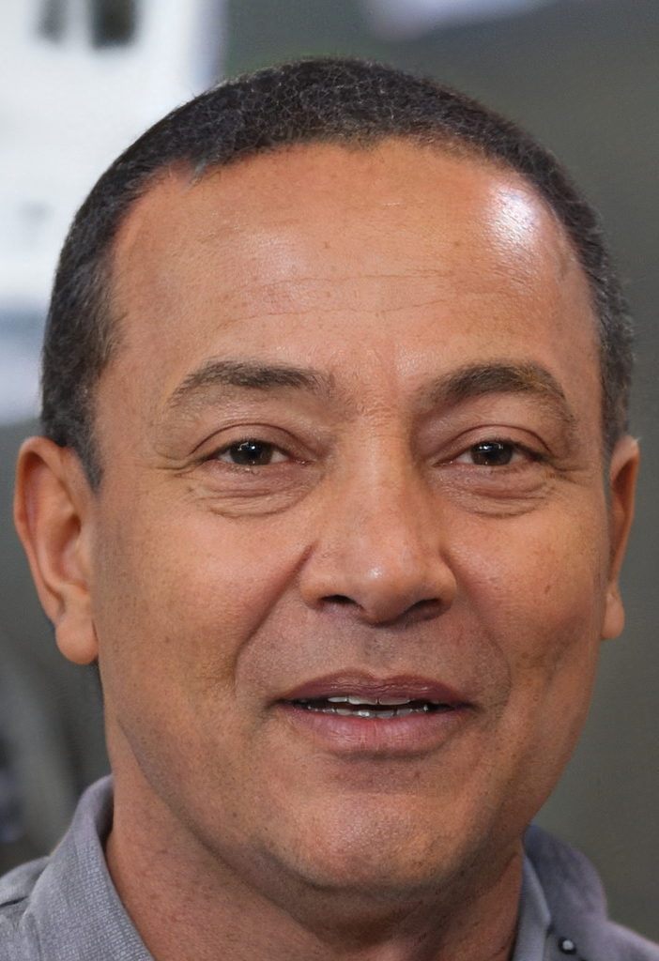
A closer perspective
Meet Gene Garcia, a 70-year old Filipino-American veteran living in Mira Mesa, CA.
How can he start his mental healthcare journey in this new age of information?
Notes:
I hope this guy looks like the user snapshot cus he’s not real
Living by himself and on Medicare, his children are looking to get him involved in mental healthcare services, given his status and age.

Slide 7
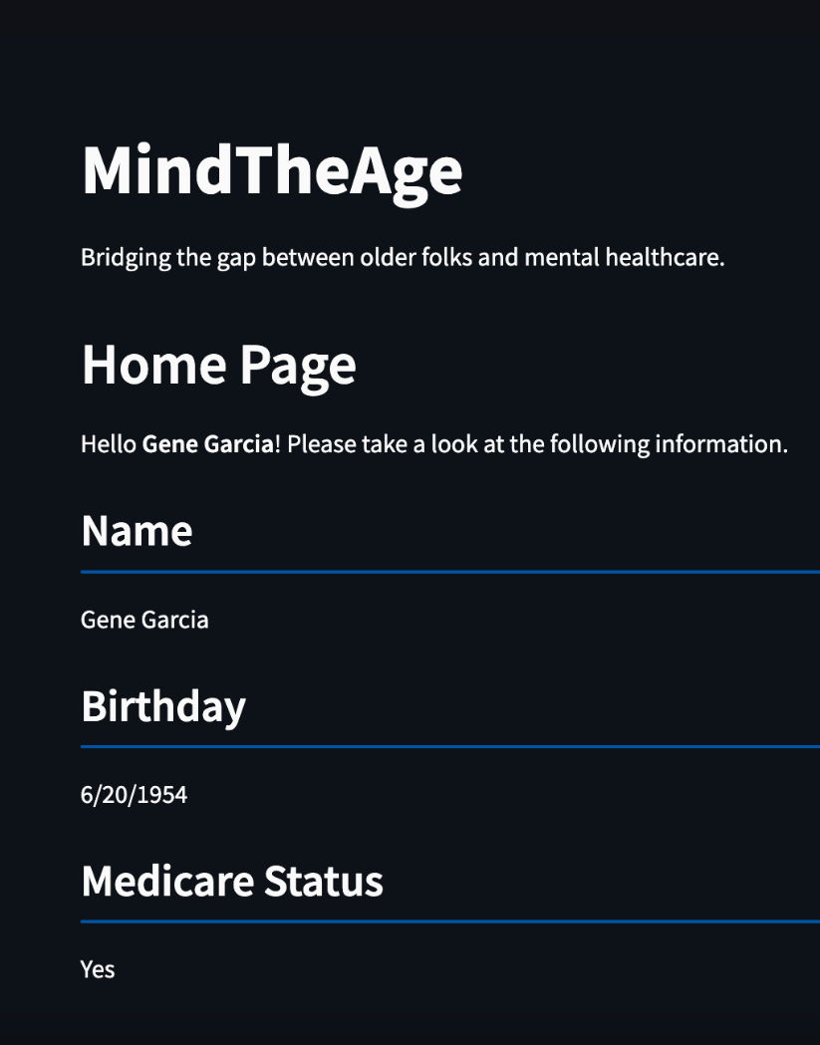
Our solution
An app dedicated to recommend mental health resources based on patient profile. (EDIT PIC)
Notes:
Include screenshot of app

Slide 8
The backend-ish
We utilize a mental condition classification model, along with traditional filtering techniques and Claude AI(???) to return recommendations based on both self-reported patient comments and medical information provided by medical staff.
Personalized to each patient
Provides accessible information easily

Slide 9
Why this app?
Notes:
Discuss importance here! -> why do we need this app?

Slide 10
Do we include a link to the app (cus we can publish it via Streamlit)

Slide 11
Thank you!
MindTheGap made by Alexandra Hernandez, Armin Irvije, and Zaina Kudchiwala.

