Slide 1

Airbnb in NYC analysis
New York Airbnb Open Data

Slide 2
New York Airbnb Open Data
Our dataset have 102.058 rental properties
From Manhattan, Brooklyn, Queens and Bronx
With Apartments, shared and private rooms
Information about price and review score

Slide 3
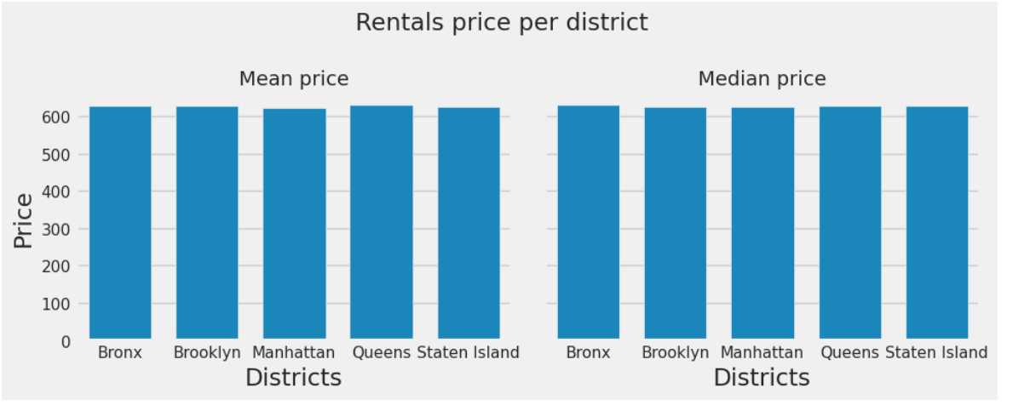
Access price based on qualitative characteristics
There is no difference in price per NY region

Slide 4
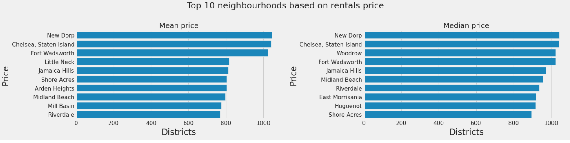
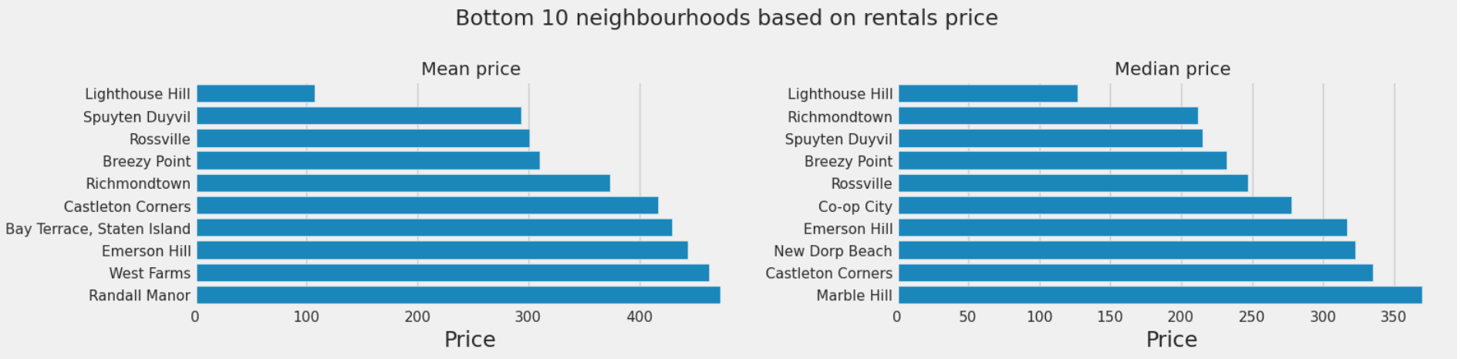
Access price based on qualitative characteristics
There are neighbourhoods that we can offer rentals in higher prices

Slide 5
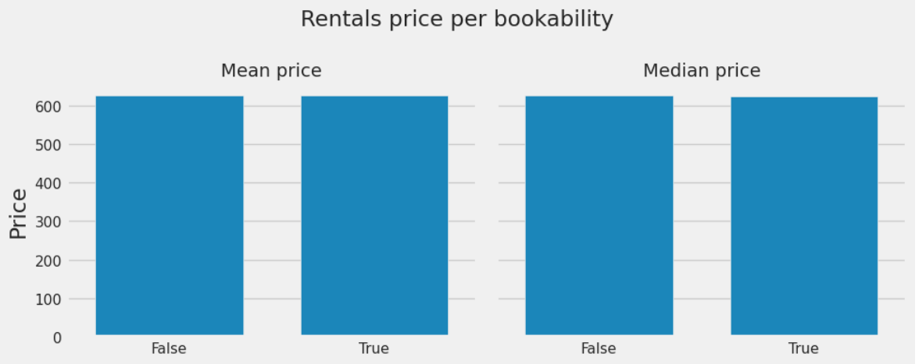
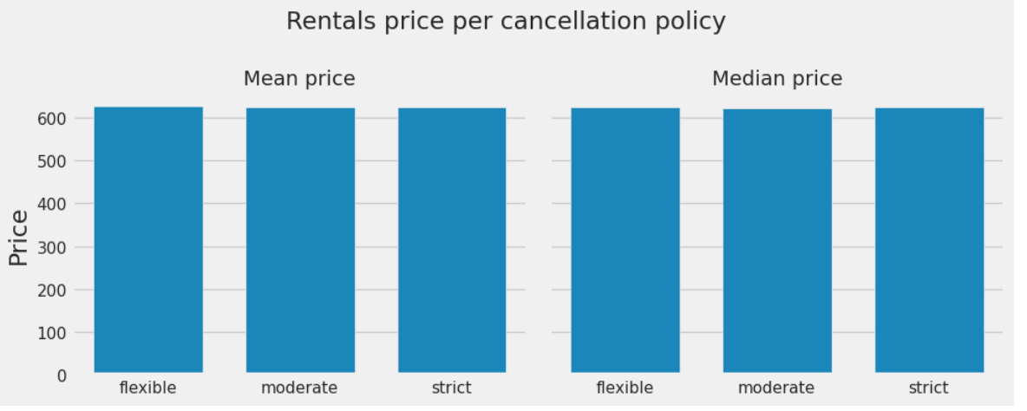
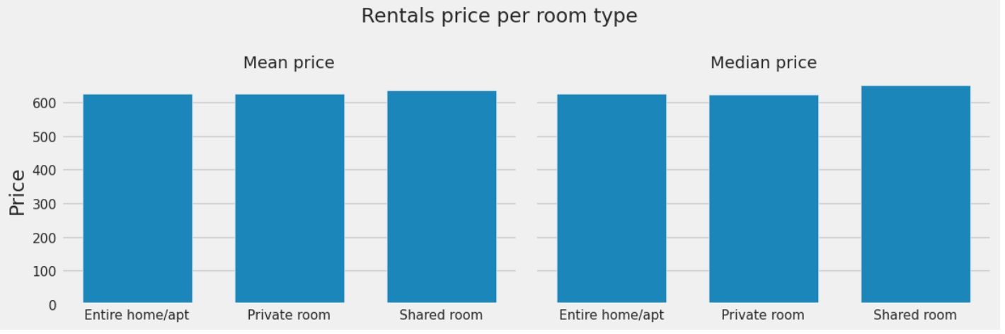
Access price based on qualitative characteristics

Slide 6
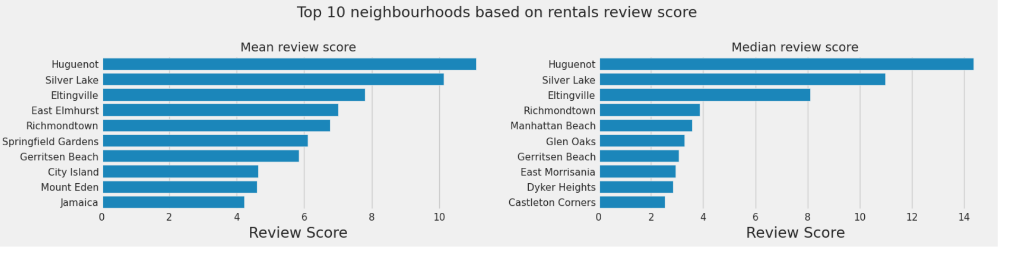
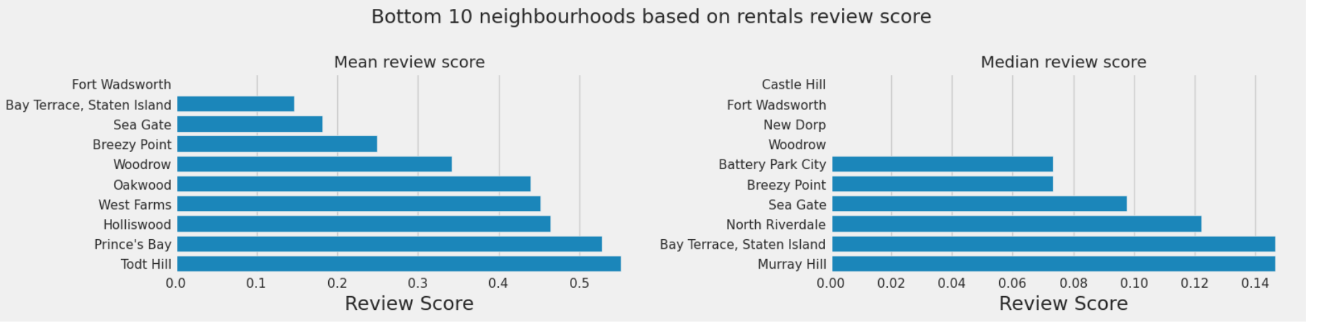
Access reviews on qualitative characteristics

Slide 7
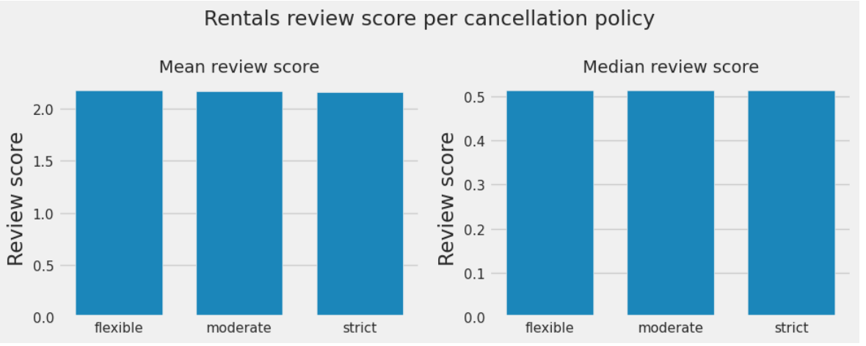
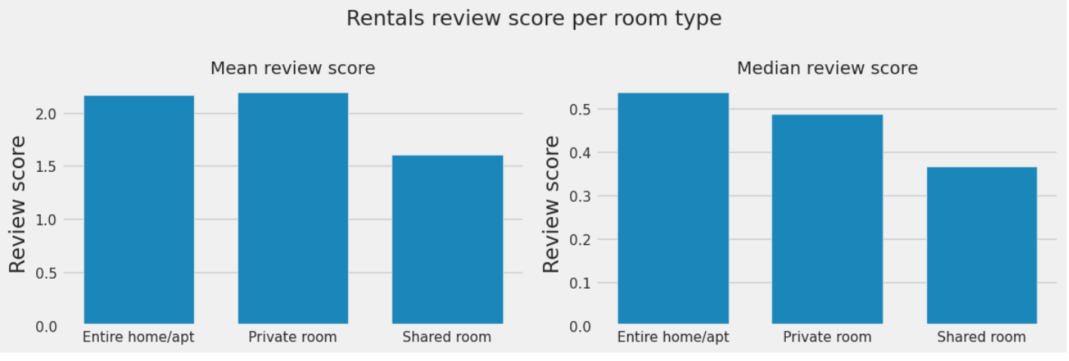
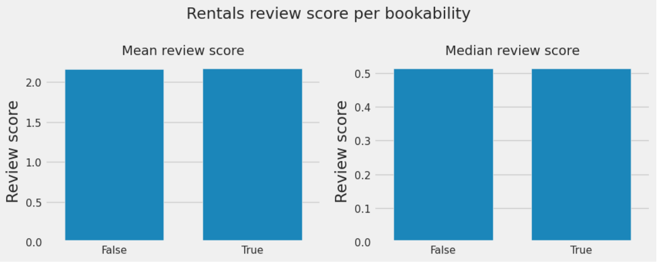
Access reviews on qualitative characteristics

