Slide 1
Research on Language Models for Detecting Texts Generated by Artificial Intelligence
Oleksandra Tkachenko, Kyrylo Smelyakov Kharkiv National University of Radio Electronics, Nauky ave., 14, Kharkіv, 61166, Ukraine

Slide 2
Motivation
Language models have become the foundation of modern natural language processing technologies. Large language models (LLMs), such as ChatGPT and Mistral 7B, have gained particular popularity due to their ability to generate texts that look almost the same as texts written by humans.
The rapid spread of LLMs comes with a number of challenges: the growing use of AI-generated content in academic and public domains threatens integrity, the reliability of information, and respect for copyright.
According to Liang, W., Zhang, Y., Wu, Z., et al. “Mapping the Increasing Use of LLMs in Scientific Papers’’ (2024), who analyzed 950,965 scientific publications from 2020 to 2024, up to 17.5% of texts in the field of computer science exhibit signs of large language model usage.
2

Slide 3
Overview of Existing Approaches
Main approaches to AI-generated text detection:
Statistical methods. Analyze perplexity, entropy, and n-grams. Do not require training but are ineffective against modern LLMs.
Classifiers. Trained to distinguish between human and AI-generated texts. Language models like BERT and DeBERTa are used to extract features.
Watermarks. Embedded during text generation. Only effective if supported by the generating model.
The object of this study is language models - their effectiveness and applicability in detecting texts generated by AI.
3

Slide 4
Problem Statement
Problem AI-generated texts are increasingly used in science, education, and media. This creates the need for reliable tools capable of identifying such content. However, the effectiveness of language models as a means of detection remains insufficiently studied.
Research Objective To investigate language models in terms of their ability to detect AI-generated texts and to identify the most suitable ones for this task.
Expected Outcomes A set of evaluation criteria and a ranking of language models based on their classification accuracy, computational efficiency, and practical applicability.
4

Slide 5
Theoretical Part
To identify the most effective models for detecting AI-generated texts, a comparison was conducted among language models representing four stages of their evolution:
Statistical Language Models (SLM)
Neural Language Models (NLM)
Pretrained Language Models (PLM)
Large Language Models (LLM)
The most promising representatives were selected from each group. To ensure an objective comparison, five evaluation criteria were used:
Number of parameters
Maximum context length
Memory consumption
Vocabulary size
Designed for text classification
Model | Number of parameters (in millions) | Maximum context length (tokens) | Memory consumption (GB) | Vocabulary size (tokens) | Designed for text classification
Modified Kneser-Ney | - | 3 | 1 | 20 000 | No
FastText | - | 10 | 4 | - | Yes
ELMo | 30 | 512 | 8 | 50 000 | No
BERT | 110 | 512 | 12 | 30 000 | Yes
RoBERTa | 125 | 512 | 16 | 50 000 | Yes
DeBERTa-v3 | 184 | 512 | 16 | 128 000 | Yes
Phi-2 | 2700 | 2048 | 5.6 | 51 200 | No
Orion-14B | 14000 | 4096 | 29 | 84 608 | No
Mistral 7B | 7000 | 32000 | 14.4 | 32 000 | No
OpenChat-3.5 | 7000 | 8192 | 14.4 | 32 002 | No
5

Slide 6
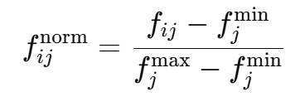
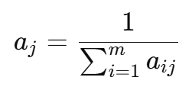
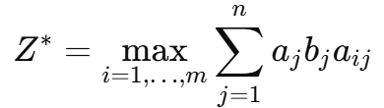
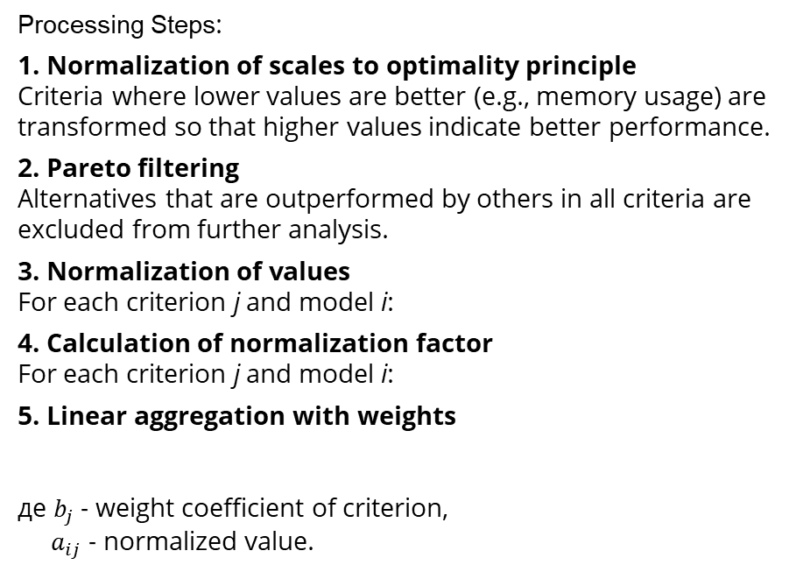
Results of the Theoretical Part
Processing Steps:
Normalization of scales to optimality principle Criteria where lower values are better (e.g., memory usage) are transformed so that higher values indicate better performance.
Pareto filtering Alternatives that are outperformed by others in all criteria are excluded from further analysis.
Normalization of values For each criterion j and model i:
Calculation of normalization factor For each criterion j and model i:
Linear aggregation with weights де $b_{j}$ - weight coefficient of criterion, $a_{ij}$ - normalized value.
Model | Result
Modified Kneser-Ney | 0.0144543
FastText | 0.2024076
BERT | 0.0897989
DeBERTa-v3 | 0.1346456
Phi-2 | 0.0686771
Orion-14B | 0.1142685
Mistral 7B | 0.2557635
OpenChat-3.5 | 0.1199842
Therefore, four models that demonstrated the highest overall scores were selected for further study: FastText, Mistral 7B, DeBERTa-v3, and OpenChat-3.5
6

Slide 7
Practical Part
For the experiment, the following models were selected: FastText, DeBERTa-v3, Mistral 7B, and OpenChat-3.5 — the most promising based on theoretical analysis.
Data: The ChatGPT-Research-Abstracts dataset (Hugging Face) was used — 20,000 English "human–AI" text pairs generated by GPT-3.5.
Preprocessing: Lowercasing, noise and special character removal, stop-word filtering..
Tools: Python 3.x, libs: transformers, datasets, peft, pandas, nltk, re.
Environment: Google Colab (GPU Nvidia A100).
Experiment setup:
Data split: train (15k), validation (2k), test (3k);
Fine-tuning on the training set;
Hyperparameter tuning on validation, evaluation on test set;
Metrics: Accuracy, Precision, Recall.
Model | Average Evaluation Time (3000 texts) | Minimum GPU Memory Usage
FastText | <1s | 0 GB
DeBERTa-v3 | 5 min 40 s | 4 GB
Mistral-7B | 38 min | 18 GB
OpenChat 3.5 | 29 min | 16 GB
7

Slide 8
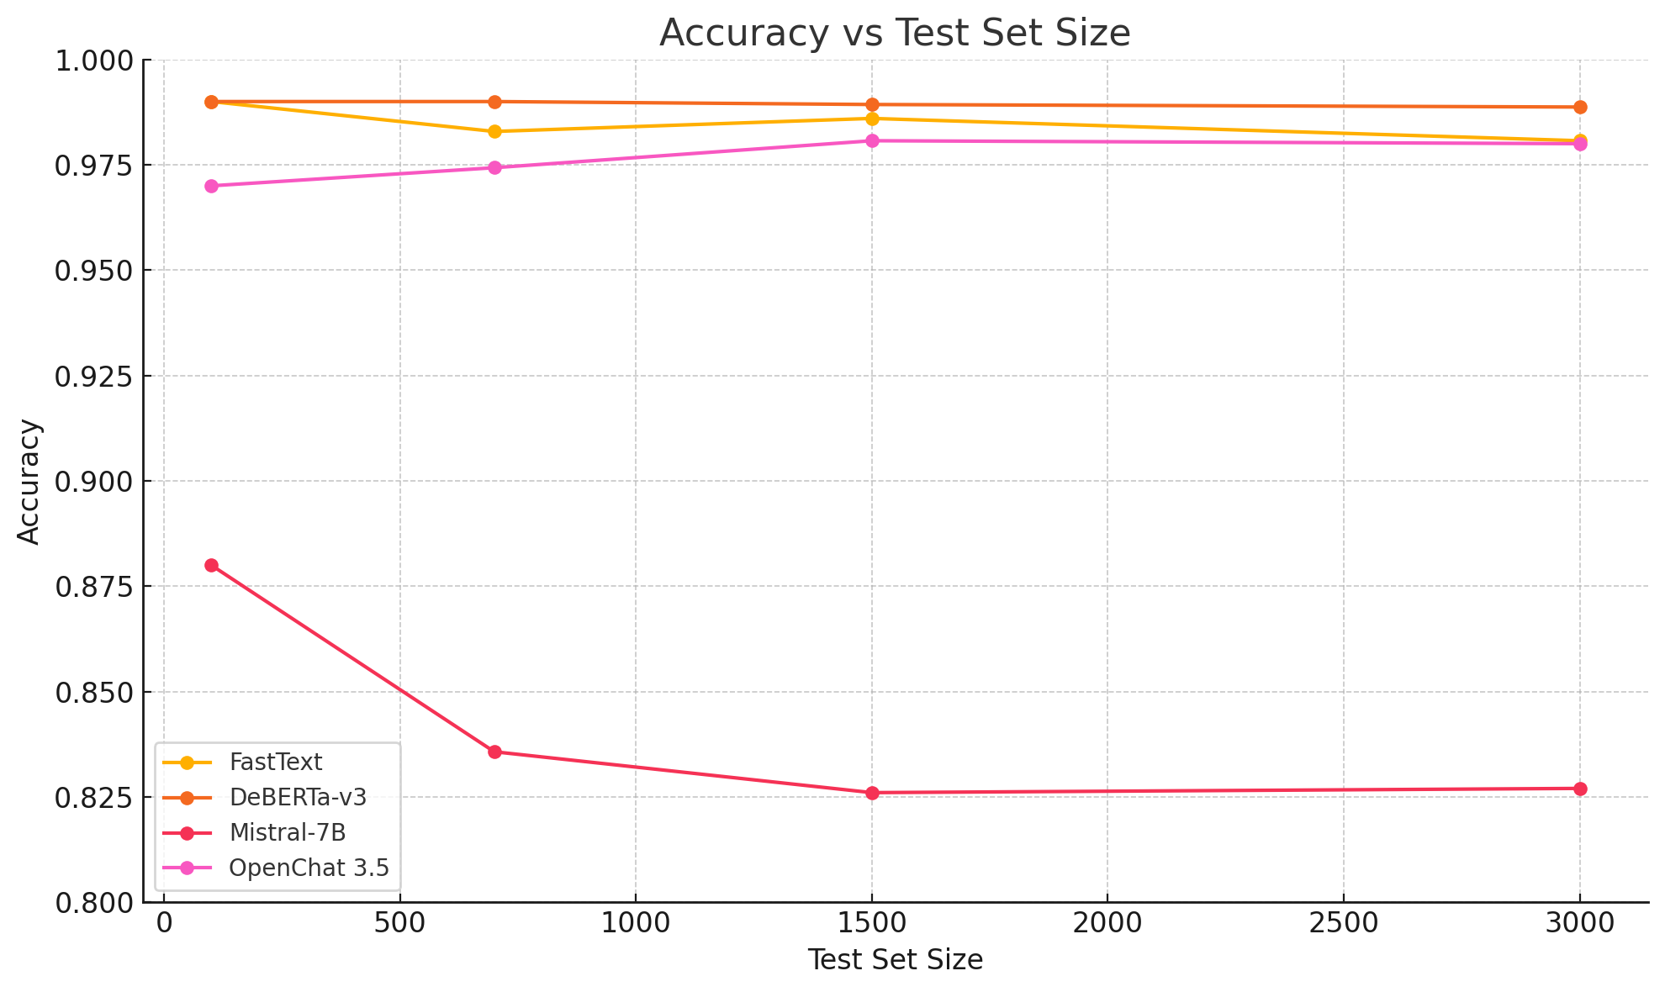


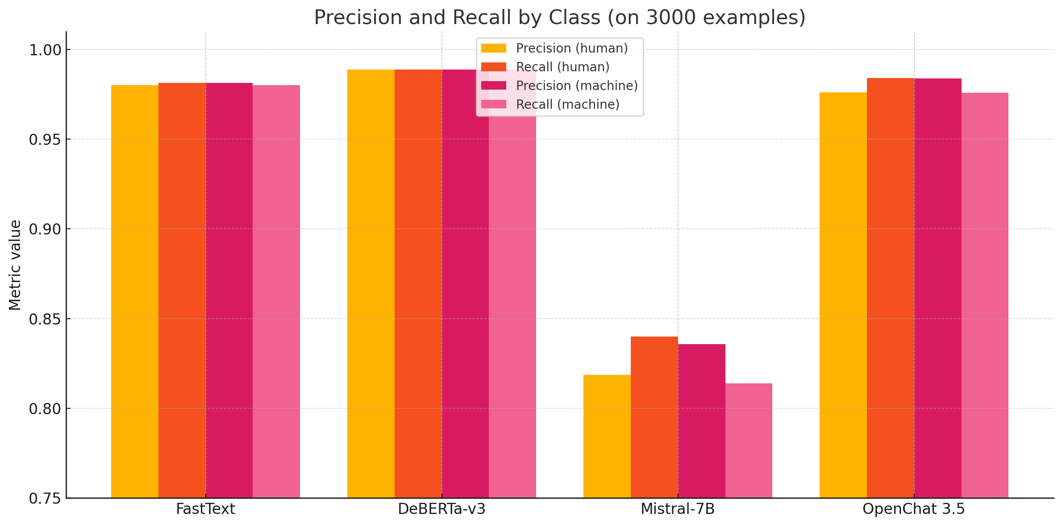

Results of the Practical Part
8

Slide 9
Summary
DeBERTa-v3 achieved the highest classification accuracy, offering a good balance between performance and computational efficiency. FastText showed comparable effectiveness with minimal resource requirements and extremely fast processing without GPU support.
OpenChat 3.5 delivered solid but less accurate results and required over 16 GB of memory. Mistral-7B proved the least suitable due to its lower accuracy and significant resource consumption.
The task of detecting AI-generated texts does not require deep contextual analysis, which is why large models do not demonstrate clear advantages over more compact solutions.
Recommendations:
FastText, suitable for fast classification under limited resources;
DeBERTa-v3, best when accuracy is the top priority;
LLM, better suited for text generation rather than classification.
A promising direction for future research is the integration of language models with alternative approaches such as stylometry, syntactic analysis, or detection of structural patterns.
9

Slide 10
Thank you for your attention!

