Slide 1

ROMANIAN RESTAURANT
by Alexandra Vladu

Slide 2
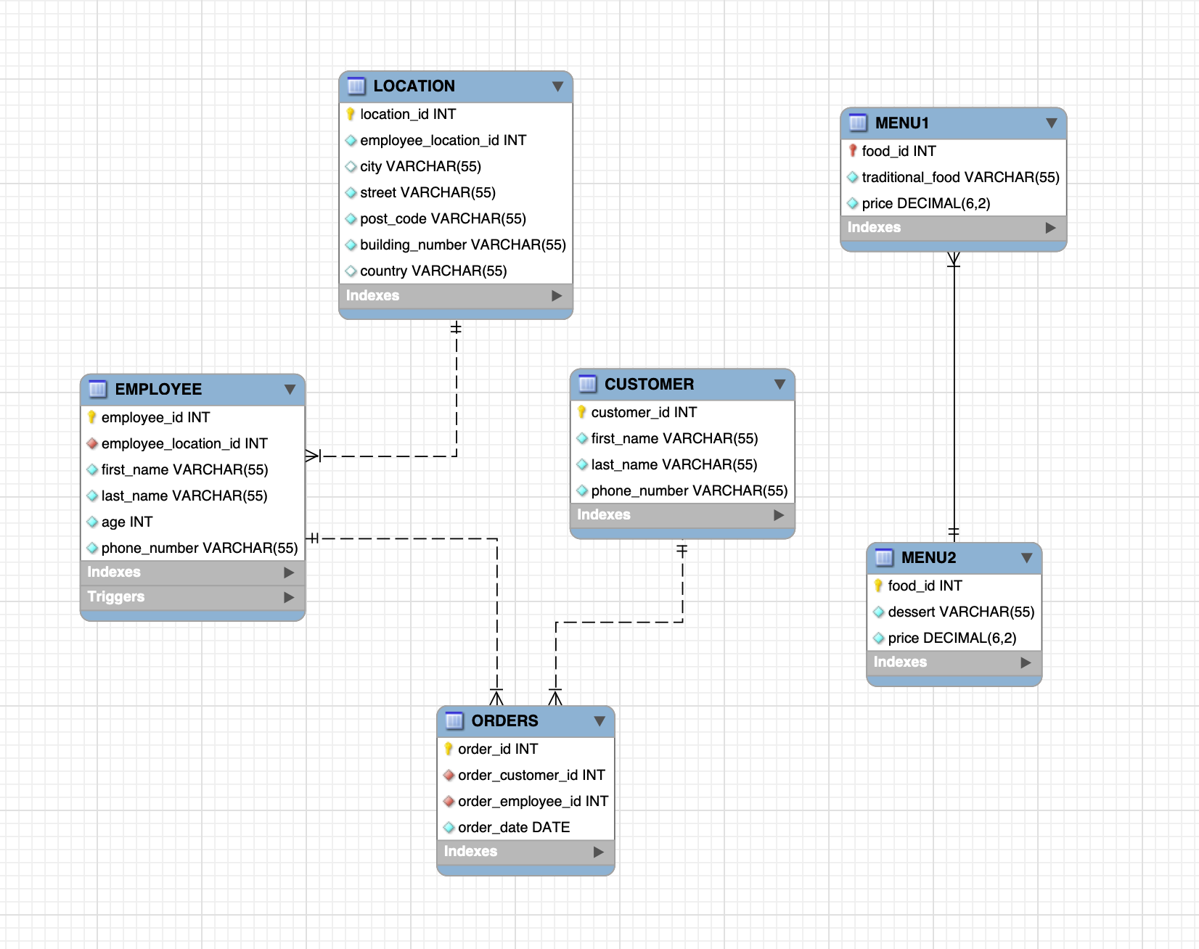
EER DIAGRAM
⚡️ Relational Database with minimum 5 tables.
⚡️Primary Key and Foreign Key constraints.

Slide 3
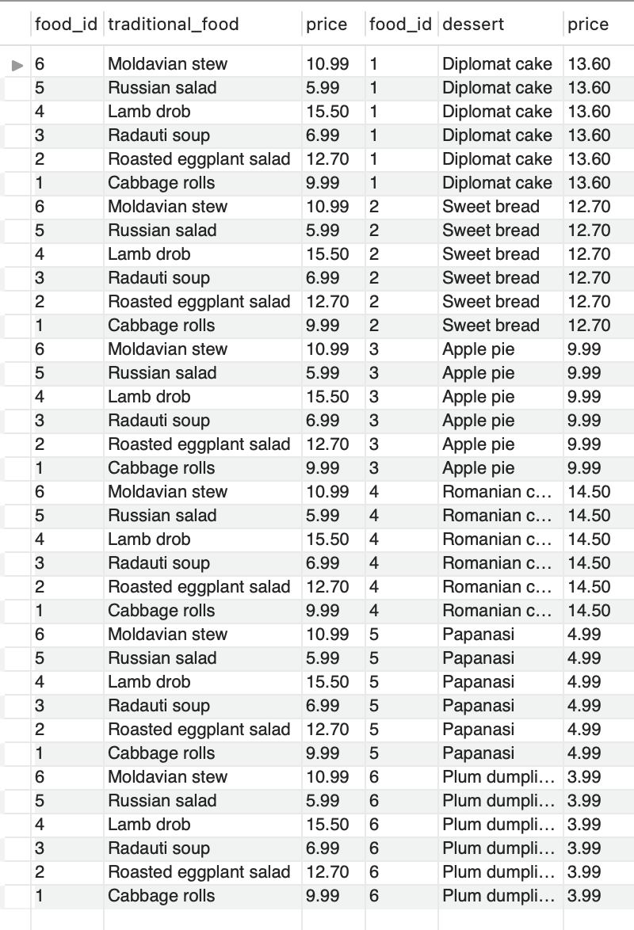
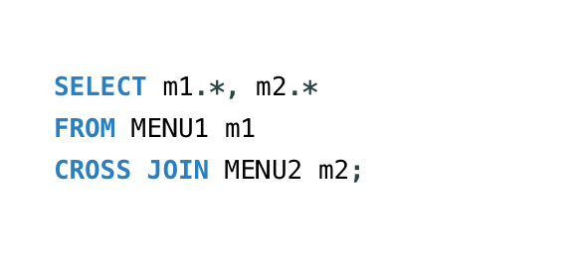
RESULT
⚡️ CROSS JOIN used to generate a paired combination of each row of the first table with each row of the second table.
⤵️

Slide 4
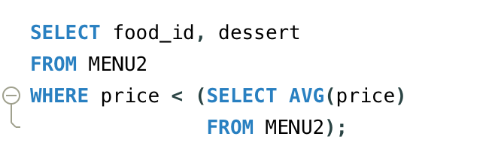
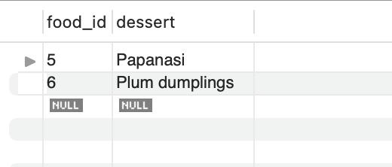
BASIC QUERY WITH A SUBQUERY, TO DEMONSTRATE HOW TO EXTRACT DATA FOR ANALYSIS.

Slide 5
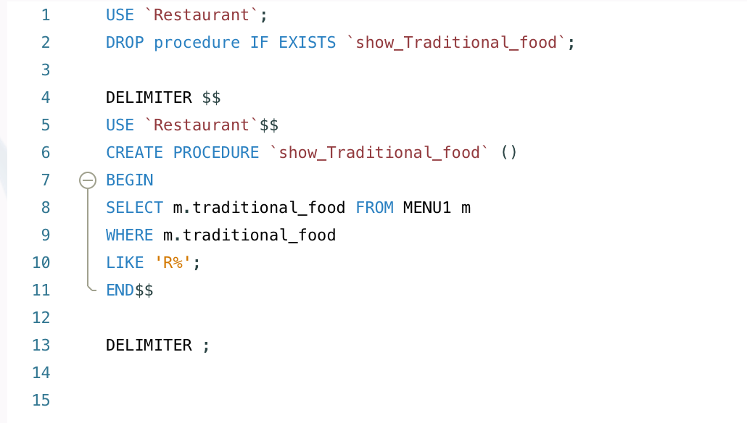

STORED PROCEDURE

Slide 6
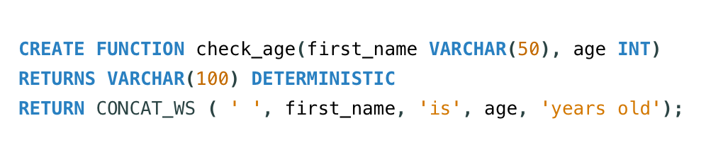
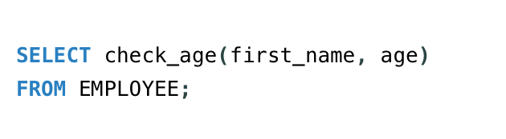
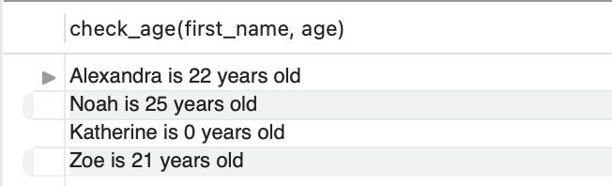
STORED FUNCTION

Slide 7
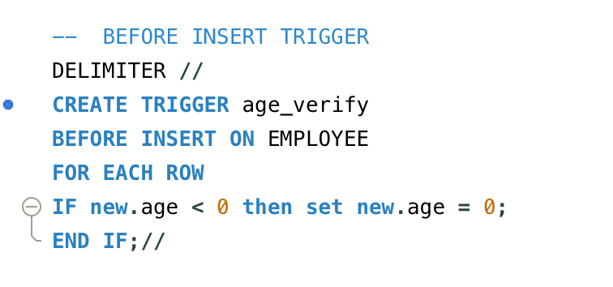
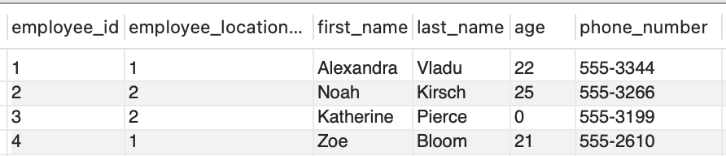
TRIGGER
⚡️TRIGGER BEFORE INSERT, IF THE AGE IS LESS THAN ZERO, THE VALUE ZERO WILL BE AUTOMATICALLY ADDED.

Slide 8

Thank you for your attention!

