Slide 1
Human Resources Management tool
Alex Ponomarev
Luis Ernesto romano

Slide 2
Purposes:
Train ourselves with:
WCF
WPF
Entity Framework communication through WCF and serialization
Cloud database implementation

Slide 3
Main features and advantages
Simple and intuitive ERP system aiming to simplify HR management
Has basic authorization verification, not so sophisticated but enough from somebody to intrude
Neat and clean design, pleasant to look at

Slide 4
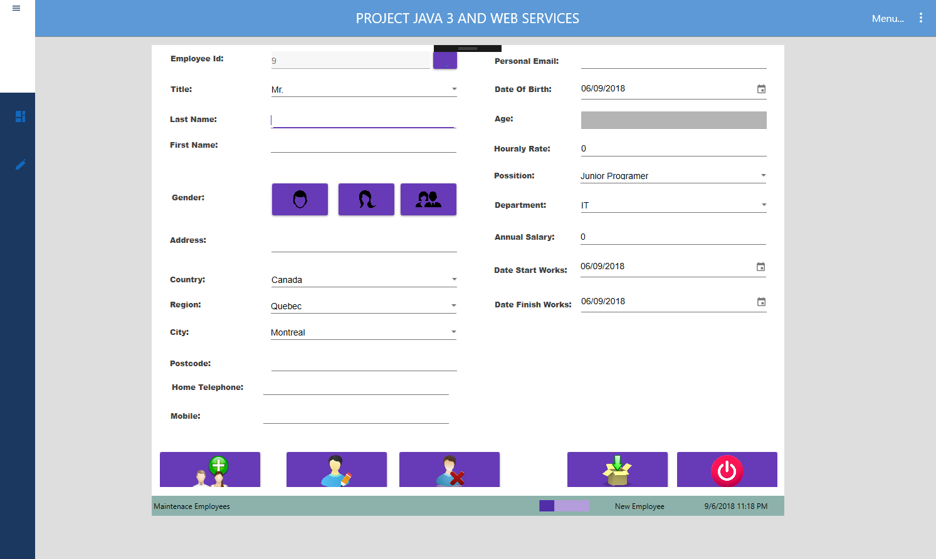
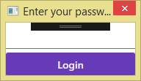

Slide 5
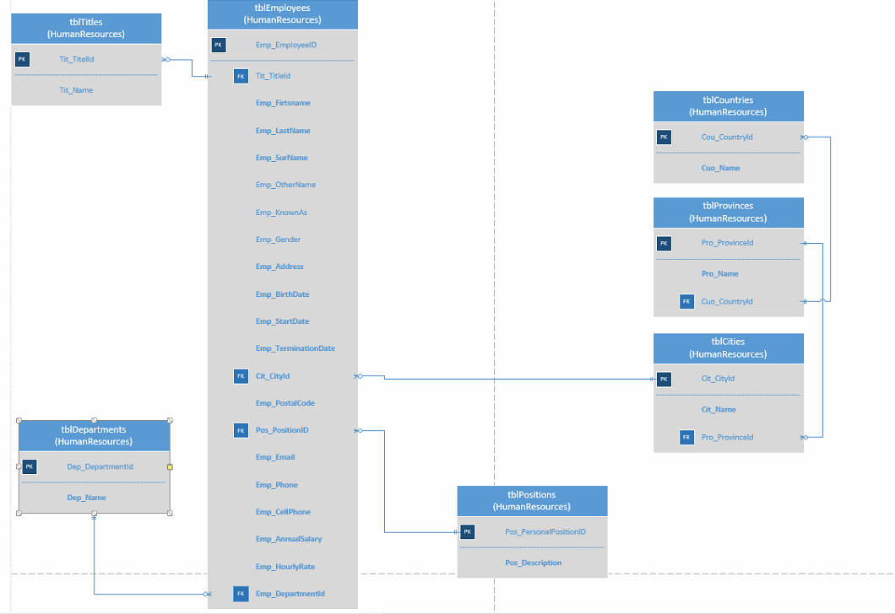
DB

Slide 6
Challenges and solutions:
WCF and Entity Framework interaction
Serialize referenced child tables (FK inner joins)
WPF layout manipulations
Photo upload and download

Slide 7
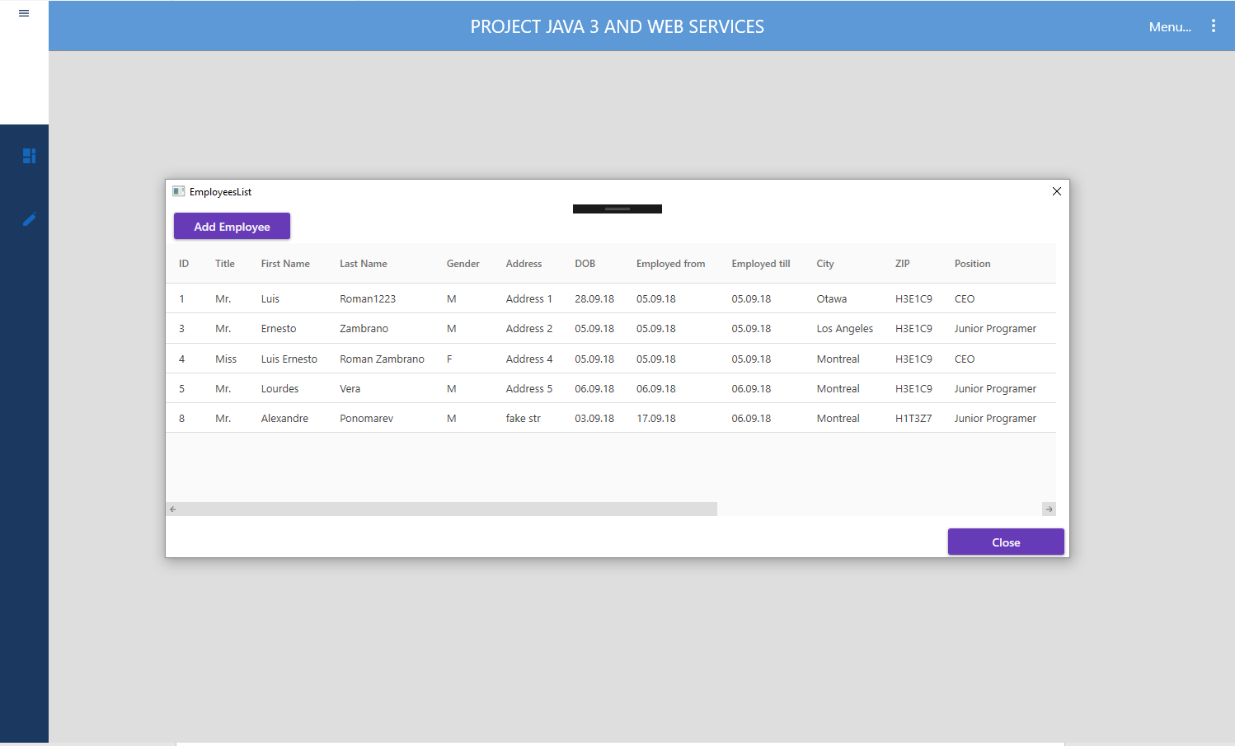
EF & WCF

Slide 8
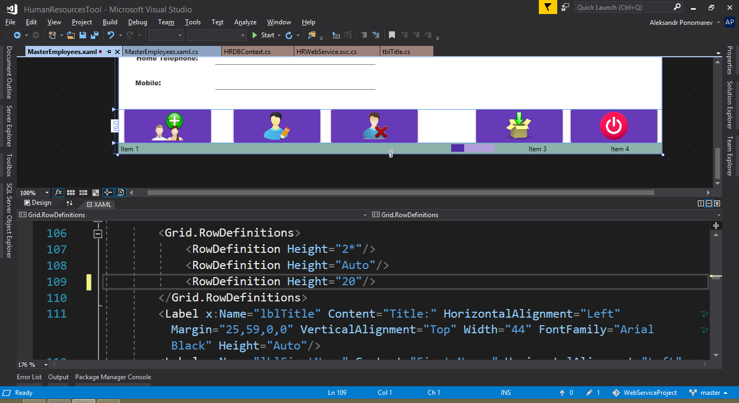
WPF layout manipulations

Slide 9
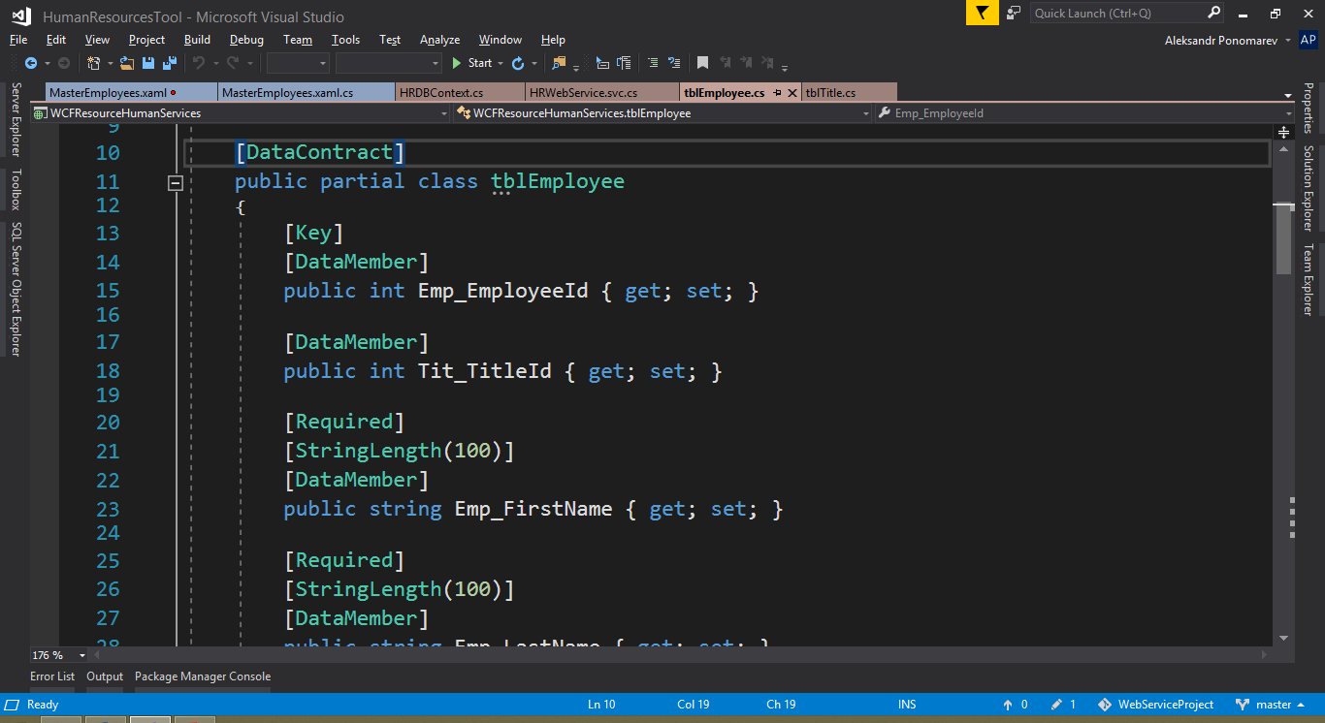
Teach One Thing

Slide 10
Future work
To add ability to add photos
Maybe to implement clock in/out system
Some simple calendar planner

Slide 11
Summary
Login
Entity Framework Code First on existing database
Cloud hosting of DB
WCF
WPF and layouts especially

