Slide 1


Cybersecurity Presentation 2018/2019
Linux Security
Jérémy Alzary - Alexandre Aubois – Thibaut Champion

Slide 2
Table of content
Methodology
Attack surface
Vulnerabilites list and counter measure
Recommendation on production

Slide 3

Methodology
Attack surface
Informations
Threats
Countermeasure

Slide 4



1- Architecture
Applications
Root
Lab-User
GRUB
BootLoader
GNU libc
Kernel

Slide 5
Attack surface
Bootloader
Process / services running
Docker running a webserver
Network

Slide 6
Vulnerabilities list and counter measure

Slide 7

START UP

Slide 8
2 – Linux bootloader
Applications
GRUB
BootLoader
GNU libc
Kernel

Slide 9



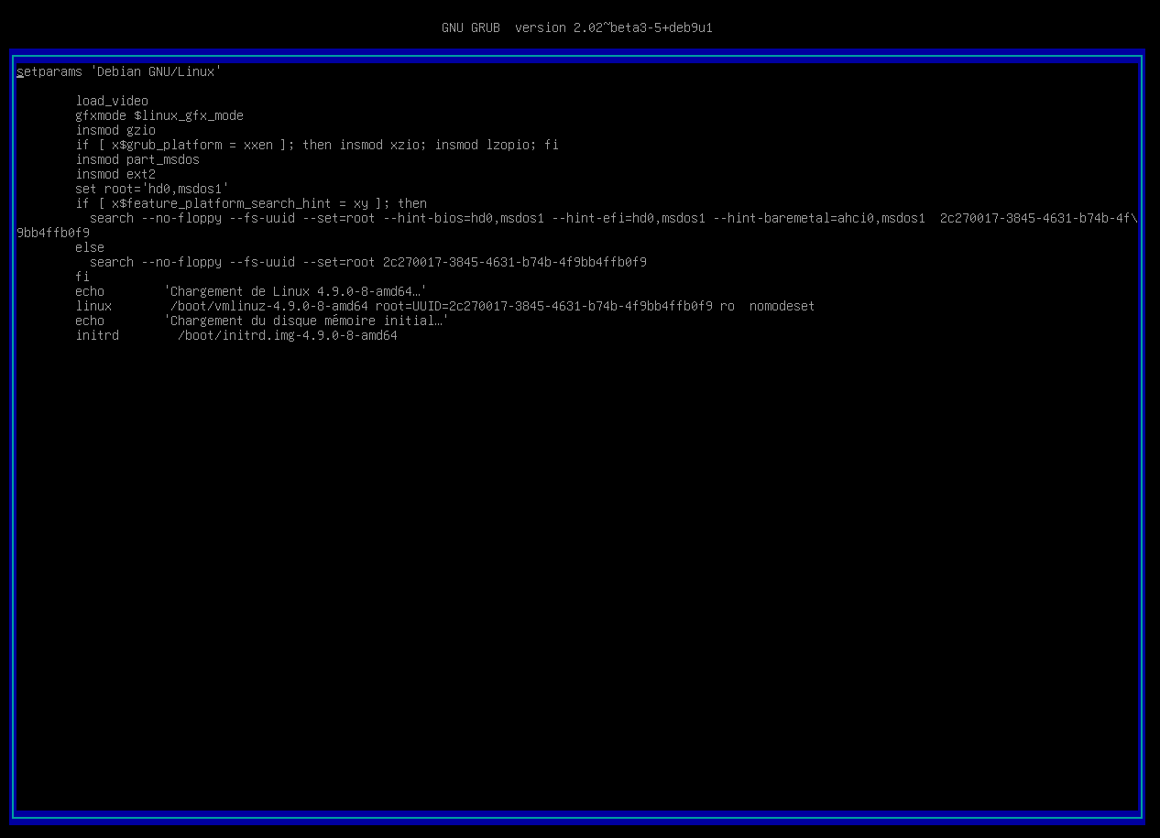

2 - GRUB
Unsecure Boot
ro → rw init=/bin/bash

Slide 10

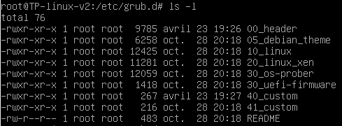

2 - GRUB
Password Protection
set superusers=‘’user’’
password user abcdef
/etc/grub.d/40_custom
Notes:
00_header est le script qui load les setting du bootloader depuis /etc/default/grub
40_custom permet d’ajouter des lignes sans passer par 00_header qui sera potentiellement modifié par une update du grub
Update-grub pour effectuer nos modifications

Slide 11
3 - TTY
Applications
GRUB
BootLoader
GNU libc
TTY
Kernel

Slide 12

3 - TTY
Autoroot tty login
Tty service collision
tty1
tty2
tty6
……..
/sbin/init

Slide 13

3 - TTY
getty@tty1.service.d configuration
Delete the second tty service calling /sbin/agetty in /etc/systemd/system

Slide 14
4 – Kernel hardening
Applications
GRUB
BootLoader
GNU libc
Kernel

Slide 15

4 – ASLR/IP Forwarding
No address space randomization
/etc/sysctl.conf
Enable ASLR
Disable IP Forwarding
Notes:
Sysctl.conf c’est pour configurer les paramètres du Kernel, ce fichier est lu au boot.
Quand un programme est chargé en mémoire, il faut l’ASLR pour que les adresses mémoires ne soient pas statiques pour protéger des BUFFER OVERFLOW
Pas d’intérêt à laisser l’ip forwarding à part si on veut que la machine agisse comme un routeur qui transfert les paquets d’un réseau à un autre.

Slide 16

BINARIES

Slide 17
5 - Binaries
Applications
Binaries
GRUB
BootLoader
GNU libc
Kernel

Slide 18



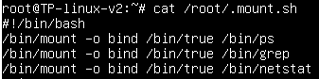
5 - Binaries
Unused binaries
Binaries mounted on others
Keep only useful binaries

Slide 19


6 – Test file
/etc/profile
Dangerous binary
Potential harmful alias
./test
lab-user
sh
/home/lab-user/test
root

Slide 20
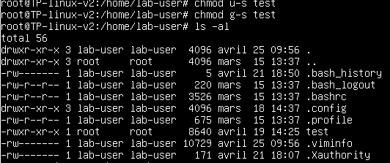

6 - Test file
Changer les setuid et groupuid
Delete the alias or all the file

Slide 21

SERVICE

Slide 22
7 - Docker
Applications
GRUB
BootLoader
GNU libc
Kernel

Slide 23

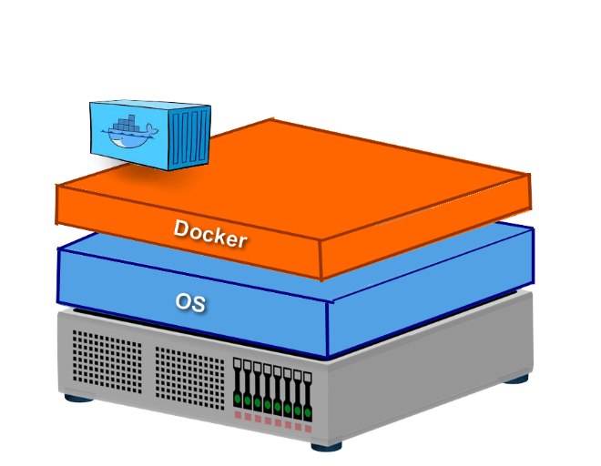
7 - Docker
Privileged Mode
Container Jailbreak
Port 80:80 Default page

Slide 24

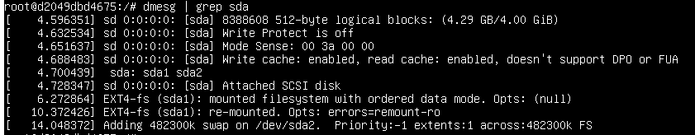
7 - Docker
Attack path

Slide 25
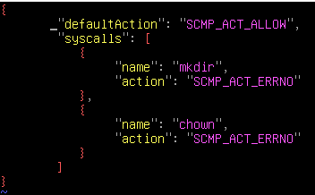
7 - Docker
Seccomp
Unpriviliged mode
Drop capabilities
/deny.json
$docker run –security-opt seccomp=deny.json
CAP_NET_BIND_SERVICE
Port redirection
https://github.com/moby/moby/blob/master/profiles/seccomp/default.json

Slide 26

8 – Insufficient logging and monitoring
Applications
Auditd
GRUB
BootLoader
GNU libc
Kernel

Slide 27


8 - Insufficient logging and monitoring
No real logs (except systemd)
Add rules to auditctl
Log all SysCall can be a solution.
Can take a lot of place

Slide 28

USER MANAGEMENT

Slide 29

9 - Sudoers
Bad sudoers configuration
Ask for password when sudo is used
Log the sudo
Create sudoers rules for users

Slide 30
10 – Password storage
Applications
Libraries
Linux - PAM
GRUB
BootLoader
GNU libc
Kernel

Slide 31
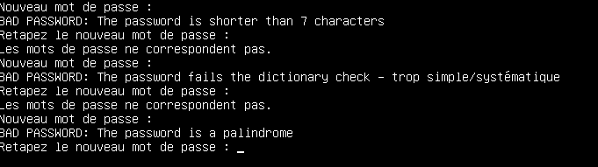
10 - Password storage
Usage of a deprecated hash algorithm
No rules on password
/etc/pam.d/common-password
Update to at least SHA256
Install the libpam-pwquality

Slide 32

NETWORK

Slide 33
11 - Network
Applications
GRUB
BootLoader
GNU libc
Kernel
Network

Slide 34
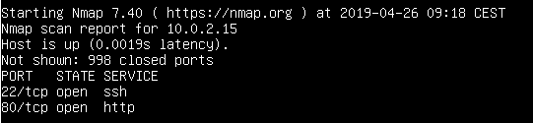
11 - Network
Ports opened but no in/forward/out filters

Slide 35

11 - Network
IP Tables
Block a specific IP
Allow incoming SSH from a specific network
Block ping
Load balancing
…
Drop all by default

Slide 36
12 - SSH
Applications
GRUB
BootLoader
GNU libc
Kernel

Slide 37
12 - SSH
SSH Root Access
Not updated
Bad ssh configuration : X11 Forwarding capabilities
Modify permissions
Disable X11 Forwarding
Change ssh port
/etc/ssh/sshd_config

Slide 38

13 - Certificate
Applications
GRUB
BootLoader
GNU libc
Kernel

Slide 39
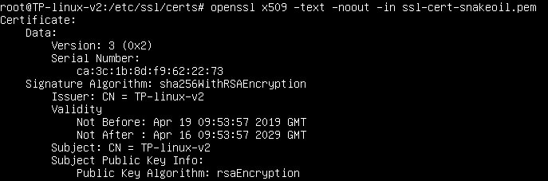
13 - Certificate
Fake certificate ssl-cert-snakeoil.pem Trusted
Delete it

Slide 40

Recommendation for production

Slide 41
Recommendation for production
2 FA
App Armor
User’s privilege limited
Use a bastion host for the network’s configuration
Encrypt the disk
TLS
Monitoring (Auditd and Syslog)
Notes:
App armor : un outil qui verrouille les applications en limitant leur accès aux ressources auxquelles elles ont droit sans perturber leur fonctionnement

Slide 42

Des questions ?

