Slide 1
Cybersecurity Presentation 2018/2019
1
Linux Security
Champion Thibaut Aubois Alexandre Alziary Jeremy
Notes:
1

Slide 2




1. Architecture
Applications
GRUB
BootLoader
GNU libc
Kernel

Slide 3
2. Linux Bootloader
Applications
GRUB
BootLoader
GNU libc
Kernel

Slide 4



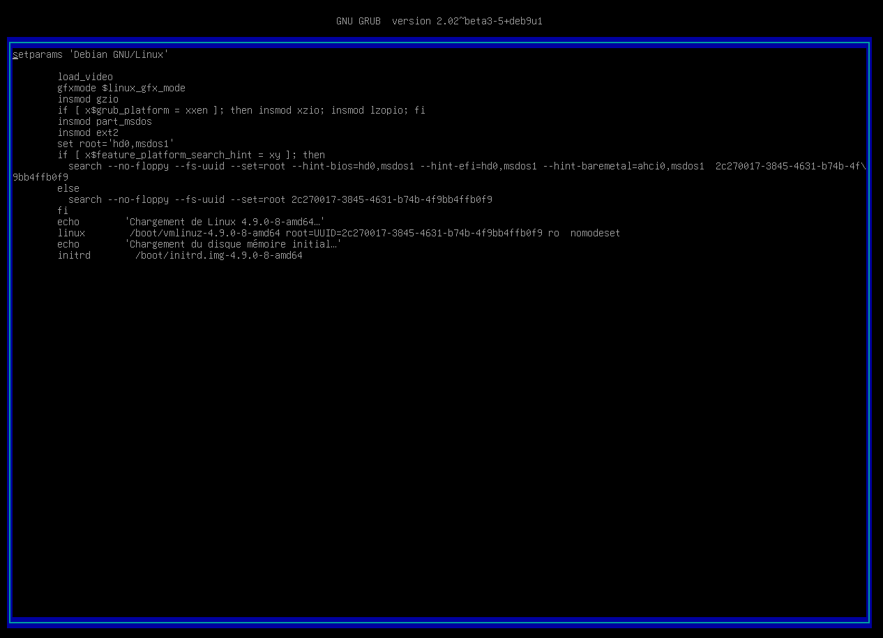

2. GRUB
Unsecure Boot
ro → rw init=/bin/bash
https://ubuntuforums.org/showthread.php?t=1369019

Slide 5

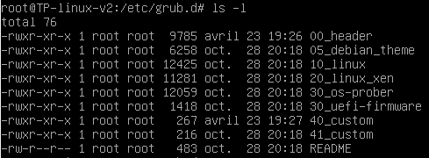

Password Protection
set superusers=‘’user’’
password user abcdef
/etc/grub.d/40_custom
Notes:
00_header est le script qui load les setting du bootloader depuis /etc/default/grub
40_custom permet d’ajouter des lignes sans passer par 00_header qui sera potentiellement modifié par une update du grub
Update-grub pour effectuer nos modifications

Slide 6
3. TTY
Applications
GRUB
BootLoader
tty
GNU libc
Kernel

Slide 7

Autoroot tty login
Tty service collision
tty1
tty2
tty6
……..
/sbin/init
Notes:
TTY's are text-only terminals commonly used as a way to get access to the computer to fix things, without actually logging into a desktop.

Slide 8

getty@tty1.service.d configuration
Delete the second tty service calling /sbin/agetty in /etc/systemd/system

Slide 9
4. SSH
Applications
GRUB
BootLoader
GNU libc
Kernel

Slide 10
Accès root en SSH
Modifier les permissions
/etc/ssh/sshd_config

Slide 11
5. Docker
Applications
GRUB
BootLoader
GNU libc
Kernel

Slide 12


Privileged Mode
Container Jailbreak
Port 80:80 Default page
Notes:
Le privileged Mode signifie que le conteneur hérite de toutes les capabilities du root
On monte la partition /dev/sda1 sur /mnt et on chroot /mnt on jailbreak du conteneur et on remonte dans la machine hôte en root.

Slide 13

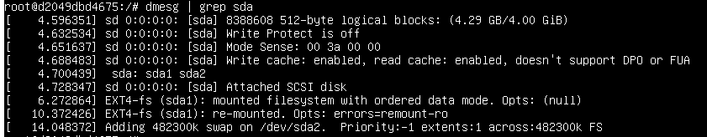
Attack Path

Slide 14
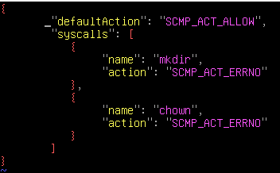
Seccomp
Unprivileged Mode
Drop capabilities
/deny.json
$docker run –security-opt seccomp=deny.json
CAP_NET_BIND_SERVICE
Port redirection
https://github.com/moby/moby/blob/master/profiles/seccomp/default.json
Notes:
CAP_NET : donner la cap de bind sur des ports priviliégiés
On fait des règles iptables pour rediriger les co sur le port 80 sur des ports non privilégiés

Slide 15
6. Password storage
Applications
Libraries
Linux - PAM
GRUB
BootLoader
GNU libc
Kernel
Notes:
Linux-PAM (short for Pluggable Authentication Modules) is a powerful suite of shared libraries used to dynamically authenticate a user to applications (or services) in a Linux system.

Slide 16
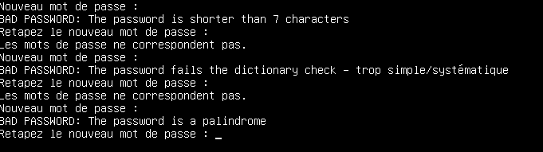
Usage of a deprecated hash algorithm
No rules on password
/etc/pam.d/common-password
Update to at least SHA256
Install the libpam-pwquality

Slide 17
Fichier passwd readable par tout le monde
Informations pour l’attaquant
/etc/passwd
Limiter les droits

Slide 18
7. Network
Applications
GRUB
BootLoader
GNU libc
Kernel
Network

Slide 19
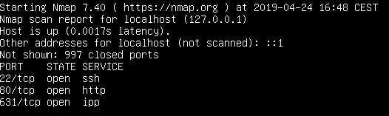
Ports opened but no in/forward/out filters

Slide 20

IP Tables
Block a specific IP
Allow incoming SSH from a specific network
Block ping
Load balancing
Drop all by default
Notes:
On drop all et après on fait ses config DNS,loopback,http

