Slide 1


Cybersecurity Presentation 2018/2019
Linux Security
Jérémy Alzary - Alexandre Aubois – Thibaut Champion

Slide 2
Table of content
Process
Attack surface
Fault’s list and counter measure
Recommendation on production

Slide 3

Process
Attack surface
Informations
Threats
Countermeasure

Slide 4
Attack surface
Bootloader
Process / services running
Docker running a webserver
Network

Slide 5
Fault’s list and counter measure

Slide 6

START UP

Slide 7



1- Architecture
Applications
Root
Lab-User
GRUB
BootLoader
GNU libc
Kernel

Slide 8
2 – Linux bootloader
Applications
GRUB
BootLoader
GNU libc
Kernel

Slide 9



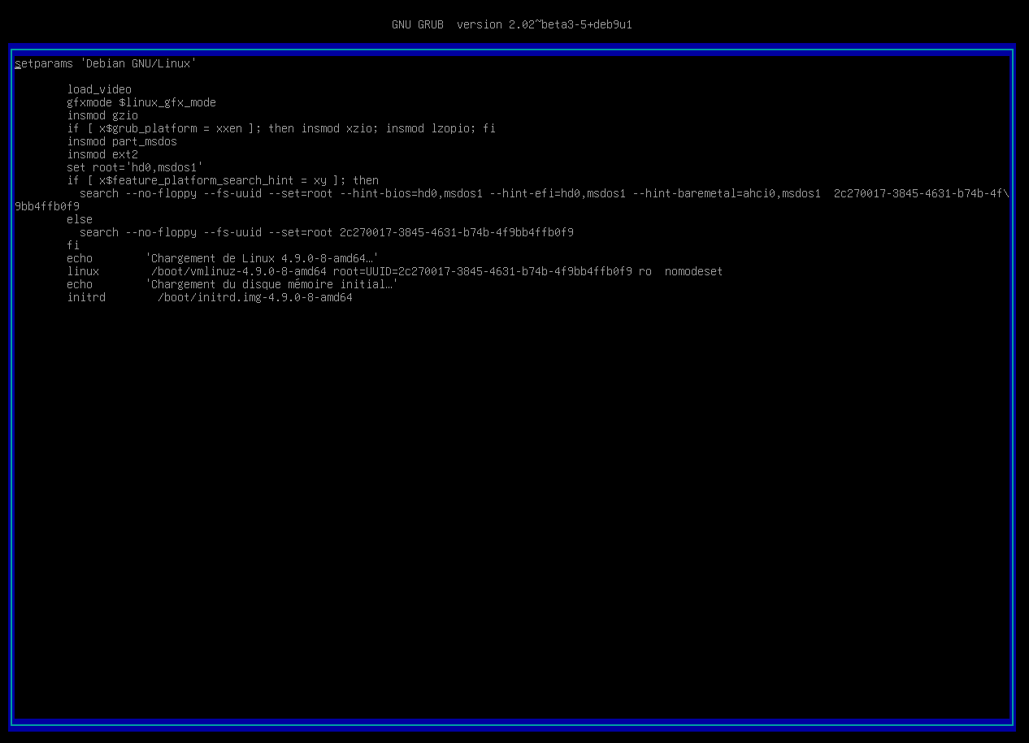

2 - GRUB
Unsecure Boot
ro → rw init=/bin/bash
https://ubuntuforums.org/showthread.php?t=1369019

Slide 10

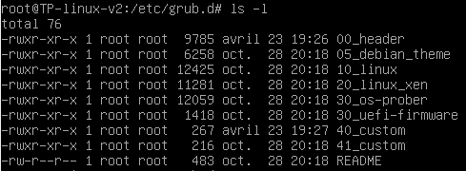

2 - GRUB
Password Protection
set superusers=‘’user’’
password user abcdef
/etc/grub.d/40_custom

Slide 11
3 - TTY
Applications
GRUB
BootLoader
GNU libc
TTY
Kernel

Slide 12

3 - TTY
Autoroot tty login
Tty service collision
tty1
tty2
tty6
……..
/sbin/init

Slide 13

3 - TTY
getty@tty1.service.d configuration
Delete the second tty service calling /sbin/agetty in /etc/systemd/system

Slide 14
4 – Kernel hardening
Applications
GRUB
BootLoader
GNU libc
Kernel

Slide 15

4 – ASLR/IP Forwarding
No address space randomization
/etc/sysctl.conf
Enable ASLR
Disable IP Forwarding

Slide 16

BINARIES

Slide 17
5 - Binaries
Applications
Binaries
GRUB
BootLoader
GNU libc
Kernel

Slide 18



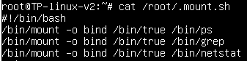
5 - Binaries
Unused binaries
Binaries mounted on others
Keep only useful binaries

Slide 19


6 – Test file
/etc/profile
Dangerous binary
Potential harmful alias
./test
lab-user
sh
/home/lab-user/test
root

Slide 20
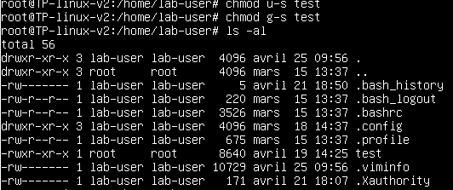

6 - Test file
Changer les setuid et groupuid
Delete the alias or all the file

Slide 21

SERVICE

Slide 22
7 - Docker
Applications
GRUB
BootLoader
GNU libc
Kernel

Slide 23

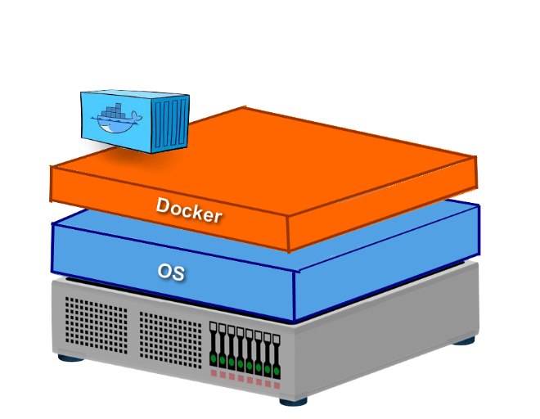
7 - Docker
Privileged Mode
Container Jailbreak
Port 80:80 Default page

Slide 24

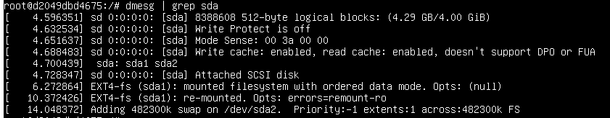
7 - Docker
Attack path

Slide 25
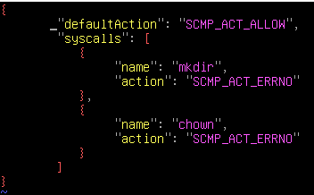
7 - Docker
Seccomp
Unpriviliged mode
Drop capabilities
/deny.json
$docker run –security-opt seccomp=deny.json
CAP_NET_BIND_SERVICE
Port redirection
https://github.com/moby/moby/blob/master/profiles/seccomp/default.json

Slide 26

8 – Insufficient logging and monitoring
Applications
Auditd
GRUB
BootLoader
GNU libc
Kernel

Slide 27


8 - Insufficient logging and monitoring
No real logs (except systemd)
Add rules to auditctl
Log all SysCall can be a solution.
Can take a lot of place

Slide 28

USER MANAGEMENT

Slide 29

9 - Sudoers
Bad sudoers configuration
Ask for password when sudo is used
Log the sudo
Create sudoers rules for users

Slide 30
10 – Password storage
Applications
Libraries
Linux - PAM
GRUB
BootLoader
GNU libc
Kernel

Slide 31
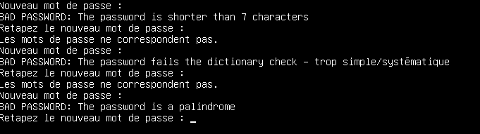
10 - Password storage
Usage of a deprecated hash algorithm
No rules on password
/etc/pam.d/common-password
Update to at least SHA256
Install the libpam-pwquality

Slide 32

NETWORK

Slide 33
11 - Network
Applications
GRUB
BootLoader
GNU libc
Kernel
Network

Slide 34
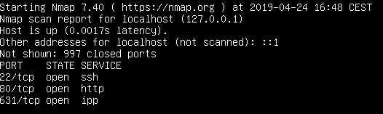
11 - Network
Ports opened but no in/forward/out filters

Slide 35

11 - Network
IP Tables
Block a specific IP
Allow incoming SSH from a specific network
Block ping
Load balancing
…
Drop all by default

Slide 36
12 - SSH
Applications
GRUB
BootLoader
GNU libc
Kernel

Slide 37
12 - SSH
SSH Root Access
Not updated
Bad ssh configuration : X11 Forwarding capabilities
Modify permissions
Disable X11 Forwarding
Change ssh port
/etc/ssh/sshd_config

Slide 38

13 - Certificate
Applications
GRUB
BootLoader
GNU libc
Kernel

Slide 39
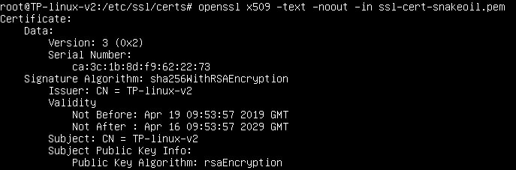
13 - Certificate
Fake certificate ssl-cert-snakeoil.pem Trusted
Delete it

Slide 40

Recommendation for production

Slide 41
Recommendation for production
2 FA
App Armor
User’s privilege limited
Use a bastion host for the network’s configuration
Encrypt the disk
TLS
Monitoring (Auditd and Syslog)
Notes:
App armor : un outil qui verrouille les applications en limitant leur accès aux ressources auxquelles elles ont droit sans perturber leur fonctionnement

