Slide 1
Cybersecurity Presentation 2018/2019
1
Linux Security
Champion Thibaut Aubois Alexandre Alziary Jeremy
Notes:
1

Slide 2




1. Architecture
Applications
GRUB
BootLoader
GNU libc
Kernel

Slide 3
2. Linux Bootloader
Applications
GRUB
BootLoader
GNU libc
Kernel

Slide 4



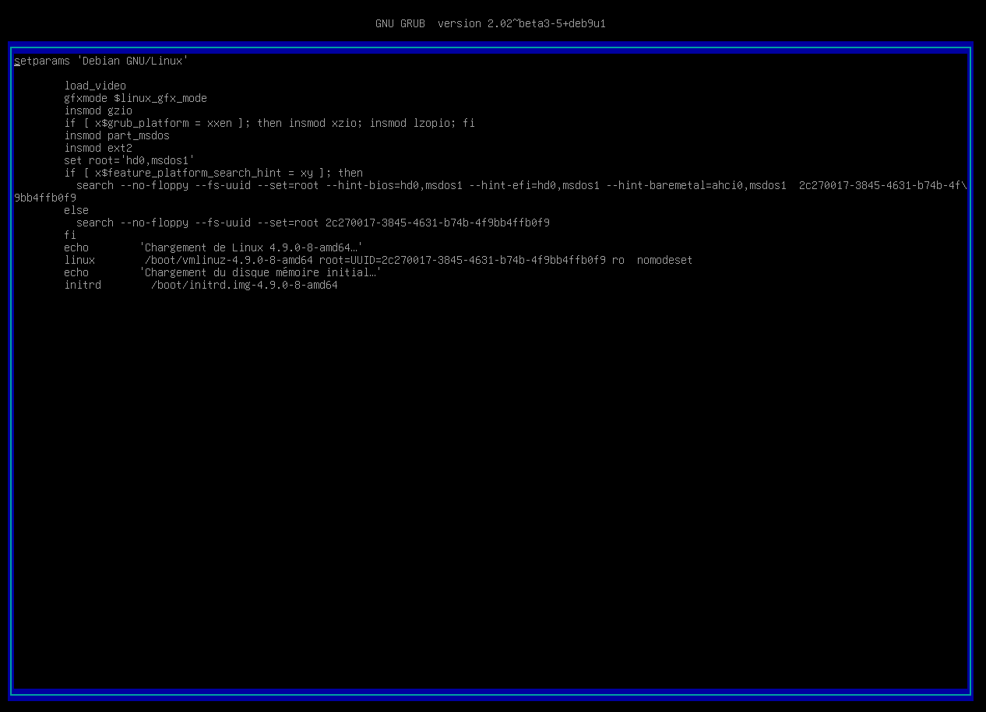

2. GRUB
Unsecure Boot
ro → rw init=/bin/bash
https://ubuntuforums.org/showthread.php?t=1369019

Slide 5

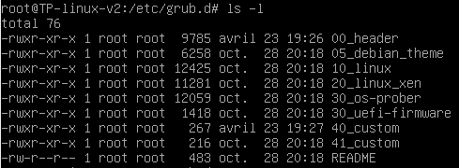

Password Protection
set superusers=‘’user’’
password user abcdef
/etc/grub.d/40_custom
Notes:
00_header est le script qui load les setting du bootloader depuis /etc/default/grub
40_custom permet d’ajouter des lignes sans passer par 00_header qui sera potentiellement modifié par une update du grub
Update-grub pour effectuer nos modifications

Slide 6
3. TTY
Applications
GRUB
BootLoader
tty
GNU libc
Kernel

Slide 7

Autoroot tty login
Tty service collision
tty1
tty2
tty6
……..
/sbin/init
Notes:
TTY's are text-only terminals commonly used as a way to get access to the computer to fix things, without actually logging into a desktop.

Slide 8

getty@tty1.service.d configuration
Delete the second tty service calling /sbin/agetty in /etc/systemd/system

Slide 9
4. SSH
Applications
GRUB
BootLoader
GNU libc
Kernel

Slide 10
5. Docker
Applications
GRUB
BootLoader
GNU libc
Kernel

Slide 11

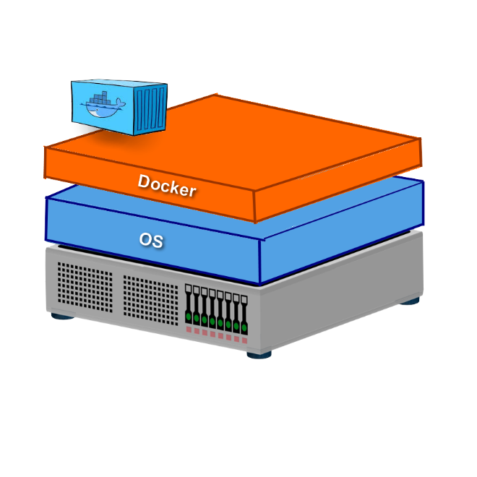
Privileged Mode
Container Jailbreak
Port 80:80 Default page
Notes:
Le privileged Mode signifie que le conteneur hérite de toutes les capabilities du root
On monte la partition /dev/sda1 sur /mnt et on chroot /mnt on jailbreak du conteneur et on remonte dans la machine hôte en root.

Slide 12

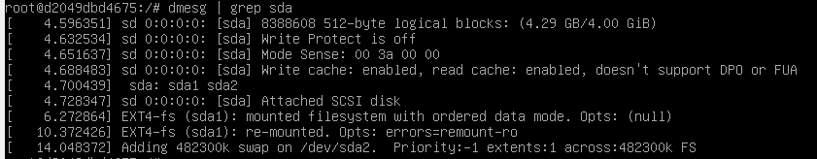
Attack Path

Slide 13
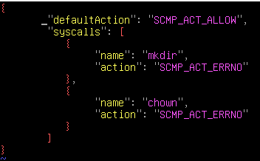
Seccomp
Unprivileged Mode
Drop capabilities
/deny.json
$docker run –security-opt seccomp=deny.json
https://github.com/moby/moby/blob/master/profiles/seccomp/default.json

Slide 14
6. Password storage
Applications
Libraries
Linux - PAM
GRUB
BootLoader
GNU libc
Kernel
Notes:
Linux-PAM (short for Pluggable Authentication Modules) is a powerful suite of shared libraries used to dynamically authenticate a user to applications (or services) in a Linux system.

Slide 15
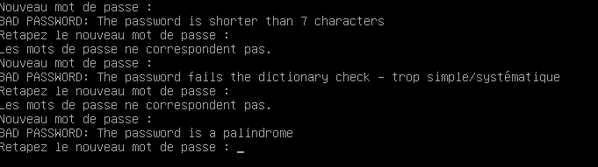
Usage of a deprecated hash algorithm
No rules on password
/etc/pam.d/common-password
Update to at least SHA256
Install the libpam-pwquality

Slide 16
7. Network
Applications
GRUB
BootLoader
GNU libc
Kernel
Network

Slide 17
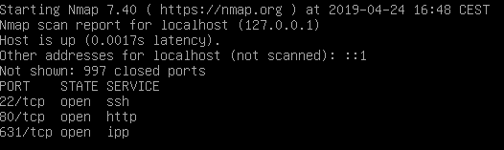
Ports opened but no in/forward/out filters

Slide 18
IP Tables
https://www.thegeekstuff.com/2011/06/iptables-rules-examples/?utm_source=feedburner pas fait la slide

