Slide 1
Cybersecurity Presentation 2018/2019
1
Linux Security
Champion Thibaut Aubois Alexandre Alziary Jeremy
Notes:
1

Slide 2







1. Architecture
Root
Applications
lab-user
GRUB
BootLoader
GNU libc
Kernel

Slide 3
Bootloader
Process / Services running
Docker running a Webserver
Network

Slide 4
2. Linux Bootloader
Applications
GRUB
BootLoader
GNU libc
Kernel

Slide 5



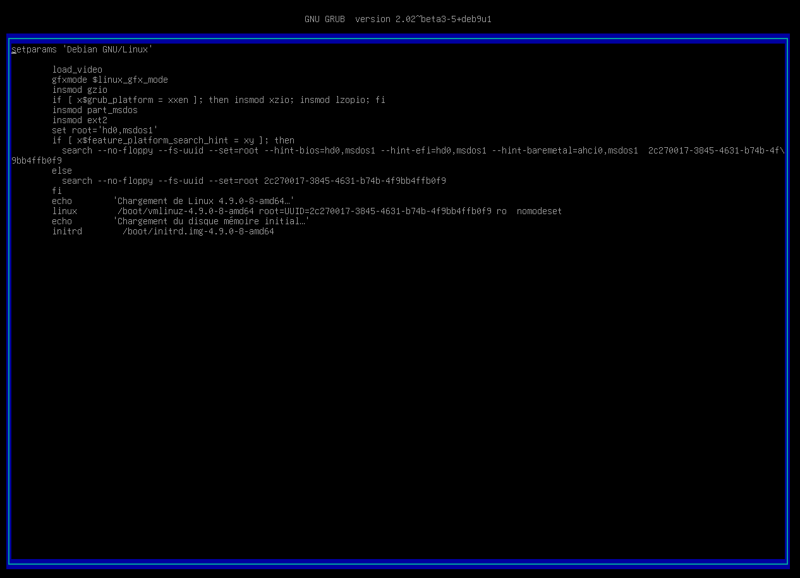

2. GRUB
Unsecure Boot
ro → rw init=/bin/bash
https://ubuntuforums.org/showthread.php?t=1369019

Slide 6

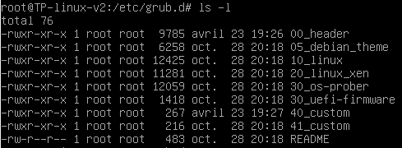

Password Protection
set superusers=‘’user’’
password user abcdef
/etc/grub.d/40_custom
Notes:
00_header est le script qui load les setting du bootloader depuis /etc/default/grub
40_custom permet d’ajouter des lignes sans passer par 00_header qui sera potentiellement modifié par une update du grub
Update-grub pour effectuer nos modifications

Slide 7
3. TTY
Applications
GRUB
BootLoader
tty
GNU libc
Kernel

Slide 8

Autoroot tty login
Tty service collision
tty1
tty2
tty6
……..
/sbin/init
Notes:
TTY's are text-only terminals commonly used as a way to get access to the computer to fix things, without actually logging into a desktop.

Slide 9

getty@tty1.service.d configuration
Delete the second tty service calling /sbin/agetty in /etc/systemd/system

Slide 10
4. SSH
Applications
GRUB
BootLoader
GNU libc
Kernel

Slide 11
SSH Root Access
Modify permissions
/etc/ssh/sshd_config

Slide 12
5. Docker
Applications
GRUB
BootLoader
GNU libc
Kernel

Slide 13

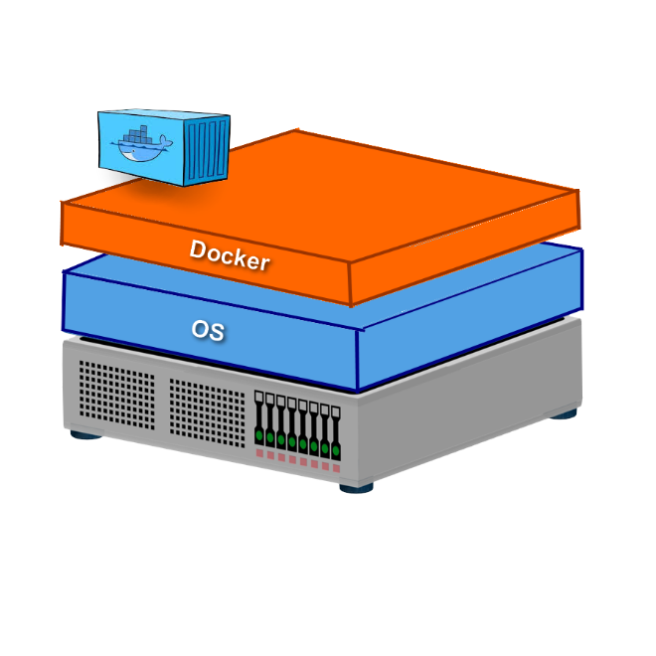
Privileged Mode
Container Jailbreak
Port 80:80 Default page
Notes:
Le privileged Mode signifie que le conteneur hérite de toutes les capabilities du root
On monte la partition /dev/sda1 sur /mnt et on chroot /mnt on jailbreak du conteneur et on remonte dans la machine hôte en root.

Slide 14

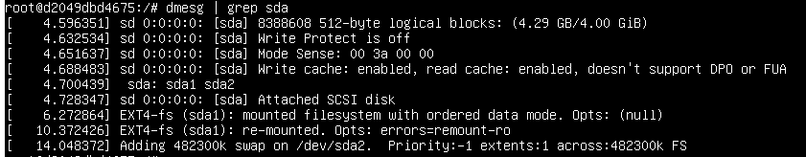
Attack Path

Slide 15
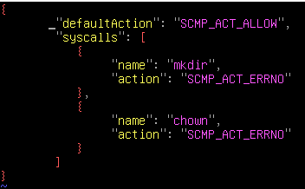
Seccomp
Unprivileged Mode
Drop capabilities
/deny.json
$docker run –security-opt seccomp=deny.json
CAP_NET_BIND_SERVICE
Port redirection
https://github.com/moby/moby/blob/master/profiles/seccomp/default.json
Notes:
CAP_NET : donner la cap de bind sur des ports priviliégiés
On fait des règles iptables pour rediriger les co sur le port 80 sur des ports non privilégiés

Slide 16
6. Password storage
Applications
Libraries
Linux - PAM
GRUB
BootLoader
GNU libc
Kernel
Notes:
Linux-PAM (short for Pluggable Authentication Modules) is a powerful suite of shared libraries used to dynamically authenticate a user to applications (or services) in a Linux system.

Slide 17
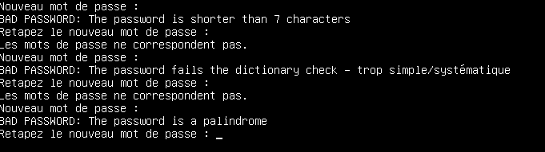
Usage of a deprecated hash algorithm
No rules on password
/etc/pam.d/common-password
Update to at least SHA256
Install the libpam-pwquality

Slide 18
Passwd readable by everyone
Informations easy to get by an intruder
/etc/passwd
Change permissions

Slide 19
7. Network
Applications
GRUB
BootLoader
GNU libc
Kernel
Network

Slide 20
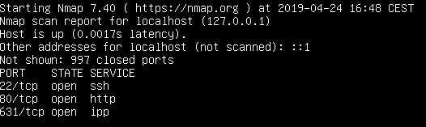
Ports opened but no in/forward/out filters

Slide 21

IP Tables
Block a specific IP
Allow incoming SSH from a specific network
Block ping
Load balancing
…
Drop all by default
Notes:
On drop all et après on fait ses config DNS,loopback,http

Slide 22
8. Binaries
Applications
Binaries
GRUB
BootLoader
GNU libc
Kernel

Slide 23

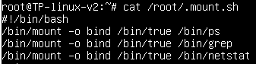
Unused binaries
Binaries mounted on others
Keep only useful binaries
Notes:
Mount.sh,service qui se lance au démarrage qui monte true sur trois binaires. Pas la bonne solution pour empêcher l’utilisation des binaires

Slide 24

9. Sudoers
Bad sudoers configuration
Ask for password when sudo is used
Log the sudo
Create sudoers rules for users
Notes:
Sudoers rule pour lab-user, intéressant de se poser la question de ce qu’il pourrait avoir comme droit

Slide 25

10. Certificate
Applications
GRUB
BootLoader
GNU libc
Kernel

Slide 26
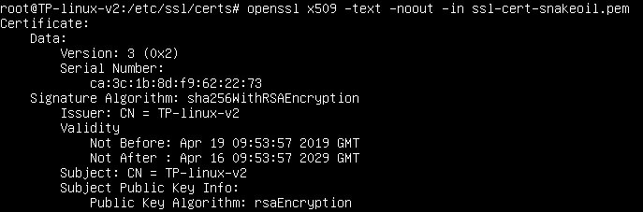
Fake certificate ssl-cert-snakeoil.pem Trusted
Delete it

Slide 27
11. Insufficient logging and monitoring
Applications
Auditd
GRUB
BootLoader
GNU libc
Kernel

Slide 28


No real logs (except systemd)
Add rules to auditctl
Log all SysCall can be a solution.
Can take a lot of place

Slide 29

/etc/profile
Dangerous binary
Potential harmful alias
./test
lab-user
sh
/home/lab-user/test
root
Notes:
Root utilisant le binaire sh executera un binaire potentiellement non maîtrisé et dangereux.

Slide 30

AppArmor: Mandatory Access Control

Slide 31
11. Test file
Applications
Auditd
GRUB
BootLoader
GNU libc
Kernel

Slide 32
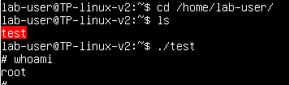
Fichier permettant de passer en root à l’exécution
/home/lab-user

Slide 33
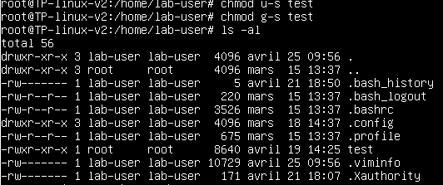

Changer les setuid et groupuid
Notes:
On drop all et après on fait ses config DNS,loopback,http

