Slide 1


Underlying Blocks behind classification scores
A quick guide to machine learning
SAGEX, 30th of July 2019

Slide 2

Overview
Regression
Description
Linear solution
Loss function
Classification
Description
Logistic solution
Loss function
Interpretation
Scores are probabilities ?
Limits of the analogy

Slide 3
Regression: description
Merriam-Webster dictionary: Regression definition:
A trend or shift toward a lower or less perfect state: such as [...]
[d] a functional relationship between two or more correlated variables that is often empirically determined from data and is used especially to predict values of one variable when given values of the others.
Use in machine learning:
A procedure to compute numerically the best parameters of a given set of functions to fit train-data and the resulting method that can be applied on test-data.

Slide 4
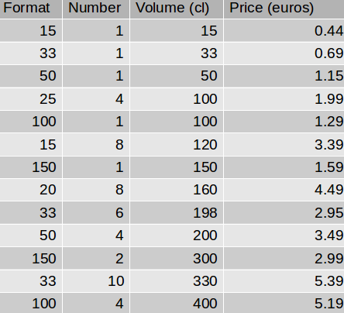
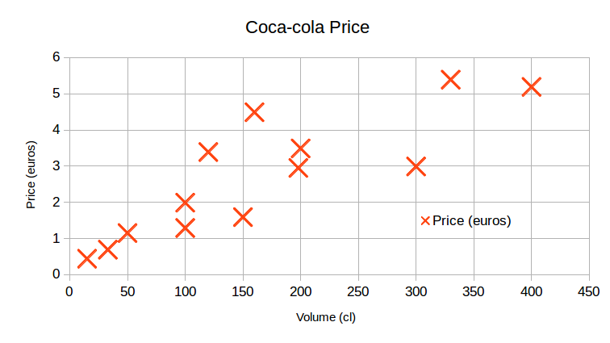
Regression: linear solution
https://www.monoprix.fr/search/coca-cola

Slide 5
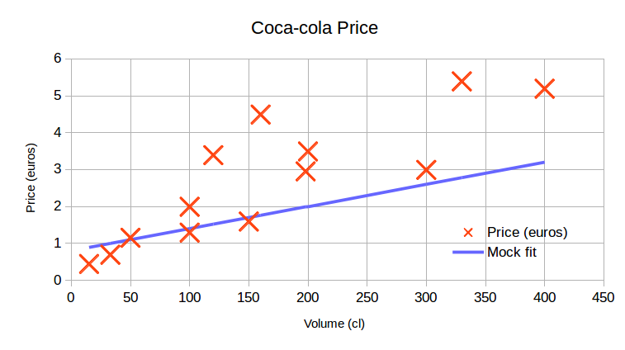
Regression: linear solution

Slide 6
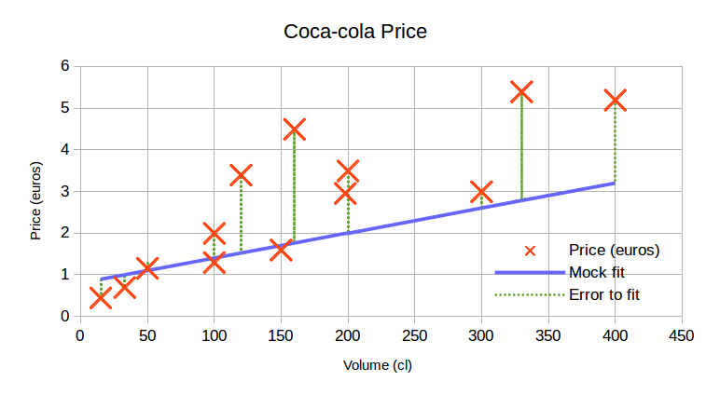
Regression: linear solution

Slide 7
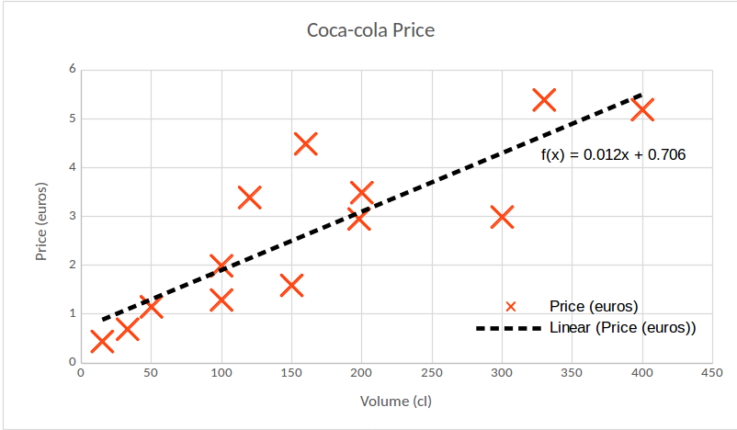
Regression: linear solution

Slide 8
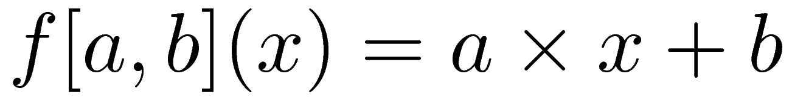
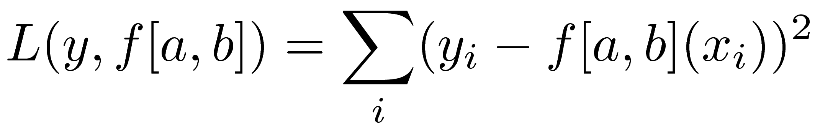
Regression: loss function
Function:
a and b are the parameters to optimize. x is the value of the input and f[a,b](x) is the prediction.
Loss/Cost function :
Mean square error
Interpretation: Minimisation of the quadratic error.
Optimisation method: Gradient Descent
0) start from a given set of parameters
1) find the direction of parameters decreasing the loss
2) update the parameters according to this direction
3) go back to 1) until error is sufficiently small

Slide 9
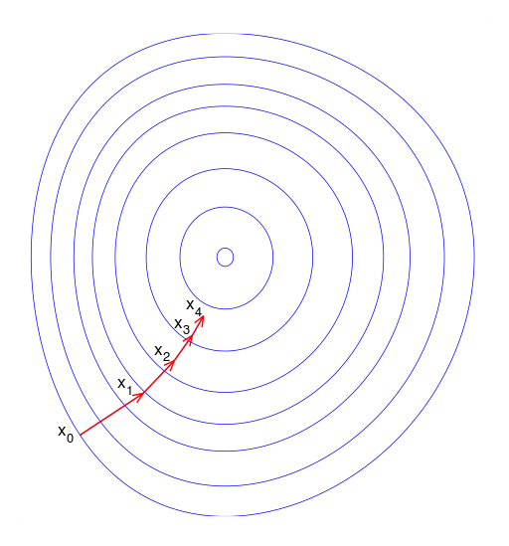
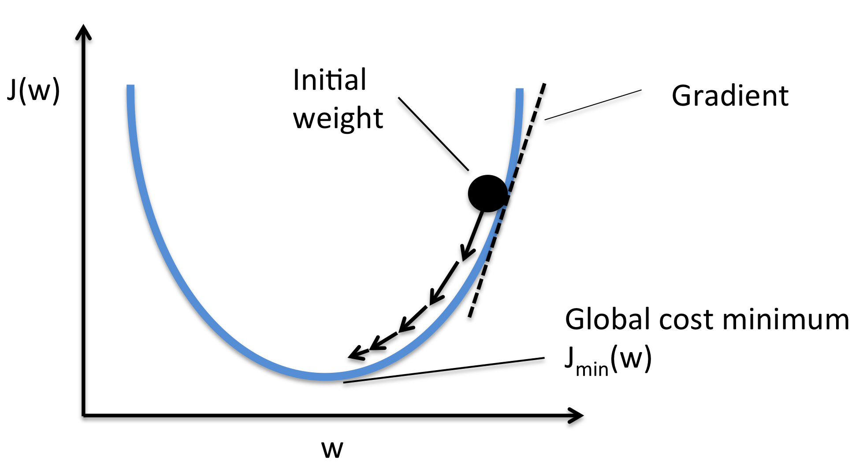
Gradient descent

Slide 10
Classification: description
Merriam-Webster dictionary: Classification definition:
Systematic arrangement in groups or categories according to established criteria.
Use in machine learning:
A procedure to compute numerically the likelihood of a element to belong to a set using the information of train-data.

Slide 11
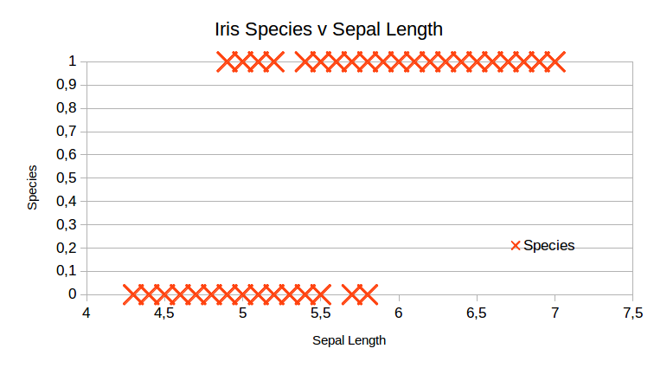
Classification: logistic solution
The logistic function produces continuous values between 0 and 1.
To make a predict, a threshold has to be placed in order to match the 0 or 1 classification.
https://www.kaggle.com/uciml/iris

Slide 12
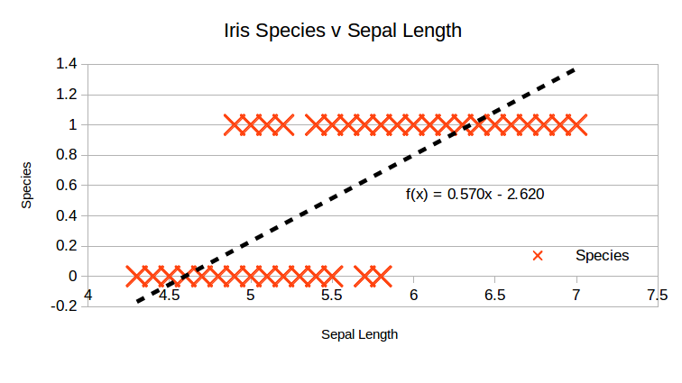
Classification: logistic solution
Linear regressions are not suited for classification problems because the values of the prediction function are not bounded.
The mean square error does not go to zero for high values of the input.

Slide 13
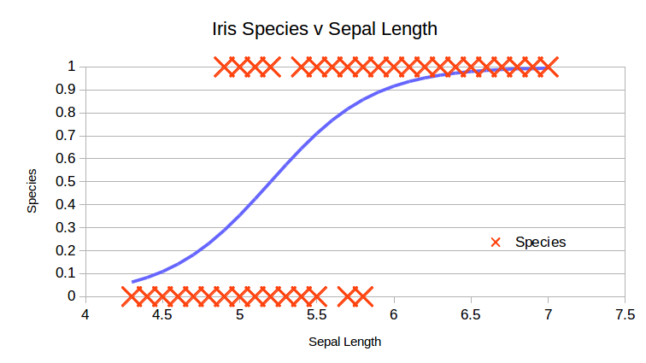
Classification: logistic solution

Slide 14
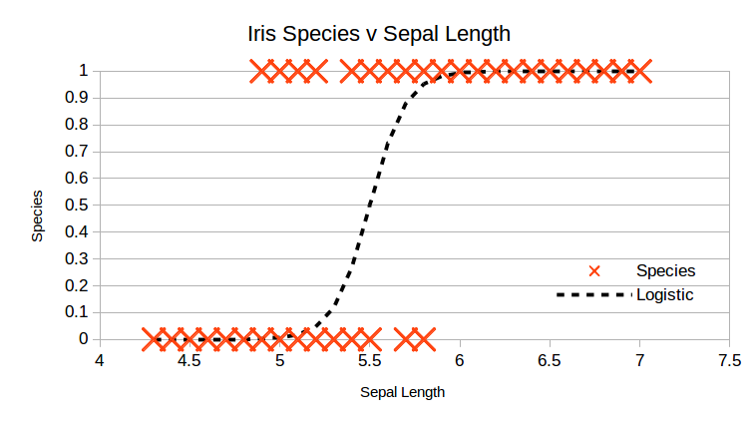
Classification: logistic solution

Slide 15
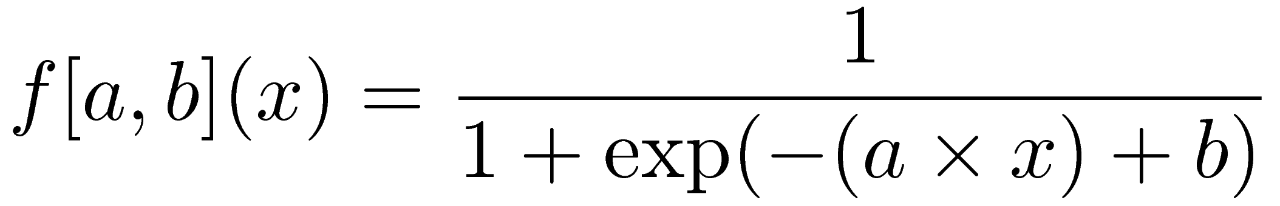
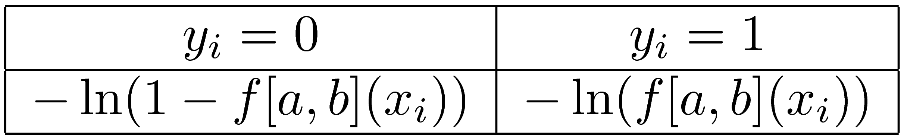
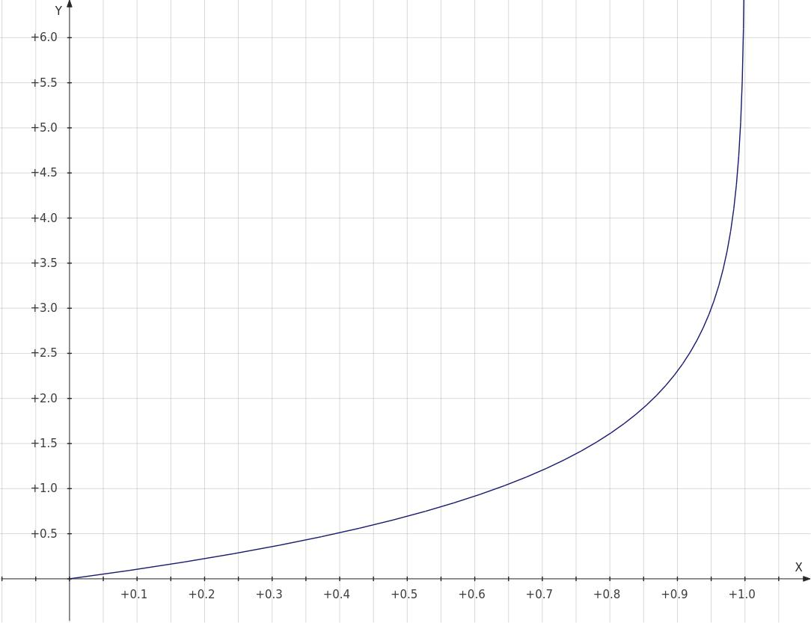
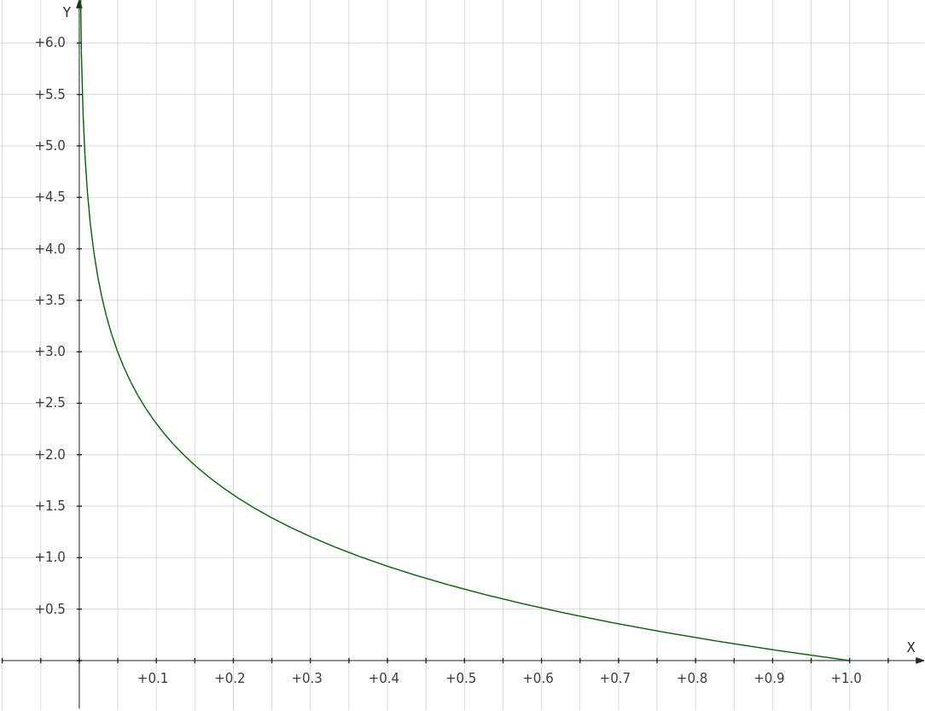
Classification: loss function
Function:
a and b are the parameters to optimize. x is the value of the input and f[a,b](x) is the prediction.
Loss/Cost function :
Binary cross-entropy
Interpretation:
The loss function decreases as
the logistic function gets closer
to the data.
Optimisation method: Gradient Descent (identical as the regression)

Slide 16
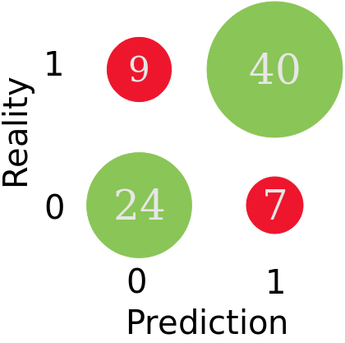
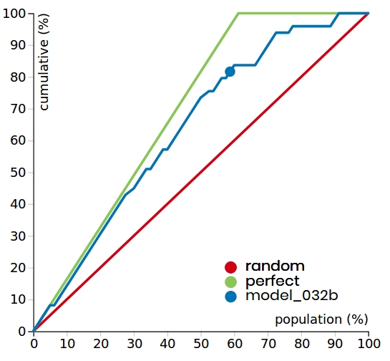
Classification: success metric
Confusion matrix
Cumulative Gain Chart (Lift curve)
We use the Area Under the Curve (AUC) as a measurement of the performance of the classification:
AUC = 1 : perfect model , AUC=0.5 : random model

Slide 17
Scores are probabilities ?
The score is the result of the function of the model after the optimization of its parameters with respect to the loss using the train data.
The score outputted by a neural networks as properties similar to probabilities:
Score in [0,1 ]
Score of not A = 1 – Score of A
The "likelihood" of a positive outcome increases with the score

Slide 18
Limits of the analogy
However, scores cannot totally be considered as a probability because:
loss function should be adapted to the problem (done in Brain)
predictions require to choose a threshold matching business rules
scores of two different models cannot be compared (no Bayes' theorem).
Score ≠ Probability

Slide 19
THANK YOU
Alexandre CAMERON
alexandre.cameron@dreamquark.com
Jérémie ABITEBOUL
jeremie.abiteboul@dreamquark.com

