Slide 1
Accountability to Whom and For What?

Slide 2
Feel Good Words/Concepts
Certain words and concepts are unique and belong to a class of words or concepts that we will refer to as “Feel Good Words/Concepts”
They are feel good words because no one ever runs against them, no one ever opposes them and every body loves them.
Other feel good words/concepts include:
  Democracy, Fairness; Justice; Peace.
Accountability is one such feel good concept.
Click View then Header and Footer to change this footer

Slide 3
Accountability, Accountability, Accountability Everywhere
Accountability is a cornerstone of public governance and management because:
It’s the processes whereby those who hold and exercise public authority are held to account.
Accountability is also a fundamental concept in the Canadian government and a central concern in the public management arena.
That is why a great deal of rhetoric of elected officials is focused on increasing accountability:
Due to the Sponsorship Scandal, the Harper government introduced the Federal Accountability Act (FAA)
That is also why a great deal of public managers' attention has been focused on working within the accountability relationships attendant to public sector jobs.
Click View then Header and Footer to change this footer

Slide 4
So, What is Accountability?
According to Aucoin and Heintzman (2000), accountability regimes encompass processes whereby:
citizens hold their governors to account for their behaviour and performance directly through elections;
the representatives of citizens in legislative assemblies hold political executives and public servants accountable through mechanisms of public scrutiny and audit;
political executives hold their subordinate officials accountable through hierarchical structures of authority and responsibility; and,
among other things, courts and various administrative tribunals and commissions hold legislatures, executives or administrative officers accountable to the law
Accountability is based on a power relation, from a lower to a superior authority.
Click View then Header and Footer to change this footer

Slide 5
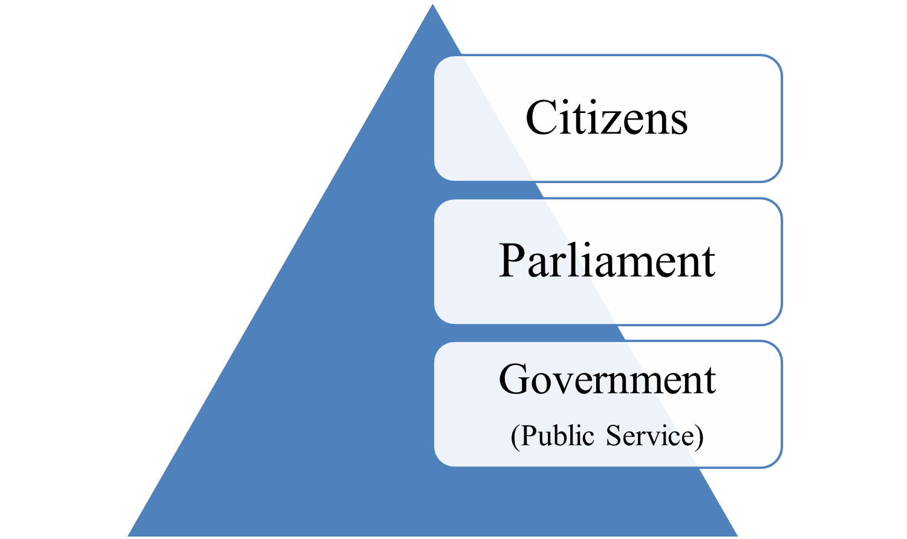
Theoretical Conceptualization of Accountability
Click View then Header and Footer to change this footer

Slide 6
Types of Accountability Relationships
According to Romzek and Ingraham (2000), four main types of accountability relationships can be established in public administration.
These are:
Hierarchical Accountability;
Professional Accountability;
Political Accountability; and
Legal Accountability.
We will conduct a detailed examination of these different types of accountability in the following sections
Click View then Header and Footer to change this footer

Slide 7
Hierarchical Accountability
Hierarchical accountability relationships are based on close supervision of individuals who have low work autonomy.
Rules, regulations, organizational directives, and supervisors are examples of this type;
The command system of the military is a classic example of hierarchical accountability; and,
Organizational codes of conduct are another example of this type of accountability.
Because of its strict adherence to rules, regulations, controls and supervisory authority, this type of accountability that is often referred to as Red-Tape.
Thus, some one’s red tape is another person’s accountability and due process.
Click View then Header and Footer to change this footer

Slide 8
Legal Accountability
Legal accountability relationships involve detailed external oversight of performance for compliance.
It is based on established mandates under which managers are obliged to work, such as legislative and constitutional structures.
Court reviews of police procedures, fiscal audits, and legislative oversight hearings are common examples
The Auditor General’s annual audit reports to Parliament are a classical example of this type of accountability.
Click View then Header and Footer to change this footer

Slide 9
Professional Accountability
Professional accountability systems are reflected in work arrangements that afford high degrees of autonomy to individuals
These norms can derive from professional socialization, personal conviction, organizational training, or work experience.
Employees have the discretion to choose the appropriate managerial responses and the organization defers to their expertise and experiences.
Employees are evaluated by whether their judgment was consistent with accepted protocols and best practices
Lawyers, Doctors, Nurses all have these types of systems that are peer reviewed and monitored
Click View then Header and Footer to change this footer

Slide 10
Political Accountability
Political accountability relationships afford managers the choice of being responsive to the concerns of key external stakeholders
elected officials, clientele groups, the general public, and so on.
Managers who work under this type of accountability are expected to anticipate the wishes of key stakeholders.
They have the discretion to decide whether and how to respond to key stakeholder concerns.
Emphasis on customer service orientations and responsiveness to client needs reflect this type of accountability relationship.
Click View then Header and Footer to change this footer

Slide 11
Why Accountability?
According to Aucoin and Heintzman (2000) the purposes that accountability are meant to serve are essentially threefold, although they overlap in several ways.
These are:
to control for the abuse and misuse of public authority;
to provide assurance in respect to the use of public resources and adherence to the law and public service values;
to encourage and promote learning in pursuit of continuous improvement in governance and public management.
Click View then Header and Footer to change this footer

Slide 12
Accountability as Control
The control function of accountability lies at the heart of democratic accountability in all major constitutional models.
It seeks to ensure that the authoritative and coercive powers of the state are not abused or misused.
In all systems, an array of accountability processes and mechanisms serve to control the exercise of power.
There are those who argue that NPM models of ‘let the managers manage’ might not be able to accommodate control as accountability.
Click View then Header and Footer to change this footer

Slide 13
Accountability as Assurance
Citizens, legislatures and governments need to be assured that public authority and state resources are used in ways that adhere to the law, public policy and service values.
This constitutes a major dimension of accountability precisely because:
it is not assumed that citizens can govern directly in respect to most matters;
legislatures cannot govern simply by legislating; and,
political executives cannot themselves govern without reliance on a bureaucrats.
In the language of traditional political theory, a good deal of ‘indirect government’ is inevitable in the modern state.
Thus, an effective system of accountability is necessary to provide assurance to principals that their agents are fulfilling their responsibilities as intended.
Otherwise there is an ‘accountability deficit’.
Click View then Header and Footer to change this footer

Slide 14
Accountability As Continuous Improvement
It’s a process whereby assessments of performance become demands or stimuli that promote improvements in policy, organization or management.
There is nothing automatic about this because:
assessments may be challenged;
what is learned may be ignored; and,
the political pressures on the system may not be sufficient to bring about improvements.
It is now fashionable to depict this third purpose of accountability as the most important, in large part because:
control and assurance are excessively preoccupied with the negative or inhibiting functions of ‘blaming’.
Thus, accountability as continuous improvement is explicitly or implicitly set against accountability as control and as assurance, as a reform to accountability itself.
Click View then Header and Footer to change this footer

Slide 15
Accountability and the NPM
Accountability as Continuous learning is accorded prominence among NPM advocates. Only to the extent that public managers are permitted, even encouraged, to take risks or to be entrepreneurial
The NPM de-emphasizes traditional accountability for inputs, while focusing on accountability for results, outputs, and 3Es.
Too great a focus on control or assurance can serve to undermine and diminish the capacity to improve both governance and public management.
But there is political capital to be gained in accountability as assurance and control:
Opposition political party’s, The media seek it; and Civil society rally against it.
Click View then Header and Footer to change this footer

Slide 16
The Principle of Ministerial Responsibility
The theory of Ministerial Responsibility states that the Minster is ultimately responsible for all the actions and inactions in his department and must personally answer for them.
If the mistake is big enough, and can be personally directly linked to the Minister, he/she must resign the position as the ultimate sign of responsibility.
In Canada, no Minister has ever had to resign because of a mistake made by a subordinate in his office.
Normally, when a subordinate makes a mistake, the minister appears in Parliament, answers to the mistake and outline measures to prevent future occurrences.
Click View then Header and Footer to change this footer

Slide 17
The Bev Oda Affair
Beverley "Bev" Oda, PC, MP was a member of the House of Commons and was later Minister for International Cooperation (CIDA)
On July 3, 2012, Oda announced she was resigning her seat in the House of Commons following public controversy about her spending habits;
She was dropped from Cabinet the following day in a reshuffle
Her Crimes:
In 2006, Oda incurred nearly $5,500 in limousine rides at the 2006 Juno Awards in Halifax;
In 2008, she was accused of hiding over $17,000 of limousine expenses billed to taxpayers;
In 2011, she admitted to directing one of her staff to add a handwritten annotation to an already signed CIDA memo in 2009 that resulted in a funding recommendation for KAIROS being ignored.
The costs incurred were at public expense.

Slide 18
The Doctrine of Answerability
In the Canadian system, this doctrine is a watered-down version of the doctrine of individual ministerial responsibility
In some cases, Deputy Ministers, Heads of Regulatory Agencies and Crown Corporations have had to appear before parliamentary committees to answer for their actions.
Most of these sessions are held in camera and the purpose is geared more towards accountability as continuous learning and improvement.
This is to avoid blaming them, since theoretically, their ministers are accountable while they do not have a public face, role and opinion.
Click View then Header and Footer to change this footer

