Slide 1
Public Management?

Slide 2
Objectives of the Class
The objective of this class is to:
Provide an operational definition of Public Management
Examine the relationship between public Administration and Democratic Governance
Explore some of the basic assumptions about bureaucratic organizations
Compare and contrast Public and Private Management
Click View then Header and Footer to change this footer

Slide 3
What is Public Management?
Public Management (PM) has been described as an Art, a Science, and a Profession (Lynn, 1996).
As an Art, PM epitomizes the creativity of pubic managers in carrying out their roles;
As a Science, PM denotes the methodological nature and orderliness employed by public managers in performing their duties; and finally,
As a Profession, PM symbolizes the faces, codes of conduct, vales, rules, and people associated with PM
PM has also been defined as a Structure, a Craft, and an Institution (Lynn, 2007).
As a Structure, PM is constitutional mandated to execute the legitimate orders of government;
As a Craft, PM is viewed as skilled practices by practitioners; and finally,
As an Institution, it has rules and practices that guide it
Click View then Header and Footer to change this footer

Slide 4
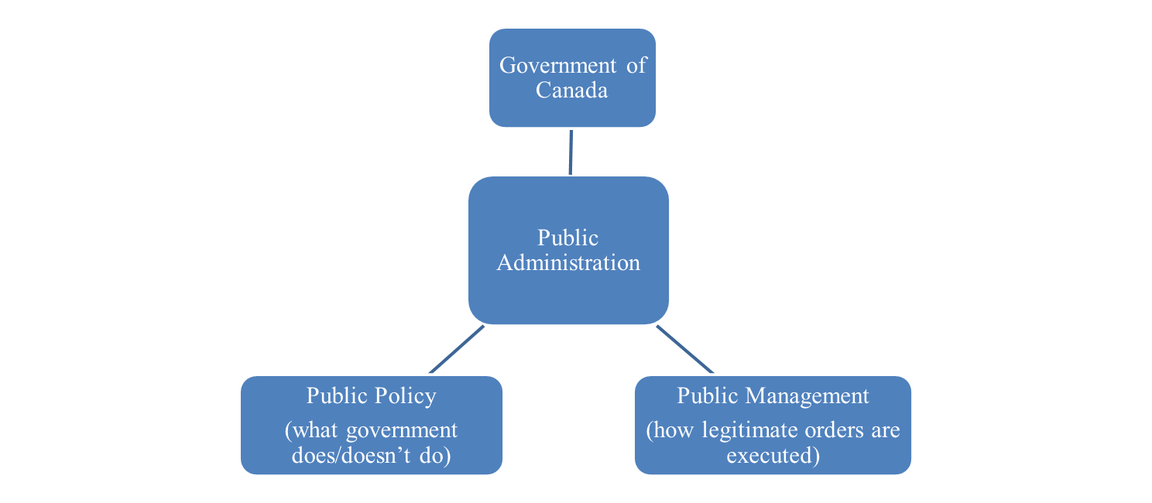
What then is Modern Public Management?
For the purposes of this class, Public Management can be described as:
A set of administrative practices and institutional arrangements constitutional mandated to execute the legitimate orders of government.
Click View then Header and Footer to change this footer

Slide 5
The Politics-Administration Dichotomy
The nature of the relationship and role of political leaders and administrators in the administrative and political process has been the subject of considerable debate (Musavi, 2011)
This is often referred to as the ‘politics/administration dichotomy’
Woodrow Wilson (1856-1924) is credited with the concept of the Politics-Administration Dichotomy
“The field of administration is a field of business…. Administration lies outside the proper sphere of politics. Administrative questions are not political questions.” (Wilson, 1887)
Goodnow (1900) also argued that the function of politics was to express the state’s will and the function of administration was to execute the state’s will
PM tends to focus on how to execute the state’s will.
Click View then Header and Footer to change this footer

Slide 6
How Governments Do What They Do
Politics is often defined as ‘who gets what, when and how’ (Lasswel 1936)
The government’s answer to this political questions, occurs within a structure known generically as a Bureaucracy
Bureaucracy is therefore made up of a Structure and Personnel with norms, formal/informal rules, traditions, values and principles of government.
Bureaucracy uses Policy Instruments to implement the express wishes of policymakers, no mater how vague, unclear and contradictory they might be.
Click View then Header and Footer to change this footer

Slide 7
Key Elements of Bureaucracy
Personnel:
bureaucracy is staffed by unelected public servants who wield a lot of power and discretion
Formal Rules:
Red Tape, formal rules, regulations and processes aimed at ensuring that citizens are treated fairly, equitably and in an accountable manner
Policy Instruments:
Tools to enforce and implement policies and programs like laws, regulations, Crown Corporations etc
Click View then Header and Footer to change this footer

Slide 8
Cont:
Conventions of Behaviour:
internal (in)formal rules, hierarchies of power, divisions of labour, norms etc
Institutions:
complex government Ministries, Departments, Crown Corporations, Central Agencies etc
Values/Ethics:
Equity/fairness, accountability/transparency, public interest, social justice, professionalism, merit
Click View then Header and Footer to change this footer

Slide 9
Management is Management. Or Is It?
Similar to the politics-administration dichotomy, the public-private conundrum goes back a long way in the study and practice of public administration
In modern times, the lines between the public and private sectors are getting closer and blurred
Public administrators have copied, imported and transferred theories, ideas and best practices from the private sector into the public sector
Through privatization, contracting-out, and public private partnerships, the two sectors have become even closer
Finally, professionals from both the public and private sectors interact at personal and professional levels, attend conferences together, share ideas
Click View then Header and Footer to change this footer

Slide 10
Difference Mandates and Goals
Private sector is committed to the ‘bottom line’ while the public sector is geared towards the provision of public goods and services
Tenure of office is shorter in the public sector compared to the private sector due to the frequent electoral cycles.
Goal ambiguity and targets measurement is another difference in both sectors
Anti-smoking policies and financial aid to tobacco farmers
How do you measure peace, security?
The provision of public goods and the free rider effect
Click View then Header and Footer to change this footer

Slide 11
Results and Performance in both Sectors
Barbara Carroll has identified five problems associated with determining and measuring results in the public and private sectors (2000)
Publicness –If the right result is difficult to decide on in the private sector, it becomes infinitely more difficult in the public sector because of the nature of public goods
Indivisibility – is about those things which cannot be divided, the things you cannot have just a little of – defence, for example, or transportation systems such as rail lines.
Exclusion (or non-exclusion) – is the impossibility of excluding people from consuming the service or good.
Private schools can choose not to teach less bright or disruptive students; public schools do not have that luxury.
Spillovers – are the negative externalities that can have an impact which is not felt for many years. For example, immigration,
Click View then Header and Footer to change this footer

Slide 12
Professionalism in Public Management
PM relies on a professional public services that is well trained, motivated, and committed to the tenants of the profession
At confederation in 1867, appointment to and promotion within the public service was based on Patronage
It is “the practice of rewarding loyal supporters, friends, and relatives with government positions”
The Civil Service Act of 1918 was aimed at fundamentally changing and replacing this system with a Merit Based alternative
The Act also created the Civil Service Commission which is today the Pubic Service Commission
Further reforms emphasising competence, training, education and affirmative action on gender, language, race and disability were introduced progressively.
Click View then Header and Footer to change this footer

Slide 13
Behaving and Acting Ethically
One of the main differences between the public and private sectors are the core values and ethics that undergird the public service
Because of the immense discretional power and resources at their disposal, public servants are held to a very high standard of ethical behaviour
But what is ethical behaviour?
“ethics involve the study, implementation and enforcement of activities designed t promote ‘proper’ behaviour and to punish ‘improper’ behaviour.
Through laws, regulation, peer pressure, and socialization, various checks and balances have been establish to promote and ensure ethical behaviour in the public sector
Most of these laws and codes of conduct are instituted in response to a scandal in the public service.
Click View then Header and Footer to change this footer

Slide 14
The Conflict Between Efficiency and Democratic Governance
From the above, an inherent conflict exist between:
Public sector norms and values vis-à-vis the need for 3Es, and
What the proper role of the state is and which values the state should project
As a result, questions about the proper role and size of the state have occupied the minds of politicians, philosophers, theologians and scholars for ages
Three key historical and ideological developments are important in explaining these critical questions about the role and size of the state. These are:
The Minimalist State
Keynesian Welfare State
The Neo-conservative State
Click View then Header and Footer to change this footer

Slide 15
The Minimalist State in Canada
At confederation in 1867, the Canadian state was a Minimalist State
“the prevailing ideology was a laissez-faire attitude that suggested the role of the state be limited to national defense and the provision of infrastructure”
A minimalist state is therefore a reduced and withdrawn state that sees little or no room and place for the government in the provision of public services.
In a minimalist state, there is little or no room for the government to provide critical welfare and social services like healthcare, Medicare, unemployment benefits
Click View then Header and Footer to change this footer

Slide 16
Shrinking the State
The minimalist state is s shrunk state, that is small enough to be irrelevant except on issues of national security, defense, peace and diplomacy
There is little or no incentive for the state to engage in the provision of welfare and social services in a minimalist state.
These are to be reserved for the family, church or the market to provide and deliver.
The Minimalist state believes in the supremacy of the market place and the laws of demand and supply
Even the role of the state in education, especially public education is limited and reduced in the Minimalist State.
Click View then Header and Footer to change this footer

Slide 17
Keynesian Welfare State
Contrary to the Minimalist state, Keynesianism is an activist, interventionist, and involved state.
It emerged after the horrors of the Great Depression when the Minimalist State was seen as inadequate and incapable of addressing the numerous problems that emerged
As thousands of Canadians were without work and any sustainable means of support and survival, the appeal of laissez-faire capitalism proved counter productive.
Support from families, religious organizations during this time also proved unsustainable
Slowly, gradually and reluctantly, the government was compelled to engage in and get involved in sectors of the economy that it previously regarded as private responsibility
Thus emerged the Keynessian Welfare State
Click View then Header and Footer to change this footer

Slide 18
The Gospel According to John Maynard Keynes
The theoretical underpinning of the Keynesian Welfare State is based on the ideas of the British economist John Maynard Keynes
He argued that “in bad economic times the government could prime the pump of economic growth by investing and spending”.
Under these circumstances were the market, family, and religious organizations are incapacitated, spending on public infrastructure and welfare services is justified.
The Stimulus Act in the USA, and
Canada’s Economic Action Plan
Keynesianism therefore advocates a more involved and engaged public sector to provide critical social safety nets for citizens
Click View then Header and Footer to change this footer

Slide 19
Is Canada A Keynesian Welfare State?
While the period from 1867-1930 was definitely a Minimalist State, it can be argued that in the period from the 1930s to mid 1980s, Canada was a Keynesian Welfare State
For instance, in the 1940s, a very comprehensive social safety net was created in the Canada including:
Universal healthcare
Unemployment insurance
Pensions and Medicare
Due to the long reign of the Liberal Party in Canada, whose ideology aligns with Keynesianism, the public sector expanded with more programs and services
As a result, a large, sophisticated, and well trained public service also emerged, first at the federal and later at the provincial levels to manage and provide these services
Click View then Header and Footer to change this footer

Slide 20
The Neo-Conservative State
The public service has become increasingly uncertain about its role in this fast changing, globalised and ICT dominated environment.
The rules of the game have changed and public servants have tried as best they can to reconcile this new world and its requirements with old processes and traditional values.
They also have had to try to define a new working relationship with their political masters.
Margaret Thatcher (Thatcherism) in the UK and Donald Reagan (Reaganomics) in the US were opponents of Keynesianism.
‘Government is the problem, not the solution’
Click View then Header and Footer to change this footer

Slide 21
‘They Are Neither Servants Nor Civil’
“Government is not the solution, government is the problem”
Red tape, rules, regulations and controls. It is risk-aversed
It carries a pejorative connotation as inept, corrupt, bloated and inefficient
“I do not rule Russia: Ten thousand clerks do” (Tsar Nicholas)
“They are neither servants nor civil” (Winston Churchill)
Click View then Header and Footer to change this footer

Slide 22
Let The Bureaucratic Bashing Begin
Soon, politicians in many countries and from all sides of the political spectrum, began to point the finger at bureaucracy.
Once respected as a dedicated cadre of professionals, public servants now came to be viewed as a problem
Public servants have been subjected to an unprecedented assault by politicians on their capacity to produce policy advice and deliver government programs
Bureaucracy bashing became de rigueur for those on the political right seeking political office.
Confidence and morale in the public service plummeted and by most accounts, it has yet to recover

Slide 23
The Ideological Assault on the Welfare State
“Growing deficits…informed the ideological framework within which the expanded interventionist role of the state was questioned”
A concerted attack on the state by businesses, right-wing ideologues and think tanks, successfully conveyed the image of Canada on the verge of economic collapse
From the 1970s, Canadian governments began pushing for fiscal responsibility and cut backs in government spending
A period of public sector retrenchment, privatization, contracting-out, and deregulation all ensued.
The role of religious and charitable organizations and family re-emerged to fill the vacuum created by the withdrawn state.
Click View then Header and Footer to change this footer

