Slide 1
Introduction to the New Public Management (NPM)

Slide 2
What is the New Public Management (NPM)?
The rise of the New Public Management (NPM) can be described as one of the most striking and influential trends and changes in public administration
Despite this, there is no universal acceptable definition as to what constitutes the NPM, but what is acceptable is that is it a loose term.
“Its usefulness lies in its convenience as a shorthand name for the set of broader similar administrative doctrines which dominated the bureaucratic reform agenda in many OECD countries from the late 1970s” (Hood, 1991)
Click View then Header and Footer to change this footer

Slide 3
What is the New Public Management (NPM)?
NPM espouses strong feelings and reactions among its advocates and opponents:
At one extreme end of the political-right are advocates who argue that the NPM was the antidote to the dysfunction and bureaucratic pathologies of the welfare state.
At the other end are mostly left-wing opponents who stress that the NPM is a slippery road to dismantling a century’s work of building a distinctive public service culture and ethic.
Click View then Header and Footer to change this footer

Slide 4
Why the NPM and Why Now?
The rise of the NPM can be linked to what Hood (1991) refers to as four Administrative Megatrends. These are:
Attempts to slow down or reverse government growth in terms of overt public spending and staffing.
In order words, the NPM emerged to ‘shrink the size of the state’
The shift towards privatization and quasi-privatization and away from core government institutions.
The NPM attempts to reduce the role and impact of bureaucrats in the policymaking and implementation process
The rise and prominence of ICTs and globalization.
The NPM seeks to maximise the benefits that these two forces have in store for public administration
The emergence of what can be described as the ‘Internationalization of Public Administration’
policy learning, best practices and international conventions have increased the appeal of NPM.
Click View then Header and Footer to change this footer

Slide 5
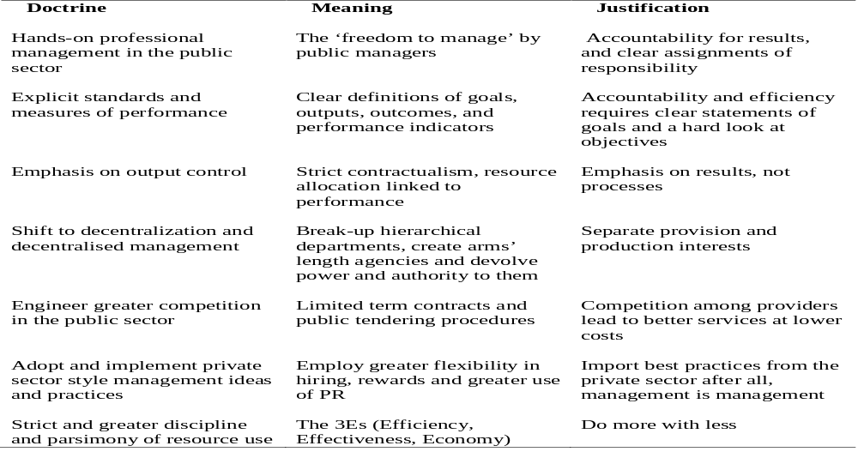
Doctrinal Components of the NPM
Adapted from Hood (1991)

Slide 6
Reinventing Government (Osborne and Gaebler, 1993)
Reinvention | Meaning
Catalytic Government | Steering, rather than rowing
Community-owned Government | Empowering, rather than serving
Competitive Government | Injecting competition into service delivery
Mission-Driven Government | Transforming Rule-Driven Organization
Results-Oriented Government | Funding Outcomes, Not Inputs
Customer-Driven Government | Meeting the needs of the customer, not the bureaucracy
Enterprising Government | Earning rather than spending
Anticipatory Government | Prevention rather than cure
Decentralised Government | From hierarchy to participatory teamwork
Market-Oriented Government | Leveraging Change through the market

Slide 7
Core Features of the NPM
Steering, rather than rowing
Empowering, rather than serving
Competitive service deliveries
Transforming Rule-Driven Organization
Funding Outcomes, Not Inputs
Meeting the needs of the customer
Earning rather than spending

Slide 8
Generic Managerialism
Closely related to the NPM is the concept of Generic Managerialism:
“It represents an attempt to distil the principles of management that have evolved in the private sector and transplant these principles into a public sector context”
“There is a body of sound management practices applicable to the private sector that is generic in its scope and thus directly transferable to the public sector” (Dixon et al 1998, p.168).
An empirical, quantitative, technical and scientific approach as opposed to a normative, qualitative and dogmatic approach.

Slide 9
Government and Market Failure Theories
Government Failure: “The phenomenon of government failure can be defined as the inability of a public agency of public agencies at any level of government to secure desired economic, social or other policy objectives” (p. 48):
Privatization; Contracting-Out, etc
Market Failure: “If private markets yielded economically inefficient outcomes or socially inequitable outcomes, then government intervention was justified to remedy the situation” (p48)
Nationalization; Crown Corporations etc

Slide 10
Has Canada Adopted the NPM?
The NPM has become an established public administration model and all major developed countries have adopted and implemented various aspects of it.
In New Zealand, Australia, the UK and USA, the NPM has been fully or partially adopted and implemented.
New Zealand and Australia are considered the most radical adopted of the NPM.
Our objective is to examine whether Canada, just like most of the OECD countries, has adopted and implemented the NPM.
If so, we seek to find out what impact the NPM has had on Public Administration in Canada over the past two decades.
Click View then Header and Footer to change this footer

Slide 11
Thematic Focus
To answer the above question, we will focus on the following areas:
Changes to the Canadian Machinery of Government;
Decentralization of Public Service Delivery;
Separation of Policy and Service Delivery Functions;
Changes to Managerial Methods and Procedures; and,
Financial Reforms, Program and Budgets Cuts;
Click View then Header and Footer to change this footer

Slide 12
Changes to the Canadian Machinery of Government: NPM Style
In theory, NPM changes in structures of government involve:
departmental restructuring and creation of service delivery agencies;
decentralization of authority and separation of policy and service delivery functions (Loefer 1997).
In Canada, a major federal restructuring in 1993 by the conservative Campbell and Mulroney governments amalgamated departments and reduced the size of the Cabinet.
The provinces of New Brunswick, Alberta, Saskatchewan, Manitoba and Ontario also reorganized structures and downsized cabinets.
The Common Sense Revolution in Ontario under the Harris Government saw a lot of NPM reforms
The Government of Canada has also introduced a number of service agencies – special operating agencies (SOAs) and alternative service delivery (ASD) agencies
Service Canada
Click View then Header and Footer to change this footer

Slide 13
Decentralization of Public Service Delivery
Besides arm’s-length delivery through service agencies, decentralization includes devolution of responsibilities to other levels of government.
The federal government devolved responsibilities to provinces through the Canada Labour Market Development Agreements (LMDAs).
Under LMDAs the federal government retained responsibility for employment insurance while devolving responsibility and funding for training and employment programmes to the provinces.
Provinces in turn devolved responsibilities to municipalities/regional bodies.
Saskatchewan and Alberta created regional health authorities, responsible for all aspects of health in their regions, including allocation of funding.
Ontario realigned local responsibilities, making municipalities responsible for welfare funding
Click View then Header and Footer to change this footer

Slide 14
Separation of Policy and Service Delivery Functions
The separation of policy and service delivery functions of government is a major demand and policy expectation of the NPM.
In Canada, the government has gone through two phases in its attempt to separate the policy and service delivery functions.
Under Conservative governments, most policy units in the government were reduced in size, and policy direction came directly from Cabinet and ministers’ offices
Under the Liberals, policy units have received higher profiles, though not necessarily more resources.
But, it is the creation of SOAs/ASDs that has truly separated the policy and service delivery functions.
SOAs/ASDs allowed policy to remain as part of the public service while agencies gained more independence, responsibility and accountability for service.
Click View then Header and Footer to change this footer

Slide 15
Changes to Managerial Methods and Procedures: NPM Style
The adoption of the NPM will automatically lead to changes both in organizational managerial structures, composition and even processes.
In Canada, these NPM management changes involved three levels.
Private sector management approaches were introduced in Canada, using concepts such as downsizing, re-engineering, corporate culture, and value for money.
Production and service standards were adopted by some government agencies.
The federal government also introduced a series of quality initiatives from 1988 to1995.
More recently it introduced citizen centred service delivery.
User pay including queue-jumping/faster service based on additional fees was a focus in the federal government following Programme Review in 1995.
Passport Canada
Click View then Header and Footer to change this footer

Slide 16
Market-type Mechanisms Were Also Used
Performance contracting and contracting-out of service provision were major strategies since the 1980s.
Incentives and performance measurement efforts were used in managing people in central agencies and departments (Management Accountability Framework)
Departments focused on human resource management and performance management while performance-related pay was introduced for all senior personnel
The federal government introduced internal markets, where departments sold services to each other.
User fees were increased for services such as parks and vehicle licences.
Several agencies were put on full cost recovery, such as printing shops and the employee assistance programme.
Click View then Header and Footer to change this footer

Slide 17
Shrinking the State:
A reduction in the role and size of the state is a core component of the NPM’s attempt to improve and control public finance and debt.
Advocates of the NPM recommend privatization of Crown Corporations, budgetary and programme cut-backs, withdrawal from programmes and tax reductions.
Cuts to the public service and deregulation also reduce the impact of the public sector.
The Government has privatized a number of government services including:
Airports, air navigation, telephone companies, and ports; and,
Crown Corporations including Petro Canada, Canadian National Railways and Air Canada.
Alberta and Manitoba also sold their telephone companies; Alberta sold its liquor stores while Ontario and New Brunswick created private toll highways
Cities like Toronto, Ottawa, Edmonton and Winnipeg contracted-out garbage collection;
Click View then Header and Footer to change this footer

Slide 18
Financial Reforms, Program and Budgets Cuts
Financial reform is a major objective of the NPM because of its ability to reduce the size of the state while transferring critical government services to the private sector.
During the mid-1990s governments responded to new financial demands and cut back programme spending and transfers to other governments and individuals.
The federal government conducted Programme Review 1 and 2 from 1993 to 1998, reducing overall spending by 10% (TBS 1997a).
Taxes were cut for corporations and high-income earners during the late 1980s
Canadian governments have also reduced the size of public services.
management category by 26% between 1991–7, the entire public service by 20,000 between 1992–4, and another 31,500 between 1995–7
Click View then Header and Footer to change this footer

Slide 19
Deregulation
Governments exited from regulation and cut back regulatory capacity.
Canada withdrew substantially from regulation of the environment and energy, finance, airline, trucking, telecommunications and food industries.
Sometimes Canada adopted lower internationally agreed standards – for example, European Union drug approvals
At other times it introduced more co-operative and less expensive strategies, such as the
Hazard Analysis Critical Control Point Fish Quality Programme
The Harper Government has withdrawn from the Kyoto-Protocol.
Click View then Header and Footer to change this footer

Slide 20
Cut-Backs and Downsizing
The operating and capital budget of government in 2000–01 was $32.605 billion, $4 billion less than in 1993–4 (TBS, 2000).
Canada’s downsizing of its public sector has matched that of the most vigorous proponents of NPM.
The federal government’s 21 per cent cut in personnel compares to the UK and US.
Cut-backs have eliminated universality of all programmes except primary and secondary education and health care
The adequacy of programmes such as unemployment insurance and subsidies to universities, welfare, health care and farmers is a challenge.
Click View then Header and Footer to change this footer

Slide 21
So, Has Canada Adopted The NPM?
NPM as identified by the OECD and Hood (1991) has been widely adopted in Canada.
But there was variation in application and timing:
Alberta, Ontario, Manitoba and the federal government took up NPM most fully.
Similarly, results in government restructuring, management and downsizing are comparable to those of the primary exponents of NPM – Britain and New Zealand.
Negative consequences have been lower value from the public sector and programmes under-resourced; while,
Positive improvements in service have been achieved.
A more disillusioned public and public service have been the costs of an acrimonious debate about NPM.
It can be argued that Canada has managed to retain some but not all of its welfare-state programmes – but they are under pressure
Finally, it can be said that Canada has adapted, not just adopted the NPM.
Click View then Header and Footer to change this footer

