Slide 1
Introduction to Public Policy

Slide 2
Class Objectives
Understand the importance, nature, and limits of public policies, their success criteria and factors
Identify the numerous stakeholders, processes, and methods that lead to the formulation of better public policies
Learn, know and master the instruments, tools and methodological approaches use for designing evidence based policy making
Improve our ability to evaluate public policy performance and to master the latest and numerous assessment and evaluation methods used

Slide 3
What is Public Policy?
A public policy is a complex phenomenon consisting of numerous decisions made by numerous individuals and organizations in government (Howlett and Ramesh, 2003)
In this class, a “Public Policy is anything a government chooses to do or not to do” (Dye, 1972)
When we talk about public policies therefore, we fundamentally mean the actions and in-actions of government. Public Policies therefore involve a choice to be made by government.
Public policy could therefore be a ‘negative or a non-decision’. This happens when a government decides to do nothing but maintain the status-quo (Howlett and Ramesh, 2003)
Thus, we have two main types of Policies:
Positive Policies: When the government DOES SOMETHING
Negative Policies: When the government DOES NOTHING
Click View then Header and Footer to change this footer

Slide 4
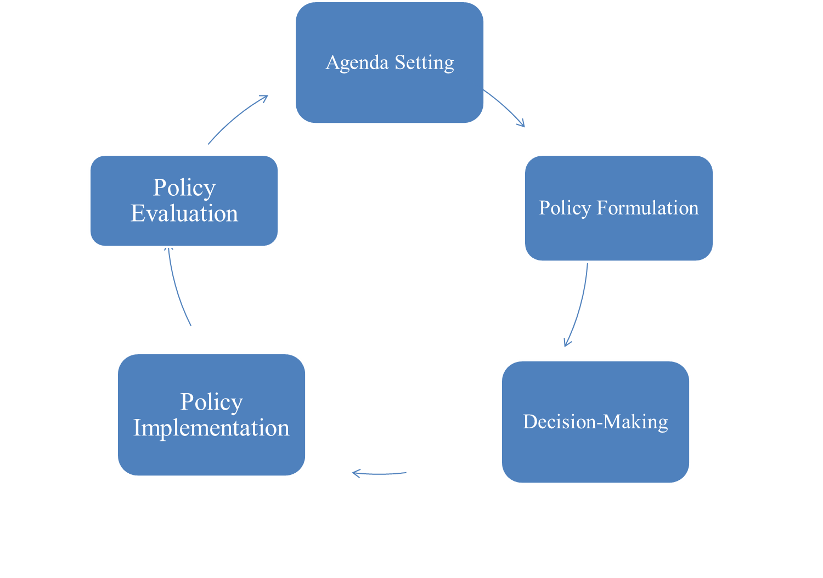
Introduction to the Policy Cycle
Public Policies

Slide 5
Merits of the Policy Cycle
It breaks down the complexity of the process into a number of stages and sub-stages so
that each can be investigated separately or in relation to the others (Wu et al., 2010)
It allows for numerous and complex cases to be analysed in a comparative manner and
at each stage of the cycle.
we can know in a logical manner at which stage a particular policy is, and then determine its success at that stage
It can be used at the local (agency), national (government), and international (UN)level
for policy analysis.
it can also be used to determine what each jurisdiction is doing at any particular time.
Since different stages can be studied separately, it can be used to determine where more
resources/training is needed
Public Policies

Slide 6
Demerits of the Policy Cycle
It can be misunderstood to mean that policymakers use a very systematic, linear and logical system all the time
In reality, the policy process is non-linear, sometimes impromptu and difficult to map out
It is a one-size-fits-all approach? Magical bullets are few and non-existent in public policy making
There are no indications as to who and what drives the policy from one stage to the other and why.
For instance, what forces and drivers move a policy from adoption to implementation and why?
As an analytical tool, it is very good, but not as an actual and practical tool.
In short, there are usually no linear progression of the public policy process as implied by the ideal model.
Public Policies

Slide 7
Introduction To Agenda-Setting?
In order to better understand Agenda-Setting, we need answers to the following questions.
Why do some issues end up getting government attention while other do not?
Why do governments feel the need to respond or act to some issues while ignoring others?
How come when some people, institutions, and actors speak, the government listens while it ignores others with similar concerns?
At its most basics, therefore, agenda-setting is about the recognition of a problem, issue, concern, and demand by the government (Howlett and Ramesh, 2003)
Problem recognition is a socially constructed process.

Slide 8
Policy Windows and Agenda-Setting
John Kingdon (1984) developed the concept of Policy Windows to explain agenda-setting processes in the US government.
A policy window is an opportunity provided by circumstances and characteristics of political institutions that can lead to the opening/closing of windows of opportunity for agenda entrance.
Four main types of policy windows can be identified in the literature:
Routinized Political windows: here, the normal institutionalised procedures dictate predictable window openings. E.g the budget statement might indicate changes to policy
Discretionary Political Windows: here, the behaviour of individual political actors leads to less predictable window opening. Statements by the president, head of state, finance minister, foreign minister.
Spillover Problem Windows: related issues are drawn into an already open window.
Random Problem Windows: random events and crisis open unpredictable windows.
Public Policies

Slide 9
Challenges in Agenda-Setting
Public managers must have the expertise and capacity to anticipate, identify and act
upon the specific circumstance as and when the opportunity presents itself
This is necessary because opened policy windows are scarce and short lived
Wu et al., (2010) have identified five challenges public managers face in the agenda
setting stage.
These are:
The increasing use of crisis-driven agendas;
Prevention is better than cure, but most often, politicians wait until its too late;
Agenda setting is mostly a lip service opportunity by politicians to promise every and anything to an expectant electorate.
Over crowding of the policy agenda is a pervasive problem
Agenda setting might be hijacked by the media, special interest groups with little concern for the holistic government priorities.
Public Policies

Slide 10
Actors in Agenda Setting in Canada
Policymakers (PM, Cabinet, Ministers, Parliament, Bureaucrats)
Government Institutions (Central Agencies, Ministries/Departments, Courts)
The media, social networks (twitter, facebook, etc)
Think Tanks (Fraser Institute, Council of Canadians), Civil Society (MADD, Green Space)
Click View then Header and Footer to change this footer

Slide 11
Policy Formulation?
After a government recognises the existence of a public problem and the need to address it, policymakers need to decide on some course of action
Deciding and formulating a course of action is the second most important stage in the policymaking process
At its basics, therefore, policy formulation involves assessing the various options available for addressing a public problem
It involves assessing available options, narrowing them down and selecting the optimal one.
It is therefore a cycle that involves defining, considering, and accepting or rejecting options in the policy formulating process.

Slide 12
The Policy Formulation Process
Jones (1984) has identified six (6) broad characteristics of the policy formulation process:
It needs not be limited to one set of factors and actors and it may proceed even without a clear definition of the policy problem
Formulation is usually done in a particular government institution and that institution might become synonymous with the policy
It may occur without any support from inside or outside government for any proposal put forth
There are turf-wars involved in the formulation process
Several appeal points exists for those that loose out of the initial formulation process
The process is not neutral. There are always winners and losers.

Slide 13
Players in Policy Formulation/Adoption
In any given political system, the role of actors is determined by and depends upon the nature of the political system and the specific nature of the policy problem
Broader generalizations of actors include:
Senior elected (cabinet) and Appointed (bureaucrats) officials
Legislatures and specific legislative committees through legislative overview and review
Key government Ministries, Departments or Agencies with jurisdiction over the policy
Central Agencies whose regulatory and supervisory roles extend to all government ministries, departments and agencies (Finance Department)
International Financial Institutions (IMF/WB/WTO/OECD)
Consultants, think tanks, NGOs

Slide 14
Policy Implementation
“After a problem has made its way to the policy agenda, various options proposed to solve it, and a government makes a choice among various options, what remains is putting the decision into action” (Howlett and Ramesh, 2003, p.185)
At its basics therefore, policy implementation involves putting into action the intentions and decisions of government
Breathing life into vague, unclear, and conflicting intentions and beliefs
It involves the allocation of normative and empirical inputs:
Normative inputs: political support, coordination/collaboration between and among actors
Empirical inputs: funding, personnel, time,
Policy Implementation is inherently a political process

Slide 15
Actors/Activities in Policy Implementation
Bureaucracy is the most important actor in the policy implementation process.
Implementation is often expensive and long and requires continued funding and which is neither permanent nor guaranteed
Manage expectations and budget for the unexpected
Unions, NGOs, and Civil Society can enhance or constrain policy implementation
What is needed is collaboration and networking among and between all stakeholders
International Financial Institutions like the World Bank/IMF and the entire donor community and funding plays a big role

Slide 16
Operational Capacity Barriers
Fund and resource limitation:
The shortage or unavailability of funds is a classical challenge to policy implementation
Poor Institutional memory and organizational expertise
New challenges demand new ideas and expertise. Some organizations just lack expertise
Lack of clarity in Operational plans:
Mismanagement of approved and funded plans
Poor monitoring and regulation of oversight agencies

Slide 17
Research Essay

Slide 18
Instructions
✓ It is a 5 page review of a case study and due in class on March 18th 2015
✓ It must be double- spaced, and 12 point font.
✓ The deadline for submission is: March 18th 2015 in Class.
✓ You must use at least 10 Academic, peer reviewed sources and publications properly cited.
✓ Notes from Lecture Slides DO NOT constitute peer reviewed academic sources and CAN’T be part of the 10 academic courses.

Slide 19
Questions
Answer Only One Question
1. According to Karl Marx (1818-1883), Public Bureaucracy is an exploitative and oppressive instrument in the hands of the capitalist state to be used for the interests of the bourgeois class. Discuss the merits and demerits of this statement with regards to contemporary public bureaucracy in Canada.
2. Using Concrete Examples from any ONE Municipal Government in Canada, answer this question. Has Canada adopted the New Public Management?

Slide 20
Essay Structure
Introduction (10%)
Background or Definition of the Main Concept(s) (10%)
Analysis (50%)
Conclusion (5%)
Organization and Scholarliness (25%) – overall assessment

Slide 21
Sources and Citation:
The cardinal rule of writing research papers is “cite everything”
You CAN’T cite Lecture Slides and you CAN’T use Lecture Slides as a source for the essay.
You are advised to use only the APA Style of citation. Examples of APA Style citation:
1. In this case, “individuals, unfettered by state interference, would use their ingenuity to the greatest extent… State interventions to relieve poverty would inhibit initiative, and would stifle investment because they would rely on increased taxes” (Rapley 2002: p. 7)
2. According to Inwood (2010), public management is complicated
3. Borins (1995) has argued that the NPM is here to stay.
Students must use not less than 10 academic books and/or academic journal sources.

Slide 22
Cover Page
Question/Topic: Public Management
By
(Name of Student)
Student #: 01234567
A paper presented to Dr. Joshua Jebuntie Zaato, School of Political Studies, in Partial Fulfillment of the Requirements for PAP 2320A.
University of Ottawa
Date: 18th March, 2015

