Slide 1
AI ENGINEERING ASSESSMENT
Invoice Canonicalization
Agent
Deterministic first. AI only for uncertainty.
Human approvals become cheaper future knowledge.
TIER 1
TIER 2
TIER 3
Approved lookup
Retrieval / AI
Human learning
no LLM
bounded
governed
Production-ready concept + tested reference implementation

Slide 2

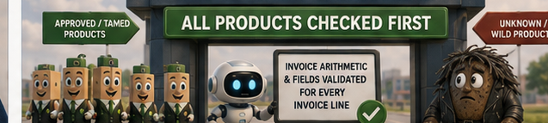
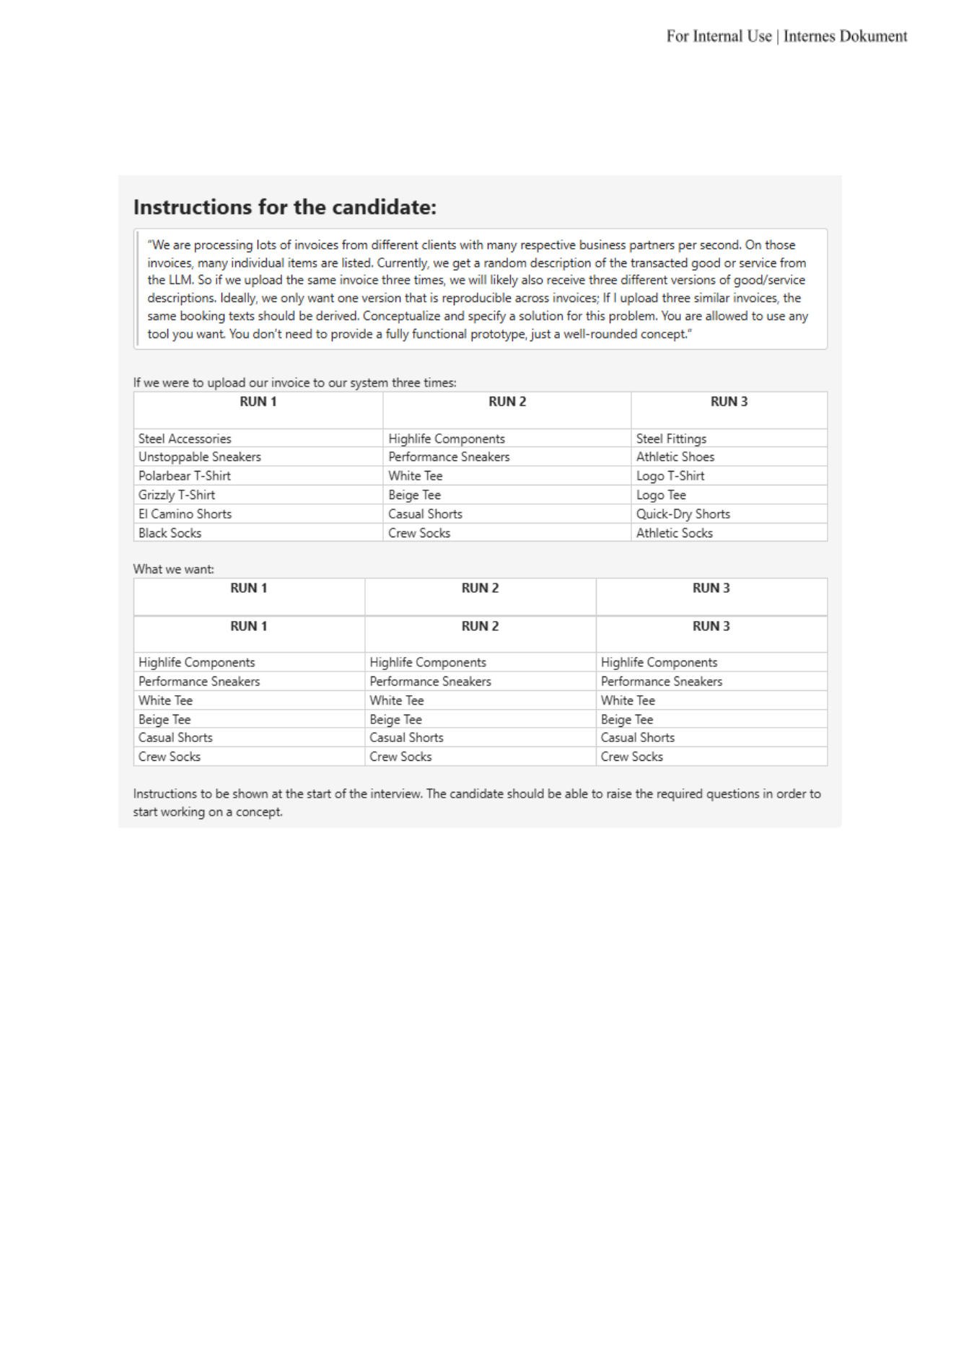
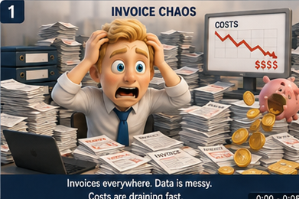
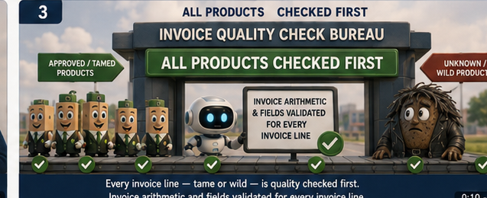
STORY · 1
Every product is checked before canonicalization
Known or wild, the same extraction and arithmetic quality gate runs first.
THE BUSINESS MESS
UNIVERSAL QUALITY GATE
Invoices arrive with noisy descriptions and full financial context.
Every line — tamed or wild — is checked first
quantity × unit price = line total
If extraction is wrong, every downstream match starts from bad evidence.
Σ line totals = subtotal
discount / tax / shipping reconciled separately
Only clean product-line evidence enters canonicalization.

Slide 3





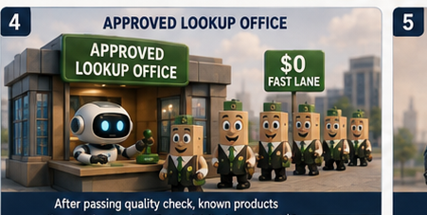
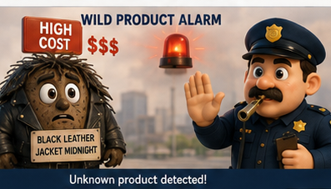
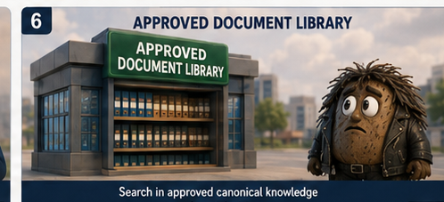
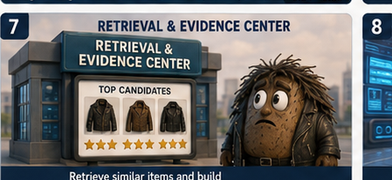
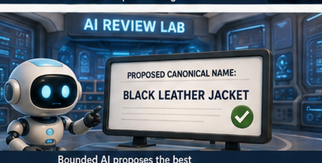
STORY · 2
Known = fast lane. Unknown = uncertainty lab.
After the same quality gate, approved aliases are deterministic; only unknowns see retrieval or AI.
KNOWN / TAMED
UNKNOWN / WILD
TIER 2 · UNCERTAINTY LAB
1
Approved knowledge
2
Retrieve evidence
Approved Lookup
Fast lane blocked
Exact tenant-scoped alias → stable canonical product ID.
Unknown is routed deliberately — not treated as a failed invoice.
3
Bounded AI / abstain
0 LLM CALLS · FAST
UNCERTAINTY ROUTE
Investigate once → promote approved knowledge → next time use Tier 1.

Slide 4


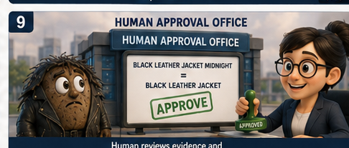



STORY · 3
Approval turns a wild product into reusable knowledge
First cycle: evidence + review. Second cycle: exact alias, no model, no review.
FIRST CYCLE
SECOND CYCLE
→
Next time: exact alias
Human approves the mapping
LEARN
0
0
$0
↓
Black Leather Jacket Midnight
LLM calls
human reviews
model cost
cost curve
↓ Black Leather Jacket
Approval is promoted to the tenant-scoped alias registry.
Model spend follows unique unresolved concepts — not repeated invoice volume.

Slide 5
ARCHITECTURE
Three-tier canonicalization architecture
That story maps directly to three production tiers; delivery primitives stay outside the business logic.
DELIVERY PRIMITIVES
REST
MCP
Docker
CI/CD
PostgreSQL
1
Deterministic lookup
2
Retrieval / AI / abstain
3
Human knowledge loop
cache + approved tenant alias
approved-only evidence
weekly unique-concept review
default
uncertain
learning
stable product ID
dedupe candidate first
approve / edit / redirect
zero model call
strong retrieval can skip LLM
reject stays untrusted
highest trust
bounded proposal or abstain
promote exact alias
approved decisions return to Tier 1
Story -> code: Approved Lookup = approved aliases | Uncertainty Lab = approved retrieval + bounded AI / abstention | Human Approval = review queue -> knowledge promotion.

Slide 6
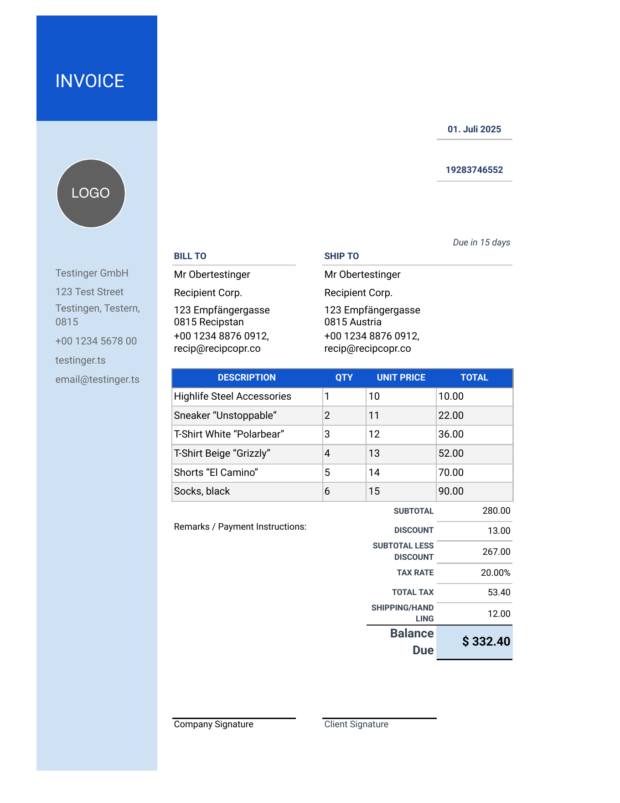
EVIDENCE
Challenge file: integration smoke test, not ML accuracy
The expected mappings are seeded approved aliases - this verifies deterministic replay and extraction integrity.
Deterministic replay
Highlife Steel Accessories
Highlife Components
NO LLM
Sneaker “Unstoppable”
Performance Sneakers
NO LLM
T-Shirt White “Polarbear”
White Tee
NO LLM
T-Shirt Beige “Grizzly”
Beige Tee
NO LLM
Shorts “El Camino”
Casual Shorts
NO LLM
Socks, black
Crew Socks
NO LLM
6 / 6
0
PASS
280=280
seeded aliases
LLM calls
extraction gate
subtotal check
smoke test
canonicalization
6/6 row equations
Decimal
Interpretation: proves integration + deterministic replay. It does not estimate unseen-model accuracy.

Slide 7
RESULTS
Measured reliability: regression gates, not vanity metrics
We distinguish deterministic smoke tests from model-quality claims.
107
26→1
11
100%
0
tests passed
repeated unknowns
routing cases
routing accuracy
unexpected LLM calls
full offline gate
observations → proposal
curated regression
on curated cases
target 0
What the results prove
What we do NOT claim
approved knowledge replays deterministically
6/6 challenge = ML accuracy (it is a seeded smoke test)
routing chooses the intended path in regression cases
11 cases predict production accuracy at scale
repeated unknowns do not trigger repeated model calls
vector RAG outperforms lexical retrieval (not benchmarked)
unsafe input can abstain before generation
live model cost/latency is validated by offline fixtures
package builds and installs in isolation
Engineering gate: 83% branch-aware coverage (threshold >= 80%). Ruff, mypy, and Docker were unavailable locally; strict CI / make assess-full requires them.

Slide 8
CONCLUSION
Why this is stronger than the original brief
The implementation stays faithful to the simple requirement while proving a credible path to production.
ORIGINAL ASSIGNMENT
OUR RESPONSE
same invoice should produce one reproducible description
approved canonical IDs + aliases make replay deterministic
tenant-specific taxonomy prevents client collisions
different clients and business partners
AI is bounded to the unknown tail and deduplicated
conceptualize a solution; prototype optional
human decisions become trusted future exact matches
fix randomness from direct LLM generation
operational guardrails + packaging demonstrate production readiness
THE TAKEAWAY
The goal is not to make the LLM more consistent. It is to need the LLM less often.

Slide 9
APPENDIX
Technical depth
when the interviewer asks
Unknown lifecycle, review workflow, tenant isolation, delivery packaging, testing, retrieval, security, CI/CD, and limitations.
18-stage quality contract
test matrix
security + cost
retrieval / RAG
review data model
limitations

Slide 10
UNKNOWNS
An unseen description uses AI once - then becomes deterministic
The same pending concept is reused before approval; approval converts it into exact knowledge.
01
02
03
04
05
New description
Bounded AI
Repeated 26x
Human approval
Next invoice
Black Leather Jacket Midnight
1 proposal: Black Leather Jacket
0 additional model calls
promote trusted alias
exact alias; 0 model calls
Scalability rule
26 observations
1 proposal
after approval
0 future calls
The model is called once per unique pending concept - not once per invoice row.
This is the declining cost curve in operational form.

Slide 11
HUMAN LOOP
Humans approve knowledge - not invoices
A weekly queue contains unique unresolved concepts with evidence, impact, and flexible actions.
PENDING KNOWLEDGE REVIEW
27 unique concepts
71,482 lines affected
Priority
Observed variants
Proposal
Score
LLM
Occurrences
Status
HIGH
Air Runner Pro Black
AirRunner Pro blk
Performance Sneakers
98.2%
Yes
18,400
approve
HIGH
Black Leather Jacket Midnight
Black Leather Jacket
73.0%
Yes
26
waiting
MED
Athletic crew socks
Crew Socks
97.8%
No
127
waiting
Reviewer actions
Approve existing
Redirect
Create new
Edit + approve
Reject
Defer
Completed decisions leave the active queue but remain archived + audited.

Slide 12
MULTI-CLIENT
Tenant taxonomies prevent cross-client collisions
The raw string is not a global key: alias lookup is scoped by tenant + partner + language.
RAW SUPPLIER TEXT
“Steel Accessories”
TENANT A · testinger
TENANT B · other-tenant
Internal taxonomy
Internal taxonomy
Highlife Components
Maintenance Hardware Kit
exact alias · no LLM
exact alias · no LLM
Uniqueness scope: tenant_id + partner_id + normalized_alias + language
Authentication binds the request to a tenant; PostgreSQL RLS is a second defense-in-depth layer.

Slide 13
SCOPE
Core solution vs. production packaging
This avoids over-engineering the story: the business logic stays small; the rest is delivery discipline.
CORE BUSINESS LOGIC
OPERATIONAL GUARDRAILS
DELIVERY PRIMITIVES
canonical product IDs
extraction arithmetic gate
REST API
tenant-scoped approved aliases
auth + tenant binding
MCP integration boundary
normalization + retrieval policy
budgets / timeouts / retries
Docker / Compose
bounded AI for unknowns
validation + abstention
GitHub CI/CD
human knowledge promotion
audit + monitoring
PostgreSQL migrations
Interview rule: lead with the first column. Use the other two only when asked how you would productionize it.

Slide 14
Internal quality sequence - 18 machine-checked stages
Appendix detail: this is an implementation contract, not the primary business architecture.
01-06
07-10
11-14
15-18
Input + evidence
Deterministic state
Uncertainty handling
Governance
auth + tenant binding
normalize text
approved-only retrieval
staged review queue
file validation
version-safe cache
policy scoring
human action
deterministic parsing
approved exact alias
bounded generation
knowledge promotion
Decimal line gate
atomic pending claim
output/security validation
audit + metrics
model extraction fallback
persist invoice envelope

Slide 15
Testing strategy
Offline determinism for CI; live-provider evaluation remains opt-in.
Layer
What it proves
Property
Unit / contracts
normalization, money, budgets, prompt schemas
fast / deterministic
Integration
repository, canonicalization, review promotion
real application wiring
Document metamorphic
PDF / XLSX / DOCX / JSON / CSV / TXT
same business result across formats
AI fixtures
stored prompt examples + model outputs
no API-spend CI, stable regressions
Adversarial
prompt injection, PII/financial leakage, cross-tenant, malformed output
safe failure / abstention
Concurrency
same unknown arriving simultaneously
one candidate / one proposal
Packaging
wheel build + isolated install smoke
delivery integrity
Current verified gate: 107 tests passed · 83% branch-aware coverage · 11 curated routing cases all correct.

Slide 16
Security, reliability, and cost guardrails
These protect the product logic; they do not decide the canonical product.
SECURITY
RELIABILITY
COST / LATENCY
tenant-bound auth
Decimal financial fields
exact alias before retrieval
PostgreSQL RLS
line arithmetic gate
dedupe before model
party PII kept out of prompts
commercial reconciliation
max calls + dollar budget
prompt-injection guard
schema + attribute validation
timeouts + bounded retries
CSV formula neutralization
immutable audit history
cache by taxonomy version

Slide 17
Retrieval / RAG boundary
Use the simplest retrieval method that meets false-match, latency, and recall targets.
CURRENT ASSESSMENT
SCALE-UP OPTION
approved aliases only
SemanticScoreProvider interface exists
sequence similarity
PostgreSQL schema is pgvector-ready
token overlap
benchmark Recall@K + false match first
character trigrams
measure latency + memory before enabling
category + protected attributes
do not index unapproved model suggestions
margin vs. second candidate
Anti-feedback-loop rule: staging data never becomes retrieval evidence until a human promotes it.

Slide 18
Review data model and state transitions
Local CSV is an editable projection; production persistence is relational.
Candidate record
Human-editable final status
normalized candidate key
waiting
approve existing
source variants + occurrence count
affected value by currency
redirect
create new
retrieval / policy scores
edit + approve
reject
model + prompt provenance
risk flags + evidence
defer
human overrides + notes
Processed rows leave the active work queue but remain in archive + audit history.
Concurrency: one active candidate per tenant + partner + normalized description.

Slide 19
Limitations and next validation
What still needs evidence before a real production rollout.
Area
Current evidence
Next validation
Production accuracy
11 curated cases are regression evidence, not population statistics
Build a blind labelled dataset across clients/categories/languages
Threshold calibration
current thresholds are configuration, not statistically calibrated probabilities
Optimize to a business target such as false auto-resolution < 0.1%
Live provider
offline fixtures prove contracts but not real latency/cost/drift
Run controlled live evaluation with approved model + pricing
Semantic retrieval
pgvector seam exists but is not benchmarked as better
Compare Recall@K / latency / false-match against lexical hybrid
Release environment
Ruff, mypy, Docker skipped in sandbox
Run make assess-full in CI / local Docker environment
Operational UX
CSV proves workflow but is not a polished reviewer product
Replace with dashboard when reviewer volume justifies it

Slide 20
Delivery and demo commands
Everything needed to inspect, test, demonstrate, and package the solution.
./run_assessment.sh
Offline quality gate: tests, coverage, evaluation, package smoke
Assessor-facing artifacts
README.md
make interview-demo
Three-tier lifecycle demonstration + machine-readable evidence
docs/assessor_summary.md
make review-demo
Generate the editable pending-knowledge CSV
docs/invoice_data_model.md
reports/final_delivery_check.md
make review-process
Apply reviewer decisions, archive completed items
docs/verified_results.md
make assess-full
Strict release gate including Ruff, mypy, Docker
docs/production_validation_plan.md
presentation/PPTX + PDF
Version 1.0.0

