Slide 1
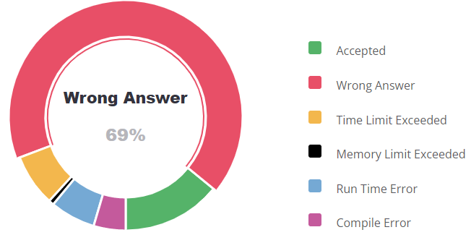
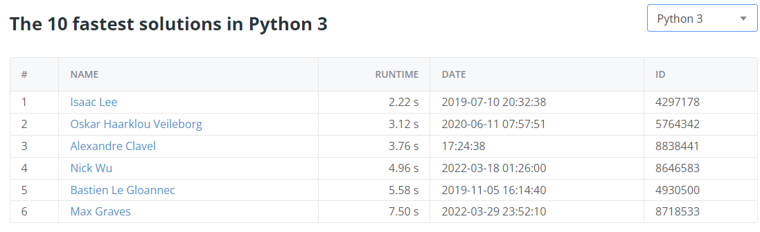

Criss-Cross
Alex Clavel, David Yang, Nathan DuPont

Slide 2

Problem Description
Given a number of lines, find the number of distinct points at which the line segments intersect or touch.

Slide 3
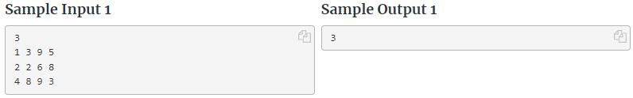
Input
Line 1: a integer n (1 ≤ n ≤ 1000) which is the number of lines.
The following n lines contain four integers , lines are non-zero length. The two points will be distinct meaning

Slide 4
Output
Output the number of distinct points for which there is at least one pair of line segments that intersects or touches at this point. If there are infinitely many such points, output -1.

Slide 5
Edge Cases
We need to find the intersections between lines
There are a few edge cases we need to be aware of:
Coincident
Not Overlapping
Coincident
Endpoint Overlapping
Coincident
Multiple Overlapping

Slide 6
Edge Cases
This problem ensures you are not using inexact calculations (usage of floats and doubles)
Even with a functionally correct solution, using floats and doubles will cause test failures
Python’s Fraction class provides a drop in replacement for floats
Since all of the line end points are whole numbers, we know that each intersection can be expressed as a rational number
Given the equations of two lines with an intersection:
y = ax + b
y = cx + d
ax + b = cx + d
ax + b = cx + d

Slide 7
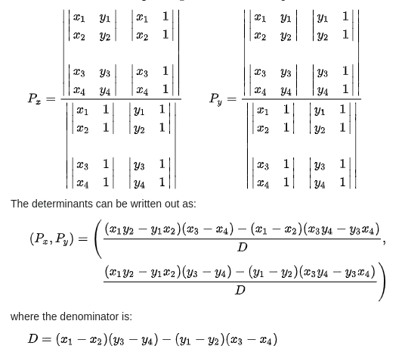
Line intersection Algorithm
We use determinants to find the intersection between lines
If D=0, the lines are either coincident or parallel
Coincident:
Both segments are part of the same line
Can have 0, 1, or ∞ intersections
Parallel
Has 0 intersections

Slide 8
Algorithm
Read in lines
For each pair of lines, check if there is an intersection.
If there is no intersection, they are either parallel, or coincident
Check if the lines are parallel
Check if axis intercepts are the same
If the lines are coincident, check if they overlap
Find the largest distance (d) between 2 points, and the sum of the lengths of the 2 segments (SoS)
If d > SoS: no intersection
If d = SoS: one intersection
If d < SoS: infinite intersections
Add the intersection to a set
Output the size of the set
If there is an infinite amount of intersections, we print -1 and exit

Slide 9
Optimizations
Python’s Fraction class
Handles all basic arithmetic quickly
Hashable (easy set insertion)
Drop in replacement for floating point math
Handling infinite intersections
Once we find infinite intersections, we can stop calculating
Tuple
We do not need to modify the segments once created
Tuples allow for faster read of values

Slide 10
Code Walk-through

