Slide 1

Classification of Mice by their Protein Expressions
by Alexandre Yano

Slide 2
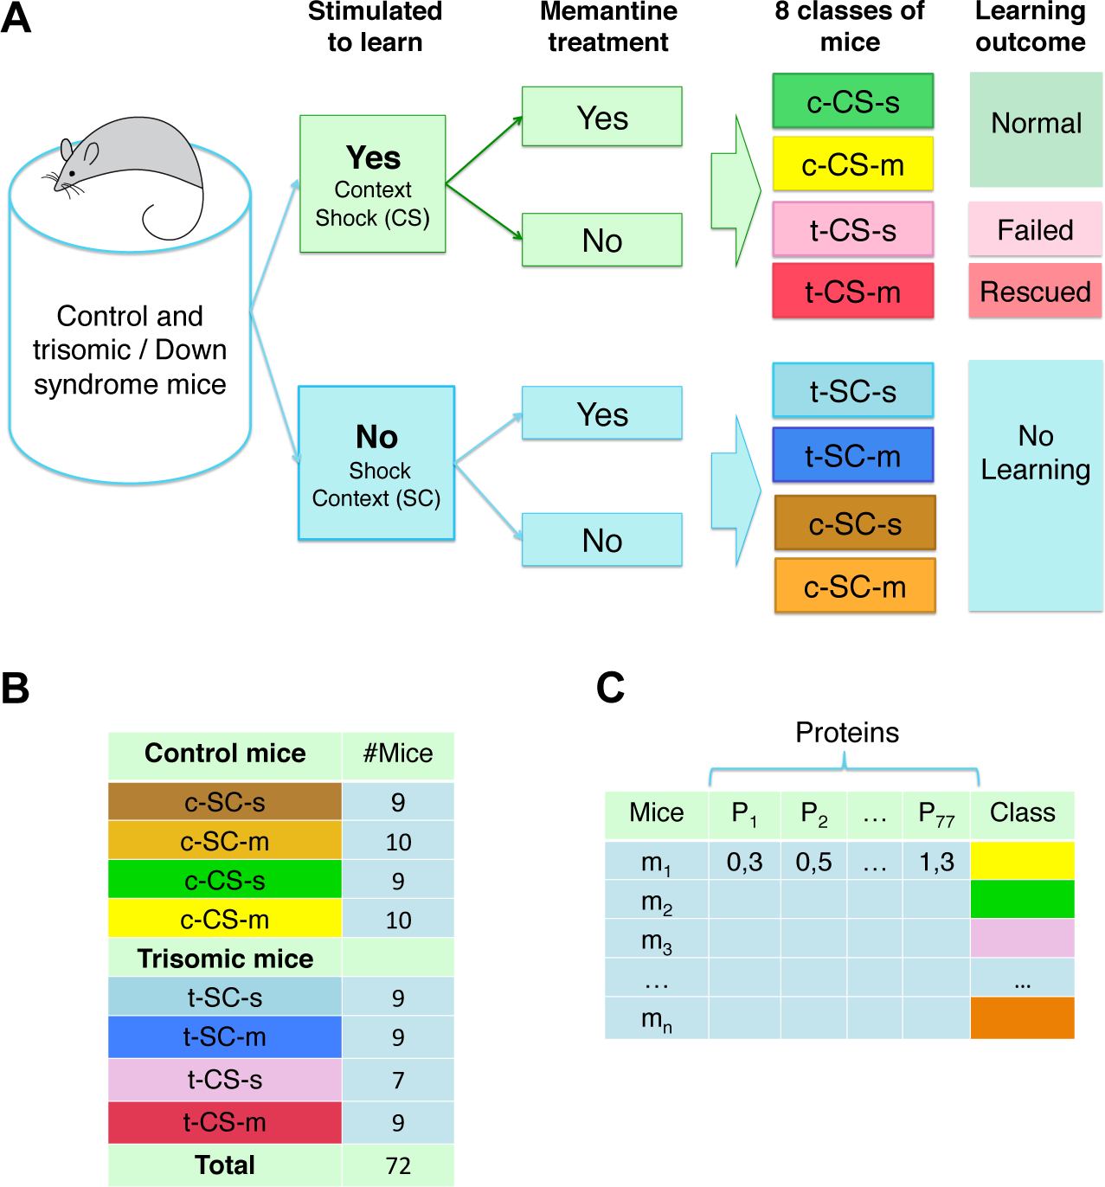
Introduction
The dataset contains a total of 1080 measurements per protein(77 proteins in total) where each measurement can be considered as an independent sample.
There are eight classes of mice which are described based on features such as genotype, behavior and treatment.
According to genotype, mice can be control or trisomic(down syndrome mice).
According to behavior, some mice have been stimulated to learn (context-shock) and others have not (shock-context).
And in order to assess the effect of the drug memantine, some mice have been injected with the drug and others have not.
Control mice learn successfully while the trisomic mice fail, unless they are first treated with a drug, which rescues their learning ability.
The data was obtained from the UCI repository .
The Ts65Dn mouse model of down syndrome display many features relevant to those seen in Down Syndrome in humans(including deficits in learning and memory) and for this reason, it can be used to learn more about Down Syndrome.

Slide 3
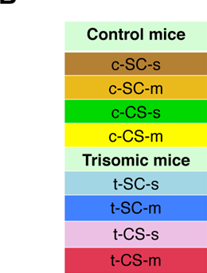
The 8 Mice Classes
c-CS-s: control mice, stimulated to learn, injected with saline
c-CS-m: control mice, stimulated to learn, injected with memantine
c-SC-s: control mice, not stimulated to learn, injected with saline
c-SC-m: control mice, not stimulated to learn, injected with memantine
t-CS-s: trisomy mice, stimulated to learn, injected with saline
t-CS-m: trisomy mice, stimulated to learn, injected with memantine
t-SC-s: trisomy mice, not stimulated to learn, injected with saline
t-SC-m: trisomy mice, not stimulated to learn, injected with memantine

Slide 4
Objective
The goal of this project is to find a model that is able to extract a subset of proteins that can help us classify mice by their protein expressions.
The model should contain just a subset while maintaining higher accuracy.
Again, the data set consists of the expression levels of 77 proteins/protein modifications that produced detectable signals in the nuclear fraction of cortex.

Slide 5
Method
We will use XGBOOST and Random Forest to extract a subset of proteins that help us classify each mouse based on their protein expression.
XGOOBST was chosen as it is particularly famous for outperforming others machine learning algorithms.
Random Forest was chosen was for practical purposes as it easily help visualize the most important features in the dataset which leads to feature reduction.

Slide 6
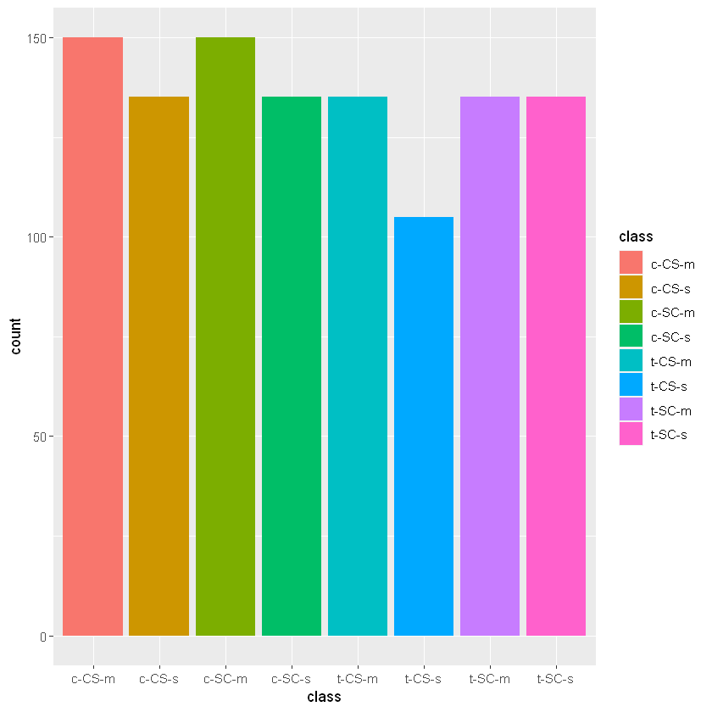
Checking for Class imbalance
The “class variable” is almost evenly distributed, that is, none of the mice type is totally dominating the other types.

Slide 7

Classification of mice by their protein expressions
XGBOOST model

Slide 8
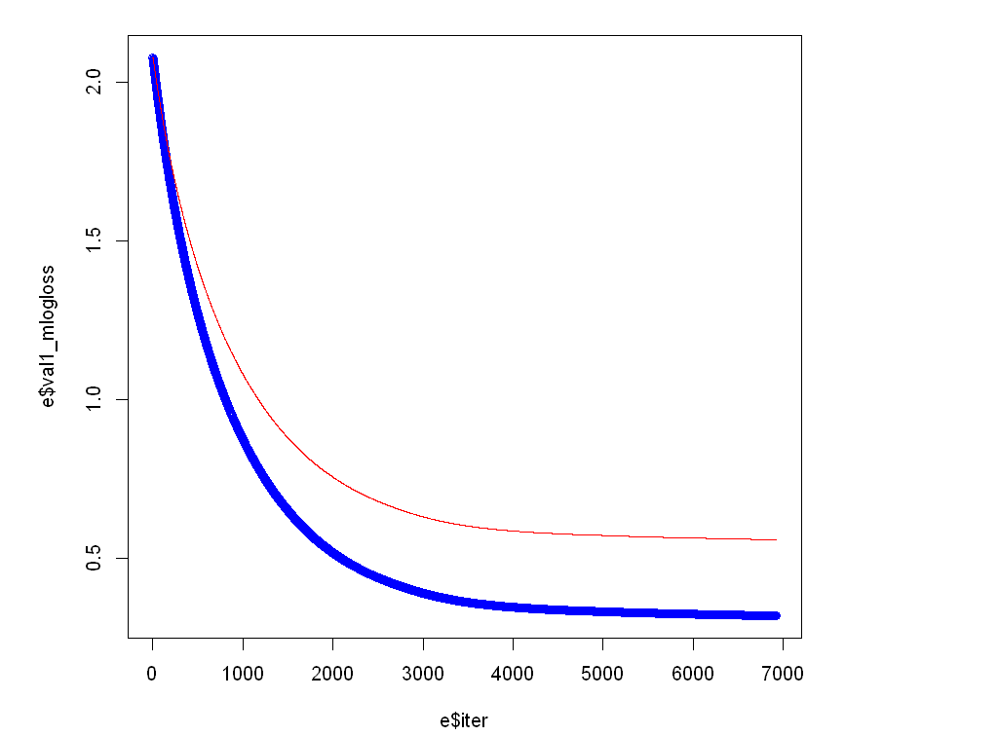
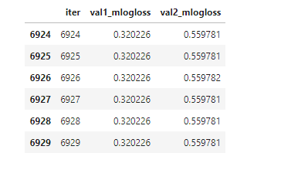

Slide 9
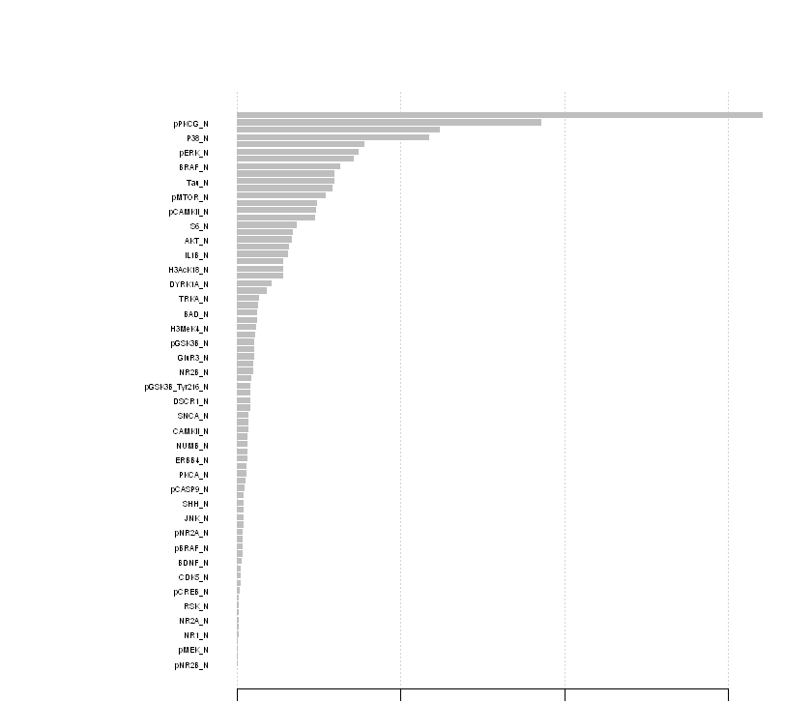
XGBOOST feature importance using the 77 proteins
Accuracy of 90%

Slide 10
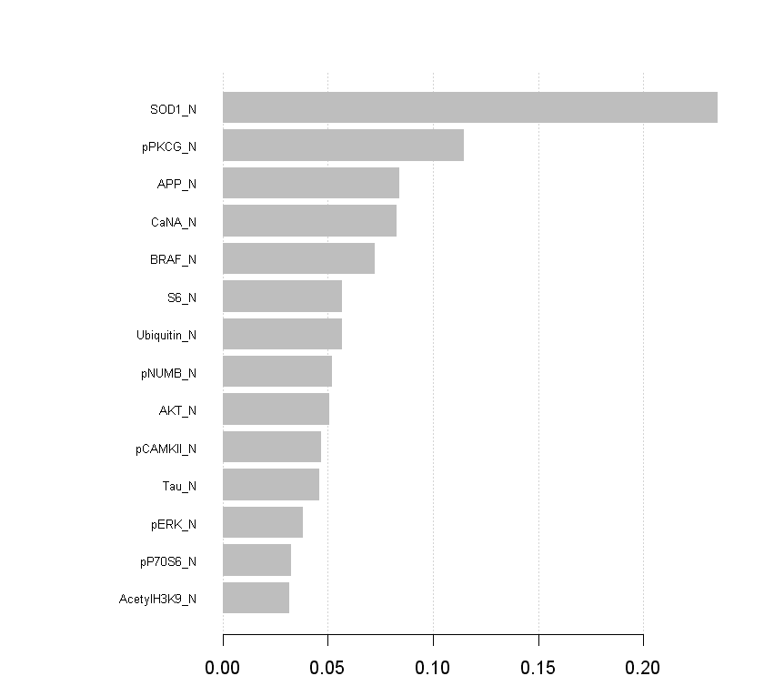
XGBOOST Short Model using the 14 most important proteins accuracy of 85%

Slide 11
Classification of mice by their protein expressions
Random Forest

Slide 12
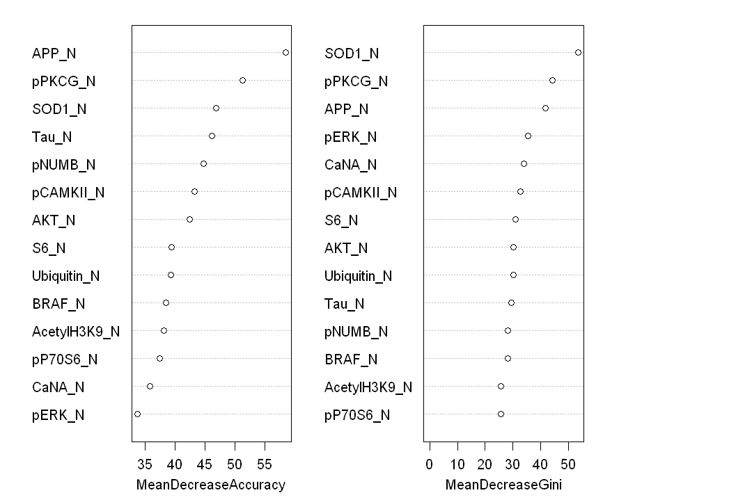
14 Proteins accuracy of 96.11% web

Slide 13
Results
Random Forest outperformed Extreme Gradient Boosting in overall, for the large dataset and for the smaller sample which not usually the case.
XGBOOST had an accuracy of 90% and in a smaller the accuracy went down to just 85.93%.
Random forest was able to predict with 96.11% accuracy on a smaller sample. So, in particular, the subset of proteins for our final model were:
('SOD1_N', 'APP_N', 'pPKCG_N', 'pERK_N', 'pCAMKII_N’, 'CaNA_N', 'Tau_N', 'pP70S6_N', 'pNUMB_N', 'BRAF_N’, 'Ubiquitin_N', 'AKT_N', 'S6_N ', 'AcetylH3K9_N', ‘c)

Slide 14
Limitations
Due to the nature of the experiment, not many data point could be collected as it involved live animal which were then euthanized.
The experiment involved context fear conditioning (CFC), which, if not done correctly, can give rise to unethical issues.
The was no description on the type of proteins in the dataset, so I did not know the meaning or the relevance of each type of protein.

Slide 15
References
Morde, V. (2019, April 08). XGBoost Algorithm: Long May She Reign! Retrieved October 18, 2020, from https://towardsdatascience.com/https-medium-com-vishalmorde-xgboost-algorithm-long-she-may-rein-edd9f99be63d
Ahmed MM, Dhanasekaran AR, Block A, Tong S, Costa ACS, Stasko M, et al. (2015) Protein Dynamics Associated with Failed and Rescued Learning in the Ts65Dn Mouse Model of Down Syndrome. PLoS ONE 10(3): e0119491. https://doi.org/10.1371/journal.pone.0119491
Higuera C, Gardiner KJ, Cios KJ (2015) Self-Organizing Feature Maps Identify Proteins Critical to Learning in a Mouse Model of Down Syndrome. PLoS ONE 10(6): e0129126. https://doi.org/10.1371/journal.pone.0129126
Chromosome 21: MedlinePlus Genetics. (2020, August 18). Retrieved October 20, 2020, from https://medlineplus.gov/genetics/chromosome/21/

