Slide 1
Parameter-Efficient Fine-Tuning
for Czech-to-English Machine Translation
Group 4: Andreia Alexa · Jie Huang · Yu Chien Lin · Diana Mikova

Slide 2
Motivation & Research Question
01
Problem: Full fine-tuning is computationally expensive, hard to scale across language pairs and risks overfitting.
RESEARCH QUESTION
?
02
Setting: We evaluate Czech -> English translation with NLLB-200-distilled-600M in a low-resource setting. Czech is challenging because of rich morphology and flexible word order.
How do LoRA, IA3, and prefix tuning compare to full fine-tuning and zero-shot for Czech→English MT in a low-resource setting?
03
Approach: PEFT methods are lightweight. LoRA, IA3, and Prefix tuning keep the base model frozen while training less than 0.2% of the parameters.
04
Goal: Evaluate whether PEFT methods preserve translation quality while substantially reducing the number of trainable parameters.

Slide 3
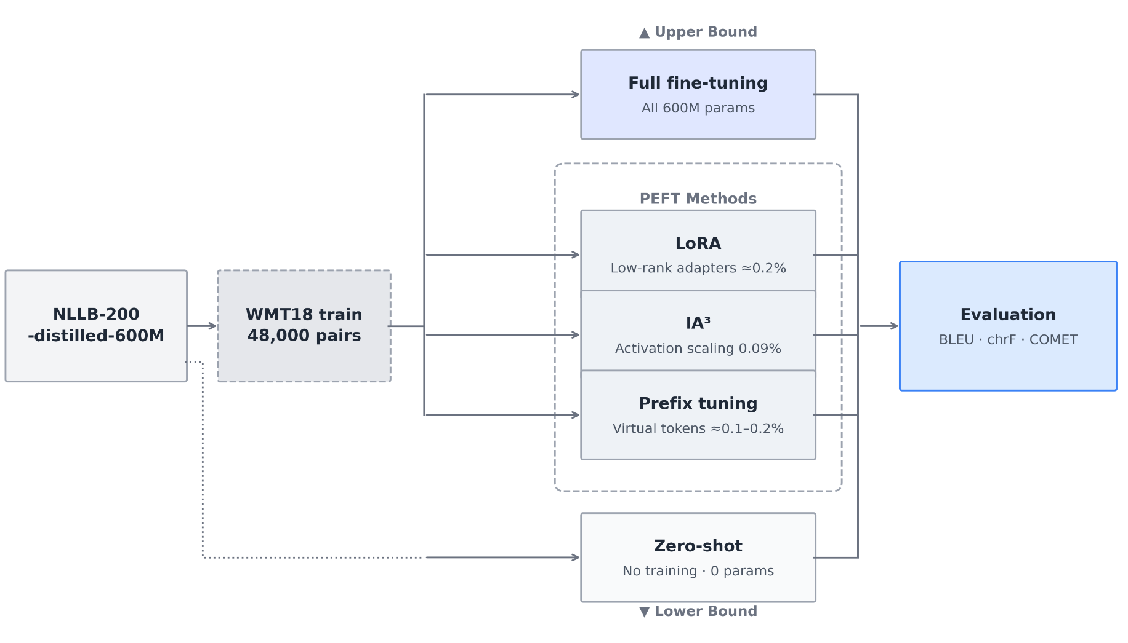
Experiment Framework
Same base model
Same dataset
  WMT18 Czech-English
  48k/1k/1k split
Same evaluation metrics
  BLEU, chrF, COMET
Five pipelines
  Baselines: Zero shot, full fine-tuning
  PEFT methods: LoRA, IA3, Prefix tuning
Notes:
Our experiment is built around a single question: how much can we reduce trainable parameters without sacrificing translation quality?
We start from the same pre-trained model — NLLB-200-distilled-600M. For the four fine-tuned systems, we use the same 48,000 Czech-English training pairs from WMT18. Zero-shot bypasses training entirely, going directly from the model to evaluation. All five systems are then evaluated on the same 1,000-sentence test set with the same script, giving us a fair comparison.
Full fine-tuning sets the upper bound — the best quality we can expect. Zero-shot sets the lower bound. The three PEFT methods sit in between, and that gap is what we're trying to close.

Slide 4
Results
System | Trainable params | BLEU | COMET | chrF
Zero-shot | 0 | 23.04 | 0.741 | 50.11
LoRA | 1.18M(0.19%) | 31.70 best BLEU | 0.831 | 57.82
IA³ | 560k (0.09%) | 30.26 | 0.828 | 56.83
Prefix tuning | 491K (0.08%) | 30.55 | 0.828 | 56.98
Full fine-tuning | 600M (100%) | 31.15 | 0.833 best COMET | 57.47
PEFT methods match full fine-tuning with <0.2% of parameters
slightly exceeded in some cases
Notes:
We report three metrics: BLEU for lexical overlap, chrF for character-level accuracy, and COMET for semantic quality. chrF is particularly informative for morphologically rich languages like Czech, but we use BLEU and COMET as the primary comparison metrics to align with standard MT evaluation practice.
Looking at the results, the zero-shot baseline scores BLEU 23.04, and full fine-tuning reaches 31.15 — an 8-point gap. That's the space the PEFT methods are operating in.
All three PEFT methods land between BLEU 30.5 and 31.7 — essentially matching full fine-tuning while training less than 0.2% of parameters.

Slide 5
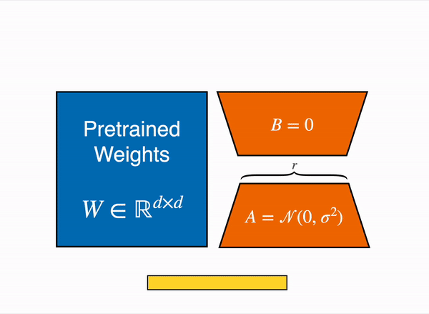
LoRA Fine-tuning
METHOD
Pretrained weights stay frozen. Two small decomposed matrices A and B are injected in selected attention layers of the transformer’s architecture. Only these are updated during training, then they are merged at inference time.
ΔW = B × A rank r controls capacity
h = Wx + BAx
Fig 1: Medium.com, Understanding Low-Rank Adaptation (LoRA)

Slide 6
LoRA Fine-tuning
TAKEAWAYS
BLEU
chrF
COMET
Trainable parameters (rank=8)
1.18M 0.19% of model
31.70
57.82
0.831
Learning rate
LoRA Rank vs. alpha
BLEU vs COMET
LR 3e-4 was best after 1 epoch, but worse after 3 epochs.
LoRA has fewer trainable parameters, so optimization behaves differently from full fine-tuning.
LoRA Rank controls the capacity of the LoRA adapter by setting the size of the low-rank matrices.
Alpha hyperparam. determines the scaling factor (the multiplier applied to weight changes): alpha/r
The best BLEU checkpoint was not the best COMET checkpoint, suggesting lexical quality and semantic quality peaked at different points.
Notes:
r - LoRA r did not impact results meaningfully when all projection layers were used.

Slide 7

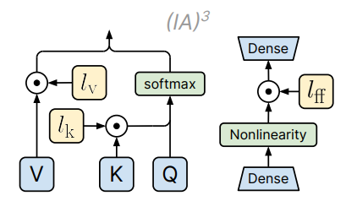
IA³ （Infused Adapter by Inhibiting and Amplifying Inner Activations） Fine-tuning
Add learnable scaling vectors
Modulate attention and feed-forward activations via element-wise scaling
Fine-tune only a small number of parameters for
efficient adaptation 560k (0.09%)
Liu et al. (2022)
Notes:
The main idea is that instead of updating all model parameters, IA³ only learns three scaling vectors: lkl_klk​, lvl_vlv​, and lffl_{ff}lff​.
These vectors are applied to the Key, Value, and Feed-Forward activations through element-wise multiplication. By doing this, the model can emphasize task-relevant information and reduce the influence of less useful information.
Since only a very small number of parameters need to be trained, IA³ is much more efficient than full fine-tuning in terms of memory and computation, while still maintaining strong performance.

Slide 8
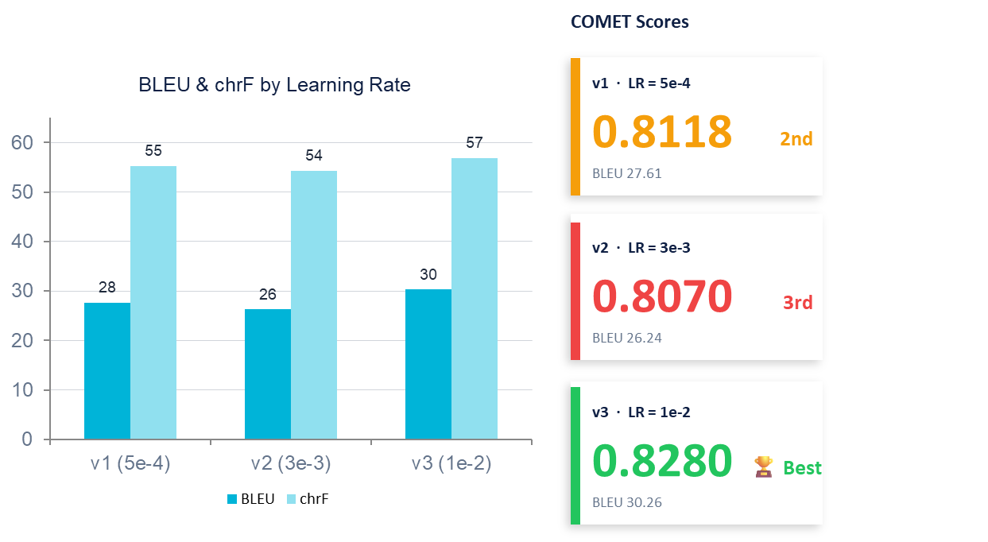
IA³ （Infused Adapter by Inhibiting and Amplifying Inner Activations） Fine-tuning
Experimental Results
TAKEAWAYS
Higher LR benefits IA³
IA³ tolerates LR as high as 1e-2 without overfitting
(Liu et al., 2022).
Non-monotonic LR response
PEFT hyperparameter landscapes are
non-monotonic with sharp drops at suboptimal values
High train loss ≠ worse eval
V3 has highest train loss (44.67) yet best BLEU/COMET.
Notes:
This slide presents the experimental results for IA³ under three different learning rates.
On the left, we compare BLEU and chrF scores. We can see that performance improves as the learning rate increases. The model trained with a learning rate of 1e-2, shown as V3, achieved the highest BLEU score of 30 and the highest chrF score of 57.
In the middle, we compare COMET scores. Again, V3 achieved the best result, with a COMET score of 0.828, outperforming the other two settings.
There are three key takeaways from these results.
First, IA³ benefits from a higher learning rate. While many fine-tuning methods become unstable at large learning rates, IA³ can effectively utilize learning rates as high as 1e-2.
Second, the relationship between learning rate and performance is not always monotonic. Small changes in hyperparameters can lead to noticeable differences in evaluation scores, highlighting the importance of hyperparameter tuning.
Third, higher training loss does not necessarily mean worse evaluation performance. Interestingly, V3 achieved the highest training loss among the three configurations, but still obtained the best BLEU and COMET scores on the test set.
Overall, these results suggest that IA³ is sensitive to learning rate selection, and a relatively high learning rate can lead to the strongest translation performance.

Slide 9
Prefix Tuning
Method principle: virtual tokens, frozen model
Trainable parameters: 491k (0.08%) vs. 1.2M (0.20%)
Key finding: The simplest configuration was the best trade-off
Notes:
Prefix tuning adds a small set of learnable tokens at the beginning of each input, training only these tokens while keeping the rest of the model completely frozen.
I ran three experiments varying prefix size, learning rate, and scheduler type.
The best experiment achieves near full fine-tuning performance while training only 0.08 % of model parameters.
It was configured in the simplest and fastest way and achieved nearly the same results as the more complex and expensive experiments.

Slide 10
Error Analysis | Linguistic-specific
Feature | Source (cs) | Reference (en) | System output | Observation
Proper nouns & named entities | Na Kolínsku hořelo pole. | A field was burning in Cologne. | Fire breaks out in Kolín. | Prefix & IA3 – Kolínsko (Czech region) mistaken for Cologne, Germany
Ellipsis | Ten s dvaceti chudý. | The poor guy with 20. | Those earning 20,000 are poor. | All systems – verb and currency unit missing from source
Idiomatic expressions | Olej do ohně přilévá chudoba. | Olej do ohně přilévá chudoba. | Poverty feeds the discontent. | Full FT – idiom copied verbatim, not translated
False friends | Fandí všichni. | They're all fanatics. | Everyone supports them. | IA3 – fandí (to cheer for) confused with fanatik (fanatic)
Missing discourse context | Jeho podmořská hrobka zachovala tělo v dokonalém stavu. | His underwater tomb kept the body in perfect condition. | But the dinosaur's undersea burial preserved its armor in exquisite detail. | All systems - sentence about a dinosaur fossil, not a human
Notes:
I also did the error analysis for the whole group, looking at the worst-scoring translations from all four systems.
I found five recurring error types: proper nouns, ellipsis, idioms ,false friends and missing discourse context
For the proper nouns, a czech town was translated as a german one.
for Ellipsis, the Czech original used very little words, so the model was not able to form the right meaning
for idioms, in this particular Full fine-tuning case, the idiom was not even translated at all
for false friends, the people cheering/supporting became fanatics.
and for missing discourse context, the dinosaur's burial spot became a person's tomb.
For method-specific errors, full fine-tuning was the worst — it sometimes copied Czech verbatim or produced fluent English saying the exact opposite of the source. PEFT methods never did this. The key finding: high-confidence wrong translations are the most dangerous, because they look correct and you'd never know without knowing Czech.

Slide 11


Other examples
Lost in translation - literal nonsense
SRC : Volič tápe i šířeji. (Full FT)
HYP : Tapestry volley and spread.
REF : The voter is more in the dark than ever.
Tápe means "fumbles/gropes in the dark" → the model apparently saw "tap" and went with tapestry.
The confident wrong answer
SRC : Dám vám hádanku. (Full FT)
HYP : I'll give you my back.
REF : Here's a puzzle for you.
Hádanku = riddle. The model decided it means "my back". Very confident, very wrong.
Notes:
for other examples, I chose this Lost in translation example, where the FULL FT produces literal nonsense - something about tapestry, volley and spread.
FULL-FT was also very confident in the next example, where it translated riggle as a someone's back I guess?

Slide 12


Other examples
The existential crisis
SRC : A moje úvodní řeč? (Full FT)
HYP : What's my first language?
REF : As for my captain's speech?
A question about an opening speech turned into an identity crisis
The supporter becomes a fanatic
SRC : Fandí všichni. (IA3)
HYP : They're all fanatics.
REF : Everyone supports them.
Fandí = to cheer for/support.
IA3 turned a wholesome crowd of supporters into a mob of fanatics.
Notes:
For FT FULL, a question about an opening speech turner into an identity crisis - when the person is not sure about his/hers first language.
and for IA3, as mentioned before, the supporters became fanatics.

Slide 13
Conclusion
PEFT methods match or closely approach full fine-tuning quality for Czech-to-English translation, achieving competitive BLEU, chrF, and COMET scores while updating only a tiny fraction of model parameters.
Parameter efficiency: LoRA, IA³, and Prefix Tuning update less than 0.2% of the parameters in NLLB-200-distilled-600M, substantially reducing training costs and memory requirements compared to full fine-tuning.
Practical takeaway: For low-resource adaptation and limited computational budgets, PEFT methods provide a highly effective alternative to full fine-tuning. Among the methods tested, LoRA offers the strongest overall performance, while Prefix Tuning provides an attractive balance between translation quality and parameter efficiency.
Notes:
In conclusion, our results show that PEFT methods can achieve translation quality close to full fine-tuning while updating only a very small fraction of the model parameters. This makes them a cost-effective solution for low-resource settings. Among the methods we evaluated, LoRA achieved the strongest overall performance, while Prefix Tuning provided a good balance between efficiency and translation quality.

Slide 14
Questions?
Group 4 · Parameter-Efficient Fine-Tuning for Czech-to-English Machine Translation

