Slide 1
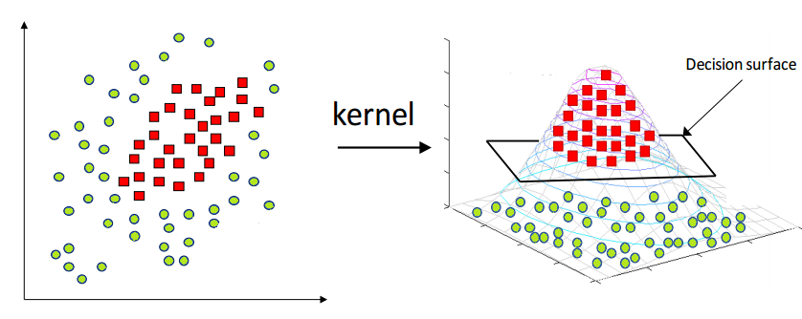
Soft Margin SVM
https://www.hackerearth.com/blog/developers/simple-tutorial-svm-parameter-tuning-python-r
Dr. Samir Rustamov

Slide 2
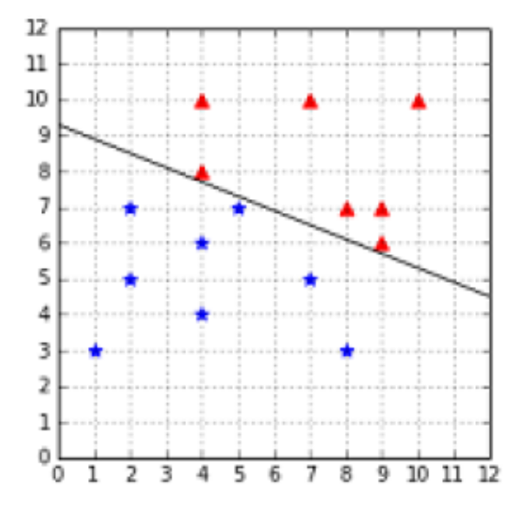
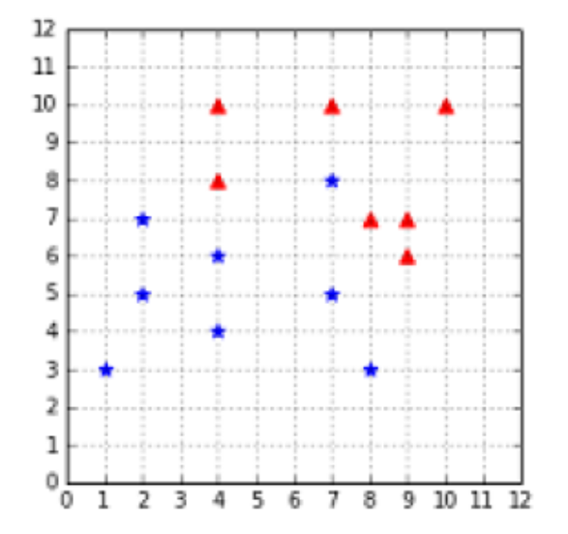
Noisy Data
Hard margin SVM requires the data to be linearly separable
  Real-life data is often noisy
  In the presence of an outlier (a data point that seems to be out of its group), there are two cases:
    the outlier can be closer to the other examples than most of the examples of its class, thus reducing the margin
    it can be among the other examples and break linear separability.
The dataset is still linearly separable with the outlier at (5, 7)
The outlier at (7, 8) breaks linear separability

Slide 3
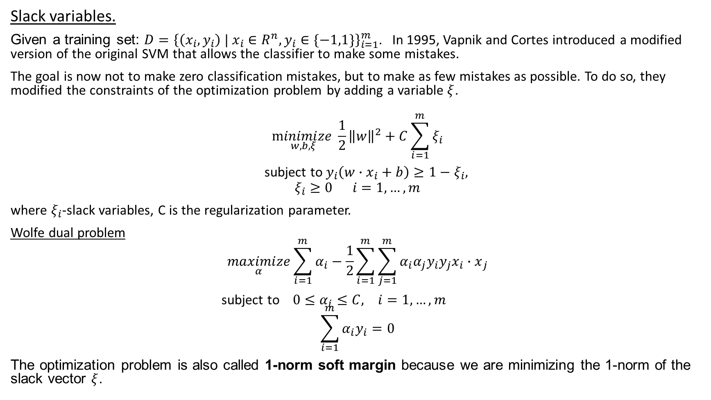
Soft margin
Slack variables.
Given a training set: $D={\left\{\left(x_{i},y_{i}\right) | x_{i}∈R^{n},y_{i}∈\{−1,1\}\right\}}_{i=1}^{m}$. In 1995, Vapnik and Cortes introduced a modified version of the original SVM that allows the classifier to make some mistakes.
The goal is now not to make zero classification mistakes, but to make as few mistakes as possible. To do so, they modified the constraints of the optimization problem by adding a variable $ξ$.
$$\underset{w,b,ξ}{minimize}{\frac{1}{2}{\left\|w\right\|}^{2}+C\sum_{i=1}^{m}{ξ_{i}}}$$
subject to $y_{i}\left(w∙x_{i}+b\right)≥{1−ξ}_{i},$
$$ξ_{i}≥0 i=1,…,m$$
where $ξ_{i}$-slack variables, C is the regularization parameter.
Wolfe dual problem
$$\underset{α}{maximize}{\sum_{i=1}^{m}{α_{i}}−\frac{1}{2}\sum_{i=1}^{m}{{\sum_{j=1}^{m}{α_{i}{α_{j}y}_{i}y_{j}x_{i}}∙x}_{j}}}$$
subject to $0≤α_{i}≤C, i=1,…,m$
$$\sum_{i=1}^{m}{α_{i}y_{i}}=0$$
The optimization problem is also called 1-norm soft margin because we are minimizing the 1-norm of the slack vector $ξ$.

Slide 4
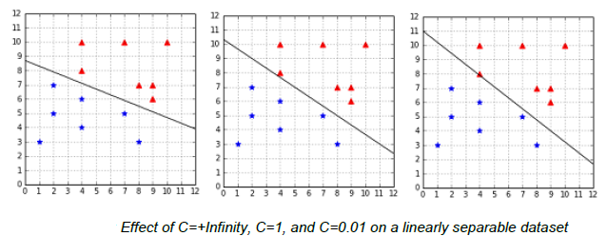
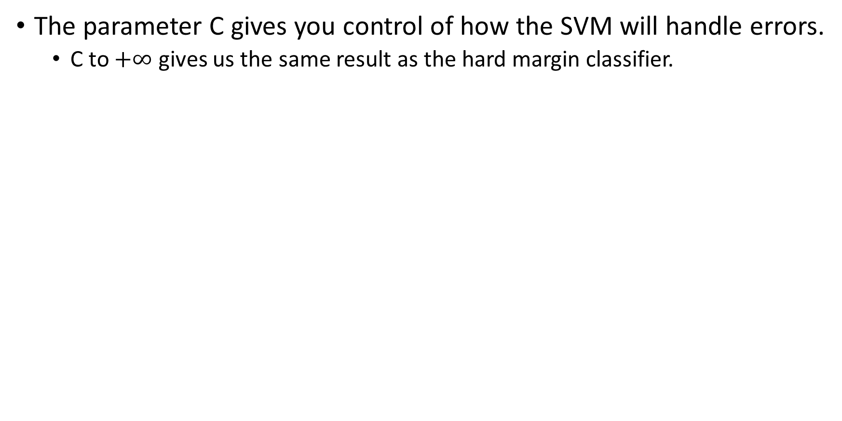
Understanding what C does
The parameter C gives you control of how the SVM will handle errors.
  C to $+∞$ gives us the same result as the hard margin classifier.
when the data is linearly separable, big C is the best choice.

Slide 5
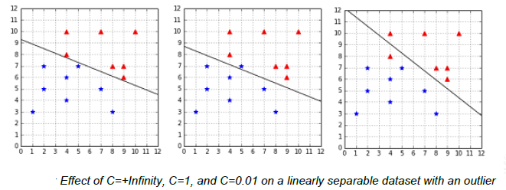
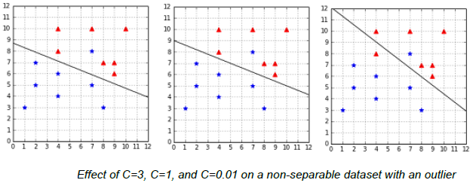
Understanding what C does (in case of noisy outlier)
A small C will give a wider margin, at the cost of some misclassifications.
A huge C will give the hard margin classifier and tolerates zero constraint violation.
The recommended approach to select is to use grid search with cross-validation (Hsu, Chang, & Lin, A Practical Guide to Support Vector Classification).

Slide 6
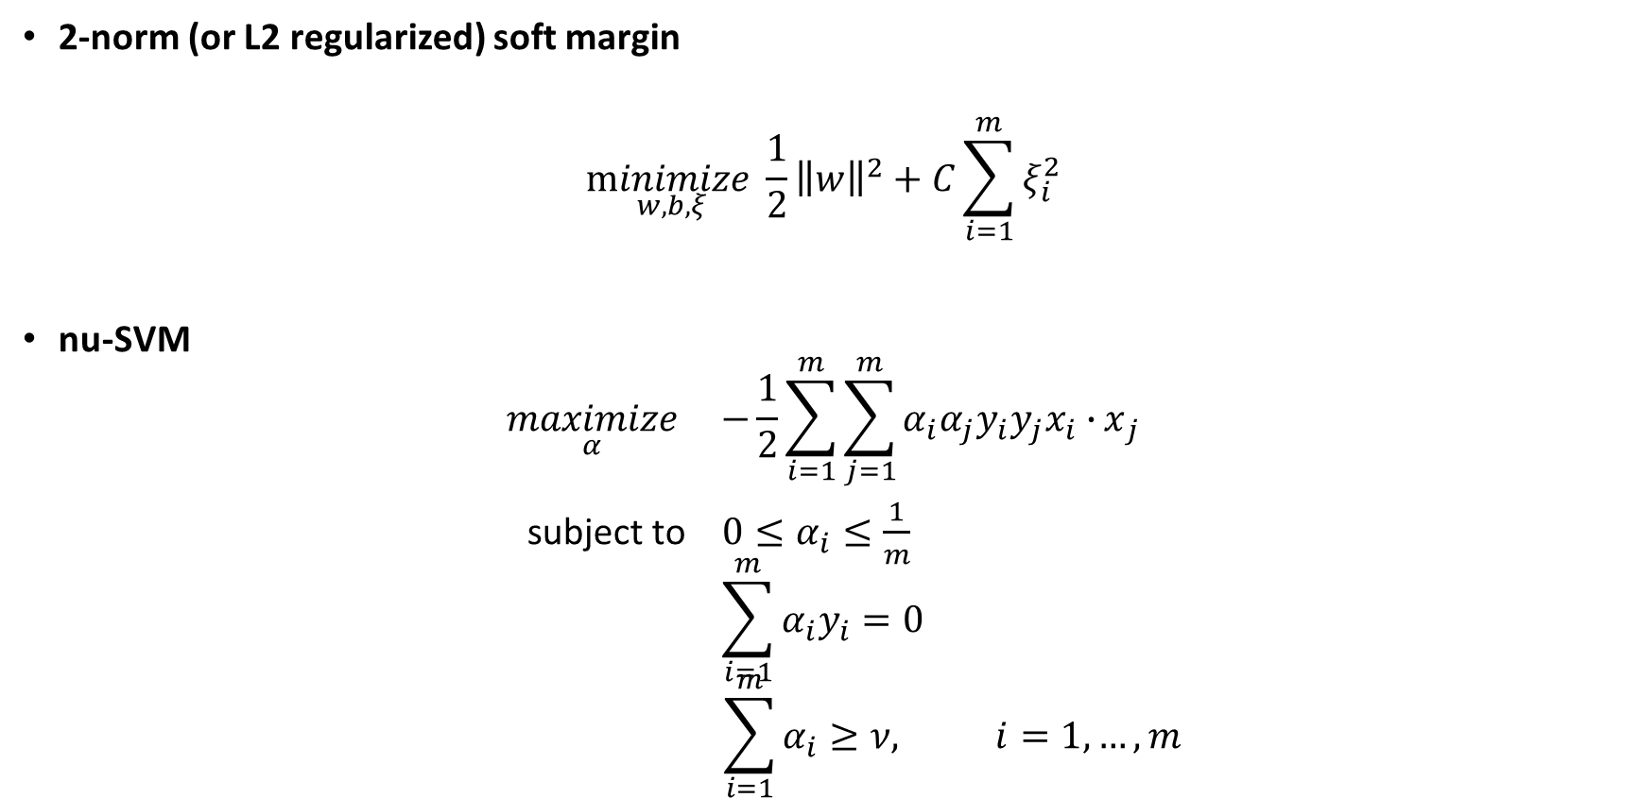
Other soft-margin formulations (Optional)
2-norm (or L2 regularized) soft margin
$$\underset{w,b,ξ}{minimize}{\frac{1}{2}{\left\|w\right\|}^{2}+C\sum_{i=1}^{m}{ξ_{i}^{2}}}$$
nu-SVM
$$\underset{α}{maximize}{ −\frac{1}{2}\sum_{i=1}^{m}{{\sum_{j=1}^{m}{α_{i}{α_{j}y}_{i}y_{j}x_{i}∙}x}_{j}}}$$
subject to $0≤α_{i}≤\frac{1}{m}$
$$\sum_{i=1}^{m}{α_{i}y_{i}}=0$$
$$\sum_{i=1}^{m}{α_{i}}≥ν, i=1,…,m$$

Slide 7
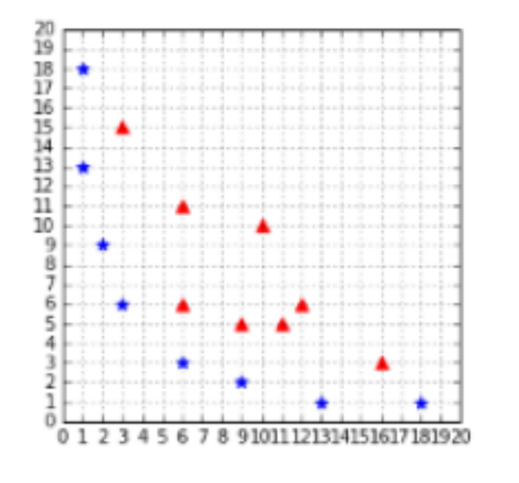
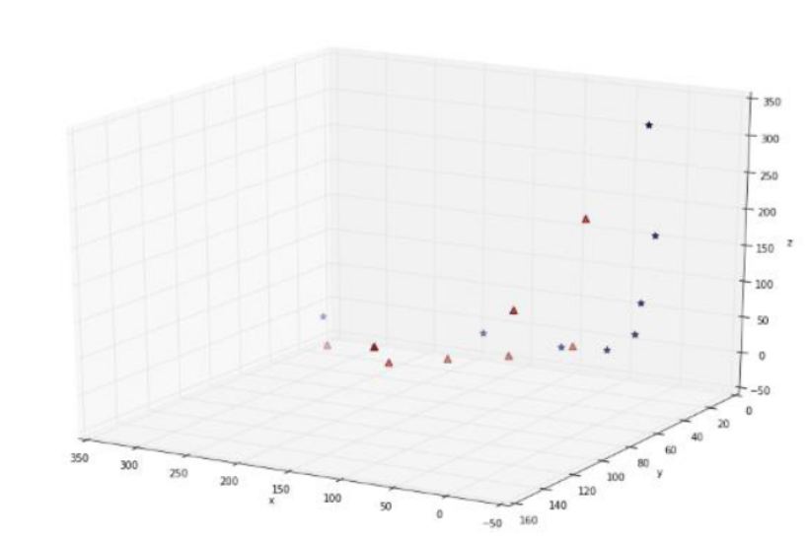
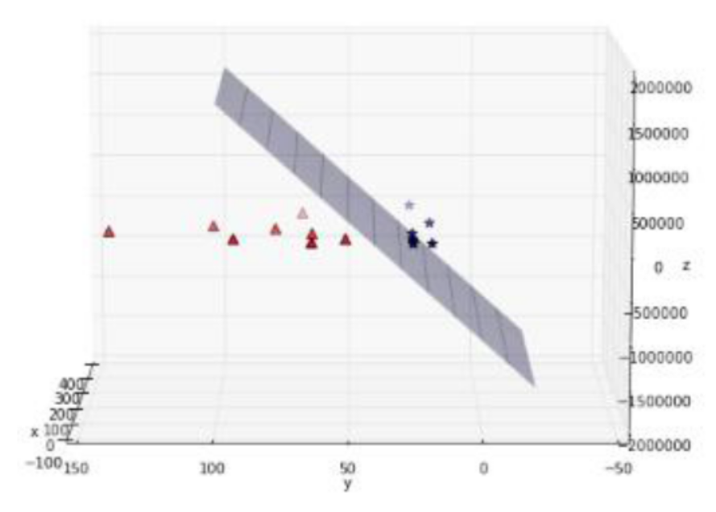


Kernels.
Feature transformations.
The data from the example is not linearly separable in two dimensions.
Example: polynomial mapping:
$$φ:R^{2}→R^{3}$$
$$φ\left(x_{1},x_{2}\right)=(x_{1}^{2},\sqrt{2}x_{1}x_{2},x_{2}^{2})$$
A straight line cannot separate the data
The data is separable by a plane

Slide 8
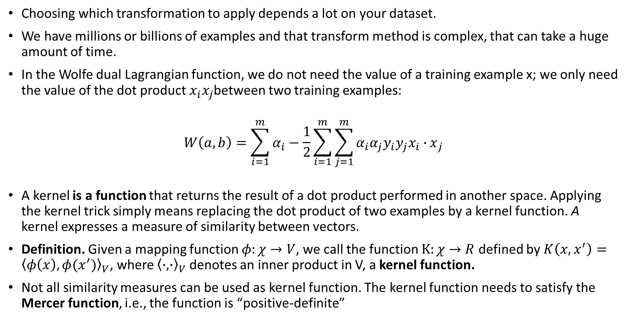
Kernel
Choosing which transformation to apply depends a lot on your dataset.
We have millions or billions of examples and that transform method is complex, that can take a huge amount of time.
In the Wolfe dual Lagrangian function, we do not need the value of a training example x; we only need the value of the dot product $x_{i}x_{j}$between two training examples:
$$W\left(a,b\right)=\sum_{i=1}^{m}{α_{i}}−\frac{1}{2}\sum_{i=1}^{m}{{\sum_{j=1}^{m}{α_{i}{α_{j}y}_{i}y_{j}x_{i}∙}x}_{j}}$$
A kernel is a function that returns the result of a dot product performed in another space. Applying the kernel trick simply means replacing the dot product of two examples by a kernel function. A kernel expresses a measure of similarity between vectors.
Definition. Given a mapping function $φ:χ→V$, we call the function $K:χ→R$ defined by $K\left(x, x^{′}\right)={\left\langle φ\left(x\right),φ(x^{′})\right\rangle }_{V}$, where ${\left\langle ∙,∙\right\rangle }_{V}$ denotes an inner product in V, a kernel function.
  Not all similarity measures can be used as kernel function. The kernel function needs to satisfy the Mercer function, i.e., the function is “positive-definite”

Slide 9
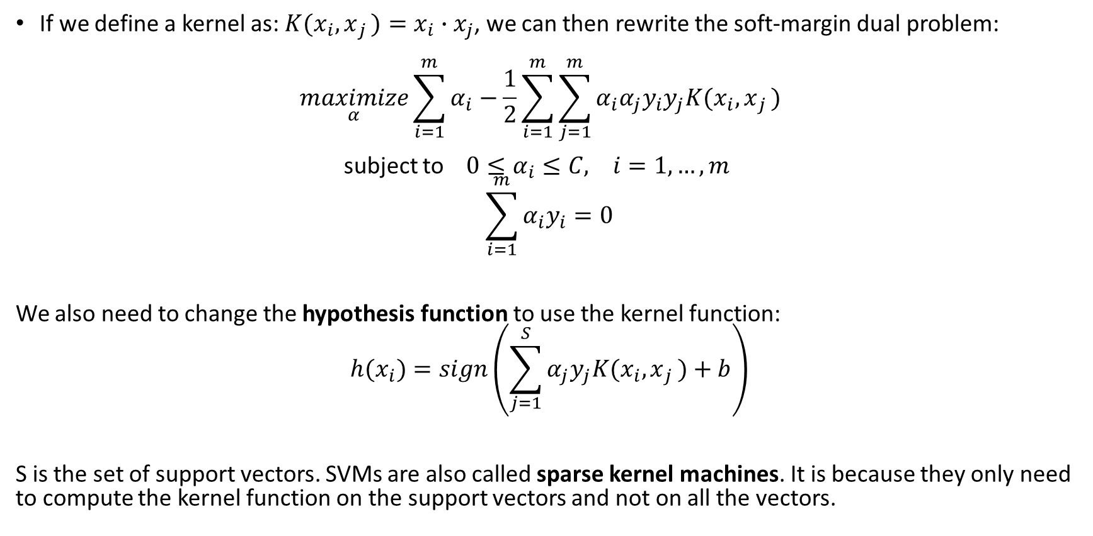
The kernel trick
If we define a kernel as: ${K(x}_{i}{,x}_{j})=x_{i}{∙x}_{j}$, we can then rewrite the soft-margin dual problem:
$$\underset{α}{maximize}{\sum_{i=1}^{m}{α_{i}}−\frac{1}{2}\sum_{i=1}^{m}{{\sum_{j=1}^{m}{α_{i}{α_{j}y}_{i}y_{j}{K(x}_{i}{,x}_{j})}}_{}}}$$
subject to $0≤α_{i}≤C, i=1,…,m$
$$\sum_{i=1}^{m}{α_{i}y_{i}}=0$$
We also need to change the hypothesis function to use the kernel function:
$${h(x}_{i})=sign\left(\sum_{j=1}^{S}{α_{j}y_{j}{K(x}_{i}{,x}_{j})+b}\right)$$
S is the set of support vectors. SVMs are also called sparse kernel machines. It is because they only need to compute the kernel function on the support vectors and not on all the vectors.

Slide 10
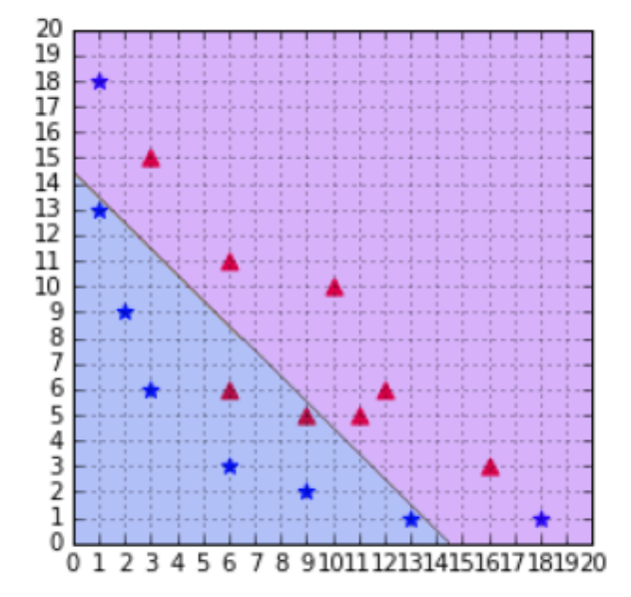
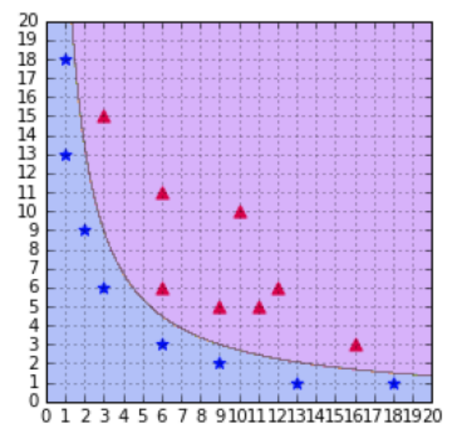
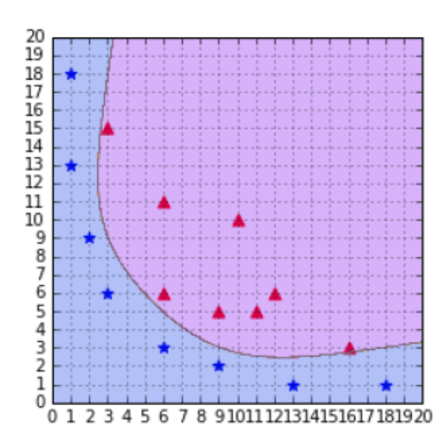
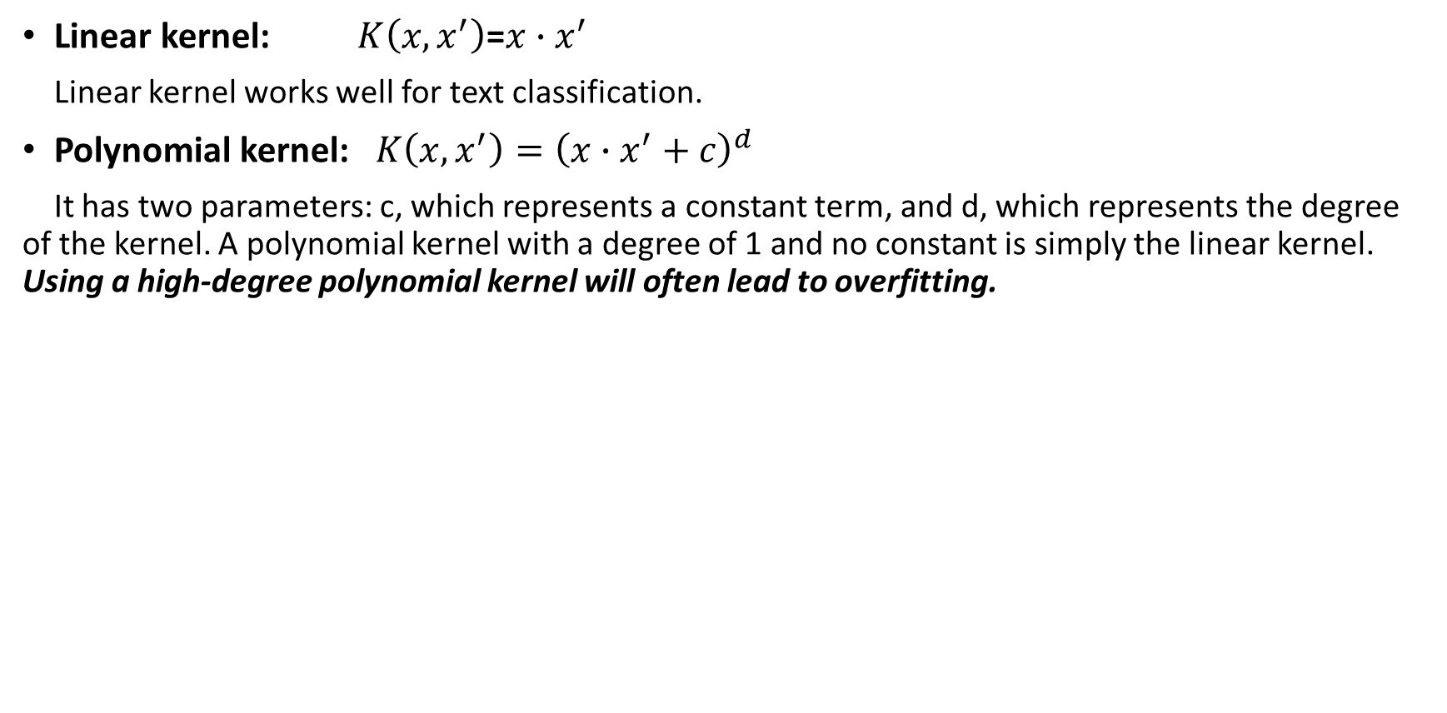
Kernel types
Linear kernel: $K\left(x, x^{′}\right)$=$x∙x^{′}$
Linear kernel works well for text classification.
Polynomial kernel: $K\left(x, x^{′}\right)={\left(x∙x^{′}+c\right)}^{d}$
It has two parameters: c, which represents a constant term, and d, which represents the degree of the kernel. A polynomial kernel with a degree of 1 and no constant is simply the linear kernel. Using a high-degree polynomial kernel will often lead to overfitting.
A polynomial kernel with degree = 1
A SVM using a polynomial kernel is able to separate the data (degree=2)
A polynomial kernel with degree = 6

Slide 11
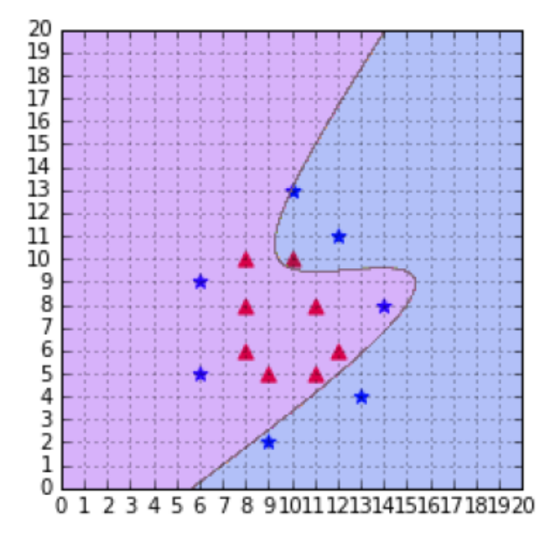
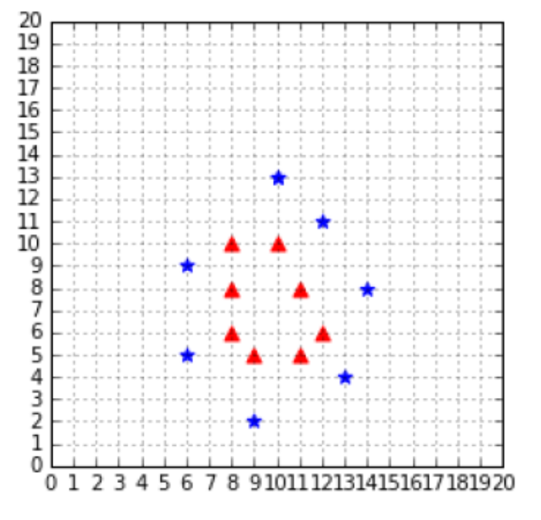
Example:A polynomial kernel is not able to separate the data (degree=3, C=100)

Slide 12
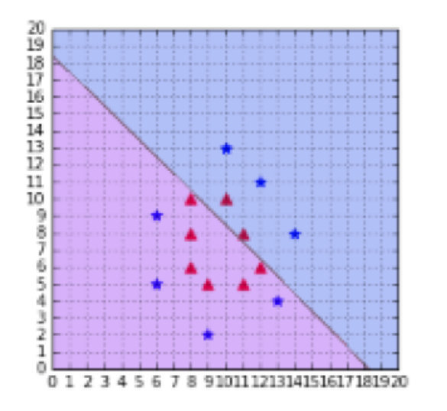
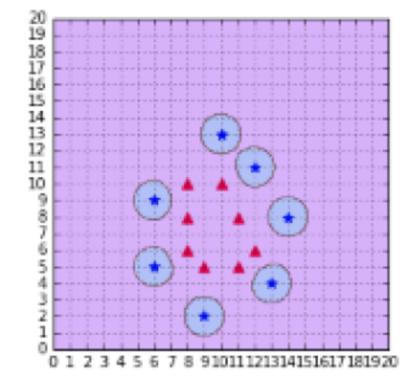
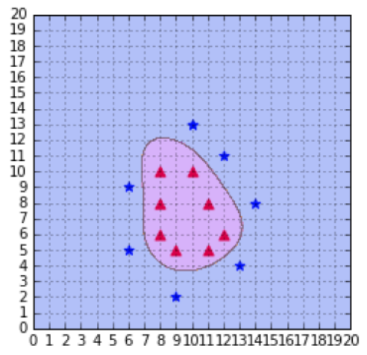
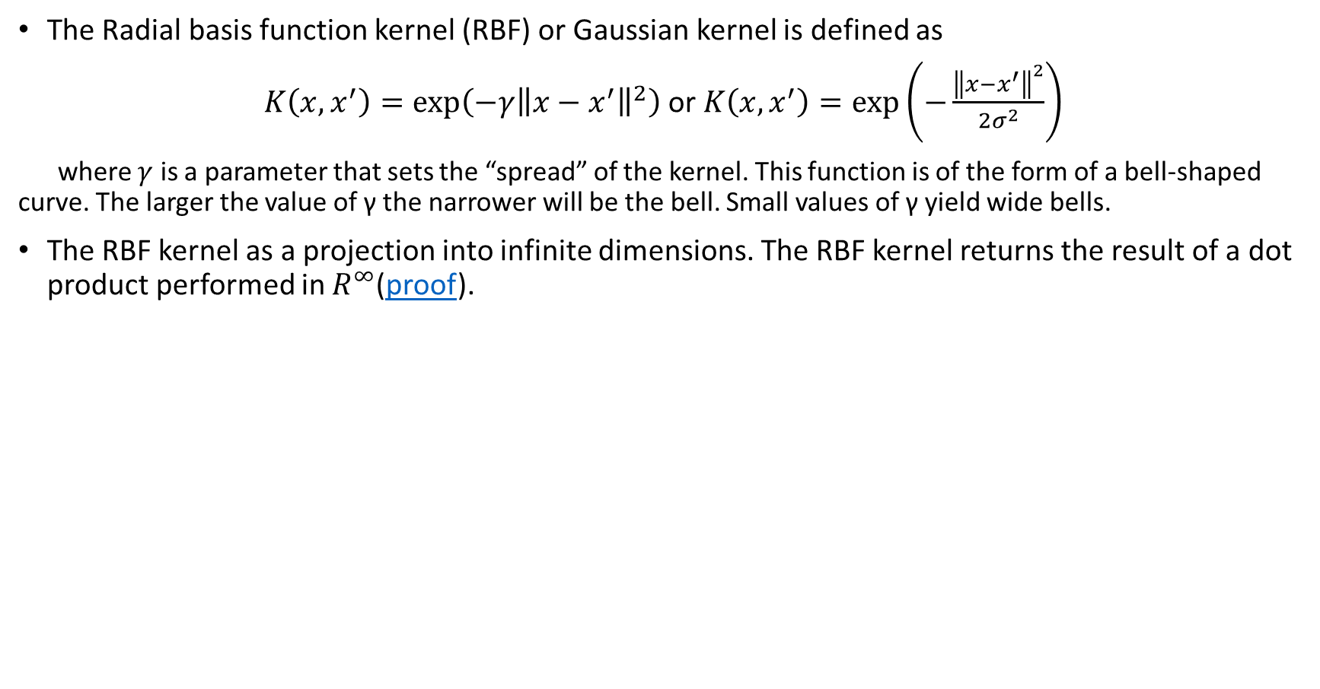
RBF or Gaussian kernel
The Radial basis function kernel (RBF) or Gaussian kernel is defined as
$K\left(x, x^{′}\right)=\exp\left(−γ{\left\|x−x^{′}\right\|}^{2}\right)$ or $K\left(x, x^{′}\right)=exp⁡\left(−\frac{{\left\|x−x^{′}\right\|}^{2}}{2σ^{2}}\right)$
where $γ$ is a parameter that sets the “spread” of the kernel. This function is of the form of a bell-shaped curve. The larger the value of γ the narrower will be the bell. Small values of γ yield wide bells.
The RBF kernel as a projection into infinite dimensions. The RBF kernel returns the result of a dot product performed in $R^{∞}$(proof).
A Gaussian kernel with gamma = 1e-5
The RBF kernel classifies the data correctly with gamma = 0.1
A Gaussian kernel with gamma = 2
When gamma is too small, the model behaves like a linear SVM. When gamma is too large, the model is too heavily influenced by each support vector (read scikit-learn documentation )

Slide 13
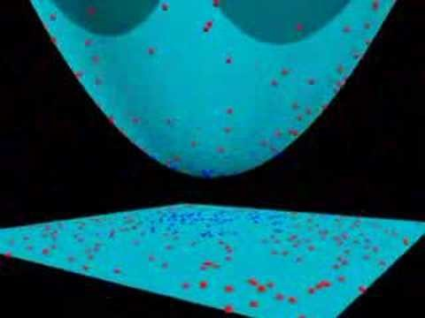
Example of RBF
Other types of Kernel. César Souza describes 25 kernels.

Slide 14
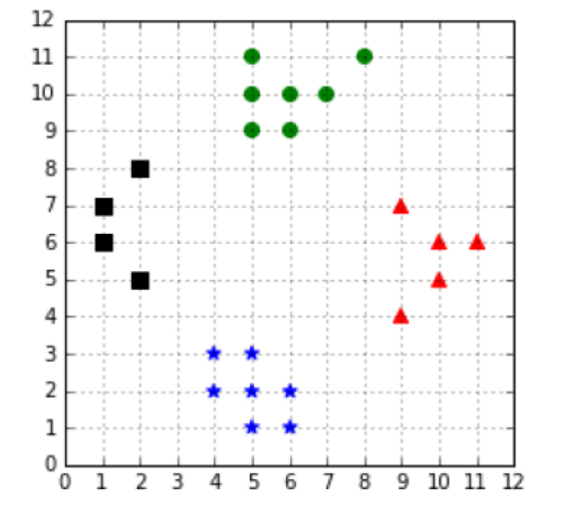
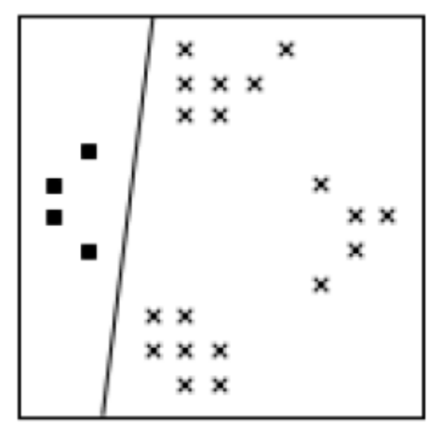
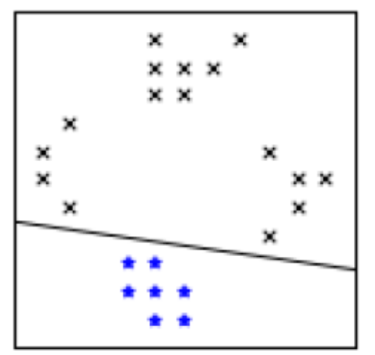
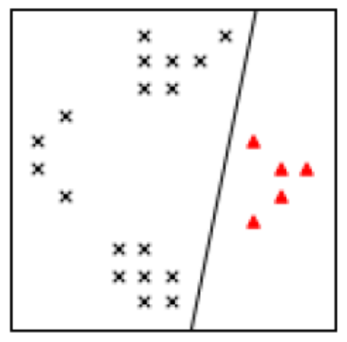
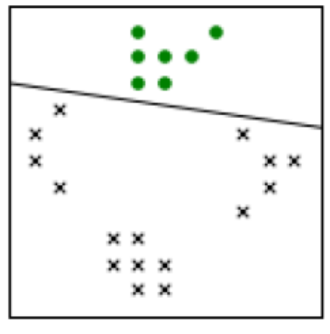
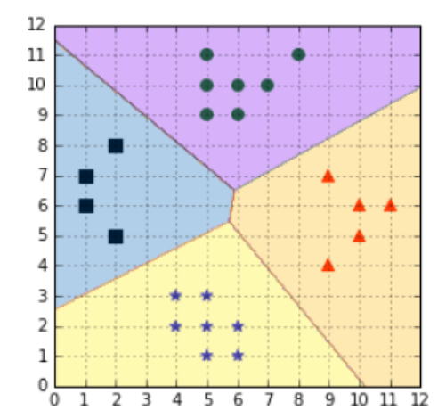
Multi-Class SVMs
One-against-all. In order to classify K classes, we construct K different binary classifiers. For a given class, the positive examples are all the points in the class, and the negative examples are all the points not in the class
A four classes classification problem
The One-against-all approach creates one classifier per class
Vladimir Vapnik suggested using the class of the classifier for which the value of the decision function is the maximum

Slide 15
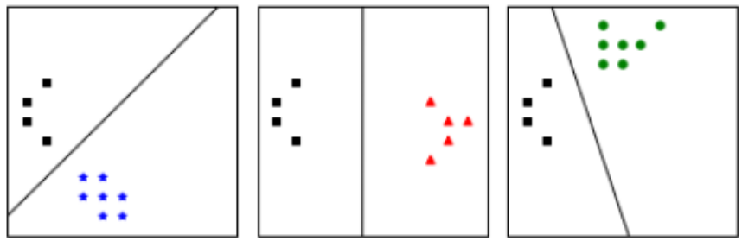
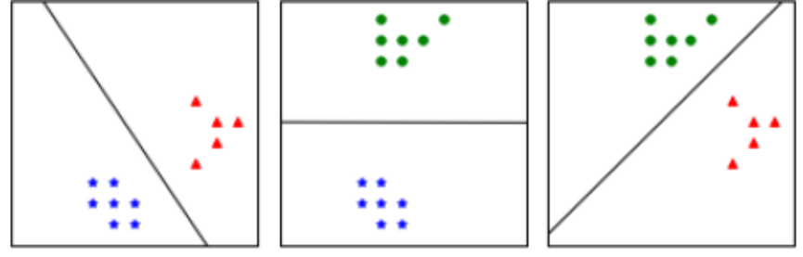
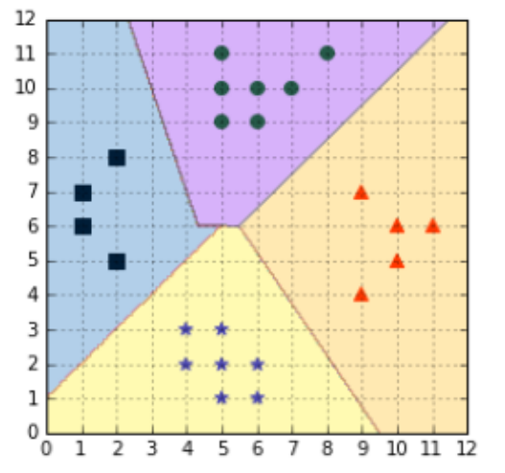
Multi-Class SVMs
One-against-one: we train one classifier per pair of classes, which leads to K(K-1)/2 classifiers for K classes. Each classifier is trained on a subset of the data and produces its own decision boundary.
Predictions are made using a simple voting strategy. Each example we wish to predict is passed to each classifier, and the predicted class is recorded. Then, the class having the most votes is assigned to the example
One-against-one construct with one classifier for each pair of classes
The one-against-one approach is the default approach for multi-class classification used in sklearn.
Predictions are made using a voting scheme

Slide 16
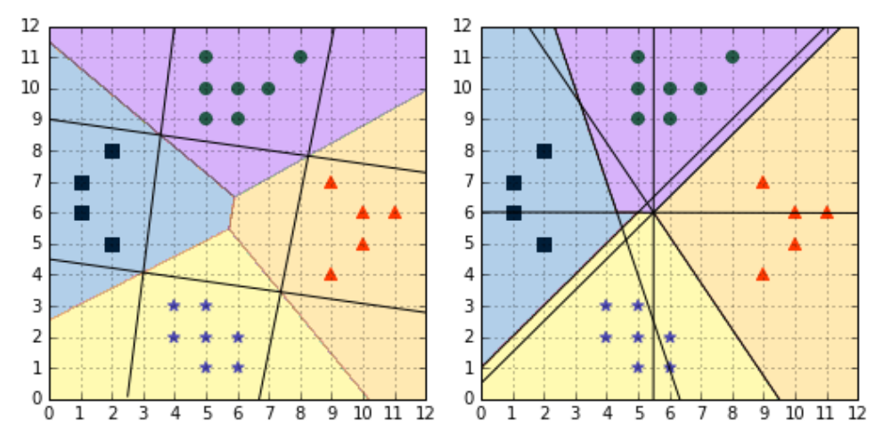
Comparison of one-against-all and one-against-one
Comparison of one-against-all (left) and one-against-one (right)

Slide 17
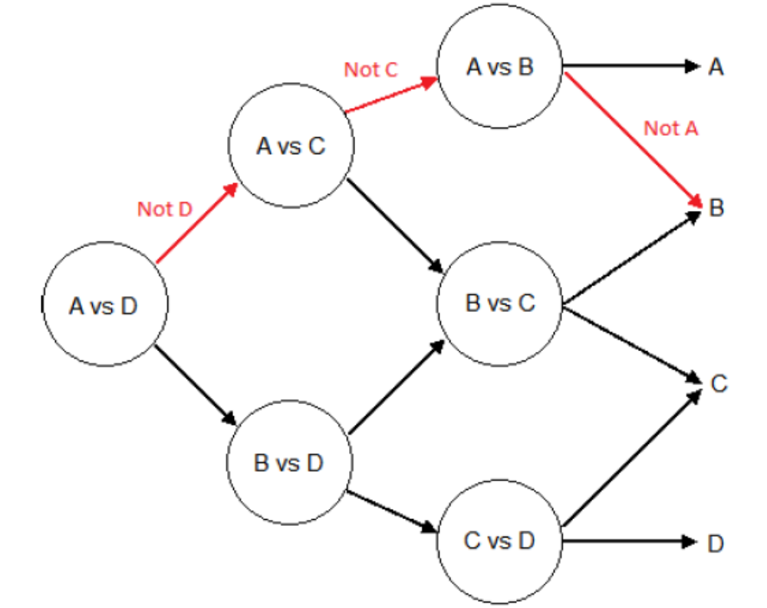
Directed Acyclic Graph SVM (DAGSVM)
The idea behind DAGSVM is to use the same training as one-against-one, but to speed up testing by using a directed acyclic graph (DAG) to choose which classifiers to use.
If we have four classes A, B, C, and D, and six classifiers trained each on a pair of classes: (A, B); (A, C); (A, D); (B, C); (B, D); and (C, D). We use the first classifier, (A, D), and it predicts class A, which is the same as predicting not class D, and the second classifier also predicts class A (not class C). It means that classifiers (B, D), (B, C) or (C, D) can be ignored because we already know the class is neither C nor D. The last “useful” classifier is (A, B), and if it predicts B, we assign the class B to the data-point. This example is illustrated with the red path in Figure . Each node of the graph is a classifier for a pair of class.
In general, for a problem with K classes, K-1 decision nodes will be evaluated.
Illustration of the path used to make a prediction along a Directed Acyclic graph

Slide 18
Overview of multi-class SVM methods
Method name | One-against-all | One-against-one | Weston and Watkins | DAGSVM | Crammer and Singer
First SVMs usage | 1995 | 1996 | 1999 | 2000 | 2001
Approach | Use several binary classifiers | Use several binary classifiers | Solve a single optimization problem | Use several binary classifiers | Solve a single optimization problem
Training approach | Train a single classifier for each class | Train a classifier for each pair of classes | Decomposition method | Same as one-against-one | Decomposition method
Number of trained classifiers | K | K(K-1)/2 | 1 | K(K-1)/2 | 1
Testing approach | Select the class with the biggest decision function value | “Max-Wins” voting strategy | Use the classifier | Use a DAG to make predictions on K-1 classifiers | Use the classifier
Drawbacks | Class imbalance | Long training time for large K | Long training time | Not available in popular libraries | Long training

Slide 19
Tips from Andrew Ng : Logistic regression vs. SVMs
n – number of features, m – number of training examples.
If n is large (relative to m): (example: n=10000, m=10-1000)
  Use logistic regression, or SVM without a kernel (“linear kernel”)
If n is small, m is intermediate (example: n=1-1000, m=10-10000)
    Use SVM with Gaussian kernel
If n is small, m is large: (example: n=1-1000, m=50000)
    Create/add more features, then use logistic regression or SVM without a kernel

Slide 20
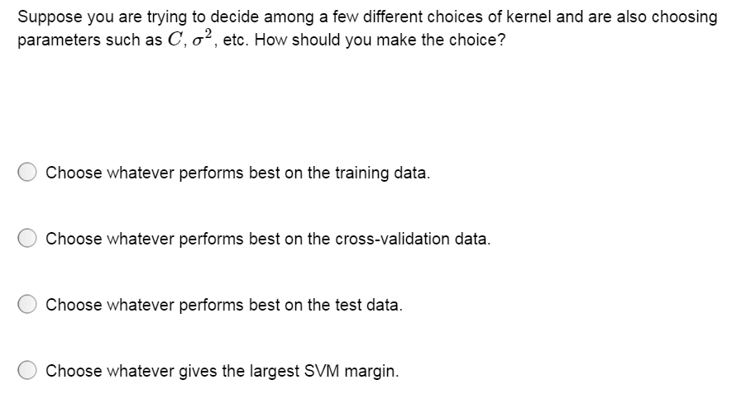

Slide 21
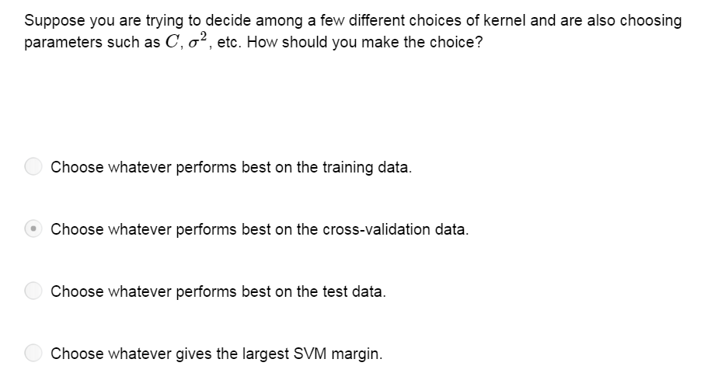

Slide 22
Summary
Weaknesses
  Training (and Testing) is quite slow compared to ANN
      Because of Constrained Quadratic Programming
  Essentially a binary classifier
      However, there are some tricks to evade this.
  Very sensitive to noise
      A few off data points can completely throw off the algorithm
  Biggest Drawback: The choice of Kernel function.
      There is no “set-in-stone” theory for choosing a kernel function for any given problem
Strengths
  Training is relatively easy
      We don’t have to deal with local minimum like in ANN
      SVM solution is always global and unique (check “Burges” paper for proof and justification).
  Unlike ANN, doesn’t suffer from “curse of dimensionality”.
      We have infinite dimensions?! Maximum Margin Constraint: DOT-PRODUCTS!
  Less prone to overfitting
  Simple, easy to understand geometric interpretation.

Slide 23
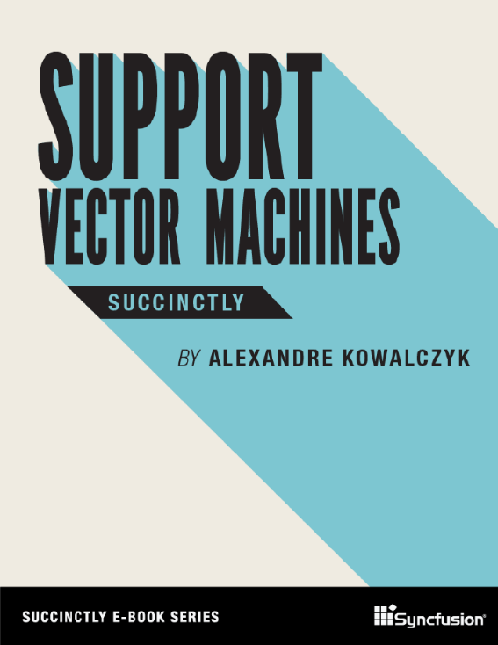
Reading Materials
Support Vector Machines. Alexandre Kowalczyk.
https://www.syncfusion.com/ebooks/support_vector_machines_succinctly

