Slide 1
Support Vector Machines
for linearly separable data
Dr. Samir Rustamov

Slide 2
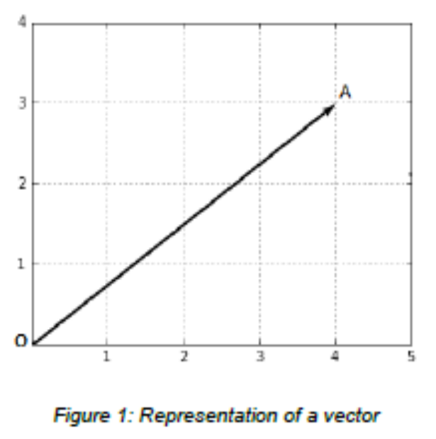
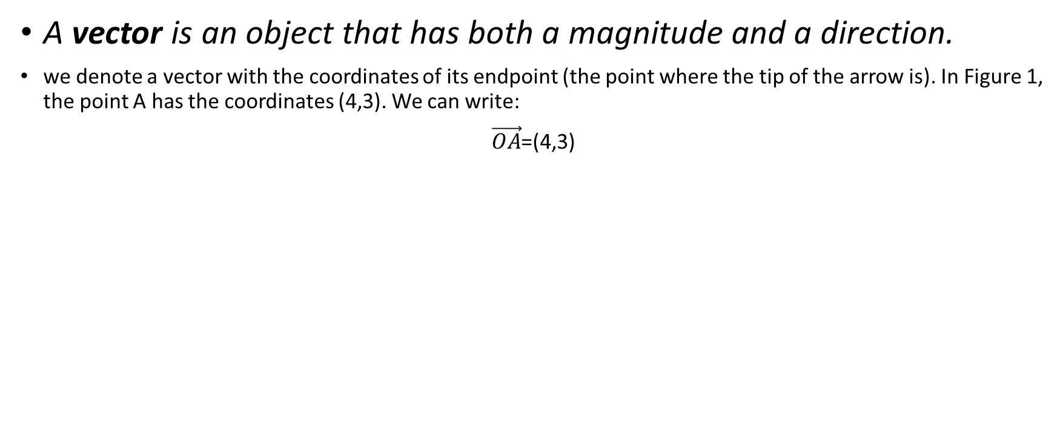
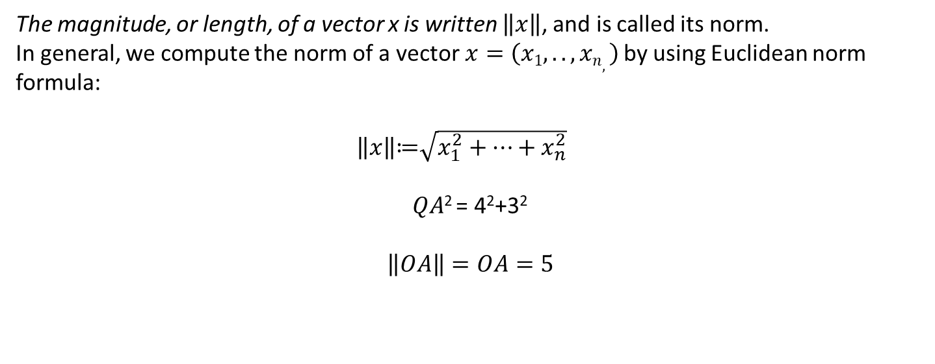
Prerequisites: Vectors
A vector is an object that has both a magnitude and a direction.
we denote a vector with the coordinates of its endpoint (the point where the tip of the arrow is). In Figure 1, the point A has the coordinates (4,3). We can write:
$\vec{OA}$=(4,3)
The magnitude, or length, of a vector x is written $\left\|x\right\|$, and is called its norm.
In general, we compute the norm of a vector$x=\left(x1,..,xn,\right)$ by using Euclidean norm formula:
$\left\|x\right\|$≔$\sqrt{x_{1}^{2}+…+x_{n}^{2}}$
$QA$² = 4²+3²
$$\left\|OA\right\|=OA=5$$

Slide 3
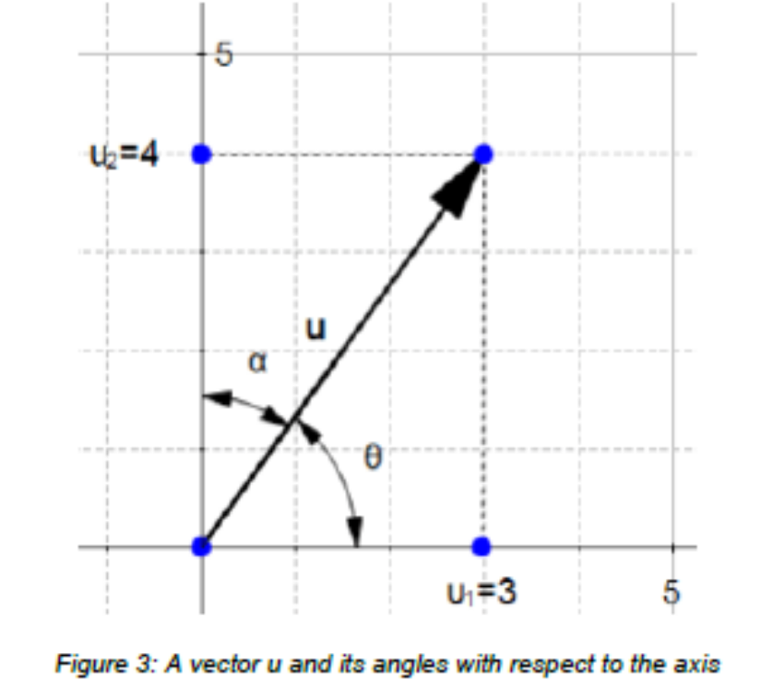
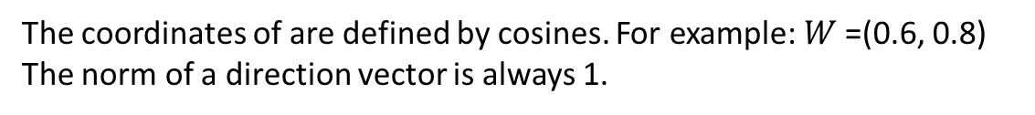



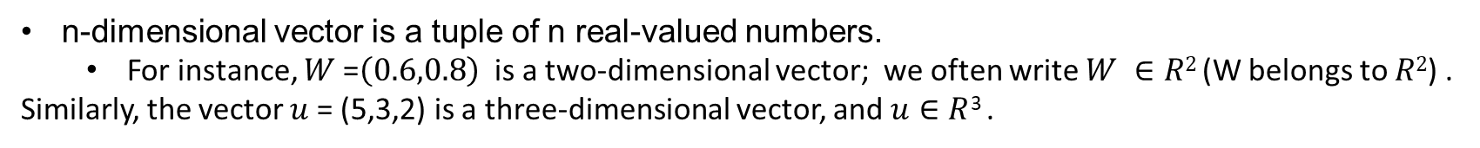
Direction of vector
$$u=\left(u1,u2\right)$$
The direction of a vector is the vector:
$$W=\left(\frac{u1}{\left\|u\right\|},\frac{u2}{\left\|u\right\|}\right)$$
$W=\left(\frac{u1}{\left\|u\right\|},\frac{u2}{\left\|u\right\|}\right)$=$\left(\cos\left(θ\right),\cos{(α)}\right)$
The coordinates of are defined by cosines. For example: $W$=(0.6, 0.8)
The norm of a direction vector is always 1.
n-dimensional vector is a tuple of n real-valued numbers.
  For instance, $W$=$\left(0.6,0.8\right)$ is a two-dimensional vector; we often write $W ∈R2$ (W belongs to $R2$) .
Similarly, the vector $u$= (5,3,2) is a three-dimensional vector, and $u∈R$³ .

Slide 4
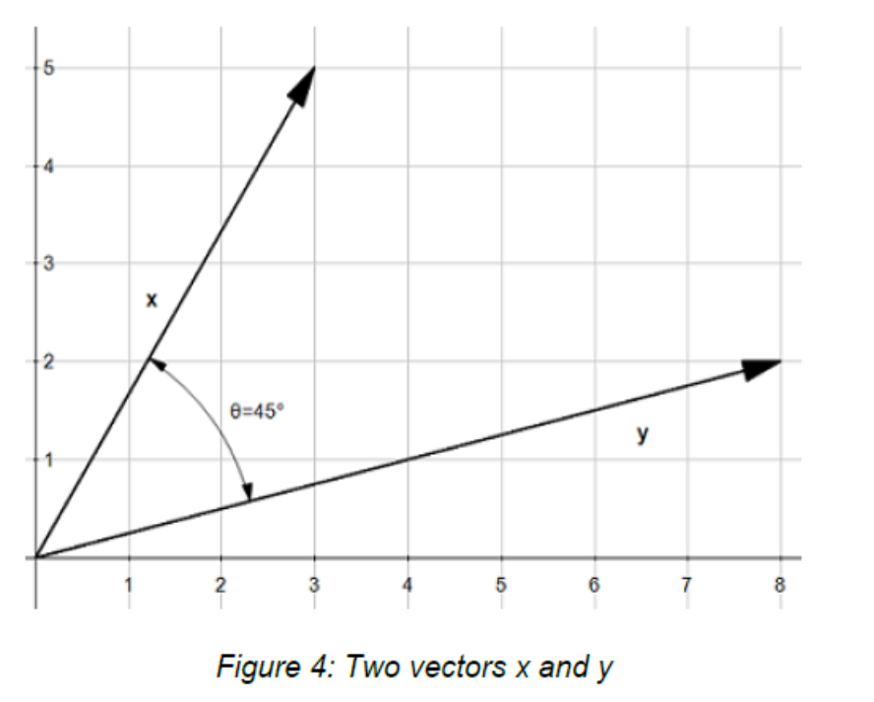
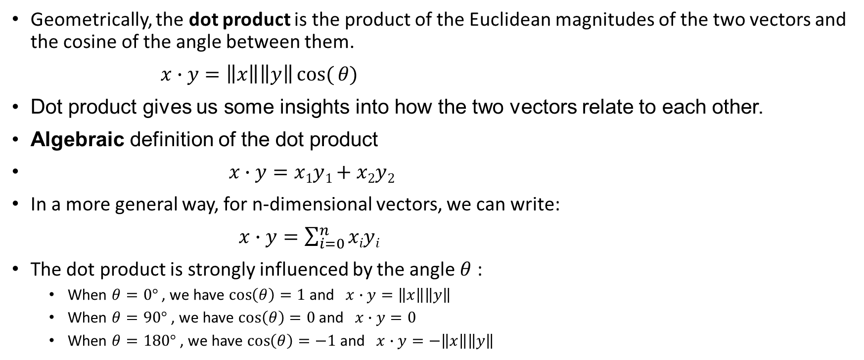
Dot product or scalar product
Geometrically, the dot product is the product of the Euclidean magnitudes of the two vectors and the cosine of the angle between them.
$x∙y=\left\|x\right\|\left\|y\right\|cos({θ)}$
Dot product gives us some insights into how the two vectors relate to each other.
Algebraic definition of the dot product
$x∙y=x1y1+x2y2$
In a more general way, for n-dimensional vectors, we can write:
$x∙y=\sum_{i=0}^{n}{xiyi}$
The dot product is strongly influenced by the angle $θ$ :
  When $θ=0°$ , we have $\cos\left(θ\right)=1$and $x∙y=\left\|x\right\|\left\|y\right\|$
  When $θ=90°$ , we have $\cos\left(θ\right)=0$and $x∙y=0$
  When $θ=180°$ , we have $\cos\left(θ\right)=−1$and $x∙y=−\left\|x\right\|\left\|y\right\|$

Slide 5
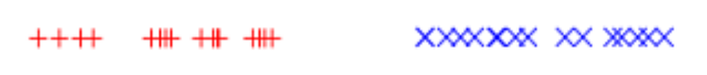
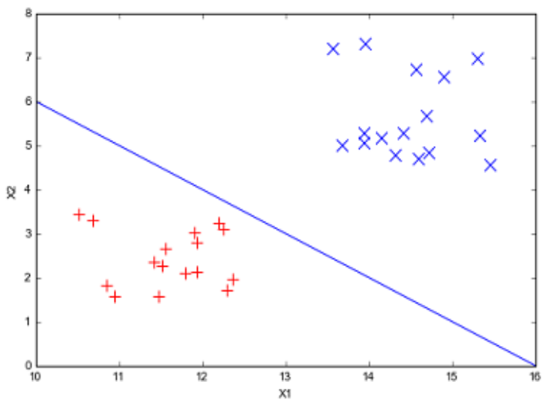
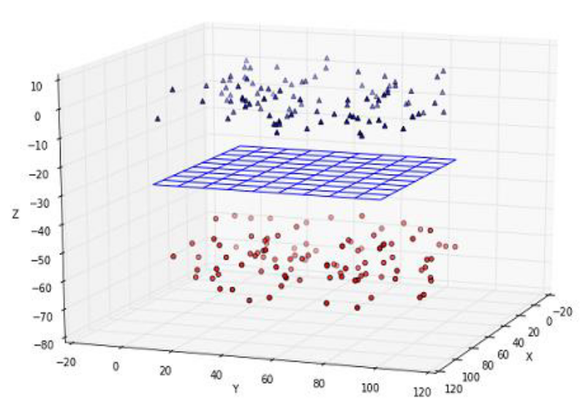
Linearly separable data
In one dimension, you can find a point separating the data
In two dimensions, you can find a line separating the data
In three dimensions, you can find a plane separating the data

Slide 6
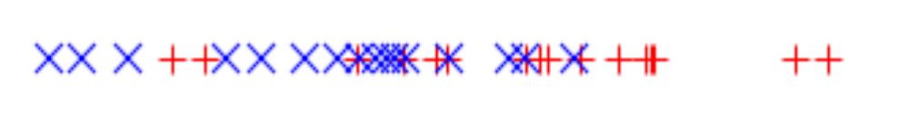
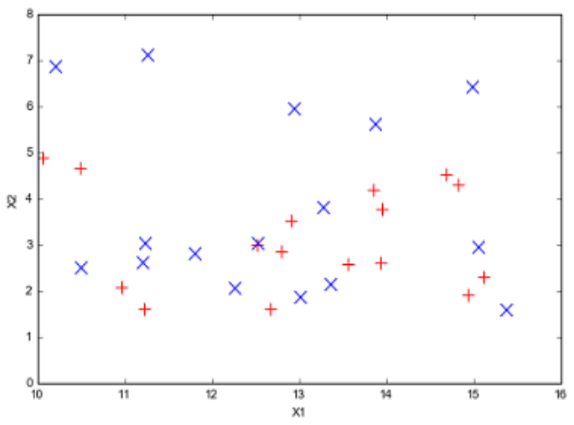
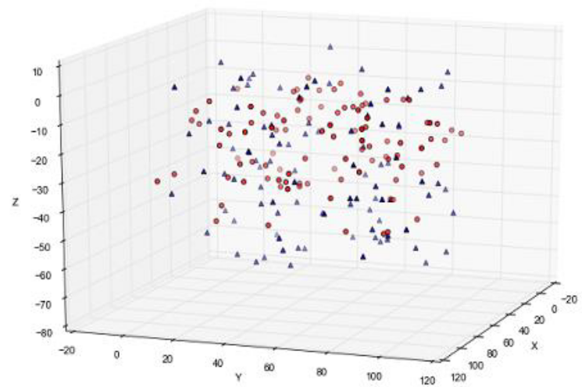
Example: non-linearly separable data
When data is non-linearly separable, we cannot find a separating point, line, or plane.
Non-linearly separable data in 1D
Non-linearly separable data in 2D
Non-linearly separable data in 3D

Slide 7
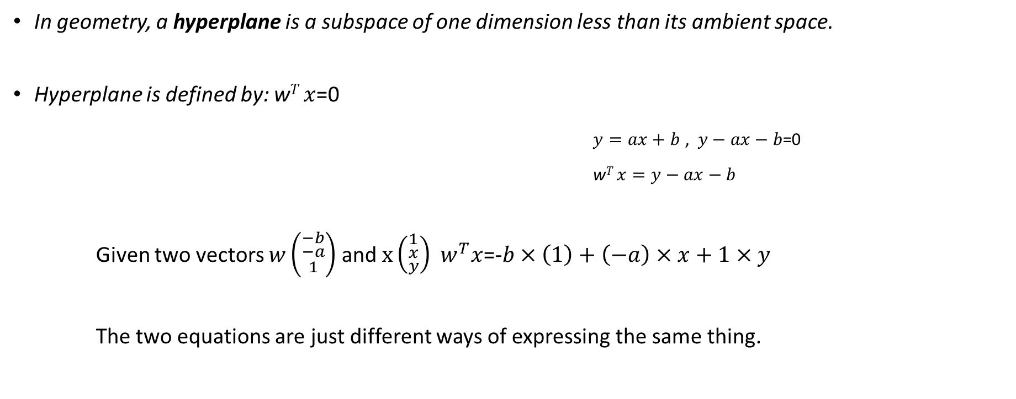
Hyperplanes
In geometry, a hyperplane is a subspace of one dimension less than its ambient space.
Hyperplane is defined by: w$T x$=0
$y=ax+b$ , $y−ax−b\text{=0}$
w$T x=y−ax−b$
Given two vectors $w\left({\begin{aligned}−b \\ −a\end{aligned} \atop 1}\right)$ and $x\left({\begin{aligned}1 \\ x\end{aligned} \atop y}\right)$ $w^{T}x$=-$b×\left(1\right)+\left(−a\right)×x+1×y$
The two equations are just different ways of expressing the same thing.

Slide 8
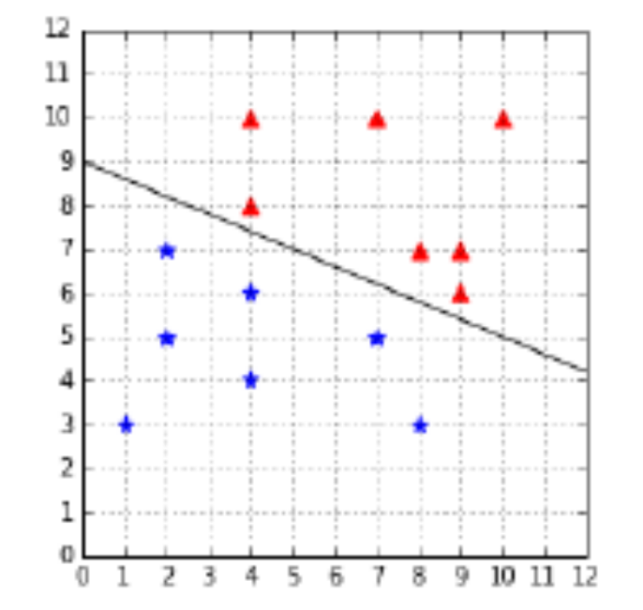
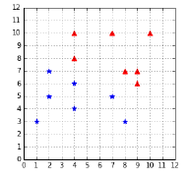
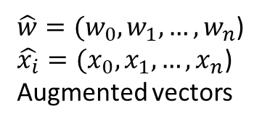
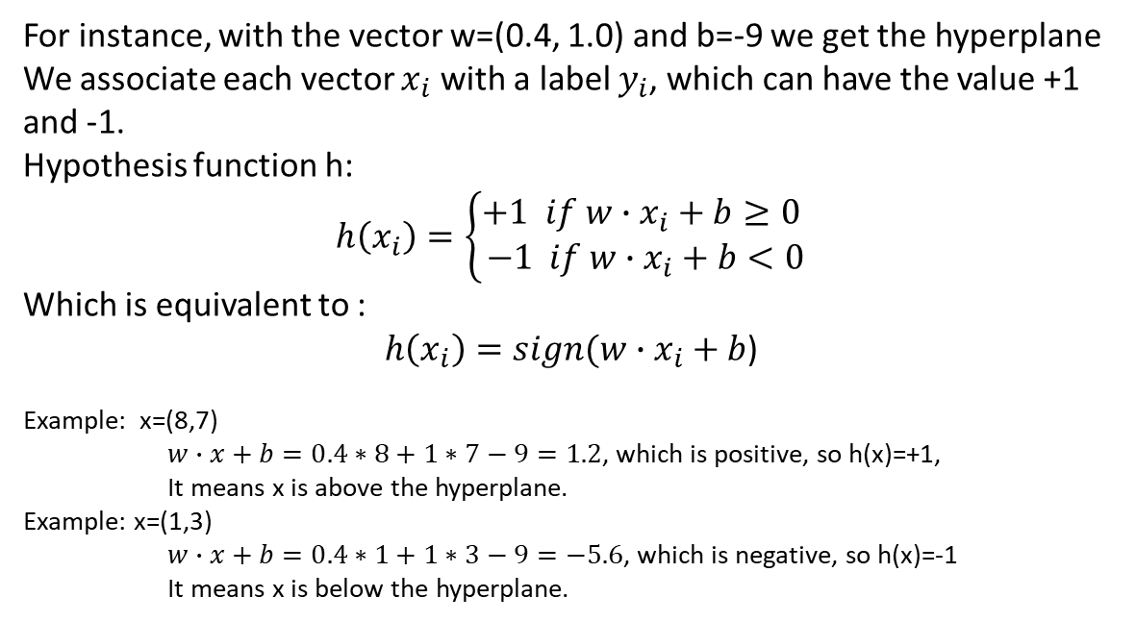

Classifying data with a hyperplane
For instance, with the vector w=(0.4, 1.0) and b=-9 we get the hyperplane
We associate each vector $x_{i}$ with a label $y_{i}$, which can have the value +1 and -1.
Hypothesis function h:
$$h\left(x_{i}\right)=\left\{\begin{aligned}+1 if w∙x_{i}+b≥0 \\ −1 if w∙x_{i}+b<0\end{aligned}\right.$$
Which is equivalent to :
$h\left(x_{i}\right)=sign(w∙x_{i}+b$)
Example: x=(8,7)
$w∙x+b=0.4∗8+1∗7−9=1.2$, which is positive, so h(x)=+1,
It means x is above the hyperplane.
Example: x=(1,3)
$w∙x+b=0.4∗1+1∗3−9=−5.6$, which is negative, so h(x)=-1
It means x is below the hyperplane.
We add a component $x_{0}=1$ and $w_{0}=b$ then we get
$h\left(x_{i}\right)=sign(\hat{w}∙\hat{x_{i}}$)
$\hat{w}=(w_{0},w_{1},…,w_{n}$)
$\hat{x_{i}}=(x_{0},x_{1},…,x_{n}$)
Augmented vectors
We use augmented vectors

Slide 9
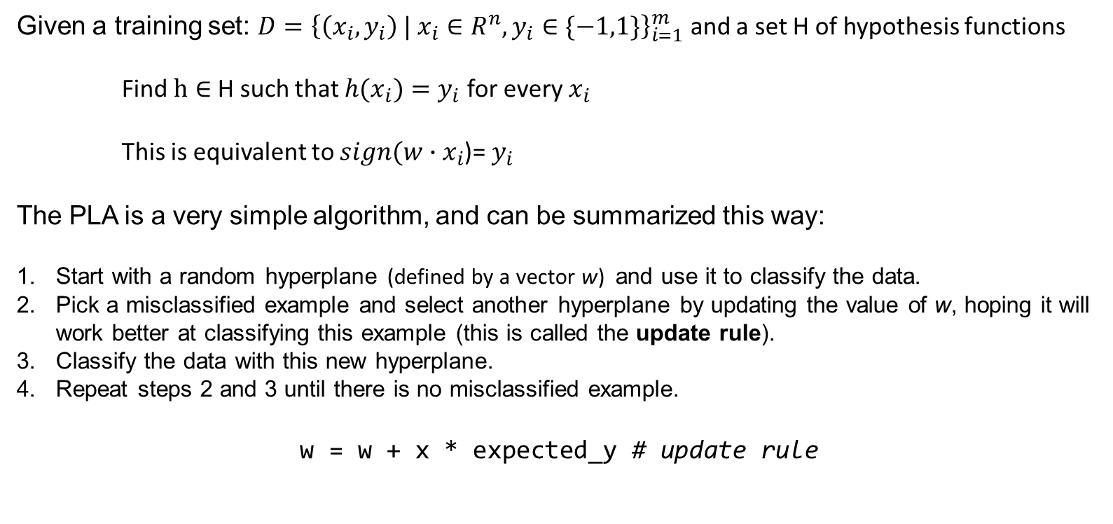
The Perceptron learning algorithm
Given a training set: $D={\left\{\left(x_{i},y_{i}\right) | x_{i}∈R^{n},y_{i}∈\{−1,1\}\right\}}_{i=1}^{m}$ and a set H of hypothesis functions
Find $h∈$ H such that ${h(x}_{i})=y_{i}$ for every $x_{i}$
This is equivalent to $sign(w∙x_{i}$)= $y_{i}$
The PLA is a very simple algorithm, and can be summarized this way:
Start with a random hyperplane (defined by a vector w) and use it to classify the data.
Pick a misclassified example and select another hyperplane by updating the value of w, hoping it will work better at classifying this example (this is called the update rule).
Classify the data with this new hyperplane.
Repeat steps 2 and 3 until there is no misclassified example.
w = w + x * expected_y # update rule

Slide 10
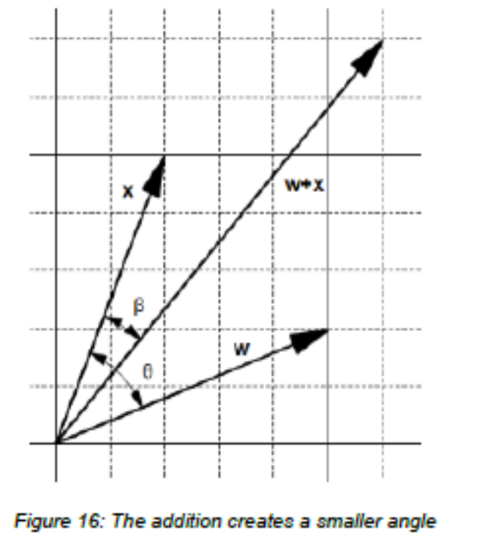
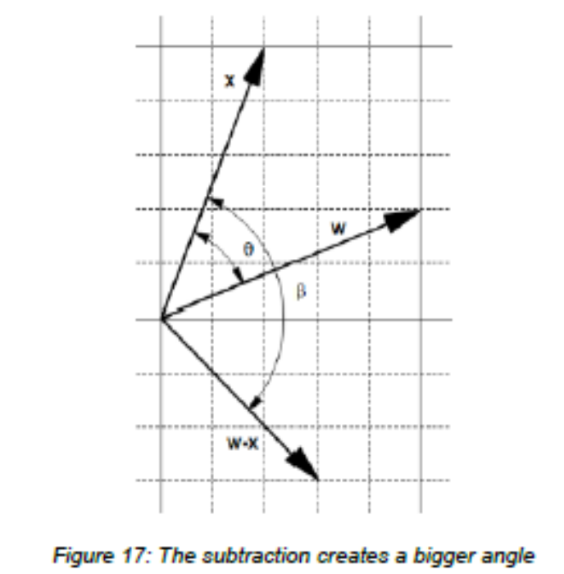
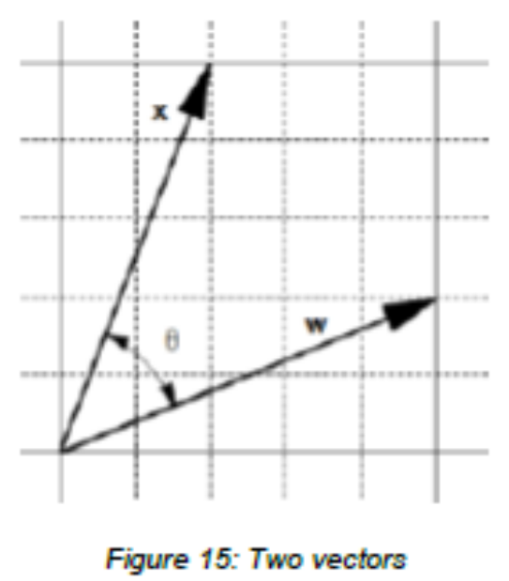
Understanding the update rule
We can use these two observations to adjust the angle:
If the predicted label is 1, the angle is smaller than $90°$. We want to increase the angle, so we set w:=w-x.
If the predicted label is -1, the angle is bigger than $90°$. We want to decrease the angle, so we set w:=w+x

Slide 11
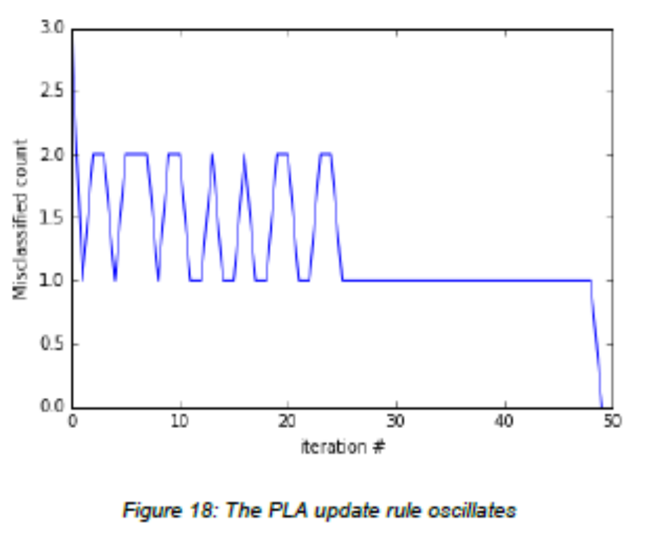
Convergence of the algorithm
Sometimes updating the value of w for a particular example changes the hyperplane in such a way that another example x* previously correctly classified becomes misclassified. So, the hypothesis might become worse at classifying after being updated. This is illustrated in Figure 18, which shows us the number of classified examples at each iteration step.
One way to avoid this problem is to keep a record of the value of before making the update and use the updated only if it reduces the number of misclassified examples. This modification of the PLA is known as the Pocket algorithm (because we keep in our pocket).
Perceptron convergence theorem guarantees that if the two sets P and N (of positive and negative examples respectively) are linearly separable, the vector w is updated only a finite number of times, which was first proved by Novikoff in 1963 (Rojas, 1996).

Slide 12
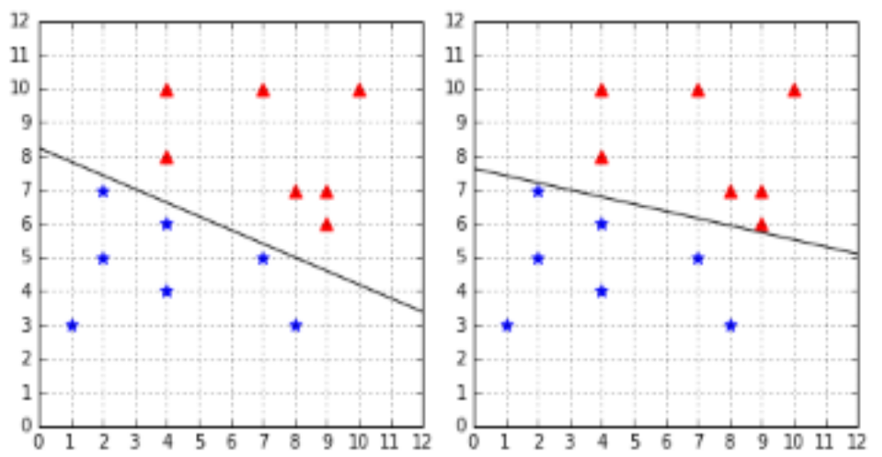
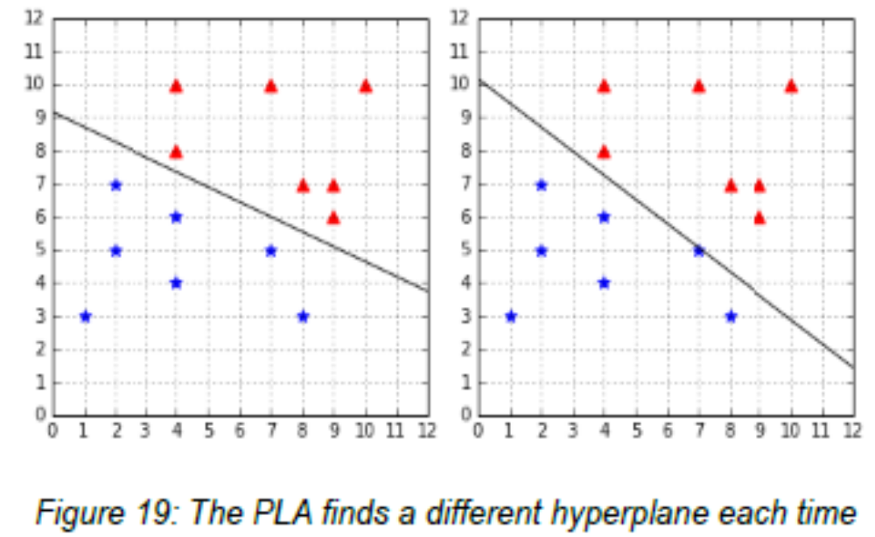
Understanding the limitations of the PLA
One thing to understand about the PLA algorithm is that because weights are randomly initialized and misclassified examples are randomly chosen, it is possible the algorithm will return a different hyperplane each time we run it.

Slide 13
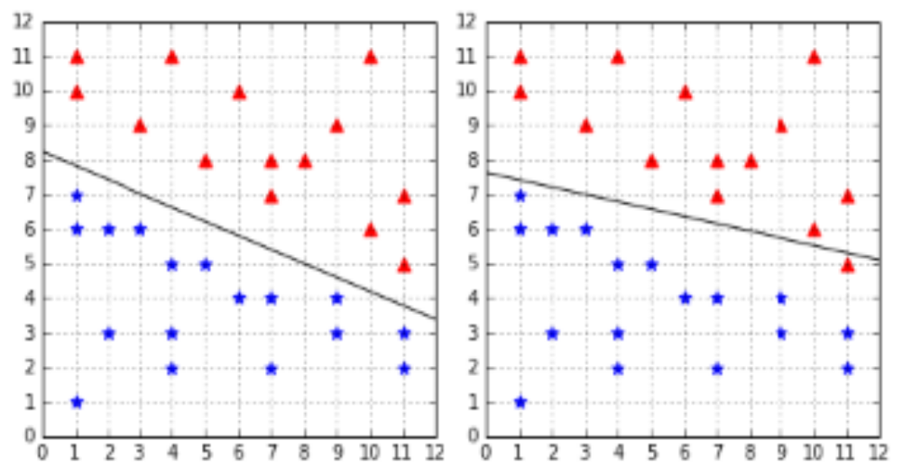
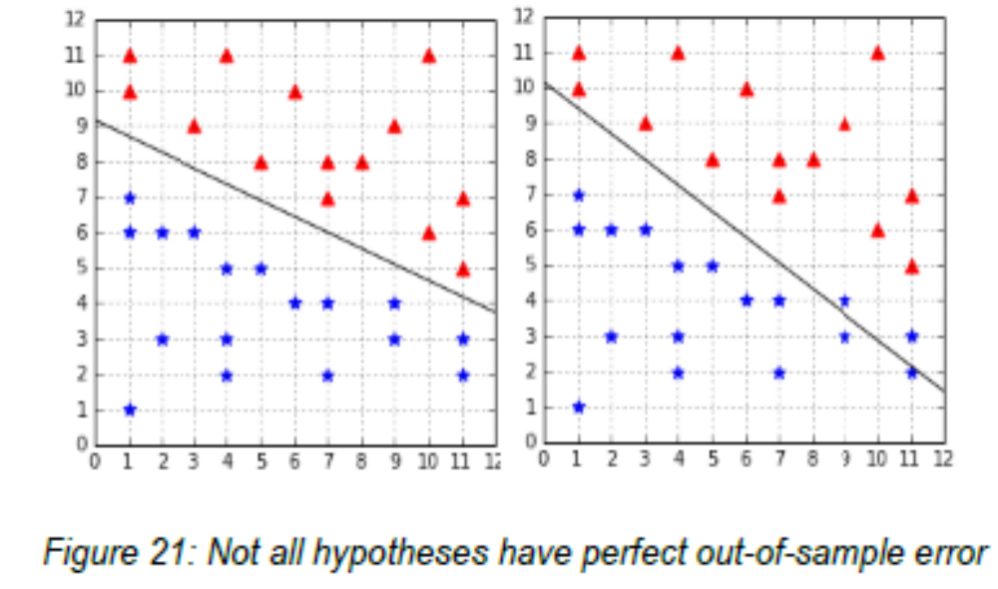
Generalization
When using the Perceptron with a linearly separable dataset, we have the guarantee of finding a hypothesis with zero in-sample error (training error), but we have no guarantee about how well it will generalize to unseen data (the test set)
If an algorithm generalizes well, its out-of-sample error will be close to its in-sample error. How can we choose a hyperplane that generalizes well? This is one of the goals of SVMs.

Slide 14
SVMs search for the optimal hyperplane
The Perceptron has several advantages: It is a simple model, the algorithm is very easy to implement, and we have a theoretical proof that it will find a hyperplane that separates the data.
However, its biggest weakness is that it will not find the same hyperplane every time. Why do we care? Because not all separating hyperplanes are equals.
If the Perceptron gives you a hyperplane that is very close to all the data points from one class, you have a right to believe that it will generalize poorly when given new data.
SVMs do not have this problem. Instead of looking for a hyperplane, SVMs tries to find the optimal hyperplane which best separates the data.

Slide 15
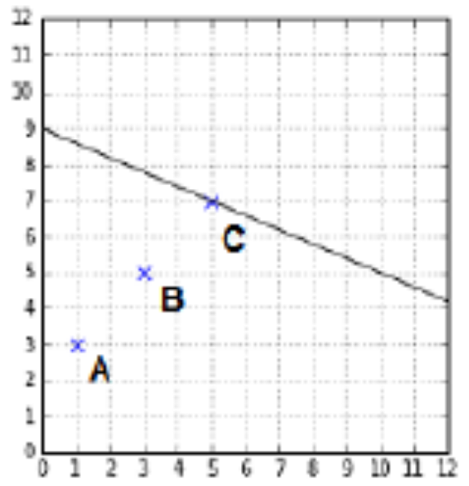
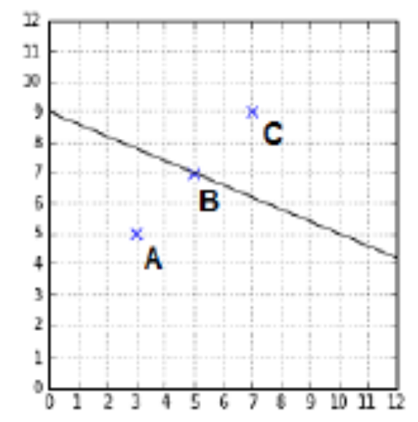
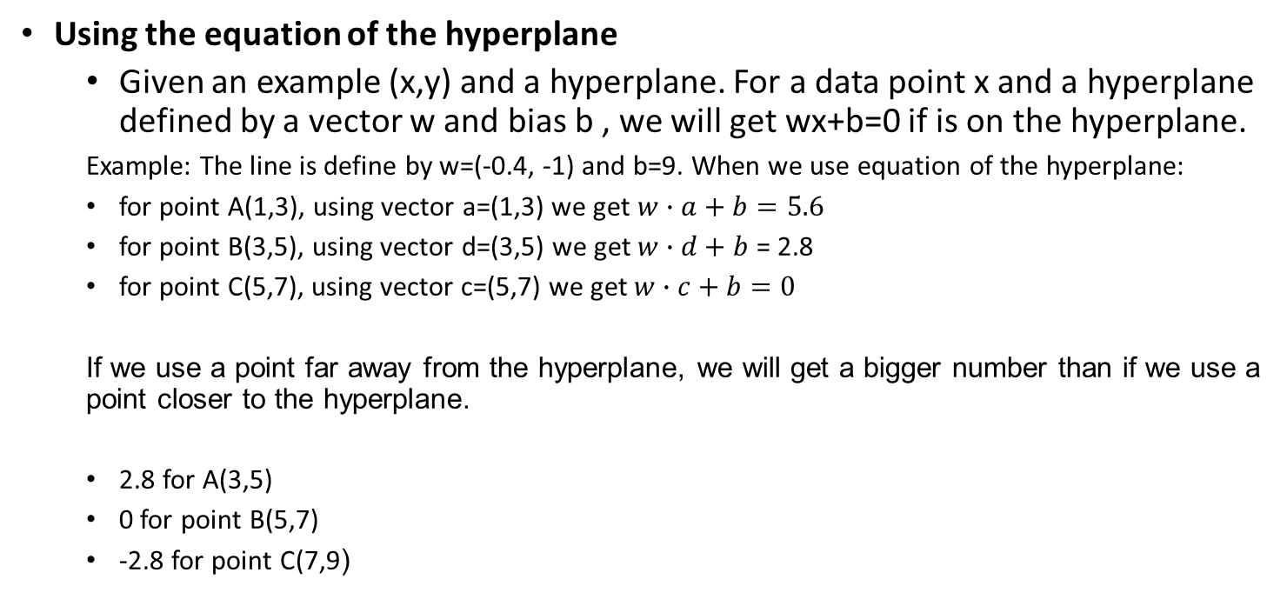
How can we compare two hyperplanes?
Using the equation of the hyperplane
  Given an example (x,y) and a hyperplane. For a data point x and a hyperplane defined by a vector w and bias b , we will get wx+b=0 if is on the hyperplane.
  Example: The line is define by w=(-0.4, -1) and b=9. When we use equation of the hyperplane:
  for point A(1,3), using vector a=(1,3) we get $w∙a+b=5.6$
  for point B(3,5), using vector d=(3,5) we get $w∙d+b$ = 2.8
  for point C(5,7), using vector c=(5,7) we get $w∙c+b=0$
  If we use a point far away from the hyperplane, we will get a bigger number than if we use a point closer to the hyperplane.
  2.8 for A(3,5)
  0 for point B(5,7)
  -2.8 for point C(7,9)

Slide 16
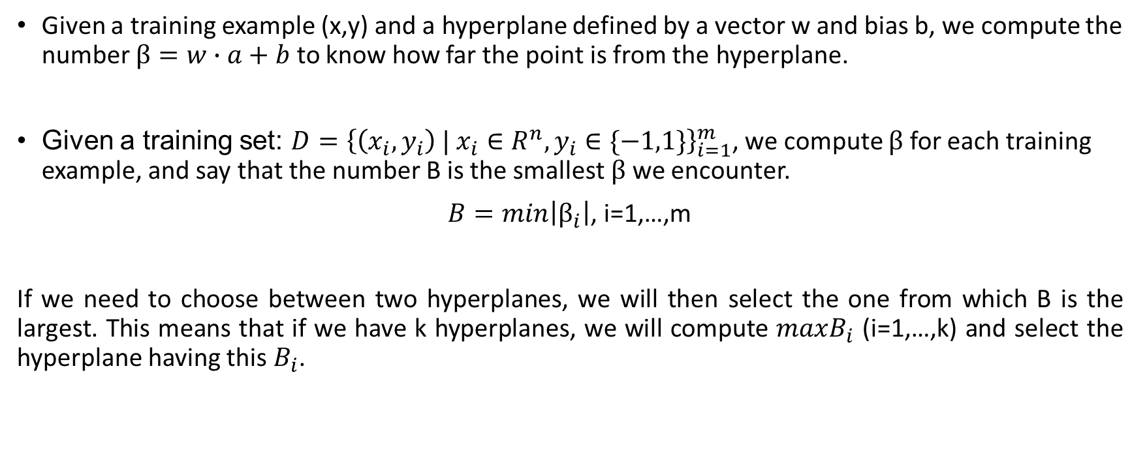
How can we compare two hyperplanes?
Given a training example (x,y) and a hyperplane defined by a vector w and bias b, we compute the number $β=w∙a+b$ to know how far the point is from the hyperplane.
Given a training set: $D={\left\{\left(x_{i},y_{i}\right) | x_{i}∈R^{n},y_{i}∈\{−1,1\}\right\}}_{i=1}^{m}$, we compute $β$ for each training example, and say that the number B is the smallest $β$ we encounter.
$B=min\left|β_{i}\right|$, i=1,…,m
If we need to choose between two hyperplanes, we will then select the one from which B is the largest. This means that if we have k hyperplanes, we will compute $maxB_{i}$ (i=1,…,k) and select the hyperplane having this $B_{i}$.

Slide 17
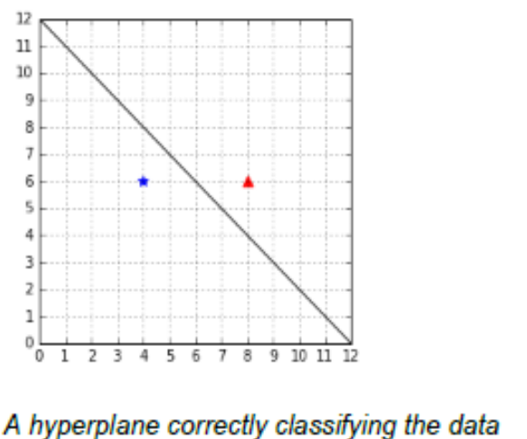
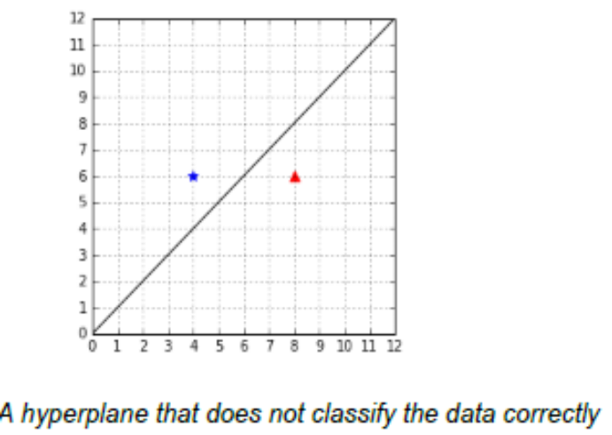
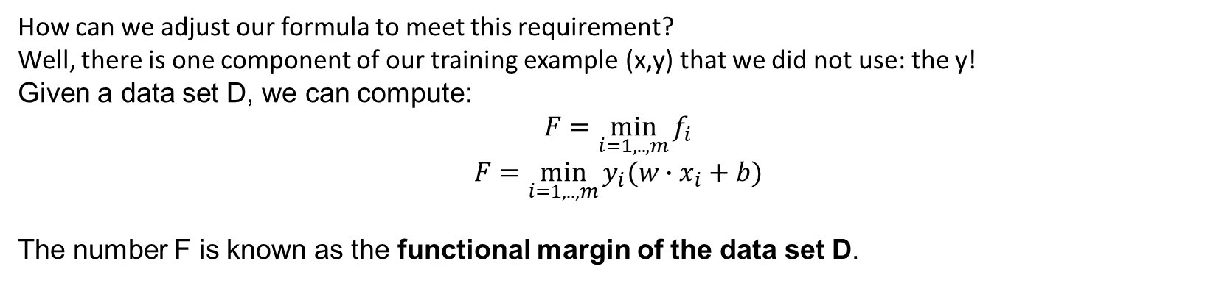
Does the hyperplane correctly classify the data?
Computing the number B allows us to select a hyperplane.
How can we adjust our formula to meet this requirement?
Well, there is one component of our training example (x,y) that we did not use: the y!
Given a data set D, we can compute:
$$F=\min_{i=1,..,m}{f_{i}}$$
$$F=\min_{i=1,..,m}{y_{i}(w∙x_{i}+b)}$$
The number F is known as the functional margin of the data set D.

Slide 18
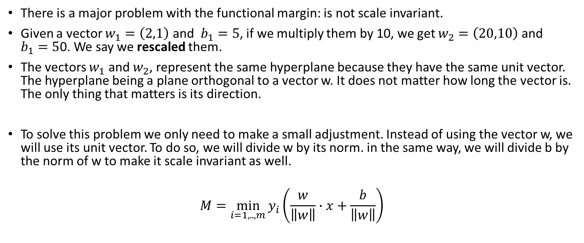
Scale invariance
There is a major problem with the functional margin: is not scale invariant.
Given a vector $w_{1}=\left(2,1\right)$ and $b_{1}=5$, if we multiply them by 10, we get $w_{2}=\left(20,10\right)$ and $b_{1}=5$0. We say we rescaled them.
The vectors $w_{1}$ and $w_{2}$, represent the same hyperplane because they have the same unit vector. The hyperplane being a plane orthogonal to a vector w. It does not matter how long the vector is. The only thing that matters is its direction.
To solve this problem we only need to make a small adjustment. Instead of using the vector w, we will use its unit vector. To do so, we will divide w by its norm. in the same way, we will divide b by the norm of w to make it scale invariant as well.
$$M=\min_{i=1,..,m}{y_{i}}\left(\frac{w}{\left\|w\right\|}∙x+\frac{b}{\left\|w\right\|}\right)$$

Slide 19
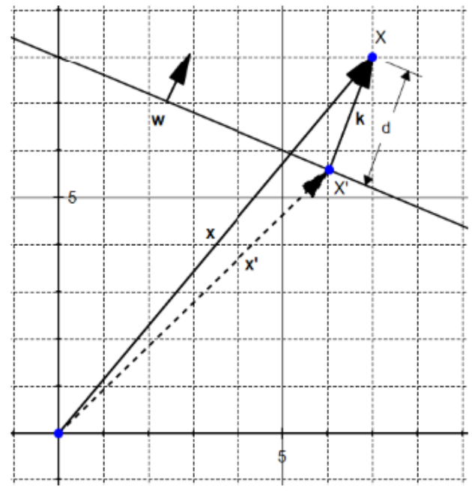
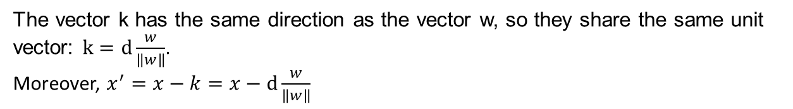
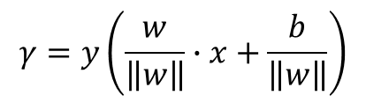
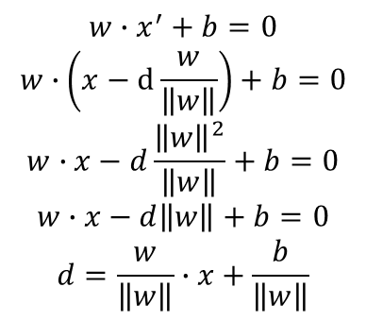
Finding the optimal hyperplane
The vector k has the same direction as the vector w, so they share the same unit vector: $k=d\frac{w}{\left\|w\right\|}$.
Moreover, $x^{′}=x−k=x−d\frac{w}{\left\|w\right\|}$
$$w∙x^{′}+b=0$$
$$w∙\left(x−d\frac{w}{\left\|w\right\|}\right)+b=0$$
$$w∙x−d\frac{{\left\|w\right\|}^{2}}{\left\|w\right\|}+b=0$$
$$w∙x−d\left\|w\right\|+b=0$$
$$d=\frac{w}{\left\|w\right\|}∙x+\frac{b}{\left\|w\right\|}$$
We multiply by to ensure that we select a hyperplane that correctly classifies the data, and it gives us the geometric margin formula
$$γ=y\left(\frac{w}{\left\|w\right\|}∙x+\frac{b}{\left\|w\right\|}\right)$$

Slide 20
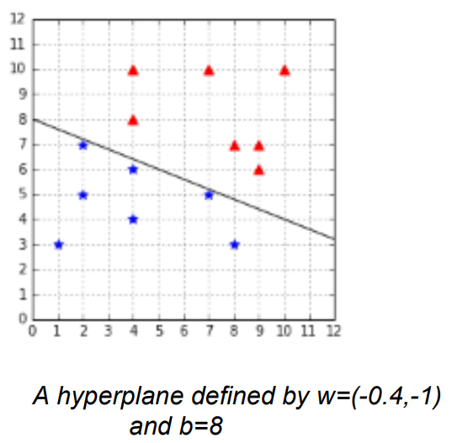
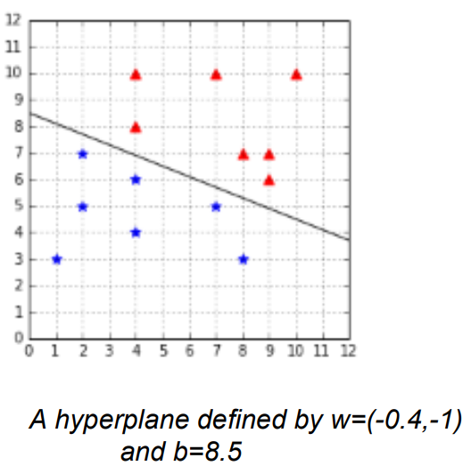
Finding the optimal hyperplane
Example:
The geometric margin of the second hyperplane defined by w=(-0.4,-1) and b=0.85 is larger (0.64 > 0.18). Between the two, we would select this hyperplane.
Finding the optimal hyperplane is just a matter of finding the values of w and b for which we get the largest geometric margin.

Slide 21
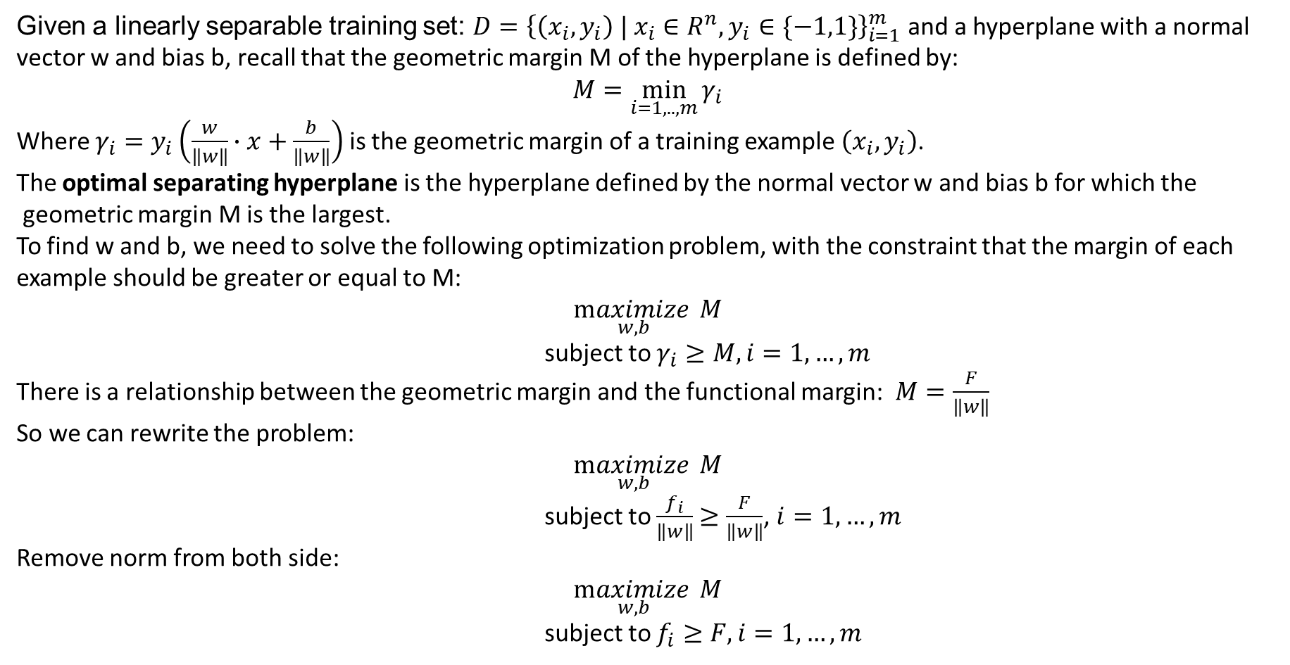
The SVMs optimization problem
Given a linearly separable training set: $D={\left\{\left(x_{i},y_{i}\right) | x_{i}∈R^{n},y_{i}∈\{−1,1\}\right\}}_{i=1}^{m}$ and a hyperplane with a normal
vector w and bias b, recall that the geometric margin M of the hyperplane is defined by:
$$M=\min_{i=1,..,m}{γ_{i}}$$
Where $γ_{i}=y_{i}\left(\frac{w}{\left\|w\right\|}∙x+\frac{b}{\left\|w\right\|}\right)$ is the geometric margin of a training example $\left(x_{i},y_{i}\right)$.
The optimal separating hyperplane is the hyperplane defined by the normal vector w and bias b for which the
geometric margin M is the largest.
To find w and b, we need to solve the following optimization problem, with the constraint that the margin of each example should be greater or equal to M:
$$\underset{w,b}{maximize}{M}$$
subject to $γ_{i}≥M, i=1,…,m$
There is a relationship between the geometric margin and the functional margin: $M=\frac{F}{\left\|w\right\|}$
So we can rewrite the problem:
$$\underset{w,b}{maximize}{M}$$
subject to $\frac{f_{i}}{\left\|w\right\|}$ $≥\frac{F}{\left\|w\right\|}$, $i=1,…,m$
Remove norm from both side:
$$\underset{w,b}{maximize}{M}$$
subject to $f_{i}≥F, i=1,…,m$

Slide 22
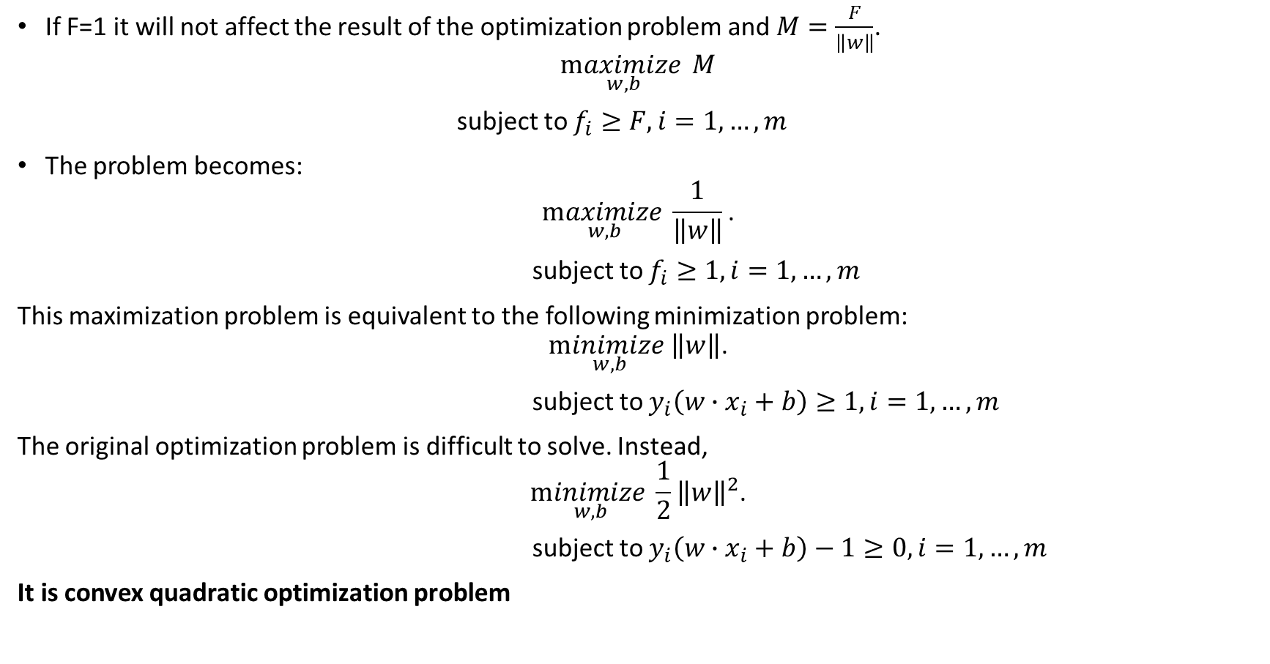
The SVMs optimization problem
If F=1 it will not affect the result of the optimization problem and $M=\frac{F}{\left\|w\right\|}$.
$$\underset{w,b}{maximize}{M}$$
subject to $f_{i}≥F, i=1,…,m$
The problem becomes:
$$\underset{w,b}{maximize}{\frac{1}{\left\|w\right\|}\text{.}}$$
subject to $f_{i}≥1, i=1,…,m$
This maximization problem is equivalent to the following minimization problem:
$$\underset{w,b}{minimize}\left\|w\right\|\text{.}$$
subject to $y_{i}\left(w∙x_{i}+b\right)≥1, i=1,…,m$
The original optimization problem is difficult to solve. Instead,
$$\underset{w,b}{minimize}{\frac{1}{2}{\left\|w\right\|}^{2}\text{.}}$$
subject to $y_{i}\left(w∙x_{i}+b\right)−1≥0, i=1,…,m$
It is convex quadratic optimization problem

Slide 23
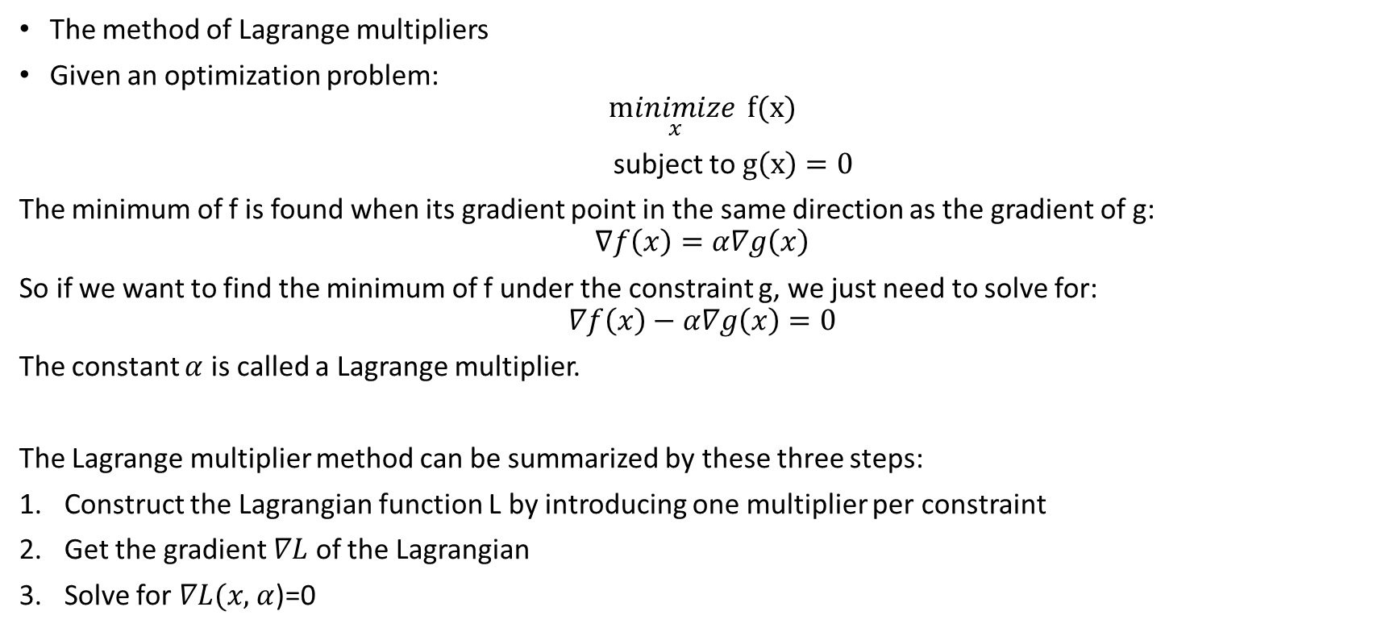
Solving the Optimization Problem
The method of Lagrange multipliers
Given an optimization problem:
$$\underset{x}{minimize}{\text{f}\text{(}\text{x}\text{)}}$$
subject to $g\left(x\right)=0$
The minimum of f is found when its gradient point in the same direction as the gradient of g:
$$∇f\left(x\right)=α∇g\left(x\right)$$
So if we want to find the minimum of f under the constraint g, we just need to solve for:
$$∇f\left(x\right)−α∇g\left(x\right)=0$$
The constant $α$ is called a Lagrange multiplier.
The Lagrange multiplier method can be summarized by these three steps:
Construct the Lagrangian function L by introducing one multiplier per constraint
Get the gradient $∇L$ of the Lagrangian
Solve for $∇L(x,$ $α$)=0

Slide 24
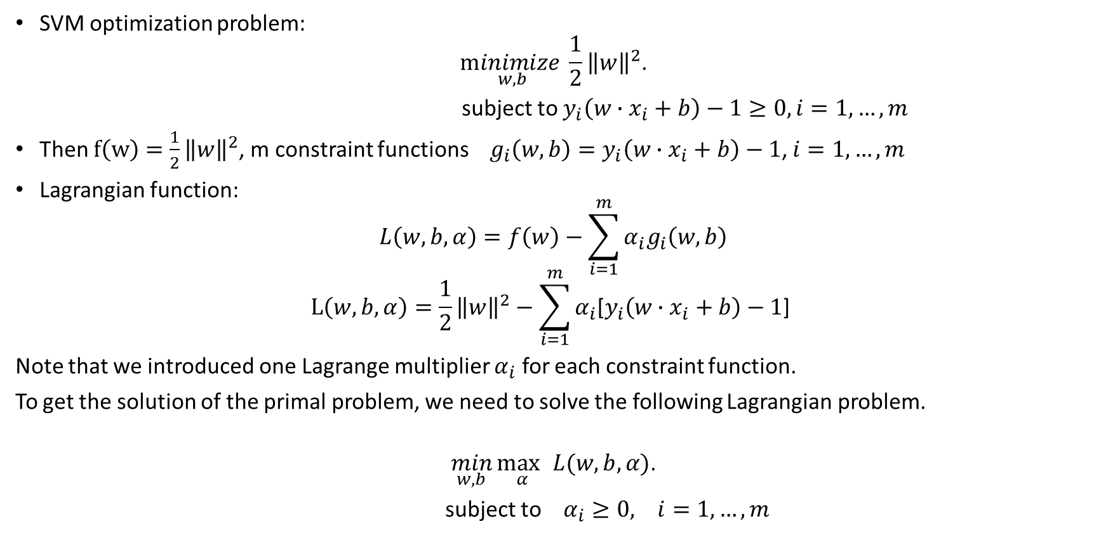
The SVM Lagrangian problem
SVM optimization problem:
$$\underset{w,b}{minimize}{\frac{1}{2}{\left\|w\right\|}^{2}\text{.}}$$
subject to $y_{i}\left(w∙x_{i}+b\right)−1≥0, i=1,…,m$
Then $f\left(w\right)=\frac{1}{2}{\left\|w\right\|}^{2}$, m constraint functions $g_{i}\left(w,b\right)=y_{i}\left(w∙x_{i}+b\right)−1$, $i=1,…,m$
Lagrangian function:
$$L\left(w,b,α\right)=f\left(w\right)−\sum_{i=1}^{m}{{α_{i}g}_{i}\left(w,b\right)}$$
$$L\left(w,b,α\right)=\frac{1}{2}{\left\|w\right\|}^{2}−\sum_{i=1}^{m}{α_{i}\text{[}y_{i}\left(w∙x_{i}+b\right)−1\text{] }}$$
Note that we introduced one Lagrange multiplier $α_{i}$ for each constraint function.
To get the solution of the primal problem, we need to solve the following Lagrangian problem.
$$\min_{w,b}{\underset{α}{\max{ }}L(w,b,α)\text{.}}$$
subject to $α_{i}≥0, i=1,…,m$

Slide 25
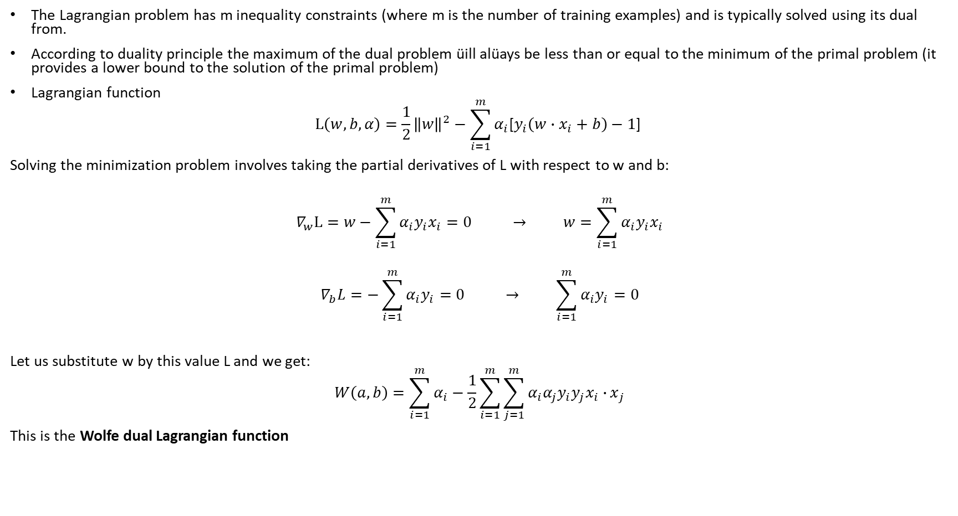
The Wolfe dual problem
The Lagrangian problem has m inequality constraints (where m is the number of training examples) and is typically solved using its dual from.
According to duality principle the maximum of the dual problem üill alüays be less than or equal to the minimum of the primal problem (it provides a lower bound to the solution of the primal problem)
Lagrangian function
$$L\left(w,b,α\right)=\frac{1}{2}{\left\|w\right\|}^{2}−\sum_{i=1}^{m}{α_{i}\text{[}y_{i}\left(w∙x_{i}+b\right)−1\text{] }}$$
Solving the minimization problem involves taking the partial derivatives of L with respect to w and b:
$$∇_{w}L=w−\sum_{i=1}^{m}{α_{i}y_{i}x_{i}}=0 → w=\sum_{i=1}^{m}{α_{i}y_{i}x_{i}}$$
$$∇_{b}L=−\sum_{i=1}^{m}{α_{i}y_{i}}=0 → \sum_{i=1}^{m}{α_{i}y_{i}}=0$$
Let us substitute w by this value L and we get:
$$W\left(a,b\right)=\sum_{i=1}^{m}{α_{i}}−\frac{1}{2}\sum_{i=1}^{m}{{\sum_{j=1}^{m}{α_{i}{α_{j}y}_{i}y_{j}x_{i}∙}x}_{j}}$$
This is the Wolfe dual Lagrangian function

Slide 26
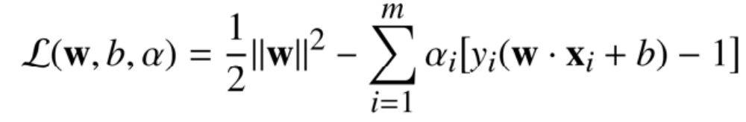
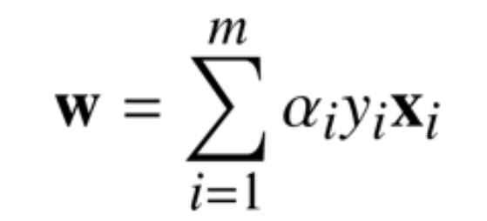
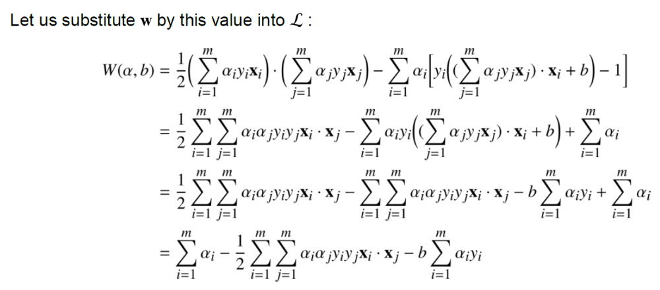
Optional

Slide 27

Wolfe dual problem
$$\underset{α}{maximize}{\sum_{i=1}^{m}{α_{i}}−\frac{1}{2}\sum_{i=1}^{m}{{\sum_{j=1}^{m}{α_{i}{α_{j}y}_{i}y_{j}x_{i}∙}x}_{j}}}$$
subject to $α_{i}≥0, i=1,…,m$
$$\sum_{i=1}^{m}{α_{i}y_{i}}=0$$
The main advantage of the Wolfe dual problem over the Lagrangian problem is that the objective function W now depends only on the Lagrange multipliers.
When we solve the Wolfe dual problem, we get a vector $α$ containing all Lagrange multipliers and then we will compute w and b.
Compute w:
$$w=\sum_{i=1}^{m}{α_{i}y_{i}x_{i}}$$
Compute b:
$$w∙x_{i}+b=y_{i}$$
$$b=y_{i}−w∙x_{i}$$

Slide 28

Hypothesis function
The SVMs use the same hypothesis function as the perseptron. The class of an example
$${h(x}_{i})=sign(w∙x_{i}\text{+}\text{b}\text{)}$$
When using the dual formulation, it is computed using only the support vectors:
$${h(x}_{i})=sign\left(\sum_{j=1}^{S}{α_{j}y_{j}\left(x_{j}∙x_{i}\right)+b}\right)$$
This formulation of the SVM is called the hard margin SVM. It cannot work when the data is not linearly separable. Soft margin SVM applied non-linearly separable data.

Slide 29

Reading Materials
Support Vector Machines. Alexandre Kowalczyk.
https://www.syncfusion.com/ebooks/support_vector_machines_succinctly

