Slide 1

Kestrel Health
KESTREL HEALTH
SERIES A, NOVEMBER 2026
£1.9M
Kestrel Health
GMV, Q3 2026, finance figure
DOCS/BOARD-UPDATE-2026-Q3.MD
41
employers and 312 clinics active, end of September 2026
DATA/KPIS-WEEKLY.CSV
£9.5M
Fast physiotherapy for employees, booked into independent clinics' empty weekday slots
Series A round
Notes:
Question: What is this, in plain words?
Say: Kestrel Health sells employers fast physiotherapy for their staff, booked into the empty weekday slots of independent clinics. We keep 22% of each booking.
Context: GMV is the gross value of bookings before the clinics' share.
Transition: Here is how fast it is growing.
Time: 30

Slide 2
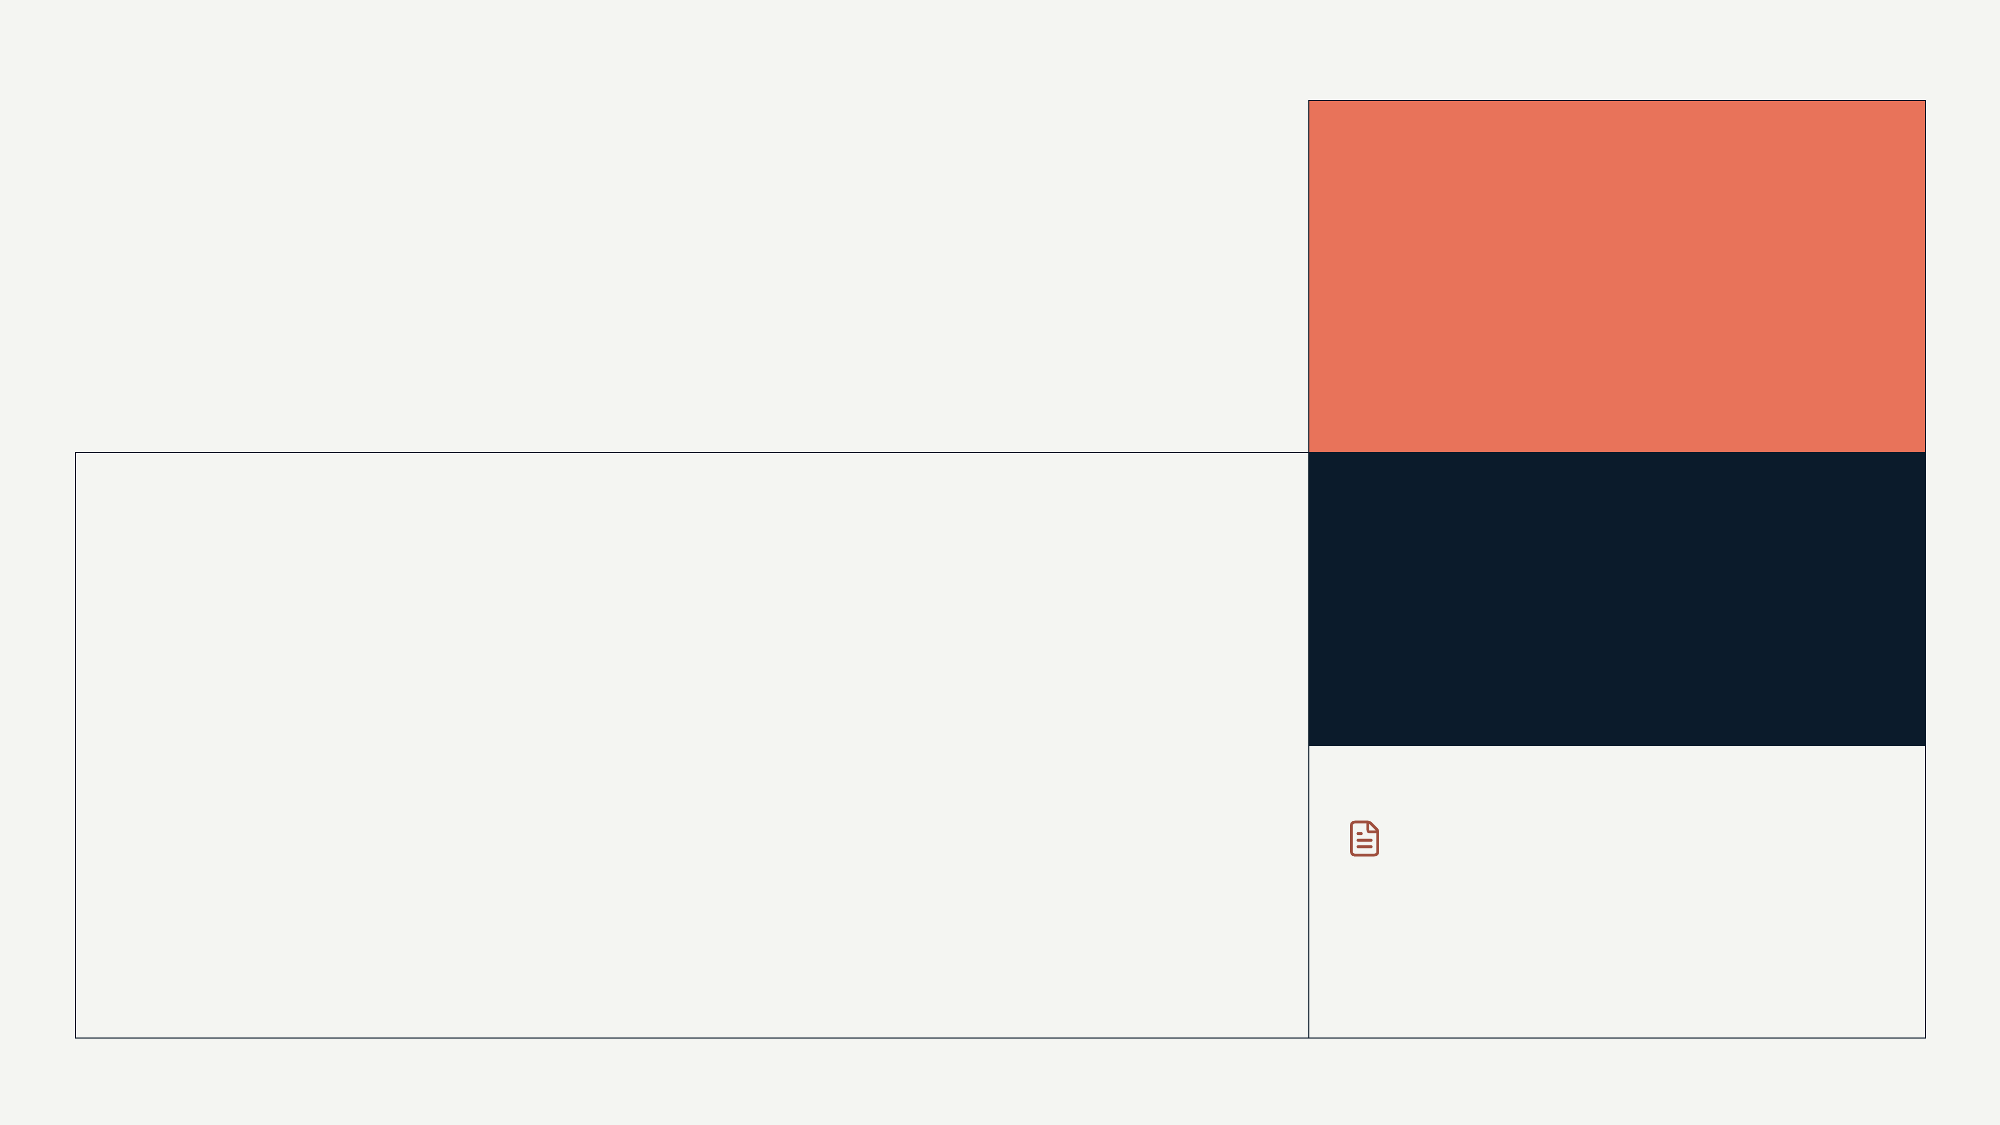
Bookings reached £1.9M in Q3 2026, up 31% on Q2
KESTREL HEALTH
02 / 23
TRACTION
Bookings reached £1.9M in Q3 2026, up 31% on Q2
31%
growth, Q2 to Q3 2026; the Q2 base is being reconciled
GMV, £ THOUSAND PER QUARTER, FINANCE FIGURES
£7.6M
GMV run-rate, Q3 2026 annualised
Finance is the system of record. The weekly booking export shows £1.73M for Q3 because it leaves out manually invoiced enterprise bookings.
SOURCE: DOCS/BOARD-UPDATE-2026-Q3.MD
KESTREL HEALTH, CONFIDENTIAL, NOVEMBER 2026
Notes:
Question: Is this working, and how fast?
Say: Bookings were £1.9M in the third quarter, up 31% on the second. Net revenue was £418k.
Context: GMV is bookings paid through Kestrel before the clinics' share. Q2 grew 23% on Q1, so we do not claim 30% a quarter as a trend. The Q1 and Q2 export figures run above finance and are being reconciled.
Transition: The growth comes from a wait nobody else has fixed.
Time: 90

Slide 3

An employee in pain waits about 14 weeks for NHS physiotherapy, by our estimate
KESTREL HEALTH
03 / 23
THE PROBLEM
An employee in pain waits about 14 weeks for NHS physiotherapy, by our estimate
14^{weeks}
NHS physiotherapy wait, our estimate; public source to be added
The wait
About 14 weeks on the NHS in most areas; 10 days or more through an insurer's pathway (our estimates)
19^{days}
Who pays
The employer carries the absence either way, most of all in logistics, care, manufacturing and retail
to a first appointment through one employer's previous occupational health route, January to June 2025, n=212
Meanwhile
Independent clinics have empty slots on weekday mornings and afternoons
DOCS/CLINICAL-OUTCOMES-WHITEPAPER.MD
SOURCE: NOTES/FOUNDER-PERSPECTIVE.MD, DOCS/COMPETITIVE-LANDSCAPE.MD
KESTREL HEALTH, CONFIDENTIAL, NOVEMBER 2026
Notes:
Question: Who hurts, how much, and what do they do about it now?
Say: An employee with a back injury waits about 14 weeks for NHS physiotherapy, by our estimate, and the employer pays for the absence either way. Priya's own team waited while the insurer's fast track took days, not hours.
Context: The 14 weeks and the insurer figure are our estimates; the public source and year are still to be added. The 19 days is measured at one employer.
Transition: Kestrel closes that gap to days.
Time: 75

Slide 4
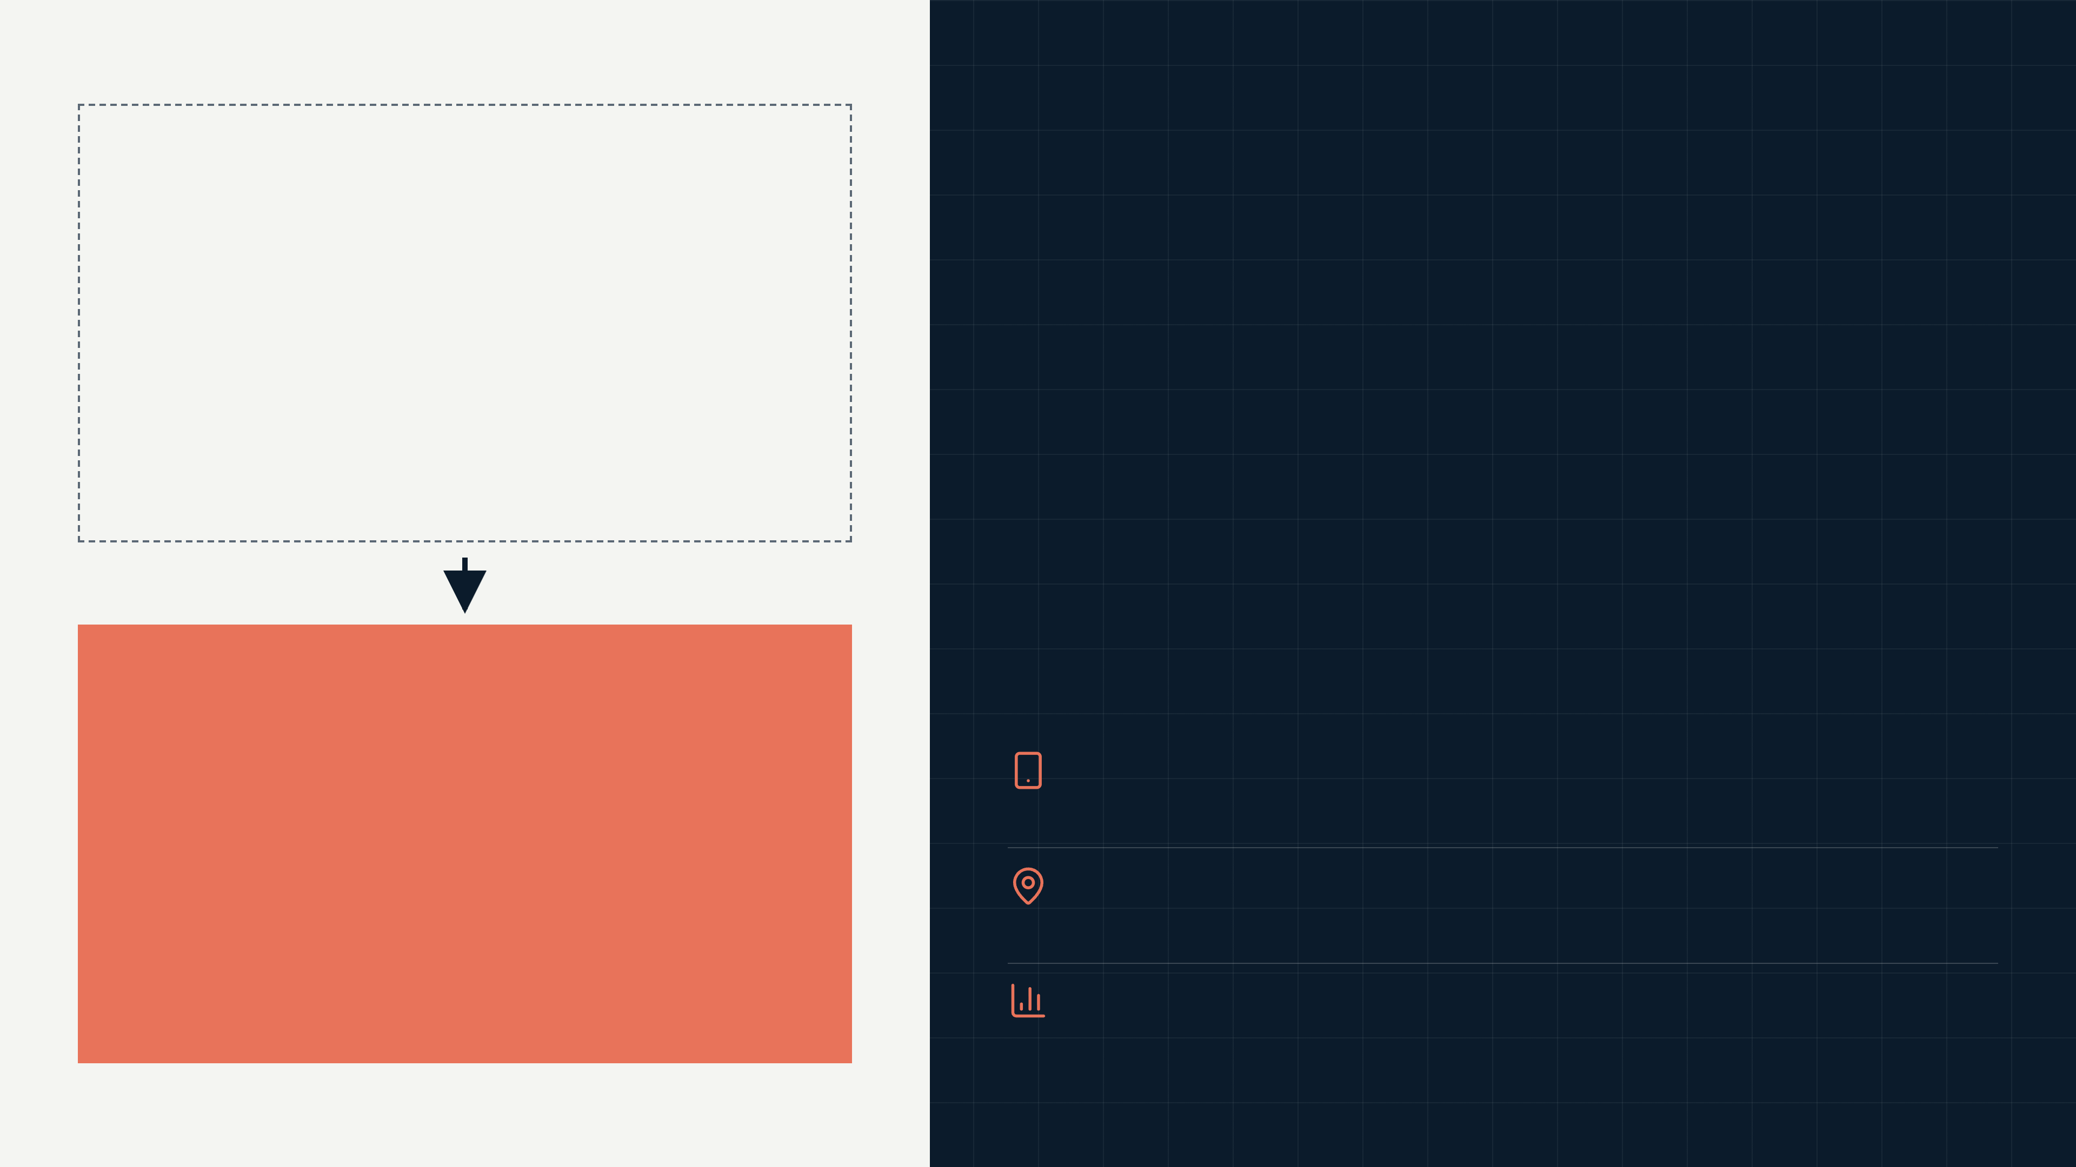
With Kestrel, the first appointment came in 2.3 days, not 19
KESTREL HEALTH
04 / 23
THE SOLUTION
BEFORE: OCCUPATIONAL HEALTH ROUTE
With Kestrel, the first appointment came in 2.3 days, not 19
19^{days}
Average wait for a first appointment, January to June 2025
One logistics employer, 212 employees, January to June 2026
WITH KESTREL
Digital triage first, then a physiotherapist in person when the case needs hands
2.3^{days}
312 partner clinics, booked into slots that would otherwise sit empty
The same 212 employees, January to June 2026
The employer sees sick days and return to work for its own people
SOURCE: DOCS/CLINICAL-OUTCOMES-WHITEPAPER.MD, DATA/KPIS-WEEKLY.CSV
KESTREL HEALTH, CONFIDENTIAL, NOVEMBER 2026
Notes:
Question: What do you do about it, and for whom?
Say: At one logistics employer the wait for a first appointment fell from 19 days to 2.3 days, across 212 employees.
Context: This is one employer and two sites. A network-wide figure needs a booking export we have not produced yet.
Transition: Here is what happens between the employee's message and the treatment room.
Time: 75

Slide 5
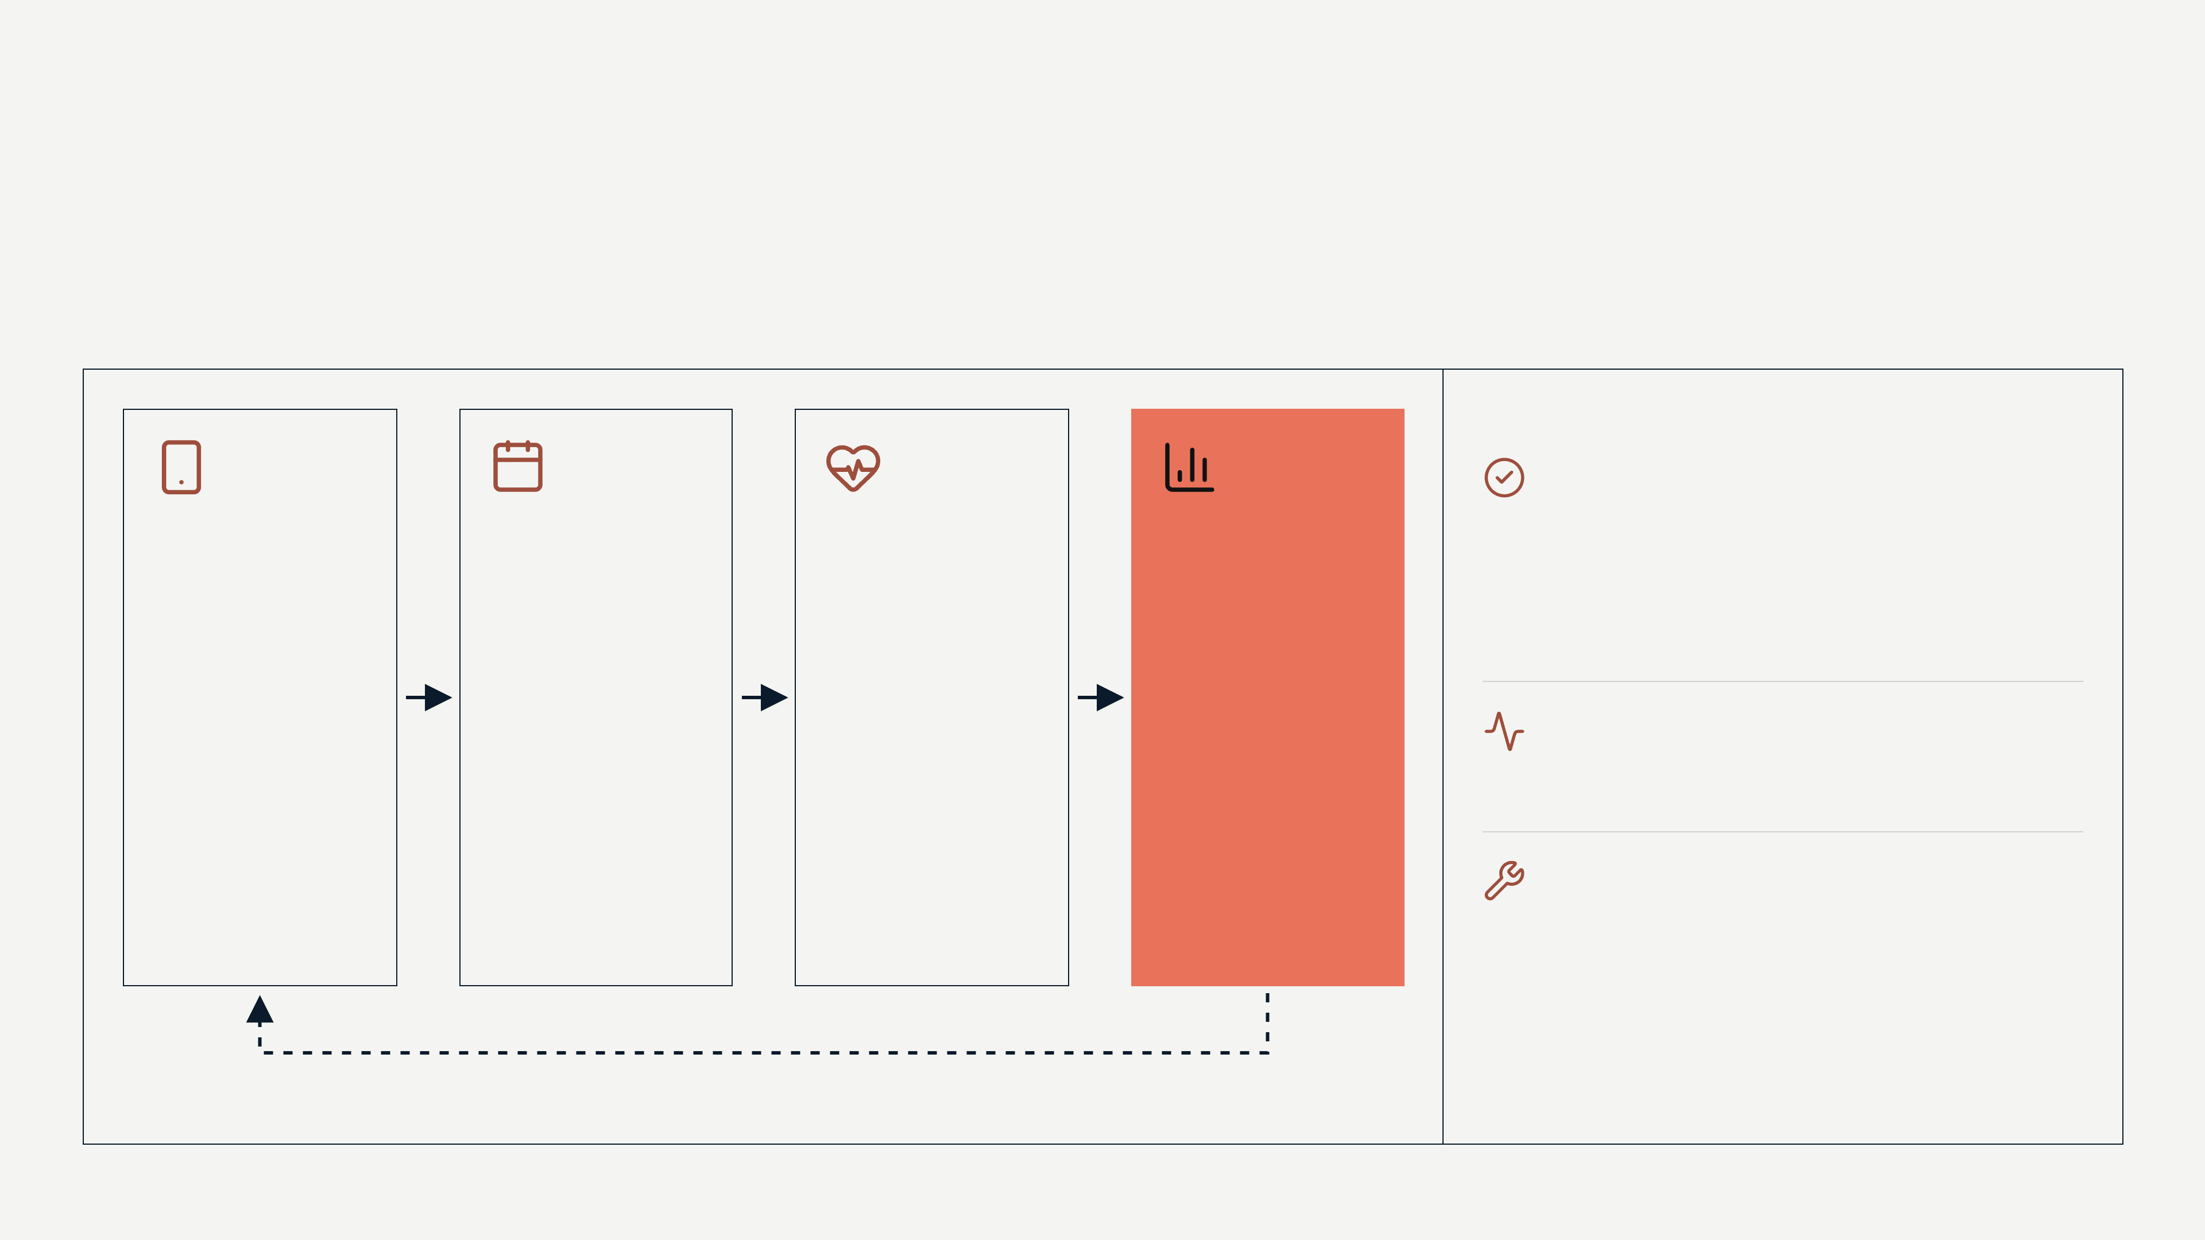
One booking connects the employee, a clinic's empty slot and the employer's absence data
KESTREL HEALTH
05 / 23
PRODUCT
One booking connects the employee, a clinic's empty slot and the employer's absence data
Live today: booking engine, clinic app and employer dashboard, sold on annual contracts
Triage
The employee describes the problem online and gets an exercise programme
Treatment
30,100 bookings in Q3 2026 across 312 active clinics
In person when needed: 40% of cases get hands-on treatment
Outcomes
Booking
The employer sees sick days and return to work
Into a partner clinic's empty weekday slot
Planned with this round: outcomes tracking, clinician tooling, HR system integrations
Outcomes data is why employers renew
SOURCE: NOTES/FOUNDER-PERSPECTIVE.MD, DOCS/BOARD-UPDATE-2026-Q3.MD, DATA/KPIS-WEEKLY.CSV
KESTREL HEALTH, CONFIDENTIAL, NOVEMBER 2026
Notes:
Question: Does it exist, and does it do what you say?
Say: Everything in this flow is live. We handled 30,100 bookings in the third quarter. 40% of our cases get hands-on treatment, and those are the expensive absences.
Context: The 40% is our own figure and needs a case export behind it. We have no product screenshot in this deck yet.
Transition: The reason clinics say yes is simple.
Time: 60

Slide 6
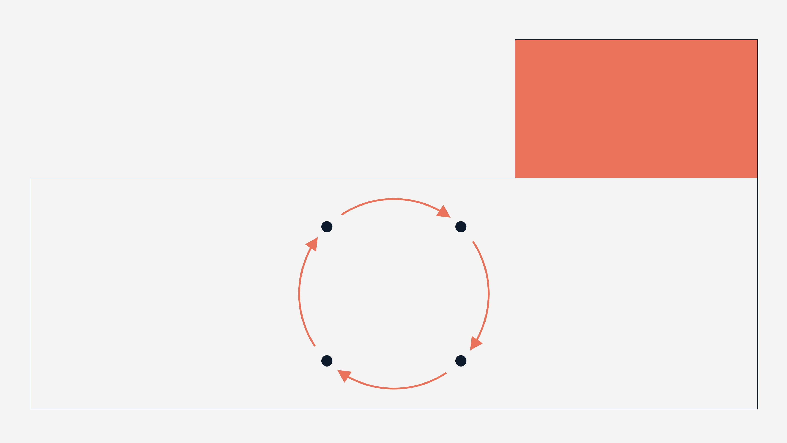
Clinics take a 22% cut gladly: the alternative is an empty 11am Tuesday
KESTREL HEALTH
06 / 23
INSIGHT
Clinics take a 22% cut gladly: the alternative is an empty 11am Tuesday
22%
of each booking kept by Kestrel, Q3 2026
Faster appointments
Employers add staff
2.3 days at one employer
71,400 employees covered
Filled slots
Clinics prioritise us
Off-peak bookings
312 active clinics
Slots clinics could not fill
SOURCE: DATA/UNIT-ECONOMICS.XLSX, DOCS/BOARD-UPDATE-2026-Q3.MD, DATA/KPIS-WEEKLY.CSV AND 1 MORE, SEE SOURCES
KESTREL HEALTH, CONFIDENTIAL, NOVEMBER 2026
Notes:
Question: Why does this work now, and why will you be the one to build it?
Say: Private physiotherapy is thousands of small clinics with empty weekday slots and no aggregator. We fill slots they could not fill otherwise, so they accept 22%.
Context: The network is not exclusive and never will be. We win only while we are a clinic's best channel.
Transition: Now the proof.
Time: 60

Slide 7

Proof: employers stay, and spend more
KESTREL HEALTH
07 / 23
SECTION 01
01
Proof: employers stay, and spend more
Network growth, one employer's outcomes, unit economics and retention
KESTREL HEALTH, CONFIDENTIAL, NOVEMBER 2026
Notes:
Time: 5

Slide 8

41 employers and 312 clinics were active at the end of September 2026
KESTREL HEALTH / PROOF: EMPLOYERS STAY, AND SPEND MORE
08 / 23
TRACTION
41 employers and 312 clinics were active at the end of September 2026
41
active employers, end of September 2026
ACTIVE EMPLOYERS, LAST WEEK OF EACH MONTH, WEEKLY EXPORT
312
active partner clinics, end of September 2026
Counts come from the weekly export. The board update's March and June counts are two lower; the two are being reconciled.
SOURCE: DATA/KPIS-WEEKLY.CSV
KESTREL HEALTH, CONFIDENTIAL, NOVEMBER 2026
Notes:
Question: Is the network growing on both sides?
Say: We added 16 employers in eleven months and ended September with 41 employers, 312 clinics and 71,400 covered employees.
Context: Active means at least one booking in the period. Clinic supply is no longer the constraint in the big cities; it is still thin in the South West and Scotland.
Transition: What does an employer get for it?
Time: 60

Slide 9
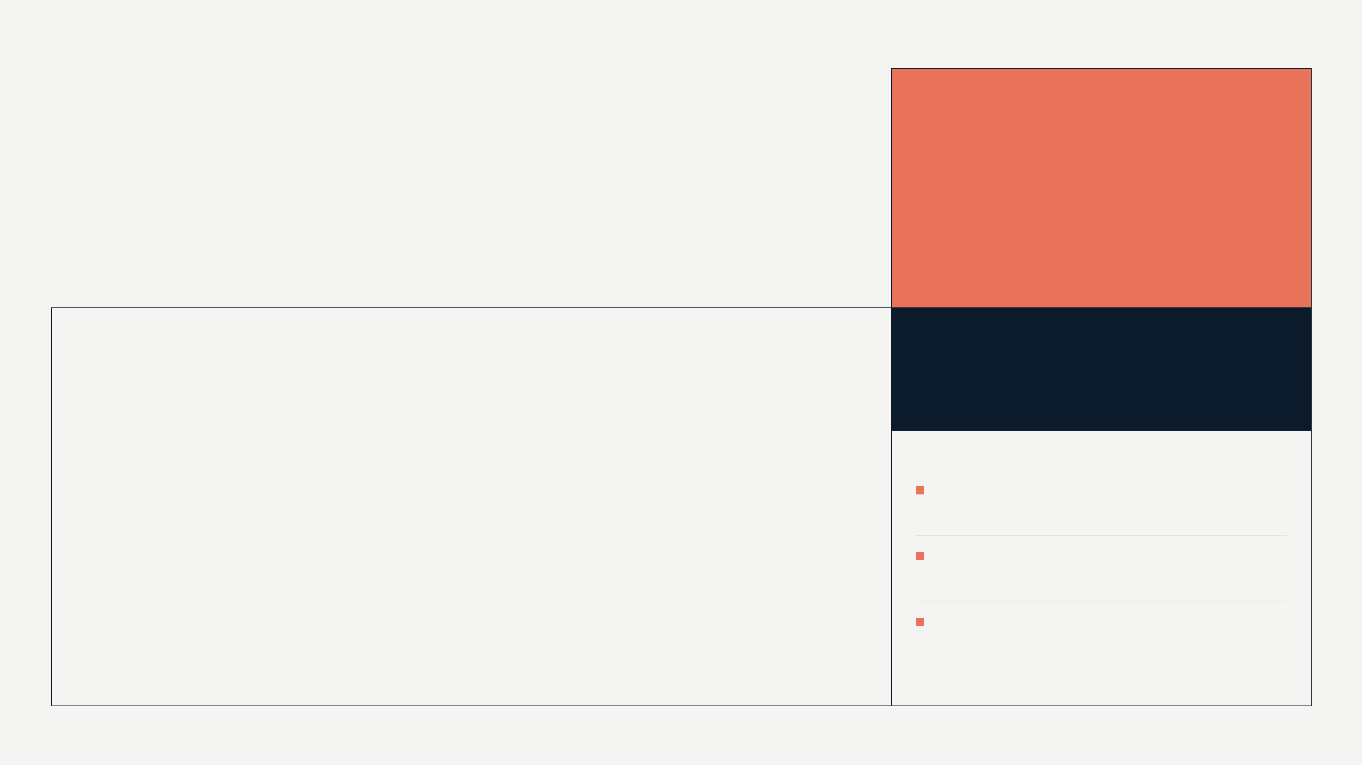
At one logistics employer, MSK sick days fell 34% among 212 employees
KESTREL HEALTH / PROOF: EMPLOYERS STAY, AND SPEND MORE
09 / 23
CASE STUDY
At one logistics employer, MSK sick days fell 34% among 212 employees
34%
fewer MSK sick days, n=212, no control group
MSK SICK DAYS, THE SAME 212 EMPLOYEES
2.3^{days}
to a first appointment, down from 19
One employer, two sites; the same employees a year apart
No control group; employees chose the pathway; shifts changed in March 2026
Controlled evaluation across 4 employers planned for 2027
SOURCE: DOCS/CLINICAL-OUTCOMES-WHITEPAPER.MD
KESTREL HEALTH, CONFIDENTIAL, NOVEMBER 2026
Notes:
Question: Does a real customer get the value you claim?
Say: At one logistics employer, the 212 employees who used Kestrel recorded 936 MSK sick days in six months, against 1,418 in the same months a year earlier.
Context: Single employer, no control group, self-selected participants, and the employer changed shift patterns in March 2026. Regression to the mean is likely. We do not present this as a general result.
Transition: That difference in what the buyer wants is the heart of the company.
Time: 75

Slide 10

Insurers optimise for claims cost. Employers optimise for people being at work.
KESTREL HEALTH / PROOF: EMPLOYERS STAY, AND SPEND MORE
10 / 23
Insurers optimise for claims cost. Employers optimise for people being at work.
Those are different products. Kestrel sells to the employer.
KESTREL HEALTH, CONFIDENTIAL, NOVEMBER 2026
Notes:
Say: Insurers optimise for claims cost. Employers optimise for people being at work. Those are different products, and in the UK the employer is the right buyer.
Time: 20

Slide 11
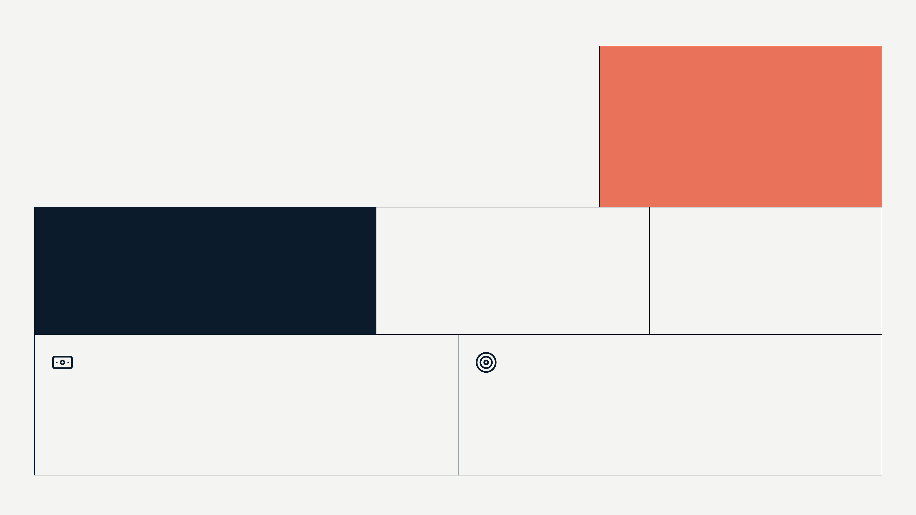
Kestrel keeps 22% of each booking, at a 61% gross margin
KESTREL HEALTH / PROOF: EMPLOYERS STAY, AND SPEND MORE
11 / 23
BUSINESS MODEL
Kestrel keeps 22% of each booking, at a 61% gross margin
22%
take rate: Kestrel's share of each booking, Q3 2026
118%
9^{months}
61%
net revenue retention, all employers, 12 months to September 2026
CAC payback, blended, median employer; our target was 6
gross margin on net revenue, Q3 2026
Employers pay for each booking through Kestrel and the clinic receives the rest: £418k of net revenue on £1.9M of bookings in Q3 2026
Enterprise employers repay their acquisition cost in 1.9 months (n=14); the table is in the appendix
SOURCE: DOCS/BOARD-UPDATE-2026-Q3.MD, DATA/UNIT-ECONOMICS.XLSX
KESTREL HEALTH, CONFIDENTIAL, NOVEMBER 2026
Notes:
Question: Who pays, how much, and does a pound in produce more than a pound out?
Say: We keep 22% of each booking. Gross margin on that is 61% after clinical operations, payment processing and the triage team. Net revenue annualises to £1.67M.
Context: Blended payback is 9 months against a target of 6; it crept up as enterprise cycles lengthened and two new sales hires ramped. Gross retention is not measured yet.
Transition: Retention depends on who the employer is.
Time: 75

Slide 12
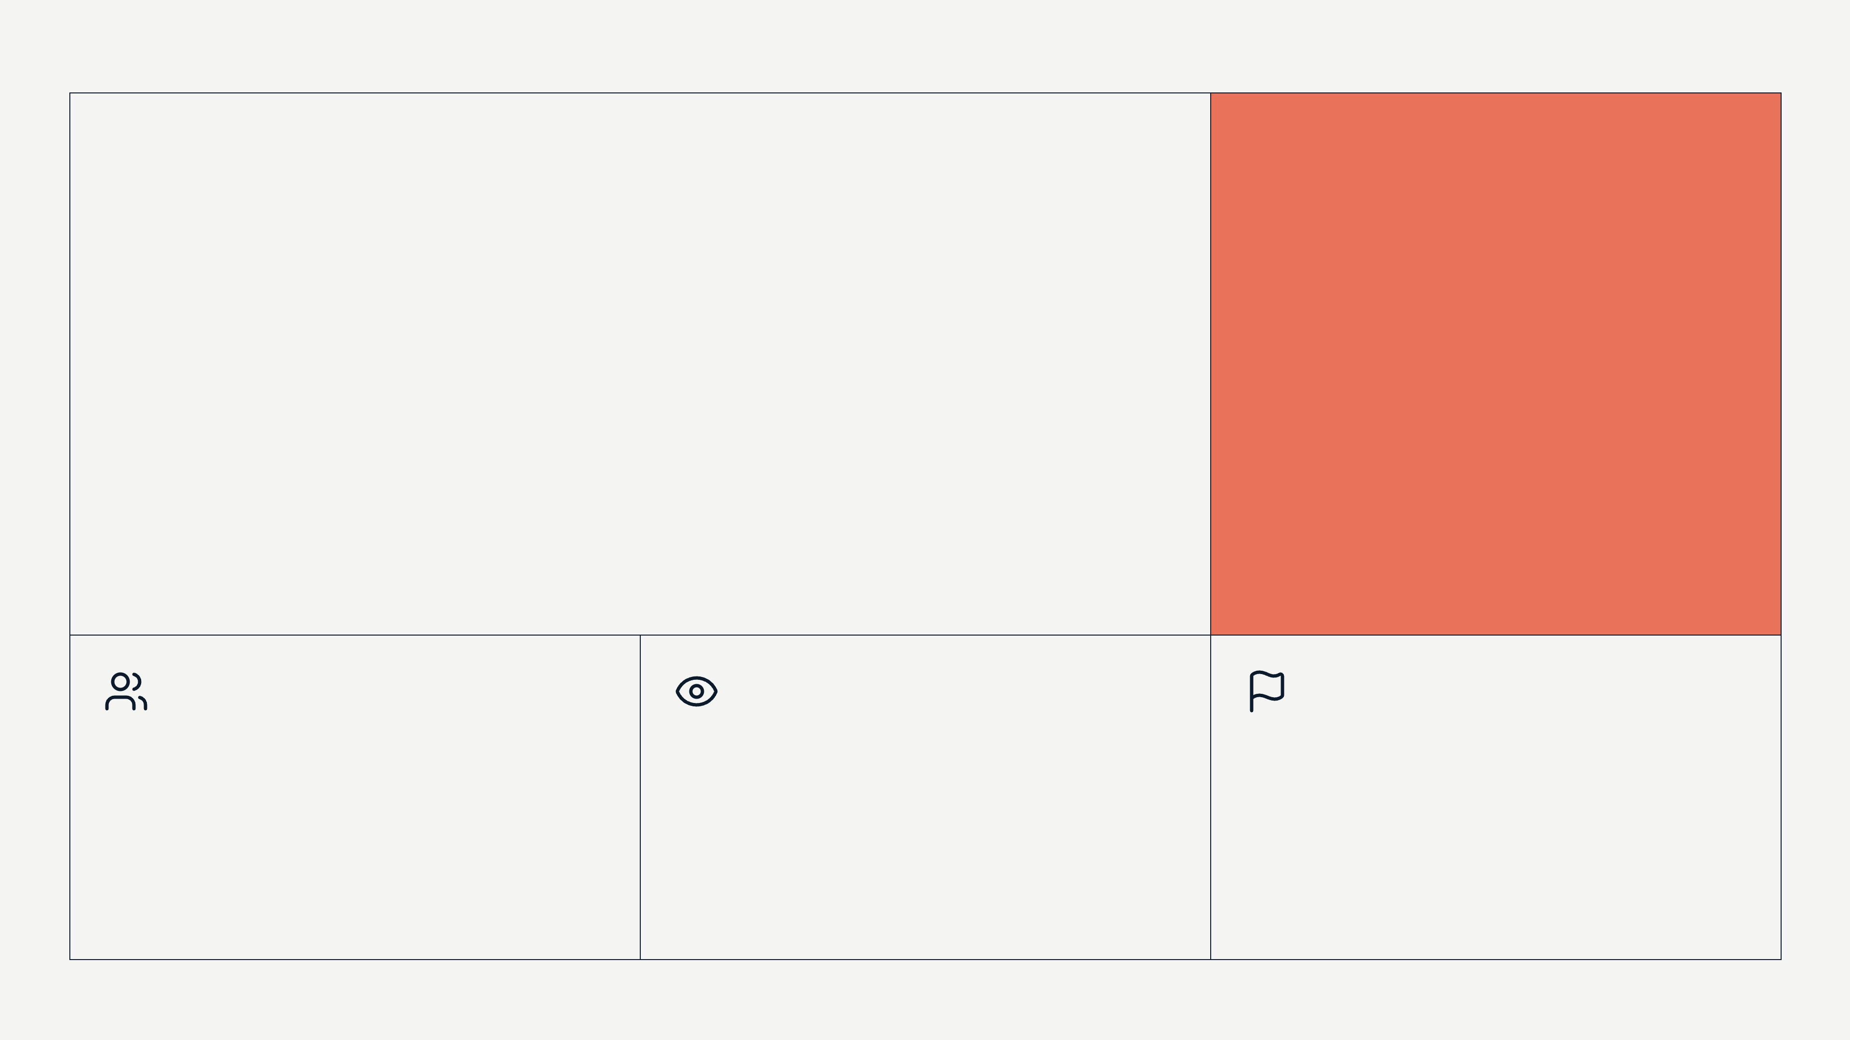
Employers who own absence as a metric stay: none of 14 enterprise employers has left
KESTREL HEALTH / PROOF: EMPLOYERS STAY, AND SPEND MORE
12 / 23
INSIGHT
Employers who own absence as a metric stay: none of 14 enterprise employers has left
0 of 14
enterprise employers lost in two years (small sample, short record)
Where we lost
Why
What we changed
7 employers left in 12 months, every one with fewer than 200 employees
Too few employees book, so finance cancels at renewal
From Q4 2026 we sell only to employers with 250 or more staff
SOURCE: DATA/UNIT-ECONOMICS.XLSX, NOTES/FOUNDER-PERSPECTIVE.MD
KESTREL HEALTH, CONFIDENTIAL, NOVEMBER 2026
Notes:
Question: Is it one kind of customer or many, and do they stay?
Say: We lost 7 employers in 12 months, all under 200 employees. None of our 14 enterprise employers has left in two years, and employers as a group spent 118% of the year before.
Context: 14 accounts over two years is a small sample. Enterprise means 250 or more staff on an annual contract. Gross retention is not measured yet.
Transition: So how many such employers are there?
Time: 60

Slide 13
The market, and why Kestrel wins it
KESTREL HEALTH
13 / 23
SECTION 02
02
The market, and why Kestrel wins it
The serviceable market, how we sell, and the alternatives an employer has
KESTREL HEALTH, CONFIDENTIAL, NOVEMBER 2026
Notes:
Time: 5

Slide 14
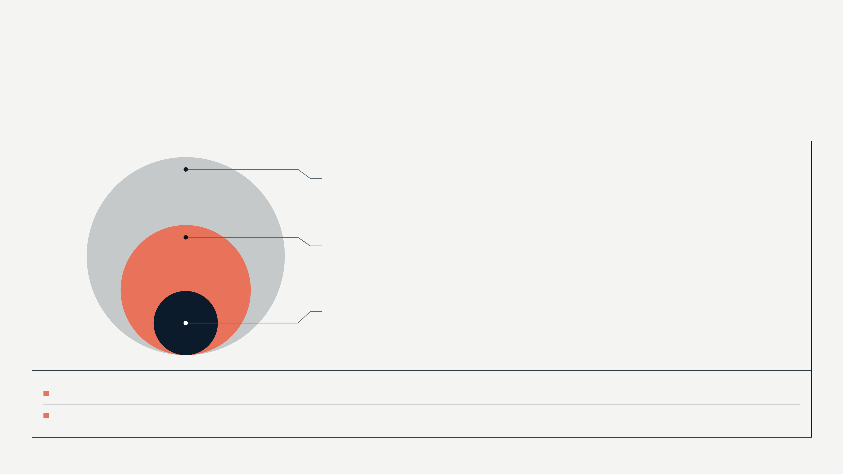
We estimate £1.1B of serviceable bookings a year: 15.6M employees x 18% x £403
KESTREL HEALTH / THE MARKET, AND WHY KESTREL WINS IT
14 / 23
MARKET
We estimate £1.1B of serviceable bookings a year: 15.6M employees x 18% x £403
£1.1B
Serviceable bookings: 15.6M employees x 18% x £403 (assumption)
£242M
Net revenue pool: serviceable bookings x our 22% take rate (assumption)
£1.7M
Kestrel today: net revenue run-rate, Q3 2026 annualised (fact)
Employees at 250+ employers in the UK, Netherlands and Ireland. 18% report an MSK problem in a year; fewer seek treatment, so the real figure is lower.
£403 is the market average spend per case, at 6.2 sessions. Booking value, not Kestrel revenue. Public sources for the three inputs are being added.
SOURCE: DOCS/MARKET-SIZING-2026.MD, DATA/UNIT-ECONOMICS.XLSX
KESTREL HEALTH, CONFIDENTIAL, NOVEMBER 2026
Notes:
Question: How big can this get, and how do you know?
Say: Employees at large employers in three countries, times the share with an MSK problem, times the spend per case: £1.1B of bookings a year, of which our 22% would be £242M.
Context: Physiotherapy pathway only, no prevention or occupational health layers. Our own cases average slightly less than the market spend per case.
Transition: Here is how we reach those employers.
Time: 60

Slide 15
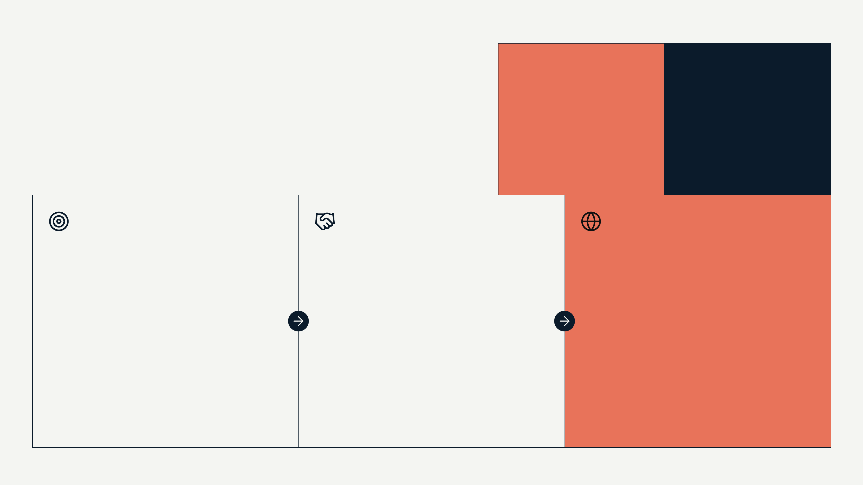
Enterprise sales wins a 250+ employer for £11,400, repaid in 1.9 months
KESTREL HEALTH / THE MARKET, AND WHY KESTREL WINS IT
15 / 23
GO TO MARKET
Enterprise sales wins a 250+ employer for £11,400, repaid in 1.9 months
£11,400
5^{months}
CAC per enterprise employer, 12 months to September 2026
average enterprise sales cycle, Q3 2026
Beachhead
Motion
UK employers with 250 or more staff in logistics, care, manufacturing and retail, where someone owns absence
An enterprise sales team led by a VP Sales with 10 years in employee benefits; the outcomes whitepaper opens the conversation
Next
First market outside the UK with this round: the Netherlands or Ireland
SOURCE: DATA/UNIT-ECONOMICS.XLSX, DOCS/BOARD-UPDATE-2026-Q3.MD
KESTREL HEALTH, CONFIDENTIAL, NOVEMBER 2026
Notes:
Question: How do you get customers repeatably, and what does one cost?
Say: An enterprise employer costs £11,400 to win and brings £9,900 of net revenue a month on average, so the cost is repaid in 1.9 months.
Context: The sales cycle is 5 months and got longer this year; that is the weak number here. 14 enterprise employers is a small base.
Transition: What else could that employer buy?
Time: 60

Slide 16
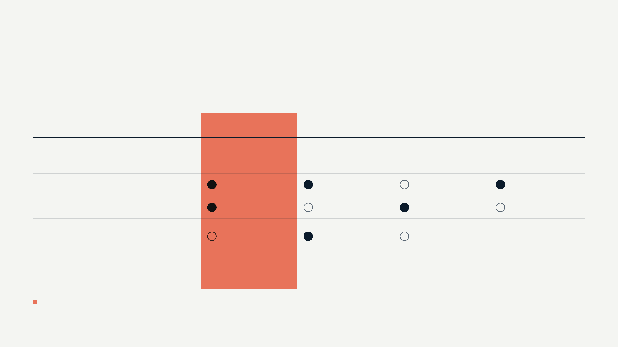
Only Kestrel pairs in-person treatment in days with absence data for the employer
KESTREL HEALTH / THE MARKET, AND WHY KESTREL WINS IT
16 / 23
COMPETITION
Only Kestrel pairs in-person treatment in days with absence data for the employer
Kestrel Health
INSURER MSK PATHWAYS
US DIGITAL MSK PROVIDERS
NHS
Wait for a first appointment
2.3 days (one employer, n=212)
10+ days
no clinic visit
about 14 weeks
Hands-on treatment in a clinic
Outcomes data for the employer
Already in the employer's benefits
free to all
Brand and scale of evidence
one employer so far
established
ahead of us
n/a
Risks we name: our clinic network is not exclusive, and an insurer has talked about 48-hour access.
SOURCE: DOCS/COMPETITIVE-LANDSCAPE.MD, DOCS/CLINICAL-OUTCOMES-WHITEPAPER.MD, NOTES/FOUNDER-PERSPECTIVE.MD
KESTREL HEALTH, CONFIDENTIAL, NOVEMBER 2026
Notes:
Question: Why will you win against the obvious alternatives, and why won't the incumbent copy you?
Say: The employee's real default is waiting for the NHS. Insurers are already in the benefits stack but slow; the US digital providers have the brand and the evidence but no UK clinics, and 40% of our cases get hands-on treatment.
Context: The grid is our own August 2026 reading of public information and customer conversations. The insurer and NHS waits are our estimates.
Transition: The people doing this.
Time: 60

Slide 17

The team and the round
KESTREL HEALTH
17 / 23
SECTION 03
03
The team and the round
Who builds Kestrel, what £9.5M buys, and what will be true at the end of 2027
KESTREL HEALTH, CONFIDENTIAL, NOVEMBER 2026
Notes:
Time: 5

Slide 18
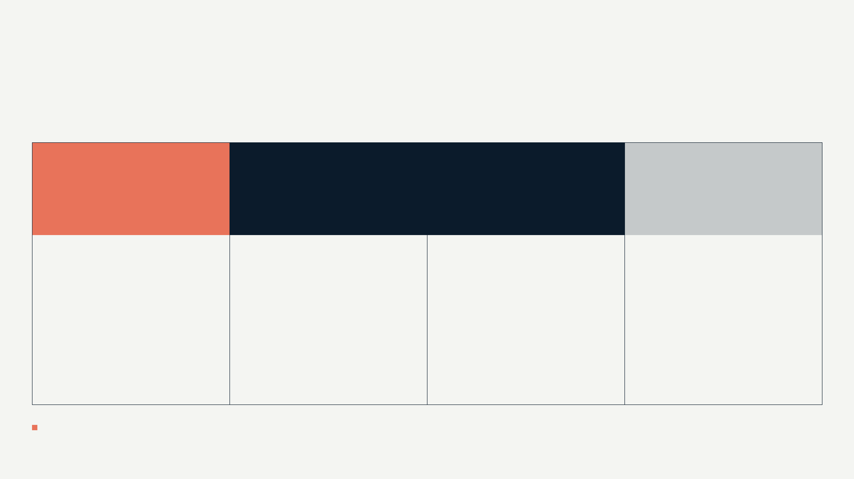
We sold health benefits to employers, ran physiotherapy clinics and built payments infrastructure
KESTREL HEALTH / THE TEAM AND THE ROUND
18 / 23
TEAM
We sold health benefits to employers, ran physiotherapy clinics and built payments infrastructure
PR
CF
MK
GN
Priya Raghunathan
Callum Fairbairn
Mateusz Kowal
Grace Ndlovu
COO AND CO-FOUNDER
CTO AND CO-FOUNDER
VP SALES, ENTERPRISE
CEO AND CO-FOUNDER
Chartered physiotherapist, 12 years clinical; ran and sold a 4-site physiotherapy group
Staff engineer in payments at a UK fintech; built the booking engine, clinic app and employer dashboard
10 years selling employee benefits at two insurers and a benefits platform; joined September 2025
6 years at a UK health insurer selling benefits to large employers; owned a £120M book
24 people: 9 in engineering and product, 6 in sales and employer success, 5 in clinical and clinic partnerships
SOURCE: TEAM/TEAM.MD
KESTREL HEALTH, CONFIDENTIAL, NOVEMBER 2026
Notes:
Question: Why these people, and who writes the code?
Say: Priya sold this to employers from the insurer's side. Callum is a physiotherapist who ran clinics and knows why they distrust marketplaces. Mateusz built the product.
Context: The independent board seat is vacant.
Transition: What we are asking for.
Time: 60

Slide 19
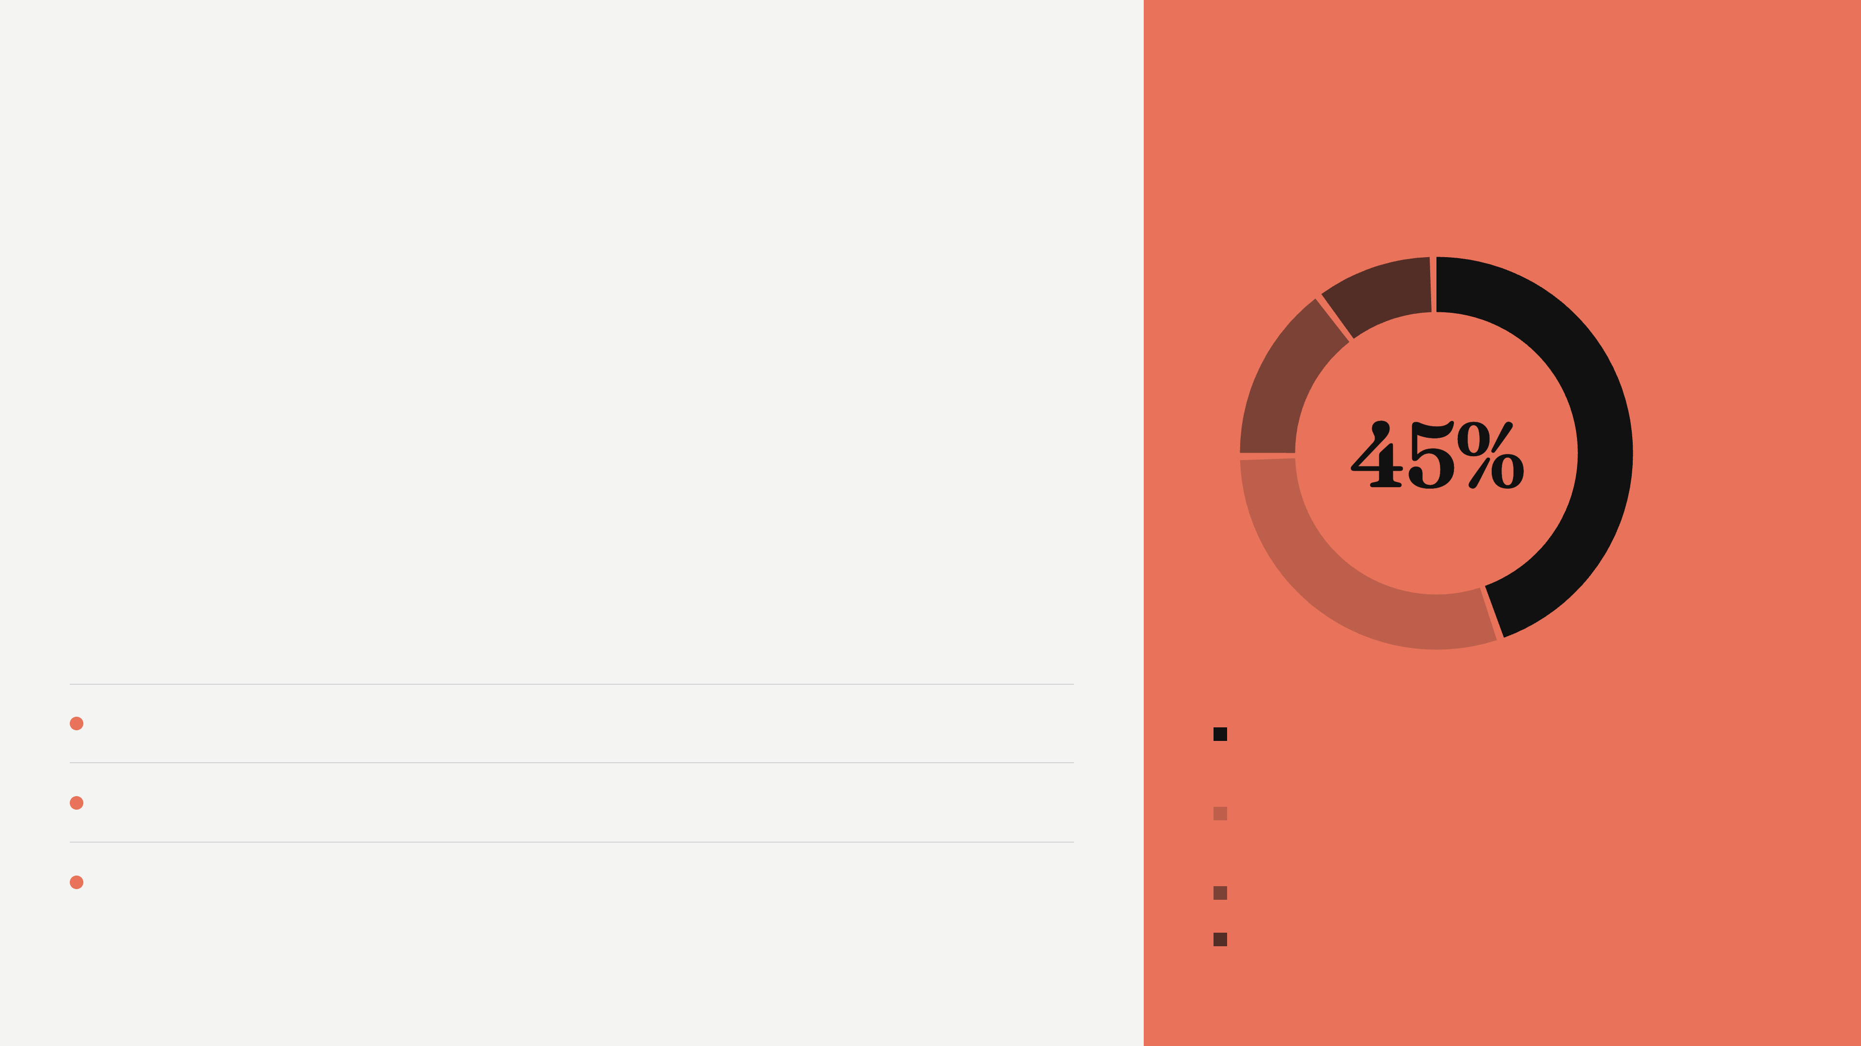
Raising £9.5M to reach a £10M GMV run-rate and 120 employers by end of 2027
KESTREL HEALTH / THE TEAM AND THE ROUND
19 / 23
THE ASK
USE OF FUNDS
Raising £9.5M to reach a £10M GMV run-rate and 120 employers by end of 2027
Runway after the round: needs number months
WHAT IT BUYS
End of 2027
£10M GMV run-rate (projection; £7.6M today)
Go-to-market: enterprise sales and employer success
45%
End of 2027
120 active employers (projection; 41 today)
Product: outcomes tracking, clinician tooling, HR system integrations
30%
Date to be set
First market outside the UK live: the Netherlands or Ireland
Clinical team and supply operations
15%
Buffer
10%
SOURCE: DOCS/BOARD-UPDATE-2026-Q3.MD, DATA/KPIS-WEEKLY.CSV
KESTREL HEALTH, CONFIDENTIAL, NOVEMBER 2026
Notes:
Question: How much, for what, and what will be true when it is spent?
Say: We are raising £9.5M. 45% goes to enterprise sales and employer success, 30% to product, 15% to the clinical team and supply, 10% is buffer.
Context: The milestones are targets, not a model; the financial model and the runway figure are still to come. The run-rate today is £7.6M, so expect the question of why only £10M.
Transition: In one line.
Time: 90

Slide 20
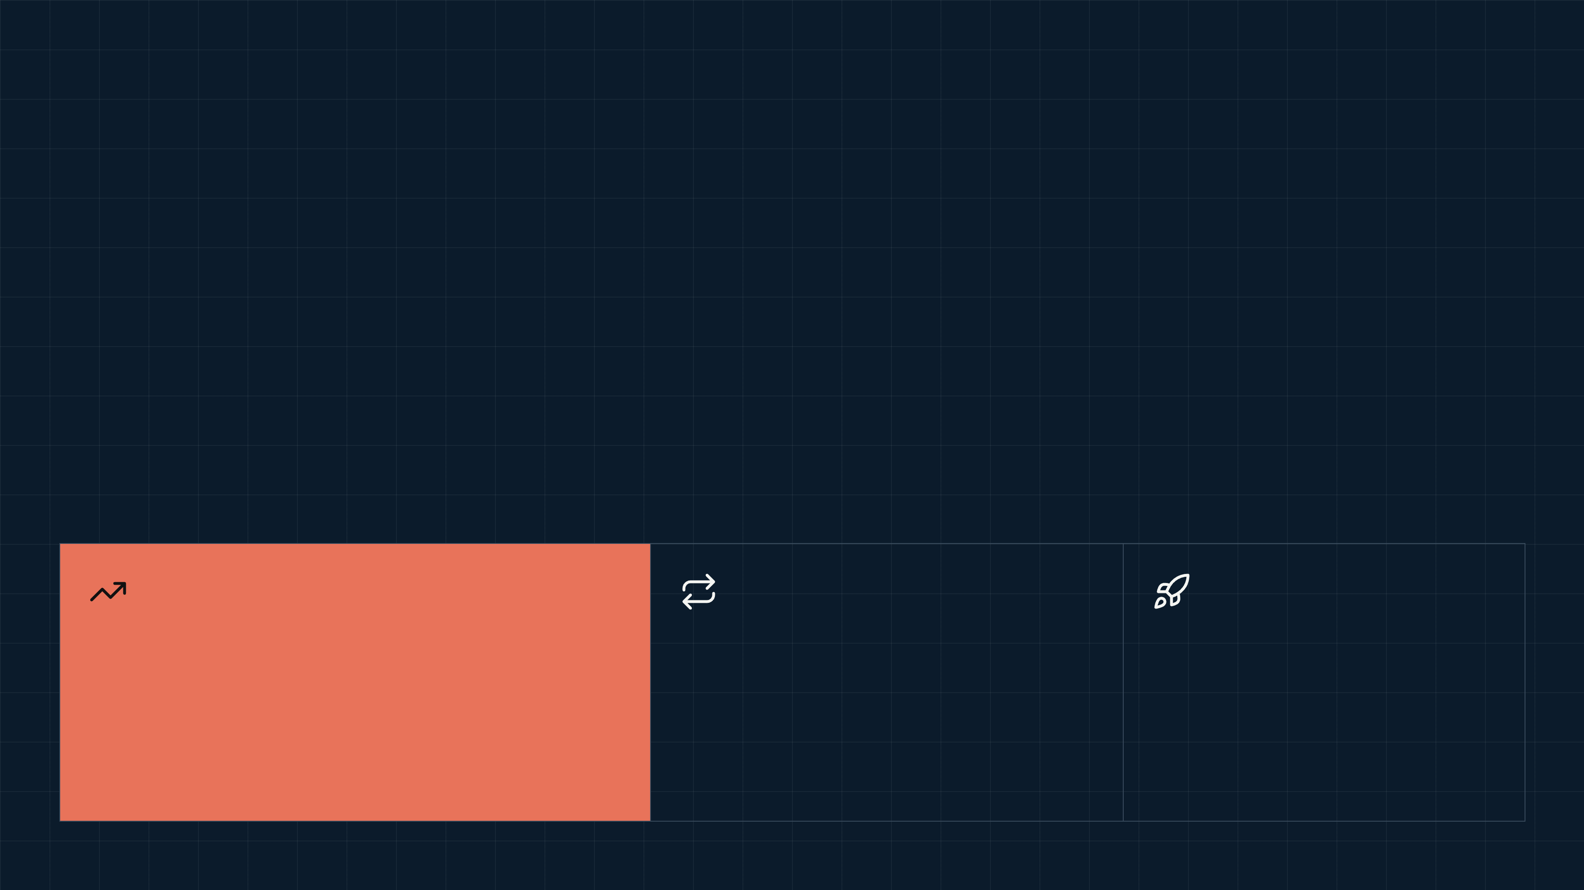
Fast physiotherapy for employees, in clinics' empty weekday slots
KESTREL HEALTH
20 / 23
Fast physiotherapy for employees, in clinics' empty weekday slots
PRIYA RAGHUNATHAN, CEO. CONTACT: NEEDS DETAIL
£9.5M
118%
£1.9M
to reach a £10M GMV run-rate and 120 employers by end of 2027
net revenue retention; none of 14 enterprise employers has left
of bookings in Q3 2026, up 31% on Q2
KESTREL HEALTH, CONFIDENTIAL, NOVEMBER 2026
Notes:
Say: Kestrel is the fastest way to get an employee in pain in front of a physiotherapist in the UK, with the outcomes data to show it mattered.
Time: 20

Slide 21
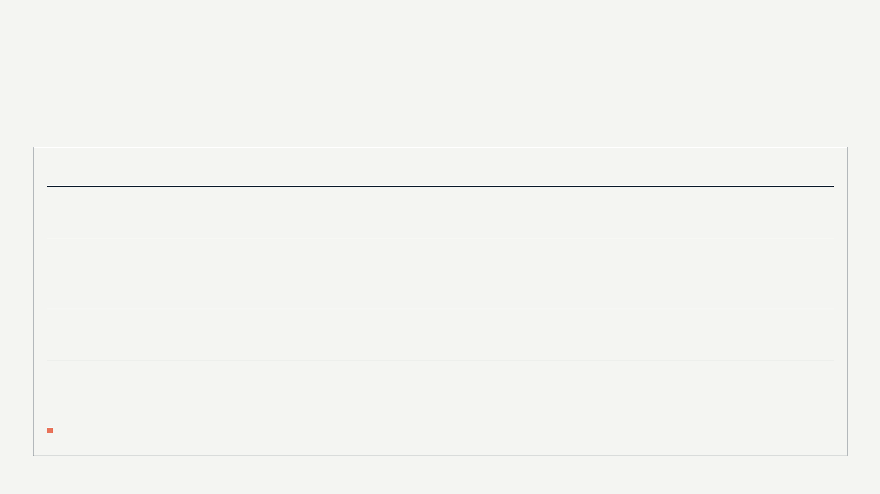
Unit economics: enterprise employers repay acquisition cost in 1.9 months
KESTREL HEALTH / APPENDIX
21 / 23
APPENDIX
Unit economics: enterprise employers repay acquisition cost in 1.9 months
12 MONTHS TO SEPTEMBER 2026
MEDIAN EMPLOYER, BLENDED
ENTERPRISE EMPLOYER (N=14)
Acquisition cost per employer
£6,800
£11,400
Monthly net revenue per employer
£1,241 (median)
£9,900 (mean)
Gross margin on net revenue
61%
61%
CAC payback
9 months (target 6)
1.9 months
Acquisition cost is fully loaded sales and marketing spend over new employers won. Payback divides it by monthly net revenue after gross margin.
SOURCE: DATA/UNIT-ECONOMICS.XLSX
KESTREL HEALTH, CONFIDENTIAL, NOVEMBER 2026
Notes:
Question: Show me the unit economics.
Say: Two columns because the two kinds of employer behave differently. The median employer brings £1,241 a month; the mean enterprise employer £9,900.
Context: Enterprise is 14 accounts. Lifetime value is not shown: two years of enterprise history is too short to state one.
Time: 45

Slide 22
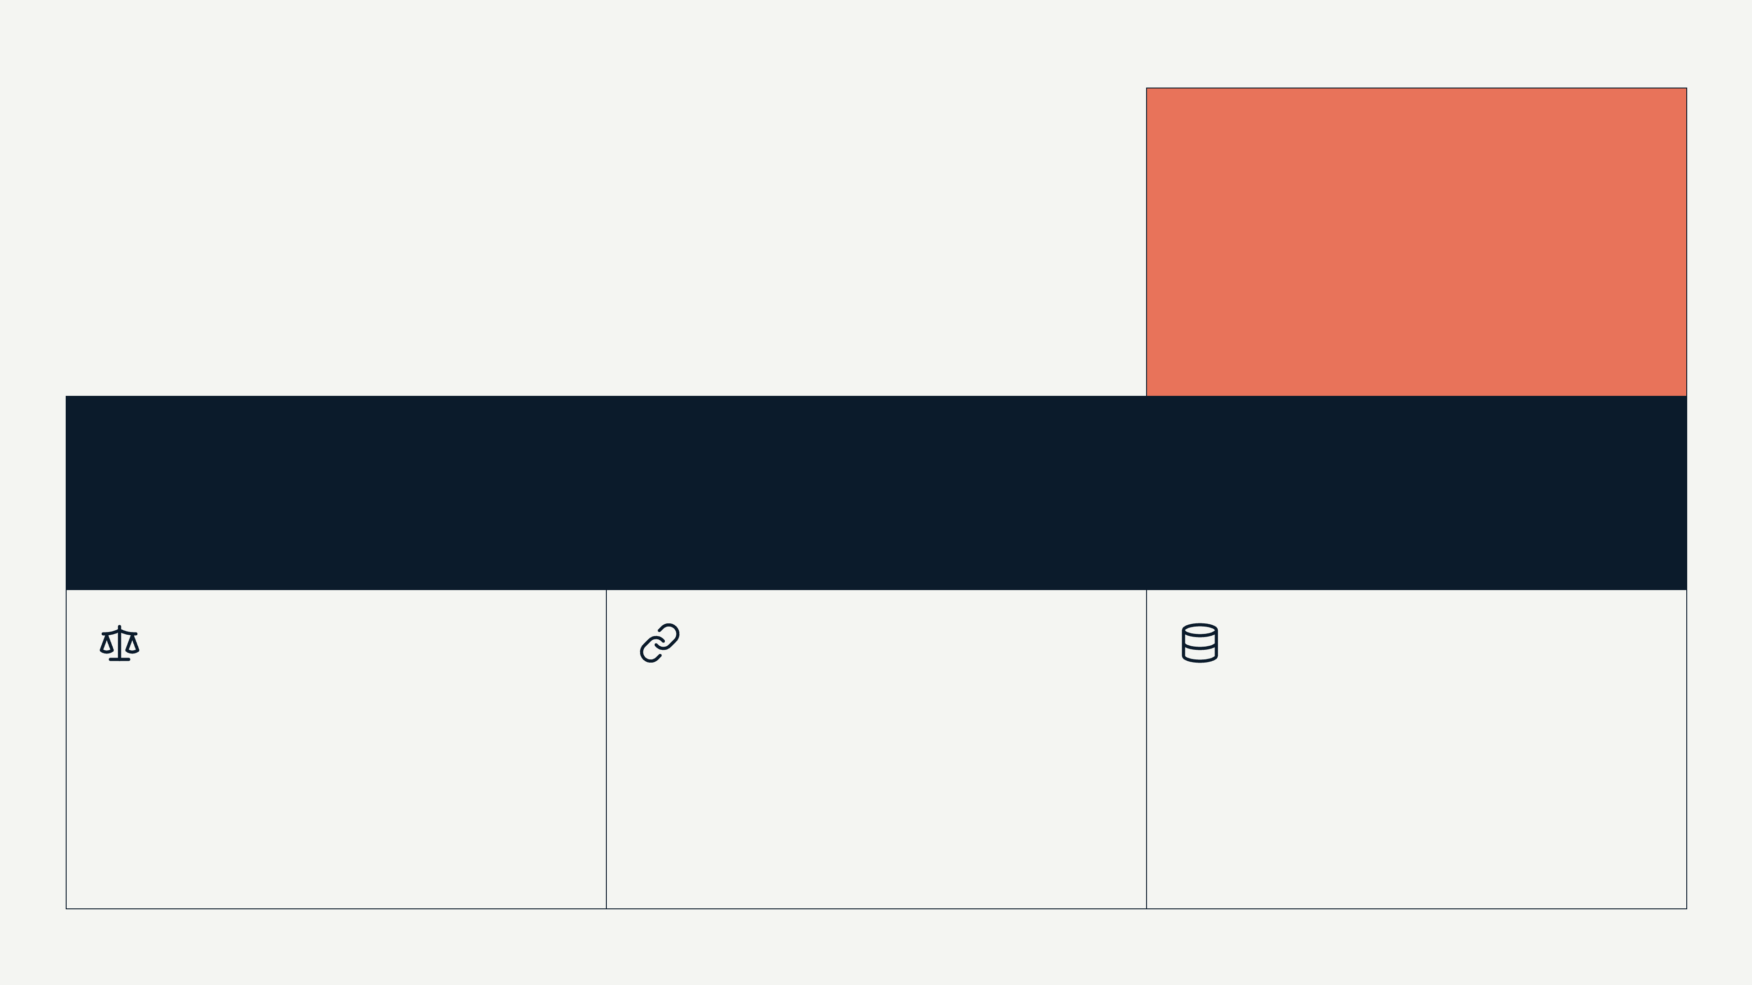
The risks we name ourselves, and what we are doing about each
KESTREL HEALTH / APPENDIX
22 / 23
APPENDIX
58%
The risks we name ourselves, and what we are doing about each
of GMV from the five largest employers, Q3 2026; none of 14 enterprise employers has left in two years
8.8^{months}
of cash at Q3 net burn, end of September 2026
Evidence
Data
One employer, no control group; controlled evaluation planned for 2027
Supply
Finance and the booking export differ by quarter; being reconciled
Clinics are not exclusive; we fill slots they could not fill otherwise
SOURCE: DOCS/BOARD-UPDATE-2026-Q3.MD, DATA/UNIT-ECONOMICS.XLSX
KESTREL HEALTH, CONFIDENTIAL, NOVEMBER 2026
Notes:
Question: What could go wrong, and do you know it?
Say: These are the four things we would ask about in your seat.
Context: Cash was £1.9M at the end of September at £215k monthly net burn.
Time: 45

Slide 23
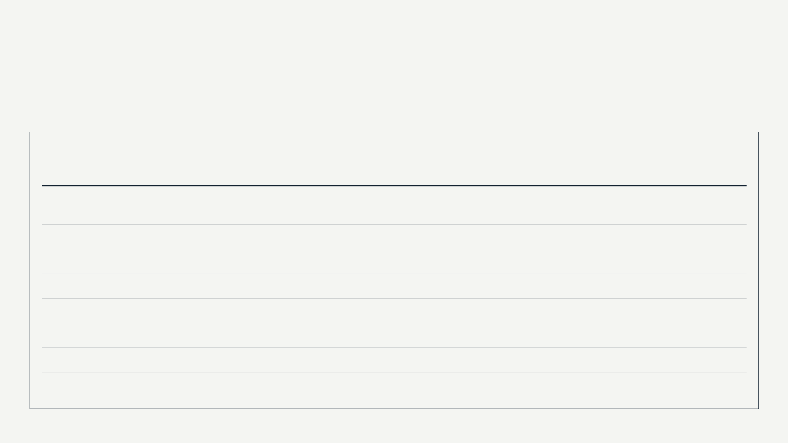
Sources
KESTREL HEALTH / APPENDIX
23 / 23
APPENDIX
Sources
48 figures from 8 source files. Each figure has an entry in the fact ledger (facts.yaml) that names its file and location.
SOURCE FILE
FIGURES
KINDS
SLIDES
docs/board-update-2026-Q3.md
18
12 facts, 2 projections, 4 assumptions
1, 2, 5, 6, 11, 14, 15, 19, 22
data/kpis-weekly.csv
4
4 facts
1, 2, 4 to 6, 8, 19
notes/founder-perspective.md
3
1 assumption, 2 facts
3, 5, 12, 16
docs/competitive-landscape.md
2
2 assumptions
3, 16
docs/clinical-outcomes-whitepaper.md
4
4 facts
3, 4, 6, 9, 16
data/unit-economics.xlsx
12
11 facts, 1 assumption
6, 11, 12, 14, 15, 21, 22
docs/market-sizing-2026.md
5
5 assumptions
14
team/team.md
1
1 fact
18
KESTREL HEALTH, CONFIDENTIAL, NOVEMBER 2026

