Slide 1
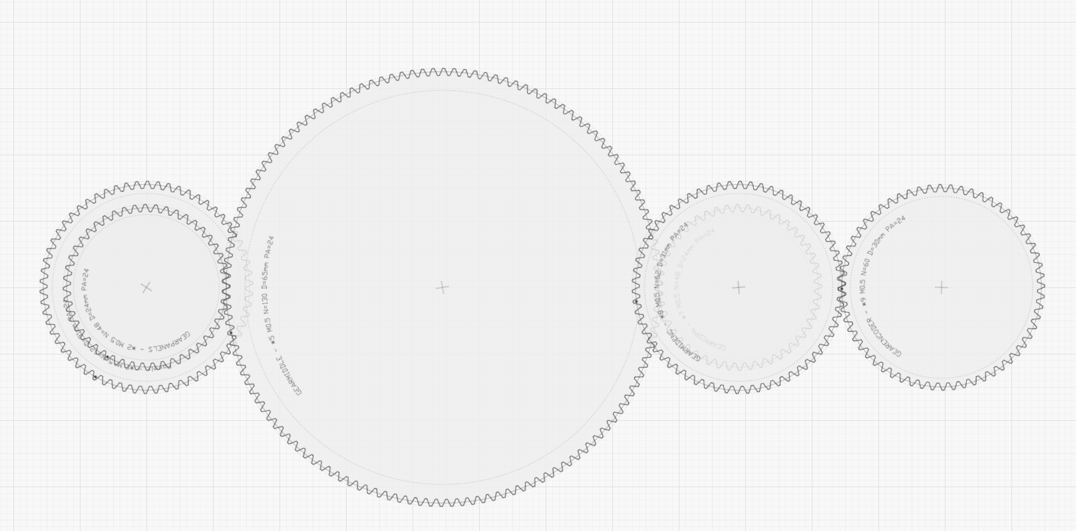
Middle gear ~130 teeth
Coaxial
62 panels
48 teeth gear
Coaxial
48 teeth gear
62 teeth gear
1 optical slot
Coaxial
60 teeth gear
360 steps/rev encoder
1 tooth = 1 panel = 24 pulses
Ratio 1:1
Ratio (irrelevant, no impact on final ratio)
Ratio 1:1
Ratio 1.03:1
1 panels rev = 1.03 encoder rev
Optical slot is always in sync with the same panel.
(does not matter which one, adjusted via pulseOffset)
Encoder revs are not in sync with panels revs. What matters is that 1 panel = an integer number of pulses

