Slide 1
Match Flow
Under Construction

Slide 2
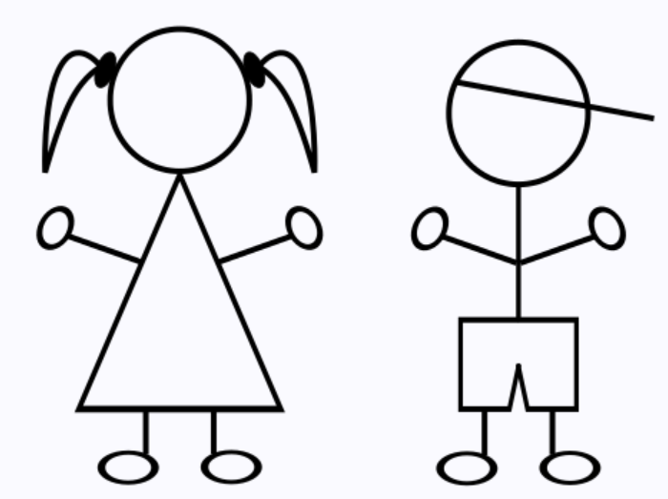
Start- Launch Page/Public Content
Sign up- Provide verification information
Basic Profile Set-up
User
User Swipes right
Receives Confirmation Email.
Matched User sent connection Notification
Matched User Swipes Right
Completes Full Profile
Chat Enabled between Users
Matched User Swipes Left
Navigate basic profiles (No pictures)
5 Days
Matches Found & Reviewed
Users asked:
Swipe Right or Left?
User Swipes Left
Either User Swipes Left
Both users swipe right
Match Disappears
Permanent Access to Complete Profiles

