Slide 1

Data Analysis
Analysis of Reports of UFO sightings (alt. Looking at the sky)
Made by: Lagornii A. IA-213

Slide 2

Problem: Analyze reports about UFO sightings over the last century
Chosen Dataset: 80,000 reports of UFO sightings over the last century
Scope and Objectives:
Find out the areas of the World that are most likely to have UFO sightings
Find out the most common UFO descriptions
Find out the time when UFO sightings are very common

Slide 3
Categorical Variables: Datetime, country, city, state, shape (Merged with general description), comments (Cleaned and normalized), month (Made from Datetime)
Numerical Variables: Longitude, latitude, year (Made from Datetime)
Data Summary

Slide 4
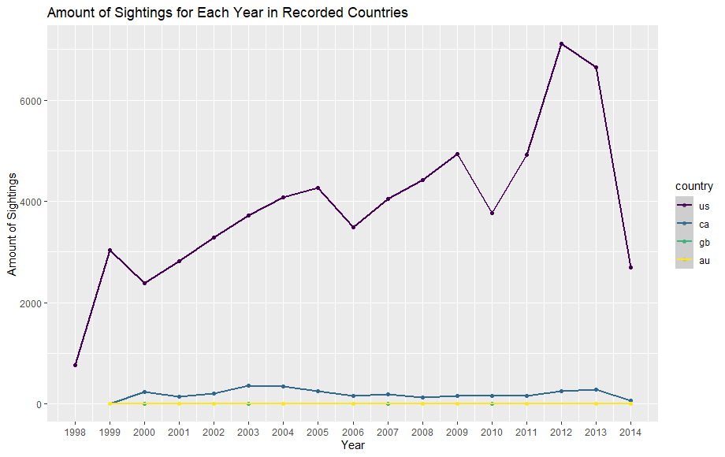

Slide 5
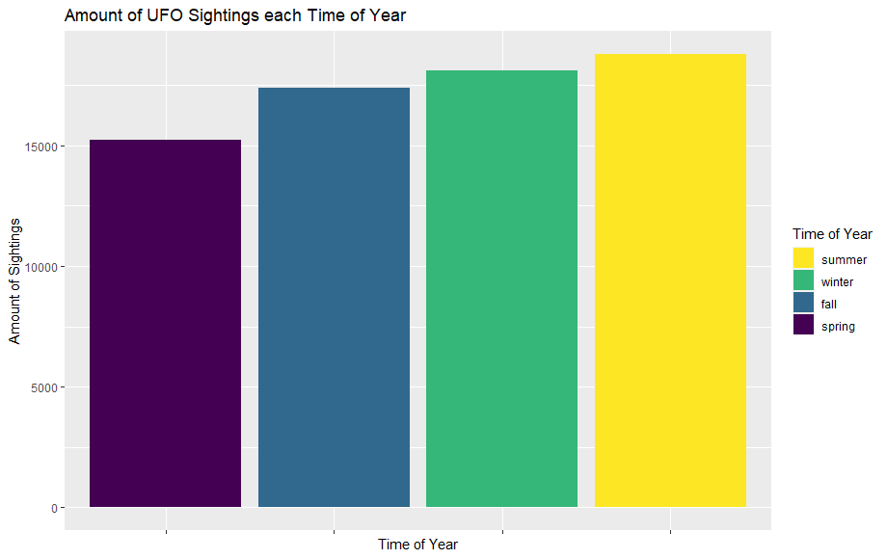

Slide 6
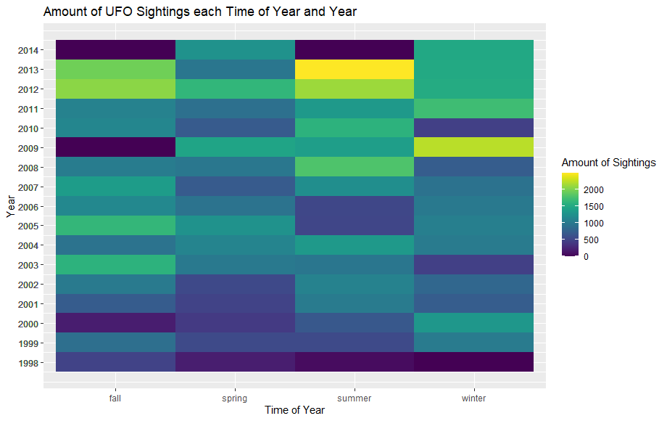

Slide 7
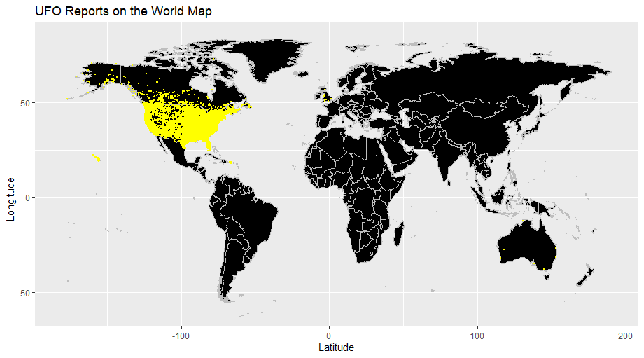

Slide 8
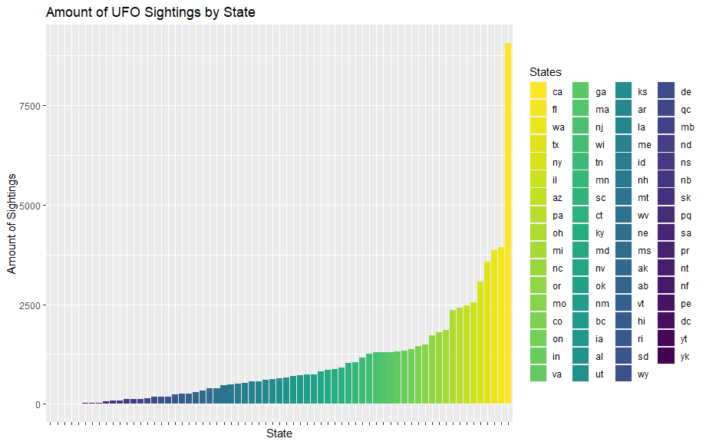

Slide 9
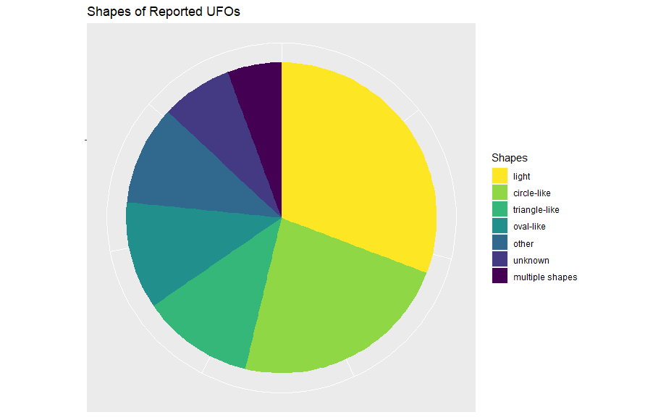

Slide 10
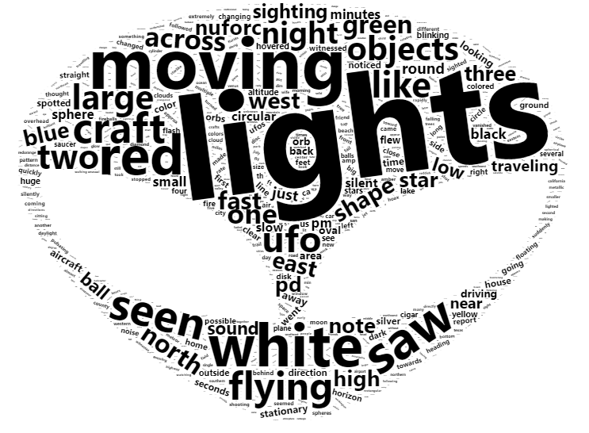
Word Cloud from the Comments

Slide 11
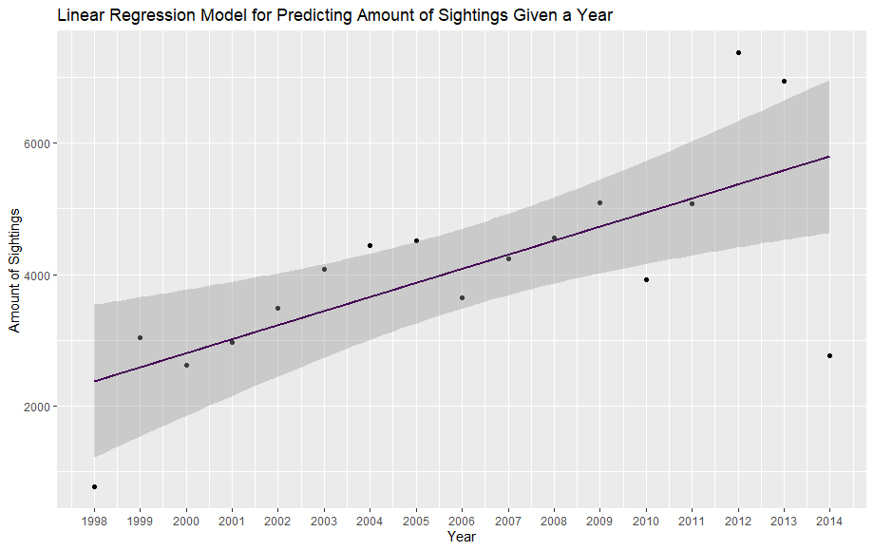

Slide 12
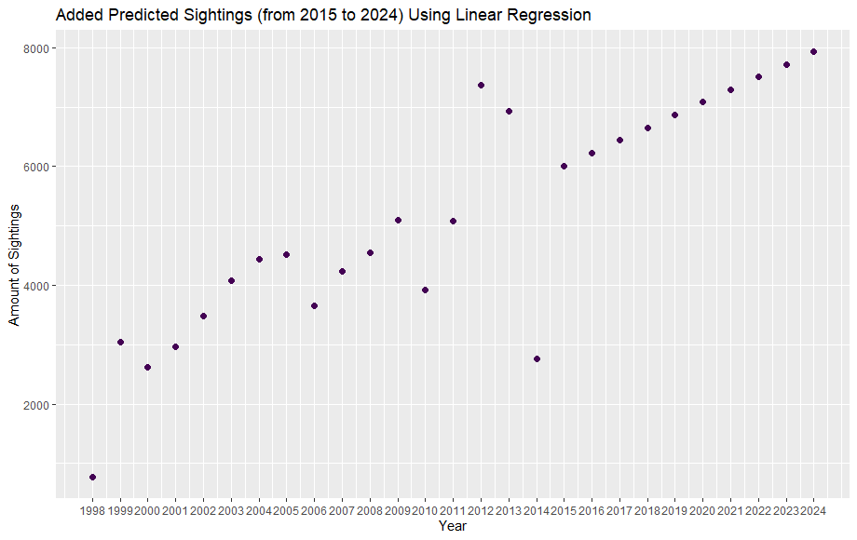

Slide 13
BIBLIOGRAPHY:
https://www.kaggle.com/datasets/NUFORC/ufo-sightings - Used Dataset

