Slide 1

Data Analysis
Analysis of Reports of UFO sightings (alt. Looking at the sky)
Made by: Lagornii A. IA-213

Slide 2

Overview of the Analysis
Problem: Why do people see UFOs in the first place? Do aliens exist?
Chosen Dataset: 80,000 reports of UFO sightings over the last century
Scope and Objectives:
Find out the areas of the World that are most likely to have UFO sightings
Find out the most common UFO descriptions
Find out the time when UFO sightings are very common

Slide 3
Data Summary
Categorical Variables: Datetime, country, city, state, shape (Merged with general description), comments (Cleaned and normalized), month (Made from Datetime)
Numerical Variables: Longitude, latitude, year (Made from Datetime)

Slide 4
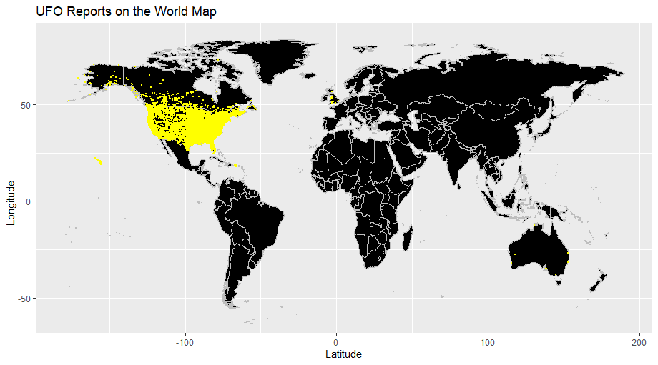

Slide 5
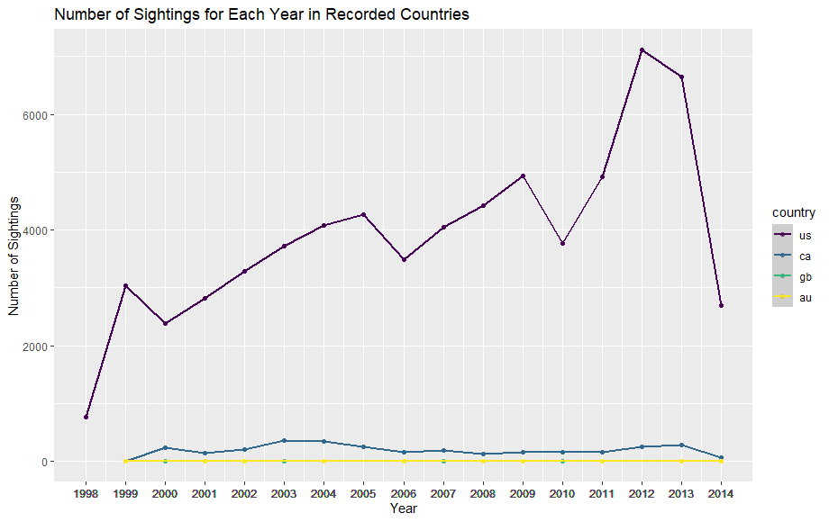

Slide 6
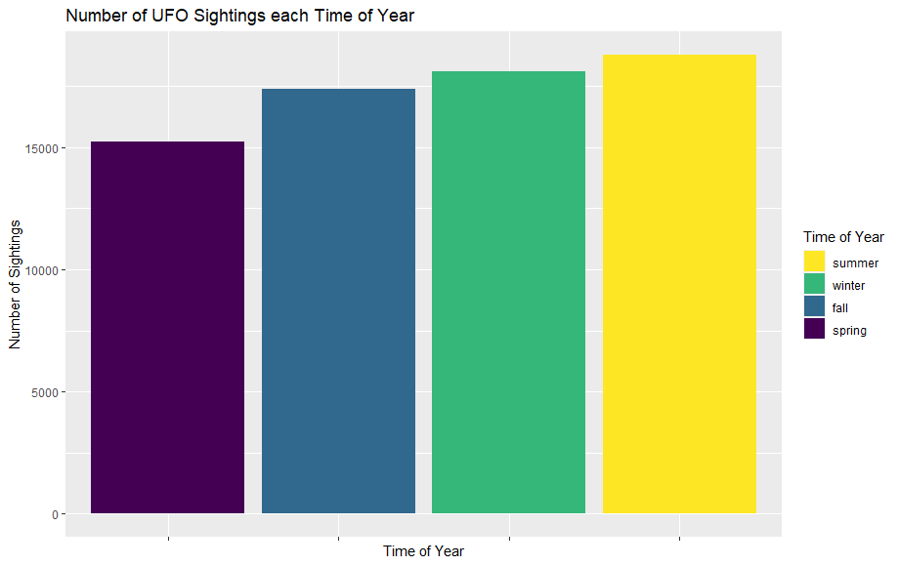

Slide 7
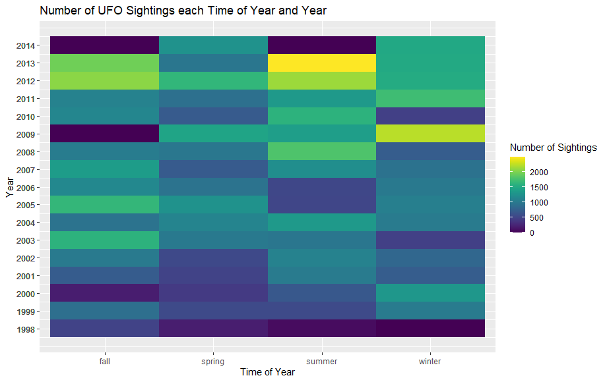

Slide 8
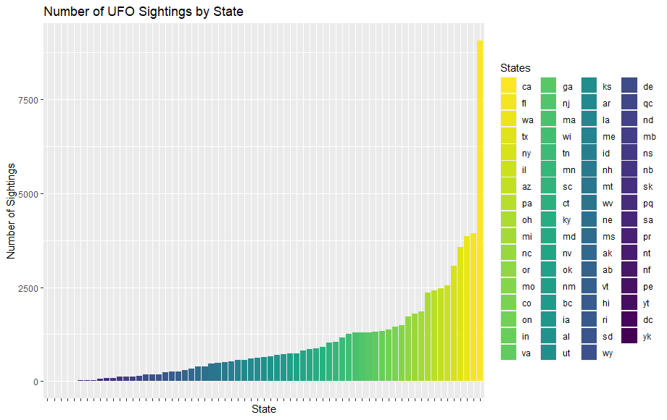

Slide 9
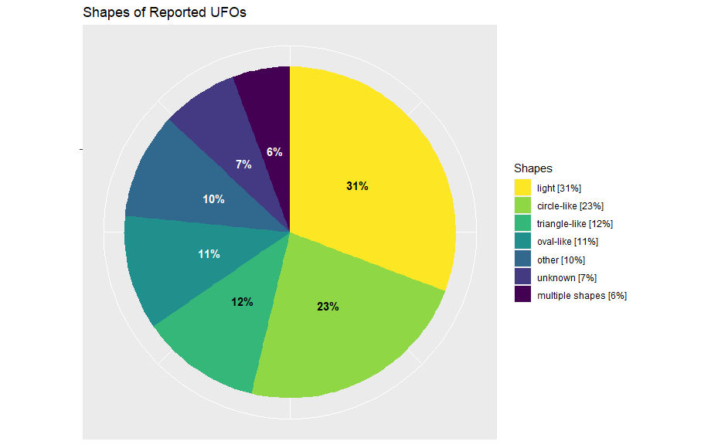

Slide 10
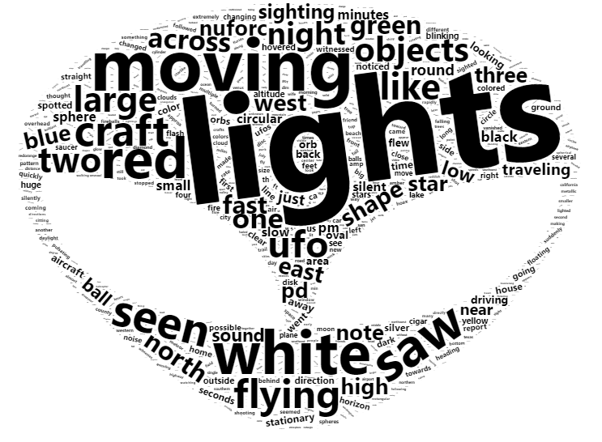
Word Cloud from the Comments

Slide 11
Model for Predicting the Number of Reports
Problem: Given a year predict the number of UFO sightings that year
Chosen Statistical Model: Linear Regression with one variable — y = wx + b, where x is the year and y is the number of UFO reports

Slide 12
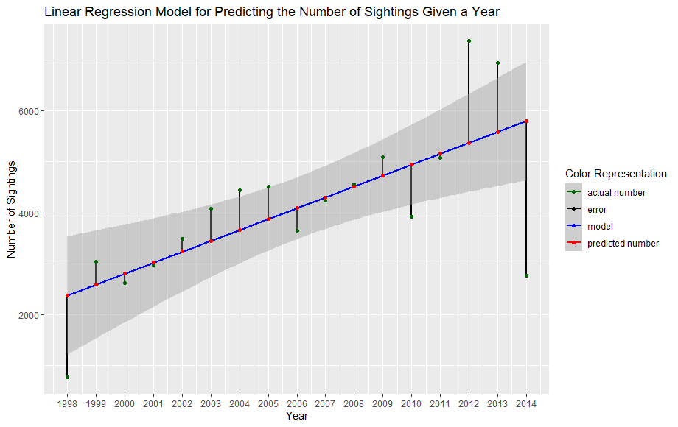

Slide 13
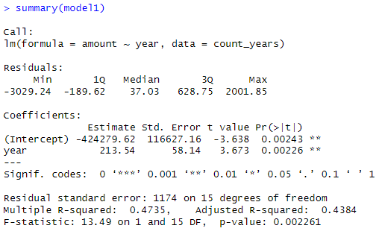
Model Summary

Slide 14
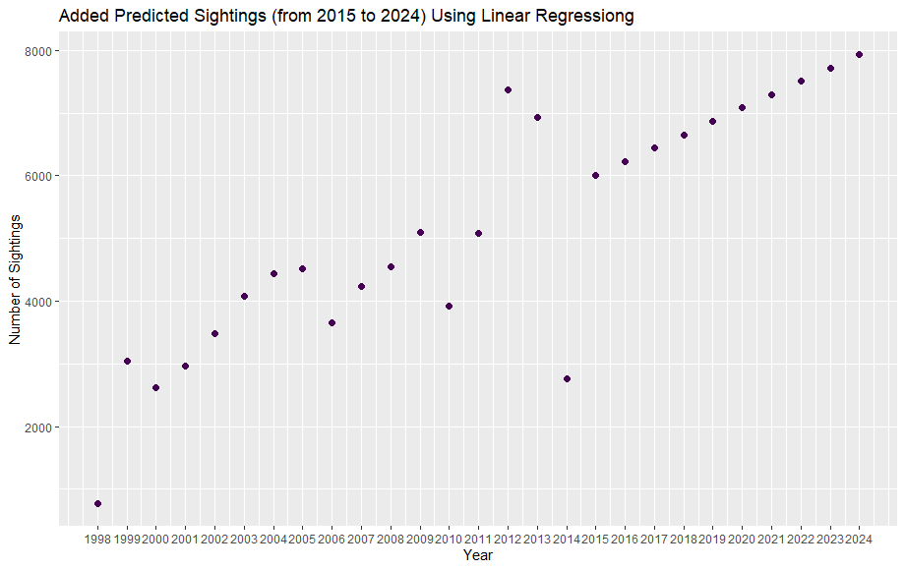

Slide 15
Bibliography
https://www.kaggle.com/datasets/NUFORC/ufo-sightings - Used Dataset

