Slide 1
TensorFlow
Getting started

Slide 2
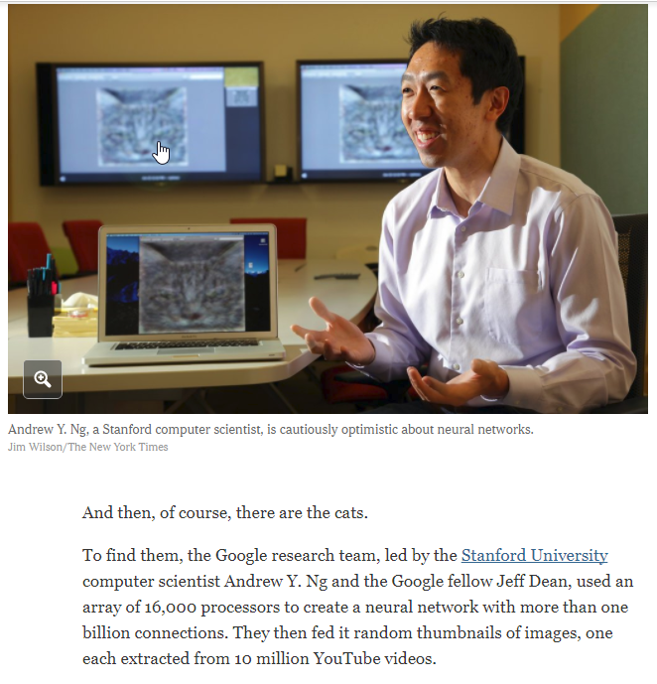
How Many Computers to Identify a Cat? 16,000
Google Brain project at Google

Slide 3
Brief history
2011 - Andrew Ng and cats
2011 - Google builds DistBelief
2013-2014 - Google acquires DeepMind and others
2015-2016 - AlphaGo beats humans
2015 November 9 - TensorFlow initial release under Apache 2.0
2016 May - Google announces Tensor Processing Unit (TPU)
2017 February 11 - TensorFlow 1.0.0 release

Slide 4
In a nutshell
FOSS library (Apache 2.0) “for numerical computation using data flow graphs. Nodes in the graph represent mathematical operations, while the graph edges represent the multidimensional data arrays (tensors) communicated between them.”
Distributed by design: CPUs, GPUs, TPUs, Android, iOS, XLA
Rich infrastructure: TensorBoard, Serving
Mobile support via TensorFlow Lite
Python API is the main. Also C++, Haskell, Java, Go, and Rust APIs.
Third party packages are available for C#, Julia, R, and Scala.
Becomes popular (80K stars on github)

Slide 5
What is a tensor?
Is a multidimensional array
Rank is its number of dimensions
3 # a rank 0 tensor; a scalar with shape []
[1., 2., 3.] # a rank 1 tensor; a vector with shape [3]
[[1., 2., 3.], [4., 5., 6.]] # a rank 2 tensor; a matrix with shape [2, 3]
[[[1., 2., 3.]], [[7., 8., 9.]]] # a rank 3 tensor with shape [2, 1, 3]

Slide 6
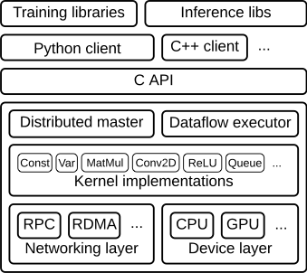
Architecture
Clients to declare the model/ graph
Execution engine

Slide 7
Quick start
# mkdir on host
mkdir /root/jupyter/notebooks
chmod -R a+w jupyter/notebooks/
# launch a container
docker run -d -p 8888:8888 \
-v '/root/jupyter/notebooks:/home/jovyan/work' \
jupyter/tensorflow-notebook start-notebook.sh --NotebookApp.token=''

Slide 8
Hello world
import tensorflow as tf
hello = tf.constant('Hello, TensorFlow!')
with tf.Session() as session:
print(session.run(hello))

Slide 9
Basics Demo

Slide 10
MNIST Demo

Slide 11
TensorBoard

Slide 12
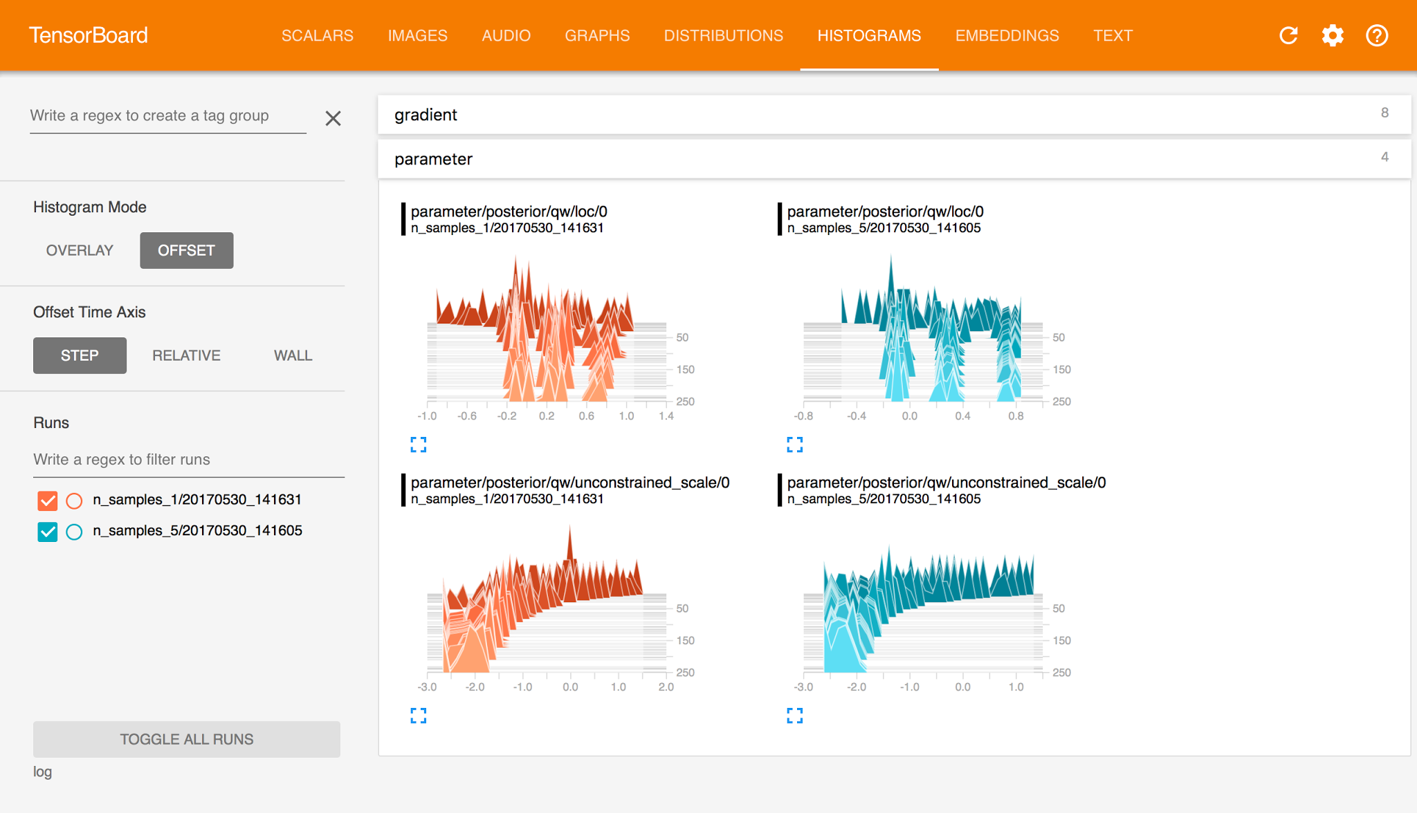

Slide 13
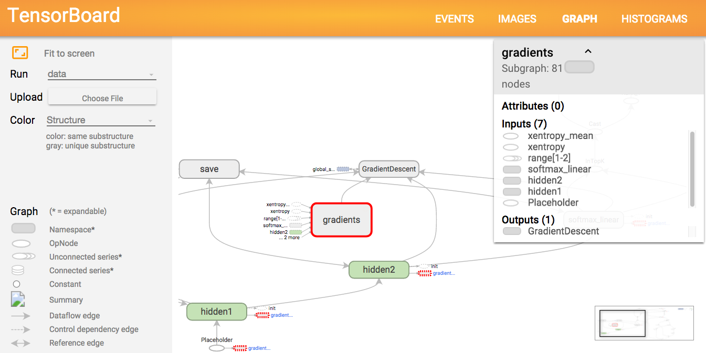

Slide 14
TensorBoard Basics
# Declare summaries for tensors that you'd like to collect.
tf.summary.scalar("summary_name", variable)
# Group all previously declared summaries for serialization.
# To pick a subset, use tf.summary.merge([summaries]).
merged = tf.summary.merge_all()
# Construct a writer object
writer = tf.summary.FileWriter(summary_dir, sess.graph)
# At runtime, evaluate the summaries graph, to assign a value.
summary_value, ... = sess.run([merged, ...], feed_dict={...})
# Write the summary value
writer.add_summary(summary_value, step)

Slide 15
Supported summary ops:
tf.summary.scalar
tf.summary.image
tf.summary.audio
tf.summary.text
tf.summary.histogram

Slide 16
Demo

Slide 17
TensorFlow Serving

Slide 18
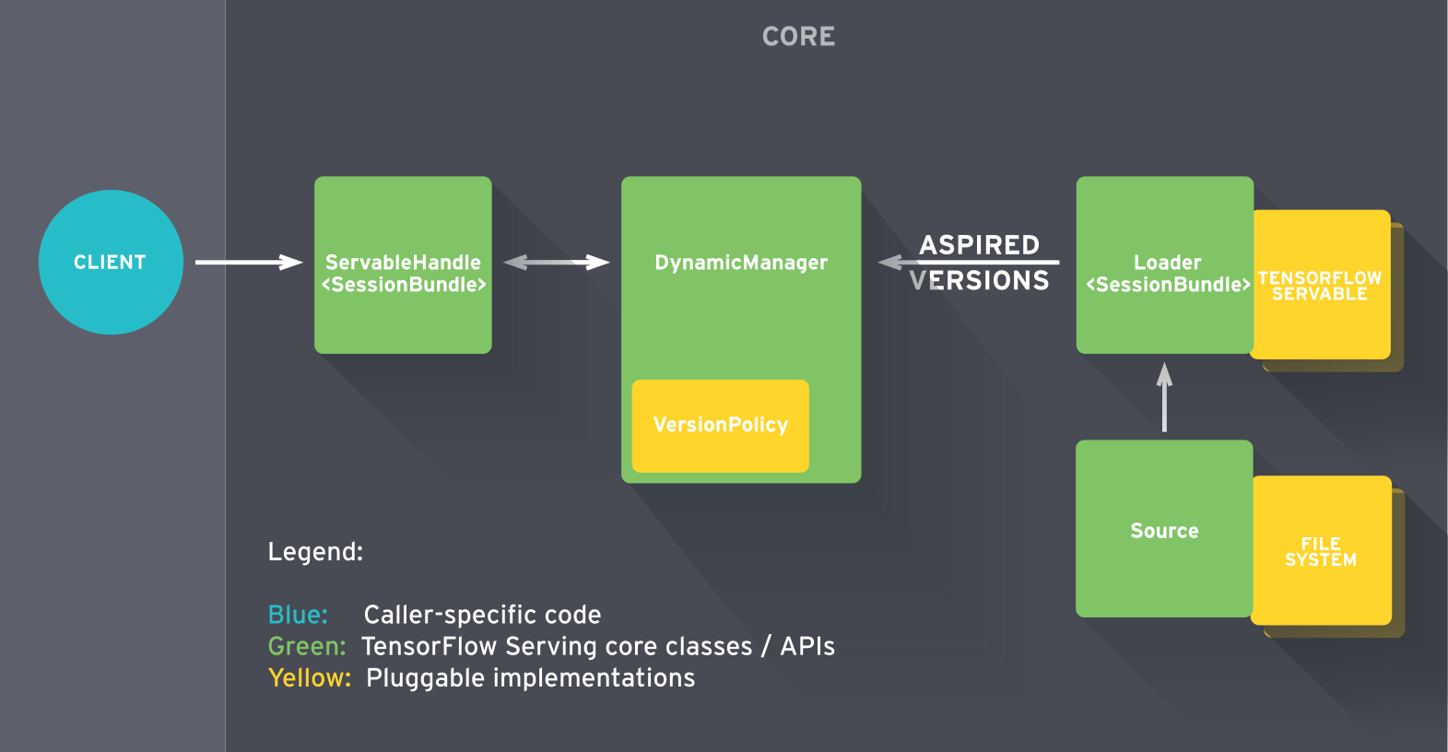

Slide 19
Internals
GRPC
ProtoBuf

Slide 20
Quickstart
docker run -d -p 8500:8500 \
-v '/root/jupyter/notebooks/models/:/root/models/' \
tensorflow-serving-devel \
tensorflow_model_server --port=8500 --model_name=mnist \ --model_base_path=/root/models/alex/

Slide 21
Demo

Slide 22
Distributed TensorFlow

Slide 23
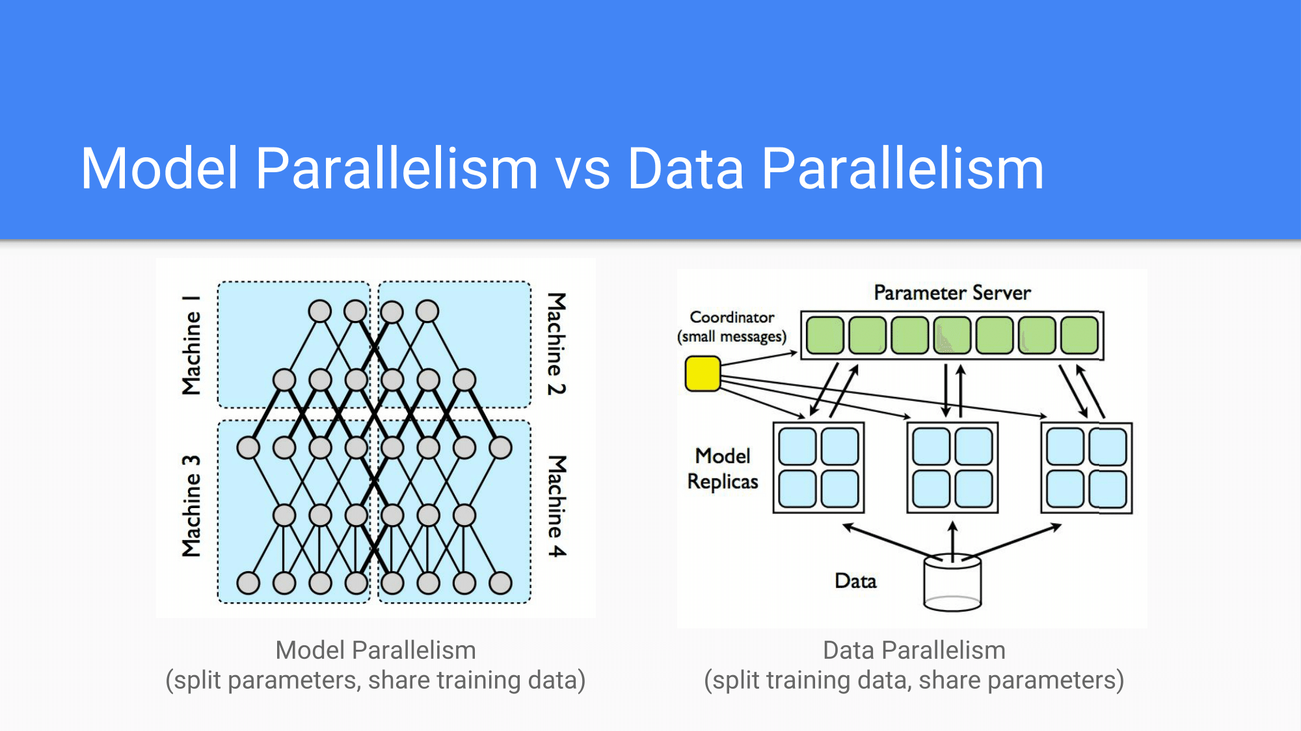

Slide 24
Hello distributed TensorFlow!
Demo

Slide 25
TensorFlow cluster
Cluster -> Job -> Task (Server) -> Device
Parameter Server (Stateful) <-> Worker (Stateless)
In-graph replication
Between-graph replication

Slide 26
Where to go next?
https://www.tensorflow.org Get started, tutorials, advanced examples
https://github.com/jtoy/awesome-tensorflow

Slide 27
Benchmarks
Google for it
https://www.tensorflow.org/performance/benchmarks
https://eng.uber.com/horovod/
https://github.com/szilard/benchm-dl/blob/master/keras_backend.md

Slide 28
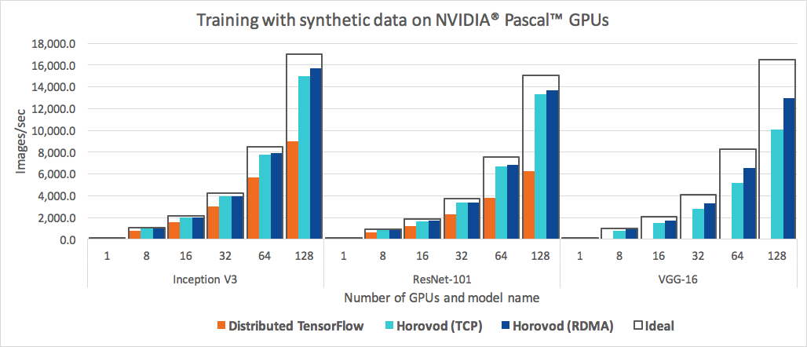
Distributed benchmarks
Source: https://github.com/uber/horovod

Slide 29
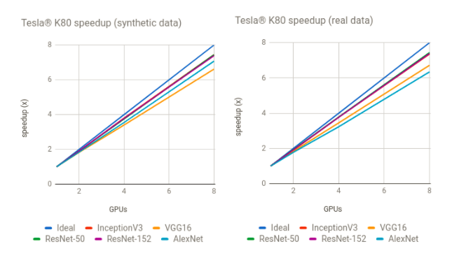

Slide 30
XLA (Accelerated Linear Algebra)
a domain-specific compiler for linear algebra that optimizes TensorFlow computations.
Uses LLVM
supports JIT on x86-64 and NVIDIA GPUs
and AOT compilation for x86-64 and ARM

Slide 31
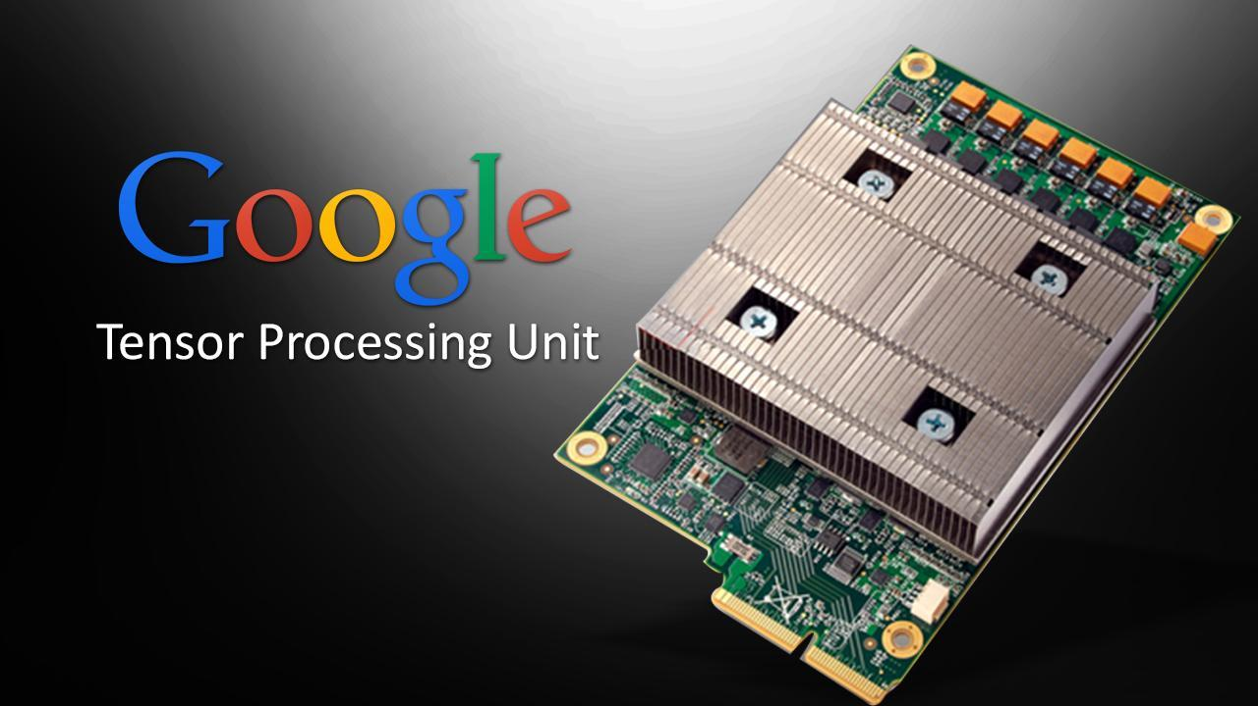

Slide 32
Tensor Processing Unit (TPU)
A chip for matrix multiplication
High throughput (600GB/s)
low-precision arithmetic (8 bit)
Already in use (AlphaGo)
2017 May - Google announces the second generation
180 TFLOPS performance (top CPU ~1 TFLOPS, top GPU ~10 TFLOPS)
64 TPUs - 11.5 PFLOPS (faster than 10th Supercomputer)

Slide 33
Software 2.0 by Andrej Karpathy
“Neural networks are not just another classifier, they represent the beginning of a fundamental shift in how we write software. They are Software 2.0.”
“The “classical stack” of Software 1.0 is what we’re all familiar with — it is written in languages such as Python, C++, etc. It consists of explicit instructions to the computer written by a programmer.”
“In contrast, Software 2.0 is written in neural network weights. No human is involved in writing this code because there are a lot of weights (typical networks might have millions), and coding directly in weights is kind of hard (I tried). Instead, we specify some constraints on the behavior of a desirable program (e.g., a dataset of input output pairs of examples) and use the computational resources at our disposal to search the program space for a program that satisfies the constraints.”

Slide 34
“It turns out that a large portion of real-world problems have the property that it is significantly easier to collect the data than to explicitly write the program. “
“Software 2.0 is not going to replace 1.0 (indeed, a large amount of 1.0 infrastructure is needed for training and inference to “compile” 2.0 code), but it is going to take over increasingly large portions of what Software 1.0 is responsible for today.”
“In the long term, the future of Software 2.0 is bright because it is increasingly clear to many that when we develop AGI, it will certainly be written in Software 2.0.
And Software 3.0? That will be entirely up to the AGI.“
Source: https://medium.com/@karpathy/software-2-0-a64152b37c35

