Slide 1
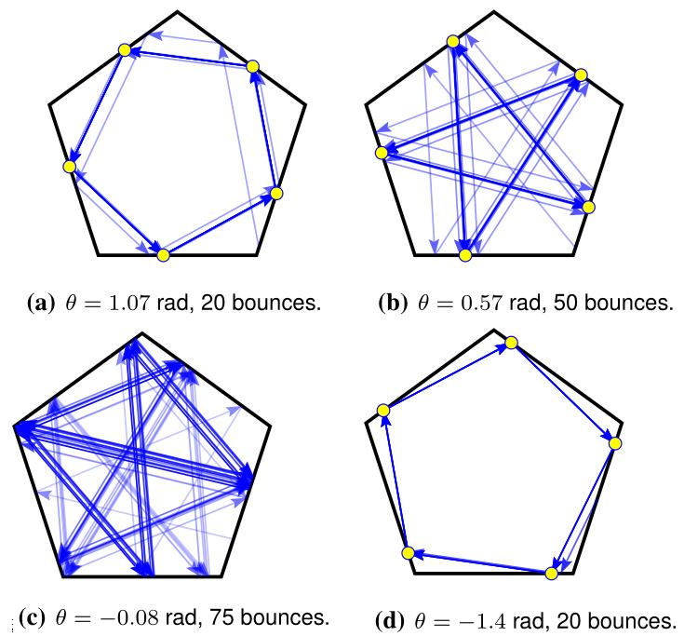

Periodic Trajectories of Mobile Robots
Alexandra Nilles, Israel Becerra, and Steven M. LaValle
Computer Science, University of Illinois at Urbana-Champaign, USA
Imagine a robot which can only move forward in straight lines and “bounce” off boundaries at a controllable angle θ
Question: If we fix θ and let the robot “bounce around” in a 2D regular polygon, what are the resulting trajectories?
Given any regular polygonal environment, we find expressions for everywhere-stable limit cycles for explicit ranges of θ
Low complexity, high-level controller for ensuring patrolling behavior, or reducing location uncertainty
Example simulated trajectories and analytic predictions (circles)

