Slide 1
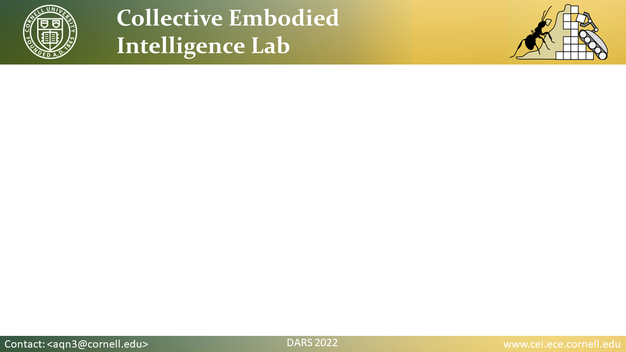
Characterization of the Design Space of Collective Braitenberg Vehicles
Jack A. Defay, Alexandra Q. Nilles, and Kirstin Petersen

Slide 2
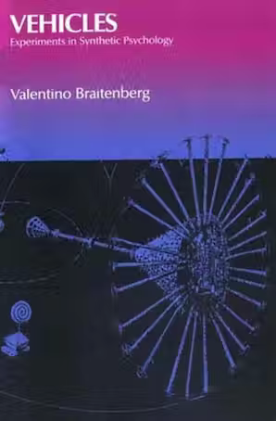
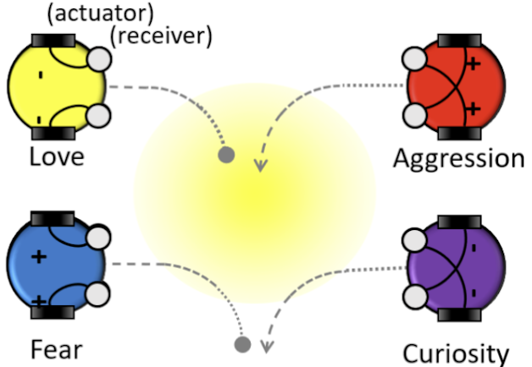
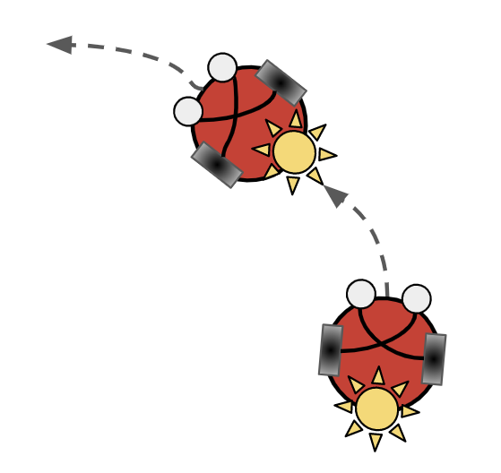
Braitenberg Vehicles
Simple abstract vehicles: four “configurations” arising from two sensors, two actuators, and reactions to stimulus in environment
  Kinesis: speeding up (+) or slowing down (-) in response to stimuli
  Taxis: turning toward (+) or away (-) from stimuli
Towards reactive robotic collectives: onboard stimulus and the resulting collective dynamics
2

Slide 3
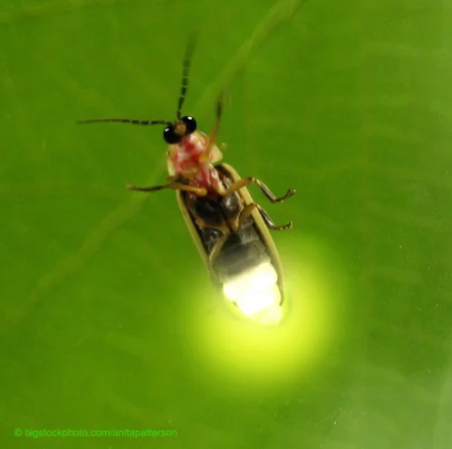
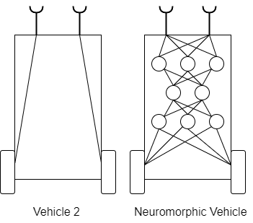
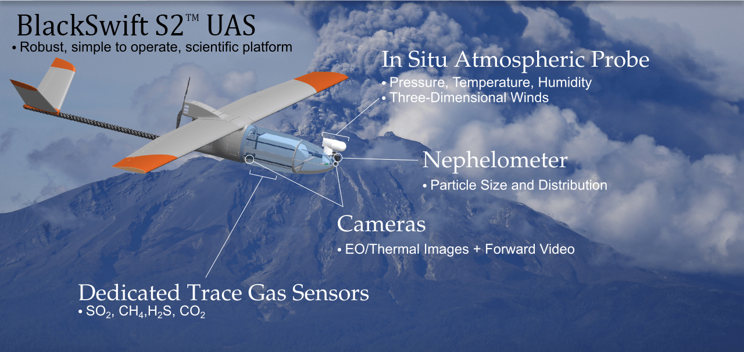
Motivation
Goal: reactive collectives with switchable behaviors and minimal sensing/communication requirements
Advantages of minimal, reactive, local control:
  Lower design complexity
  More scalable
  More private and secure
Model with hardware implementation in mind:
  Actuation noise
  Geometric constraints on sensing and stimulus
  Analyze system by varying constraints, gain, noise
Unifying framework for reactive collective design
Extensions to embodied learning
3
Notes:
Advantages:
Longer persistence in environment, easier to verify designs
More scalable up in number (ex: S2 still uses centralized conflict resolution / collision avoidance), down in size (microbots)
Privacy: scene understanding and cameras may not be needed for tasks such as crowd navigation.

Slide 4
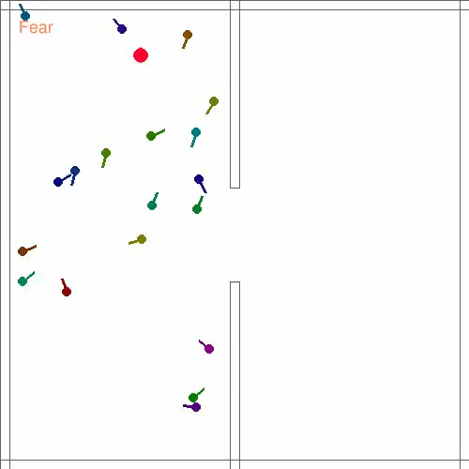
Highlights
Open-source simulation of Braitenberg Vehicles with onboard stimulus
12 potential collective behaviors
Aggregation, coverage, formations at high/low kinetic energy
Robust to noise
4
Notes:
Model has an embodied, control-theoretic grounding
Simulation includes interactive demo; shows potential for coarse global control of reactive swarms, with potential for one or a few controllable agents within larger swarm
Regimes: over-, under-stimulation and in between; related to density of agents in the space

Slide 5
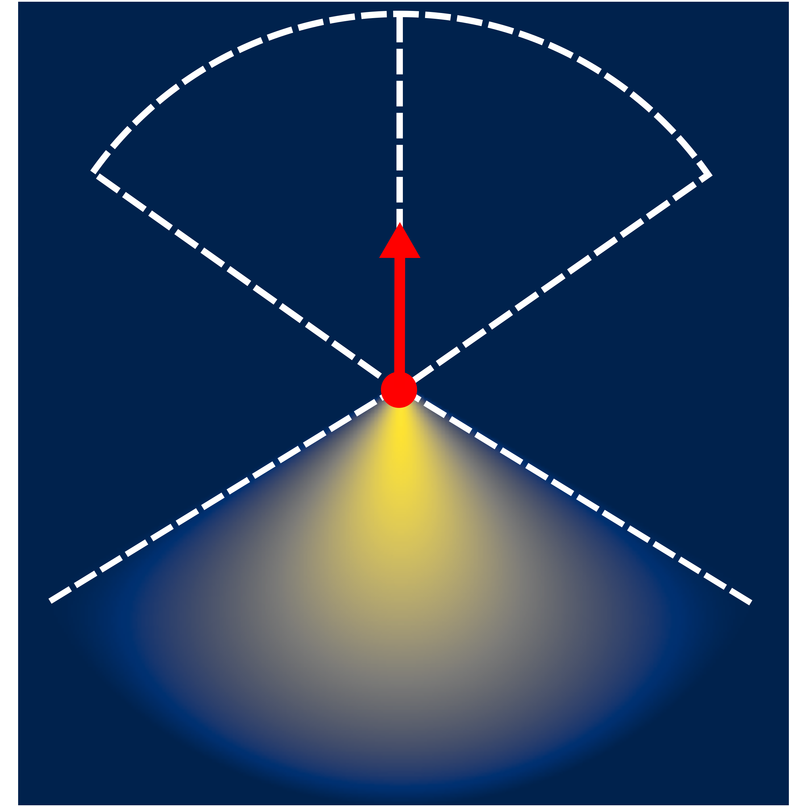
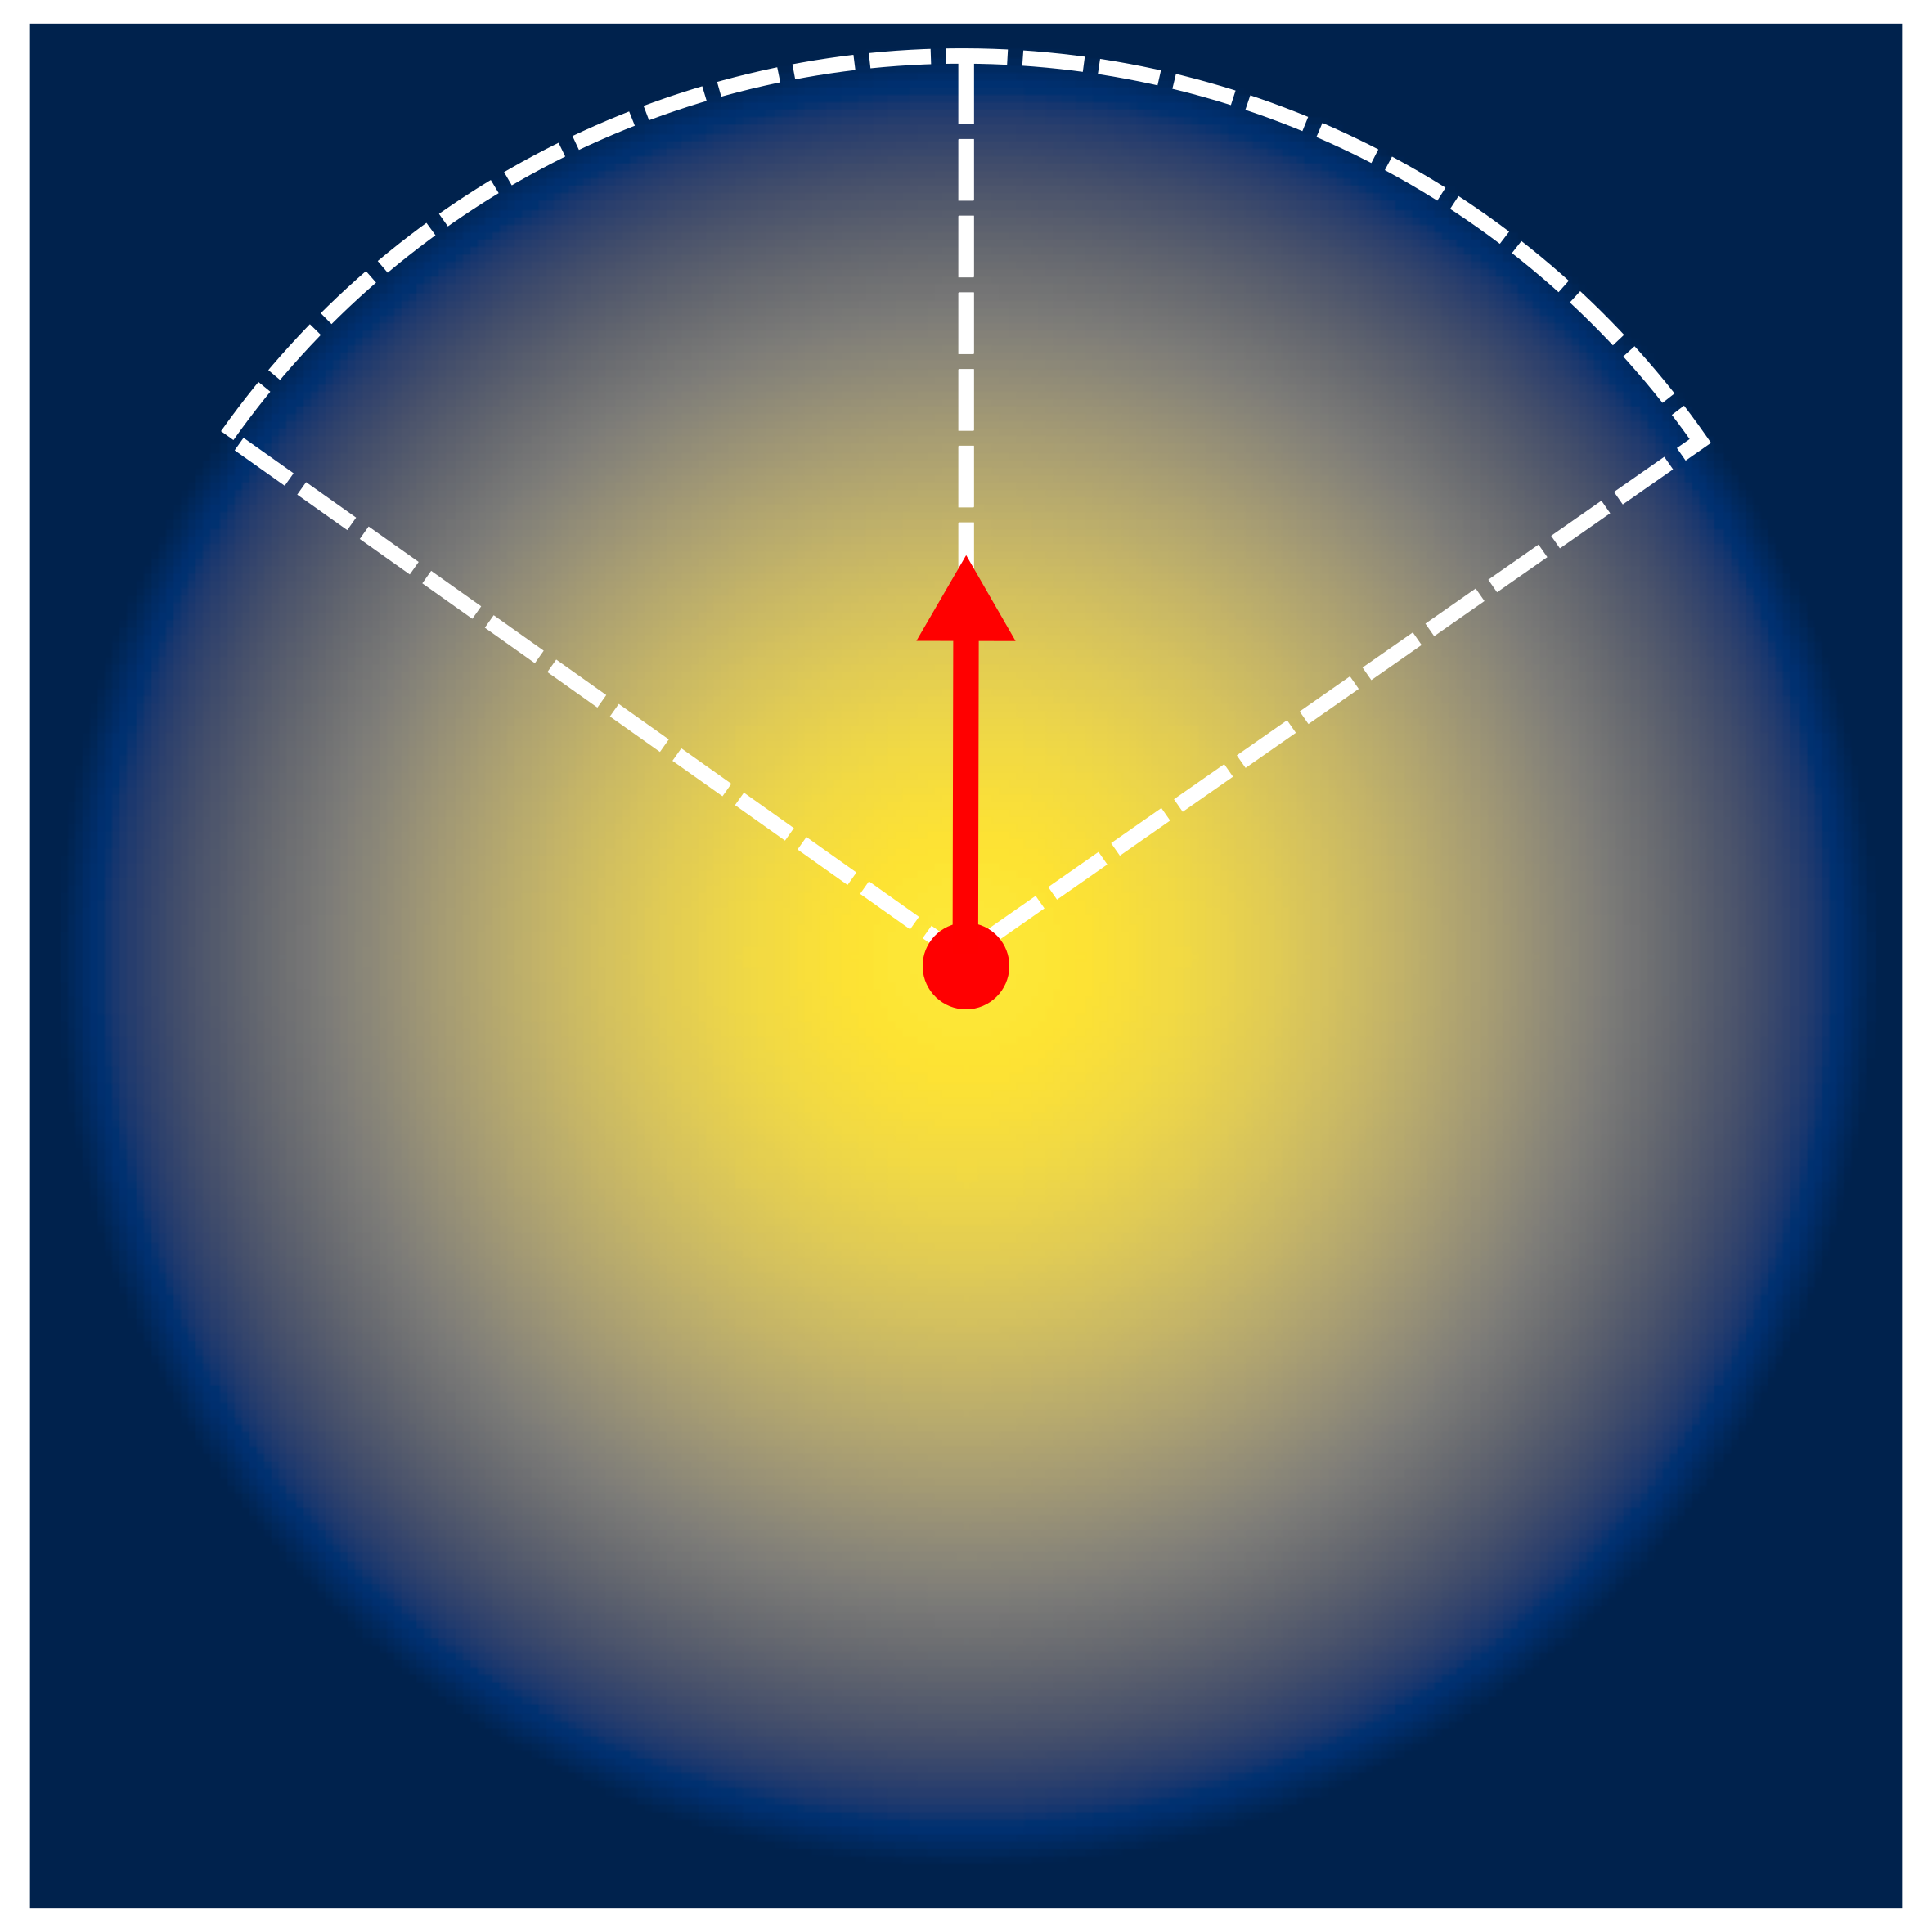
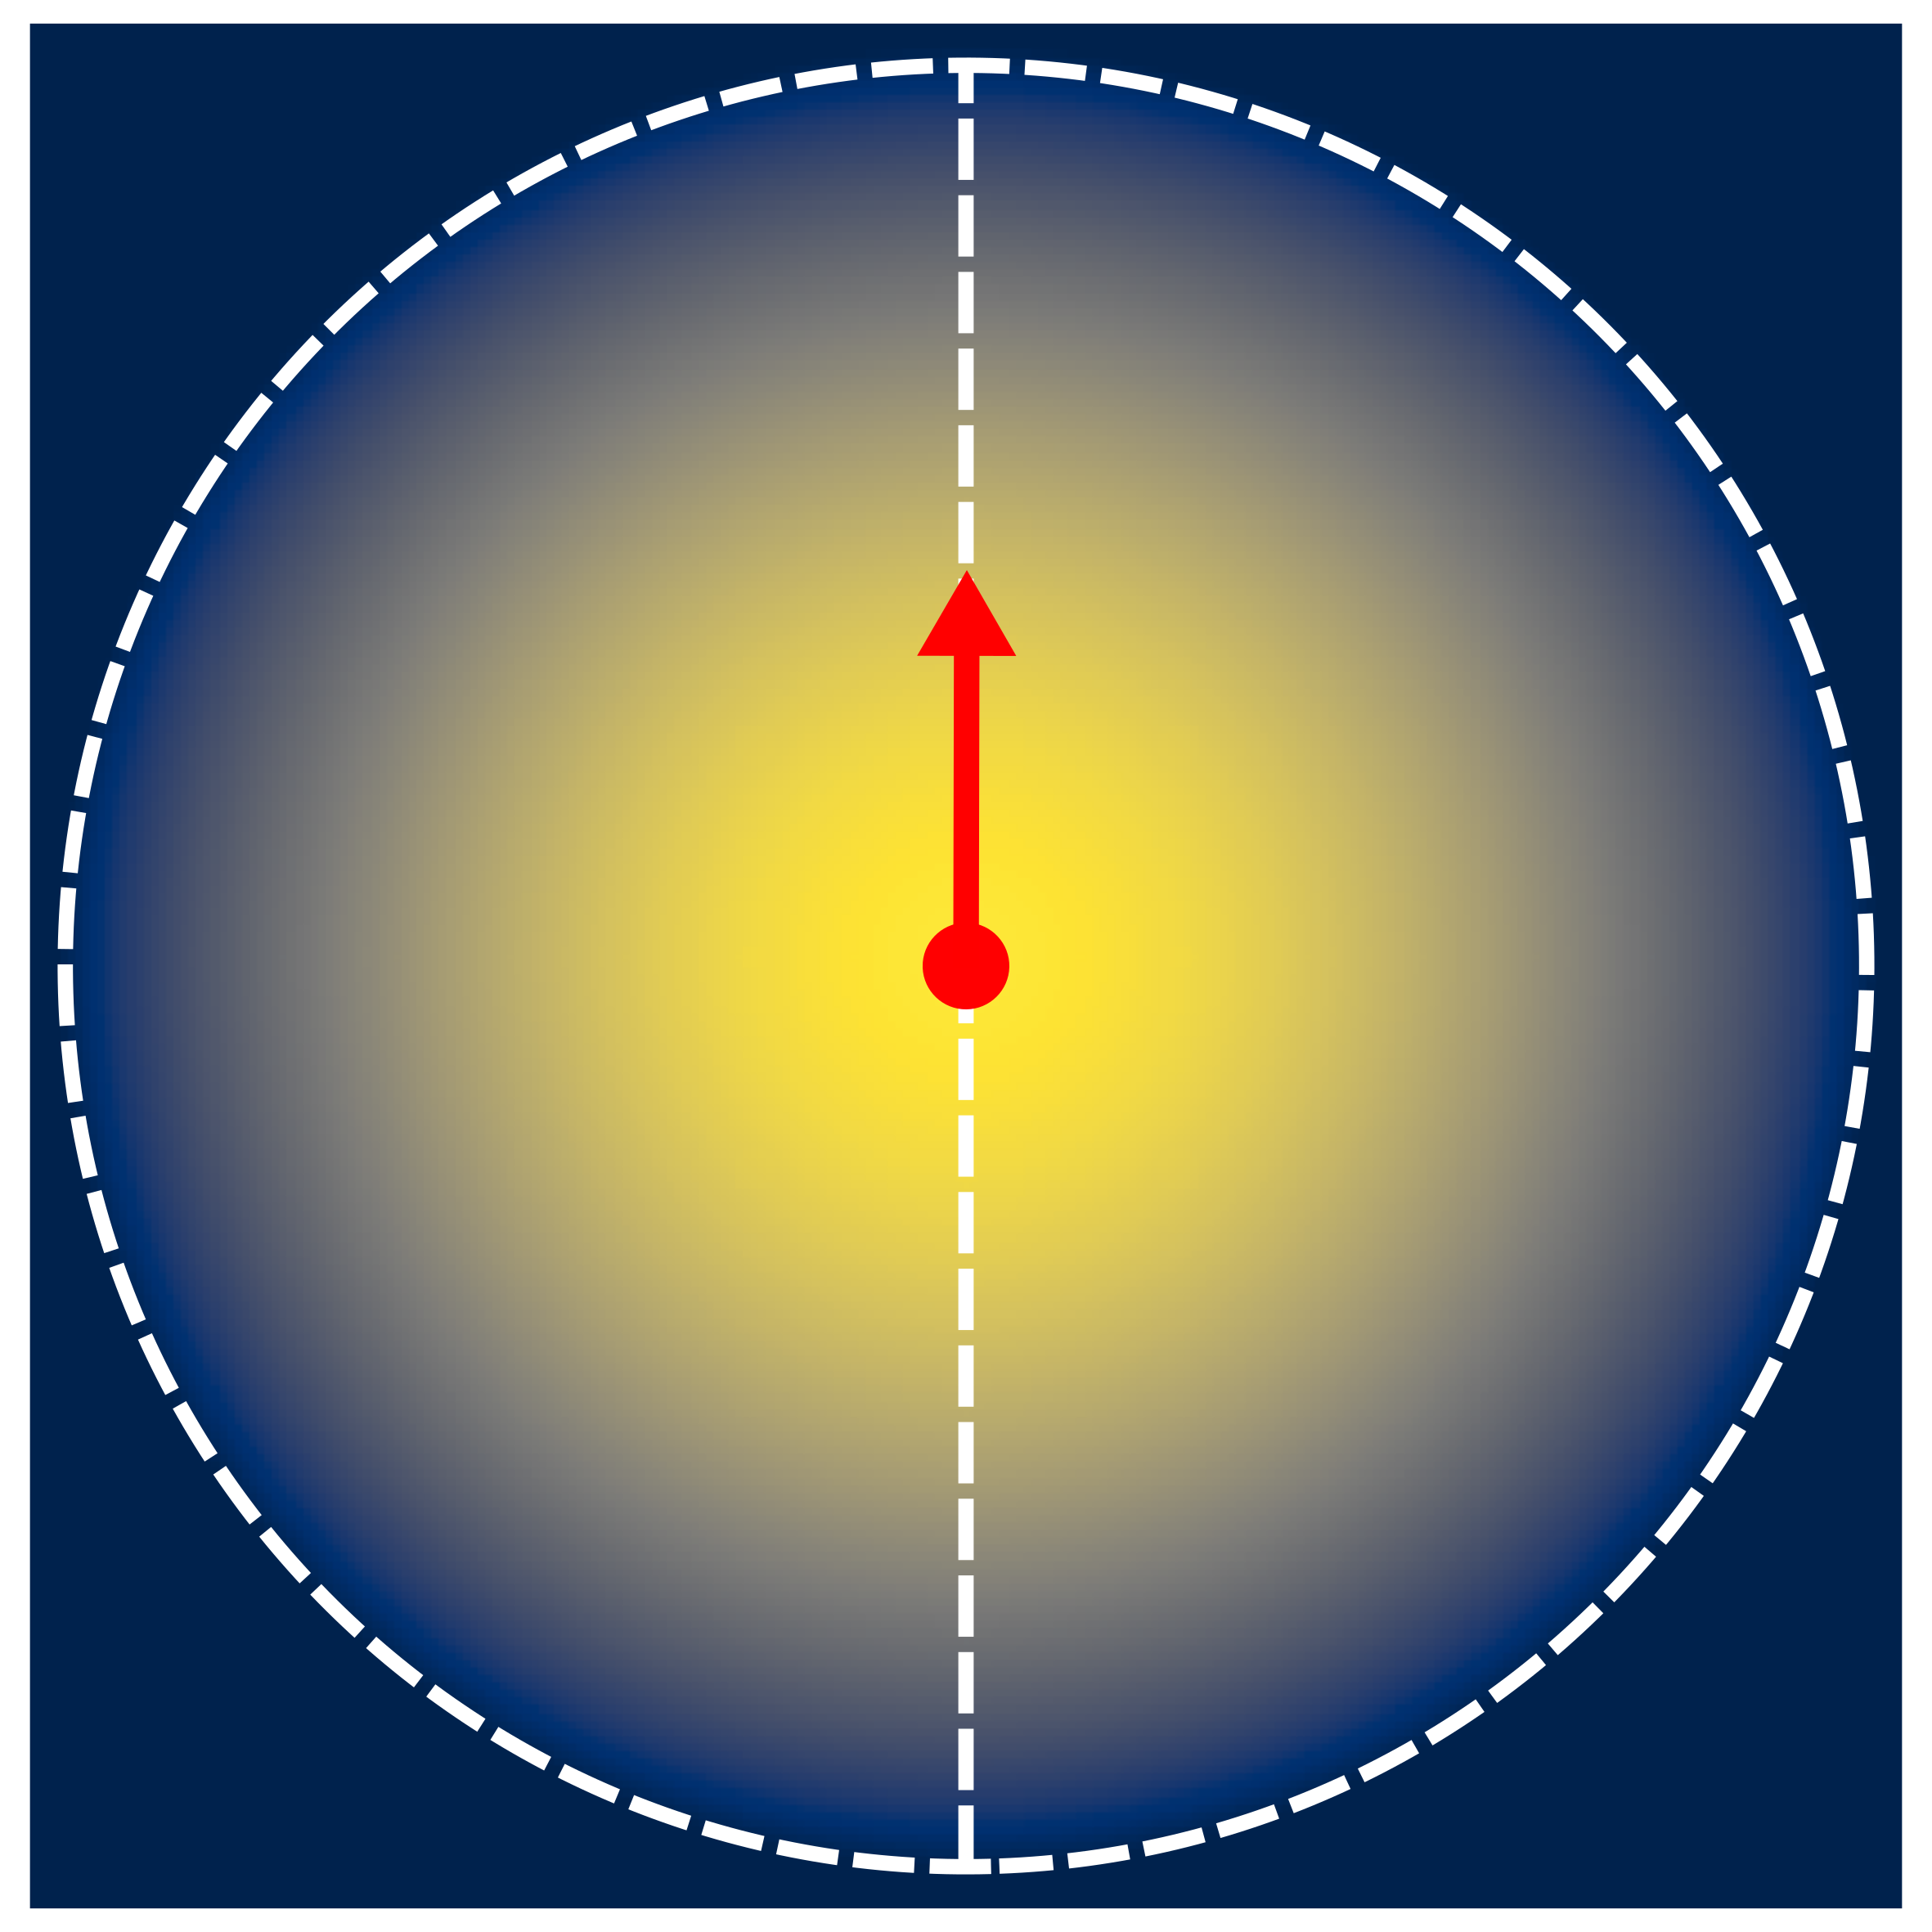
Stimulus and Sensing Models
Three combinations considered in paper:
1. Both directional
2. Directional sensing,
omnidirectional stimulus
3. Both omnidirectional
Examples:
Single LED
and photodiode
Audio source
and directional microphone
Radio transmitter
and receiver
5

Slide 6
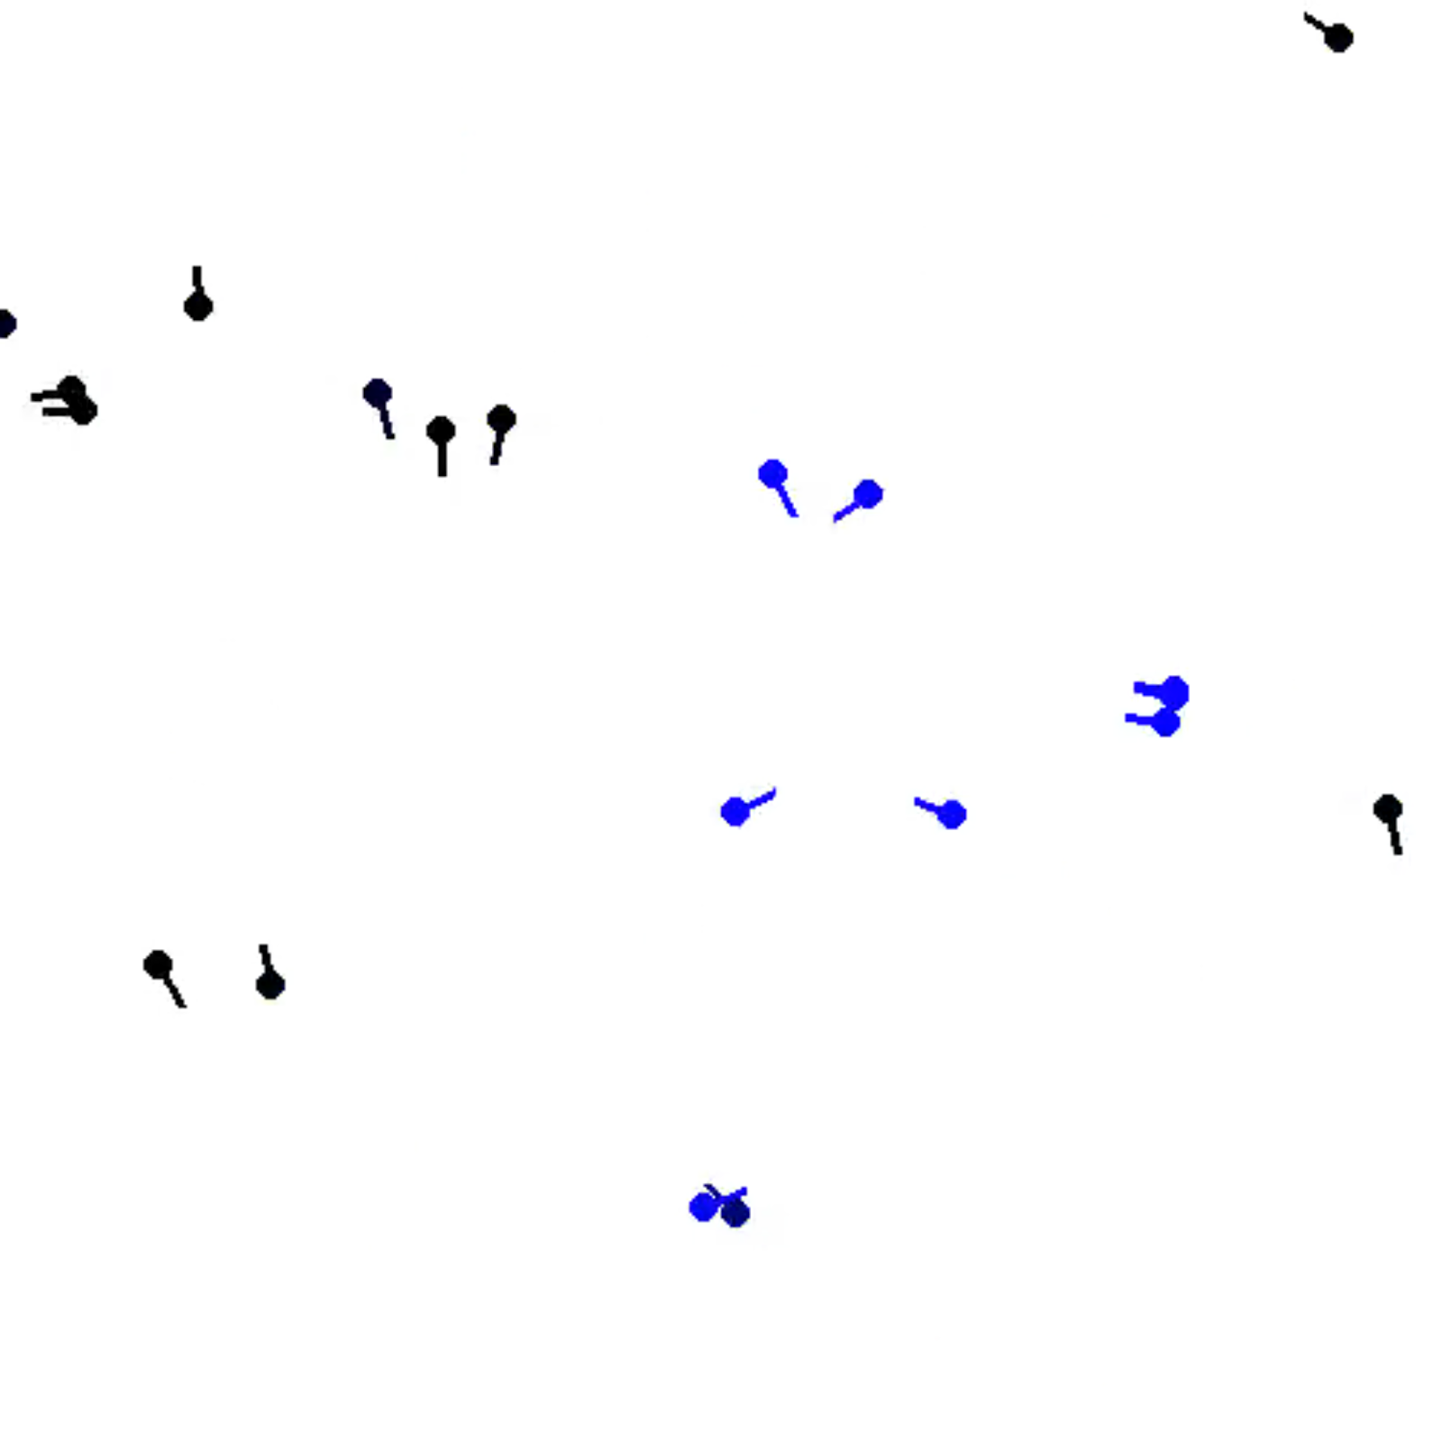

Simulation
2D agent-based model
  (x, y, θ) and speed [0, v_{max}]
  No boundary conditions
Agent control
  Global mode switching (uniform agents)
Open-source Python implementation: full code on CEI lab GitHub
  https://github.com/CEI-Lab
High stimulus
Low stimulus
6

Slide 7
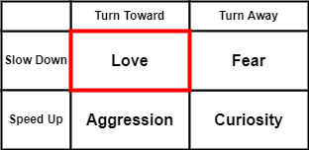
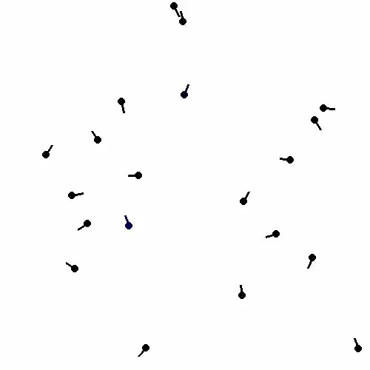
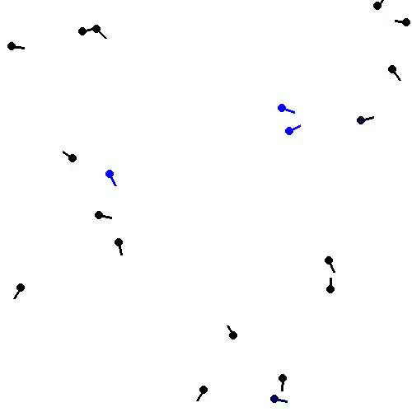
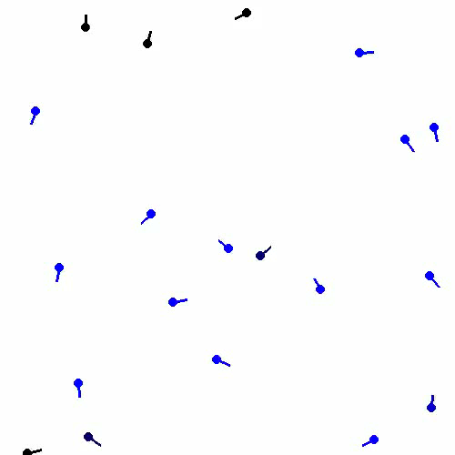
Love: Turn towards, Slow down
Directional Stimulus, Directional Sensing
Low
Sensing angle = 3π/24
Gain = 0.25
Medium
Sensing angle = π/3
Gain = 1.5
High
Sensing angle = π/2
Gain = 2.5
7

Slide 8
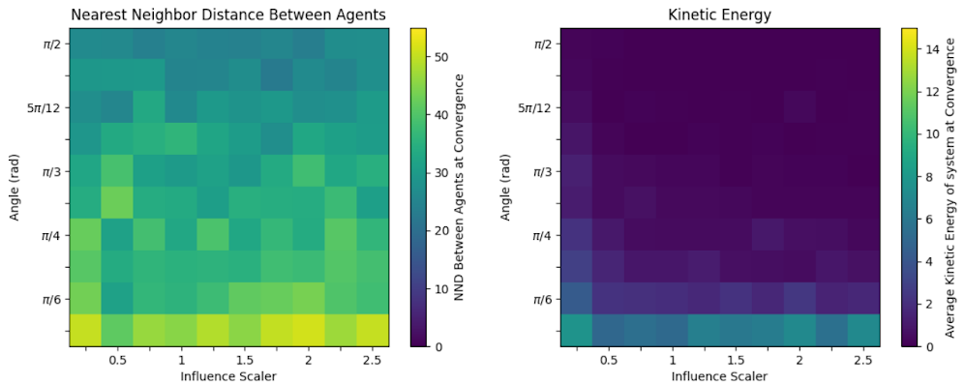
Love: Trends
Nearest Neighbor Distance
Kinetic Energy
Kinetic energy always low, except in low-visibility case
Robust to changes in gain
Sensing Angle θ (rad)
Sensing Angle θ (rad)
Gain (γ)
Gain (γ)
8

Slide 9
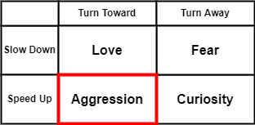
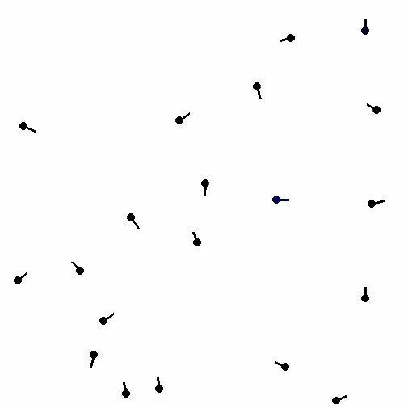
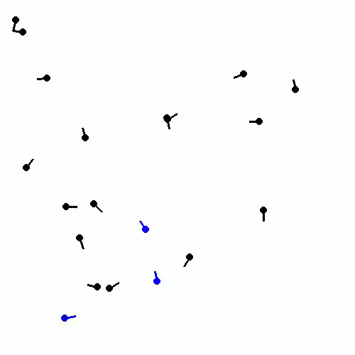
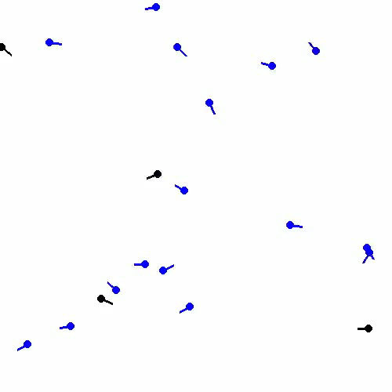
Aggression: Turn towards, Speed up
Directional Stimulus, Directional Sensing
Low
Sensing angle = 3π/24
Gain = 0.25
Medium
Sensing angle = π/3
Gain = 1.5
High
Sensing angle = π/2
Gain = 2.5
9

Slide 10
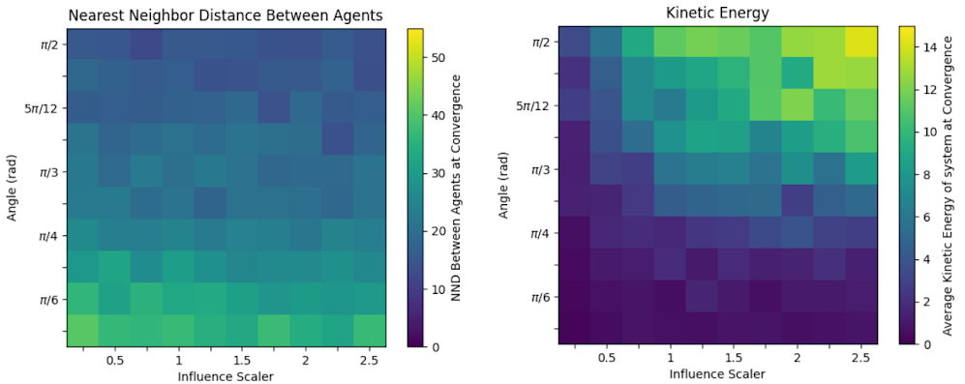
Aggression: Trends
Nearest Neighbor Distance
Kinetic Energy
Sensitive to both sensing angle and gain
Demonstrates a range of clustering and speeds
Sensing Angle θ (rad)
Sensing Angle θ (rad)
Gain (γ)
Gain (γ)
10

Slide 11
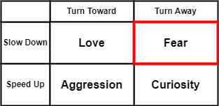
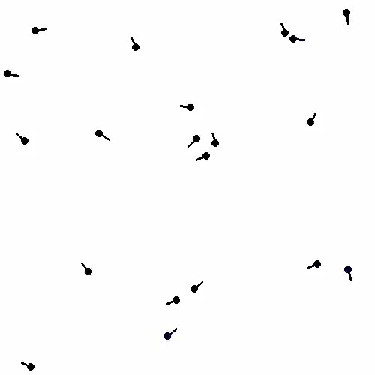
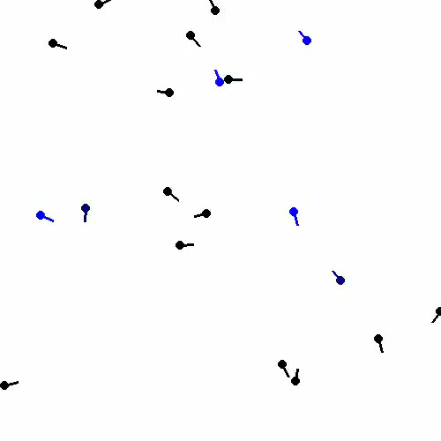
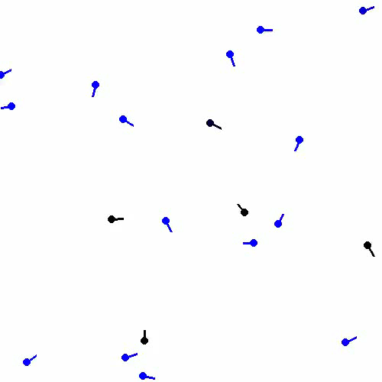
Fear: Turn away, Slow down
Directional Stimulus, Directional Sensing
Low
Sensing angle = 3π/24
Gain = 0.25
Medium
Sensing angle = π/3
Gain = 1.5
High
Sensing angle = π/2
Gain = 2.5
11

Slide 12
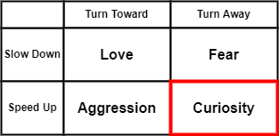
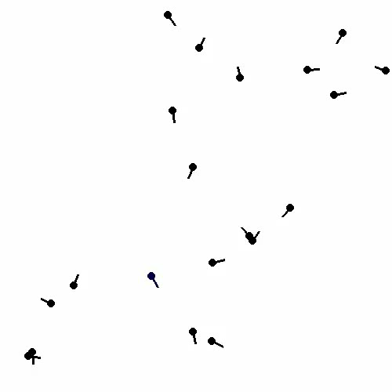
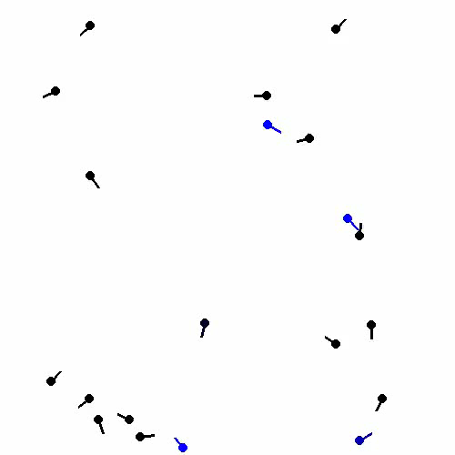
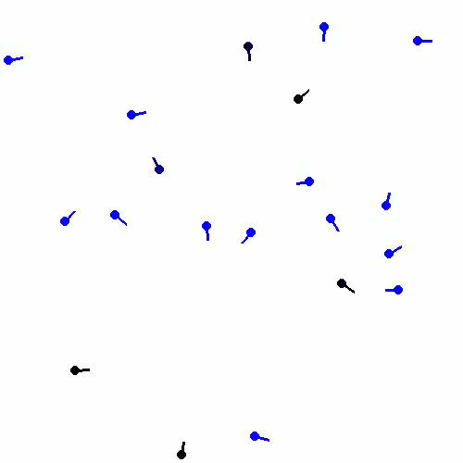
Curiosity: Turn away, Speed up
Directional Stimulus, Directional Sensing
Low
Sensing angle = 3π/24
Gain = 0.25
Medium
Sensing angle = π/3
Gain = 1.5
High
Sensing angle = π/2
Gain = 2.5
12

Slide 13
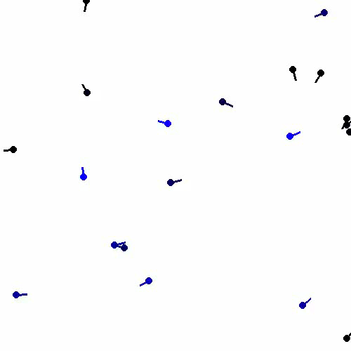
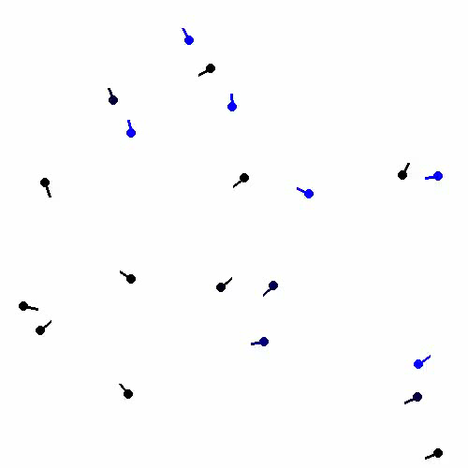
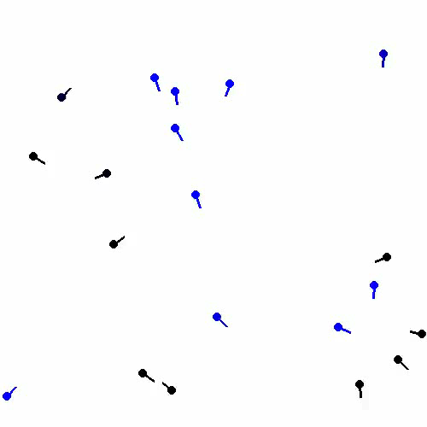
The Effect of Noise on Actuation
Aggression with directional stimulus & sensing
No noise
Sensing angle = π/3
Gain = 1.5
~5° noise
Sensing angle = π/3
Gain = 1.5
~50° noise
Sensing angle = π/3
Gain = 1.5
13

Slide 14
Conclusions and Next Steps
Well-grounded model for more formal design of reactive, multimodal collectives.
Promising applications for resource-constrained artificial collectives!
Next Steps
Agent-environment interactions
Adversarial agents
Compositional system design
14

Slide 15
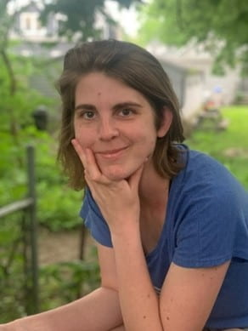



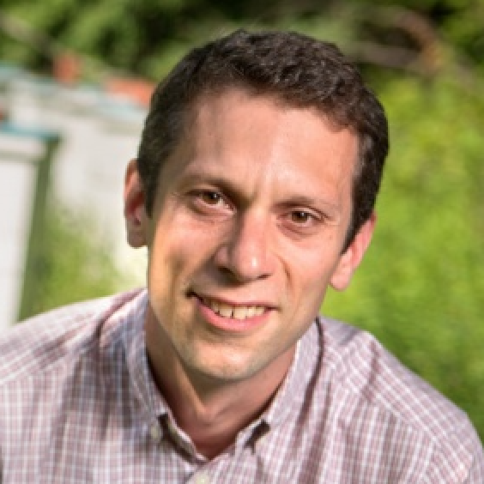
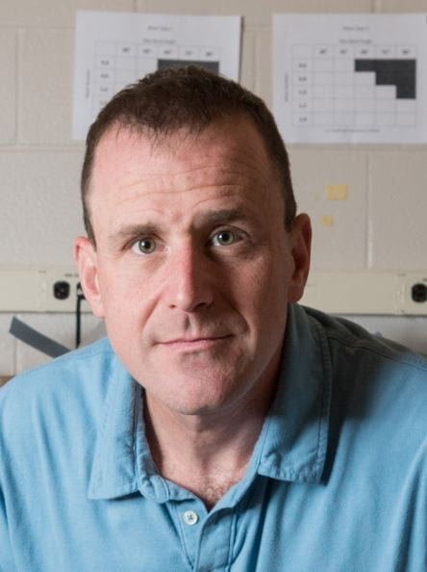



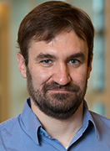
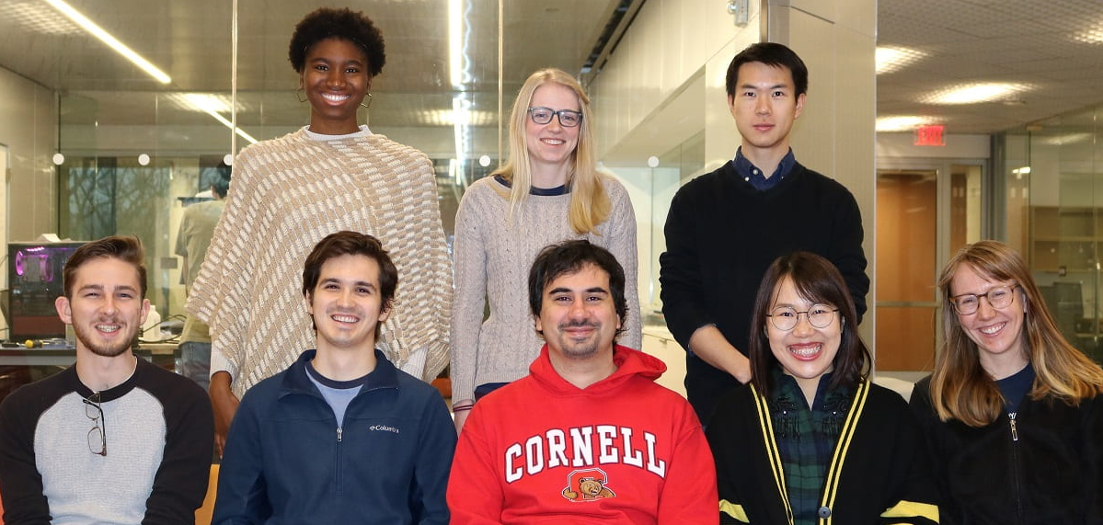


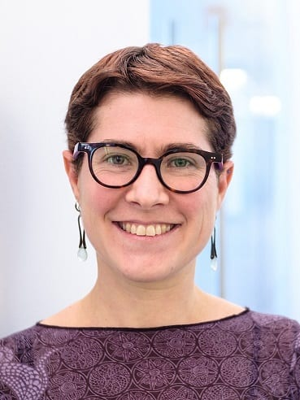
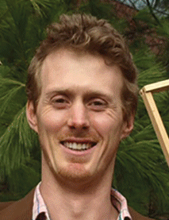
Thank you!
https://github.com/CEI-lab/DARS2022-BVcollectives

