Slide 1
Regular Expression
AM Internship, APRIL 2017

Slide 2
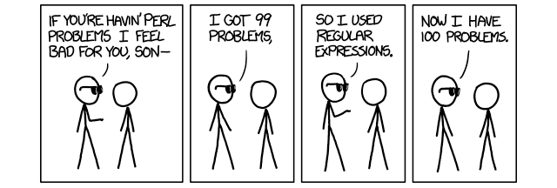
agenda
Intro
Basic Concepts
Syntax
Regex engines
examples

Slide 3
Introduction in Regex
What is the regular expression ?
a sequence of characters that define a search pattern, mainly for use in pattern matching with strings, or string matching, i.e. "find and replace"-like operations
Do we really need them ?
Yup. Just accept this and remember basic concepts + some of the syntax. They`ll help you to find anything you need almost everywhere
And how can we use regex ?
Just start looking for something. Or replacing some string with other one. Or removing a bunch of patterned strings. Or maybe you`ll find the other way

Slide 4
Basic Concepts
So. Once again – what is the regex ?
Any string is already a regular expression.
Is there any basic stuff there?
Remember these 3 concepts:
Boolean “Or”
Grouping
Quantification

Slide 5
syntax
Quantifications
Meta-Characters
? – 0 or 1
* - 0 or more
+ - 1 or more
{n}
{m,n}
{m,}
{,n}
REMEMBER of greediness
. – any char
[ ] – list of available chars
[^ ] - negation
( ) - group
^ - start of string
$ - end of string
\b – start of word
\B – end of word
(?i) – case insensitivity
(?#comment)

Slide 6
syntax
Symbolic classes
Advanced grouping
\w – any word char
\W – any non word char
\s – any whitespace
\S – any non-whitespace
\d – any digit
\D – any non-digit
\xNN – a hex number NN
\dDDD – an octal num DDD
\X – an Unicode char
(?: ) – no back-ref
(?> ) – atomic group
(?<name> ) or (?P<name> ) or (?’<name>’ )
(?<num>) – recurse of group <num>
(?R)
(?&name) or (?P>name)
(?= ) – positive lookahead
(?! ) – negative lookahead
(?<= ) – positive lookbehind
(?<! ) – negative lookbehind
(?(?=<IF>)<THEN>|<ELSE>)
(?(<num>)<THEN>|<ELSE>)

Slide 7

Regex engine
What is a Regex Engine ?
A regex engine is …
Main Regex engines
Perl, PCRE, Python, RE2, Ruby, QRegExp, Golang, Java, TRE, Tcl, Php, .NET, JS, vim, GNU grep …
How do they work ?!
Magic!!!

Slide 8
examples
E-mail check
^[_A-Za-z0-9-]+(\.[_A-Za-z0-9-]+)*@[A-Za-z0-9]+(\.[A-Za-z0-9]+)*(\.[A-Za-z]{2,})$
IP v4
^([01]?\d\d?|2[0-4]\d|25[0-5])\.([01]?\d\d?|2[0-4]\d|25[0-5])\.([01]?\d\d?|2[0-4]\d|25[0-5])\.([01]?\d\d?|2[0-4]\d|25[0-5])$
File extension
([^\s]+(\.(?i)(jpg|png|gif|bmp))$)
HTML-tags
<("[^"]*"|'[^']*'|[^'">])*>
(?i)<a([^>]+)>(.+?)</a>

Slide 9
Useful Links
http://www.regular-expressions.info/tutorial.html
https://regex101.com/
http://regexr.com/
https://www.princeton.edu/~mlovett/reference/Regular-Expressions.pdf
https://learncodethehardway.org/regex/
https://www.hackerrank.com/domains/regex/re-introduction
https://media.cheatography.com/storage/thumb/davechild_regular-expressions.750.jpg
http://i.imgur.com/y8trHna.jpg

Slide 10
Roman Tudvasev
AM Engineer
Roman.Tudvasev@endava.com

