Slide 1


SQL INTRO

Slide 2
RDBMS
RDBMS - Relational Database Management System.
RDBMS - the basis for SQL and for all database systems
Example: MS SQL Server, IBM DB2, Oracle, MySQL, Microsoft Access, others
RDBMS - stores the data in database objects called tables.
Table - a collection of related data entries and it consists of columns and rows.

Slide 3
SQL Purpose:
Create database and relationships structures.
Execute basic data management operations such as insert, update and delete of the relationships.
Transform raw data into information.
SQL is essentially as free format, that most modern languages​​, which means that it is not necessary to be written instructions fragments in certain places on the screen.

Slide 4
SQL
SQL - Structured Query Language
SQL – language for accessing and manipulating databases
SQL - ANSI (American National Standards Institute) standard
Note: Most of the SQL database programs also have their own proprietary extensions in addition to the SQL standard!

Slide 5
SQL Objectives
Execute queries against a database
Retrieve data from a database
Insert records in a database
Update records in a database
Delete records from a database
Create new databases
Create new tables in a database
Create stored procedures in a database
Create views in a database
Set permissions on tables, procedures, and views

Slide 6
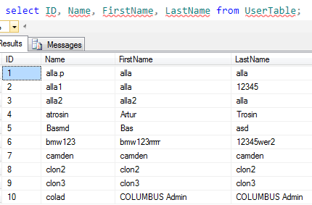
Database Tables
Database - contains one or more tables.
Each table is identified by a name (e.g. “UserTables"). Tables contain records (rows) with data.
Below is a selection from the " UserTables " table:

Slide 7
Main SQL Commands
SELECT - extracts data from a database
UPDATE - updates data in a database
DELETE - deletes data from a database
INSERT INTO - inserts new data into a database
CREATE DATABASE - creates a new database
ALTER DATABASE - modifies a database
CREATE TABLE - creates a new table
ALTER TABLE - modifies a table
DROP TABLE - deletes a table
CREATE INDEX - creates an index (search key)
DROP INDEX - deletes an index

Slide 8
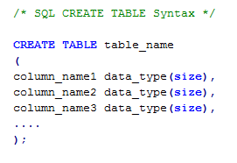
SQL CREATE TABLE
CREATE TABLE - is used to create a table in a database.
Examples: Show CREATE TABLE examples

Slide 9
Data Type
Categories:
Exact Numeric
Approximate Numeric
Monetary
Date and Time
Character
Binary
Special purpose

Slide 10
Data Type
Exact Numeric:
bigint -> 8 bytes -> -2^63 (-9,223,372,036,854,775,808) to 2^63-1 (9,223,372,036,854,775,807)
int -> 4 bytes -> -2^31 (-2,147,483,648) to 2^31-1 (2,147,483,647)
smallint -> 2 bytes -> -2^15 (-32,768) to 2^15-1 (32,767)
tinyint -> 1 byte -> 0 to 255
decimal(p,s) -> 5–17 bytes -> –10^38 + 1 to 10^38 –1
numeric(p,s) -> 5–17 bytes -> –10^38 + 1 to 10^38 –1

Slide 11
Data Type
Approximate Numeric:
Float(p) -> 8 Bytes -> –1.79E +308 to1.79E+308
Real -> 4 bytes -> –3.4E38 to 3.4E38
Monetary
Money ->8 bytes -> –922,337,203,685,477.5808 to 922,337,203,685,477.5807
SmallMoney -> 4 bytes -> –214,748.3648 to 214,748.3647
Date & Time
DateTime -> 8 bytes -> January 1, 1753 to December 31,9999, (accuracy 3.33 milliseconds)
SmallDateTime -> 4 bytes -> January 1, 1900, to June 6, 2079, (accuracy 1 minute)

Slide 12
Data Type
Character Data Types:
char(n) -> 1–8,000 bytes -> Maximum of 8,000 characters
nchar(n) -> 2–8,000 bytes -> Maximum of 4,000 characters
varchar(n) -> 1–8,000 bytes -> Maximum of 8,000 characters
nvarchar(n) -> 2–8,000 bytes -> Maximum of 4,000 characters
varchar(max) -> Up to 2 GB -> Up to 1,073,741,824 characters
nvarchar(max) -> Up to 2 GB Up -> to 536,870,912 characters
text -> Up to 2 GB -> Up to 1,073,741,824 characters
ntext -> Up to 2 GB -> Up to 536,870,912characters

Slide 13
Data Type
Binary Data Types:
Binary(n) -> 1–8,000 bytes
Varbinary(n) -> 1–8,000 bytes
Varbinary(max) -> Up to 2 GB
Image -> Up to 2 GB
Specialized Date Types:
Bit -> Stores a 0, 1, or null.
Timestamp -> An automatically generated value.
Uniqueidentifier -> A 16-bit GUID
sql_variant -> Can change the data type based on the data that is stored Max-8,000 bytes.
table -> Used to hold a result set. (Note: Cannot be used for a column)
Xml -> Stores an XML document of up to 2 GB in size

Slide 14
Identity & Nullability
NULL -> Denote the absence of a value.
A null is not a value!!!
You cannot use a null in comparisons
Identity -> Automatically generated number (incremental)
Applied to -> bigint, int,smallint, tinyint, decimal, and numeric!
Examples: Show examples

Slide 15
Table Type
Permanent Tables.
Stored in Data Files
Temporary Tables .
Stored in tempdb
Table Variables.
Stored in Memory

Slide 16
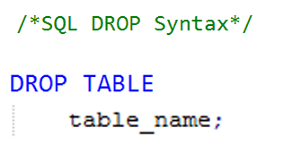
SQL DROP
DROP statement - used to destroy an existing database, table, index, or view.
Examples: Show DROP examples

Slide 17
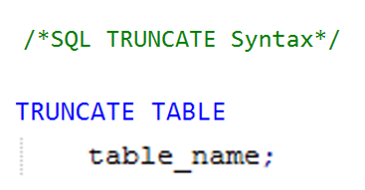
SQL TRUNCATE
TRUNCATE statement - used to delete the data inside the table, and not the table itself.
Examples: Show TRUNCATE examples

Slide 18
SQL CONSTRAINTS
SQL constraints - used to specify rules for the data in a table.
NOT NULL - Indicates that a column cannot store NULL value
UNIQUE - Ensures that each row for a column must have a unique value
PRIMARY KEY - A combination of a NOT NULL and UNIQUE. Ensures that a column (or combination of two or more columns) have an unique identity which helps to find a particular record in a table more easily and quickly
FOREIGN KEY - Ensure the referential integrity of the data in one table to match values in another table
CHECK - Ensures that the value in a column meets a specific condition
DEFAULT - Specifies a default value when specified none for this column

Slide 19
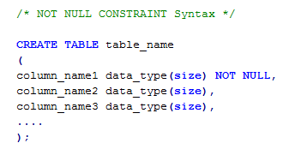
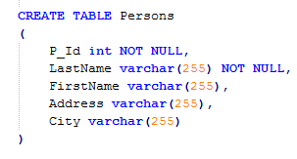
NOT NULL CONSTRAINTS
NOT NULL constraint enforces a column to NOT accept NULL values.
Examples: Show NOT NULL examples

Slide 20
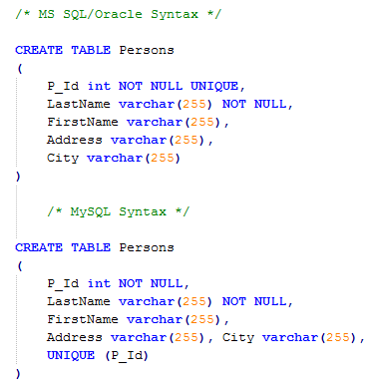
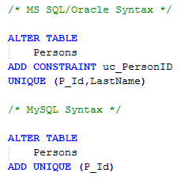
UNIQUE CONSTRAINTS
UNIQUE constraint - uniquely identifies each record in a database
Examples: Show UNIQUE examples

Slide 21
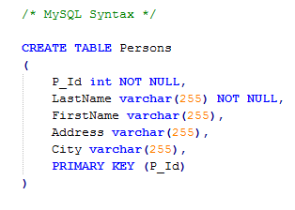
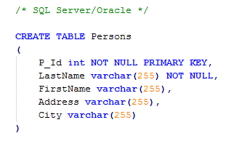
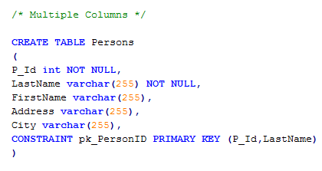
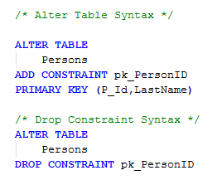
PRIMARY KEY CONSTRAINTS
PRIMARY KEY constraint - uniquely identifies each record in a database and cannot contain NULL’s
Examples: Show PK examples

Slide 22
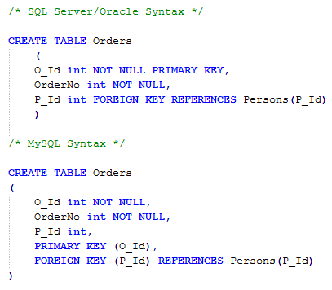
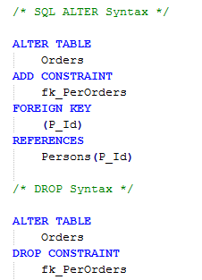
FOREIGN KEY CONSTRAINTS
FOREIGN KEY constraint - points to a PRIMARY KEY in another table
Examples: Show examples

Slide 23
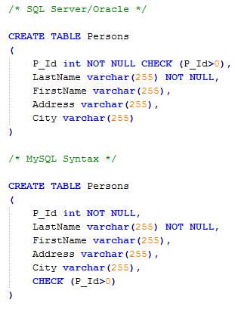
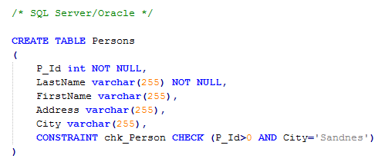
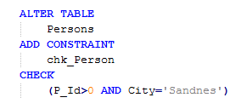
CHECK CONSTRAINTS
CHECK constraint - limit the value range that can be placed in a column.
Examples: Show examples

Slide 24
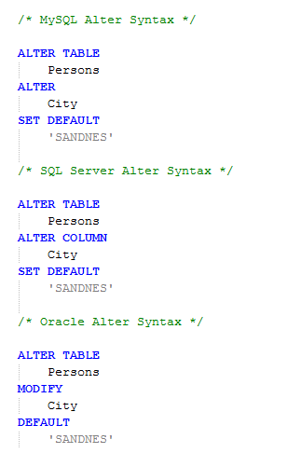
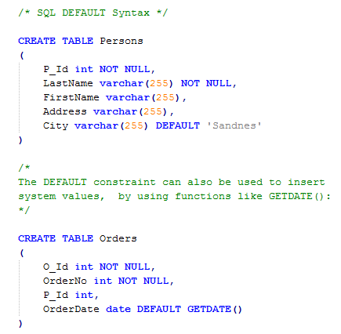
DEFAULT CONSTRAINTS
DEFAULT constraint - insert a default value into a column..
Examples: Show examples

Slide 25
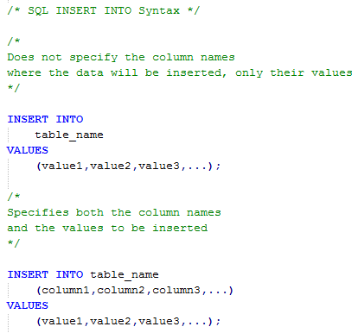
SQL INSERT INTO
INSERT INTO statement is used to insert new records in a table.
Examples: Show INSERT INTO examples

Slide 26
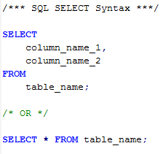
SQL SELECT Command
SELECT statement - select data from a database.
Result - is stored in a result table, called the result-set
Examples: Navigation in a Result-set

Slide 27
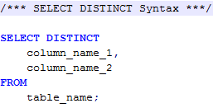
SQL DISTINCT Keyword
SELECT DISTINCT statement - used to return only distinct (different) values..
Examples: Show DISTINCT in a Result-set

Slide 28
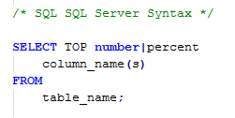
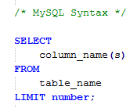
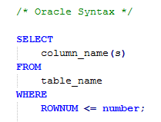
SQL SELECT TOP Clause
TOP Clause - used to specify the number of records to return.
Examples: Show TOP n examples

Slide 29
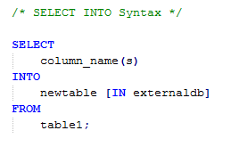
SQL SELECT INTO
SELECT INTO - copies data from one table and inserts it into a new table.
Examples: Show SELECT INTO examples

Slide 30
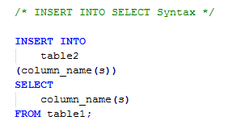
SQL INSERT INTO SELECT
INSERT INTO SELECT - copies data from one table and inserts it into an existing table..
Examples: Show INSERT INTO SELECT examples

Slide 31
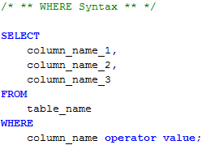
SQL WHERE Clause
WHERE clause - used to extract only those records that fulfill a specified criterion.
Examples: Show WHERE in a Result-set

Slide 32
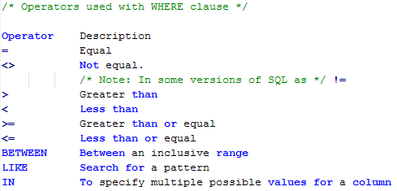
SQL WHERE Operators
Operators can be used in the WHERE clause:.
Examples: Show Operators in a Result-set

Slide 33
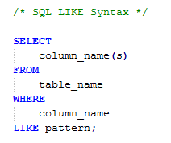
SQL LIKE Operator
LIKE operator - used in a WHERE clause to search for a specified pattern in a column.
Examples: Show LIKE examples

Slide 34
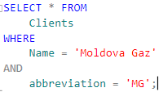
SQL AND & OR Operators
AND and OR operators are used to filter records based on more than one condition
AND operator - displays a record if both the first condition AND the second condition are true.
OR operator - displays a record if either the first condition OR the second condition is true.
Examples: Show AND/OR in a Result-set

Slide 35
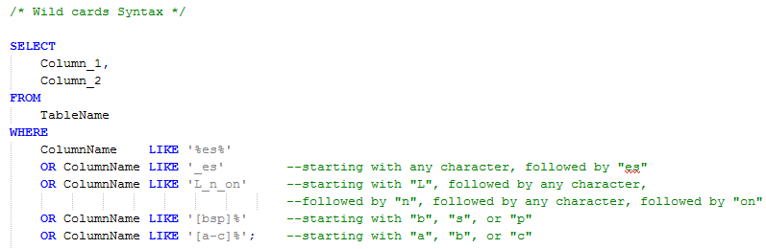
SQL LIKE Wildcards
Wildcard character - used to substitute for any other character(s) in a string.
Wildcard Description
% A substitute for zero or more characters
_ A substitute for a single character
[charlist] Sets and ranges of characters to match
[^charlist] Matches only a character NOT specified within the brackets
or
[!charlist]
Examples: Show LIKE examples

Slide 36
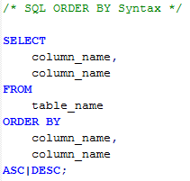
SQL Order By Keyword
ORDER BY - to sort the result-set.
ORDER BY - used to sort the result-set by one or more columns.
ORDER BY - sorts the records in ascending order by default.
Examples: Show Order By in a Result-set

Slide 37
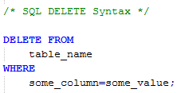
SQL DELETE
DELETE statement - used to delete rows in a table.
Examples: Show DELETE examples

Slide 38
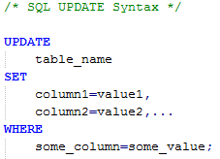
SQL UPDATE
UPDATE statement - used to update existing records in a table.
Examples: Show UPDATE examples

