Slide 1


SQL INTRO

Slide 2
SQL JOINs
SQL joins - used to combine rows from two or more tables.
INNER JOIN - Returns all rows when there is at least one match in BOTH tables
LEFT JOIN - Return all rows from the left table, and the matched rows from the right table
RIGHT JOIN - Return all rows from the right table, and the matched rows from the left table
FULL OUTER JOIN - Return all rows when there is a match in ONE of the tables
Examples: Show JOINS examples

Slide 3
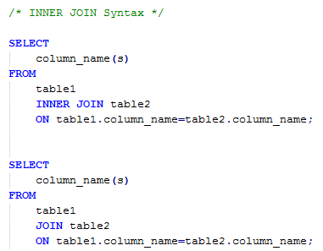
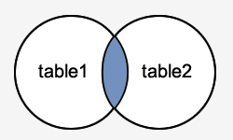
SQL INNER JOIN
SQL joins - used to combine rows from two or more tables.
Examples: Show INNER JOIN examples

Slide 4
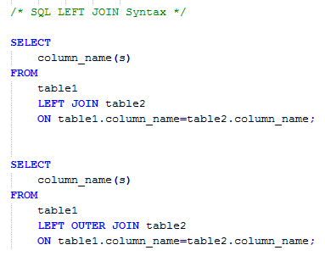
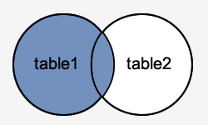
SQL LEFT JOIN
LEFT OUTER JOIN - returns all rows from the left table (table1), with the matching rows in the right table (table2). The result is NULL in the right side when there is no match.
Examples: Show LEFT JOIN examples

Slide 5
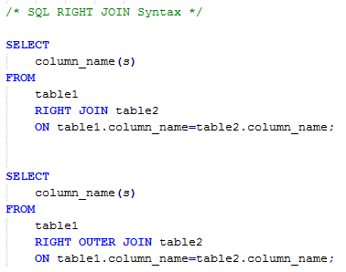
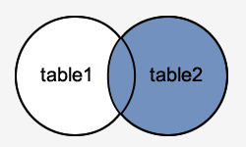
SQL RIGHT JOIN
RIGHT OUTER JOIN - returns all rows from the right table (table2), with the matching rows in the left table (table1). The result is NULL
    in the left side when there is no match.
Examples: Show RIGHT JOIN examples

Slide 6
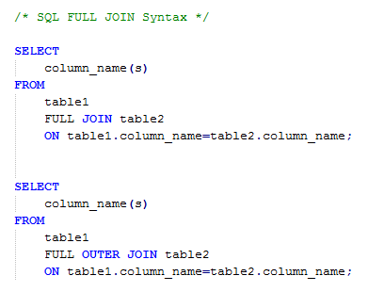
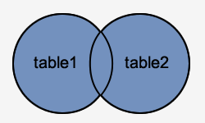
SQL FULL JOIN
FULL OUTER JOIN - returns all rows from the left table (table1) and from the right table (table2).The FULL OUTER JOIN keyword combines the result of both LEFT and RIGHT joins..
Examples: Show RIGHT JOIN examples

Slide 7
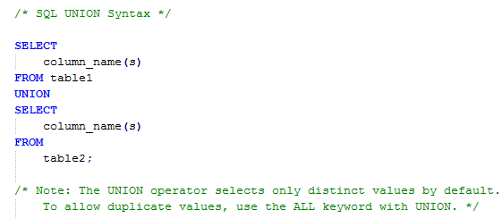
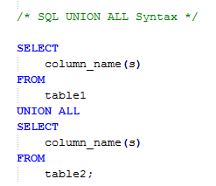
SQL UNION
SQL UNION - operator combines the result of two or more SELECT statements.
Examples: Show UNION examples

