Slide 1


SQL INTRO

Slide 2
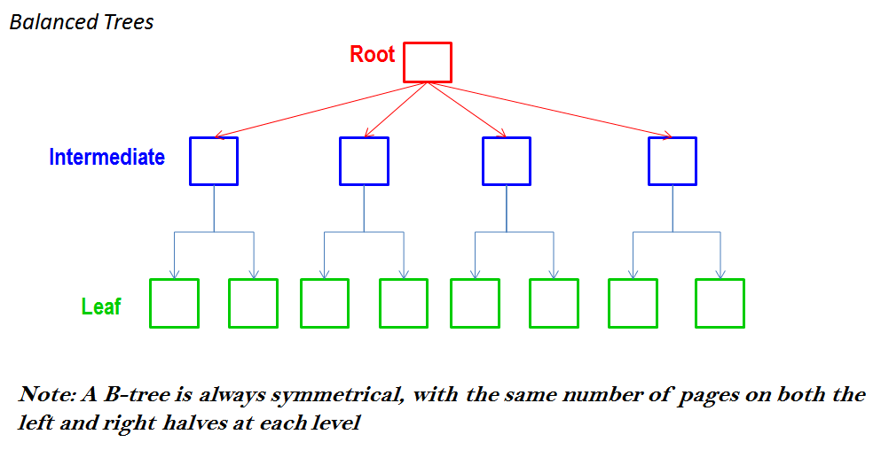
INDEXES
INDEX - allow the database application to find data fast; without reading the whole table.

Slide 3
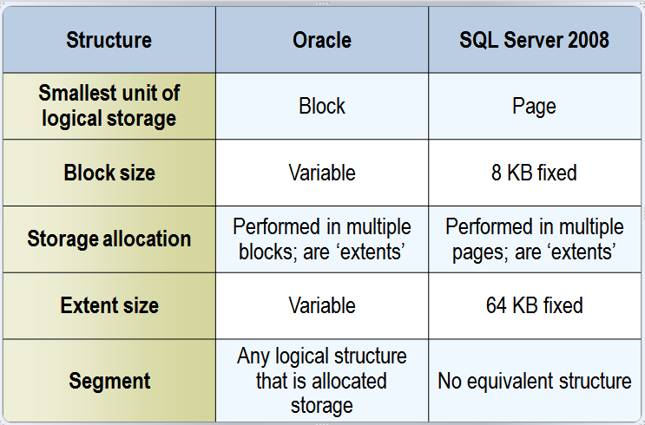
INDEXES

Slide 4
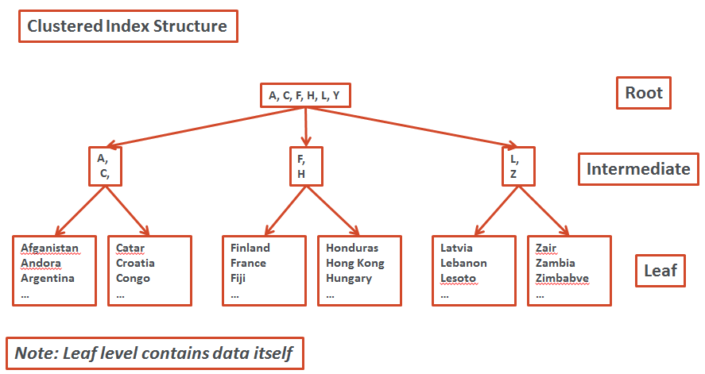
INDEXES

Slide 5
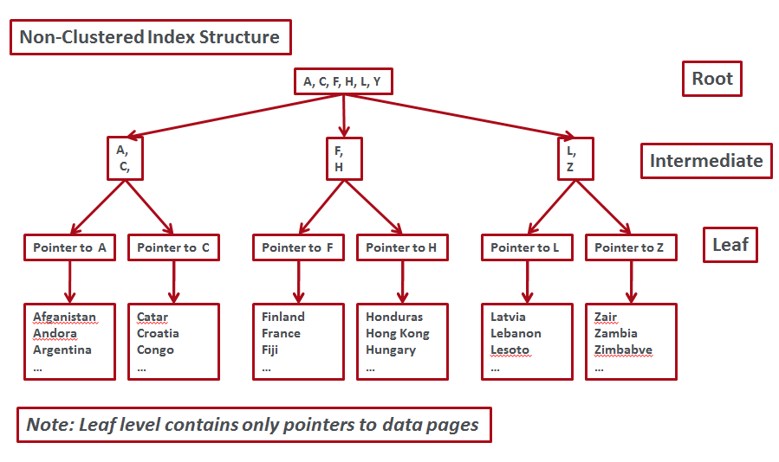
INDEXES

Slide 6
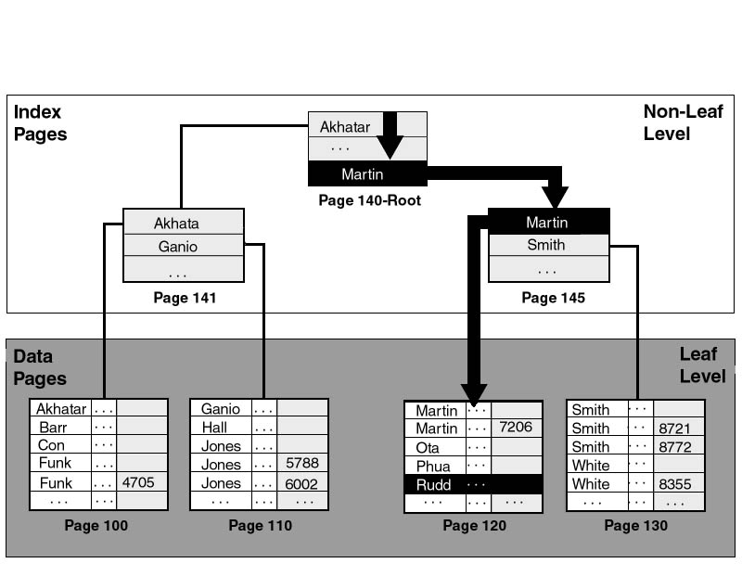
INDEXES
Example Clustered Index Search :

Slide 7
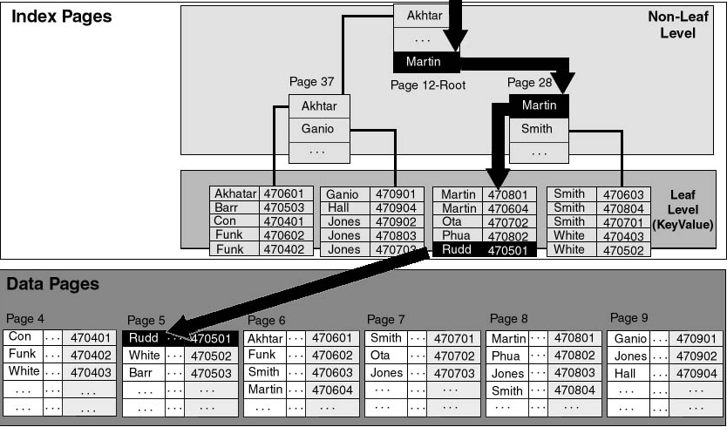
INDEXES
Example Non-Clustered Index Search :

Slide 8
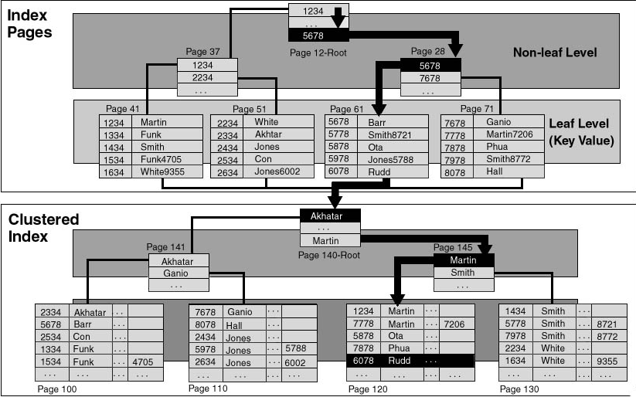
INDEXES
Example Non-Clustered Index Search with Clustered Index created on the same table:

Slide 9
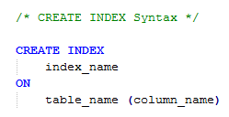


INDEXES
Examples: Show examples

Slide 10
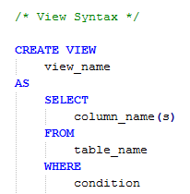
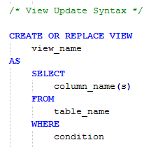
SQL Views
View is a virtual table.
Examples: Show examples

Slide 11
SQL Aggregate Functions
SQL aggregate functions return a single value, calculated from values in a column.
    AVG() - Returns the average value
    COUNT() - Returns the number of rows
    FIRST() - Returns the first value
    LAST() - Returns the last value
    MAX() - Returns the largest value
    MIN() - Returns the smallest value
    SUM() - Returns the sum
Examples: Show examples

Slide 12
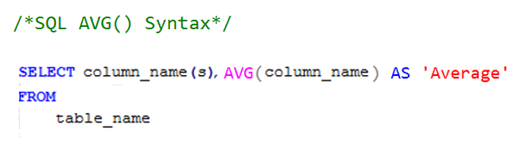
SQL AVG() Function
AVG() function- used to return the average value of a numeric column.
Examples: Show AVG() examples

Slide 13
SQL Scalar Functions
SQL scalar functions return a single value, based on the input value.
    UCASE() - Converts a field to upper case
    LCASE() - Converts a field to lower case
    MID() - Extract characters from a text field
    LEN() - Returns the length of a text field
    ROUND() - Rounds a numeric field to the number of decimals specified
    NOW() - Returns the current system date and time
    FORMAT() - Formats how a field is to be displayed
Examples: Show examples

Slide 14
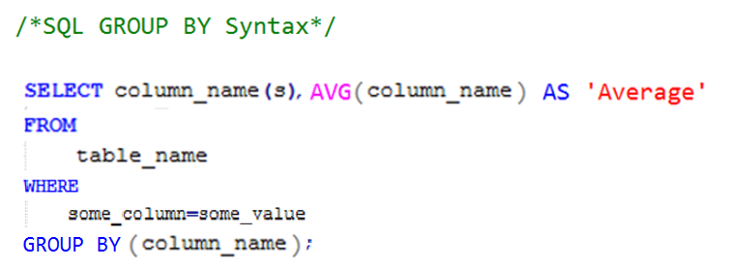
SQL GROUP BY Statement
GROUP BY statement - used in conjunction with the aggregate functions to group the result-set by one or more columns.used convert the value of a field to uppercase.
Examples: Show GROUP BY examples

Slide 15
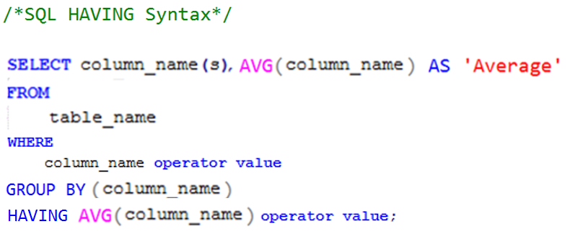
SQL HAVING Statement
HAVING statement - enables you to specify conditions that filter which group results appear in the final results.
Examples: Show HAVING examples

