Slide 1
FUNCTIONS & STORED PROCEDURES

Slide 2
AGENDA
AGGREGATE FUNCTIONS
SCALAR FUNCTIONS
GROUP BY STATEMENT
USER DEFINED FUNCTION
STORED PROCEDURES

Slide 3

AGGREGATE FUNCTIONS
  Aggregate functions are used to compute against a "returned column of numeric data" from your SELECT statement.
  They basically summarize the results of a particular column of selected data.

Slide 4
AGGREGATE FUNCTIONS
  AVG() – returns the average value;
  COUNT() – returns the number of rows;
  FIRST() – returns the first value;
  LAST() – returns the last value;
  MAX() – returns the largest value;
  MIN() – returns the smallest value;
  SUM() – returns the sum.

Slide 5
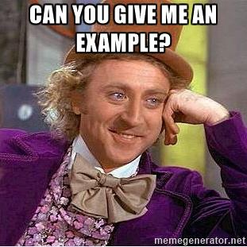

Slide 6
AGENDA
AGGREGATE FUNCTIONS
SCALAR FUNCTIONS
GROUP BY STATEMENT
USER DEFINED FUNCTION
STORED PROCEDURES

Slide 7
SCALAR FUNCTIONS
  UCASE() - converts a field to upper case;
  LCASE() – coverts a field to lower case;
  MID() – extract characters from a text field;
  LEN() – returns the length of a text field;
  ROUND() - rounds a numeric field to the number of decimals specified;
  NOW() – returns the current system date and time;
  FORMAT() – formats how a field is to be displayed.

Slide 8


Slide 9
AGENDA
AGGREGATE FUNCTIONS
SCALAR FUNCTIONS
GROUP BY STATEMENT
USER DEFINED FUNCTION
STORED PROCEDURES

Slide 10
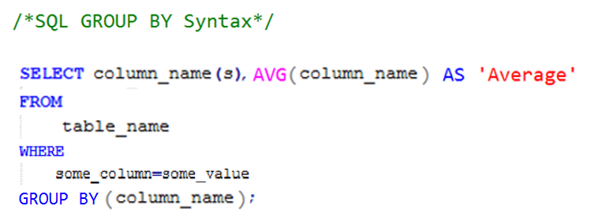
GROUP BY STATEMENT
Used in conjunction with the aggregate functions to group the result-set by one or more columns.used convert the value of a field to uppercase.

Slide 11
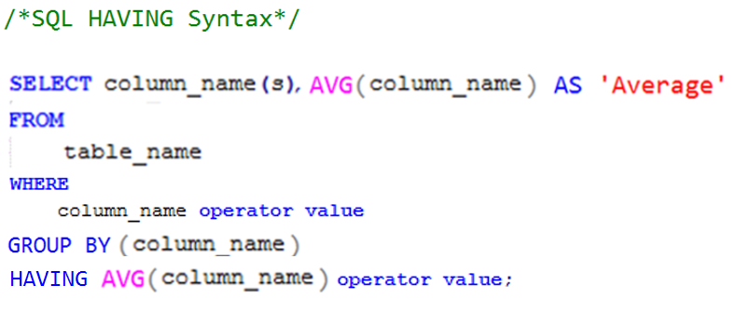
HAVING STATEMENT
Enables you to specify conditions that filter which group results appear in the final results.

Slide 12
AGENDA
AGGREGATE FUNCTIONS
SCALAR FUNCTIONS
GROUP BY STATEMENT
USER DEFINED FUNCTION
STORED PROCEDURES

Slide 13
USER DEFINED FUNCTIONS
SQL Server user-defined functions:
Are routines that accept parameters;
Perform an action, such as a complex calculation, and return the result of that action as a value;
The return value can either be a single scalar value or a result set.

Slide 14

USER DEFINED FUNCTIONS
  Allow modular programming;
  Allow faster execution;
  Can reduce network traffic.

Slide 15
USER DEFINED FUNCTIONS
  -- Transact-SQL Scalar Function Syntax
  CREATE [ OR ALTER ] FUNCTION [ schema_name. ] function_name
  ( [ { @parameter_name [ AS ][ type_schema_name. ] parameter_data_type
  [ = default ] [ READONLY ] }
  [ ,...n ]
  ]
  )
  RETURNS return_data_type
  [ WITH <function_option> [ ,...n ] ]
  [ AS ]
  BEGIN
  function_body
  RETURN scalar_expression
  END
  [ ; ]

Slide 16

USER DEFINED FUNCTIONS

Slide 17
AGENDA
AGGREGATE FUNCTIONS
SCALAR FUNCTIONS
GROUP BY STATEMENT
USER DEFINED FUNCTION
STORED PROCEDURES

Slide 18

STORED PROCEDURES
Stored procedure - A stored procedure is a set of Structured Query Language (SQL) statements with an assigned name, which are stored in a relational database management system as a group, so it can be reused and shared by multiple programs.

Slide 19
STORED PROCEDURES
  Stored procedures are compiled once and stored in executable form, so procedure calls are quick and efficient.
  Executable code is automatically cached and shared among users.
  By grouping SQL statements, a stored procedure allows them to be executed with a single call. This minimizes the use of slow networks, reduces network traffic.
  By designing applications around a common set of stored procedures, you can avoid redundant coding and increase your productivity.
  You can restrict access to Oracle data by allowing users to manipulate the data only through stored procedures that execute with their definer's privileges. (For example, you can allow access to a procedure that updates a database table, but deny access to the table itself.)

Slide 20
STORED PROCEDURES
CREATE { PROCEDURE | PROC } [schema_name.]procedure_name
[ @parameter [type_schema_name.] datatype
[ VARYING ] [ = default ] [ OUT | OUTPUT | READONLY ]
, @parameter [type_schema_name.] datatype
[ VARYING ] [ = default ] [ OUT | OUTPUT | READONLY ] ]
[ WITH { ENCRYPTION | RECOMPILE | EXECUTE AS Clause } ]
[ FOR REPLICATION ]
AS BEGIN
[declaration_section]
executable_section
END;

Slide 21

VASILE CUDALB
AM ENGINEER
069 555 646
Vasile.Cudalb@Endava.com

