Slide 1
TRIGGERS & CURSORS

Slide 2
AGENDA
TRIGGERS
CURSORS

Slide 3

WHAT IS A TRIGGER?
  A trigger is a special kind of a store procedure that executes in response to certain action on the table like insertion, deletion or updating of data.
  It is a database object which is bound to a table and is executed automatically.

Slide 4

TYPE OF TRIGGERS
There are three action query types that you use in SQL which are INSERT, UPDATE and DELETE. So, there are three types of triggers and hybrids that come from mixing and matching the events and timings that fire them. Basically, triggers are classified into two main types:
After Triggers (For Triggers)
Instead Of Triggers

Slide 5
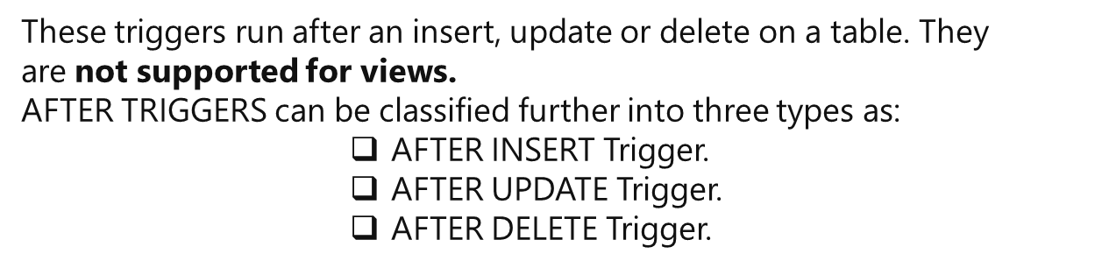

AFTER TRIGGERS

Slide 6
INSTEAD OF TRIGGERS
These can be used as an interceptor for anything that anyone tried to do on our table or view. If you define an Instead Of trigger on a table for the Delete operation, they try to delete rows, and they will not actually get deleted (unless you issue another delete instruction from within the trigger)
INSTEAD OF TRIGGERS can be classified further into three types as:
INSTEAD OF INSERT Trigger.
INSTEAD OF UPDATE Trigger.
INSTEAD OF DELETE Trigger.

Slide 7
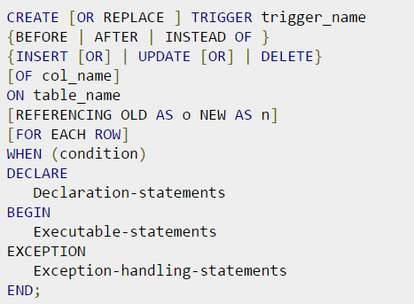
GENERAL SYNTAX

Slide 8
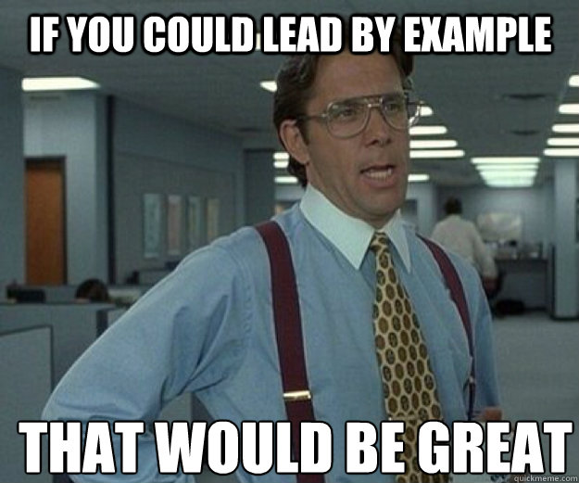
EXAMPLE TIME

Slide 9
AGENDA
TRIGGERS
CURSORS

Slide 10
CURSORS
CURSOR - temporary work area created in the system memory when a SQL statement is executed.
There are two types of cursors:
Implicit Cursors - created by default when DML statements like, INSERT, UPDATE, and DELETE statements are executed.
Explicit Cursors - created when a SELECT statement is executed that returns more than one row.
Both implicit and explicit cursors have the same functionality, but they differ in the way they are accessed.

Slide 11
CURSORS
General Syntax for Cursor:
DECLARE cursor_name CURSOR FOR
select_statement [ FOR { READ ONLY | UPDATE [ OF column_name [ ,...n ] ] } ]
Working with an Explicit cursor involves four steps:
Declaring the cursor for initializing in the memory
Opening the cursor for allocating memory
Fetching the cursor for retrieving data
Closing the cursor to release allocated memory

Slide 12

VASILE CUDALB
AM ENGINEER
069 555 646
Vasile.Cudalb@Endava.com

