Slide 1
Integration Project Systems & Control
Alexandru Cohal
May 2016

Slide 2
Introduction
Two-link arm robots very popular in industrial environments advantages in completing various tasks very fast and very precise
Development of the computational possibilities the planning of their motion can be done autonomous, without the need of an operator
The purpose of this project develop a program which can generate the motion steps of a two-link arm robots from a start point to a goal point without colliding into obstacles

Slide 3
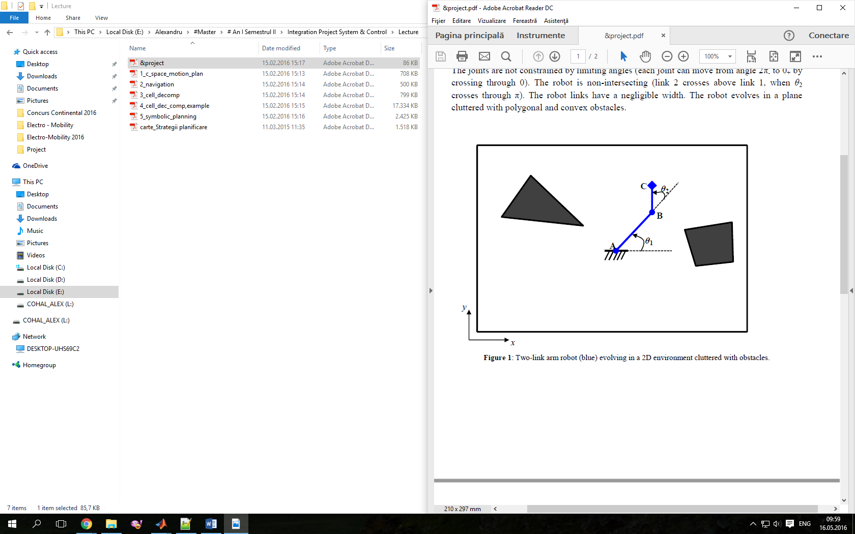
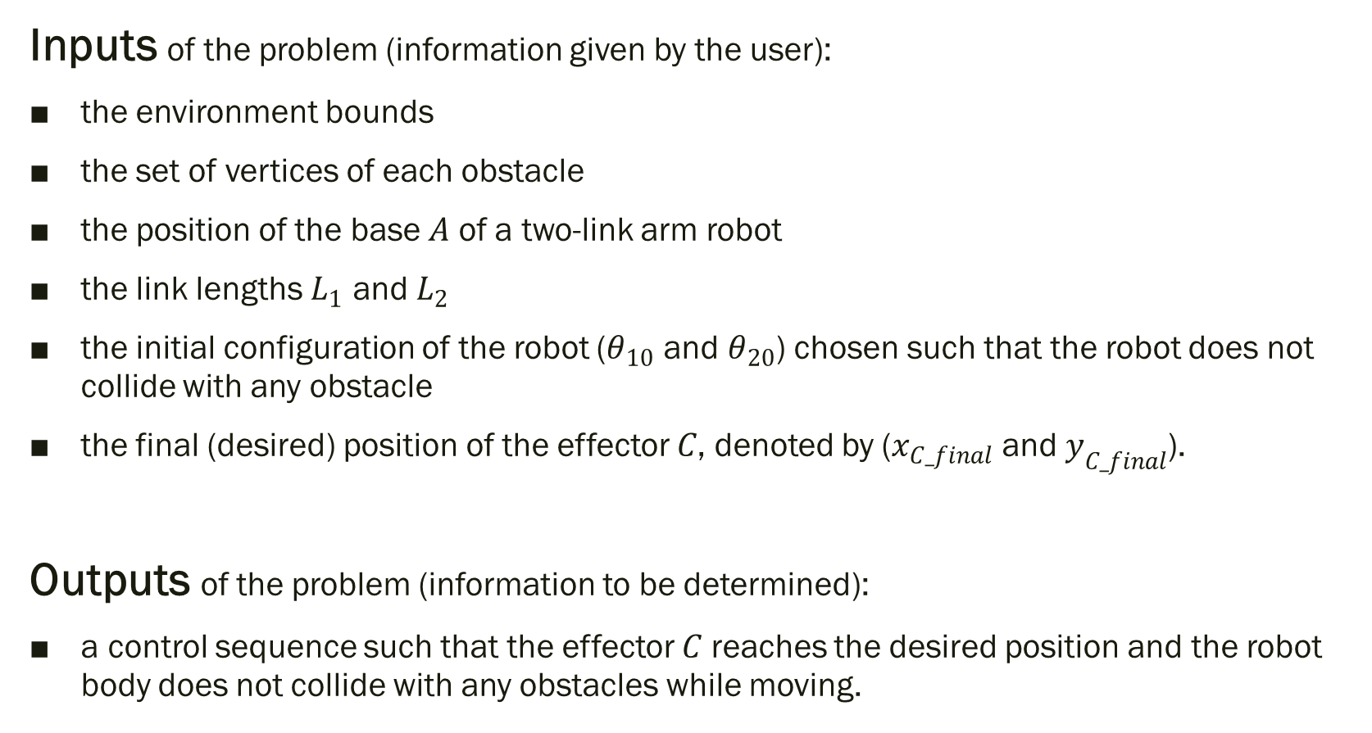
Problem definition
Inputs of the problem (information given by the user):
the environment bounds
the set of vertices of each obstacle
the position of the base $A$ of a two-link arm robot
the link lengths $L_{1}$ and $L_{2}$
the initial configuration of the robot ($θ_{10}$ and $θ_{20}$) chosen such that the robot does not collide with any obstacle
the final (desired) position of the effector $C$, denoted by ($x_{C_final}$ and $y_{C_final}$).
Outputs of the problem (information to be determined):
a control sequence such that the effector $C$ reaches the desired position and the robot body does not collide with any obstacles while moving.

Slide 4
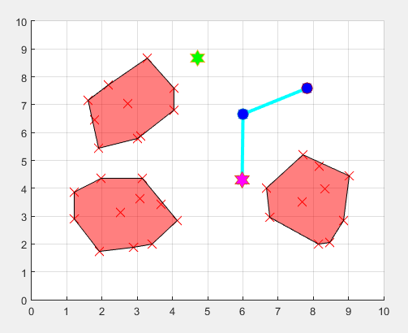
Solution
Stages of solving the problem:
Read and Store the input information
Environment bounds
Obstacles (Points Convex Hull Convex
polygon)
The initial position of the two-link arm robot
The goal point of the end-effector (point C).
Initial verification
Generate the Configuration Space
Inverse Kinematics The two positions of the goal point
Apply the Grassfire Algorithm (neighbours in 4 directions only)
Display statistics (number of visited nodes, length and cost of shortest path)
Construct the equivalent Graph (neighbours in 8 directions + cost for each edge).
Apply the Dijkstra’s algorithm
Display statistics (number of visited nodes, length and cost of shortest path)

Slide 5
Implementation
The Configuration Space stored in a structure (Cspace) together with the start and end positions
and with the value of the resolution used.
The Grassfire algorithm applied directly on the matrix storing the Configuration Space.
Disadvatage the figure containing the Configuration Space had to be generated multiple times
high execution time
The Dijkstra’s algorithm optimized by not visiting the nodes which are placed at a distance greater
than the current distance to a goal node the number of visited nodes decreases (also, the execution time decreases).
The simulation of motion of the displayed robot from the start position to the goal position storing the handlers for each component (links, joints) in a structure and then modifying their properties (e.g. XData and YData for changing the position).

Slide 6
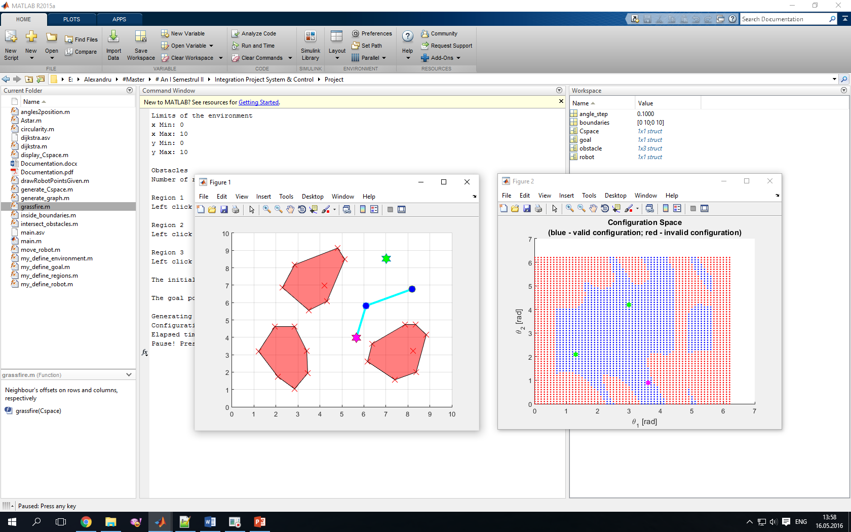
Implementation
Resolution of the Configuration Space the goal points not always have a perfect correspondent This made that the simulation of the movement of the robot to not end in the desired goal point A supplementary step was added
The robot’s joints are not constrained by limiting angles the Configuration Space had to be circular a function which was assuring this circularity was implemented.

Slide 7
Results
The work environment
The Configuration Space

Slide 8
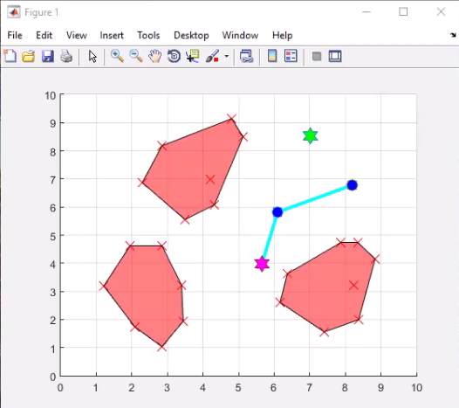
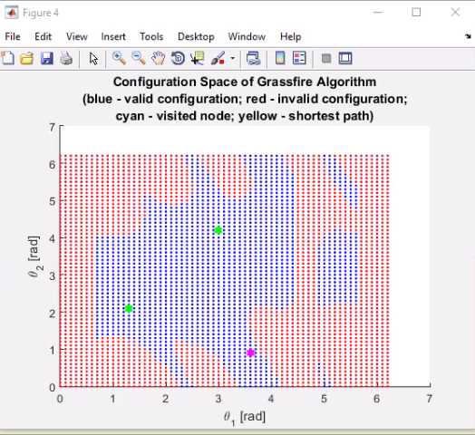
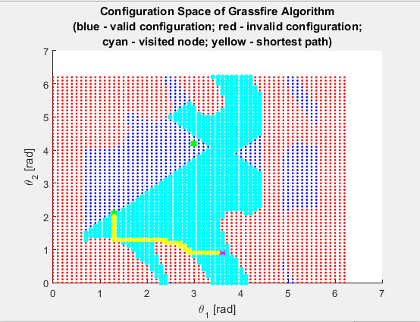
Results
- Grassfire Algorithm -
The Configuration Space

Slide 9
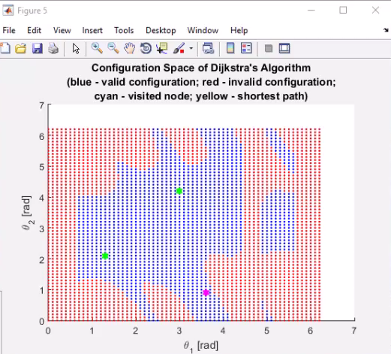
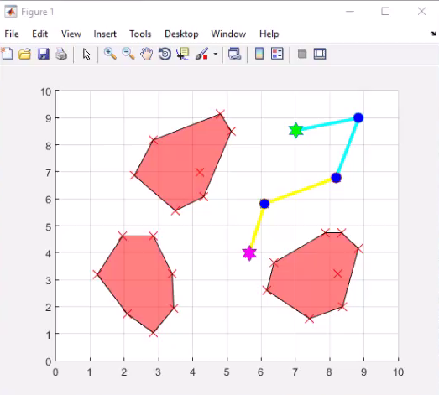
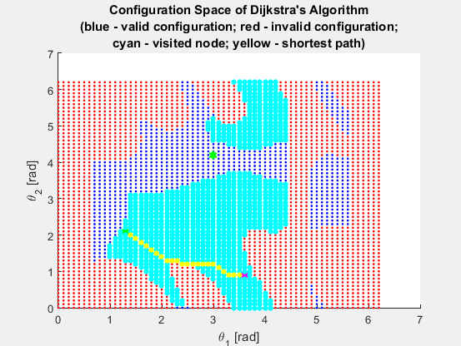
Results
- Dijkstra’s Algorithm -
The Configuration Space

Slide 10
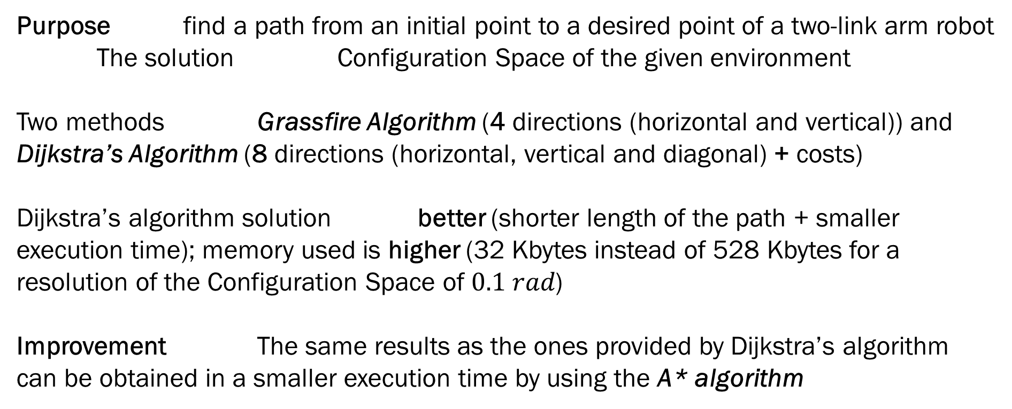
Conclusion
Purpose find a path from an initial point to a desired point of a two-link arm robot
The solution Configuration Space of the given environment
Two methods Grassfire Algorithm (4 directions (horizontal and vertical)) and
Dijkstra’s Algorithm (8 directions (horizontal, vertical and diagonal) + costs)
Dijkstra’s algorithm solution better (shorter length of the path + smaller
execution time); memory used is higher (32 Kbytes instead of 528 Kbytes for a
resolution of the Configuration Space of $0.1 rad$)
Improvement The same results as the ones provided by Dijkstra’s algorithm
can be obtained in a smaller execution time by using the A* algorithm

