Slide 1
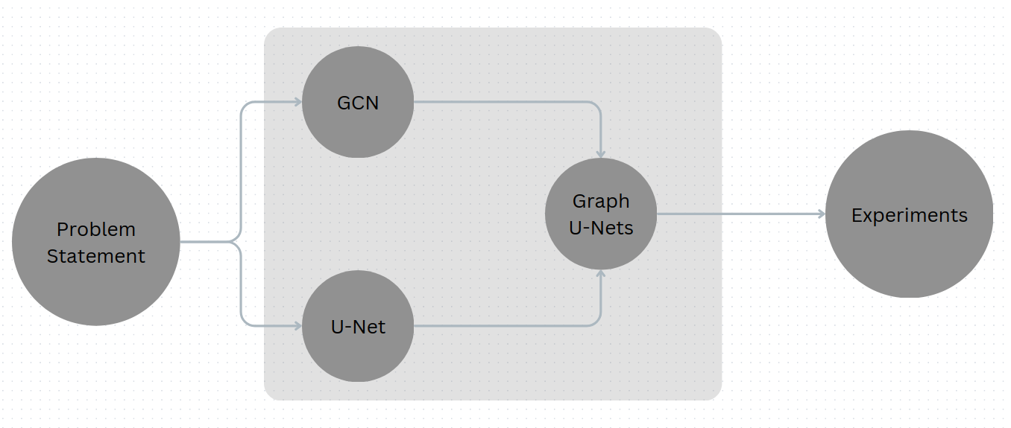
Graph U-Nets
Gao, Hongyang, and Shuiwang Ji. "Graph u-nets." international conference on machine learning. PMLR, 2019.

Slide 2
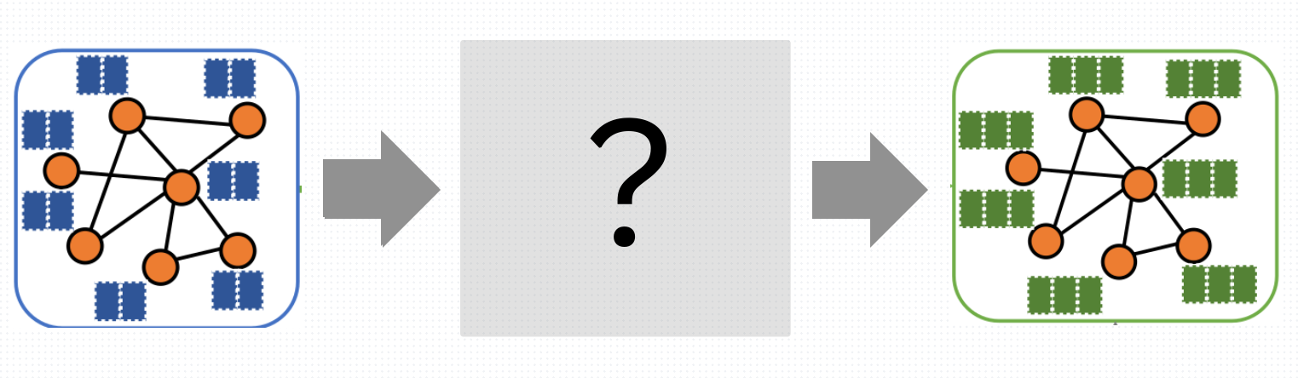
Problem statement
Learn node embeddings

Slide 3
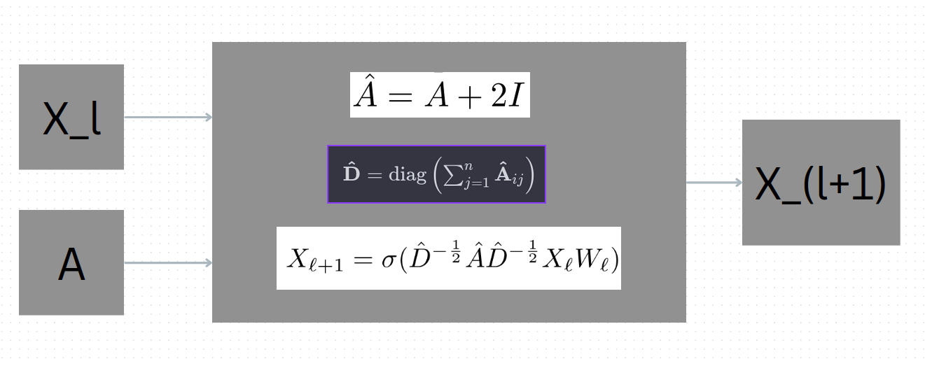
GCN
Kipf, T. N. and Welling, M. Semi-supervised classification with graph convolutional networks. International Conference on Learning Representations, 2017.

Slide 4
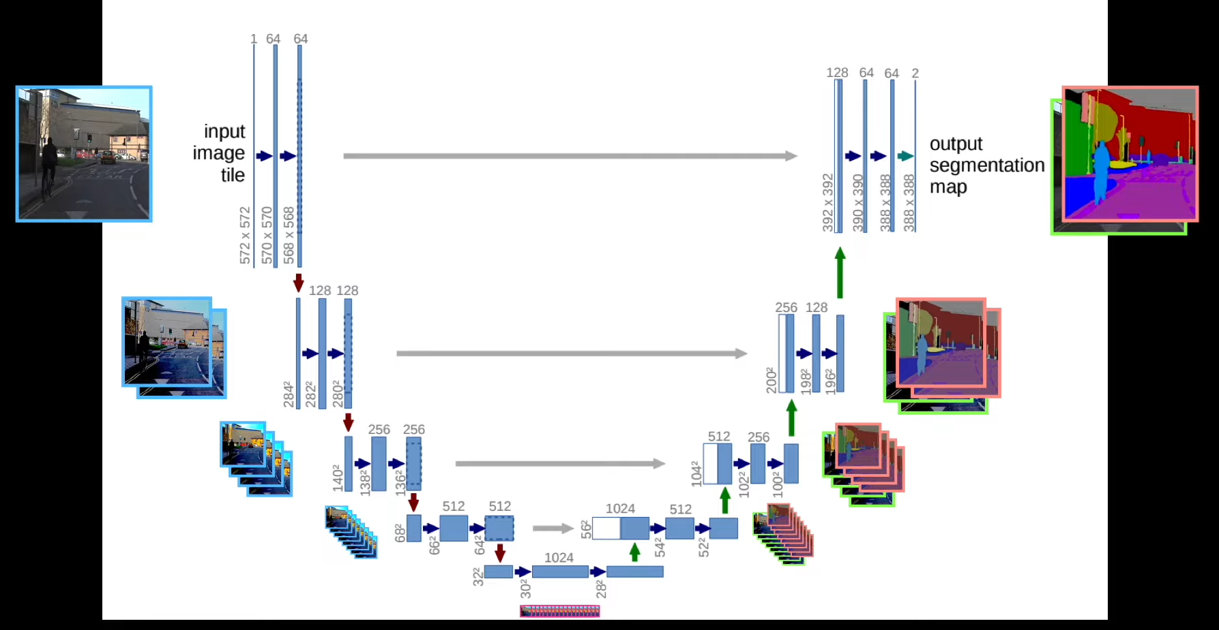
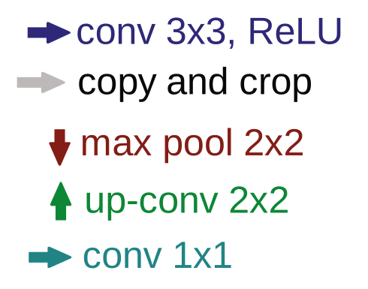
U-Net
Ronneberger, O., Fischer, P., and Brox, T. U-net: Convolutional networks for biomedical image segmentation. In International Conference on Medical image computing and computer-assisted intervention, pp. 234–241. Springer, 2015.

Slide 5
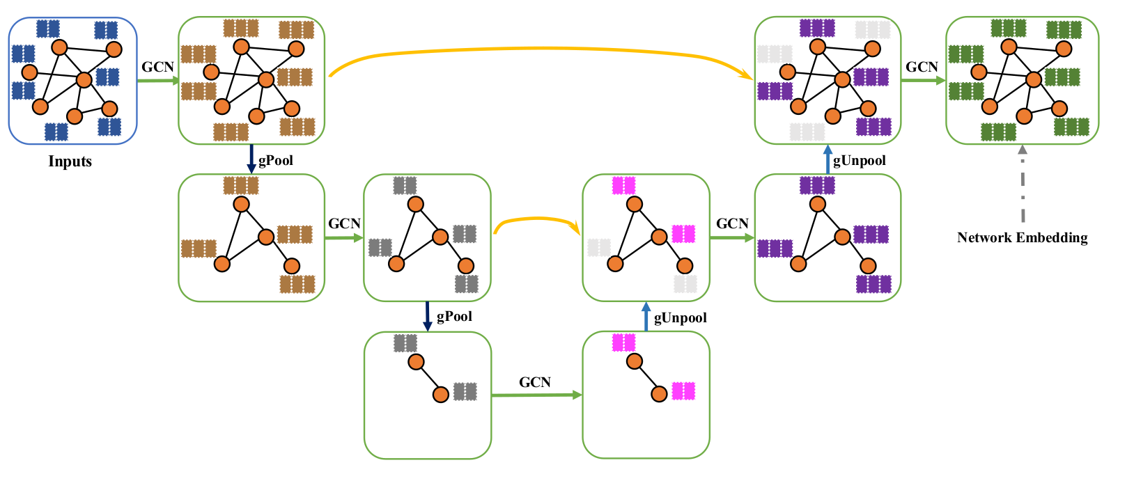
Graph U-Nets
Gao, Hongyang, and Shuiwang Ji. "Graph u-nets." international conference on machine learning. PMLR, 2019.

Slide 6
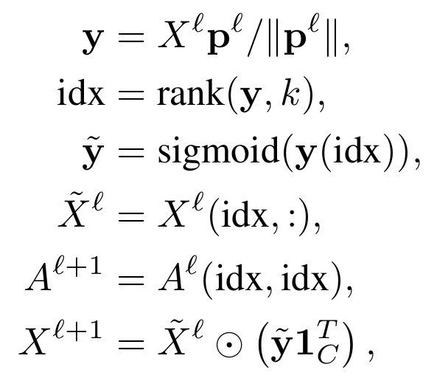
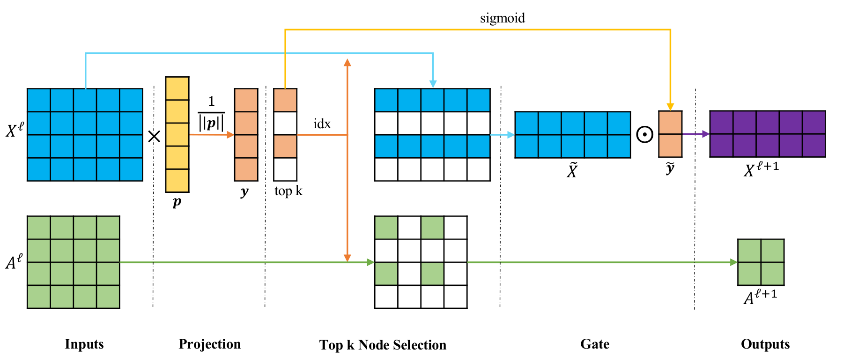
gPool
Gao, Hongyang, and Shuiwang Ji. "Graph u-nets." international conference on machine learning. PMLR, 2019.

Slide 7
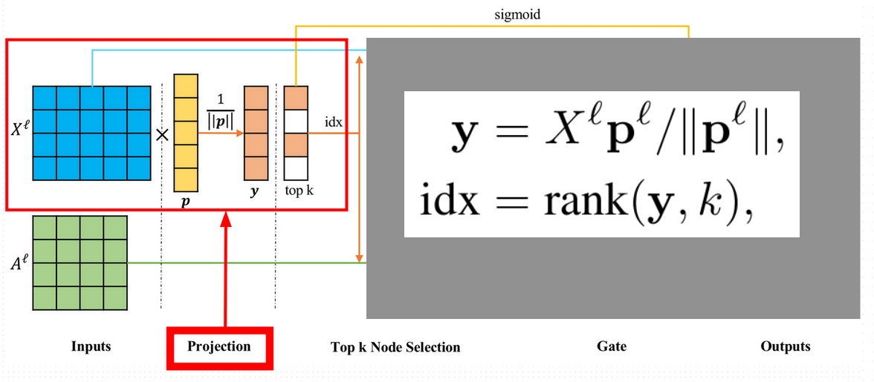
gPool - Projection
Gao, Hongyang, and Shuiwang Ji. "Graph u-nets." international conference on machine learning. PMLR, 2019.

Slide 8
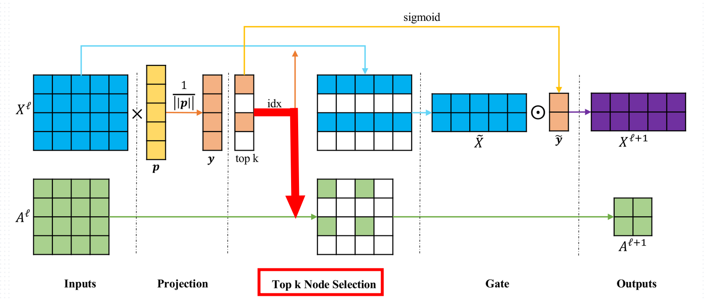
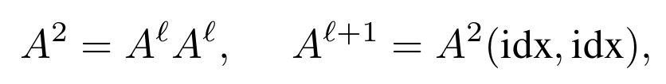
gPool - Connectivity Augmentation
Gao, Hongyang, and Shuiwang Ji. "Graph u-nets." international conference on machine learning. PMLR, 2019.

Slide 9
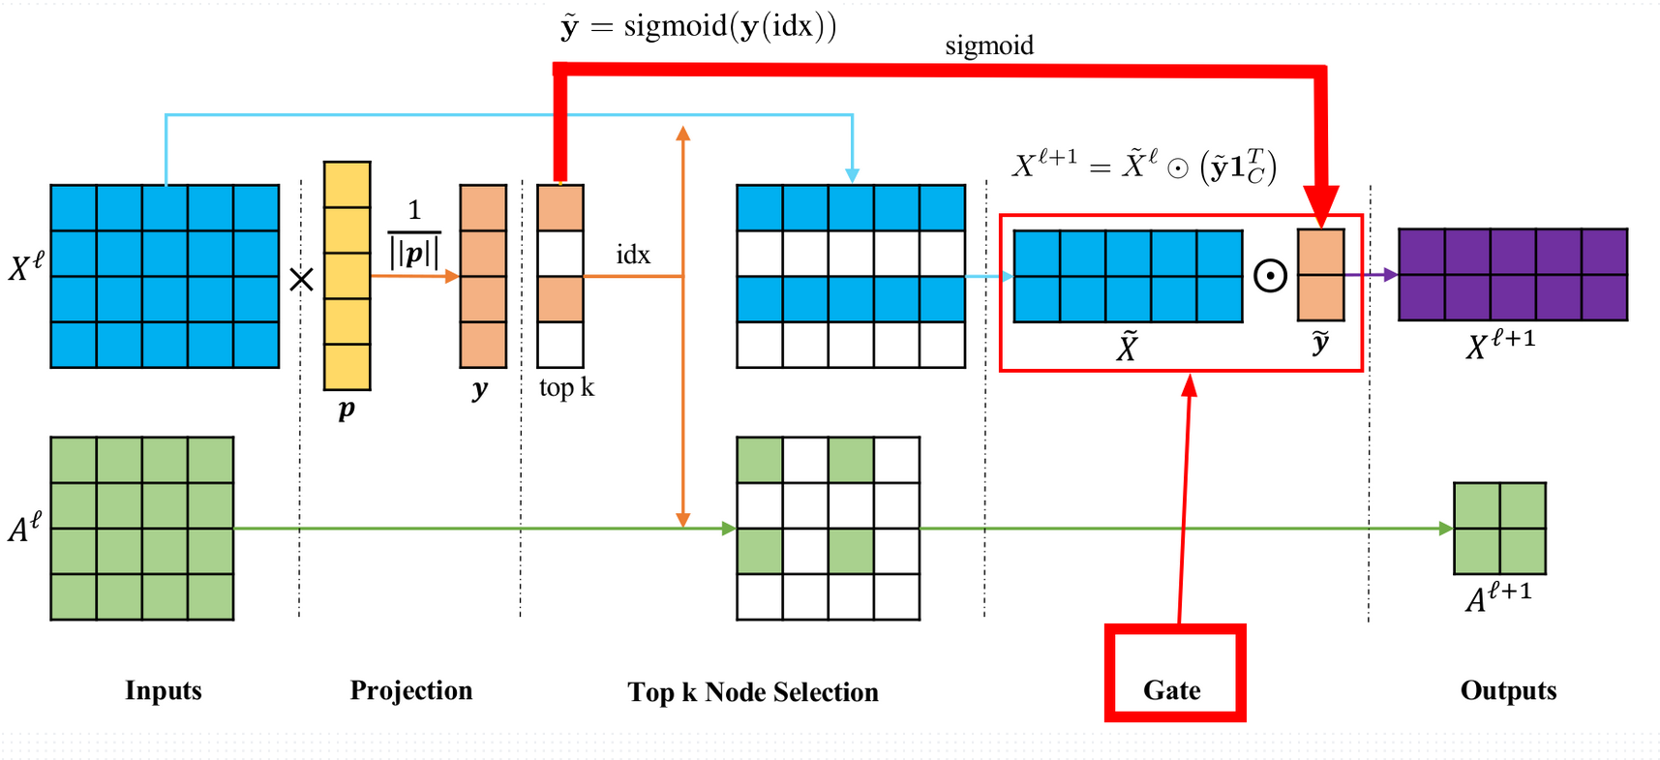
gPool - Gate
Gao, Hongyang, and Shuiwang Ji. "Graph u-nets." international conference on machine learning. PMLR, 2019.

Slide 10
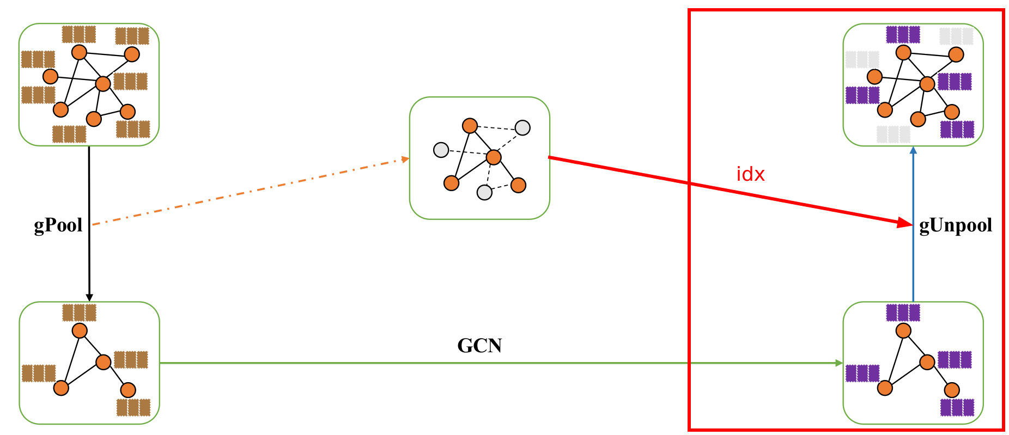

gUnpool
Gao, Hongyang, and Shuiwang Ji. "Graph u-nets." international conference on machine learning. PMLR, 2019.

Slide 11
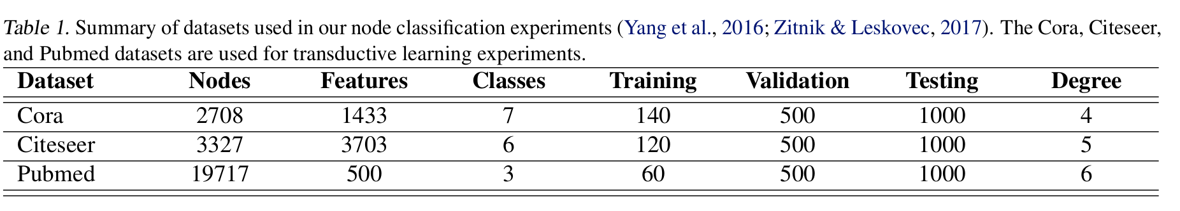
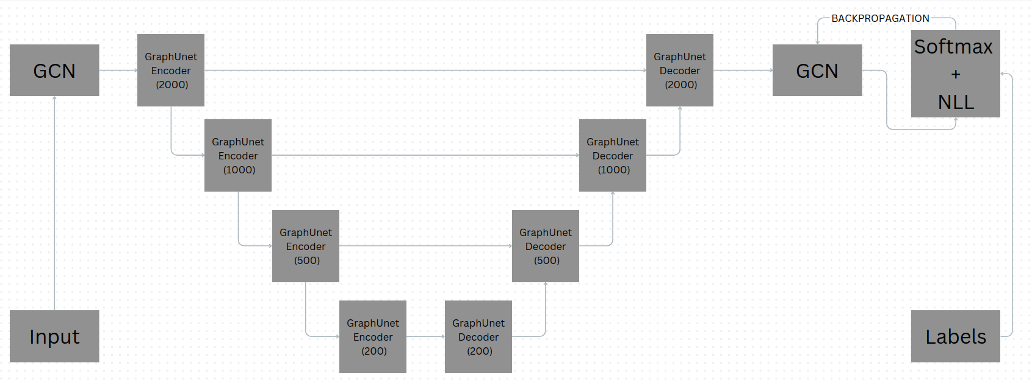
Experiments
Gao, Hongyang, and Shuiwang Ji. "Graph u-nets." international conference on machine learning. PMLR, 2019.

Slide 12
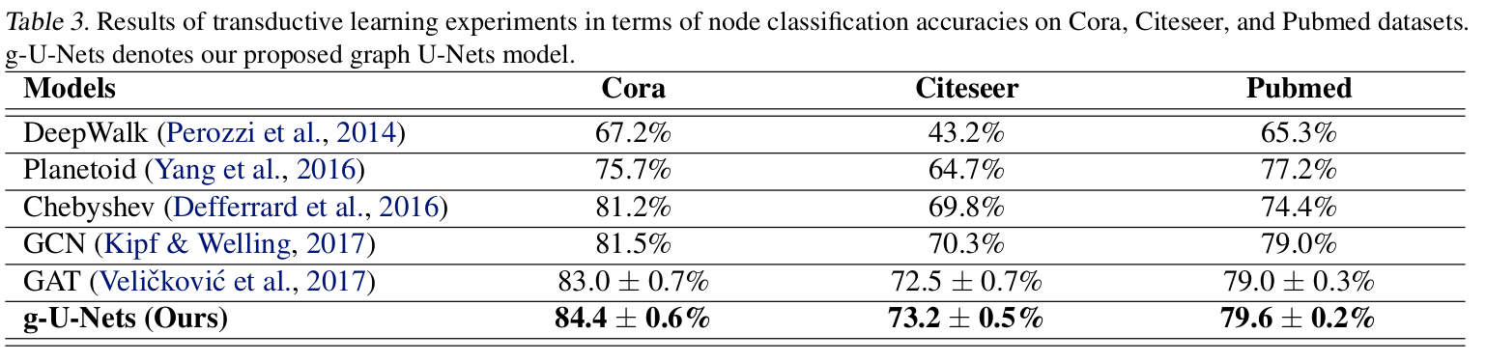
Experiments
Gao, Hongyang, and Shuiwang Ji. "Graph u-nets." international conference on machine learning. PMLR, 2019.

Slide 13
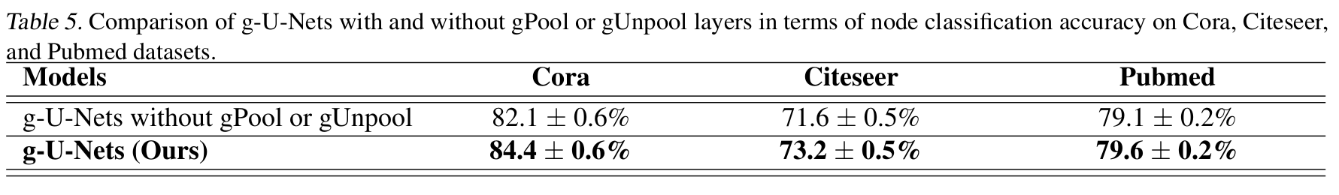
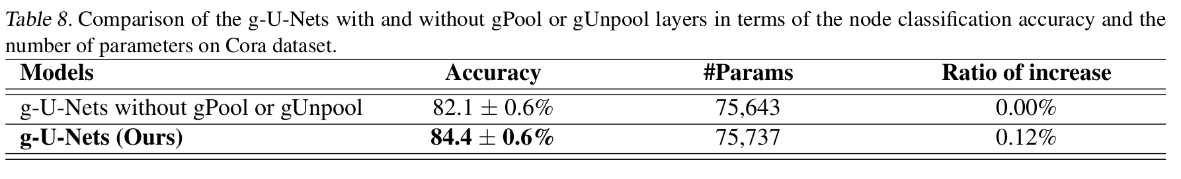
Experiments
Gao, Hongyang, and Shuiwang Ji. "Graph u-nets." international conference on machine learning. PMLR, 2019.

Slide 14
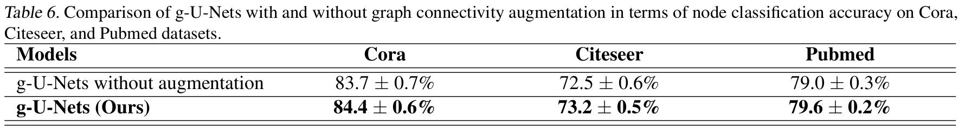
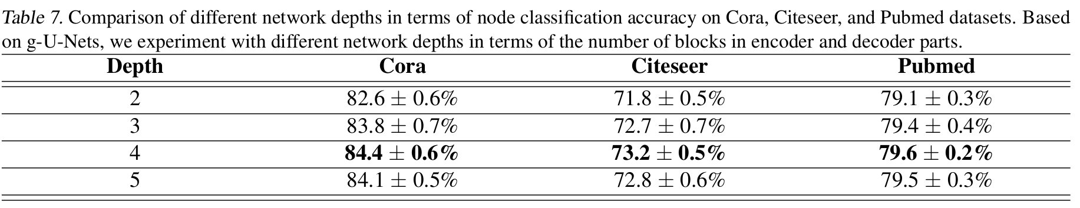
Experiments
Gao, Hongyang, and Shuiwang Ji. "Graph u-nets." international conference on machine learning. PMLR, 2019.

Slide 15
Q & A

