Slide 1
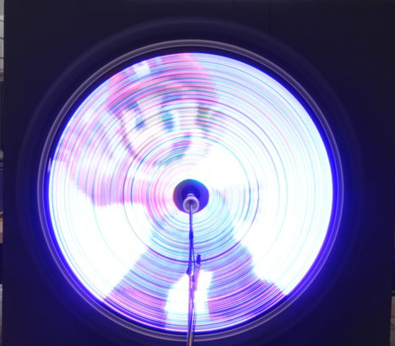
Pulse Width Modulation
A Student Presentation By:
Wayne Maxwell
Martin Cacan
Christopher Haile

Slide 2
Presentation Roadmap
Introduction and Background
Applicable Definitions
Pulse Width Modulation
Duty Cycle
Advantages/Disadvantages
PWM Types
Methods of PWM Generation
Applications
Choosing the PWM Frequency
Implementation of PWM on the HCS12

Slide 3
Wayne Maxwell Presents
Introduction and Background
Applicable Definitions
Pulse Width Modulation
Duty Cycle
Advantages/Disadvantages
PWM Types
Methods of PWM Generation
Applications
Choosing the PWM Frequency
Implementation of PWM on the HCS12

Slide 4
A Brief History of Variable Power Devices
To fulfill partial power requirements, variable resistance devices such as rheostats were used to control the current entering a device (i.e. sewing machines)
These devices suffered from major energy losses from heat in the resistor elements.
Other device power control devices included voltage stepping autotransformers such as the Autrastat.
There was a need for a low cost, efficient,and compact option for providing adjustable power for electronic devices.

Slide 5
History of PWM Use
Variable (Switching) power supplies began being used in mass by the military
Commercial product designers became curious when seeing the military applications of the switching power supplies
One of the early applications of Pulse Width Modulation was in the Sinclair X10, an audio amplifier in the 1960s
In 1976, Bob Mammano (Silicon General) invented the SG1524 regulating pulse width modulator integrated circuit. Other companies soon followed leading to the evolution of PWM techniques.
“Switching regulators are in the process of revolutionizing the power supply industry because of their low internal losses, small size and weight, and costs competitive with conventional series-pass or linear power supplies” -Abraham Pressman-

Slide 6
What is PWM?
Definition: Pulse Width Modulation is a technique that conforms a signal width, generally pulses based on modulator signal information.
The general purpose of Pulse Width Modulation is to control power delivery, especially to inertial electrical devices.
The on-off behavior changes the average power of signal.
Output signal alternates between on and off within a specified period.
If signal toggles between on and off quicker than the load, then the load is not affected by the toggling.
A secondary use of PWM is to encode information for transmission.

Slide 7
Duty Cycle
Definition: The Duty Cycle is a measure of the time the modulated signal is in its “high” state.
It is generally recorded as the percentage of the signal period where the signal is considered on.
On
Off
VH
Duty Cycle (D)
VL
Period (T)

Slide 8
Duty Cycle Formulation
Duty Cycle is
determined by:
On
Off
VH
Duty Cycle (D)
*Average value of a signal can be found as:
VL
Period (T)
*In general analysis, VL is taken as zero volts for simplicity.

Slide 9
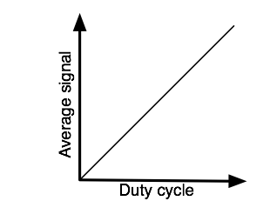
Advantages of Using PWM
Average value proportional to duty cycle, this dependence is often observed to follow a linear trend due to the previous formulaic definition.
Low power used in transistors used to switch the signal, and fast switching possible due to MOSFETS and power transistors at speeds in excess of 100 kHz
Alleviates the problem of high heat loses through resistive elements at intermediate voltage points

Slide 10
Disadvantages to Using PWM
Cost of integrated circuit packages for PWM
Complexity of circuitry necessary for implementation
Radio Frequency Interference/Electromagnetic Interference limits the performance of the circuitry
Voltage spikes in the pulse signal to a rapid succession of switches similar to an impulse

Slide 11
General Types of Pulse Width Modulation
There are three commonly used types of PWM defined by which edge of the analog signal is to be modulated
Lead Edge Modulation
Trail Edge Modulation
Pulse Center Two Edge Modulation/Phase Correct PWM

Slide 12
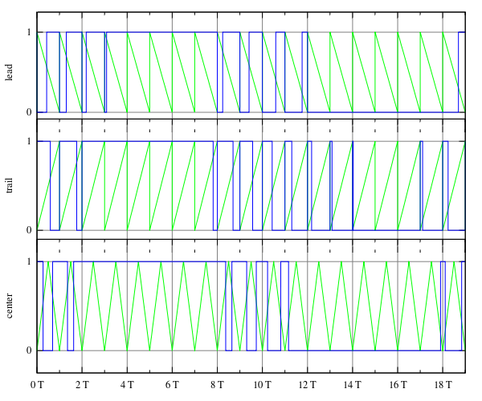
Lead Edge Modulation
The lead edge of the trigger signal is fixed to the leading edge of the time spectrum and the trailing edge is modulated
Trigger Signal
PWM Signal

Slide 13
Visual Description of PWM Types
Trail Edge Modulation: The trail edge of the trigger signal is fixed to the trailing edge of the time spectrum and the leading edge is modulated
Center Pulse Two Edge Modulation: The pulse center is fixed in the middle of the time spectrum and both edges are modulated about the center of the trigger signal Trigger Signal PWM Signal

Slide 14
Methods for Pulse Width Modulation Generation
There are several methods for generating the PWM signal, including the following:
Analog Generation Methods
The Intersective Method
Digital Generation Method
Delta Modulation
Delta Sigma Modulation
Space Vector Modulation
Application Specific Methods
Direct Torque Control
Time Proportioning

Slide 15
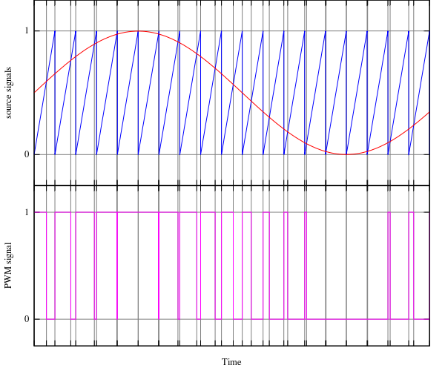
Analog Generation Methods
The Intersective Method: Allows for the analog creation of the PWM signal through simply noting the intersections between a sawtooth or triangular trigger signal and a reference sinusoid.
The length of the pulses is dependent upon the intersection of the reference sinusoid and trigger signal
When the sinusoid is greater than the signal, the PWM pulse is switched to the on/high position. When the sinusoid is less than the signal, the PWM pulse is switched to the off/low position Analog Signal Trigger Signal PWM Signal

Slide 16
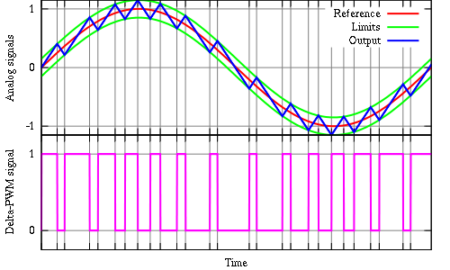
Digital Generation Methods
Delta Modulation: By using the reference analog signal only, a set of limits set by a constant offset, and the integrated PWM signal, a switching method is created.
The output is integrated and will increase or decrease toward the limits set around the reference by a constant offset
Whenever the output comes into contact with one of the limits around the reference, the PWM signal will switch modes.

Slide 17
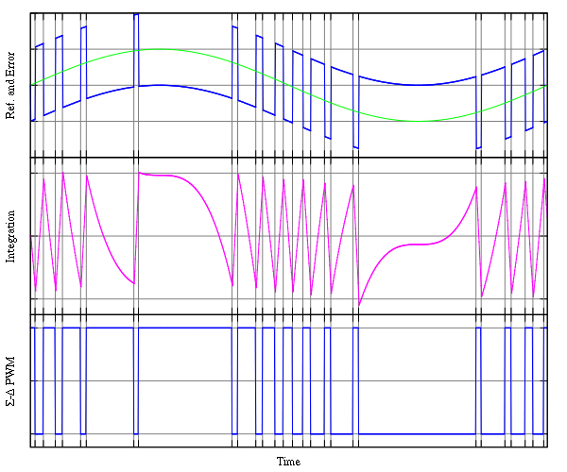
Digital Generation Methods
Delta-Sigma Modulation: Similar to the Delta Modulation method in that it involves an integral. However, an error signal is developed by subtracting the PWM signal from a reference sinusoid and then integrated. When this integrated error signal reaches a set of defined limits, the PWM signal will switch modes.
Analog Signal
Integrated Error
1: Error (AS-PWM)
2: PWM Signal

Slide 18
Martin Cacan Presents
Introduction and Background
Applicable Definitions
Pulse Width Modulation
Duty Cycle
Advantages/Disadvantages
PWM Types
Methods of PWM Generation
Applications
Choosing the PWM Frequency
Implementation of PWM on the HCS12

Slide 19
Applications
Audio and video effects
Telecommunications
Power delivery
Voltage regulation
Amplification
Controlling Actuators
Use as ADC

Slide 20
Applications
Audio and video effects
Telecommunications
Power delivery
Voltage regulation
Amplification
Controlling Actuators
Use as ADC

Slide 21
Applications: LED Displays
RGB LEDs often use 8 bit PWM control
Each pixel is individually controlled
Color can be defined as % of duty cycle (#/255)
Red: 0 – 255
Green: 0 – 255
Blue: 0 – 255
Number of colors: 256^3 = 16.77 million
Decimal Code (RR,GG,BB)
Hex Code #RRGGBB

Slide 22
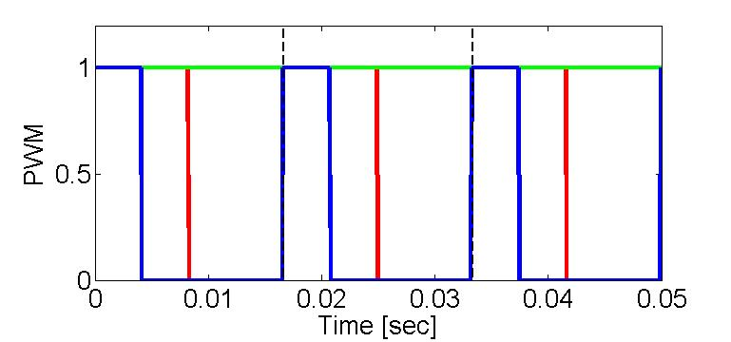

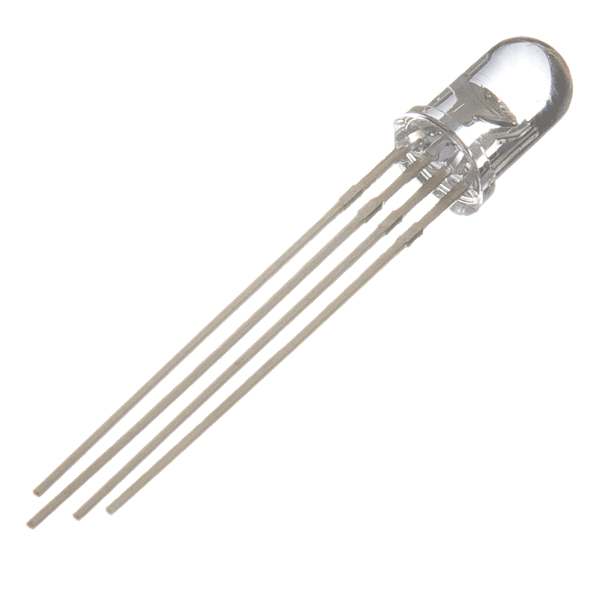

Applications: LED Displays
T_{PWM}
(RR,GG,BB)
(128,255,65)
Notes:
Important Considerations:
Question: At what frequency does your mind process images received by the eyes? ~30 Hz.
Most MC can’t source the current – Use PWM to control the gate on an transistor
22

Slide 23
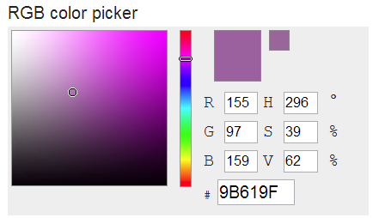
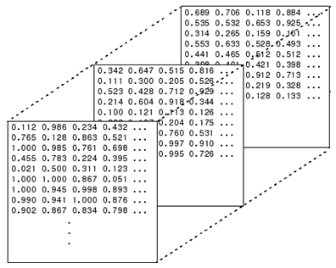

Applications: LED Displays
How to get a color code?
Use online color mapping tool:
MATLAB!
http://www.rapidtables.com/web/color/RGB_Color.htm
N
N
BLUE
M
A = imread(…); A =
M
GREEN
RED
Notes:
Important Considerations:
Question: At what frequency does your mind process images received by the eyes? ~30 Hz.
Most MC can’t source the current – Use PWM to control the gate on an transistor
23

Slide 24
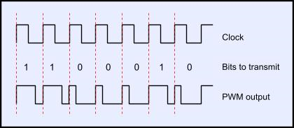
Applications: Telecommunications
Embed a data signal in a modified clock signal
Can discretize further for larger than base 2 transmission
Clock: @ 50% duty cycle
1: Extends duty cycle
0: Shortens duty cycle

Slide 25
Application: Voltage Regulator
DC voltage can be regulated by PWM to modify output voltage
12v supply controlled by PWM at 50% duty cycle can create an output signal of 6v
Use smoothing filters to get DC output
Can use feedback control to monitor output voltage and change duty cycle to ensure consistent output given varying input or load

Slide 26
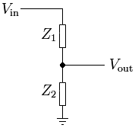
Application: Voltage Regulator
What’s the difference between a voltage regulator and a voltage divider (linear regulator)?

Slide 27
Application: Voltage Regulator
What’s the difference between a voltage regulator and a voltage divider (linear regulator)?
Linear regulators suffer from power dissipation proportional to the output current
High current also implies Ohmic Heating of elements
Efficiency of linear regulator: ~50%
Efficiency of a PWM voltage regulator: ~90%

Slide 28
Choosing a PWM Frequency
Basic considerations:
Transitions can only occur on a clock tick
Frequency limited by your clock and desired resolution
Resolution is defined by clock speed and frequency of the PWM
The faster you run the PWM, the fewer clock ticks occur in the period considered → lower duty cycle resolution

Slide 29
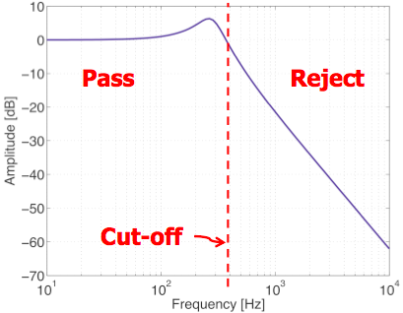
Choosing a PWM Frequency
Many actuators can be modeled as a first or second order filter (e.g. motors, servos)
A frequency in this region can excite the system!
A PWM frequency is rejected by the system

Slide 30
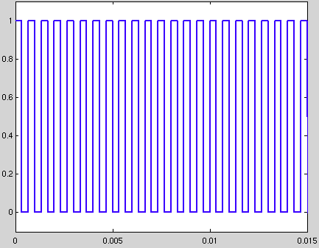
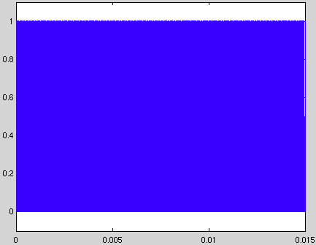
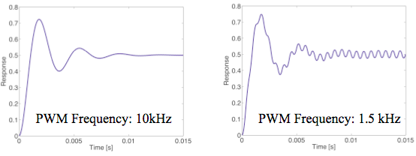
Choosing a PWM frequency
Input PWM Signal
Response of 2nd order system
30
Notes:
30

Slide 31
Christopher Haile Presents
Introduction and Background
Applicable Definitions
Pulse Width Modulation
Duty Cycle
Advantages/Disadvantages
PWM Types
Methods of PWM Generation
Applications
Choosing the PWM Frequency
Implementation of PWM on the HCS12

Slide 32
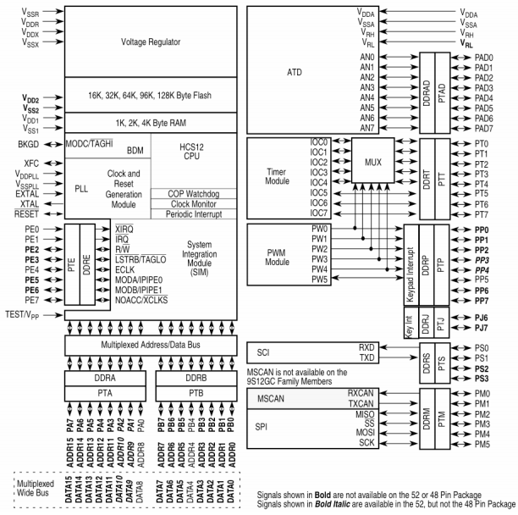
Implementation
PWM8B6C dedicated chip
Signal outputted through port P

Slide 33
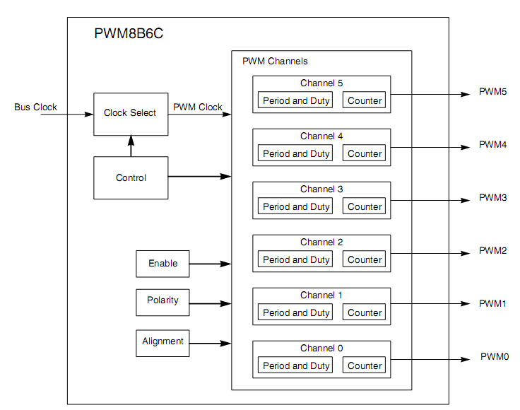
PWM8B6C Module
6 Independent 8-bit channels
Can be concatenated to 3
16-bit channels
Independently adjustable polarity, clock, alignment, duty cycle, and period
Dedicated counter for each channel

Slide 34
Features
3 Modes of Operation
Normal: everything is available
Wait: Low-power consumption and clock disabled
Freeze: Option to disable input clock
Four source clocks
A, SA, B, SB
Emergency shutdown
Some changes take a complete cycle to be implemented

Slide 35
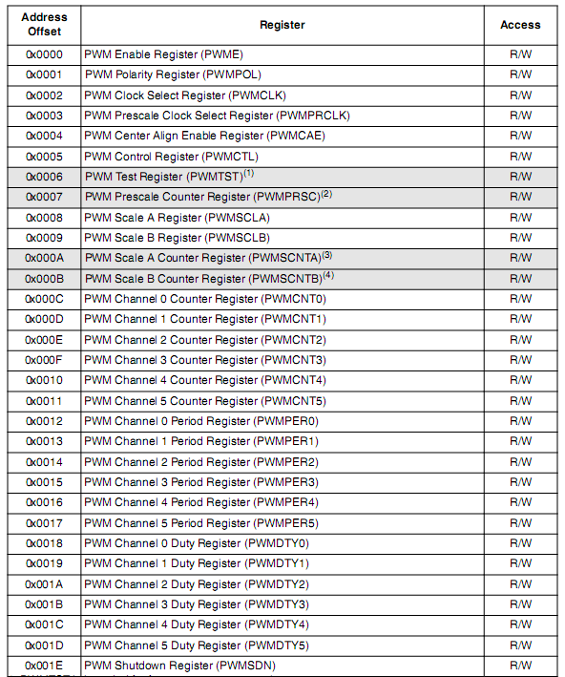
Memory Map
Configured through specific registers
Base address is defined at the MCU level
Address offset is defined at the module level
Register address = base address + address offset
Registers are located from $00E0 - $00FF

Slide 36
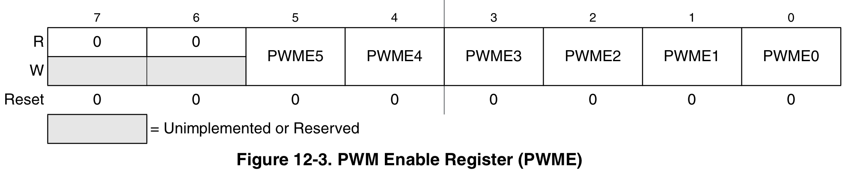
PWM Enable Register (PWME)
Located at $00E0
Set PWME “x”
0: to disable PWM channel “x”
1: to enable PWM channel “x”
Chanel is activated when bit is set
If 16-bit resolution is used, then PWME4/2/0 are disabled

Slide 37
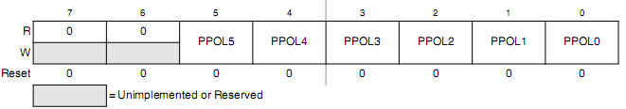
PWM Polarity Register (PWMPOL)
Located at $00E1
Set PPOLx to
0: output channel starts low and moves to high when duty cycle is reached
1: output channel starts high and moves to low when duty cycle is reached

Slide 38
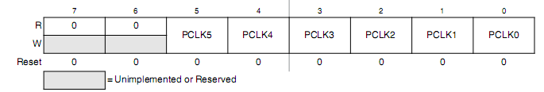
PWM Clock Select Register (PWMCLK)
PWMCLK is located at $00E2
Set PCLK5, PCLK4, PCLK1, PCLK0 to
0 to use Clock A
1 to use Clock SA
Set PCLK3, PCLK2 to
0 to use Clock B
1 to use Clock SB
Notes:
38

Slide 39
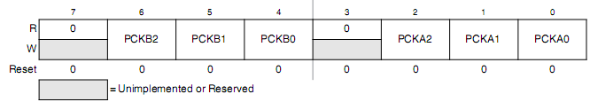
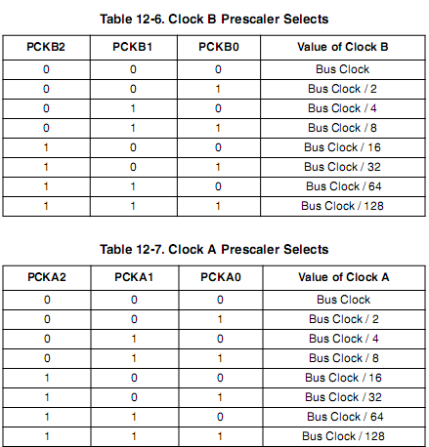
PWM Prescaler Register (PWMPRCLK)
Located at $00E3
Used to prescale clocks A and B
Notes:
39

Slide 40

PWM Scale A Register (PWMSCLA)
Located at $00E8
Scale value used in scaling Clock A to generate Clock SA
Store a hexadecimal value in order to change the clock frequency of SA
Note: When PWMSCLA = $00, PWMSCLA value is considered a full scale value of 256.
Notes:
40

Slide 41
PWM Scale B Register (PWMSCLB)
PWM Scale B Register (PWMSCLB)
Located at $00E9
Scale value used in scaling Clock B to generate Clock SB
Store a hexadecimal value in order to change the clock frequency of SB
Note: When PWMSCLA = $00, PWMSCLA value is considered a full scale value of 256.
Notes:
41

Slide 42
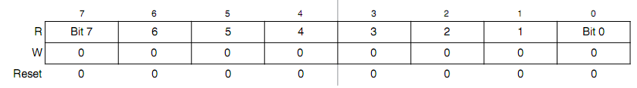
PWM Counter Register (PWMCNTx)
Six 8-bit counters located at $00EC - $00F1
One up/down counter per channel, can be read and written to
In left aligned mode, the counter counts from 0 to the value in the period register-1. In center aligned mode, the counter counts from zero to the value in the period register-1 and then back down to zero.
Any write to the register causes the value to be reset to #$00 and the counting procedure is restarted.
Notes:
42

Slide 43
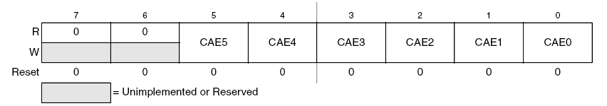
PWM Center Align Register (PWMCAE)
Located at $00E4
Set CAEx to
0: for left align output signal
1: for center align output signal
Note: can only be set when channel is disabled
Notes:
43

Slide 44
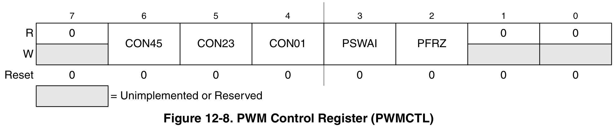
PWM Control Register (PWMCTL)
Located at $00E5
Set CONxy to
0: to keep PWM channels separate (8-bit)
1: to concatenate PWM channels x and y together (16-bit)
Channel y determines the configuration
x becomes the high byte and y becomes the low byte
Bits PSWAI and PFRZ set either wait or freeze mode
Note: Changes only occur when channels are disabled
Notes:
44

Slide 45
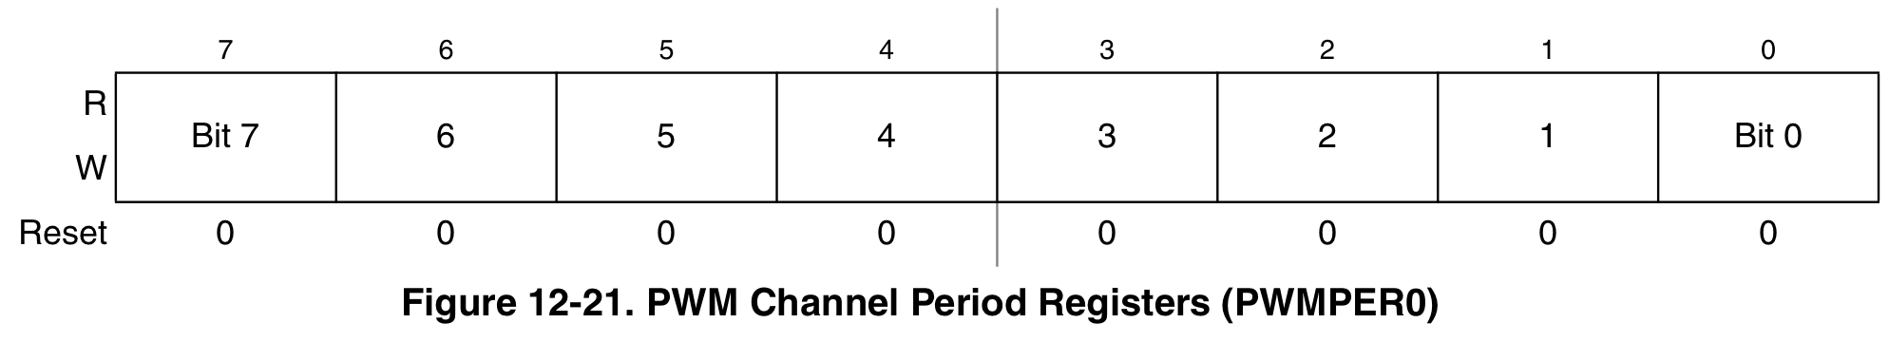
PWM Period Register (PWMPERx)
Six Period Registers located at $00F2 - $00F7
Determine the PWM period
Changes occur when:
Current period ends
Counter is written to
Channel is disabled
Left-Aligned:
Center-Aligned:
Notes:
45

Slide 46
PWM Resolution
PWM Resolution
The true resolution depends on the value in PWMPERx even though the PWM module is said to be 8-bit.
The number of distinct duty cycles equals the value stored in PWMPERx.
Maximum number of distinct duty cycles is achieved by writing $FF to the register PWMPERx so that it can represent 256 duty cycle states (00, 01, 02, …, to FF), which corresponds to 2⁸=256 resolution.

Slide 47
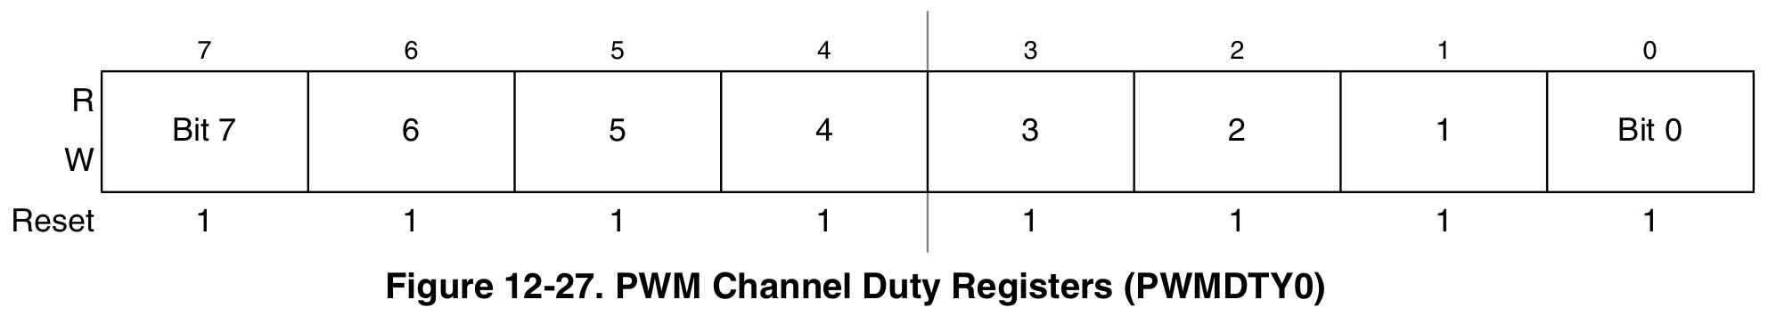
PWM Duty Register (PWMDTYx)
(6) Duty Registers located at $00F8 - $00FD
Determines the duty of the associated PWM channel
Changes occur when:
Current period ends
Counter written to
Channel is disabled
Polarity = 0:
Polarity = 1:
Notes:
47

Slide 48
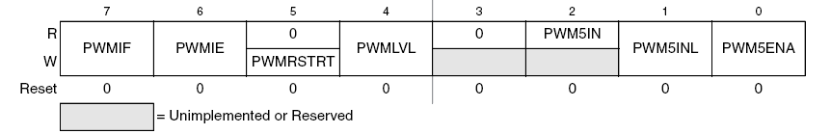
PWM Shutdown Register (PWMSDN)
Located at $00FE
PWMENA: Enables and disables emergency shut down
PWMIF (Interrupt flag): Set when an input is detected in pin 5
PWMIE (Interrupt Enable): Enables and disables CPU interrupts
PWMRSTRT: Resets the counters
PWMLVL (Shutdown Output Level): Determines if output is high or low when shutdown
PWM5IN (Input Status): Reflects status of pin 5
PWM5INL: Determines active level of pin 5
Notes:
48
Polarity 0- counts high time
Polarity 1- counts low time

Slide 49
Assembly Code
PWME EQU $00E0
PWMPOL EQU $00E1
PWMCLK EQU $00E2
PWMPRCLK EQU $00E3
PWMCAE EQU $00E4
PWMCTL EQU $00E5
PWMPER1 EQU $00F3
PWMDTY1 EQU $00F9
ORG $1000
LDAA #$00
STAA PWMCLK ; Sets source clocks to clock A
STAA PWMPOL ; The signal goes from low to high
STAA PWMCTL ; Makes all channels 8-bit
STAA PWMCAE ; Signals are left aligned
LDAA #$FA
STAA PWMPER1 ; Sets the period to 250 clock cycles
LDAA #$AF
STAA PWMDTY1 ; Makes the duty cycle equal to 30%
LDAA #$02
STAA PWMPRCLK ; Sets the prescaler to 4
STAA PMWE ; Enables and starts channel 1
……

Slide 50
QUESTIONS?
References:
www.rapidtables.com/web/color/RGB_Color.htm
http://www.mathworks.com/help/matlab/ref/imread.html
http://en.wikipedia.org/wiki/Pulse-width_modulation#Telecommunications
http://www.analog.com/en/content/ta_fundamentals_of_voltage_regulators/fca.html
http://www.monkeylectric.com
http://en.wikipedia.org/wiki/Pulse-width_modulation
http://tutorial.cytron.com.my/2012/01/14/basic-pulse-width-modulation-pwm/
http://www.societyofrobots.com/member_tutorials/book/export/html/228
http://powerelectronics.com/power-management/pwm-single-chip-giant-industry
http://www.freescale.com/files/microcontrollers/doc/data_sheet/MC9S12C128V1.pdf

