Slide 1
Jeopardy System
Mitrofan Alexandru-Cristian
Păpureanu Iulia

Slide 2
contents
Problem Statement
Indexing and Retrieval
Measuring Performance
Error Analysis
Improving Retrieval

Slide 3
Problem Statement: Jeopardy system
Create a question answering system
Use a dataset of:
100 question from previous jeopardy games
A collection of 280,000 Wikipedia pages (stored in 80 files)

Slide 4
Indexing and Retrieval​
We used Python and the Whoosh library for our implementation
For the indexing part, we used a custom analyzer that incorporates both stemming and stop words removal.
Creating the index of wiki pages: we extracted the pages into documents, as title – content pairs
For the retrieval aspect, we used a query parser which aims to match Jeopardy clues with the most relevant Wikipedia pages.

Slide 5

Measuring Performance​
We chose P@1 as our performance metric because it fits with our task of identifying the correct Wikipedia page title for Jeopardy-style questions.
For checking the answers, we parse all the questions and check if the retrieved result is correct.

Slide 6
Error analysis
Main problems:
Insufficient Context Handling
Ambiguity in Clues
Examples of issues met in results:
Clue: The dominant paper in our nation's capital, it's among the top 10 U.S. papers in circulation Retrieved Answer: Confederate States of America
Clue: 1988: "Father Figure“ Retrieved Answer: Ruhollah Khomeini
Clue: In the 400s B.C. this Chinese philosopher went into exile for 12 years Retrieved Answer: Roman Empire

Slide 7
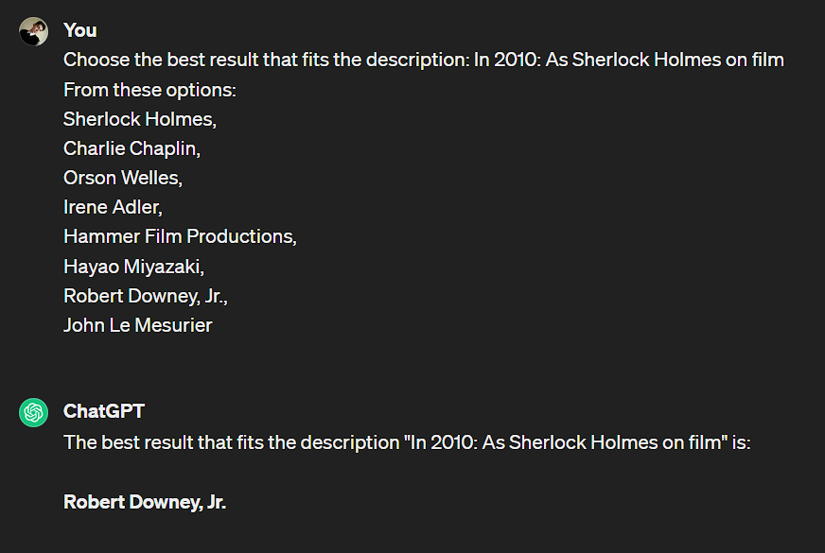
Improving Retrieval​
Using ChatGPT for reranking the top 10 pages produced by the retrieval system

