Slide 1
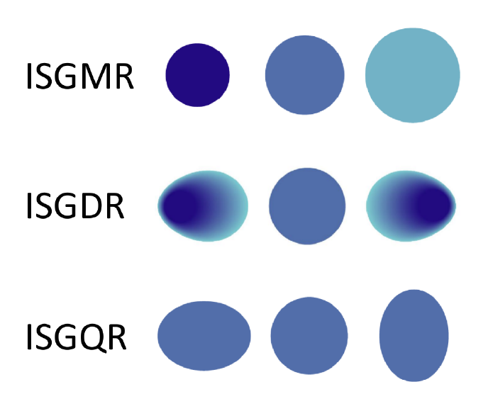
Measurement of isoscalar resonances in 58Ni
Alex Antony Arokiaraj, 21 Nov 2024
Supervised by Prof. Dr. Riccardo Raabe, Dr. Marine Vandenbrouck

Slide 2
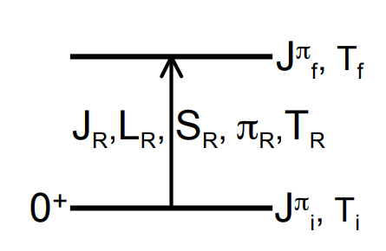
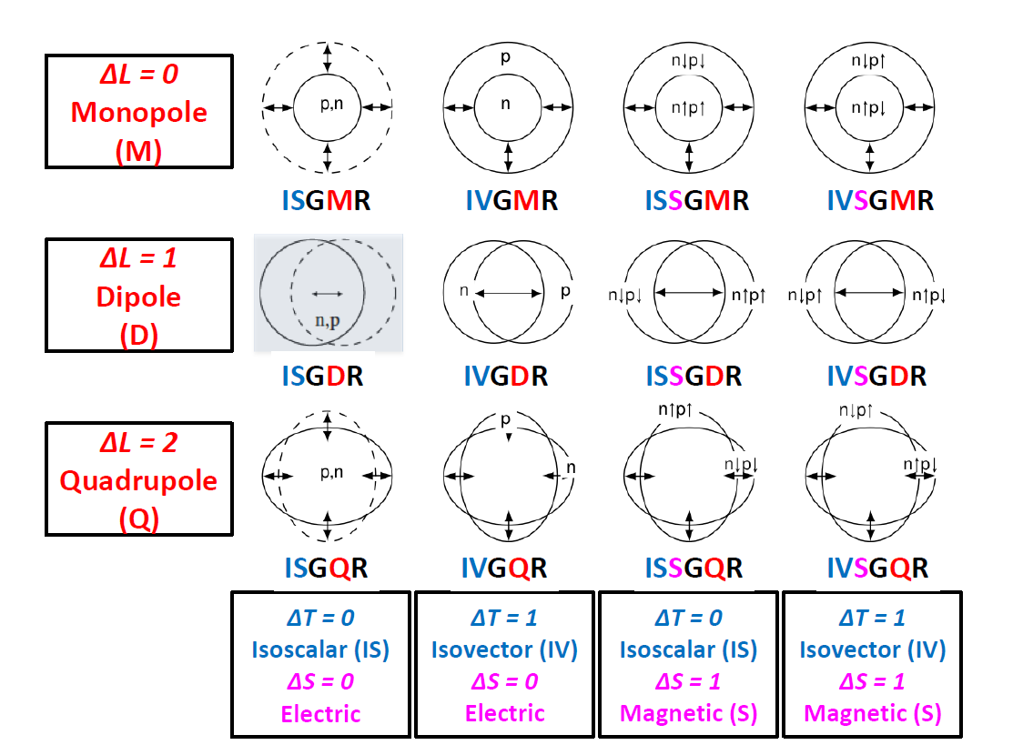
Giant Resonances
Fig courtesy: Elias Khan
Multipole Decomposition Analysis
Inelastic scattering – alpha probe
Fig courtesy: Bagchi 2015 PhD Thesis

Slide 3
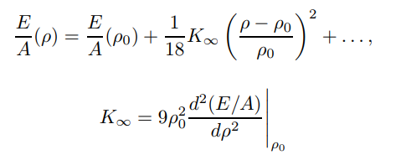





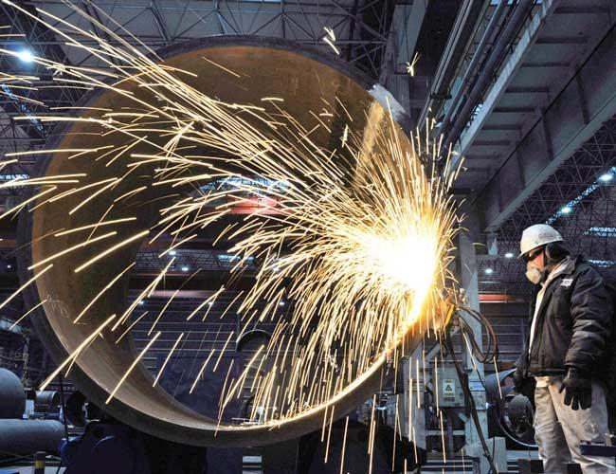
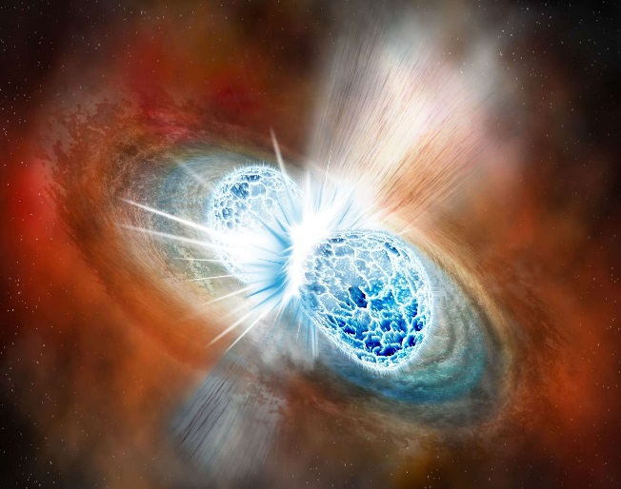
Compressibility
2.2 * 10⁹ Pa
1.6 * 10¹¹ Pa
6.6 * 10³³ Pa

Slide 4
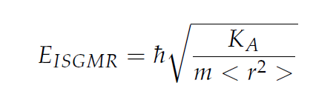
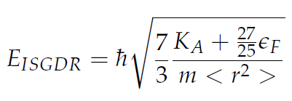
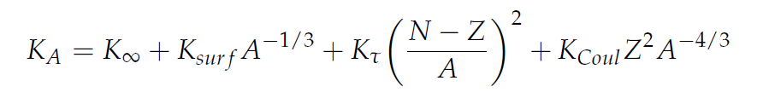
Impetus for GR measurements
Macroscopic Approach
K∞ = 100-400 MeV
J.P. Blaziot et.al 1995
Microscopic Approach
Fully Consistent RPA (Random Phase Approximations)
Provides at the same time K∞ , E_{ISGMR}
K∞ = 240 ± 10 MeV, ²⁰⁸Pb B.K.Agrawal et.al 2003
K∞ = 230 ± 40 MeV, ²⁰⁸Pb, ¹²⁰Sn Khan et.al 2013

Slide 5
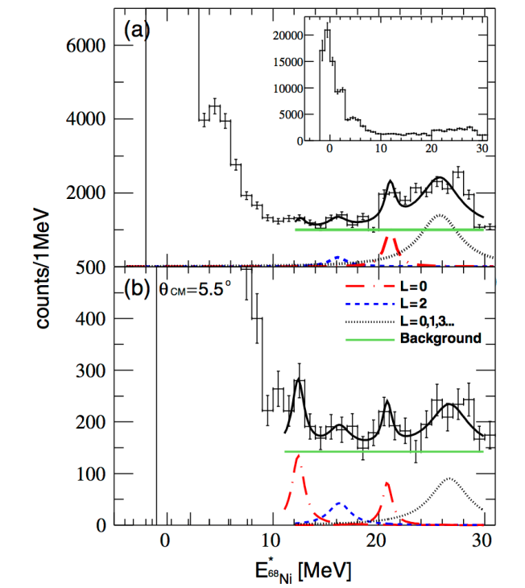
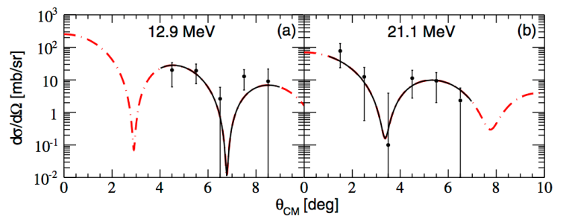

Previous Experimental works
Error of 0.5 MeV translates into a 10MeV error on K∞
Element | Beam Energy | Work | Measurements | Target
⁵⁶Ni | 50 MeV/A | Monrozeau et.al 2008 | E_{ISGMR} = 19.3 ± 0.5 MeV E_{ISGQR} = 16.2 ± 0.5 MeV | MAYA
⁶⁸Ni | 50 MeV/A | Vandebrouck et.al 2015 | E_{ISGMR} = 21.1 ± 1.9 MeV E_{ISGQR} = 15.9 ± 1.3 MeV | MAYA
⁵⁶Ni | 50 MeV/A | Bagchi et.al 2015 | E_{ISGMR} = 19.1 ± 0.5 MeV E_{ISGDR} = 17.4 ± 0.7 MeV | MAYA

Slide 6
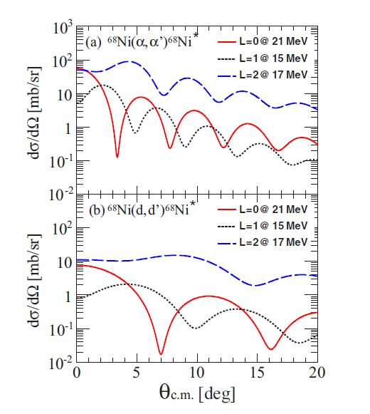
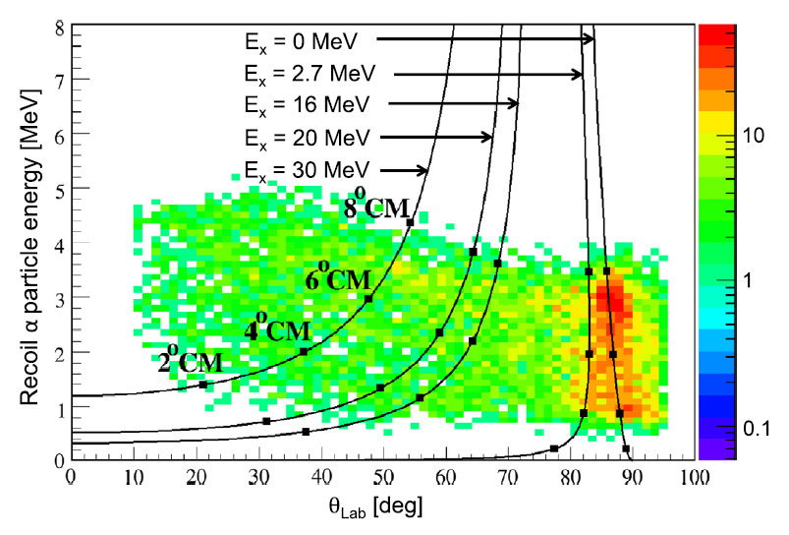
Limiting Factors
Angular distribution prediction calculated in the DWBA approximation
Vandebrouck et.al 2015
Fig courtesy: Bagchi 2015 PhD Thesis

Slide 7
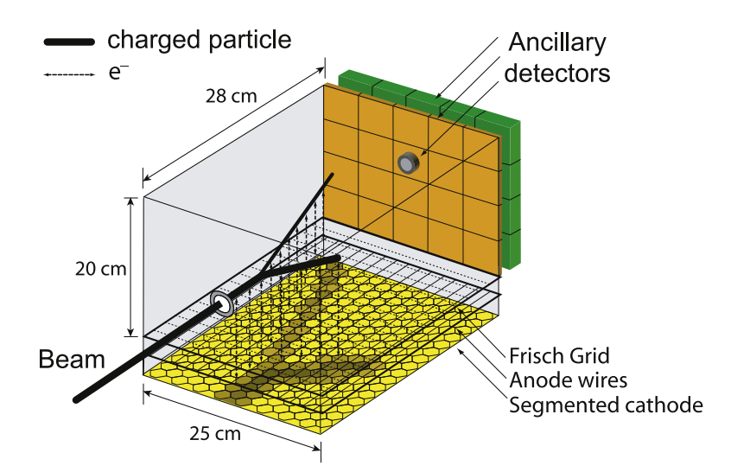
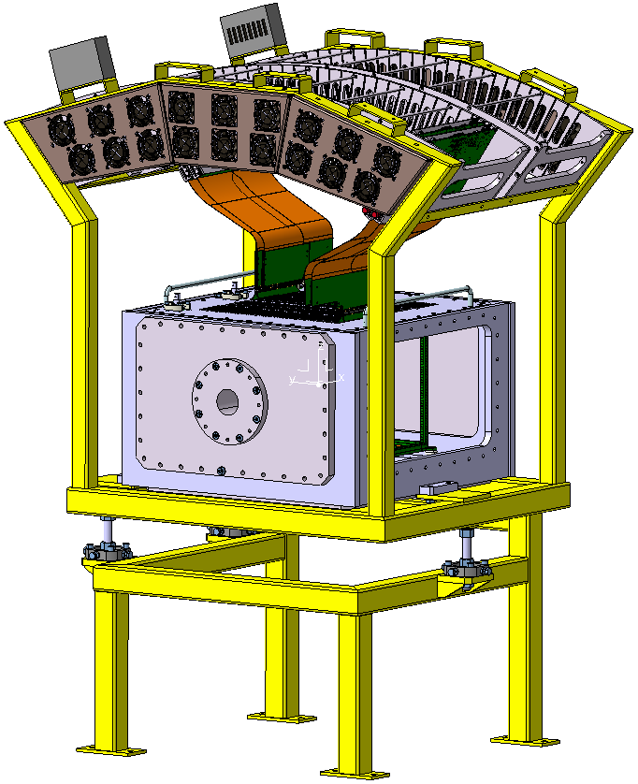
MAYA & ACTAR TPC
35×35 hexagonal pads with 5 mm sides
From 1 MeV to 100 KeV improvement in energy resolution

Slide 8
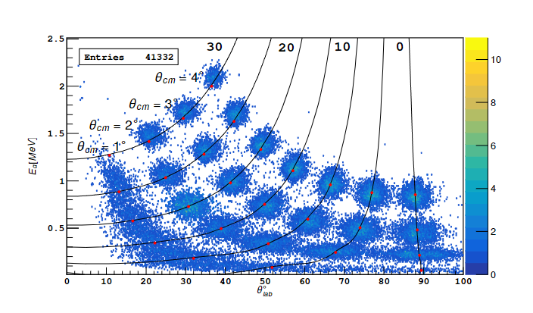
Data Analysis: Simulations – e780 @ LISE
Method based on likelihood of points belonging to a track
Events reconstructed from the simulation on the kinematic line. The numbers marked on each kinematic line represent the excitation energy in MeV. The filled red circles correspond to the center of mass angles (θcm=1.0◦, 2.0◦, 3.0◦, 4.0◦) for each excitation energy

Slide 9
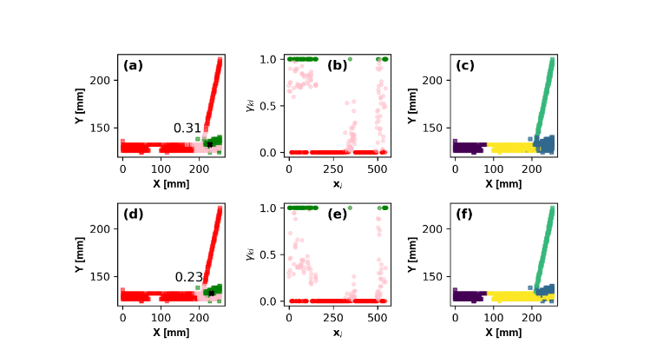
Method based on likelihood of points belonging to a track

Slide 10
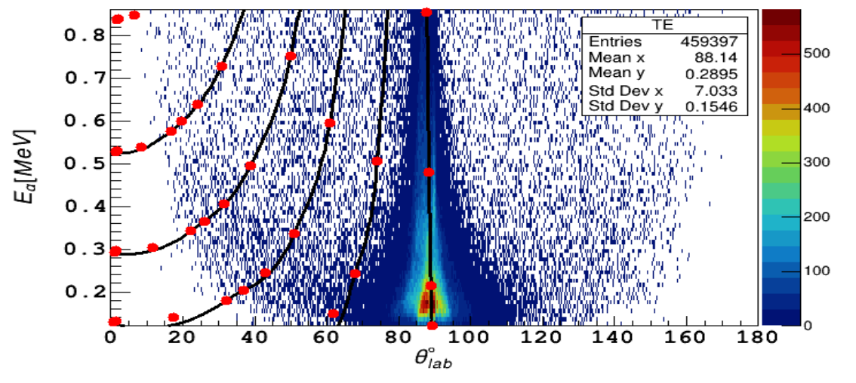
Elastic Peak

Slide 11
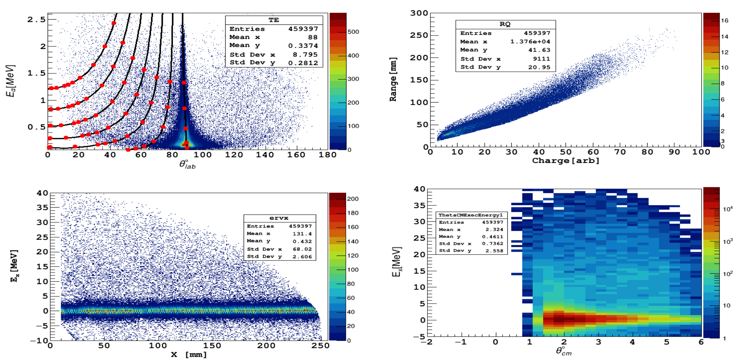
Kinematics – Experimental Data

Slide 12
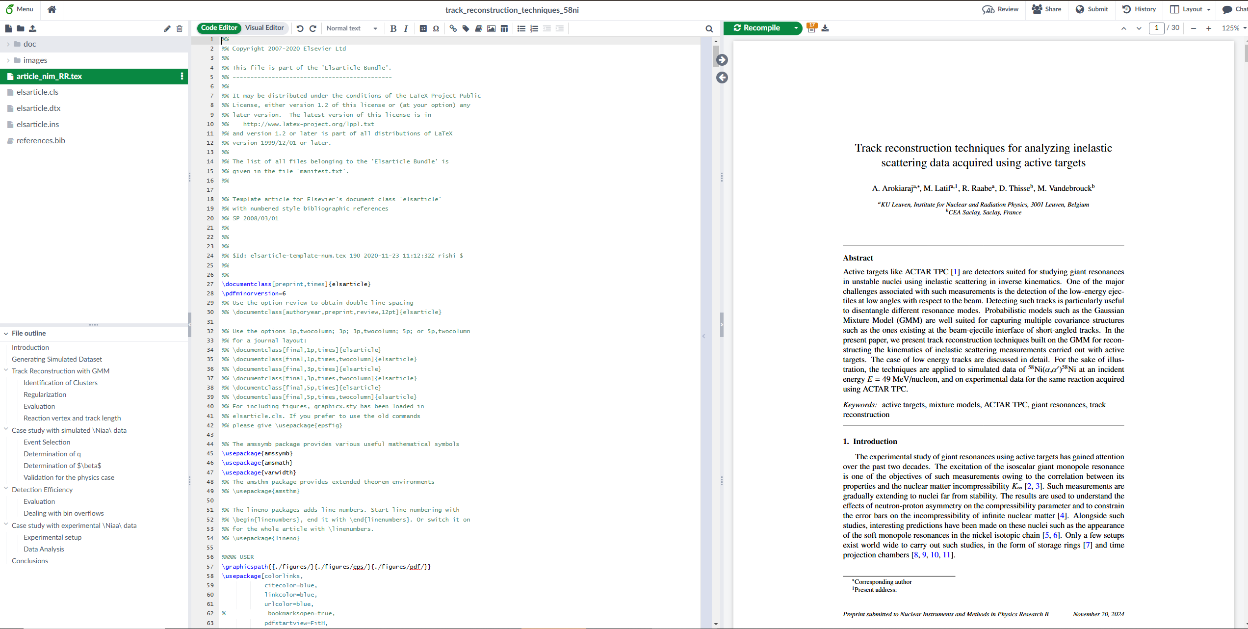
Article on the Reconstruction Techniques

Slide 13
Other Activities
Simulations for a paper on the study of the beta delayed alpha particles from 11 Be.
Master project for a 3 ECTS course (Research Methods in Nuclear Physics)
Teaching assistant for the Classical Mechanics course
Additional course units followed:
Managing my PhD
Data Analysis with Python
Intensive Academic Writing
Writing successful grants
Creative Problem Solving
Interpersonal Skills
Introduction to Leadership

Slide 14
Thank you for your attention

