Slide 1
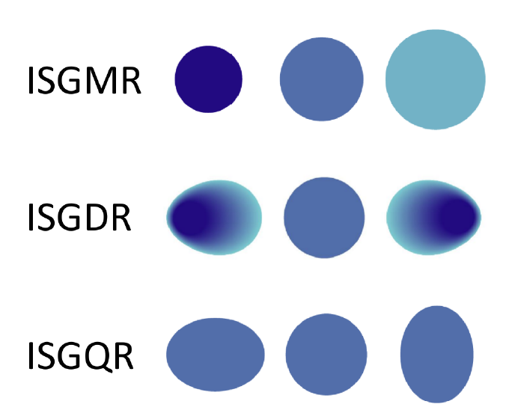
Measurement of isoscalar resonances in 58Ni
Alex Antony Arokiaraj, 27 June 2025
Supervised by Prof. Dr. Riccardo Raabe, Dr. Marine Vandenbrouck

Slide 2
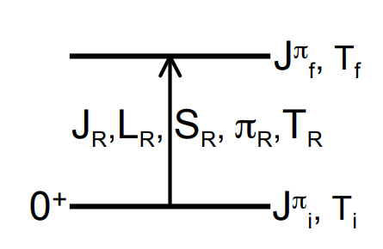
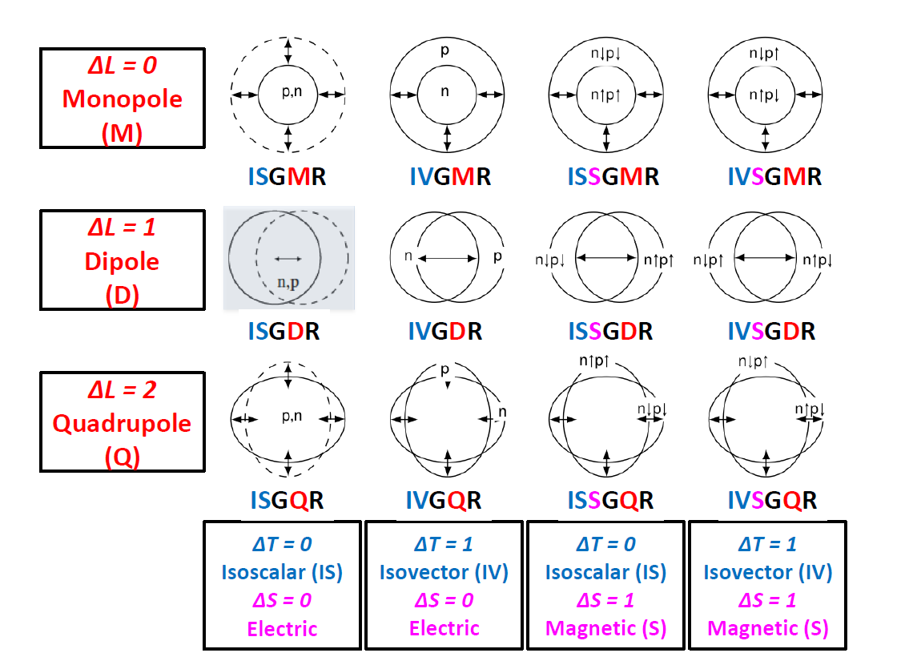
Giant Resonances
Fig courtesy: Elias Khan
Multipole Decomposition Analysis
Inelastic scattering – alpha probe
Fig courtesy: Bagchi 2015 PhD Thesis

Slide 3
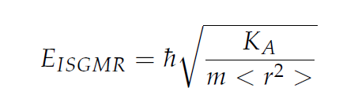
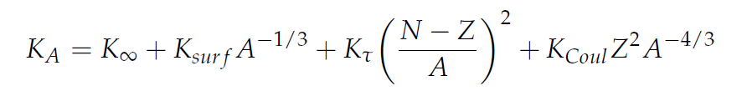
Impetus for GR measurements
Macroscopic Approach
K∞ = 100-400 MeV
J.P. Blaziot et.al 1995
Microscopic Approach
Fully Consistent RPA (Random Phase Approximations)
Provides at the same time K∞ , E_{ISGMR}
K∞ = 240 ± 10 MeV, ²⁰⁸Pb B.K.Agrawal et.al 2003
K∞ = 230 ± 40 MeV, ²⁰⁸Pb, ¹²⁰Sn Khan et.al 2013

Slide 4
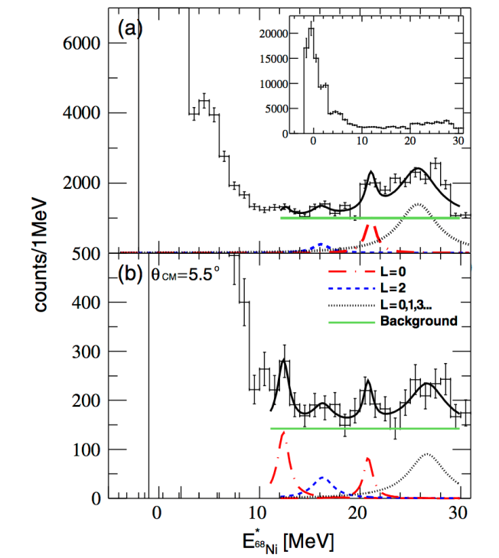
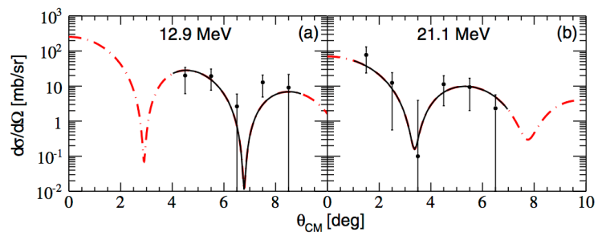
Benchmarks
Element | Beam Energy | Work | Measurements | Target
⁵⁶Ni | 50 MeV/A | Monrozeau et.al 2008 | E_{ISGMR} = 19.3 ± 0.5 MeV E_{ISGQR} = 16.2 ± 0.5 MeV | MAYA
⁶⁸Ni | 50 MeV/A | Vandebrouck et.al 2015 | E_{ISGMR} = 21.1 ± 1.9 MeV E_{ISGQR} = 15.9 ± 1.3 MeV | MAYA
⁵⁶Ni | 50 MeV/A | Bagchi et.al 2015 | E_{ISGMR} = 19.1 ± 0.5 MeV E_{ISGDR} = 17.4 ± 0.7 MeV | MAYA

Slide 5
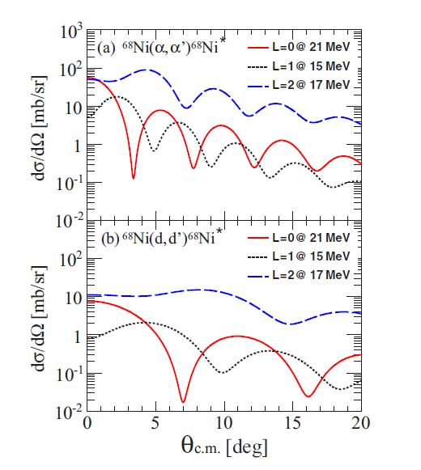
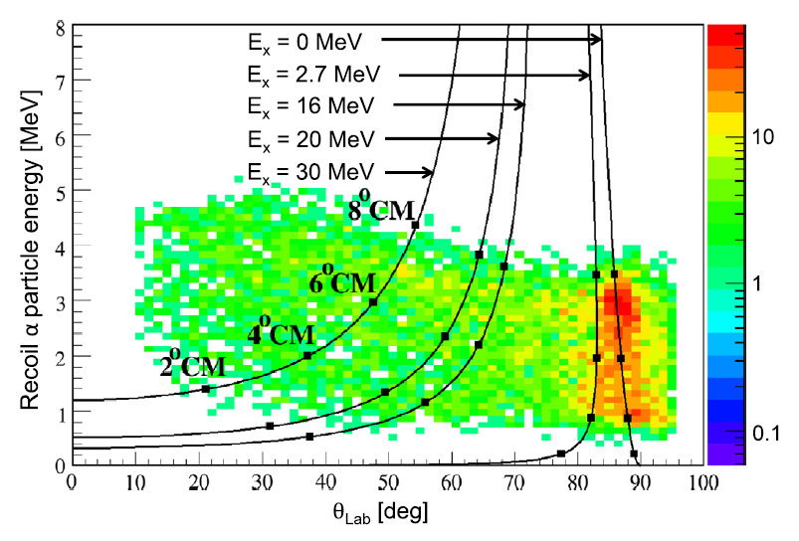
Measurements with MAYA Active Target
Vandebrouck et.al 2015
Fig courtesy: Bagchi 2015 PhD Thesis

Slide 6
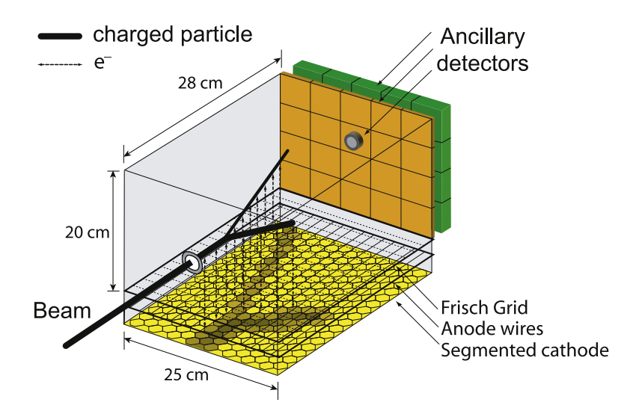
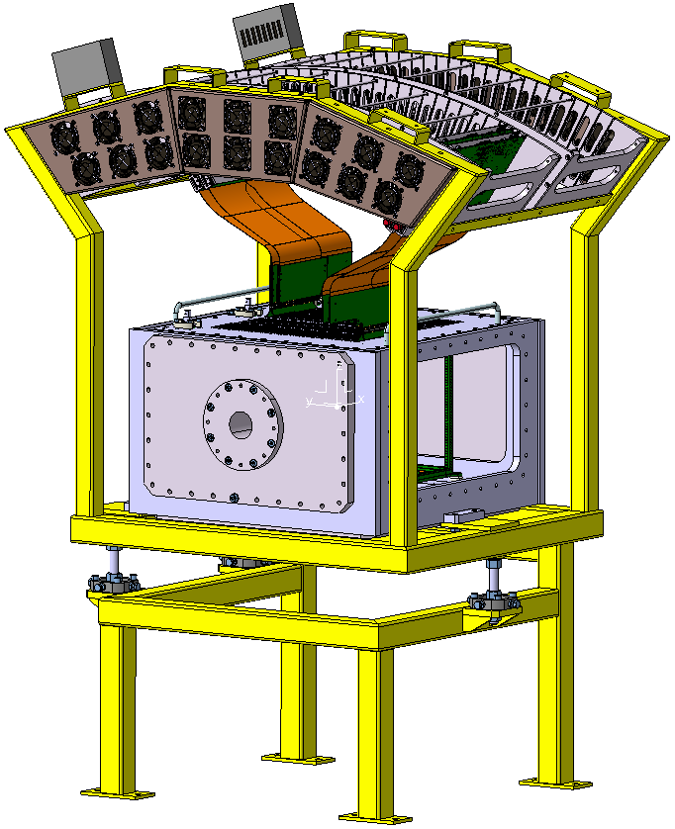
ACTAR TPC – Improved version of MAYA
MAYA - 35 × 35 hexagonal pads with 5 mm sides
ACTAR - 128 × 128 square pads with 2 mm sides

Slide 7
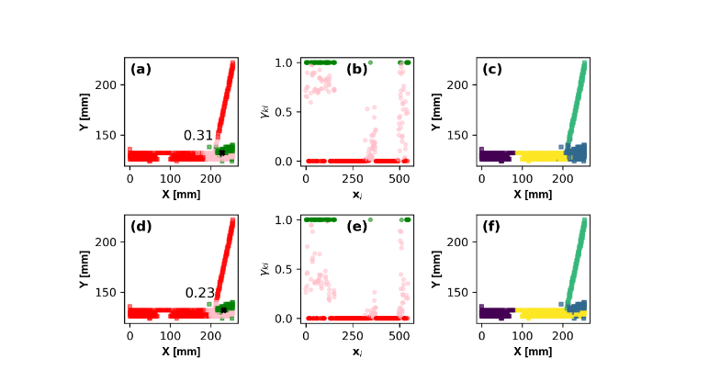
Track Reconstruction Techniques determination of lab angle and range

Slide 8
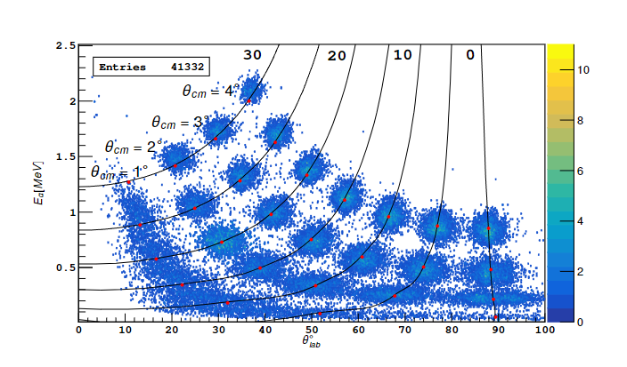
Performance on Simulated Data
Events reconstructed from the simulation on the kinematic line. The numbers marked on each kinematic line represent the excitation energy in MeV. The filled red circles correspond to the center of mass angles (θcm=1.0◦, 2.0◦, 3.0◦, 4.0◦) for each excitation energy

Slide 9
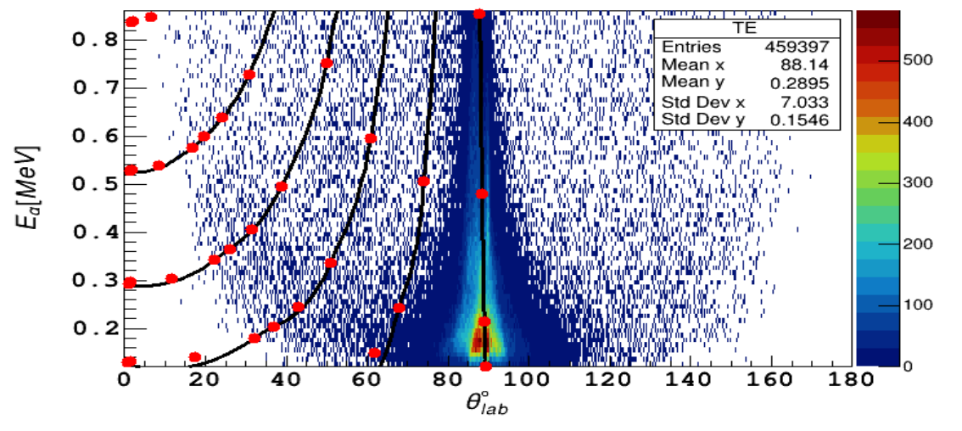
Validation on Experimental Data

Slide 10
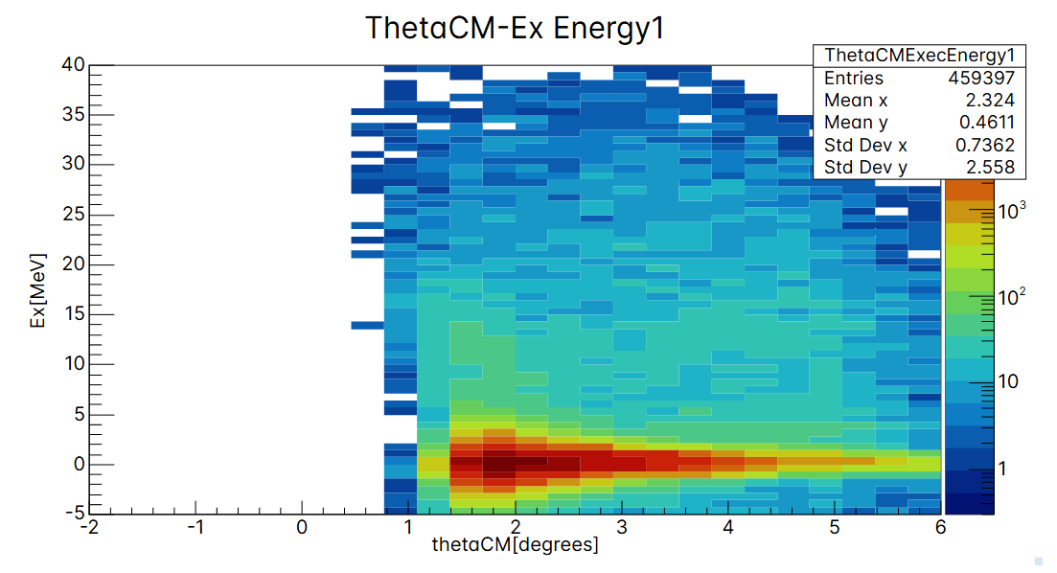
Results on the Experimental Data

Slide 11
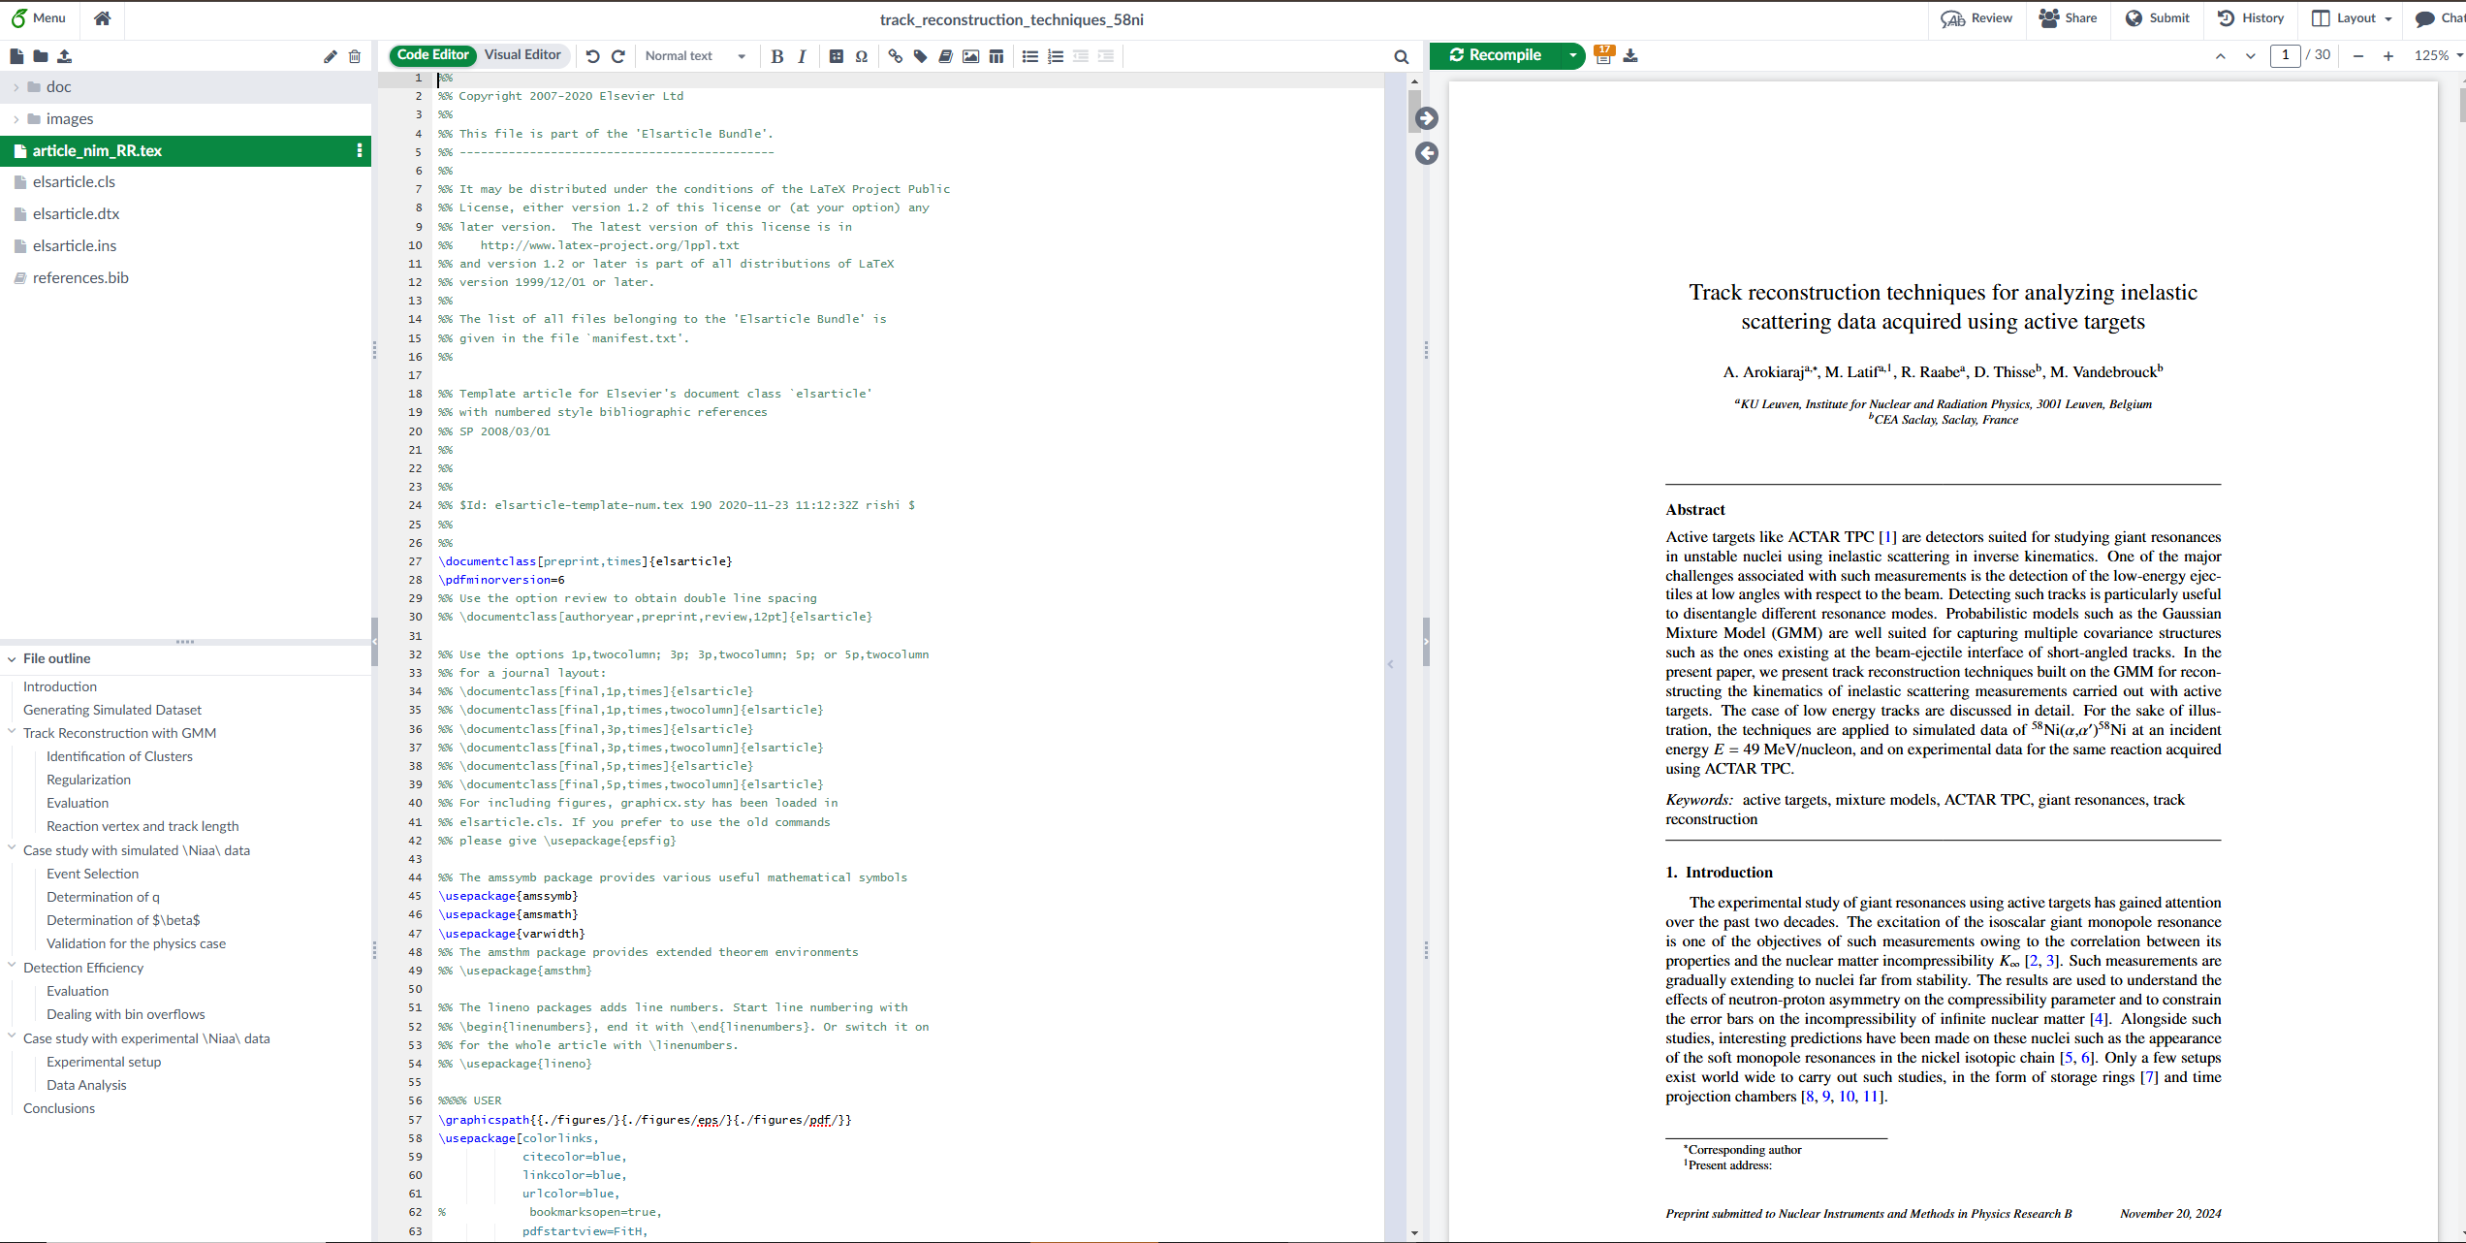
Article on the Track Reconstruction

Slide 12
PhD Activities
Simulations for a paper on the study of the beta delayed alpha particles from 11 Be.
Master project for a 3 ECTS course (Research Methods in Nuclear Physics)
Teaching assistant for the Classical Mechanics course
Additional course units followed:
Managing my PhD
Data Analysis with Python
Intensive Academic Writing
Writing successful grants
Creative Problem Solving
Interpersonal Skills
Introduction to Leadership

Slide 13
Time plan
Expected Timelines
Submission of article – October 2025
Acceptance - December 2025
Thesis Submission – March 2026
Completion – April – May 2026

